Slide 1
D2 – Presentation
Group 9
Brian, Edward, Oscar, Kristian, Kelvin

Slide 2
About our group
Meetings – weekly formal meeting plus additional informal meetings throughout the working week
Dynamics – we get on well (we stormed during sad. Now we are performing). Smooth progression so far.
Spiral development model

Slide 3
Language and tools for development
SVN: Unix: terminal; Windows: TortoiseSVN
Eclipse
Plugin: Google WBPro, SVN team
Java
GUI: Swing
Lightweight
Multi platform compatibility
Model: XML

Slide 4
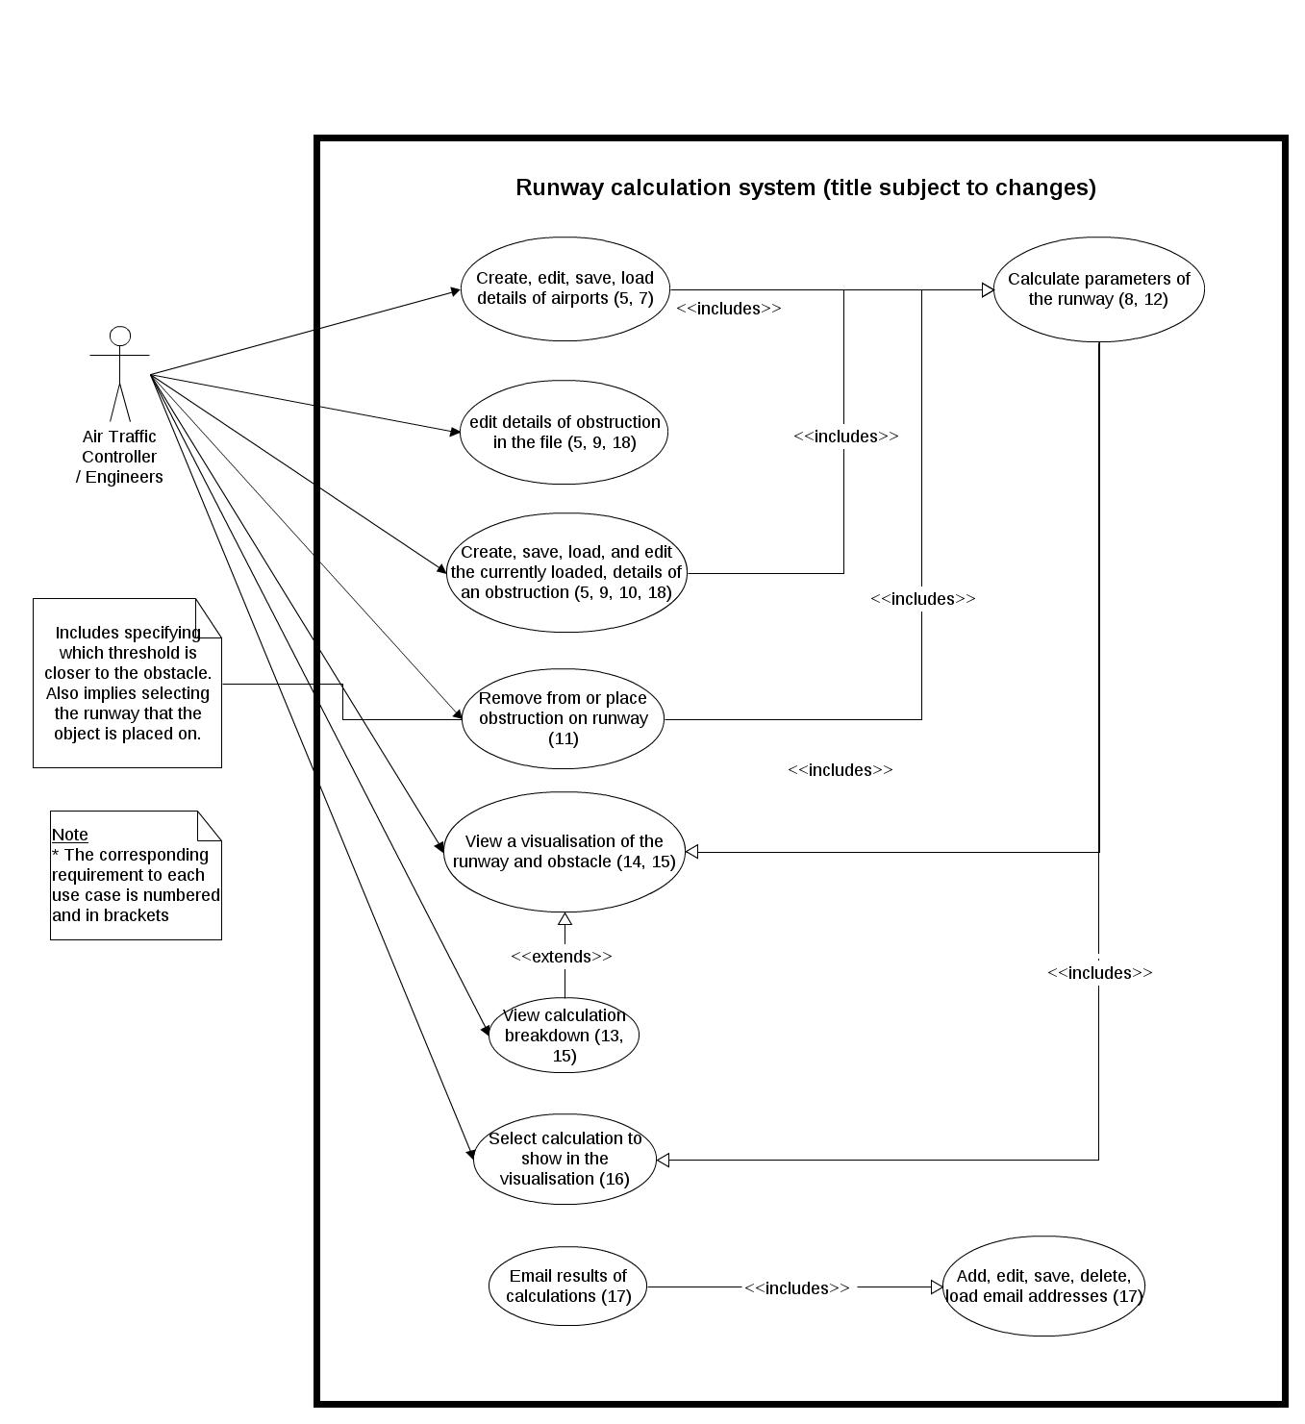

Slide 5
Evidence of early analysis & design
MVC formed the core of our project
Project planning
Design
General analysis and design: class diagrams and use case diagrams

Slide 6
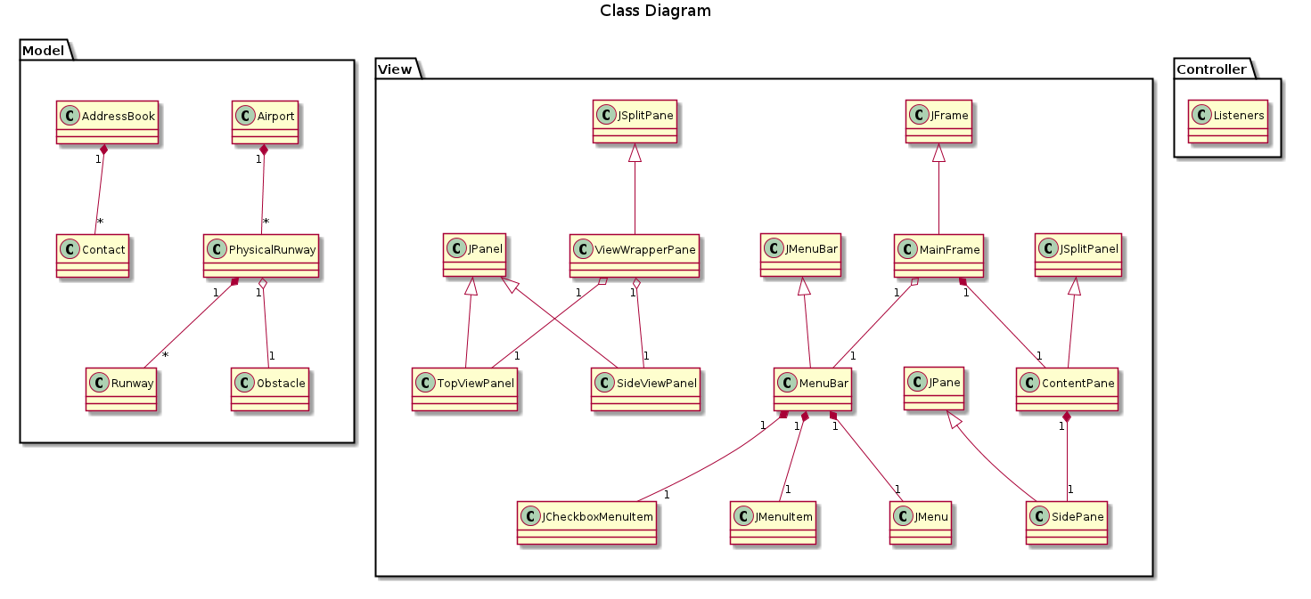
Architectural concepts

Slide 7
Demo

Slide 8
Project so far
Current state: programming, testing, refining analysis and design
Plans: We are on target in terms of the work allocations and Gantt chart times
Time budget: On budget
Notes:
Middle gantt chart

Slide 9
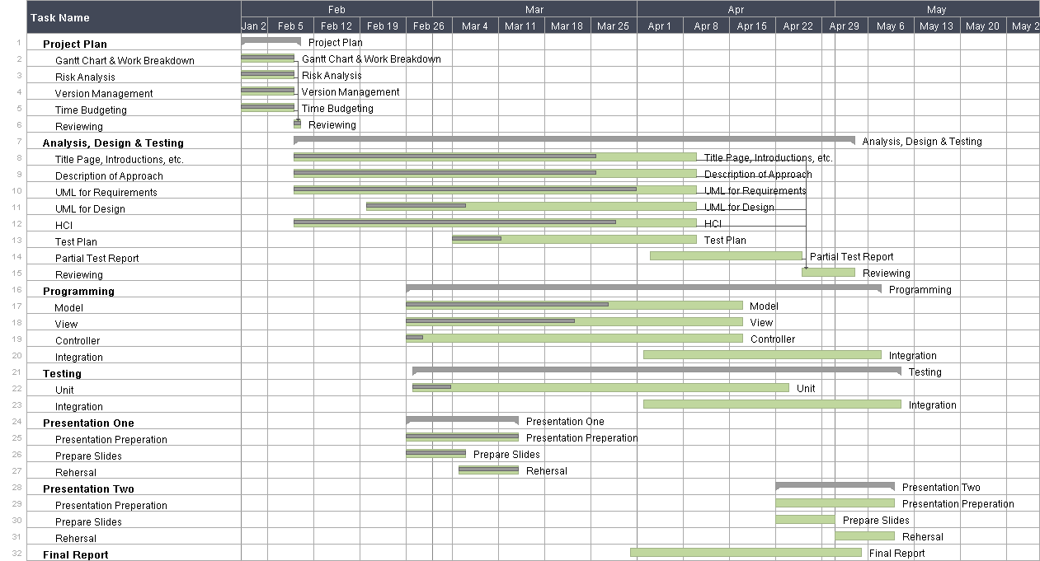

Slide 10
Time spent
P.S. Expected time spent / Person : 16

Slide 11
Time spent

