Slide 1
Can sunspot activity be seen in the Keeling curve

Slide 2
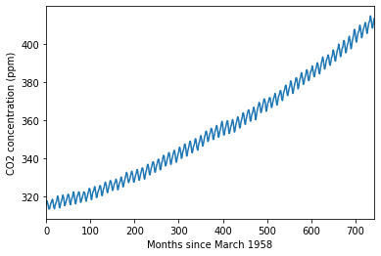
Raw CO2 data from Hawaii: The Keeling curve

Slide 3
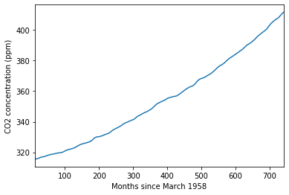
Data smoothed using a 12-month rolling average

Slide 4
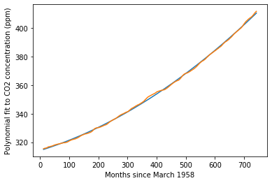
A fit of a second order polynomial to the smoothed data

Slide 5
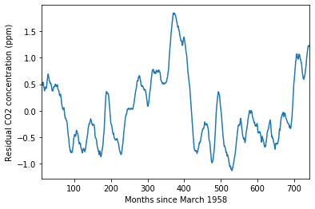
Residuals after removal of the fit to the smoothed data

Slide 6
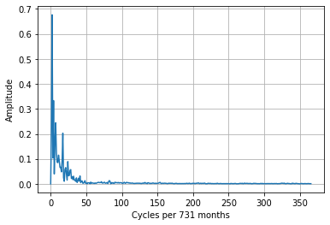
Frequency amplitude spectrum of the residuals

Slide 7
No evidence for an 11 year periodicity in the residuals

