Slide 1
Physical Disentanglement in a Container-Based File System
Lanyue Lu, Yupu Zhang, Thanh Do, Samer Al-Kiswany Andrea C. Arpaci-Dusseau, Remzi H. Arpaci-Dusseau
OSDI 2014

Slide 2
The 5 Paper Questions
What is the problem being solved?
How do they solve it?
How do they evaluate their solution?
What is the punchline?
Who are they?
How does this relate to your synthesis paper?

Slide 3
What is the problem being solved?
Isolation: virtual address spaces protects the memory of one process from others
One way to achieve this is with virtual machines
Bitmaps in filesystems track inodes and data blocks in use
Entanglement: blocks from different files allocated in same bitmap
Bitmap failure can adversely affect unrelated files (reliability)
Ext3 includes all updates in one global transaction (performance)

Slide 4
What is the problem being solved?
Central truth: logically independent entities can be physically dependent
1 disk block failure can lead to global reliability problems
Lack of disentanglement slows recovery times
Performance of unrelated tasks hindered by consistency mechanisms (e.g., journaling)

Slide 5
How do they solve it?
Systematic model of locality/parallelism/redundant comp.
Represent stencil pipelines as graphs.
Need to be efficient and scalable (clusters to smartphones).
Interleave communication & computation.
eDSL: embedded DSL implemented as C++ library.
Uses OpenMP + Pthreads, supports GPUs, Python bindings.
Has an autotuning step (genetic algorithm).
Bounds inference over polyhedral model.

Slide 6
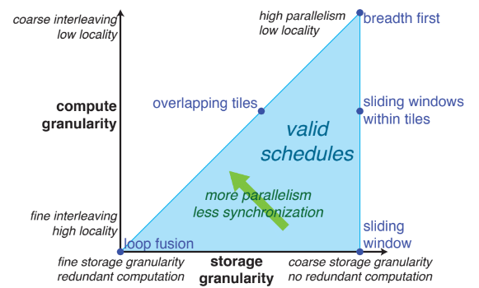
How do they solve it?

Slide 7
How do they evaluate their solution?
Compare manually optimized image processing algorithms in C & CUDA to autotuned Halide implementations.

Slide 8
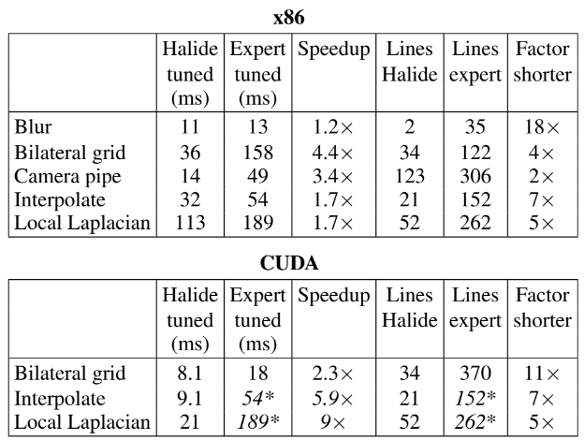
How do they evaluate their solution?

Slide 9
What is the punchline?
Algorithms can be implemented at a high level in an eDSL.
Compiler embedded in library combined with an autotuner can produce code for multiple target architectures can outperform domain expert tuned code.

Slide 10
Who are they?
Ragan-Kelley at MIT CSAIL (now at Berkely).
Connelly Barnes, researcher at Adobe.
Andrew Adams at MIT CSAIL (now at Facebook).

Slide 11
Limitations
Require axis-bound loops, does that mean no skewing?

Slide 12
THANK YOU
Presenter, Presenter Title
Email presenter@boisestate.edu

