Slide 1

Understanding Collateral Evolution in
Linux Device Drivers
Y. Padioleau, J. Lawall, G. Muller

Slide 2
Motivation
Device drivers ~70% of code in a modern OS
Driver code dependent on structures and functions in the rest of the OS (e.g, usb/core)
Changes in kernel and support libraries may have significant downstream effects

Slide 3
Collateral Evolution
Downstream code modifications triggered by kernel refactoring referred to as collateral evolution
Side effect in the context an element is used
Linux is open source, so documentation may be sparse
Propagating changes may take years and introduce bugs to already functional code

Slide 4
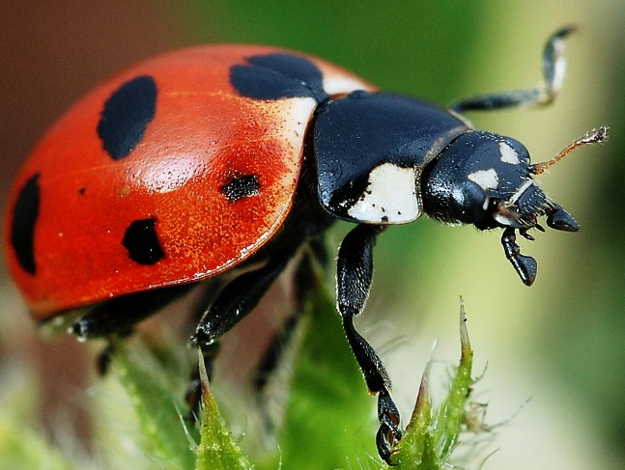
Coccinelle
Coccinelle transforms C code using Semantic Patch Language (SPL)
Formal notation for collateral evolution
Transformation engine to propagate changes

Slide 5
Transformations
Renaming a function
Adding a function argument
Reorganizing a data structure

Slide 6
Contributions
Measured Linux driver evolutions from 2.2 to 2.6
2X as many from 2.5 to 2.6
Estimated work required for propagation
Up to 35% LOC in Linux drivers due to CE
Identified challenges

Slide 7
Related Work
Wrapper functions or virtual machines
e.g., Unmodified Device Driver Reuse... (LeVasseur et al. ‘04)
Automated bug detection
e.g., CP-Miner (Li et al. ‘04)
OS Evolution (BSD)
e.g., Mining Software Repositories… (Hassan ‘04)

Slide 8
Terminology
Disambiguate the term “device driver”
Device Specific Code
Interacts directly with the hardware
Driver Support Libraries
Includes the kernel!

Slide 9
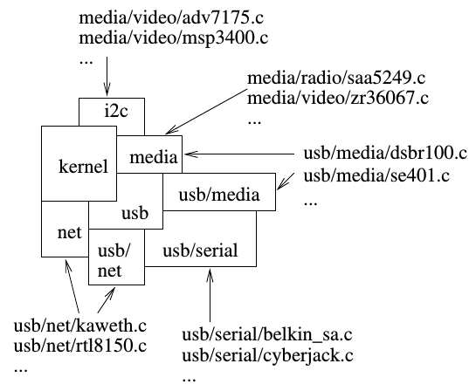
Dependence Hierarchy
Notes:
illustrated in Figure 1, these servi es are organized hi-
erar hi ally, with all servi es depending on the kernel,
spe ialized driver support libraries su h as USB-serial
depending on generi ones su h as USB, and devi e-
spe i les su h as
rtl8150.
depending on one or
more driver support libraries.

Slide 10
Interface Changes
Exported Functions
add/drop arguments
change function name
change return type

Slide 11
Interface Changes
Exported Functions
add/drop arguments
change function name
change return type
Callback functions
add/drop parameters
change return type

Slide 12
Interface Changes
Data Structures
split/merge structures
introduce indirection layers
convert member reference to getter/setter function

Slide 13
Interface Changes
Data Structures
split/merge structures
introduce indirection layers
convert member reference to getter/setter function
Protocols
add/drop required calls
change sequencing
change locking requirements
add error checking

Slide 14
Function Arguments or Callback Parameters
Adding or changing an argument
May require significant refactoring depending on type
Including control flow or data flow analysis
Drop an argument
May wish to remove the code generating the argument
Notes:
Signature changes to a support library function

Slide 15
Function Arguments or Callback Parameters
Name change
Easy if changed uniformly, otherwise problematic
May require changing device-specific definitions
Changes in return type
e.g., error handling changes (e.g., void to int)
Shift toward more informative error codes
(e.g., -EIO and -ENODEV)
Notes:
Signature changes to a support library function

Slide 16
Data Structures
Adding / dropping / reordering fields
Similar to argument / parameter changes
Tricky when local variables refer to substructures
Requires data flow analysis
Addition of getters/setters
struct usb_endpoint_descriptor *epd;
…
for (i = alt->desc.bNumEndpoints - 1; i >= 0; --i) {
epd = &alt->endpoint[i].desc;
...
Notes:
Signature changes to a support library function

Slide 17
Protocols
Order in which operations related to functions and data structures must be executed.
e.g., a calling sequence
Effects error checking and resource cleanup
May be context sensitive
Interplay between device-specific and support code
Notes:
Signature changes to a support library function

Slide 18
Detecting Evolutions
Good C compiler with warnings enabled will catch many
e.g., incorrect argument count, type mismatches
Implicit type conversions (coercion) may hinder
Function renaming or constant first argument can be scripted
Warning: find and replace can be dangerous!
Complex evolutions often done by hand
Time consuming and error prone
Notes:
Avoid void* and casting

Slide 19
Case Studies
Function Argument Addition
usb_submit_urb uses kmalloc to pass a message.
Flag to determine whether blocking is allowed
This function is in drivers/usb/core!
in_interrupt () ? GFP_ATOMIC : GFP_KERNEL
// FIXME paging/swapping requests over USB should not
// use GFP_KERNEL and might even need to use GFP_NOIO ...
// that flag actually needs to be passed from higher level.
Notes:
Signature changes to a support library function

Slide 20
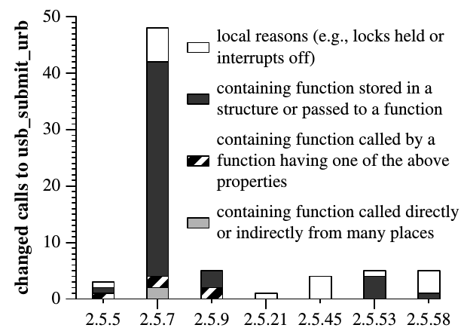
Case Studies
Notes:
Signature changes to a support library function

Slide 21
Case Studies
Parameter Type Change
video_usercopy function added to copy data between kernel and user space.
ioctl function type changed from user space to kernel space pointer
Requires changes to each ioctl command!
Notes:
Signature changes to a support library function

Slide 22
Case Studies
Function Protocol Change
Drivers initialized sequentially in early Linux
Required call to check_region to check memory availability
request_region then called to allocate
Newer versions initialize drivers in parallel
Now call request_region directly
Have to call release_region on all error paths
Notes:
Signature changes to a support library function

Slide 23
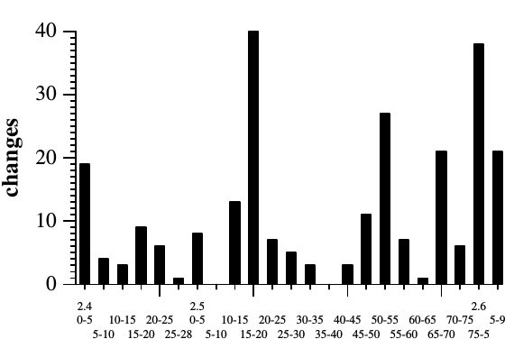
Case Studies
Notes:
Signature changes to a support library function

Slide 24
Assessment
Analyze code from version 2.2.0 to 2.6.13 (6 year span)
Distinguish between support lib and device-specific
Support lib if exports functions to multiple files or to other driver support library
Linux 2.4.0 => 2.6.13:
66 => 164 support libraries
874 => 1926 device-specific
Notes:
Signature changes to a support library function

Slide 25
Assessment
Analyze code from version 2.2.0 to 2.6.13 (6 year span)
Distinguish between support lib and device-specific
Support lib if exports functions to multiple files or to other driver support library
Linux 2.4.0 => 2.6.13:
66 => 164 support libraries
874 => 1926 device-specific
Notes:
Signature changes to a support library function

Slide 26
Methodology
Align common parts of fragments from patch file
Identify most different regions
Matched line by line
special handling for assignments and conditional tests
Function calls aligned by arguments
Notes:
Signature changes to a support library function

Slide 27
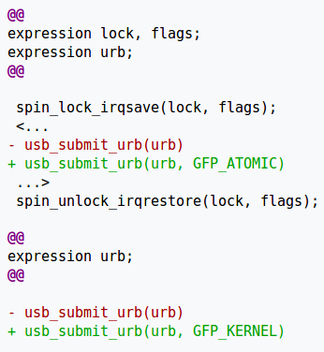
Patch File
Notes:
Signature changes to a support library function

Slide 28
Criteria
Change considered a collateral evolution if:
Occurs >= 5 times
Distributed across >= 3 files
Notes:
Signature changes to a support library function

Slide 29
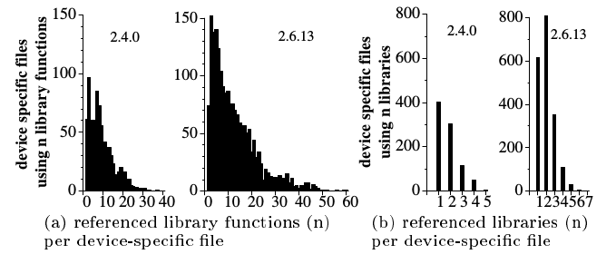
Results
Notes:
(a) Library fun tion referen es and (b) library referen es in Linux 2.4.0 and Linux 2.6.13

Slide 30
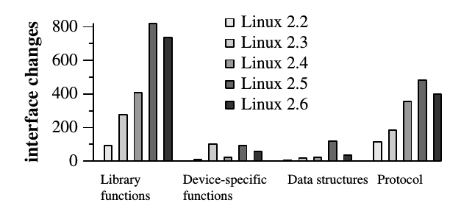
Results
Notes:
Figure 11: Number of evolutions in interface elements in Linux 2.2 to Linux 2.6

Slide 31
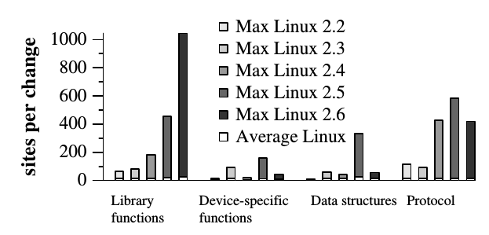
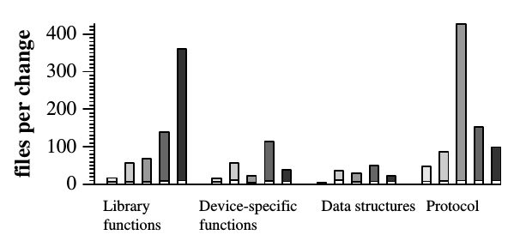
Results
Notes:
Figure 13: Maximum number of sites and files affected by a single collateral evolution

Slide 32
Conclusion
Driver evolution is critical!
Authors planned to develop formal language for expressing collateral evolution
Authors planned to develop Coccinelle tool based on this domain analysis
Notes:
Signature changes to a support library function

Slide 33
Resources
Documentation:
http://coccinelle.lip6.fr/documentation.php
Downloads:
http://coccinelle.lip6.fr/download.php
Github Repository:
https://github.com/coccinelle/coccinelle
Notes:
Signature changes to a support library function

Slide 34
Questions?

