Slide 1
Physical Disentanglement in a Container-Based File System
Lanyue Lu, Yupu Zhang, Thanh Do, Samer Al-Kiswany Andrea C. Arpaci-Dusseau, Remzi H. Arpaci-Dusseau
OSDI 2014

Slide 2
The 5 Paper Questions
What is the problem being solved?
How do they solve it?
How do they evaluate their solution?
What is the punchline?
Who are they?
How does this relate to your synthesis paper?

Slide 3
What is the problem being solved?
Image processing pipelines are computationally expensive.
Need to be efficient and scalable (clusters to smartphones).
Pipelines as stencil streams.
Decouple algorithm from execution schedule!

Slide 4
How do they solve it?
Systematic model of locality/parallelism/redundant comp.
Represent stencil pipelines as graphs.
Need to be efficient and scalable (clusters to smartphones).
Interleave communication & computation.
eDSL: embedded DSL implemented as C++ library.
Uses OpenMP + Pthreads, supports GPUs, Python bindings.
Has an autotuning step (genetic algorithm).
Bounds inference over polyhedral model.

Slide 5
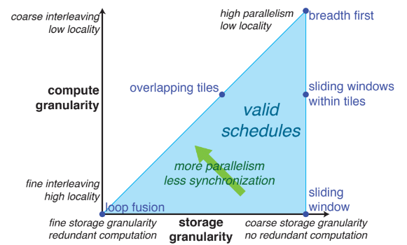
How do they solve it?

Slide 6
How do they evaluate their solution?
Compare manually optimized image processing algorithms in C & CUDA to autotuned Halide implementations.

Slide 7
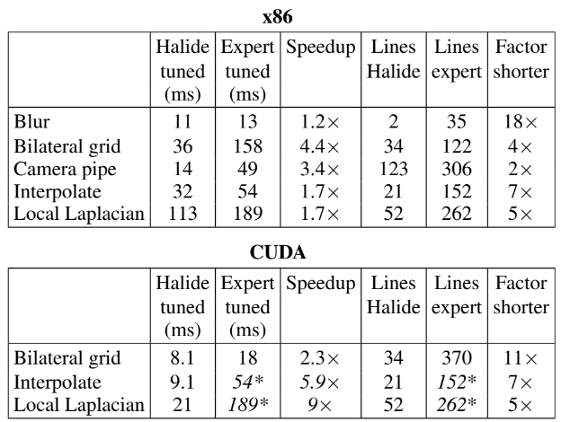
How do they evaluate their solution?

Slide 8
What is the punchline?
Algorithms can be implemented at a high level in an eDSL.
Compiler embedded in library combined with an autotuner can produce code for multiple target architectures can outperform domain expert tuned code.

Slide 9
Who are they?
Ragan-Kelley at MIT CSAIL (now at Berkely).
Connelly Barnes, researcher at Adobe.
Andrew Adams at MIT CSAIL (now at Facebook).

Slide 10
Limitations
Require axis-bound loops, does that mean no skewing?

Slide 11
THANK YOU
Presenter, Presenter Title
Email presenter@boisestate.edu

