Slide 1
Physical Disentanglement in a Container-Based File System
Lanyue Lu, Yupu Zhang, Thanh Do, Samer Al-Kiswany Andrea C. Arpaci-Dusseau, Remzi H. Arpaci-Dusseau
OSDI 2014

Slide 2
The 5 Paper Questions
What is the problem being solved?
How do they solve it?
How do they evaluate their solution?
What is the punchline?
Who are they?
How does this relate to your synthesis paper?

Slide 3
What is the problem being solved?
Isolation: virtual address spaces protects the memory of one process from others
One way to achieve this is with virtual machines
Bitmaps in filesystems track inodes and data blocks in use
Entanglement: blocks from different files allocated in same bitmap
Bitmap failure can adversely affect unrelated files (reliability)
Ext3 includes all updates in one global transaction (performance)

Slide 4
What is the problem being solved?
Central truth: logically independent entities can be physically dependent
1 disk block failure can lead to global reliability problems
Lack of disentanglement slows recovery times
Performance of unrelated tasks hindered by consistency mechanisms (e.g., journaling)

Slide 5
Entanglement Problems
Global Failure
Slow Recovery
Bundled Transactions

Slide 6
How do they solve it?
New filesystem called IceFS
Abstraction to co-locate logically similar data
Containers are called cubes
IceFS ensures cubes are disentangled

Slide 7
3 Core Principles
NO shared physical resources across cubes
Data structures within each cube are distinct
NO access dependencies
Data within a cube remains accessible no matter status of others
Directory indirection technique
NO bundled journal transactions
Transaction splitting enables concurrent updates to filesystem state
Disentangles writing of different cubes

Slide 8
Localization
micro-failures: panics, crashes, etc. constrained to one cube
micro-recovery: only faulty cubes need to be repaired
Minimizes downtime
Increases availability
Transactions from different cubes can be committed in parallel
2-5X performance speedup!

Slide 9
Specialization
Independent cubes enable specialization
Filesystem can control behavior of each
Different journaling modes per cube =>knob for performance/consistency tradeoffs

Slide 10
Motivation
Virtualized Filesystem
IceFS as host file system for VMware environment
Distributed Filesystem
IceFS as underlying filesystem for HDFS

Slide 11
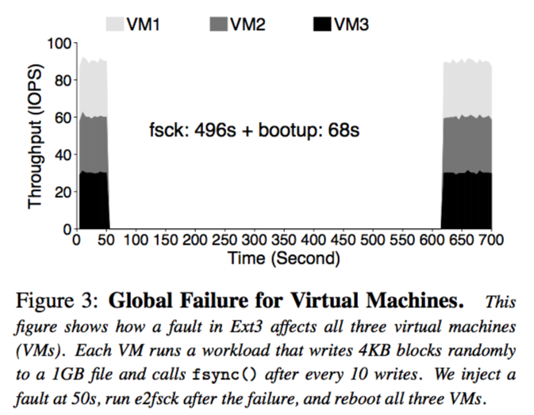
Motivation

Slide 12
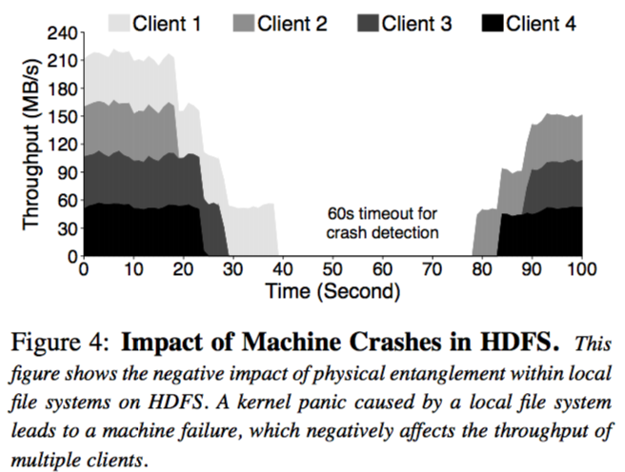
Motivation

Slide 13
Cube Abstraction

Slide 14
What is the punchline?
Algorithms can be implemented at a high level in an eDSL.
Compiler embedded in library combined with an autotuner can produce code for multiple target architectures can outperform domain expert tuned code.

Slide 15
Who are they?
Ragan-Kelley at MIT CSAIL (now at Berkely).
Connelly Barnes, researcher at Adobe.
Andrew Adams at MIT CSAIL (now at Facebook).

Slide 16
Limitations
Require axis-bound loops, does that mean no skewing?

Slide 17
THANK YOU
Presenter, Presenter Title
Email presenter@boisestate.edu

