Slide 1
Bridging the Gap between Software and Hardware Techniques for I/O Virtualization
Jose Renato Santos, Yoshio Turner, G.(John) Janakiraman, Ian Pratt
USENIX 2008

Slide 2
Introduction
I/O virtualization degrades performance
Each guest-device interaction requires interception, validation, and handling
Especially in high-bandwidth NICs
Every packet would need to be inspected by virtualization layer!

Slide 3
Paravirtualization
Guest executes a paravirtualized (PV) driver
Simplified abstract device model
Actual driver resides in the VMM
Device driver domain
Privileged access to the I/O hardware

Slide 4
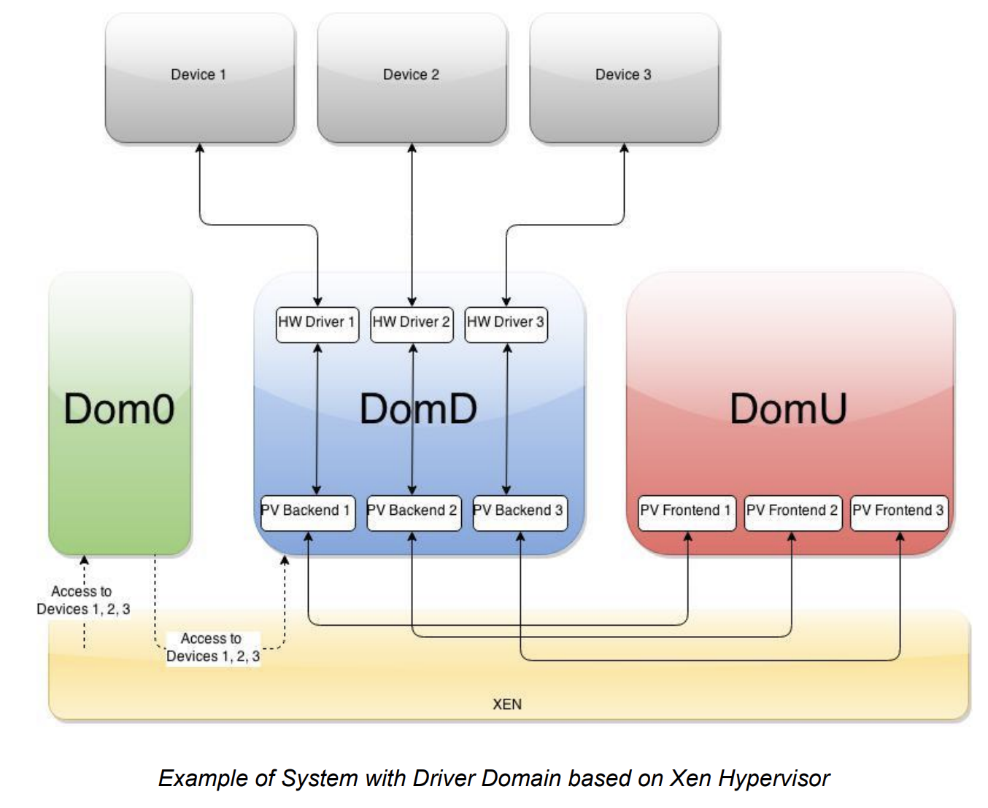
Device Passthrough
https://wiki.xen.org/images/1/17/Device_passthrough_xen.pdf

Slide 5
Device Driver Domain
Advantages
Legacy OS devices for portability
Safe execution environment
Isolation
Drawbacks
CPU overhead -> up to 4X slower!
Progress made on transmit path but not receive path

Slide 6
Direct I/O
Device presents multiple logical interfaces
Securely accessed by VMs
Virtualization layer bypassed
Near native performance
Drawbacks
HW support needed
Isolation and safety from buggy drivers compromised
No live migration
VMM must include many device drivers

Slide 7
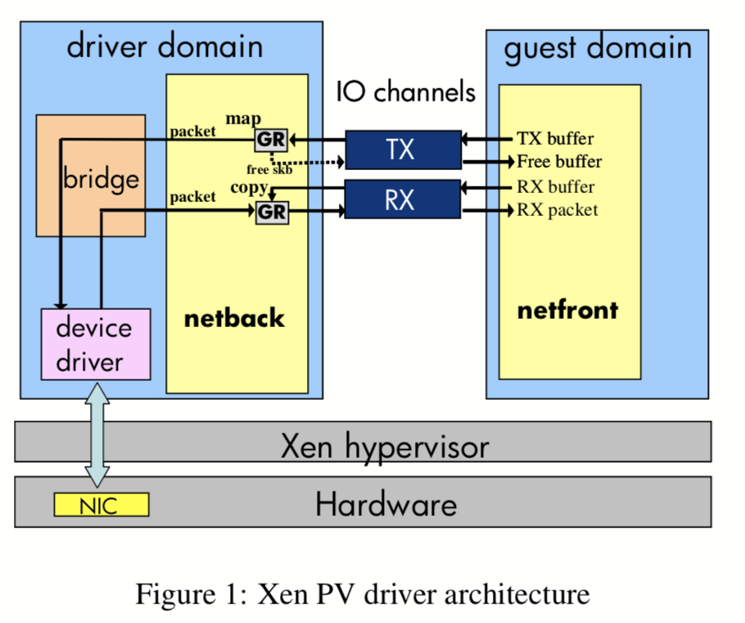
Xen Driver Architecture
Notes:
Netfront is the driver guest interacts with
Interrupts handled by hypervisor
Notifies appropriate driver domain via virtual interrupts
Shared memory channel b/w netfront and netback
SW Bridge: routes packets b/w physical device & multiple guests through their netback interfaces

Slide 8
I/O Channels
Event notification mechanism
Bidirectional ring of async requests
netfront => requests => netback
netfront <= responses <= netback
Virtual interrupts indicate new requests/responses posted

Slide 9
Page Grants
Page grants allow driver domains to access I/O buffers in guest memory
Guest sends I/O buffer descriptors with requests to netback including guest address and callback function

Slide 10
Transmission (TX)
DomD makes hypercall mapping guest page into its address space before sending through the bridge
Physical driver fills the buffer and frees the page
Callback function invoked sending data back to netfront
Page grant revoked

Slide 11
Receive (RX)
netfront posts page grants to the RX I/O channel
netback receives packet from the bridge and retrieves a grant
Grant copy hypercall transfers packet to guest page
netback sends response to guest
netfront reads packet and revokes grant

Slide 12
Network Performance Analysis
Three Models
Xen PV Driver
Xen Direct I/O
Native Linux
Domains
Dom0 == DomD
DomU == guest
Uses netperf UDP_STREAM microbenchmark
Difficult to quantify CPU costs for TCP due to ACK packets

Slide 13
Network Performance Analysis
Uses netperf UDP_STREAM microbenchmark
Difficult to quantify CPU costs for TCP due to ACK packets
Direct I/O results optimistic due to lack of IOMMU overhead
Authors unable to obtain one…

Slide 14
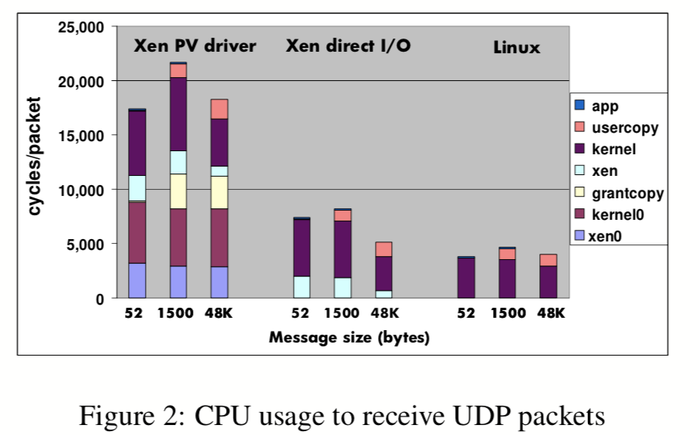
Network Performance Analysis

Slide 15
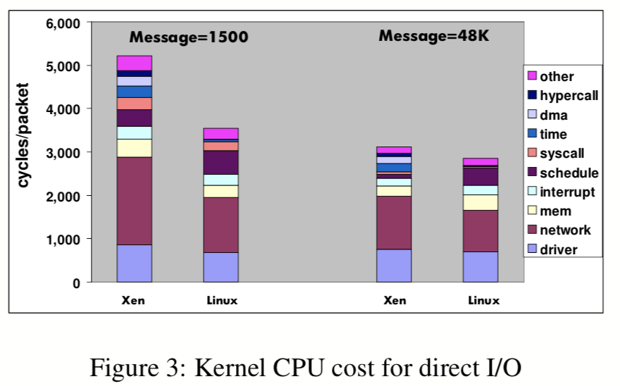
Network Performance Analysis

Slide 16
Xen Network Design Changes
Architecture-independent optimizations
Disable netfilter bridge
Aligned data copies
Avoiding socket buffer fragments
Page grant optimizations

Slide 17
Xen Network Design Changes
Data copying moved to guest…

Slide 18
Xen Network Design Changes
Grant mechanism extensions…

Slide 19
Xen Network Design Changes
Multi-queue device support…

Slide 20
Xen Network Design Changes
Caching and reusing page grants…

Slide 21
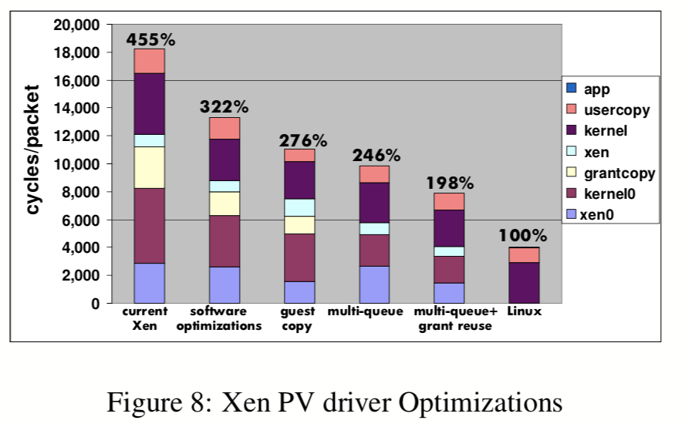
Xen Network Design Changes

Slide 22
Conclusion
Existing filesystems lack physical isolation
IceFS achieves isolation using cube abstraction
No shared resources, access dependencies, or bundled transactions among cubes
Localize failures that were previously global
Demonstrated fault isolation and fast recovery in two case studies: VM server and HDFS data nodes

