Slide 1
Physical Disentanglement in a Container-Based File System
Lanyue Lu, Yupu Zhang, Thanh Do, Samer Al-Kiswany Andrea C. Arpaci-Dusseau, Remzi H. Arpaci-Dusseau
OSDI 2014

Slide 2
Introduction
Isolation: virtual address spaces protects the memory of one process from others
One way to achieve this is with virtual machines
Bitmaps in filesystems track inodes and data blocks in use
Entanglement: blocks from different files allocated in same bitmap
Bitmap failure can adversely affect unrelated files (reliability)
Ext3 includes all updates in one global transaction (performance)

Slide 3
Introduction
Central truth: logically independent entities can be physically dependent
1 disk block failure can lead to global reliability problems
Lack of disentanglement slows recovery times
Performance of unrelated tasks hindered by consistency mechanisms (e.g., journaling)

Slide 4
Entanglement Problems
Global Failure
Slow Recovery
Bundled Transactions

Slide 5
Solution
New filesystem called IceFS
Abstraction to co-locate logically similar data
Containers are called cubes
IceFS ensures cubes are disentangled

Slide 6
3 Core Principles
NO shared physical resources across cubes
Data structures within each cube are distinct
NO access dependencies
Data within a cube remains accessible no matter status of others
Directory indirection technique
NO bundled journal transactions
Transaction splitting enables concurrent updates to filesystem state
Disentangles writing of different cubes

Slide 7
Localization
micro-failures: panics, crashes, etc. constrained to one cube
micro-recovery: only faulty cubes need to be repaired
Minimizes downtime
Increases availability
Transactions from different cubes can be committed in parallel
2-5X performance speedup!

Slide 8
Specialization
Independent cubes enable specialization
Filesystem can control behavior of each
Different journaling modes per cube =>knob for performance/consistency tradeoffs

Slide 9
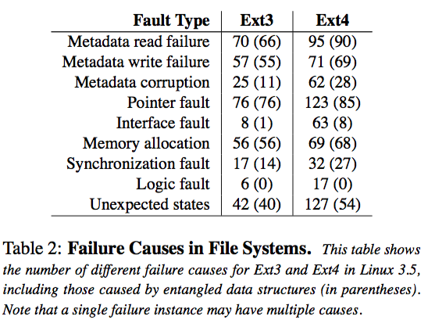
Motivation

Slide 10
Cube Abstraction
Applications specify logically related files and directories
Filesystem combines performance and reliability properties of file groups and metadata within each cube
Each cube is independent and physically isolated

Slide 11
Cube Operations
create
Created as needed
Default global cube initialized upon mkfs
add
Create or move files/directories into a cube
Files inherit cube of parent directory by default
delete
Move, rename, or unlink files or directories from a cube
remove
Remove a cube and all of its contents
Disk space is released

Slide 12
Cube Properties
isolated
Logically and physically separated
transparent
Applications can interact with filesystem with no knowledge of cubes
flexible
Created or destroyed on demand
elastic
Space can expand or contract dynamically
customizable
Diverse requirements, e.g., high consistency + immediate recovery
lightweight
Low memory and disk resources

Slide 13
IceFS
Prototype disentangled file system
Modifications to POSIX interface:
Implement cube as a special directory
Set attributes by passing flags to mkdir command
Examples
NFS server maintaining one cube per user
VM server creating one cube per machine
Application server using cubes as data containers

Slide 14
Disentanglement
Physical isolation
A block group can only be assigned to one cube at a time
Associated metadata (e.g., bitmaps and inodes) belong to same cube
Block group can be reassigned if cube is removed
Empty data blocks are assigned as cube space expands
Access Independence
Ext3 global lists partitioned as per-cube lists
One sub-superblock per cube
Fixed number of sub-superblocks set by mkfs command
Can be replicated like superblocks to prevent catastrophic loss
Data blocks must be located in same cube as the inodes of their owning files

Slide 15
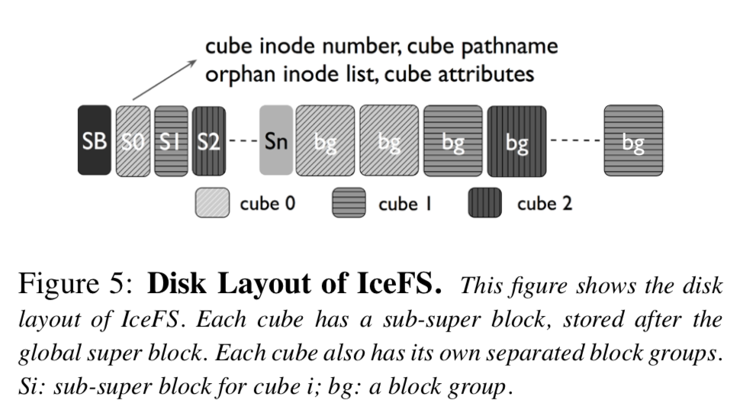
Disentanglement

Slide 16
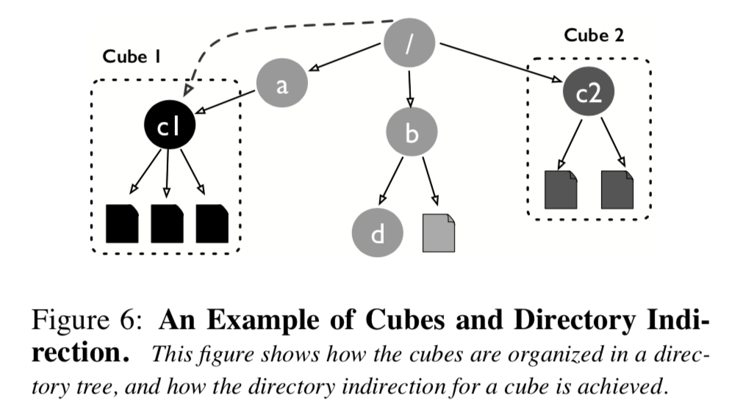
Directory Indirection
Each cube maintains top directory
Path lookup performs longest prefix match for that directory
If matches then the cube is identified and remainder of path is within it
Inode number and top directory path stored in sub-superblock
Information loaded into memory at mount time

Slide 17
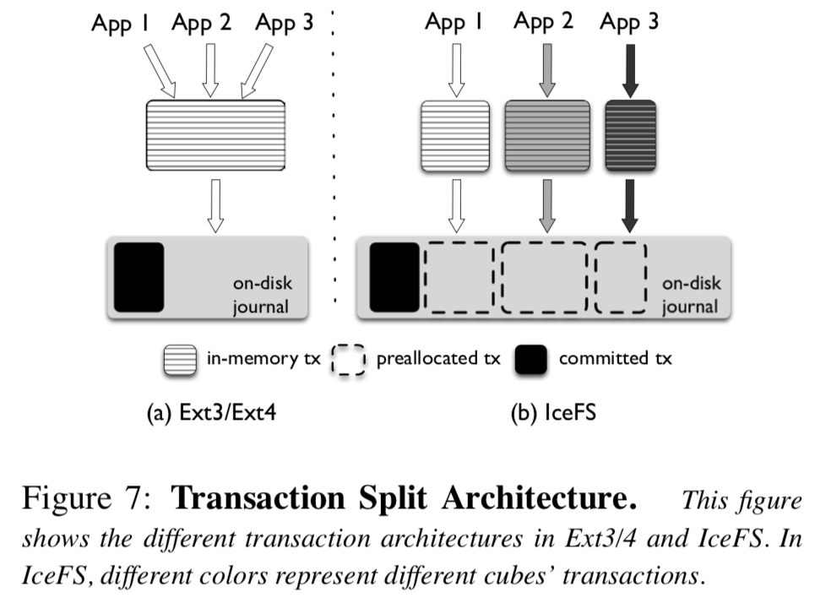
Transaction Splitting
Each cube maintains own transaction buffer
Different cubes can write buffers in parallel
Failures attributed to source cube and recovery initiated only on faulty cube
Cubes have virtual JBD journals (Ext3)
Allows individual cubes to have own journaling policies
Virtual journals share physical journal on disk

Slide 18
Localized Failures
Fault detection: existing ext3 mechanisms made “cube-aware”
Global failure behaviors isolated to a cube
Fault-handling functions modified to accept cube ID
Localized read-only: single cube marked read-only during recovery
Cube journal transactions shut down
Cube marked read-only in sub-superblock
Localized crashes
Fail the crash-triggering thread and mark cube as crashed
Prevent new threads by rejecting all requests to crashed cube
Running threads exit with error codes until counter reaches zero
Clean up the cube as though it were being unmounted

Slide 19
Localized Recovery
Offline checking: e2fsck made “cube-aware” (ice-fsck)
Only need to check faulty cubes
Repairs can be initiated without affecting rest of filesystem
Faults detected by reading error codes in journal
Online checking: difficult due to shared metadata
Fine-grained cube isolation makes it feasible
Individual cubes can be unmounted and repaired
Specialized Journaling
Per-cube consistency levels (e.g., no fsync, no journal, writeback, ordered, data)
Lower consistency => greater performance
Higher consistency => greater reliability

Slide 20
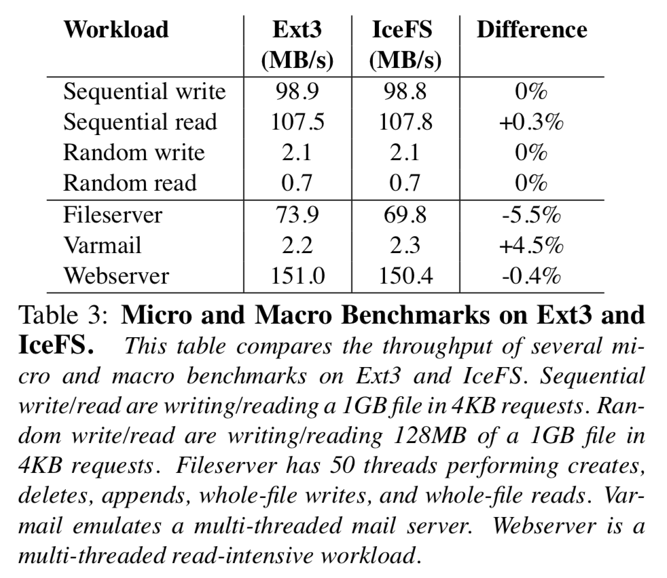
Evaluation

Slide 21
Case Studies
Virtualized Filesystem
IceFS as host file system for VMware environment
Distributed Filesystem
IceFS as underlying filesystem for HDFS

Slide 22
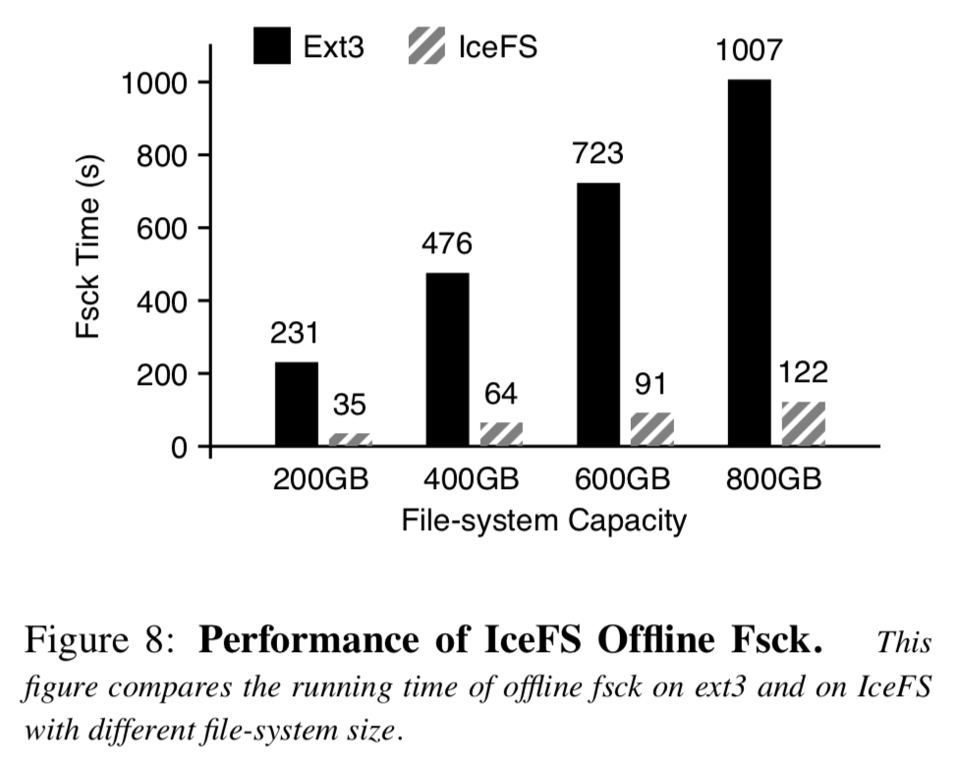
Fast Recovery

Slide 23
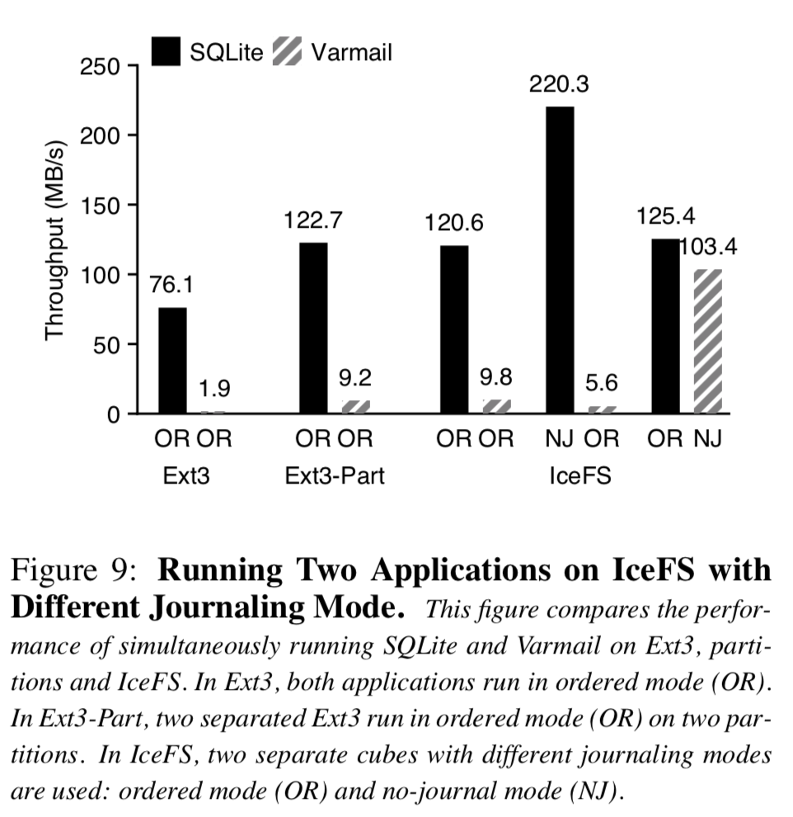
Specialized Journaling

Slide 24
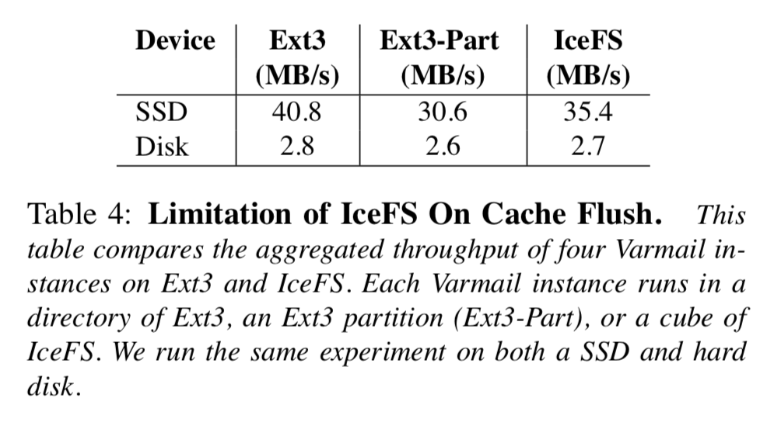
Limitations

Slide 25
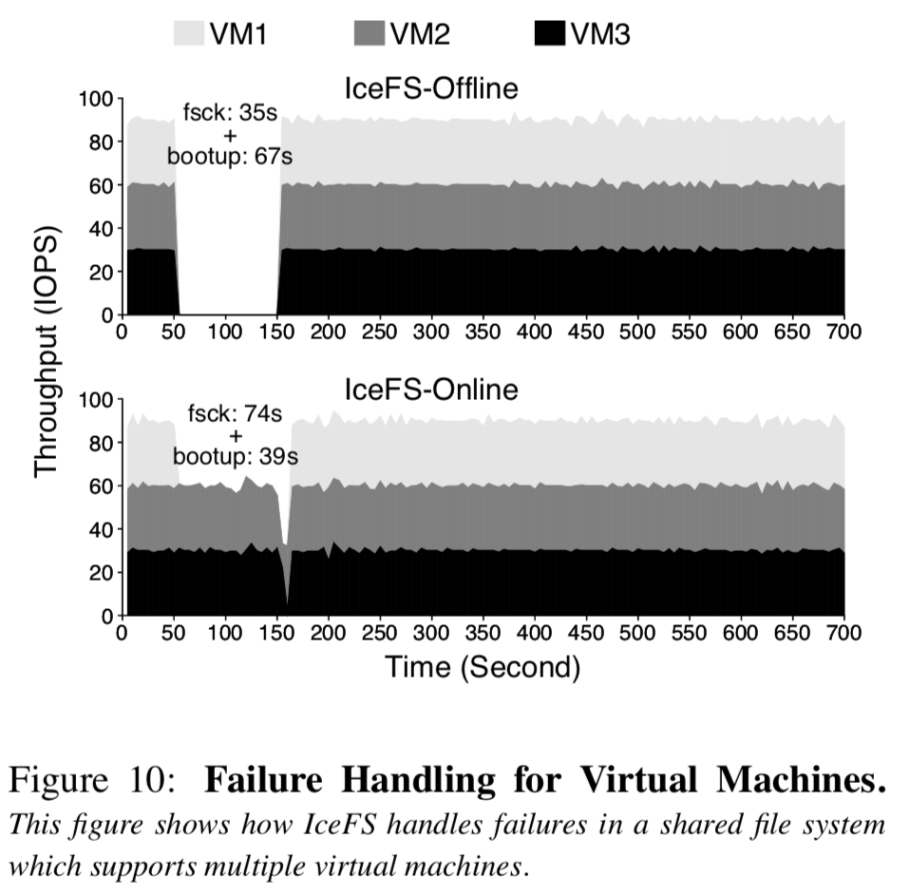
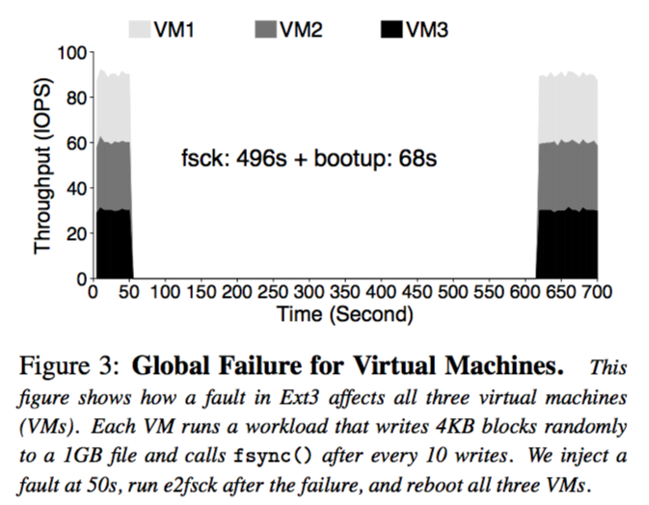
Virtual Machines

Slide 26
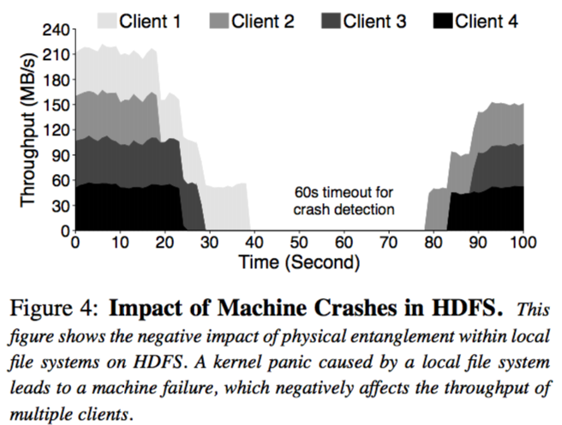
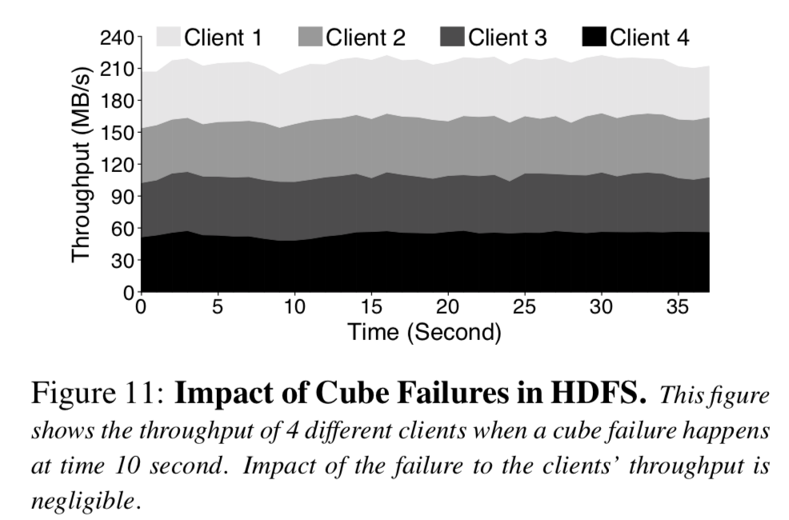
Distributed File System

Slide 27
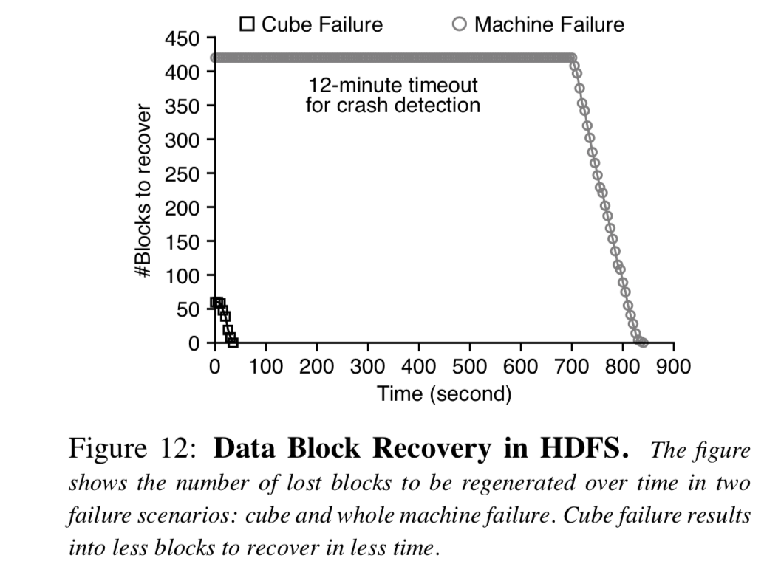
Scalable Recovery

Slide 28
Conclusion
Existing filesystems lack physical isolation
IceFS achieves isolation using cube abstraction
No shared resources, access dependencies, or bundled transactions among cubes
Localize failures that were previously global
Demonstrated fault isolation and fast recovery in two case studies: VM server and HDFS data nodes

