Slide 1
Bridging the Gap between Software and Hardware Techniques for I/O Virtualization
Jose Renato Santos, Yoshio Turner, G.(John) Janakiraman, Ian Pratt
USENIX 2008

Slide 2
Introduction
I/O virtualization degrades performance
Each guest-device interaction requires interception, validation, and handling
Especially in high-bandwidth NICs
Every packet would need to be inspected by virtualization layer

Slide 3
Paravirtualization
Guest executes a paravirtualized (PV) driver
Simplified abstract device model
Actual driver resides in the hypervisor or driver domain
Device driver domain
Privileged access to the I/O hardware

Slide 4
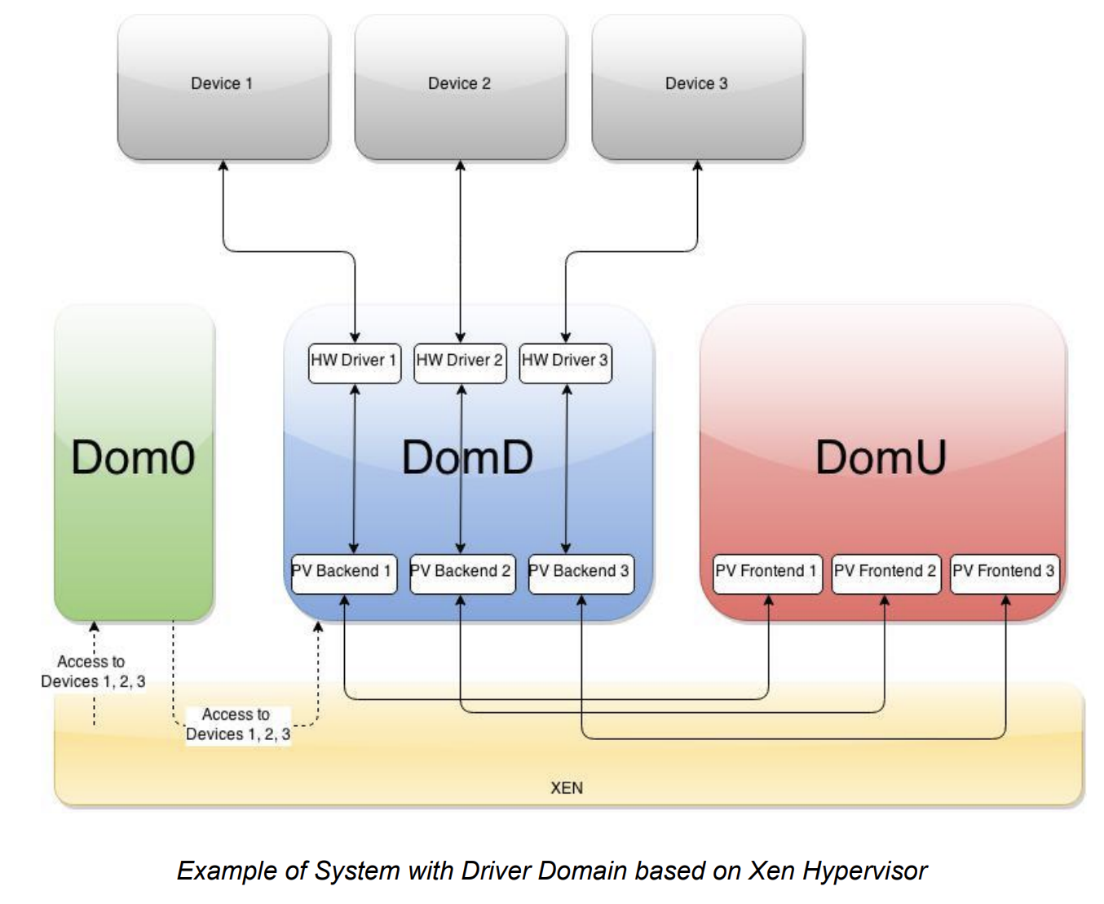
Device Passthrough
https://wiki.xen.org/images/1/17/Device_passthrough_xen.pdf

Slide 5
Device Driver Domain
Advantages
Legacy OS devices for portability
Safe execution environment
Isolation of buggy drivers or devices
Drawbacks
CPU overhead -> up to 4X slower!
Progress made on transmit path but not receive path

Slide 6
Direct I/O
Device presents multiple logical interfaces
Securely accessed by VMs
Virtualization layer bypassed
Near native performance
Drawbacks
HW support needed
Isolation and safety from buggy drivers compromised
No live migration
VMM must include many device drivers

Slide 7
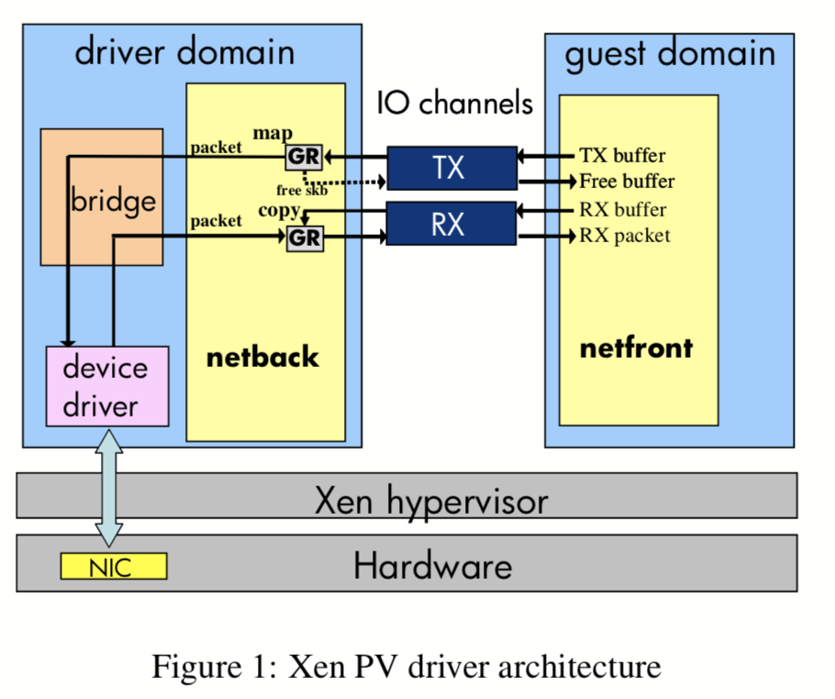
Xen Driver Architecture
Notes:
Netfront is the driver guest interacts with
Interrupts handled by hypervisor
Notifies appropriate driver domain via virtual interrupts
Shared memory channel b/w netfront and netback
SW Bridge: routes packets b/w physical device & multiple guests through their netback interfaces

Slide 8
I/O Channels
Event notification mechanism
Bidirectional ring of async requests
netfront => requests => netback
netfront <= responses <= netback
Virtual interrupts indicate new requests/responses posted

Slide 9
Page Grants
Page grants allow driver domains to access I/O buffers in guest memory
Guest sends I/O buffer descriptors with requests to netback including guest address and callback function

Slide 10
Transmission (TX)
DomD makes hypercall mapping guest page into its address space before sending through the bridge
Physical driver fills the buffer and frees the page
Callback function invoked sending data back to netfront
Page grant revoked

Slide 11
Receive (RX)
netfront posts page grants to the RX I/O channel
netback receives packet from the bridge and retrieves a grant
Grant copy hypercall transfers packet to guest page
netback sends response to guest notifying of new packet
netfront reads packet and revokes grant

Slide 12
Network Performance Analysis
Three Models
Xen PV Driver
Xen Direct I/O
Native Linux
Domains
Dom0 == DomD
DomU == guest
Notes:
Uses netperf UDP_STREAM microbenchmark
Difficult to quantify CPU costs for TCP due to ACK packets

Slide 13
Network Performance Analysis
Uses netperf UDP_STREAM microbenchmark
Difficult to quantify CPU costs for TCP due to ACK packets
IOMMU prevents guests from accessing
each others’ memory via DMA
Direct I/O results optimistic due to lack of IOMMU overhead
Authors unable to obtain one…

Slide 14
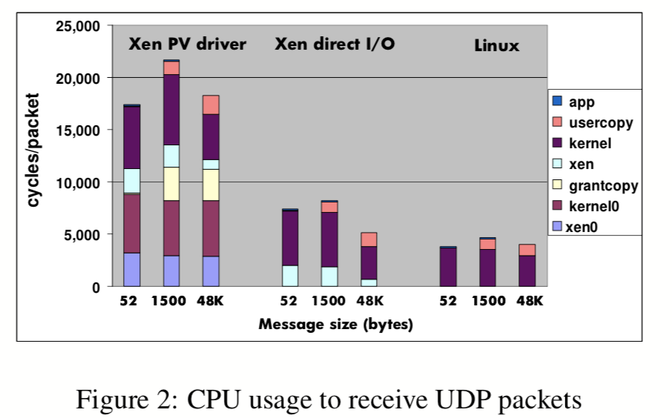
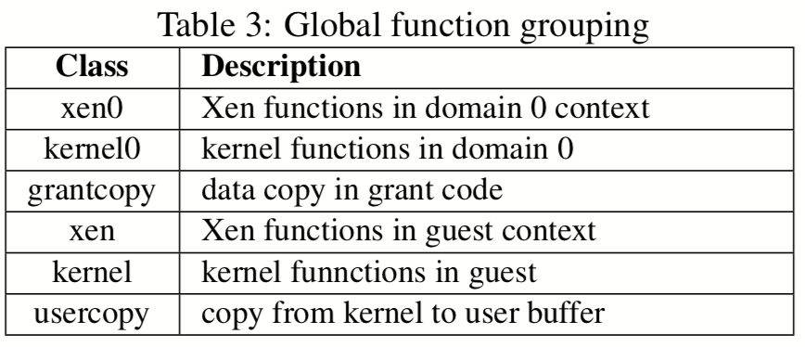
Network Performance Analysis

Slide 15
Network Performance Analysis
Direct I/O Analysis
31% overhead w.r.t. native Linux on RX
Mostly in the DMA interface
DMA driver must translate virtual addresses to device bus addresses
Requires SW emulated TLB code on x86
Linux bounce buffer if physical memory not contiguous
Notes:
Uses netperf UDP_STREAM microbenchmark
Difficult to quantify CPU costs for TCP due to ACK packets

Slide 16
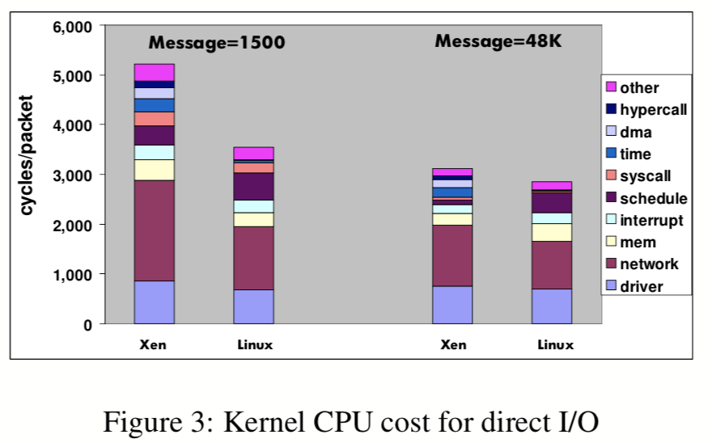
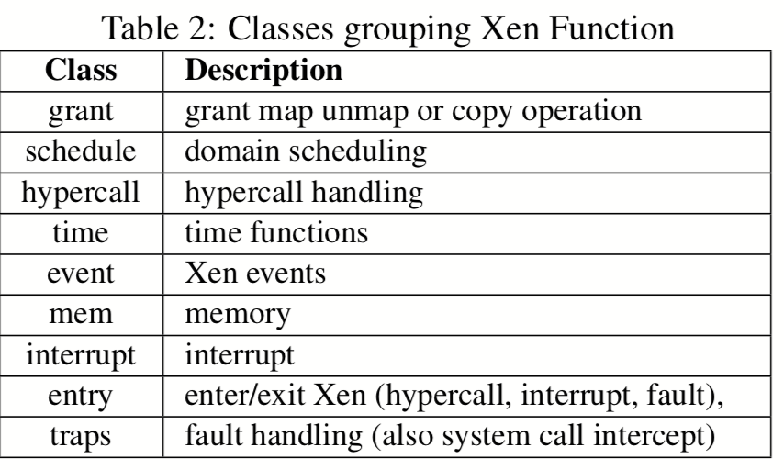
Network Performance Analysis

Slide 17
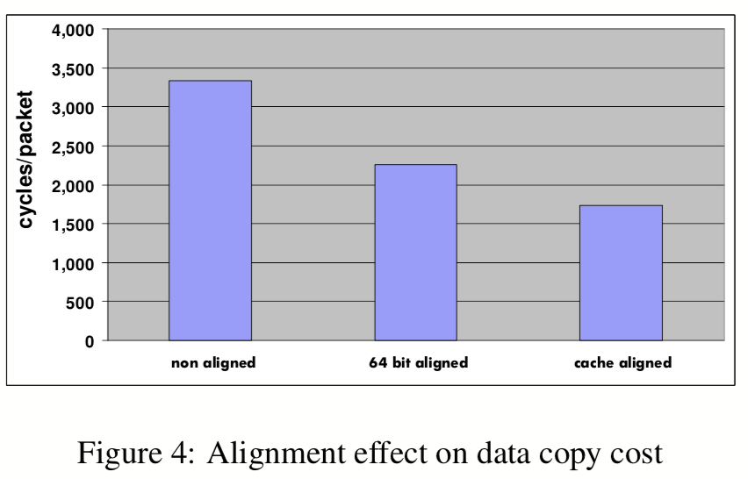
Network Performance Analysis
PV Driver: Copy overhead
x86 faster when memory addresses have same 64-bit word alignment, fastest if cache line aligned
Network packets are non aligned due to 14B Ethernet header
Notes:
Uses netperf UDP_STREAM microbenchmark
Difficult to quantify CPU costs for TCP due to ACK packets

Slide 18
Network Performance Analysis
PV Driver: Kernel overhead
↑ CPU cycles due to fragments in guest socket buffers
TCP Segmentation Offloading (TSO) and Large Receive Offloading (LRO) enable large packets spanning many pages
Fragmentation introduces copy and socket buffer allocation overheads
netfront modified to avoid using fragments, assumes packets will not span multiple pages (no jumbo packets, TSO, or LRO)
Grant permission table is updated with atomic operations, move grant bits into different words then use less expensive memory barriers
Notes:
Uses netperf UDP_STREAM microbenchmark
Difficult to quantify CPU costs for TCP due to ACK packets

Slide 19
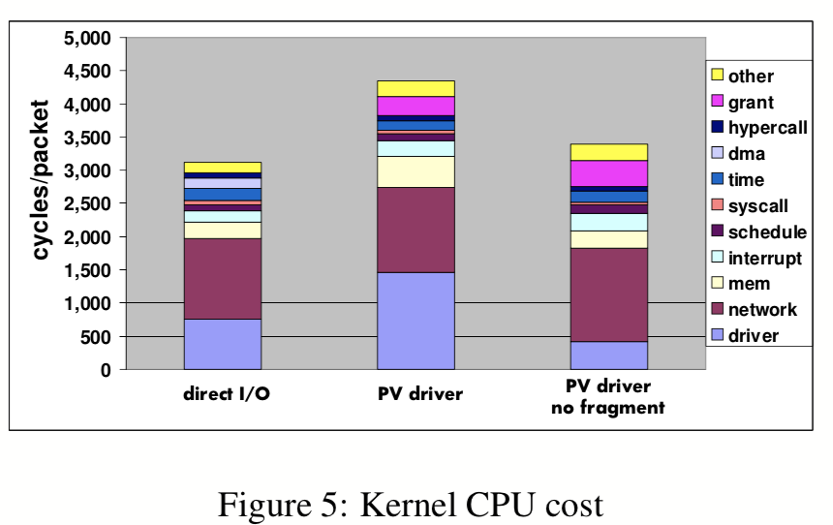
Network Performance Analysis
PV Driver: Kernel overhead
Notes:
Uses netperf UDP_STREAM microbenchmark
Difficult to quantify CPU costs for TCP due to ACK packets

Slide 20
Network Performance Analysis
PV Driver: Hypervisor overhead
↑ CPU cycles due to code executing in the driver domain
Mostly page grant operations and scheduling
With DomD and guest on different cores, accessing schedule data structures results in more cache misses
Grant operation costs from spin locks, page pinning, and atomic swap operations
Can be optimized by moving driver domain operations into guest
Notes:
Uses netperf UDP_STREAM microbenchmark
Difficult to quantify CPU costs for TCP due to ACK packets

Slide 21
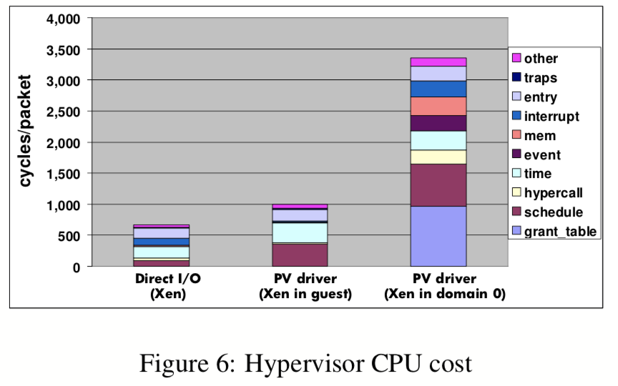
Network Performance Analysis
PV Driver: Hypervisor overhead
Notes:
Uses netperf UDP_STREAM microbenchmark
Difficult to quantify CPU costs for TCP due to ACK packets

Slide 22
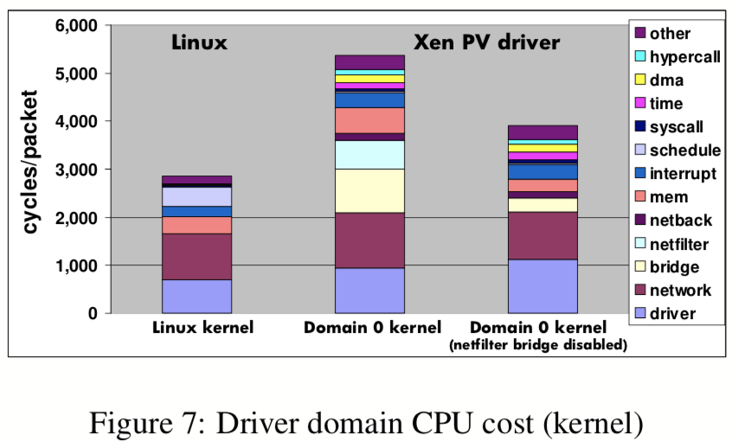
Network Performance Analysis
PV Driver: Driver domain overhead
Mostly caused by bridge and netfilter functions
Can be disabled if kernel is configured properly
Notes:
Uses netperf UDP_STREAM microbenchmark
Difficult to quantify CPU costs for TCP due to ACK packets

Slide 23
Xen Network Design Changes
Architecture-independent optimizations
Disable netfilter bridge
Aligned data copies
Avoiding socket buffer fragments
Page grant optimizations

Slide 24
Xen Network Design Changes
Data copying moved to guest
Additional copy between DomD and guest is overhead not required in native Linux
The data copy is likely performed by different CPU cores (one for driver domain, one for guest) leading to poor cache locality
Ownership of the page in the driver domain containing the packet from the NIC is transferred to the guest

Slide 25
Xen Network Design Changes
Data copying moved to guest
Grant copy operation is performed on the guest just like the second data copy so the page is likely to exist in L2 cache
Avoids polluting DomD CPU cache
Improved scalability for multiple guests (avoids DomD bottleneck)
Enables other optimizations (e.g., socket buffer fragment allocation)
Saves ~2250 cycles or 276% of native

Slide 26
Xen Network Design Changes
Grant mechanism extensions
DomD issues grant to the guest
Packets received from other guests are not owned by driver domain
Requires grant transitivity, guest domain can transfer grant to another
Same I/O buffer can receive data from different guests => potential security violation
Grants extended with offset and size fields so receiving guest only receives access to memory containing received packet data

Slide 27
Xen Network Design Changes
Multi-queue device support
If moving extra data copy to guest is good, eliminating is better!
NIC places packets directly into guest kernel buffer
Driver domain is bypassed
Some NICs demultiplex packets into multiple RX queues based on destination MAC address and VLAN IDs
Achieved by dedicating one RX queue to each guest

Slide 28
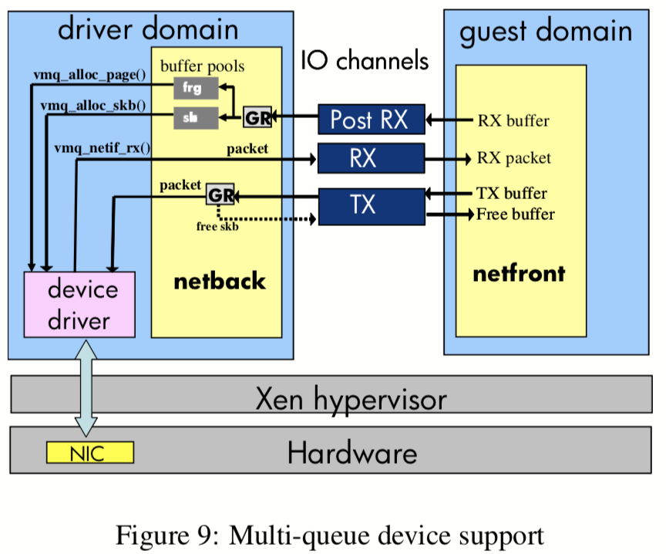
Xen Network Design Changes

Slide 29
Xen Network Design Changes
Guest copy move optimization remains useful
Number of guests can exceed number of RX queues
Still necessary for guest to guest traffic
Packets from other guests contain copy grants, those from device have pre-posted buffers

Slide 30
Xen Network Design Changes
Multi-queue summary
Device to guest data transfer reduces cost by 700 cycles
Simplified socket buffer allocation and packet routing by 1150
Grant mapping requires two grant copies (map and unmap) increasing cost by 650 cycles
Net reduction: 1200 cycles or 246% of native

Slide 31
Xen Network Design Changes
Caching and reusing page grants
Large percentage of Xen I/O CPU cycles due to page grants
Memory isolation property could be slightly relaxed
Driver domain keeps guest I/O buffers mapped in its address space
Linux slab allocator caches previously used I/O buffers allowing page grants can be reused
Security loss is minimal as DomD can only access I/O pages, no other data or code
Guest must be able to invalidate grant pages

Slide 32
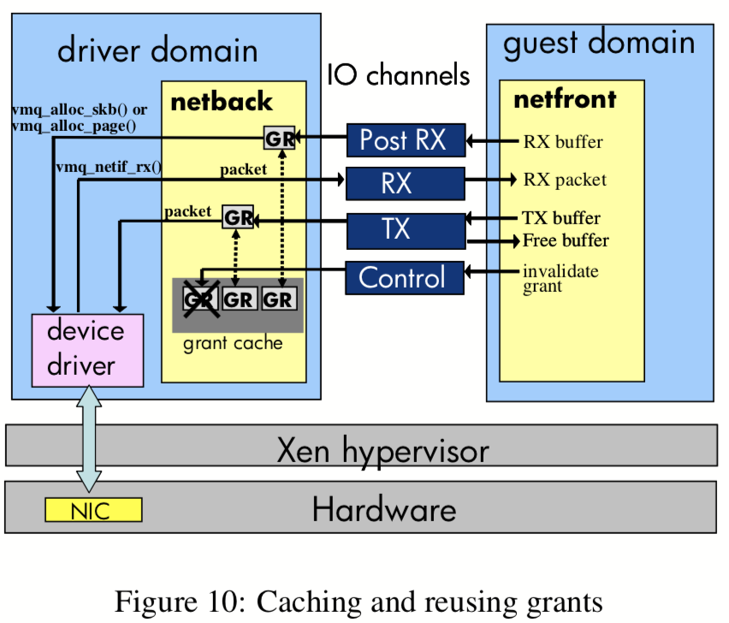
Xen Network Design Changes

Slide 33
Xen Network Design Changes
Caching and reusing page grants
Number of cached grants limited by address space of DomD kernel
Grant reuse mechanism expected to have nearly 100% hit rate
Amortized overhead should be nearly 0% over time
Not yet implemented!
Simplified, grant-free mechanism applied for simulation purposes
1950 cycles saved for total of 10,300 or 198% of native

Slide 34
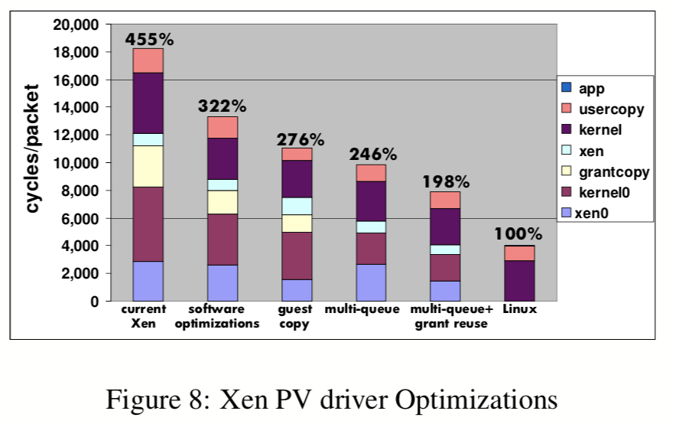
Xen Network Design Changes

Slide 35
Tuning I/O Virtualization Configuration
Decoupling DomD from Dom0
Xen allows DomD to be configured independently
No fault isolation mechanism exists (e.g., detecting crashed drivers and restarting them)
Hosting all device drivers in Dom0 limits flexibility
e.g., Disabling bridge netfilter optimization cannot be applied or iptables does not work properly

Slide 36
Tuning I/O Virtualization Configuration
Reducing interrupt rate
Data copy and page grant overhead are proportional to traffic received
Most remaining overhead proportional to number of times DomD and guest are scheduled
Physical and virtual interrupts, events, hypercalls, etc.
Device interrupt consumed by Dom0 and DomD, and the corresponding virtual interrupt in the guest

Slide 37
Tuning I/O Virtualization Configuration
Reducing interrupt rate
Modern NICs can delay interrupts until multiple packets received
Interrupt rate can be controlled by driver parameters called interrupt coalescing parameters
Interrupt generated when specified number of packets received or specified delay is reached
Limits interrupts at high I/O rates but preserves latency at low rates
Amortizes interrupt costs for Dom0, DomD, and guests

Slide 38
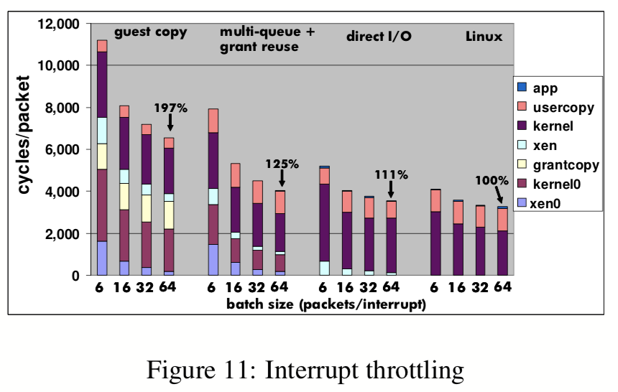
Tuning I/O Virtualization Configuration

Slide 39
Conclusion
Xen driver domain isolates device drivers from hypervisor and guest code
Device drivers need access to I/O data in guests and to move data between them resulting in overhead
Moving copy operations to guest CPU increases data locality
Data copies avoided by using HW to copy data directly into guest memory
Page grants can be reused by sharing I/O buffers
I/O tuning can greatly improve performance

