Slide 1
Build Server (Continuous Integration)
Presenter : Eddie Huang

Slide 2
Agenda
Continuous Integration (CI)
The reasons for a build server’s existence.
The preparation

Slide 3
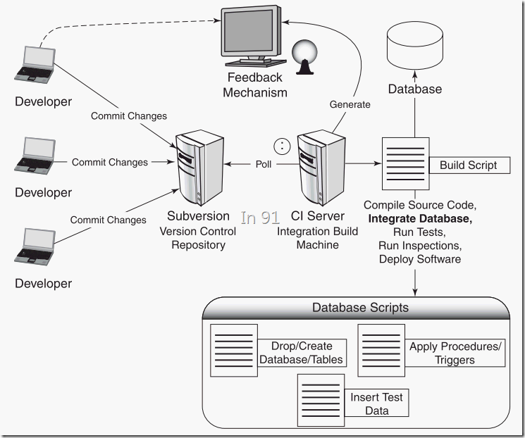
Continuous Integration (CI)

Slide 4
The reasons for a build server
Early detection of potential source code building errors.
Preserving the building environment.
Saving time for the manual creation of the release package.
Notes:
這張投影片列出有比較花時間去做的 Recovery DVD 改進

Slide 5
The preparation
Developer’s preparation
Build server administrator’s preparation

Slide 6
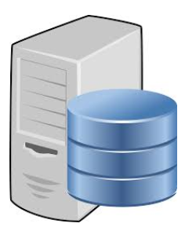



The preparation
Source code server
Build Server
Create below files in the root folder of the source code directory
build.sh (File)
package.sh (File)
ReleasePackage (Dir)
ReleasePackage/FactoryOp (Dir)
ReleasePackage/OTAUpdate (Dir)
Commit changes to the source code revision server
Import the developer’s VDI
files to the build server’ Virtual
Box.
Follow the guidance of
SourceCodeBuildingEnvironmentVMSetup.docx
to complete settings.
The VDI file with the proper
source code building environment
Notes:
這張投影片列出有比較花時間去做的 Recovery DVD 改進

Slide 7
Developer’s preparation
“VM” – A virtual box vm file with the proper source code building environment.
“build.sh” - Executes all necessary commands for building source code.
Example: build.sh : source build/envsetup.sh; lunch xxx; make
“package.sh” – Copies generated image files into “ReleasePackage” folder and compresses it into a zip file for the release.
“ReleasePackage” : Contains “FactoryOp” and “OTAUpdate”. Each folder should consist of the user manual guide, the release note.
“build.sh”, “package.sh” and “ReleasePackage” (consists of the folders of FactoryOp and OTAUpdate) should be put under the root folder of the source code directory and be checked into the source code revision server.
Notes:
這張投影片列出有比較花時間去做的 Recovery DVD 改進

Slide 8
Thank you!

