Slide 1
Virgin_Train_DB Project
Name: Eddie Chongtham
Date: [October 29, 2025]

Slide 2
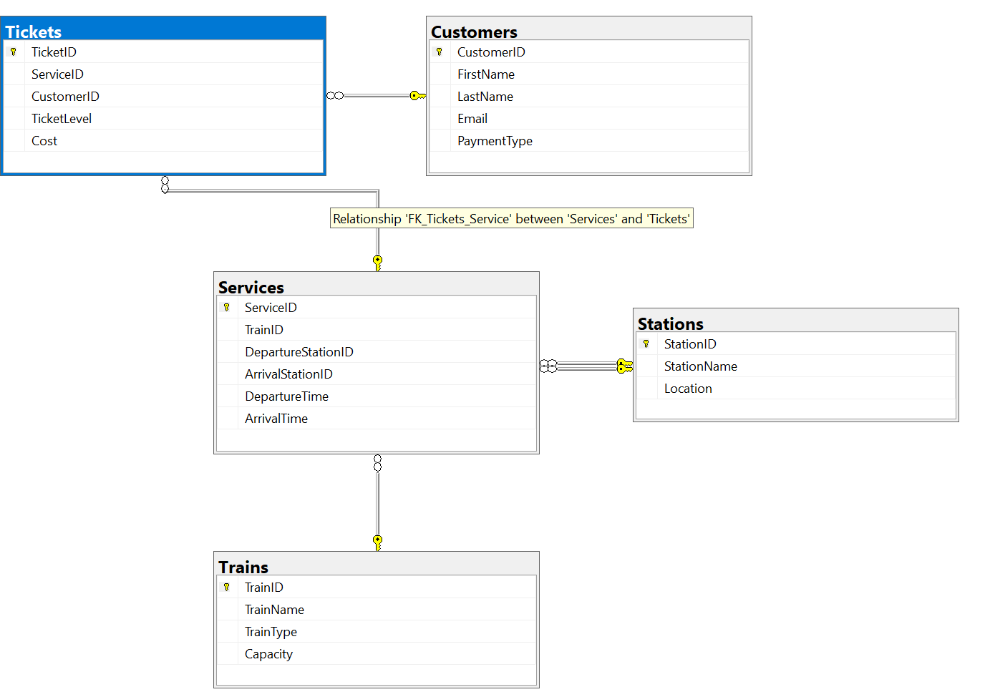
Entity Relationship Diagram
ERD showing PK/FK relationships and connector lines.

Slide 3
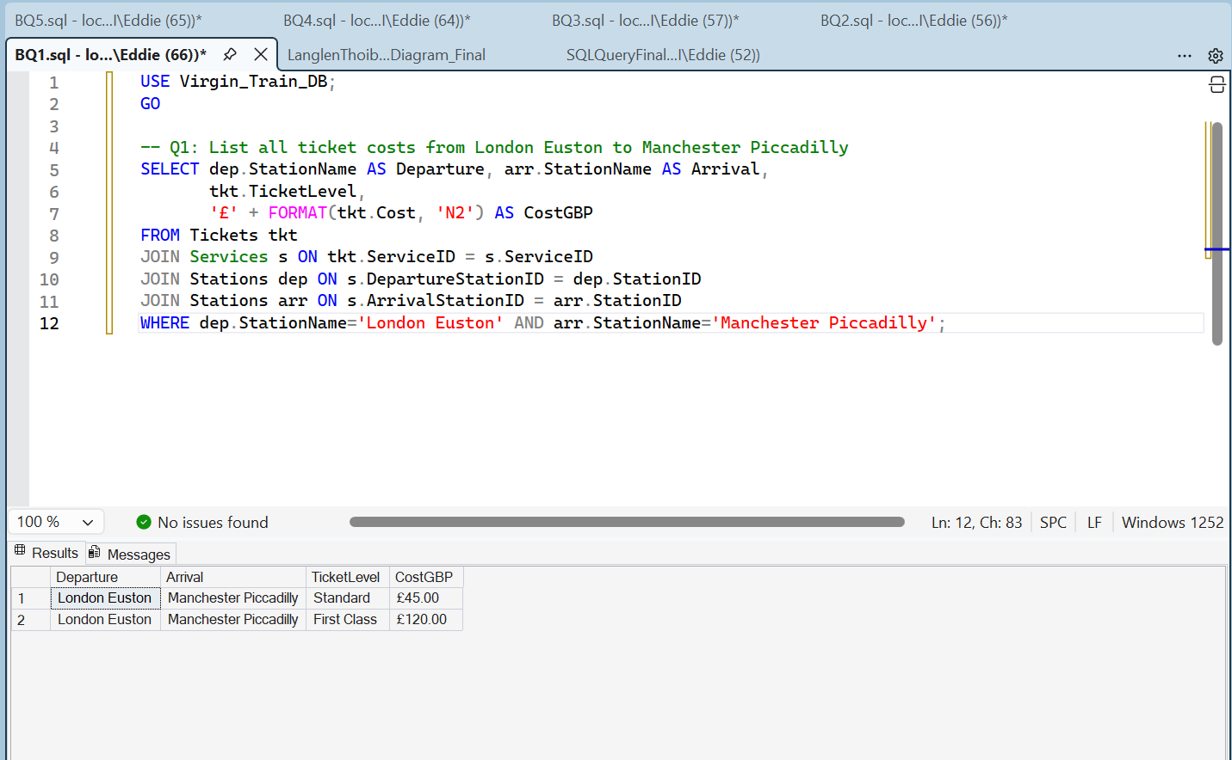
Q2 – Cheapest Ticket per London Route
Q1 - All ticket costs from London Euston to Manchester Piccadilly

Slide 4
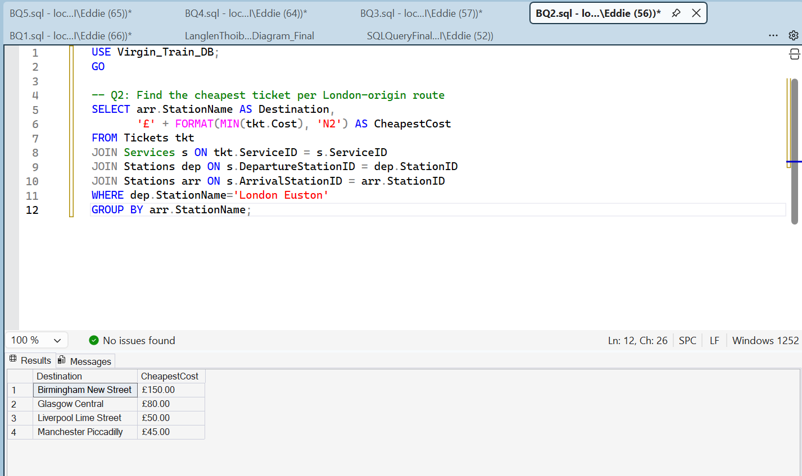
Q2 – Cheapest Ticket per London Route
Q2 - Cheapest Ticket per London Route

Slide 5
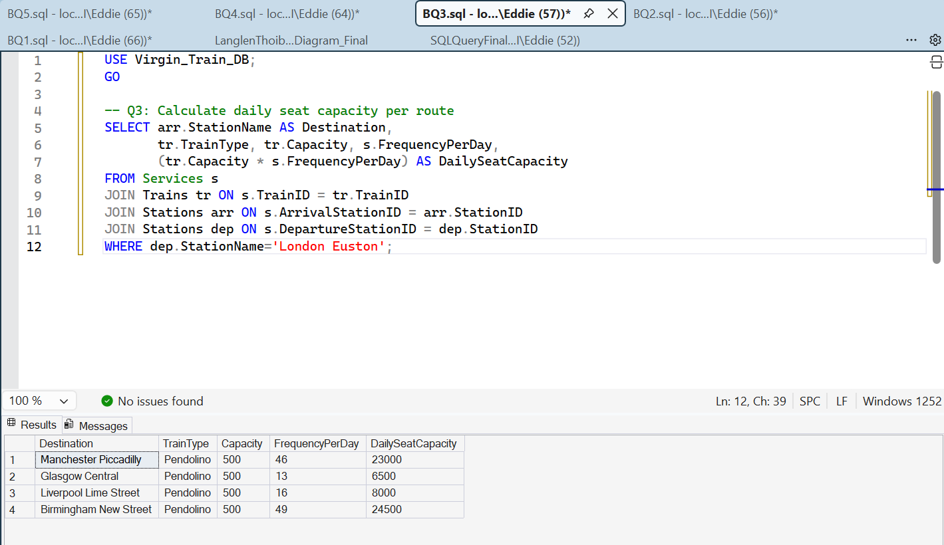
Q2 – Cheapest Ticket per London Route
Q3 – Daily Seat Capacity per Route

Slide 6
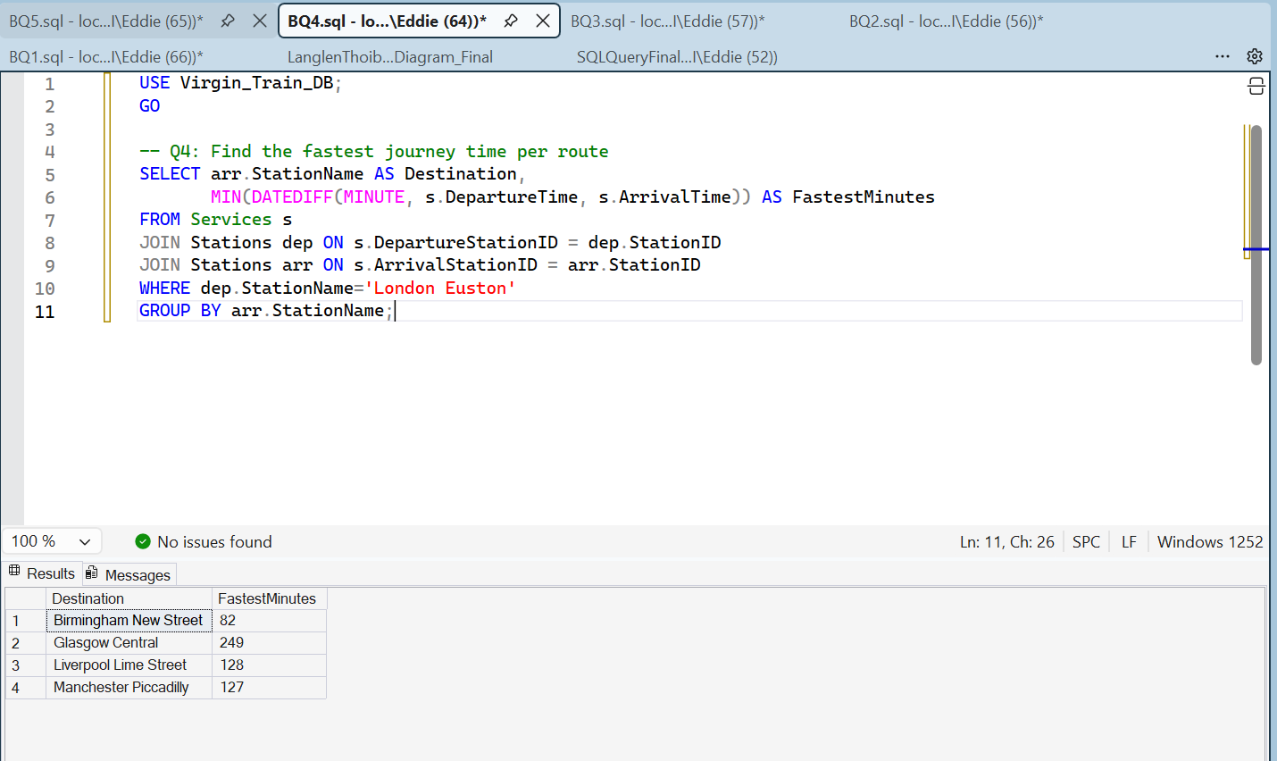
Q2 – Cheapest Ticket per London Route
Q4 – Fastest Journey Time per Route

Slide 7
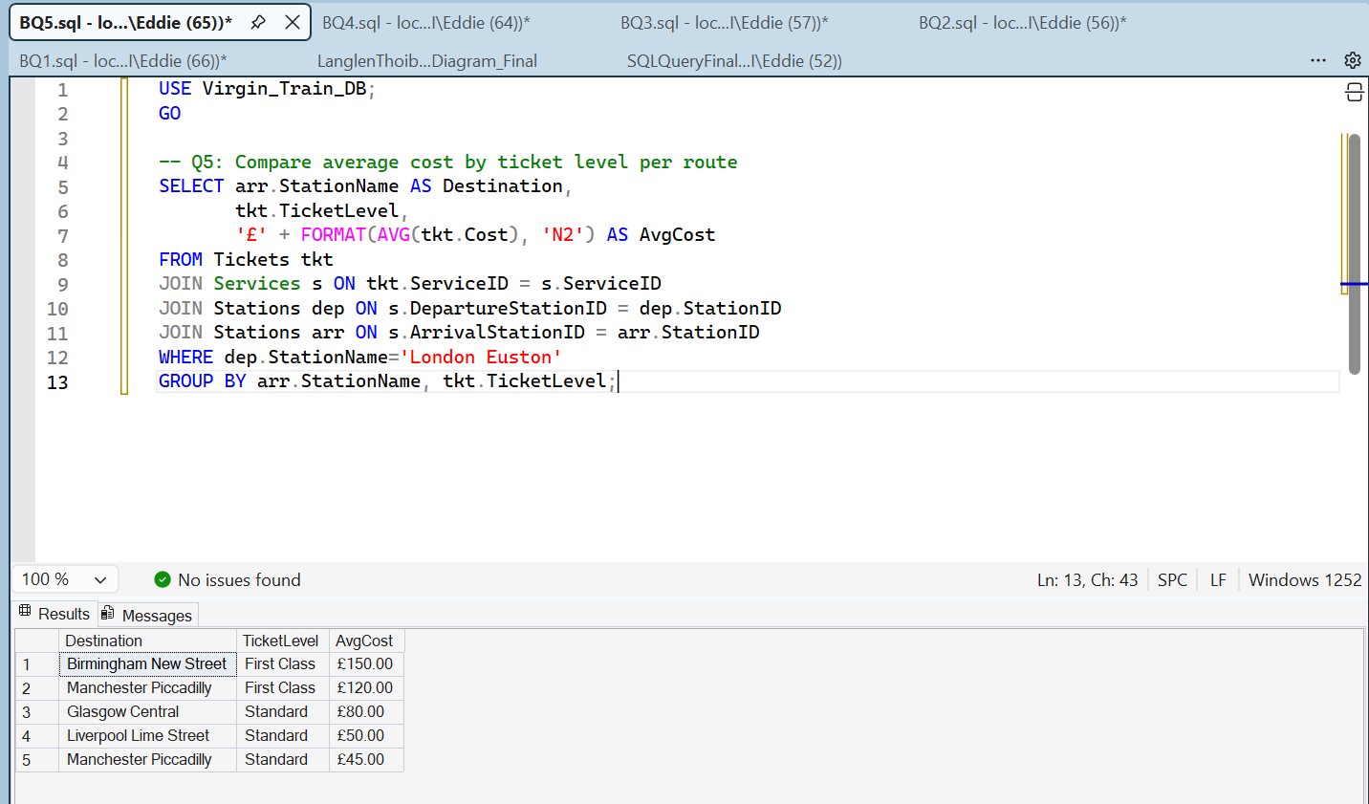
Q2 – Cheapest Ticket per London Route
Q5 – Average Cost by Ticket Level per Route

Slide 8
Summary & Insights
• Database built with PK/FK constraints.
• ERD shows clear relationships between entities.
• Queries demonstrate joins, aggregates, and business insights.
• Costs stored in GBP with two decimals for accuracy.

