Slide 1
FAIRVIEW COUNTY COLLEGE
Student Management System
OOP with C# — Final Project
Built with .NET 8 | C# | Visual Studio Code
March 2026
1 / 10

Slide 2
Project Overview
Design & implement a Student Management System for Fairview County College, applying all core OOP principles learned throughout the course.
Part 1
Part 2
Part 3
Part 4
Basic System Design
Abstraction & Polymorphism
Generics & Delegates
LINQ & Persistence
Core classes: Student, Instructor, SchoolClass, Department, Course
Abstract Person class, inheritance hierarchy, polymorphic collections
Generic Collection<T>, delegate events for enrollment & collection changes
LINQ filter/sort/group/search + CSV file-based data persistence
All 4 parts implemented, built successfully, and tested end-to-end.
2 / 10

Slide 3
Part 1 — Class Structure
Class | Key Attributes | Key Methods
Student | studentID, name, age, coursesEnrolled | enrollCourse, dropCourse, displayInformation
Instructor | instructorID, name, classesTaught | addClass, removeClass, displayInformation
SchoolClass | classID, name, instructor, dept, course, studentIDs | addStudent, removeStudent, displayInformation
Department | deptID, name, classIDs | addClass, removeClass, displayInformation
Course | courseID, name, departmentID | — (data entity, Part 1)
Relationships
▶ Department offers many SchoolClass sections
▶ SchoolClass belongs to one Course
▶ Instructor assigned to one or more sections
▶ Student enrolls in one or more Courses
▶ All entities identified by unique string ID
3 / 10

Slide 4
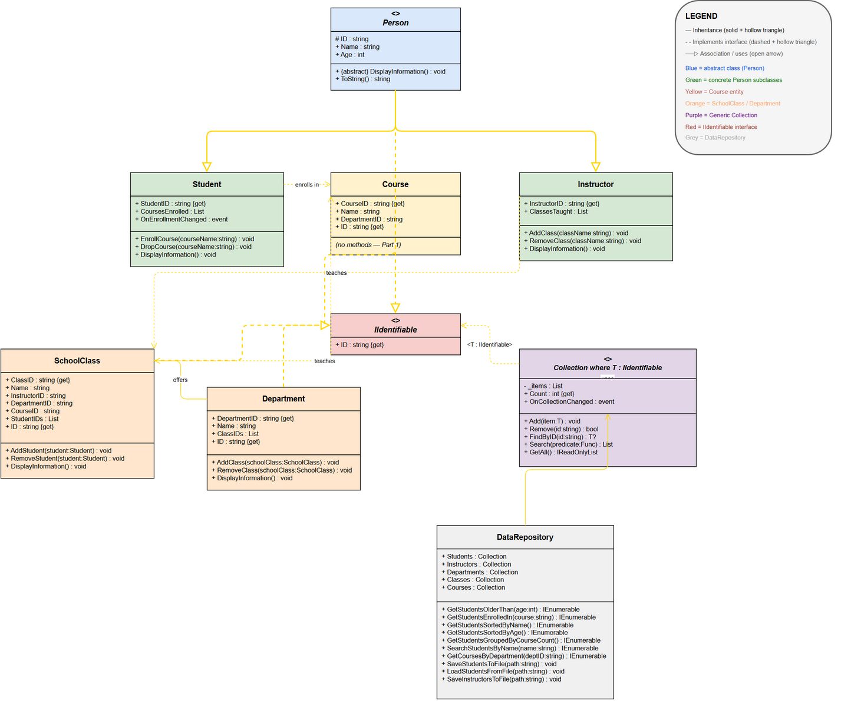
UML Class Diagram — Full System Architecture

Slide 5
Part 2 — Abstraction
public abstract class Person : IIdentifiable
{
public string ID { get; protected set; }
public string Name { get; set; }
public int Age { get; set; }
public abstract void DisplayInformation();
public override string ToString() =>
$"{Name} (ID: {ID}, Age: {Age})";
}
Why abstract class Person?
▶ Cannot be instantiated directly
▶ Forces every subclass to implement DisplayInformation()
▶ Shared state (ID, Name, Age) written once — no duplication
▶ IIdentifiable enables use in generic Collection<T>
«abstract» Person
▼ inherits
Student
Instructor
4 / 10

Slide 6
Part 2 — Polymorphism
// A mixed list of Person objects
var people = new List<Person>();
people.AddRange(students);
people.AddRange(instructors);
// Runtime polymorphism in action
foreach (Person p in people)
p.DisplayInformation();
// → correct override called automatically!
What really happens
▶ Variable type is Person (base)
▶ Runtime type is Student or Instructor
▶ C# virtual dispatch calls the correct override — no type checks
▶ No if (p is Student) needed
▶ Adding a new person type (e.g. Admin) needs zero changes to existing code
✔ Open/Closed Principle: open for extension, closed for modification
5 / 10

Slide 7
Part 3 — Generic Collection<T> & Delegates
public class Collection<T>
where T : IIdentifiable
{
public void Add(T item) { ... }
public bool Remove(string id) { ... }
public T? FindByID(string id) { ... }
public List<T> Search(Func<T,bool> pred) { ... }
public IReadOnlyList<T> GetAll() { ... }
}
Why generics?
▶ One class replaces 5 near-identical collection classes
▶ Works for Student, Instructor, Course, SchoolClass, Department
▶ IIdentifiable gives Collection<T> a guaranteed ID to work with
Delegates & Events
▶ OnCollectionChanged — fires on Add / Remove in any collection
▶ OnEnrollmentChanged — fires when student enrolls or drops a course
▶ Subscribers use += (loose coupling, Observer pattern)
▶ No tight dependency — Student doesn't know who is listening
6 / 10

Slide 8
Part 4 — LINQ Queries
Operation | LINQ Method(s) | Example
Filter by age | Where | Students older than 20
Filter by course | Where + Contains | Enrolled in 'OOP'
Sort by name | OrderBy | A → Z alphabetically
Sort by age | OrderBy | Youngest first
Group | GroupBy | By number of courses enrolled
Search | Where + Contains | Name contains 'o'
Filter courses | Where | Courses in 'CS' department
// Group students by course count
var groups = Students.GetAll()
.GroupBy(s => s.CoursesEnrolled.Count);
foreach (var g in groups)
Console.WriteLine(
$"[{g.Key} course(s)]: " +
string.Join(", ", g.Select(s => s.Name)));
// Output:
// [2 course(s)]: Emma Davis, Liam Park, Olivia Brown
// [0 course(s)]: Sofia Patel, Noah Kim
7 / 10

Slide 9
Part 4 — Data Persistence (CSV Files)
▶ Students saved to students.csv, instructors to instructors.csv
▶ CSV = human-readable, no database server needed
▶ Header row + one row per record
▶ Multiple courses stored as pipe-separated values ( | )
▶ Data fully reloaded from file into a fresh DataRepository
Step 1
1. SaveStudentsToFile()
Iterates Collection<Student>, writes CSV lines with File.WriteAllLines()
Step 2
2. students.csv on disk
Plain text — verifiable in Excel or Notepad
Step 3
StudentID,Name,Age,CoursesEnrolled
S001,Emma Davis,20,OOP|Database Systems
S002,Liam Park,22,OOP|Calculus I
S003,Sofia Patel,19,
S004,Noah Kim,24,Database Systems
S005,Olivia Brown,21,OOP|Calculus I
3. LoadStudentsFromFile()
Reads CSV, skips header, reconstructs Student objects + courses
Step 4
4. Fresh DataRepository
Identical state restored — names, ages, all enrolled courses intact
8 / 10

Slide 10
OOP Principles — Applied
Encapsulation
Inheritance
Data is protected
Shared code lives once
CoursesEnrolled is a private list — external code must call EnrollCourse() or DropCourse(). ID has a protected setter, set once at construction.
Student and Instructor inherit ID, Name, Age, and ToString() from Person. Zero duplication. New person types extend automatically.
Abstraction
Polymorphism
Hide complexity
One call, many behaviours
Person is abstract — callers work against the Person type without knowing if it's a Student or Instructor. IIdentifiable gives Collection<T> a minimal contract.
A List<Person> holds both types. p.DisplayInformation() dispatches correctly at runtime. Collection<T> works for any IIdentifiable type.
9 / 10

Slide 11
Lessons Learned & Conclusion
Key Lessons
What was built
▶ Start with abstraction — defining Person early eliminated duplication from day one
▶ Generics eliminate boilerplate — one Collection<T> replaced five near-identical classes
▶ Events decouple components — Student doesn't need to know who listens to its events
▶ LINQ improves readability — one-line Where/OrderBy/GroupBy replaces manual loops
▶ Separate entities from logic — DataRepository can grow without touching model classes
✅ 5 model classes + abstract Person
✅ IIdentifiable interface
✅ Generic Collection<T> with delegate events
✅ DataRepository with 7 LINQ queries
✅ CSV save & load persistence
✅ Full demo in Program.cs
✅ Build succeeded, all output verified
Thank You!
10 / 10

