Slide 1
Machine Learning in Health and Bioinformatics
Dr Zina Ibrahim
Department of Biostatistics and Health Informatics
King’s College London
zina.Ibrahim@kcl.ac.uk
Week 2, Day 4: Interpreting Model Output

Slide 2
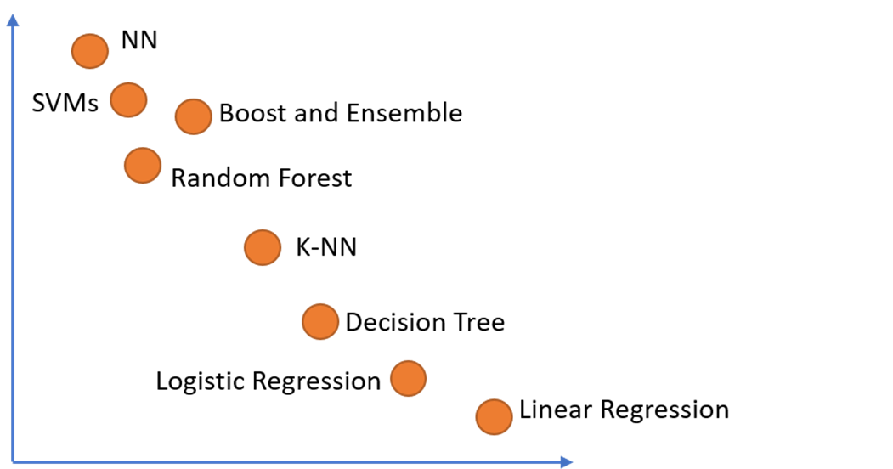
Interpretability vs Performance
Typical Performance
Model Interpretability

Slide 3
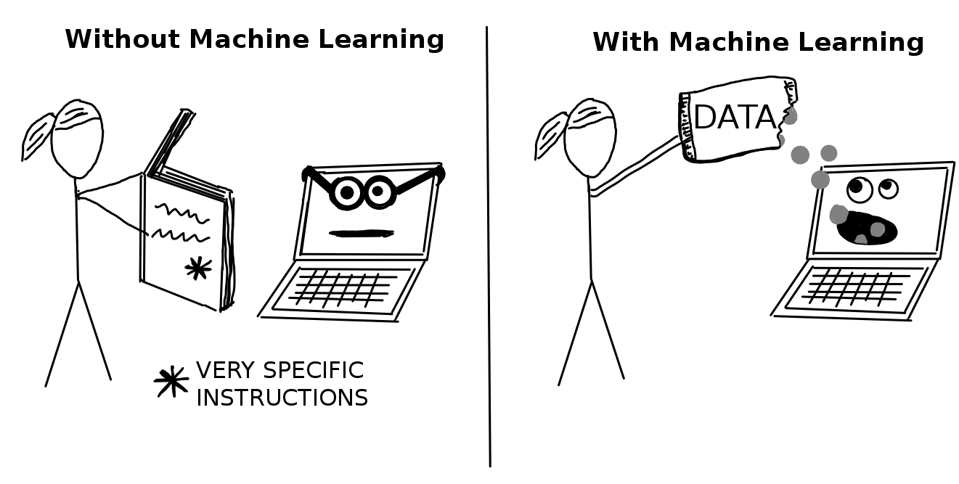
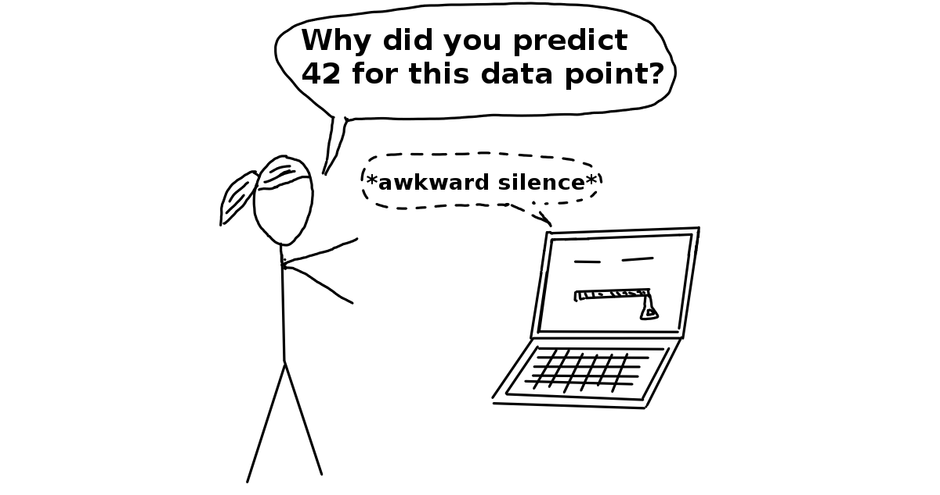
Why Need to Understand ML Output?
If a machine learning model performs well, why do we not just trust the model and ignore why it made a certain decision? “The problem is that a single metric, such as classification accuracy, is an incomplete description of most real-world tasks.” (Doshi-Velez and Kim 2017)
Doshi-Velez, Finale, and Been Kim. “Towards a rigorous science of interpretable machine learning,” no. Ml: 1–13. http://arxiv.org/abs/1702.08608 (2017).

Slide 4



Blackbox ML Models are in the Past!!
Post-hoc interpretability
Intrinsically interpretable on local level
Typical Performance
Intrinsically interpretable
Model Interpretability

Slide 5
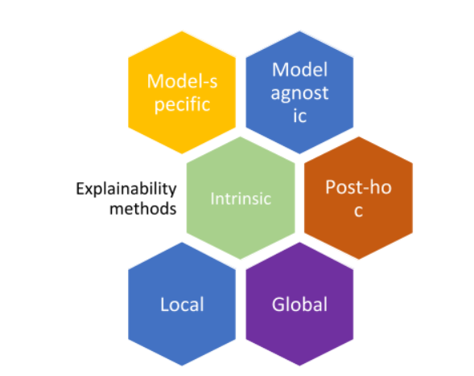

Slide 6
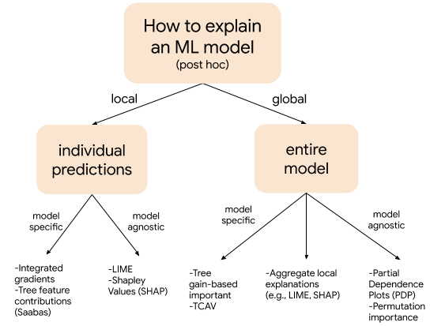
Post-hoc Interpretability

Slide 7
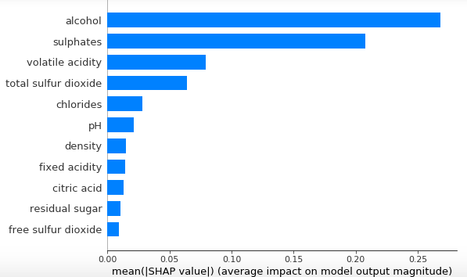
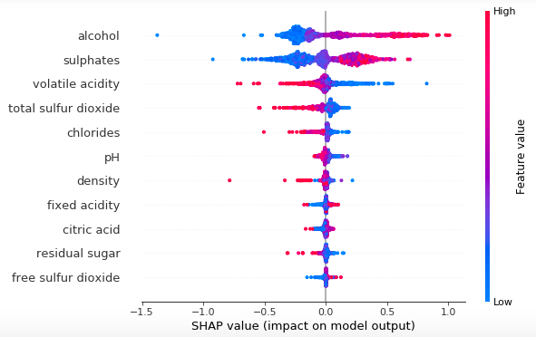
Global Post-hoc Interpretability : Variable Importance vs Shapley Plots

Slide 8
Global Post-hoc Interpretability Using Shapley Plots
Feature importance: Variables are ranked in descending order.
Impact: The horizontal location shows whether the effect of that value is associated with a higher or lower prediction.
Original value: Color shows whether that variable is high (in red) or low (in blue) for that observation.
Correlation: A high level of the “alcohol” content has a high and positive impact on the quality rating. The “high” comes from the red color, and the “positive” impact is shown on the X-axis. Similarly, we will say the “volatile acidity” is negatively correlated with the target variable.

Slide 9
Local Post-hoc Intepretability Using Shapley Plots
Using Shapley plots (again), but those time we call them ‘force plots’.

Slide 10
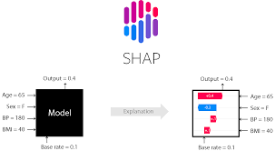
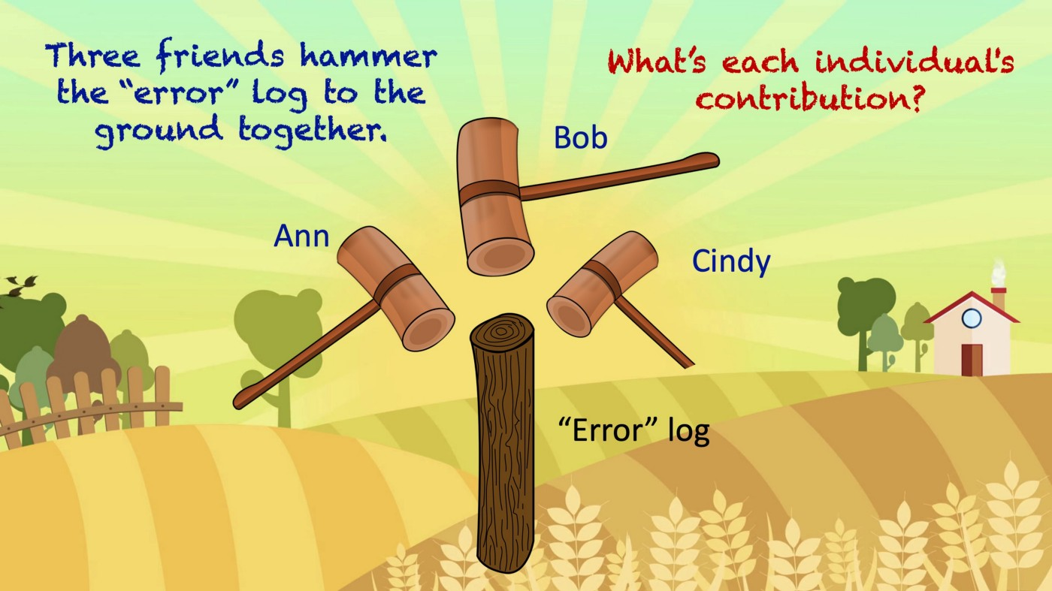

Slide 11
A Final Word on Interpretability
Model Interpretability Does Not Mean Causality
Maybe why I don’t use the terms:
Explainable AI – to refer to shap plots?!
Explainable ML – maybe because the world ‘explain’ implies causality (to me)?

Slide 12
Resources
https://odsc.medium.com/not-always-a-black-box-machine-learning-approaches-for-model-explainability-9e7d80e6085e
https://towardsdatascience.com/explain-your-model-with-the-shap-values-bc36aac4de3d
https://medium.com/dataman-in-ai/explain-your-model-with-lime-5a1a5867b423
https://christophm.github.io/interpretable-ml-book/

