Slide 1
Talking Data
Eddie Huang

Slide 2
Problem Statement and Hypothesis
Problem Statement:
Predict app downloads from click data
Hypothesis:
We can eliminate a decent amount of spam by blacklisting specific IP Addresses. Using Device, OS, Click time, and IP Addresses, we can create a model to accurately predict app downloads.

Slide 3
Description of Data Set
184mm rows of click data, each row being its own click
7 features, 1 binary target variable (download y/n)
Unevenly weighted data set: 99.7% of clicks are non-downloads

Slide 4
Features
ip: ip address of click
app: app id for marketing
device: device type id of user mobile phone (e.g., iphone 6 plus, iphone 7, huawei mate 7, etc.)
os: os version id of user mobile phone
channel: channel id of mobile ad publisher
click_time: timestamp of click (UTC)
attributed_time: if user download the app for after clicking an ad, this is the time of the app download
is_attributed: the target that is to be predicted, indicating the app was downloaded

Slide 5
Data Preprocessing
Randomly sampling dataset to shrink training set
Dropping unnecessary columns
Changing `click_time` to day of week, hour of day, minute of hour
Dummies for all categorical fields
Adding ‘Fraud’ column for IP addresses we think are fraudulent
Scaling dataset
End shape: (184904, 665)

Slide 6
EDA
Most important variables
Correlation
Click by Time

Slide 7
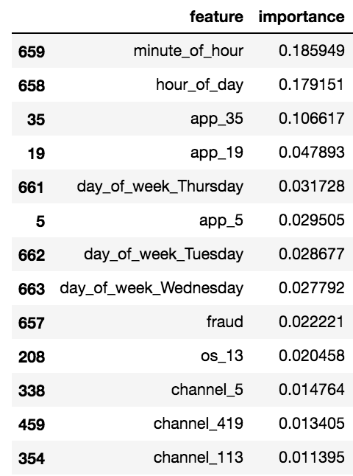
Most Important Variables

Slide 8
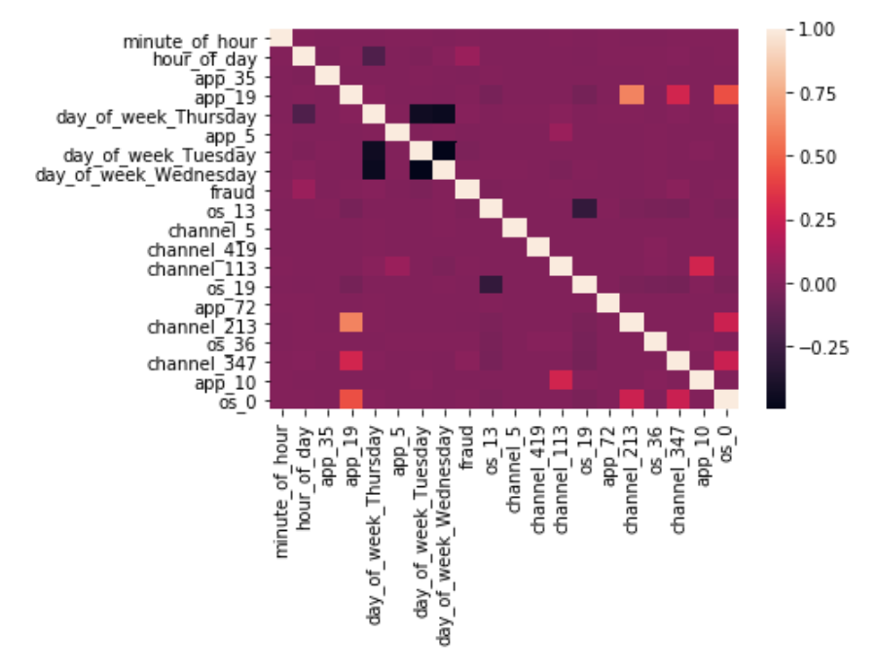
Correlation

Slide 9
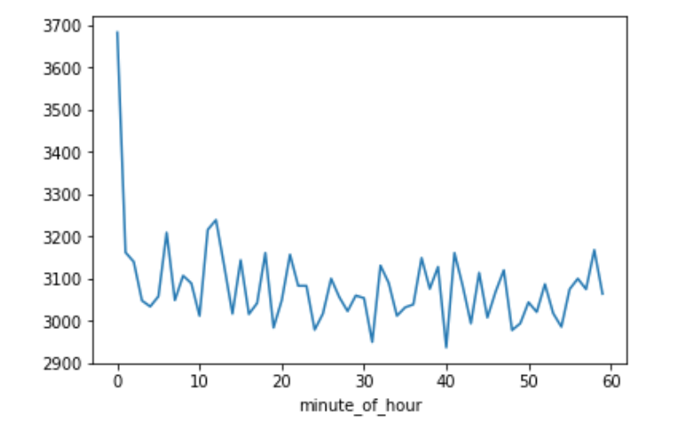
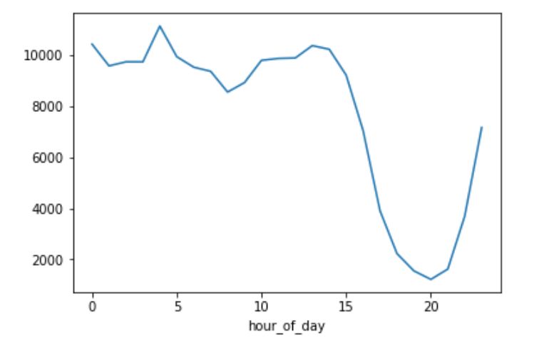
Clicks by Time

Slide 10
Modeling
Logistic Regression
Single Decision Tree
Dataset Transformation
Penalized SVM
Random Forest
Deep Learning
Parameter Optimization for Best Model

Slide 11
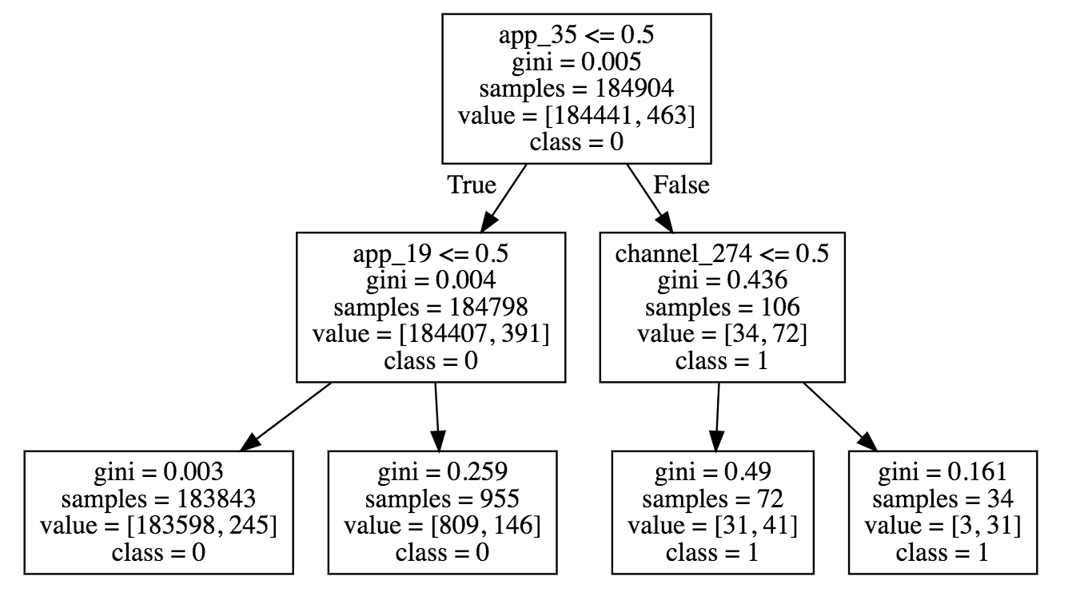
Model Scores
Logistic Regression: 99.78%
Single Decision Tree: 99.77%

Slide 12
Model Scores
Upsample Minority Class
Logistic Regression: 92.49%
Downsample Majority Class
Logistic Regression: 88.98%
Penalized SVM: 97.98%
Random Forest: 99.95%
Deep Learning:
1 hidden layer, 10 units, 10 epochs: 99.83%
2 hidden layers, 20&40 units, 10 epochs, 99.83%

Slide 13
Challenges and Successes
Challenge:
Working with large dataset – many model computation, especially cross validation took significant time to compute
Amount of features after dummies made it difficult to perform EDA
Successes
Format of dataset (binary target variable) made it very easy to experiment with multiple models

Slide 14
Extensions or Business Applications
Extensions
Use grid search
Use PCA and then logistic regression
Try different activation functions, deep learning techniques
Try using a different metric, such as accuracy only on downloads
Business Applications:
Targeted marketing to customers you identify as high change of download
Prevent fraudulent activity to minimize costs and risks

Slide 15
Conclusions and Key Learnings
Random Forest is a very flexible model that can perform well despite uneven target variable weightings and large amounts of features.
Computing power became the main limiting factor – complex models can take a lot of time!

