Slide 1
Advantages of Testing
Writing bug free software is virtually impossible!
Unit tests should be written by the developer & end-to-end tests should be implemented by the tester.

Slide 2
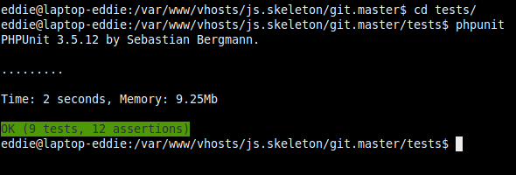
Process of a developer
Before any code is checked into the version control system, the developer must run all the unit tests which must successfully pass.
These tests must be committed into the repository along with their respective code. Therefore if a revision is removed the relevant unit tests are also removed.

Slide 3
Continuous Integration
It is more beneficial to have all tests run every time the repository receives a new commit. This is automated by the CI/Build server.
(i.e. Hudson/Jenkins, Bamboo, CruiseControl etc)
This will immediately highlight any build issues.

Slide 4
What does this mean?
Developers are less afraid to change existing code (legacy or another developers).
Bugs are caught before reaching the testers.

Slide 5

What to test?
Fat models thin controllers!
Most business logic should be in the models. Therefore at a minimum, models should have 100% code coverage, including boundary tests.

Slide 6
Additional benefits
Agile documentation generation

Slide 7
Test Driven Development (TDD)
Write tests first!
Better code design
Catch boundary conditions

Slide 8
Silver bullet
Unit tests will NOT catch every bug, however it will considerably reduce them.
This does not replace testers, it compliments them!

