Slide 1
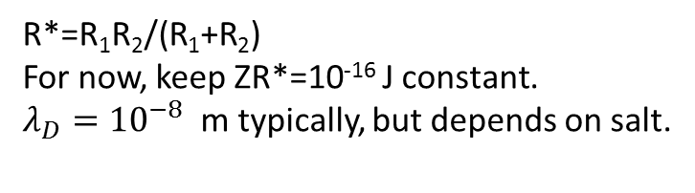
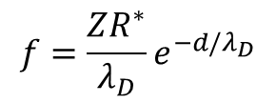
All distances in microns
3.5
1
3.5
3
10
Electrostatic force (repulsive)
$$f=\frac{ZR^{∗}}{λ_{D}}e^{−d/λ_{D}}$$
d
R*=R₁R₂/(R₁+R₂)
For now, keep ZR*=10⁻¹⁶ J constant.
$λ_{D}={10}^{−8}$m typically, but depends on salt.

Slide 2
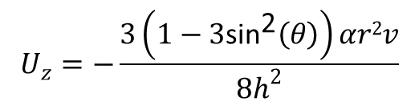
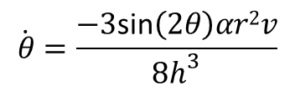

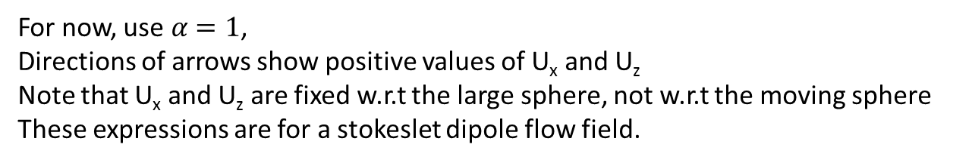
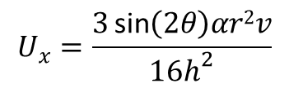
Hydrodynamic interactions
U_{x}
v
θ
h
$$\dot{θ}=\frac{−3\text{sin}\left(2θ\right)αr2v}{8h^{3}}$$
r
Angular rotation
U_{z}
$$U_{z}=−\frac{3\left(1−3\text{si}{\text{n}}^{\text{2}}\left(θ\right)\right)αr2v}{8h^{2}}$$
Model surface of
large sphere as plane
Perpendicular
velocity
Parallel
velocity
$$U_{x}=\frac{3\text{sin}\left(2θ\right)αr2v}{16h^{2}}$$
For now, use$α=1$,
Directions of arrows show positive values of U_{x} and U_{z}
Note that U_{x} and U_{z} are fixed w.r.t the large sphere, not w.r.t the moving sphere
These expressions are for a stokeslet dipole flow field.
$r=1$μm, v=5 μms⁻¹
Spagnolie and Lauga (2012) J. Fluid Mech. 700, 105

