Slide 1
THE TUNA GAME and GAME THEORY INTRODUCTION
WEEK 6

Slide 2
The Tuna Game

Slide 3
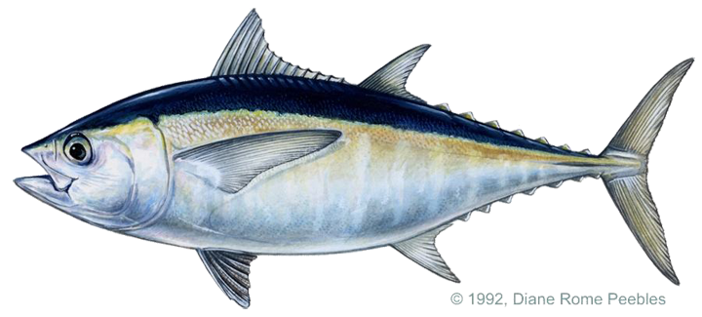
Profits = (Price – Marginal Cost) * Quantity
Your boat chooses quantity—choices are simultaneous!!
Price(Q1,Q2,Q3) = max{ 0, 45 – 0.2 * (Q1 + Q2 + Q3) }
Marginal cost = $5
Participation points determined by quantile of performance (based on half class)

Slide 4
[Excel file for data.]

Slide 5
Game Theory Introduction

Slide 6
Game Theory
Until this point in the course, rivals’ actions have been fixed
Going forward, they condition their actions on your actions
Can lead to radically different—sometimes strange—solutions, e.g. the chicken game
Allows us to understand phenomena not suited for classical micro, i.e. a price theory approach, e.g. again the chicken game
e.g. “Real world” positioning
e.g. Value of commitment
e.g. Dynamics of cooperation
e.g. Network effects and multi-sided platforms

Slide 7
Defining a game
Players
Action space—what choices players take
Payoffs—typically profits for our purposes
Timing
Sequential, e.g., tic-tac-toe, price setting with leader
Simultaneous move, e.g., rock-paper-scissors, auctions
Information issues—beyond the scope of this course
Private information, e.g., I don’t know your marginal costs when I set my prices
Complete information = everything observable

Slide 8
Equilibrium (1/2)
What is an equilibrium of the game?
i.e. What will people play?
i.e. What is the expected outcome?
Early reasoning: “I think that you think that I think that…”
Example: Poisoned chalice in the Princess Bride https://www.youtube.com/watch?v=E2y40U2LvKY
Creates total impasse in game theoretic work
Is there any way out of this?

Slide 9
Equilibrium (2/2)
Enter John Nash [1953]: equilibrium defined by each player doing the best he or she can given what everyone else is doing
Properties
Natural—but clever—concept for which he won the Nobel
Upside: at least one almost always exists
Downsides: possible multiplicity, i.e. many equilibrium
Related: does not really state how we get to an equilibrium
Example from A Beautiful Mind https://www.youtube.com/watch?v=2d_dtTZQyUM (Comment about Smith is right, but strategies proposed are not actually Nash! I’ll leave this as an assignment for next week…)

Slide 10
Example: The Tuna Game
You choose Q_{i} and rivals choose Q_{j} and Q_{k}
Price determined by (Q_{i} + Q_{j} + Q_{k})
Profit = (45 – 5 - 0.2 * (Q_{i} + Q_{j} + Q_{k})) * Q_{i}
∂Profit / ∂Price = 40 – 0.4 Q_{i} – 0.2 * (Q_{j} + Q_{k})
You maximize profit by setting marginal profit to zero
Your optimal quantity depends on what your rivals chose
That is, you cannot make your decisions independent of rivals (Nash’s point in the video segment, albeit wrongly stated)

Slide 11
Sequential move games

Slide 12
Sequential Move Games: Setup (1/2)
Player 1 Choice
Player 2 Choice
Payoff
Payoff
Player 2 Choice
Payoff
Payoff

Slide 13
Sequential Move Games: Setup (2/2)
Key feature: order of players matters
Game trees
Just a clear graphical representation of sequential reasoning
i.e. this is what is (or should be) going through your head
Absolutely not crucial to do formally
Note: games can get very complicated very quickly, so often very smart people sketch things out this way
Example: war games
For sequential games, often convenient to abbreviate payoffs: (Payoff to Player 1, Payoff to Player 2, …)

Slide 14


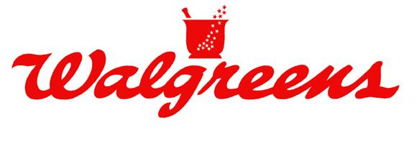
Example: Store entry/pricing
Say CVS already has a store on a street corner
Walgreens considering entering across the street
If Walgreens enters, then CVS decides on whether they will engage with a price war or not

Slide 15
Example: Store entry/pricing
Walgreens moves first
Two actions: Enter or Not Enter
If W does Not Enter:
Payoff = (W, C) = ($0, $300K)
If W Enters, C chooses Fight or Not Fight
If C Fights, payoff = (-$100K, -$100K)
If C does Not Fight, payoff = ($100K, $100K)
How to graph?

Slide 16
Example: Store entry/pricing
W
0, 300
100,100
-100,-100
C
Not Enter
Enter
Not Fight
Fight

Slide 17
How to solve
Use backward induction: “look ahead but reason backwards”
Yields a Nash Equilibrium—that strategies are optimal, conditional on correctly forecasting how rivals will respond to those strategies “later on”
What is equilibrium? That is, what are the equilibrium strategies and payoffs of the game?

Slide 18
Example: Store entry/pricing
W
0, 300
100,100
-100,-100
C
Not Enter
Enter
Not Fight
Fight

Slide 19
Example: Store entry
Equilibrium:
W plays Enter
C plays Not Fight
Payoffs are 100 for each firm

Slide 20
Example: CVS and Walgreens—in reverse
For now, let’s simply arbitrarily reverse order of play
What does that look like?

Slide 21
Example: CVS and Walgreens—in reverse
C
W
0, 300
-100,-100
W
0, 300
100, 100
Not Fight
Fight
Not Enter
Enter
Not Enter
Enter

Slide 22
Example: CVS and Walgreens—in reverse
Equilibrium
C plays Fight
W plays Not Enter
Payoffs are 0 for Walgreens and 300 for CVS
CVS prefers this outcome
Thus, it would rather the order be reversed
How can CVS ensure this outcome is realized?

Slide 23
Commitment for CVS
For sequential move games, committing is like changing the order of moves
CVS would like to commit to Fight no matter what
It dislikes this decision if Walgreens players Enter
But knowing CVS will fight, Walgreens never plays Enter
Thus, CVS never dislikes this decision in equilibrium
In essence, the firm is tying its hands to improve its outcome

Slide 24
Commitment in The Tuna Game
Commitment provides an advantage in The Tuna Game
You want to commit to q = 33.3333
In the collusion rounds…
You met
You probably promised q ≈ 33
You split up again… and almost all broke their promise
You couldn’t commit, and you all earned less than optimal
Question: any practical (or impractical) ideas about how to commit?

Slide 25
Commitment in The Tuna Game
Commitment provides an advantage in The Tuna Game
You want to commit to q = 33.3333
In the collusion rounds…
You met
You probably promised q ≈ 33
You split up again… and almost all broke their promise
You couldn’t commit, and you all earned less than optimal
Example: commitment mechanism
Suppose you could bring the janitor in and write a contract: you will either choose q=33 or you owe him $50,000
This ties your hands, i.e. restricts your ability to choose
All players in your world would place 1st for sure

Slide 26
Commitment
Think: if you were by yourself on an island, would you ever want to restrain your choices?
Yet in game theory, this can be quite useful
Example: speaking of islands… two armies and two bridges

Slide 27
Simultaneous move games

Slide 28
Simultaneous moves: Setup
Key feature: everyone moves together
Note: notation for payoffs
Easy to extend to multiple actions (many players is complicated)
Player 2
 | Left | Right
Up | ($P₁, $P₂) | ($P₁, $P₂)
Down | ($P₁, $P₂) | ($P₁, $P₂)
Player 1

Slide 29
Simultaneous moves: Setup
Player 2
 | Left | Right
Up | ($P₁, $P₂) | ($P₁, $P₂)
Middle | ($P₁, $P₂) | ($P₁, $P₂)
Down | ($P₁, $P₂) | ($P₁, $P₂)
Player 1

Slide 30
Types of simultaneous-move equilibrium (1/3)
Call a strategy s_{i’} a “dominated strategy” if alternative strategy s_{i} yields higher payoffs no matter what your rivals play
Formally, u_{i}(s₁,...,s_{i},...,s_{N}) < u_{i}(s₁,...,s_{i’},...,s_{N}) for all s₁,…,s_{N}
Eliminate all dominated strategies for all players
Iterate this procedure
If only one remains, choose it—its called a “dominant strategy”

Slide 31
Prisoners’ dilemma
Facts: Ratting on your partner is privately beneficial. Yet, if you both confess, your prison time is much longer than if you both remain silent.
Prisoner 2
 | Silence | Confess
Silence | (1 yrs, 1 yrs) | (10 yrs, 0 yrs)
Confess | (0 yrs, 10 yrs) | (5 yrs, 5 yrs)
Prisoner 1

Slide 32
A variant of the dilemma: US-Soviet Arms Race
Facts: You never expect to use nuclear weapons and doing so is quite costly. Yet, if your rival has them and you don’t, they gain almost complete control over you.
USSR
 | Build | Don’t
Build | (-$1B,-$1B) | ($1B, -$100B)
Don’t | (-$100B, $1B) | ($0, $0)
USA

Slide 33
Types of simultaneous-move equilibrium (2/3)
Suppose iteration does not yield a dominant strategy
Example: Sushi restaurants in Chicago

Slide 34
Geographic positioning (with multiple equilibria)
Facts: Generally WL>WP. Yet, both want to avoid locating next to one another.
Arami
 | West Loop | Wicker Park
West Loop | (-$1M, -$1.5M) | ($1M, $1.5M)
Wicker Park | ($3M, $2M) | (-$2M, -$2M)
Momotaro

Slide 35
Types of simultaneous-move equilibrium (3/3)
Suppose iteration does not yield exactly one dominant strategy
Example: Poisoned cups

Slide 36
Poisoned cups (with mixed strategies)
Facts. Player 1 pours the drinks. Player 2 selects which to drink from. Both players wish to avoid the poison.
Player B
 | Drink near cup | Drink far cup
Place it near B | (0, -1) | (-1, 0)
Place it far | (-1, 0) | (0, -1)
Player A
Question: what is Nash?

Slide 37
Takeaways

Slide 38
Game theory (re-)introduction
Two general types of timing
Simultaneous moves
Sequential moves
Sequential move games: timing matters
Solve via backward induction
Commitment can undo timing → tying your hands can benefit
Simultaneous move games
Might be dominant strategy equilibria
Might be multiple equilibria
Might be on “mixed strategy” equilibria—so you’ll have to randomly vary your actions

