Slide 1
A Brief History of Air Pollution and Exposure Pathways
ENVH 111
Eddie Kasner

Slide 2
Overview
Air pollution sources, exposure routes and pathways
Historic air quality events
  Meuse Valley, Belgium (1930)
  Donora, Pennsylvania (1948)
  Great Smog of London (1952)
  Los Angeles and Clean Air Act (1970)
  Beijing “Airpocalypse” (2013-2014)
  Recent wildfire smoke events (2020-2025)
Air pollution studies
Government and policy

Slide 3
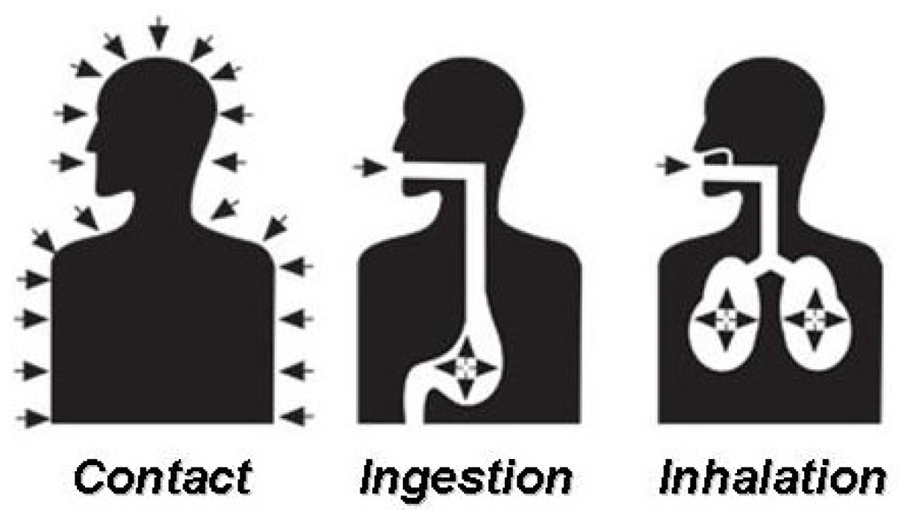
Exposure Pathways and Routes
Exposure pathway = source + medium + receptor
Exposure route = how a contaminant enters receptor
  Dermal contact
  Ingestion
  Inhalation
Damalas C. 2016. Farmers’ Exposure to Pesticides: Toxicity Types and Ways of Prevention. Open Access Toxics 2016, 4(1): 1.

Slide 4
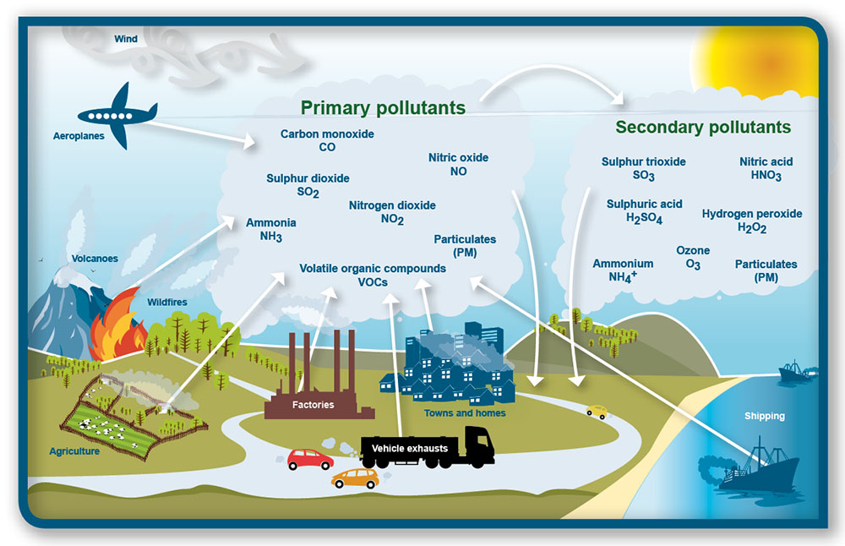
Air Pollution Sources
Scotland’s Environment. Air quality. https://www.environment.gov.scot/our-environment/air/air-quality/

Slide 5
Exposure Pathway
Sources
  Natural: volcanic eruptions, wildfires, allergens
  Human: energy use, transportation, industry, agriculture
Pollutants
  Primary: hazardous substance emitted directly into atmosphere
    CO - gas, coal, or wood combustion
    NO_{x} - fossil fuel combustion, e.g. brown haze around cities
    SO₂ - volcanoes and industrial coal combustion
    PM - particulate matter, e.g. fossil fuel combustion, brake dust, smoke
    NH₃ - agricultural processes, e.g. fertilizer
    VOCs - volatile organic compounds, e.g. benzene, toluene
    Pb - “anti-knocking” agent formerly added to gasoline
  Secondary: hazardous substance formed in atmospheric reaction
    O₃, SO₃, HNO₃, H₂SO₄, H₂O₂, NH₄⁺, PM
Receptors: humans and animals (each pollutant has different health effect)

Slide 6
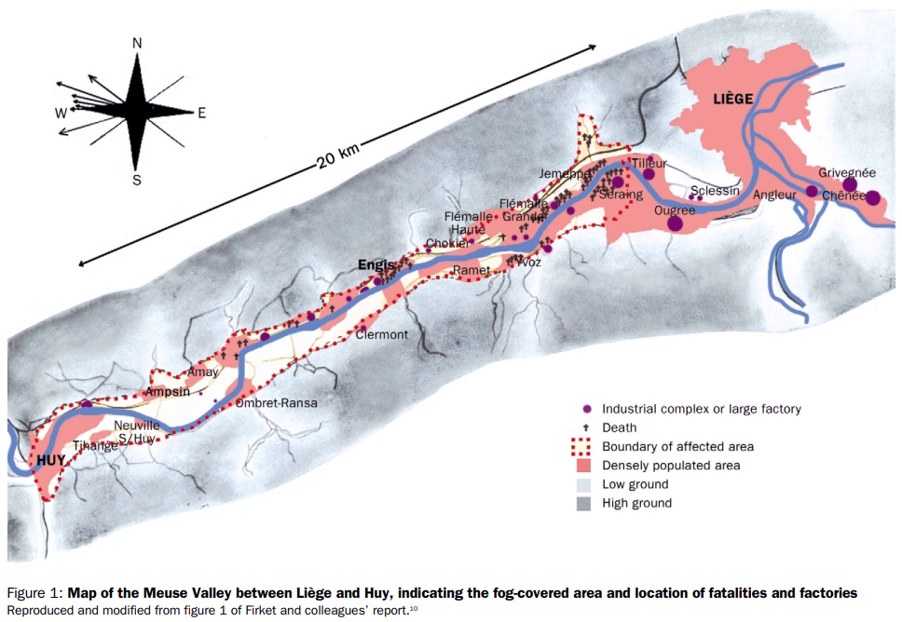
Meuse Valley Fog, Belgium (1930)
Nemery et al. 2001. The Meuse Valley fog of 1930: an air pollution disaster. The Lancet 357(9257): 704-708.

Slide 7
Meuse Valley Fog, Belgium (1930)
Sources
  SO₂, H₂SO₄, or HF from nearby zinc, glass, and steel factories
  Inversion: warm air layer trapped cold, polluted air in the valley (5 days in Dec)
Receptors
  Asthma-like symptoms: shortness of breath, coughing fits
  Estimated 60 excess deaths (20-89 years old)
Impacts
  Seen at the time as “an unavoidable consequence of prosperity”
  Interviewed family physicians and patients days after smog
  First scientific proof of link between air pollution and illness and death
  Demonstrated role of temperature inversions

Slide 8
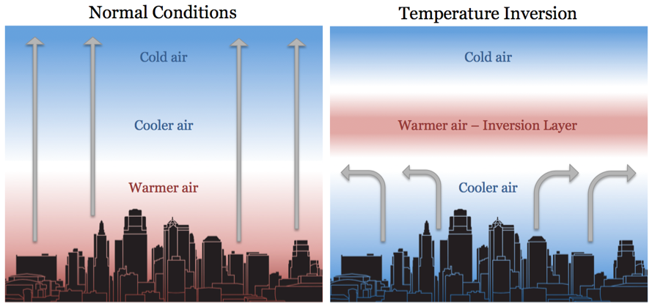
Temperature Inversion
Understory captures evidence of temperature inversion in Kansas City. http://understoryweather.com/understory-captures-evidence-of-temperature-inversion-in-kansas-city/

Slide 9
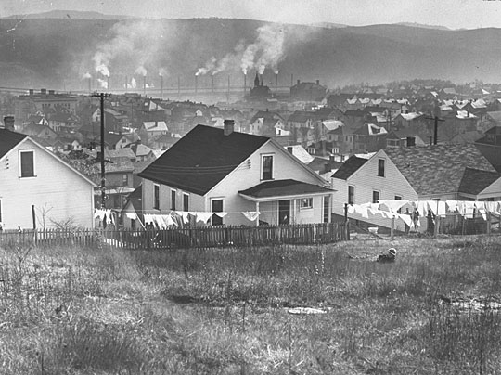
Donora, Pennsylvania Smog (1948)
Donora Historical Society and Smog Museum. https://www.sites.google.com/site/donorahistoricalsociety/1948-smog

Slide 10
Donora, Pennsylvania Smog (1948)
Sources
  CO, SO₂, and H₂SO₄ from steel and zinc factories
  Temperature inversion (5 days in Oct)
Receptors
  About 14,000 residents trapped under thick layer of smog
  Nearly 7,000 experienced respiratory or cardiovascular issues
  About 20 deaths during the event
Impacts
  Widely publicized around world and people acted
  Scientists began to study link between air pollution and health
  Helped lead to first US federal air law: Air Pollution Control Act (1955)

Slide 11
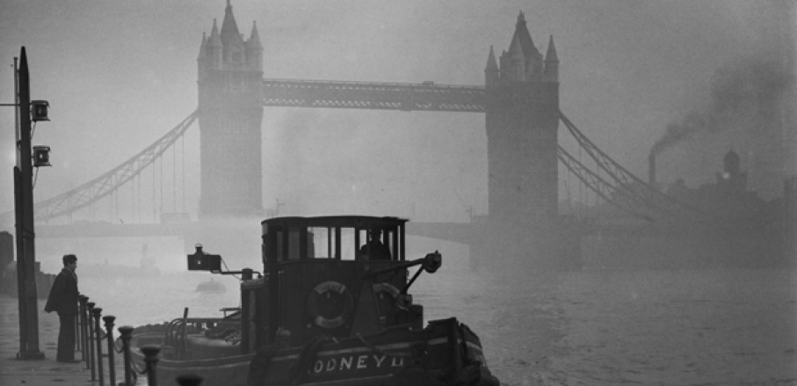
Great Smog of London (1952)
A tugboat on the Thames near Tower Bridge in heavy smog, 1952. Fox Photos, Getty Images. https://timedotcom.files.wordpress.com/2016/11/london-fog.jpg

Slide 12
Great Smog of London (1952)
Sources
  Cold weather led residents to burn extra coal [SO₂, PM] to stay warm
  Inversion: 30-mile stagnant air mass (5 days in Dec)
Receptors
  About 100,000 residents felt ill with respiratory symptoms
  Estimated 4,000-12,000 excess deaths, mostly from bronchitis and pneumonia
Impacts
  Especially bad “pea-souper” as seen on TV (e.g. The Crown)
  Led to UK Clean Air Act of 1956 (and 1970 in US)
  Landmark in air pollution epidemiology: first detailed analysis linking pollutant levels to illness and death (Nemery et al. 2001)

Slide 13
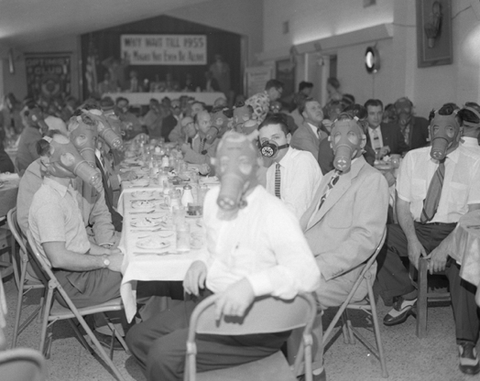
Los Angeles Smog (1954)
Highland Park Optimist Club wearing smog-gas masks at banquet, Los Angeles, c. 1954. UCLA Library.

Slide 14
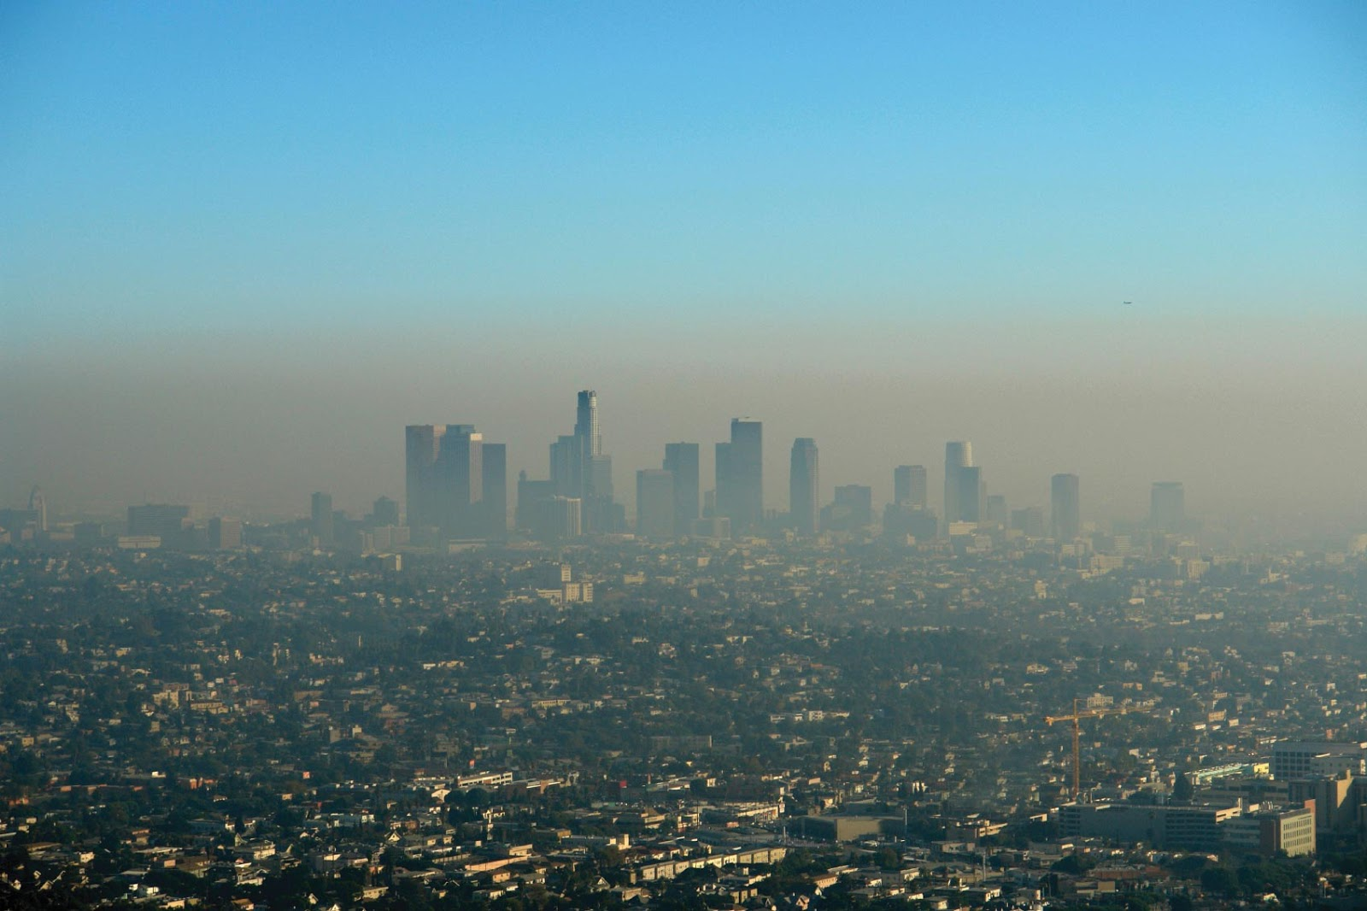
Los Angeles Smog and Clean Air Act (1970)
Photochemical smog in Los Angeles. Getty images.

Slide 15
Los Angeles Smog and Clean Air Act (1970)
Sources
  1,000,000+ vehicles on LA roads by 1940
  VOC emissions + sunlight + NO_{x} → O₃ (photochemical smog)
  LA is natural trap for smog accumulation
    Geography: flat basin between ocean and mountains
    Weather patterns: cold ocean current creates inversions
Receptors
  Respiratory and cardiovascular effects among residents
  Systematic spatial association between respiratory mortality and increased O₃ levels in 1961 (Mahoney 1976)
Impacts
  Clean Air Act of 1970 set federal and state regulations to limit stationary and mobile source emissions
  O₃ levels far below 1970s peaks despite many more cars
  Still ranked worst US metro for O₃ in 26 of last 27 years (ALA State of the Air 2026)

Slide 16
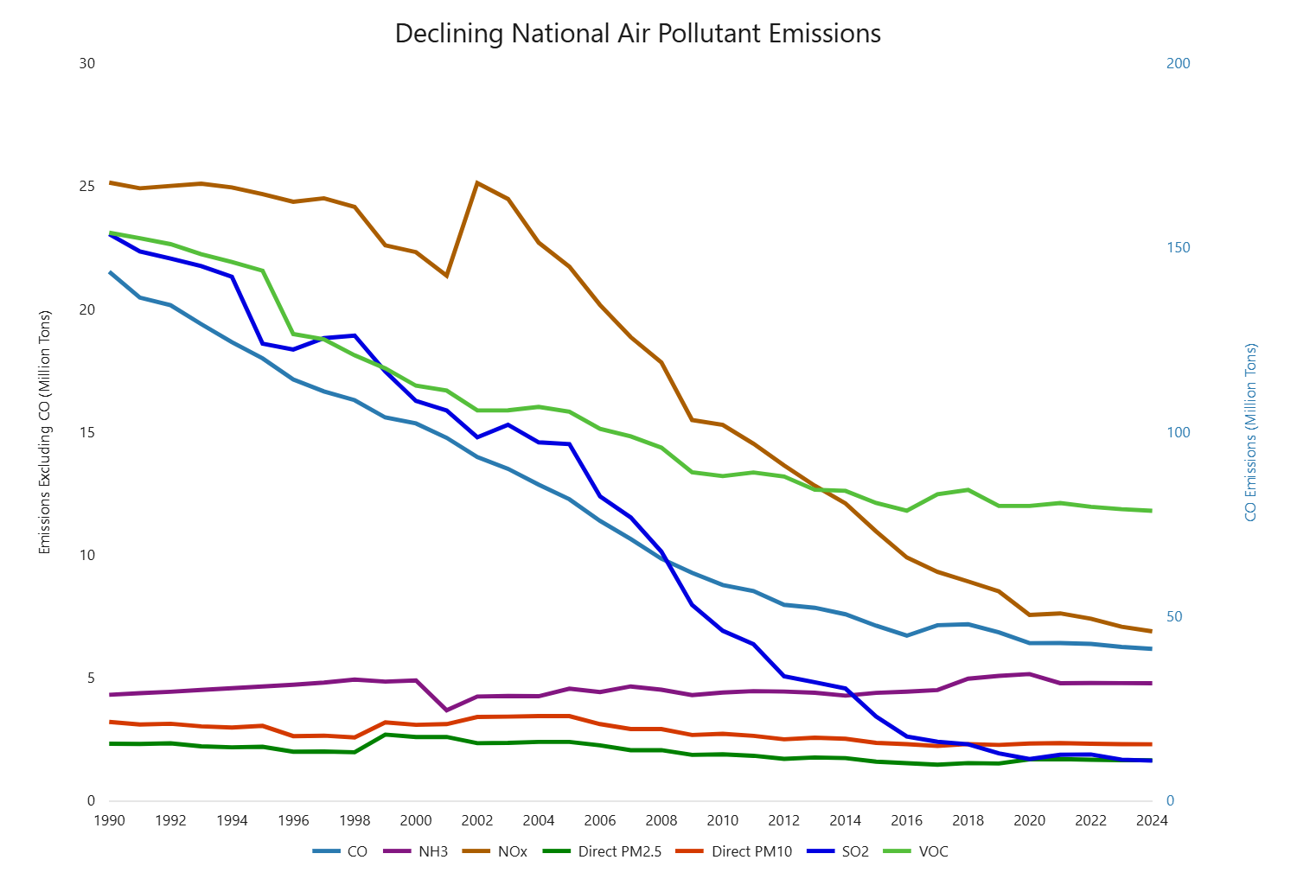
US Emissions After the Clean Air Act (1990-2024)
US EPA. Our Nation’s Air 2025. https://gispub.epa.gov/air/trendsreport/2025/

Slide 17
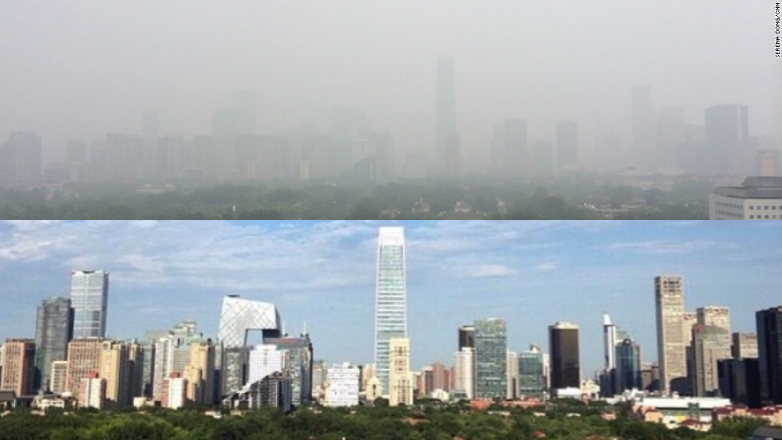
Beijing “Airpocalypse” (2013-2014)
Beijing smog vs. no smog. 2014. Getty Images.

Slide 18
Beijing “Airpocalypse” (2013-2014)
Sources
  PM from burning coal for heat in winter, industry, and vehicle traffic
  Like LA, Beijing in “natural bowl” with temperature inversions
Receptors
  Respiratory and cardiovascular effects among residents
  Jan 2013: PM_{2.5} went “beyond index,” over 20x WHO guideline
Impacts
  2013 Air Pollution Action Plan: cut coal, closed old plants, cleaner fuels
  Annual PM_{2.5} fell from about 100 µg/m³ (2013) to 27 µg/m³ (2025)
  US Embassy hourly air quality posts raised public pressure

Slide 19
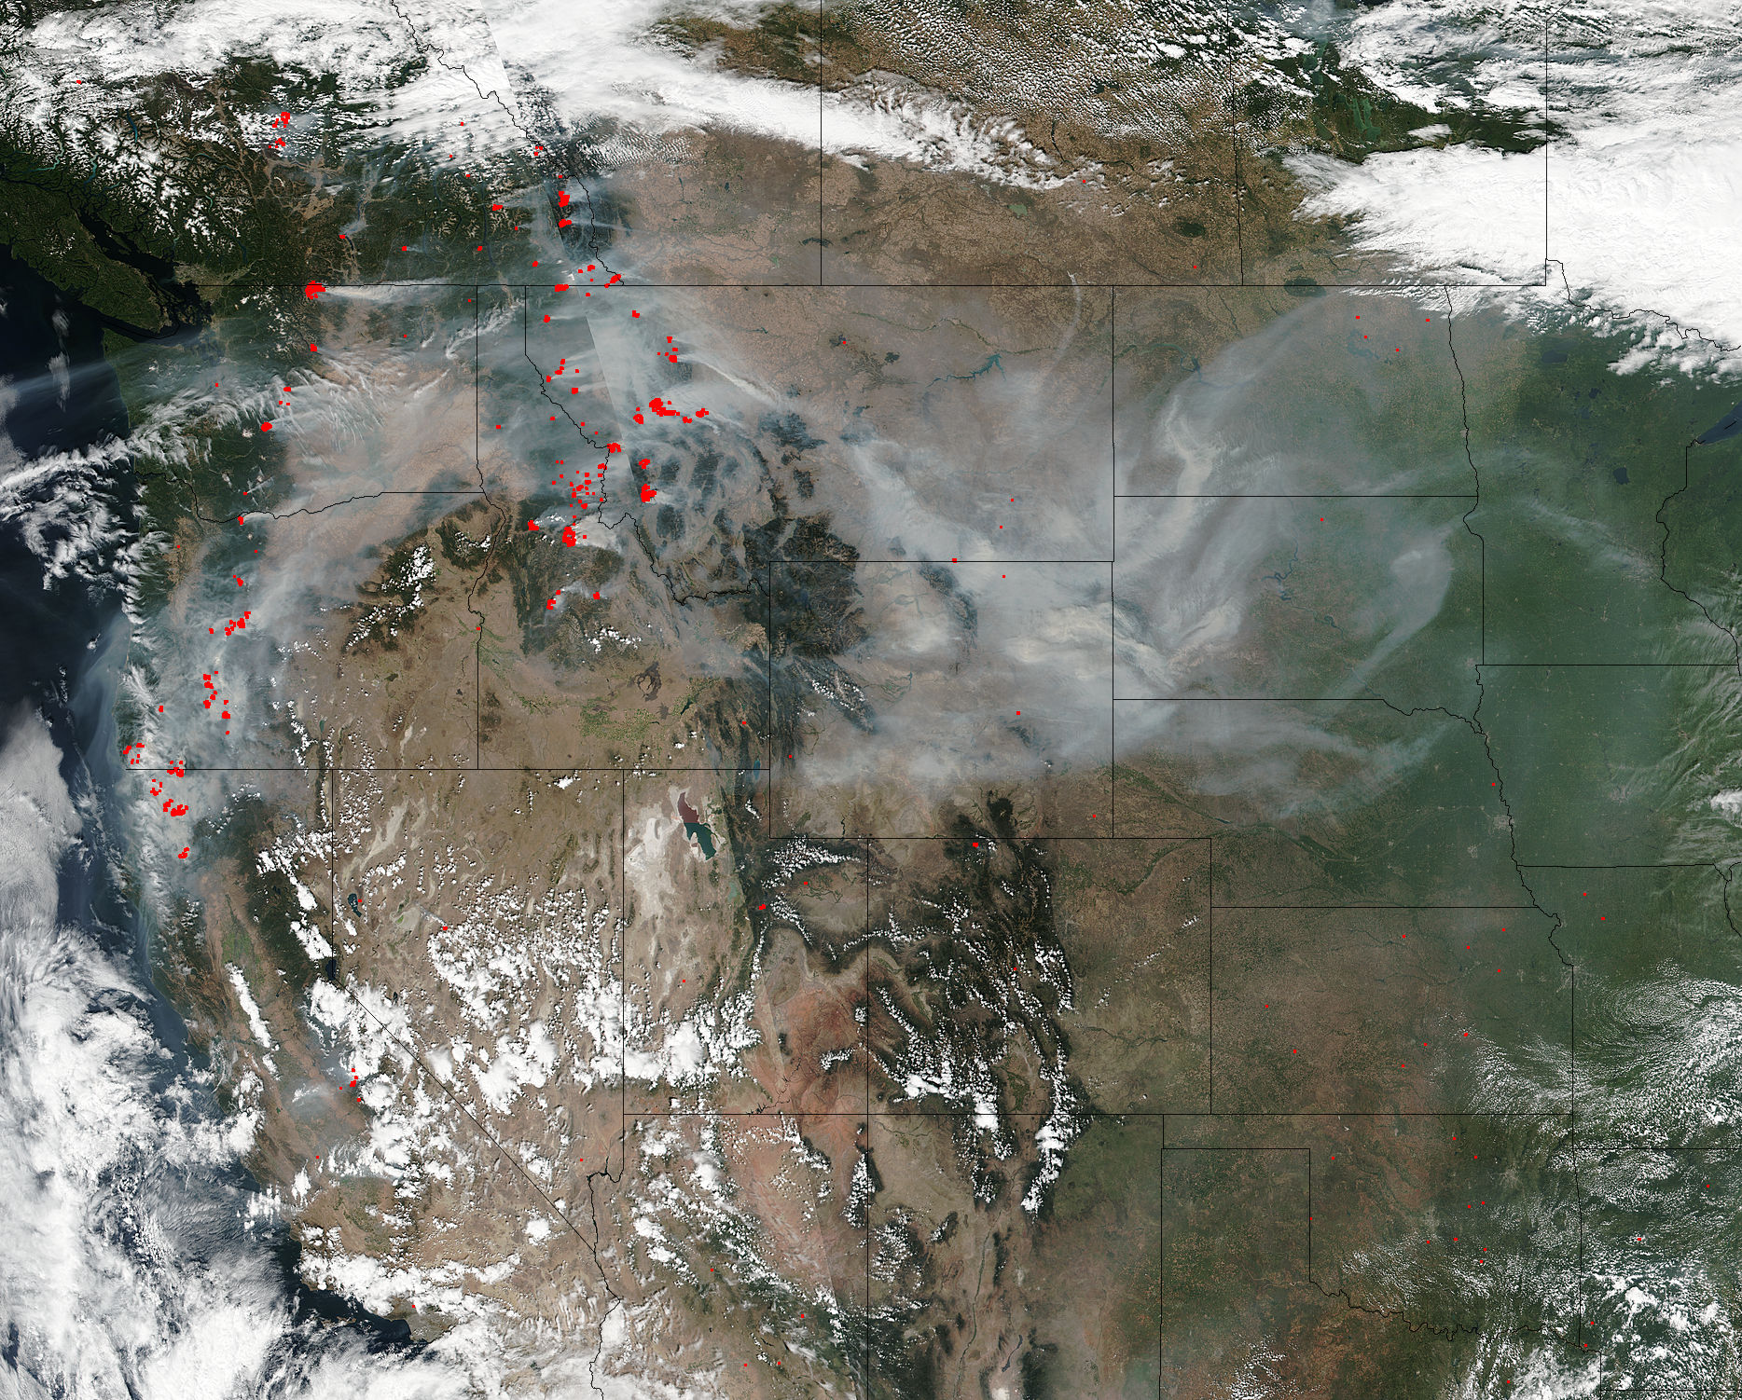
West Coast Wildfire Smoke
Smoke and wildfires in western U.S., 2017. NASA. https://www.nasa.gov/image-feature/goddard/2017/smoke-and-fires-light-up-pacific-northwest

Slide 20
Recent Wildfire Smoke Events (2020-2025)
Sources
  Hotter, drier conditions and strong winds drive larger fires
  Smoke (mostly PM_{2.5}) travels hundreds to thousands of miles
Receptors
  Entire regions, rural and urban, often far from the fire
Some recent major wildfire smoke events
  West Coast, Sept 2020: Portland had world’s worst major-city air; daily AQI peaked at 357 (Portland) and 196 (Seattle)
  East Coast, June 2023: smoke from Canadian fires pushed NYC AQI near 500; about 62 million people exposed
  Los Angeles, Jan 2025: urban fires destroyed 16,000+ structures; smoke and ash carried heavy metals
Impacts
  Protection relies on AQI alerts, indoor air filtration, and limiting time outdoors

Slide 21
Air Pollution Studies
Harvard “Six Cities” Study
Multi-Ethnic Study of Atherosclerosis and Air Pollution (MESA Air), led by UW
UW Adult Changes in Thought Air Pollution (ACT-AP) Study: PM_{2.5} and dementia
State of Global Air 2024: air pollution linked to 8.1 million deaths (2021), 2nd leading risk factor
Burke et al. 2023, Nature: wildfire smoke erased about 1/4 of PM_{2.5} gains since 2000 in 35 states
Local monitoring you can check today:
  Puget Sound Clean Air Agency sensor map, WA Ecology air quality map, EPA AirNow Fire and Smoke Map
Health effects commonly studied: mortality, respiratory disease and lung cancer, cardiovascular disease and stroke, low birthweight, dementia

Slide 22
Government and Policy
Clean Air Act (1956-UK; 1970-USA)
National Ambient Air Quality Standards (NAAQS)
  CO, Pb, NO₂, O₃, PM₁₀, PM_{2.5}, SO₂
  2024: annual PM_{2.5} standard lowered from 12 to 9 µg/m³ (upheld in federal court, 2026)
WHO Air Quality Guidelines (2021): annual PM_{2.5} guideline of 5 µg/m³
Air quality modeling and monitoring
  Dispersion and receptor modeling; Puget Sound Clean Air Agency and WA Ecology monitors
  EPA Our Nation’s Air 2025: national air quality and emissions trends
WA wildfire smoke rule for workers (L&I, 2024; updated 2025)
WA Climate Commitment Act: improving air quality in 16 overburdened communities

