Slide 1


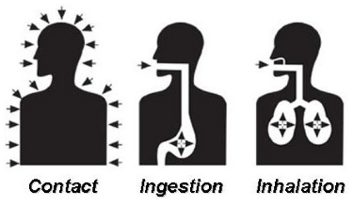


Source
Medium
Receptor
(Route of exposure)

Slide 2
