Slide 1
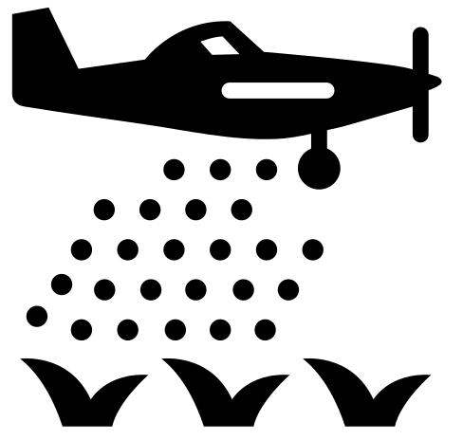
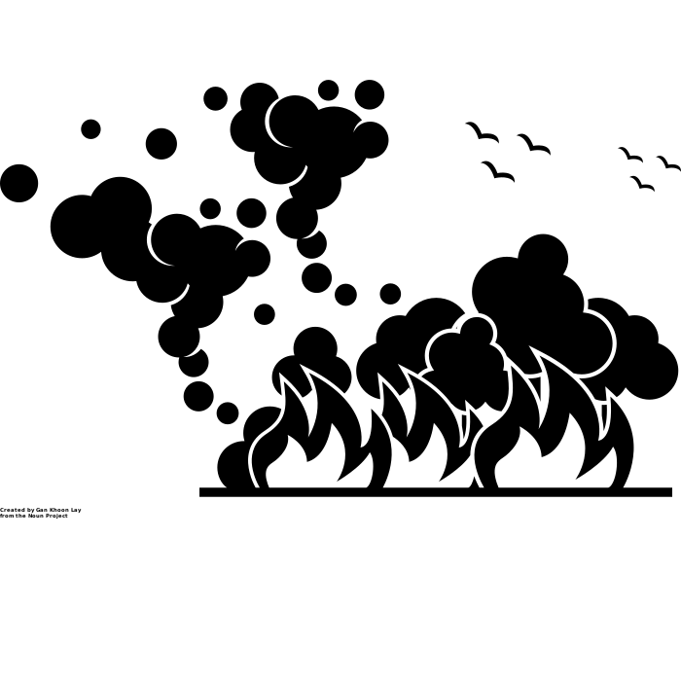
Risk Assessment
Risk = Hazard x Exposure
Pesticides
Smoke
Measuring Drift
Measuring PM_{2.5}
Field
Studies
Student
Experience
Classroom and Laboratory
 | Environmental | Occupational
Skill | Exposure Mapping | Exposure Characterization
Example Assignment | Explainer Videos | Compliance Calculations

Slide 2
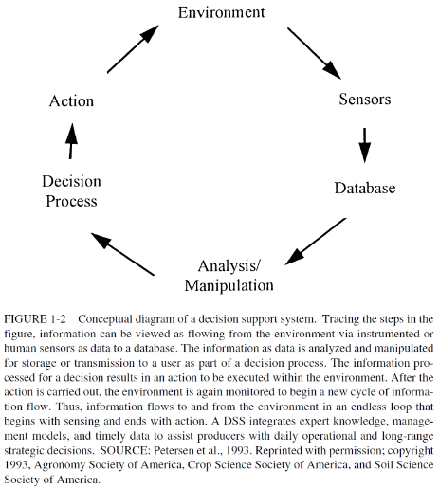
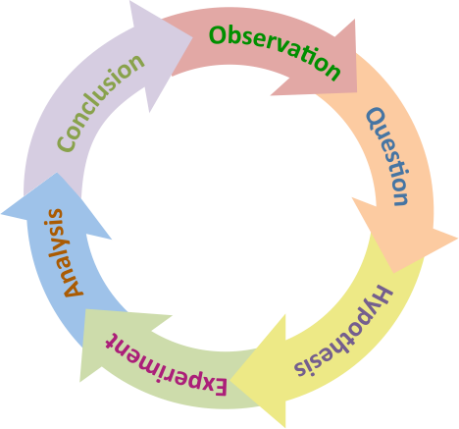
Risk Assessment
Risk = Hazard x Exposure
Pesticides
Smoke
Measuring Drift
Measuring PM_{2.5}
Use Cases
Precision
Agriculture
Field
Studies
Student
Experience
Scientific
Method
Reproducibility
Classroom and Laboratory
 | Environmental | Occupational
Skill | Exposure Mapping | Exposure Characterization
Example Assignment | Explainer Videos | Compliance Calculations

Slide 3

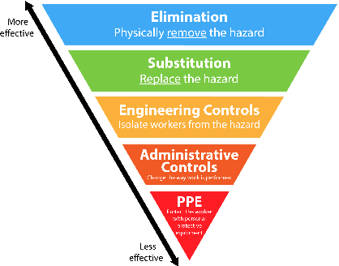
Risk Assessment
Risk = Hazard x Exposure
Pesticides
Smoke
Measuring Drift
Measuring PM_{2.5}
Use Cases
Precision
Agriculture
Field
Studies
Interventions
Student
Experience
Hierarchy of Controls
Reproducibility
Classroom and Laboratory
 | Environmental | Occupational
Skill | Exposure Mapping | Exposure Characterization
Example Assignment | Explainer Videos | Compliance Calculations

Slide 4
Dose-Response
Assessment
Hazard Identification
Risk
Characterization
Exposure
Assessment

Slide 5
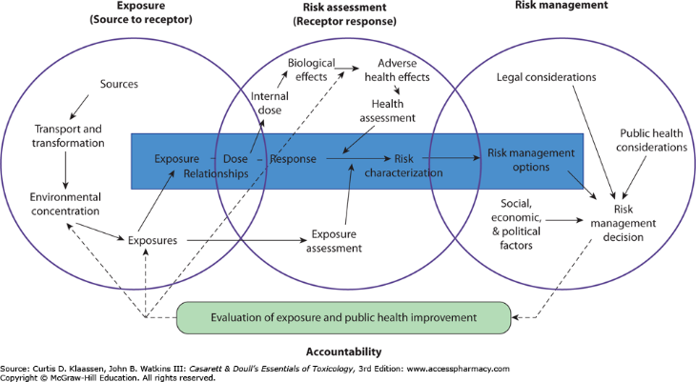

Slide 6
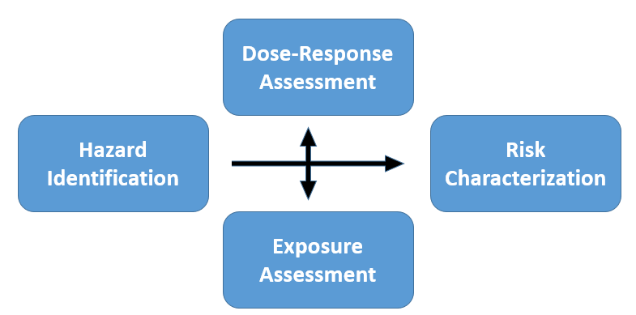
Risk = Hazard x Exposure
Pesticides
Smoke
Measuring Drift
Measuring PM_{2.5}
Use Cases
Precision
Agriculture
Field Studies
Interventions
Student
Experience
Hierarchy of Controls
Scientific
Method
Reproducibility
Classroom and Laboratory Science
 | Environmental | Occupational
Skill | Exposure Mapping | Exposure Characterization
Example Assignment | Explainer Videos | Compliance Calculations

Slide 7
Risk = Hazard x Exposure
Pesticides
Smoke
Measuring Drift
Measuring PM_{2.5}
Use Cases
Precision
Agriculture
Field Studies
Interventions
Student
Experience
Hierarchy of Controls
Scientific
Method
Reproducibility
Classroom and Laboratory Science
 | Environmental | Occupational
Skill | Exposure Mapping | Exposure Characterization
Example Assignment | Explainer Videos | Compliance Calculations

Slide 8
Risk = Hazard x Exposure
Pesticides
Smoke
Measuring Drift
Measuring PM_{2.5}
Field Studies
Student
Experience
Classroom and Laboratory Science
 | Environmental | Occupational
Skill | Exposure Mapping | Exposure Characterization
Example Assignment | Explainer Videos | Compliance Calculations

Slide 9
Risk = Hazard x Exposure
Pesticides
Smoke
Measuring Drift
Measuring PM_{2.5}
Field Studies
Student
Experience
Classroom and Laboratory Science
 | Environmental | Occupational
Skill | Exposure Mapping | Exposure Characterization
Example Assignment | Explainer Videos | Compliance Calculations

Slide 10









Knowledge
Mobilization
Ideation
Publication
Data collection and analysis

Slide 11
