Slide 1
Impact of family on School performance
By: Sukhee(Eddie) Min
Video: https://youtu.be/VqXALM_9Sqg

Slide 2
Situation
Two schools Gabriel Pereria and Mousinho da Silveira have students differing performances with their Portugal language grades
Understanding which school is performing better and why?
Some leads-family relationships, amount of resources (time & money)

Slide 3
Key Question
Which school performs better and why?
Variables to understand why
-Parent’s education level
-Family relationship with student
-Family size

Slide 4
Data Source & Wrangling
Source came from UCI’s database, particularly the Portugal grade section
Creation of 3 dataframes: All schools, only GP(Gabriel Pereria), only MS (Mousinho da Silveira)
Within the dataframes: Selected relevant columns, renamed confusing column names, filtered grades to removed outliers

Slide 5
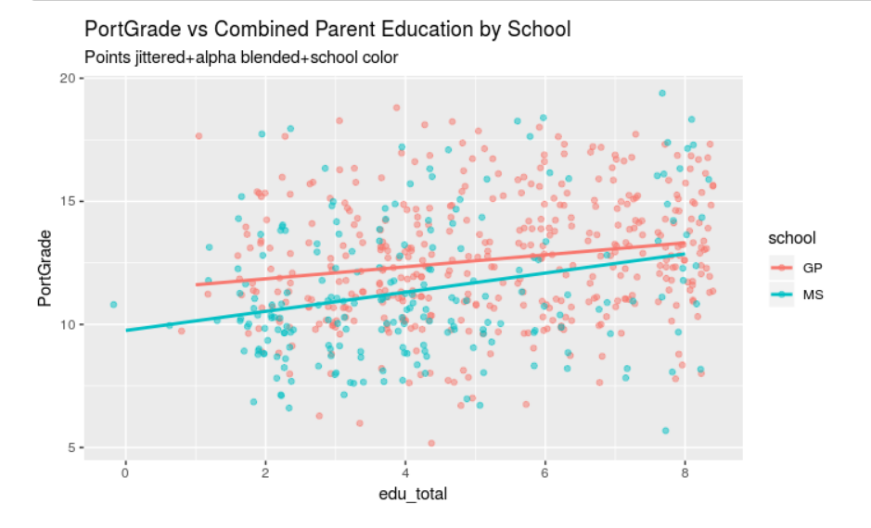
Visualization of Grades based on parent education and school

Slide 6
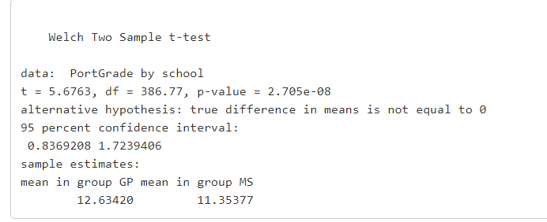
T-test of Grade to School

Slide 7
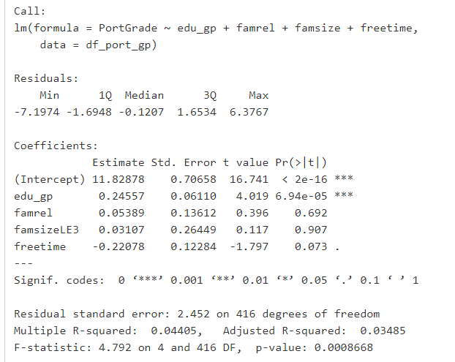
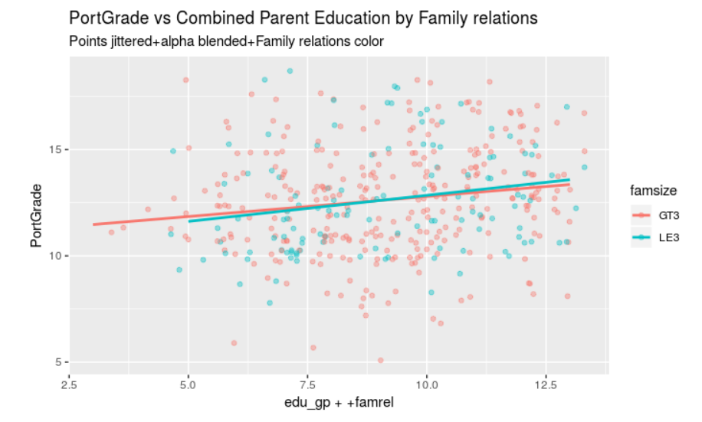
GP’s Regression of grades to family

Slide 8
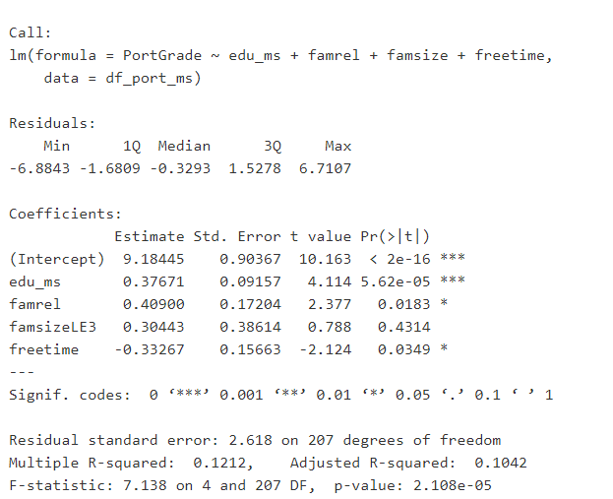
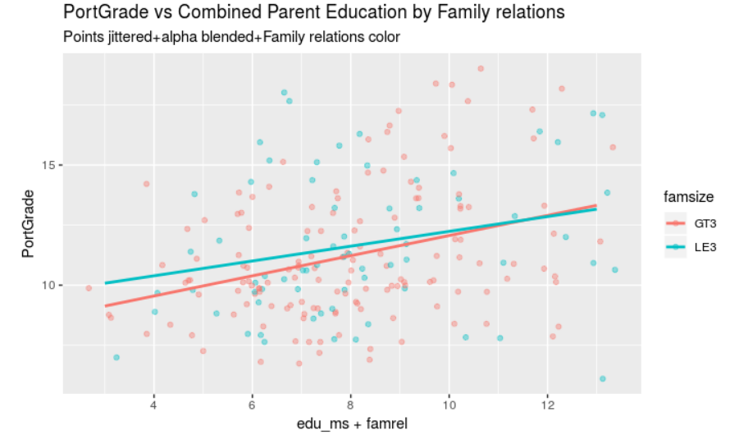
MS’s Regression of grades to family

Slide 9
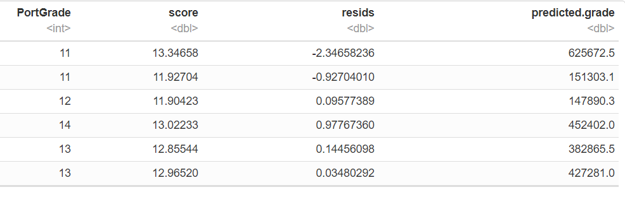
GP’s Regression performance

Slide 10
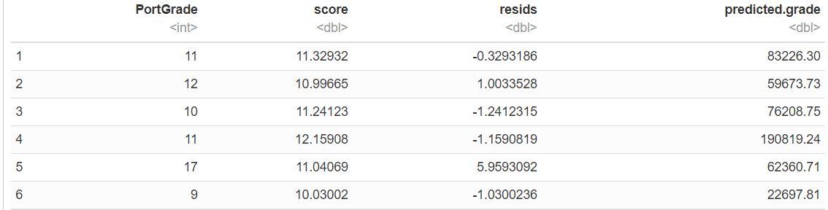
MS’s Regression Performance

Slide 11
Conclusion
When observing the portugal grades of two schools (Gabriel Pereira & Mousinho da Silveira),we can observe that GP performs better.
In order to understand why GP performs better, we can look at the family setting. We looked into the parents education levels, relationships with the student, and the family size. As expected, the higher family relations and education levels had a positive correlation with grades.
GP (on average) had a higher level of parent education and family relationship which led GP students to have higher Portugal grades than MS.

Slide 12
Source
https://archive.ics.uci.edu/ml/datasets/Student+Performance

