Slide 1
Do Information Inputs Causally Affect LLM-Generated Investment Portfolios?
A Randomized Experiment on Information Conditioning and LLM Allocation Behavior
Edward Schwasnick
STAT 6990 • Causal Inference • Spring 2026
April 29, 2026

Slide 2
Research Question
• LLMs increasingly produce structured financial recommendations.
• Vendors claim their AI analysts give better advice because of better data.
• That's a causal claim — one worth testing.
Holding model, temperature, universe, and instructions fixed, does the information in the prompt causally change the portfolio an LLM constructs?
• Approach: randomized 4-arm experiment where the only thing that varies across arms is the data block in the prompt.
Schwasnick | STAT 6990 | 2/10

Slide 3
Experimental Design
• Stock universe: 20 U.S. large-caps across 6 sectors
• Model: claude-sonnet-4-6 • Temperature: 0.7 • Seed: 42
• 30 runs per condition = 120 API calls • randomized trial order
• Output: JSON with weights for all 20 tickers, summing to 100
Control
ticker list only
Fundamental
+ fundamentals table
(P/E, growth, leverage)
Technical
+ technicals table
(returns, beta, vol, MA)
Combined
+ both tables
• Estimand: ATE of each arm vs. control on 5 portfolio outcomes.
Schwasnick | STAT 6990 | 3/10

Slide 4
Outcomes and Estimation
• HHI = Σ wᵢ² (stock-level concentration)
• Sector HHI = Σ ( Σ_{i∈sector} wᵢ )² (sector-level concentration)
• Portfolio β = Σ wᵢ · βᵢ
• Portfolio vol = Σ wᵢ · σᵢ
• Breadth = count of wᵢ > 0
Inference
• Primary: Welch's t-test on diff-in-means vs. control.
• Regression: Yᵢ = α + β₁·Fund + β₂·Tech + β₃·Comb + εᵢ (control omitted).
• Placebo #1: 5,000 permutations of condition labels.
• Placebo #2: 1,000 random splits within the control group.
• Sensitivity: re-estimate after trimming top/bottom HHI per condition.
Schwasnick | STAT 6990 | 4/10

Slide 5
Headline: Prompt Information Moves Portfolios
 | Control | Fundamental | Technical | Combined
HHI | 0.060 | 0.103 | 0.076 | 0.059
Sector HHI | 0.209 | 0.366 | 0.173 | 0.182
Portfolio β | 0.92 | 1.05 | 0.78 | 0.85
Portfolio vol (%) | 29.9 | 30.3 | 27.7 | 28.5
Breadth | 20.0 | 20.0 | 20.0 | 20.0
• Fundamental prompt → most concentrated, highest β (Tech-heavy).
• Technical prompt → most diversified, lowest β (momentum + defensive).
• Combined ≠ average of the two; HHI actually drops vs. control.
Schwasnick | STAT 6990 | 5/10
Notes:
HHI – diversification per stock
Sector HHI – diversification per sector
Portfolio Beta - measures total sensitivity to market volatility, a B > 1 means the portfolio is more volatile than the market and is a more aggressive portfolio, and a B < 1 means the portfolio is less volatile than the market and is more defensive
Portfolio vol (%) – The sum of asset weight times asset volatility for all stocks in the portfolio. Means that in a one standard deviation move of the returns of the portfolio, this portfolio can vary widely by nearly 30 percentage points
Breadth – measures how many different stocks are invested in on average, basically how many stocks got 0 weight

Slide 6
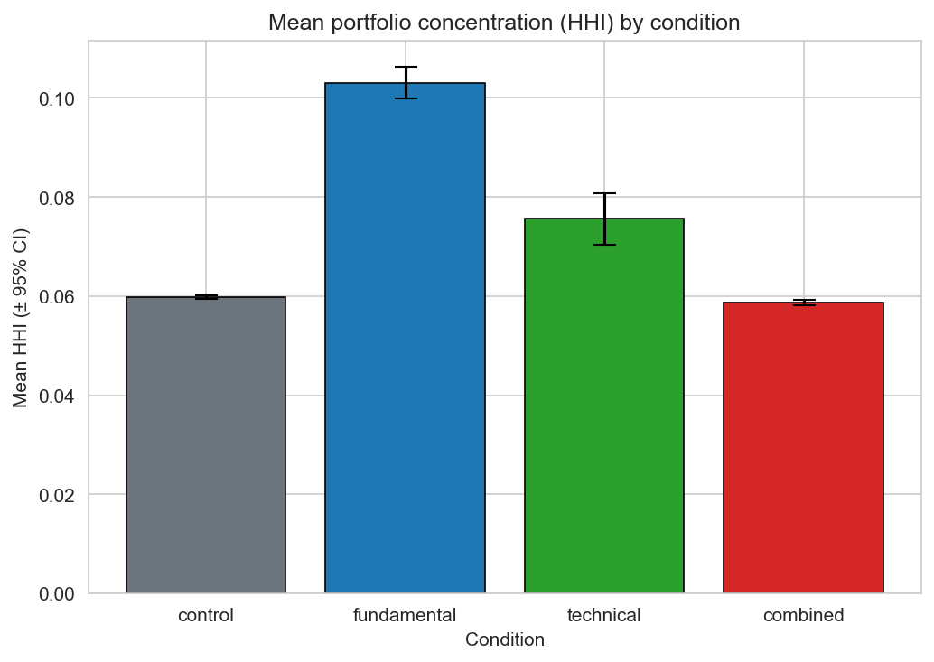
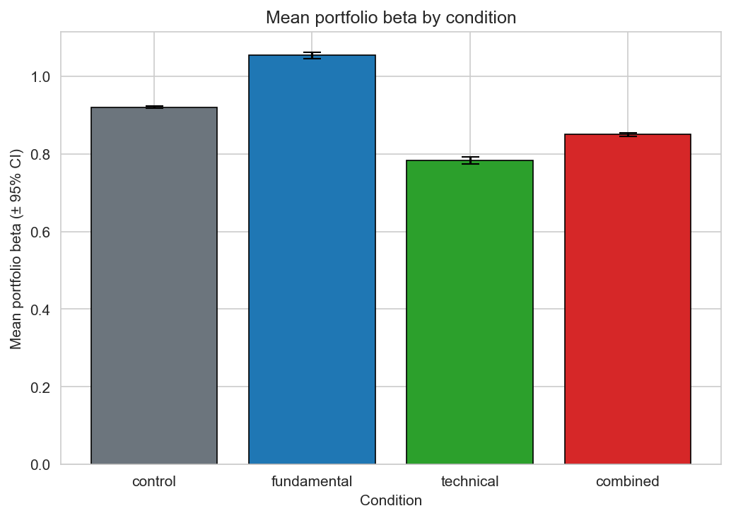
Concentration and Beta by Condition
• Error bars are 95% CIs • all pairwise differences vs. control are p < 0.001
Schwasnick | STAT 6990 | 6/10

Slide 7
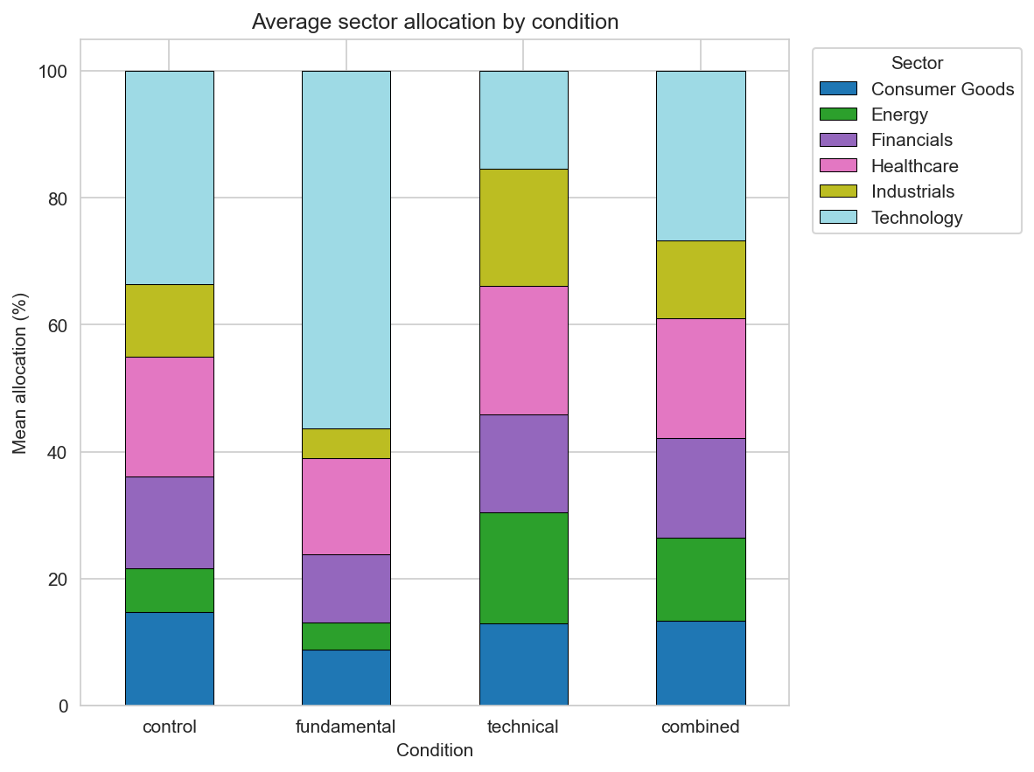
Sector Allocation: The Story Is Sectoral
• Fundamental → Tech-heavy (NVDA, MSFT, GOOGL growth numbers drive it).
• Technical → more balanced; Energy and Healthcare boosted by MA signals.
Schwasnick | STAT 6990 | 7/10

Slide 8
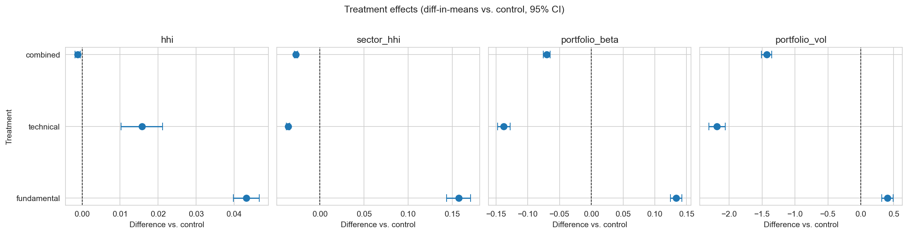
Treatment Effects vs. Control (95% CI)
• Every point lies well away from zero. Fundamental pushes metrics up; technical pulls beta and volatility down.
Schwasnick | STAT 6990 | 8/10

Slide 9
Diagnostics — Are the Effects Real?
Permutation placebo (5,000 shuffles)
• Observed effects are outside the null distribution in every case. Empirical p-value < 0.001 for 11 of 12 tests.
Within-control placebo (1,000 random splits)
• Rejection rates at α=0.05: {HHI 0.058, sector HHI 0.047, β 0.057, vol 0.049}. Calibrated to nominal 5%.
Trimmed-sample sensitivity
• Drop the top and bottom HHI observation per condition (n: 119 → 111). All point estimates change by <5%. Every effect remains p < 0.001.
The effects are not driven by noise, pipeline miscalibration, or outliers.
Schwasnick | STAT 6990 | 9/10

Slide 10
Discussion and Conclusion
Takeaways
• Information framing is a causal driver of LLM portfolio behavior.
• The combined prompt is NOT a superposition — it de-concentrates.
• The tools of randomized experiments & placebos carry over cleanly to LLMs.
Limitations
• One model (Claude Sonnet 4.6), one temperature, one snapshot of data.
• Prompts differ in length as well as content — no placebo arm for length.
• Breadth is a binding constraint; cannot vary across conditions by design.
• No out-of-sample evaluation: studies what the LLM does, not whether it's good.
Code & data: github.com/eddieschwasnick/CI-Final-Project
Schwasnick | STAT 6990 | 10/10

