Slide 1
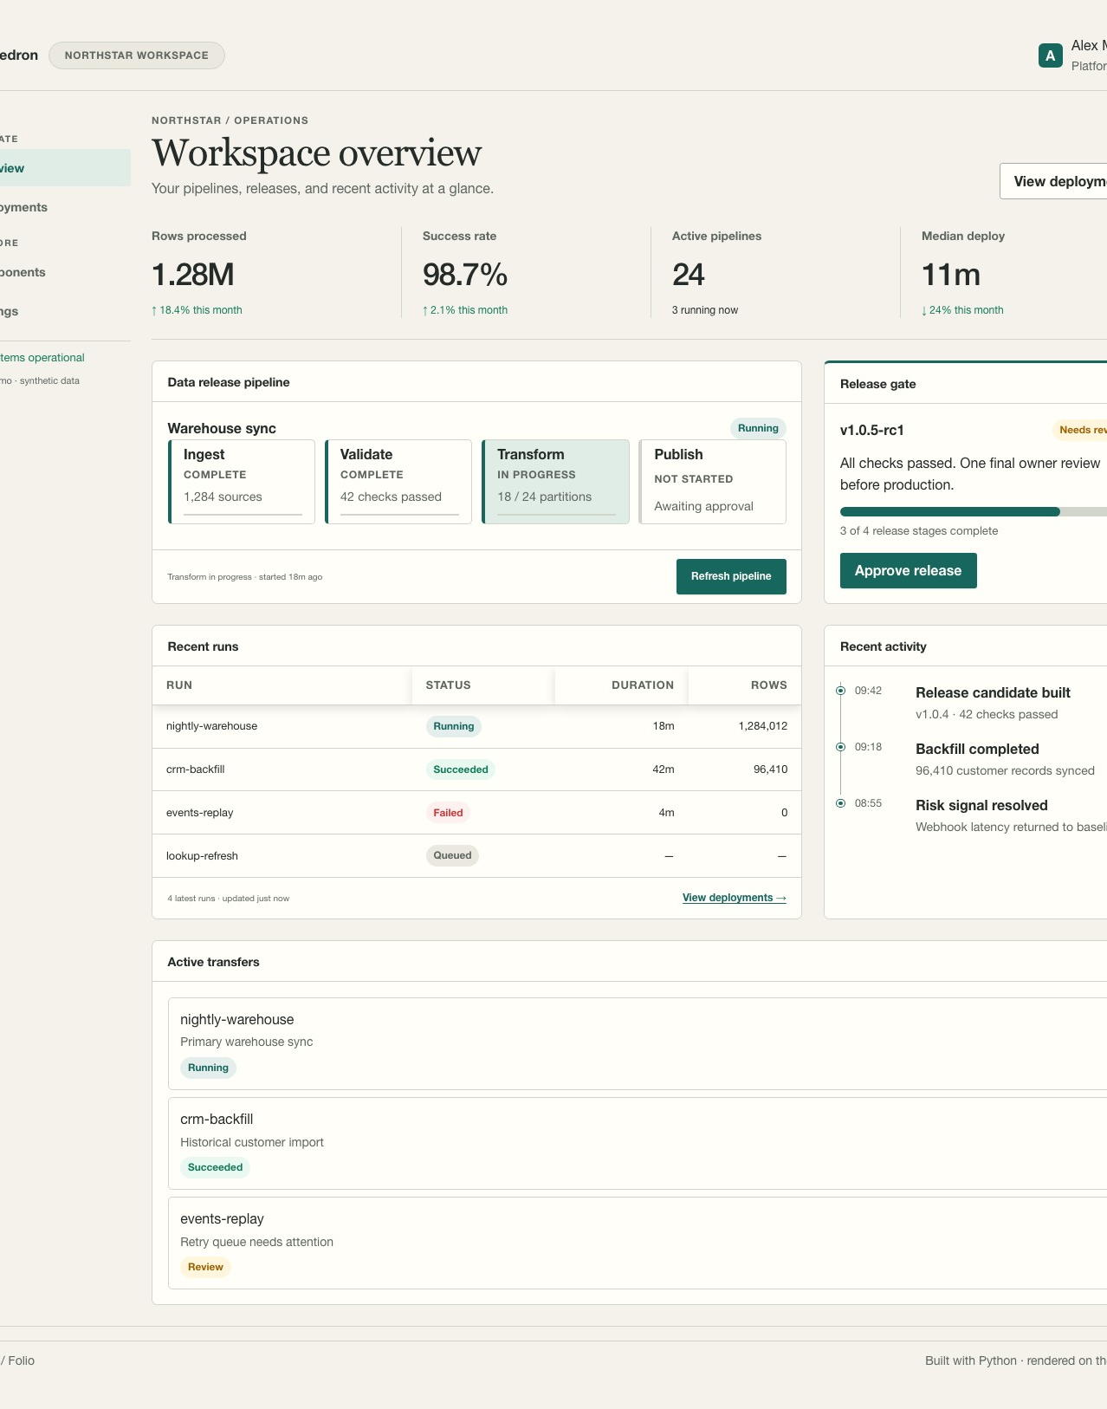
HEDRON
Python interfaces
for data work
An introduction for teams using FastAPI, Streamlit and Posit
September 2026
Notes:
Open with the audience's context: many teams already write Python analyses and Streamlit apps inside Posit. Hedron is a way to build a maintained web application in the same Python and FastAPI ecosystem. The right-hand image is the repository's synthetic Hedron Showcase, not a production government system. Preview the three questions this talk answers: what Hedron is, how requests work, and how development in Workbench leads to a Connect deployment.
Sources:
- repo README.md at 6805f107
- repo docs/assets/hedron-showcase.jpg (synthetic showcase)

Slide 2
What Hedron is
A Python framework for server-rendered interfaces on FastAPI
Python functions return pages and components
FastAPI handles routes, validation and dependencies
HTMX replaces declared regions after a request
Alpine handles small browser-local interactions
02
Notes:
Define Hedron in one sentence. It lets Python teams compose pages, forms, tables and interactions without a separate frontend application. It stays within FastAPI, so ordinary JSON endpoints, middleware, dependencies and OpenAPI can coexist. HTML is rendered on the server. HTMX is used for targeted requests and fragment updates. Alpine is used for browser-local presentation state such as a disclosure or menu. Avoid implying there is zero JavaScript in the browser: Hedron ships browser assets; application authors generally do not need a Node build for the basic path.
Sources:
- repo README.md
- repo docs/ARCHITECTURE.md

Slide 3
Interaction model: Streamlit and Hedron
Streamlit
Hedron
Widget changes
Python script reruns by default
UI is rebuilt from script output
Browser sends an HTTP request
One page, view or action runs
Server returns HTML or a redirect
Streamlit also supports forms and fragments. Hedron makes the HTTP request and response boundary explicit.
03
Notes:
Explain the default mental model with one action: a user changes a filter. In a typical Streamlit app, the script reruns, although modern Streamlit has forms and fragments that can batch inputs or rerun only a portion. In Hedron, the filter arrives as a query or form value at a specific route. That route validates the input, calls Python domain code, and returns a full page or an HTML fragment. The distinction matters for code ownership, tests, URLs, caching and side effects. Do not claim Hedron is universally faster; performance depends on application design and deployment.
Sources:
- https://docs.streamlit.io/develop/api-reference/execution-flow
- https://docs.streamlit.io/develop/concepts/architecture/forms
- https://docs.streamlit.io/develop/concepts/architecture/fragments
- repo docs/guides/streamlit-execution-state.md

Slide 4
A Hedron request
Browser
Hedron + FastAPI
Python services
Navigation or HTMX request
Route, validation, security
Data, models, jobs
The route returns safe HTML. The browser changes the full page or one declared region.
04
Notes:
Trace a request. Browser traffic enters the usual FastAPI and Starlette stack. A Hedron route uses FastAPI parsing and dependency injection. Application services read data or perform authorized work. Hedron core builds and escapes HTML. A normal navigation returns a full document; an HTMX request can return a fragment for a declared target. A component alone is never automatically exposed as a route. Mention that the database, queue and authorization decisions belong to the application, not to Hedron.
Sources:
- repo docs/ARCHITECTURE.md
- repo openwiki/architecture/requests-and-interactions.md
- repo packages/hedron/src/hedron/routing/route.py

Slide 5
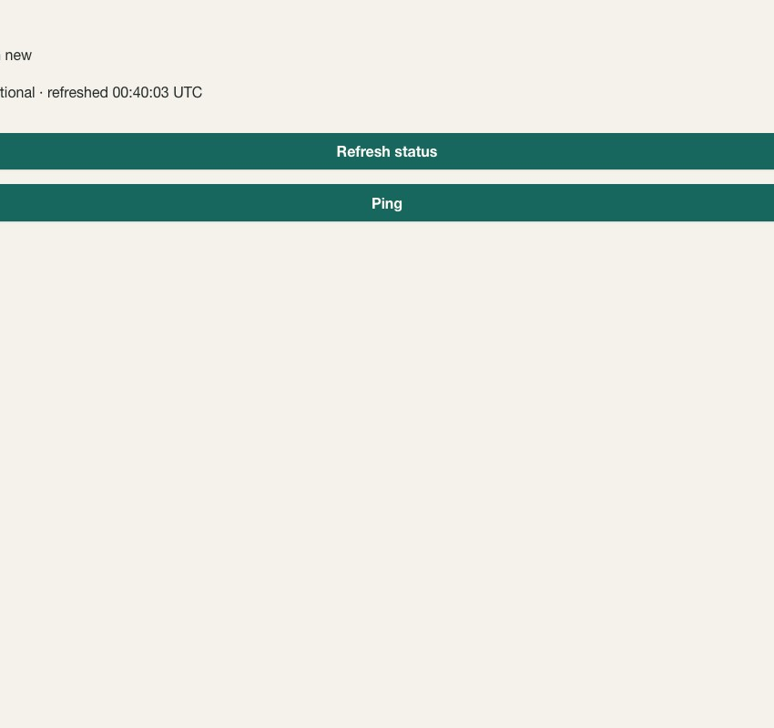
A small app
import os
from hedron import Stack, Text
from hedron_posit import HedronPosit
app = HedronPosit(
title="Operations",
security="standard",
session_secret=os.environ["HEDRON_SESSION_SECRET"],
)
@app.view("/status")
def status():
return Text("All systems operational")
@app.page("/")
def home():
return Stack(status(), status.refresh_button("Refresh"))
One app object.
Explicit routes.
Python components.
05
Notes:
Walk through only three lines: HedronPosit creates one app that also works outside Posit; @app.view names an independently requestable region; @app.page provides the initial page. The refresh button asks the view for new HTML, so there is no application script rerun. The screenshot is from the repository's basic refresh example. The code reads the session secret from an environment variable; in deployment, supply this through the approved platform secret mechanism. If a developer asks, HedronPosit is the preferred Posit facade and the regular Hedron class remains available for other hosts.
Sources:
- repo README.md
- repo docs/guides/posit.md
- repo examples/workbench-reference/app_facade.py
- repo docs/assets/hello-refresh.jpg

Slide 6
Data and visualization work
Keep Python data logic. Add a web interface.
In Hedron
In your services
Tables, forms, metrics, charts and maps
Validated filters and explicit write actions
FastAPI JSON routes beside HTML
Pandas, SQL and model code
Data permissions and audit records
Storage, queues and deployment policy
06
Notes:
Speak to the data engineers and visualization developers. The sample Streamlit migration retains the calculation and data model, while its controls become typed query parameters and a GET form. The first-party data, chart and map packages are available, but the team should check the feature matrix for any specialized Streamlit widget or third-party component. Hedron does not supply an ORM or managed data service. Mention that FastAPI JSON endpoints can remain in the same app for other clients.
Sources:
- repo README.md
- repo examples/streamlit-migration/app.py
- repo docs/guides/streamlit-migration-matrix.md

Slide 7
Development in Posit Workbench
Workbench hosts the developer session and proxies the running app.
01
Open a session
Use the approved Python environment and package index.
02
Run the app
hedron-posit run app:app
03
Open the proxy URL
The launcher handles the session path, assets and cookies.
Workbench session links are temporary. Connect provides the durable published URL.
07
Notes:
Workbench is the development environment. A developer starts VS Code or another approved IDE on the remote host, installs the project into a virtual environment, and runs hedron-posit run app:app. The Posit adapter discovers and validates the Workbench session mount before importing the app, then scopes URLs, assets and owned cookies. The app appears through Workbench's proxied servers feature. Avoid hard-coding a /s/.../p/... path or assuming port 8000. The session URL is not a durable sharing link. Repo support is verified for Workbench 2025.05.1 through 2026.07.0; check the support matrix for the organization's installed version.
Sources:
- repo docs/guides/posit-workbench.md
- repo docs/getting-started/first-app-posit-workbench.md
- https://docs.posit.co/ide/server-pro/user/vs-code/guide/proxying-web-servers.html

Slide 8
Publishing on Posit Connect
Publish the same app as FastAPI content
rsconnect deploy fastapi -n <server> --entrypoint app:app ./
01
Package the app
Include pinned Hedron dependencies in the content environment.
02
Configure Connect
Set access, a session secret and deployment settings there.
Validate the installed Connect version against Hedron’s support matrix.
08
Notes:
The same HedronPosit application object can run locally, inside Workbench and as a Posit Connect content item. Connect's official FastAPI publishing workflow uses rsconnect deploy fastapi and an app:app entrypoint. Install hedron-posit into the content environment; the repository explicitly warns against merely copying its source on Connect 2025.06. Configure the app session secret through approved secret handling. Connect provides a durable published content URL and content access controls. The application must still authorize actions and data. The repo's native Connect GUID mode is supported on 2025.06.0 through 2026.07.0; newer versions require validation before making a support claim.
Sources:
- https://docs.posit.co/connect/user/fastapi/
- https://docs.posit.co/connect/user/publishing-cli-apps/
- repo docs/guides/posit.md
- repo packages/hedron-posit/README.md

Slide 9
Security and operating responsibilities
Hedron provides
The application and platform own
Escaped HTML and typed trust markers
CSRF profiles and declared fragment targets
FastAPI integration and diagnostics
Identity and record-level authorization
Data storage, tenancy and audit retention
Secrets, network policy and approvals
Workbench or Connect sign-in does not automatically authorize a Hedron action.
09
Notes:
This is the key slide for a government audience. Hedron offers useful controls but does not certify an application or replace agency review. Its framework handles escaping and typed trust markers, and its configured security profiles handle CSRF and fragment target policy. The application must implement authentication integration, authorization of every protected route and row, data retention, tenancy, audit storage, secrets and deployment controls. A user being signed in to Workbench or Connect is not automatically an application identity or authorization decision. Avoid implying Hedron itself has a federal authorization or security certification.
Sources:
- repo docs/ARCHITECTURE.md
- repo docs/guides/posit.md
- repo docs/guides/streamlit-cutover.md

Slide 10
A good first pilot
Choose one maintained internal dashboard with filters, a form and a clear data owner.
Build it in Workbench
Publish beside Streamlit
Use the current approved Python environment and normal FastAPI tests.
Use a non-production Connect space and compare tasks, access and operations.
Stay with Streamlit for short-lived analysis or workflows built around its rerun model.
10
Notes:
Recommend a bounded pilot rather than a wholesale replacement. Choose a small but real maintained app: enough routes, filters and one write path to expose architectural benefits, but no highly specialized Streamlit component dependency. Define acceptance criteria with stakeholders: users can complete the same tasks, the app follows agency authorization and secret handling, the team can test it at the HTTP boundary, and operations can publish and roll it back on Connect. Streamlit remains the right tool for some short-lived analyses and notebook-style dashboards. The current Hedron docs explicitly say this.
Sources:
- repo docs/guides/why-hedron.md
- repo docs/guides/streamlit-migration.md
- repo docs/guides/training-streamlit-to-hedron-posit.md

