Slide 1
Web applications
in Python
Interactive pages on FastAPI
An introduction to Hedron 1.1.1
Notes:
Hedron lets a Python team build a maintained web application using Python components and the FastAPI request model. Introduce the product through the interface it produces, then explain pages, views and actions. The presentation covers a deployment option later, after the application model is clear. Hedron 1.1.1 is the current published coordinated release documented by this repository.
Sources:
- Repository README.md and docs/STATUS.md at 6805f107
- Repository docs/assets/hedron-logo-light.svg and docs/assets/polyhedron-mesh.svg

Slide 2
What Hedron adds to FastAPI
Python components that render
HTML on the server
UI in Python
FastAPI underneath
Compose pages, forms and tables
without a separate frontend app.
Keep validation, dependencies,
middleware and JSON endpoints.
Pages, views and actions give each request a clear job.
02
Notes:
Hedron is a Python framework for server-rendered interfaces on FastAPI. A handler returns a component tree, which the renderer turns into HTML. Developers can use existing FastAPI middleware, dependency injection, typed validation and JSON routes in the same application. Standard application authoring does not require a separate frontend application or Node.js build. Browser code still exists: Hedron ships the assets used for bounded server interactions and local controls. The framework-neutral renderer also supports separate Flask and Django adapters.
Sources:
- Repository README.md
- Repository docs/ARCHITECTURE.md
- Repository packages/hedron/src/hedron/app/hedron.py

Slide 3
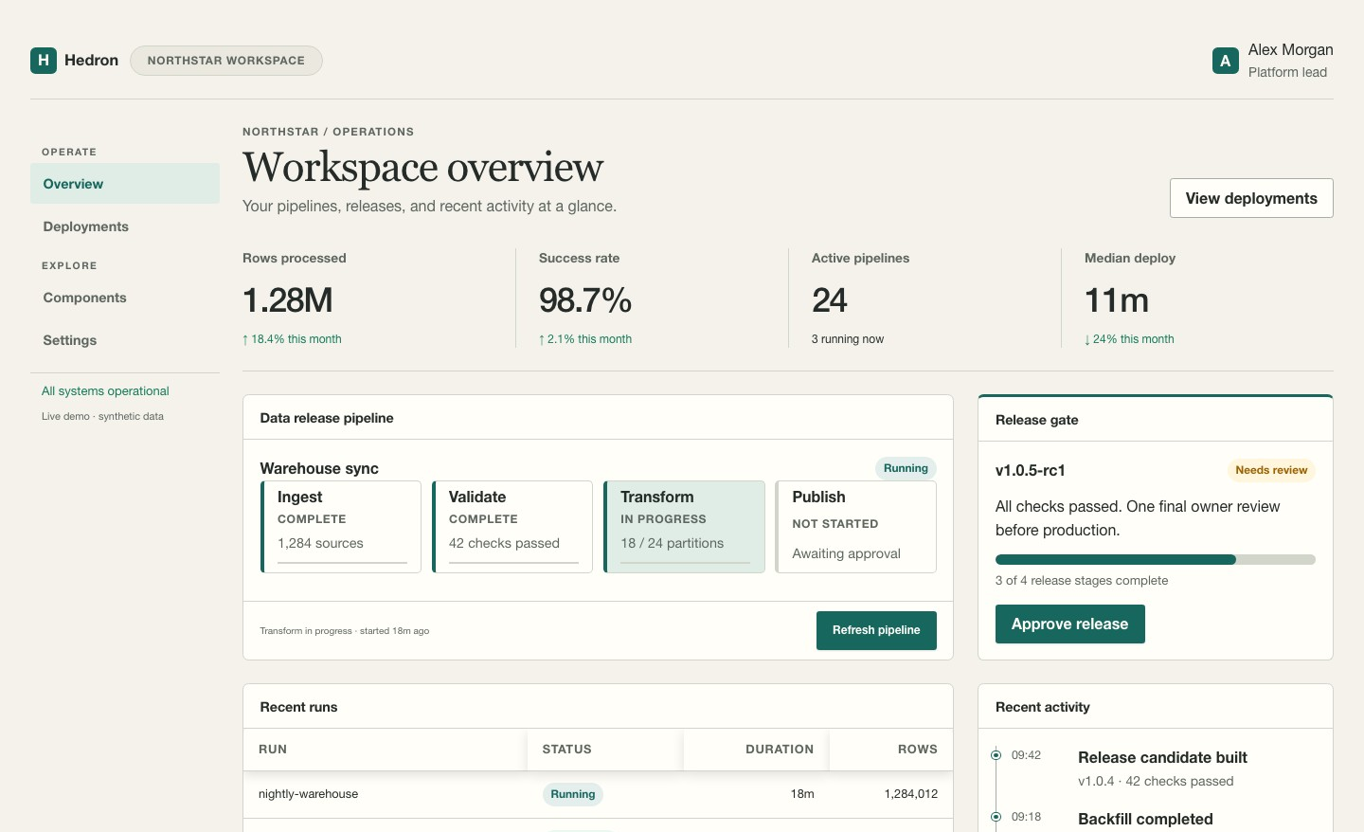
A working Hedron interface
App layout
Navigation and a
consistent page shell
Data and workflows
Metrics, progress and
actions in one screen
Hedron Showcase with demo data
03
Notes:
Use this screenshot to make the product concrete. It comes from the runnable Hedron Showcase, an operations console built with the public component, layout, styling, view and action APIs. The screenshot shows synthetic demo data, so its numbers are not claims about production performance or adoption. The crop focuses on navigation, metrics and the release workflow. The full example also includes tables and other controls. A team supplies its own authorized data and application services behind these components.
Sources:
- Repository examples/showcase/app.py
- Repository examples/showcase/README.md
- Repository docs/assets/hedron-showcase.jpg
- https://hedron.readthedocs.io/en/latest/examples/showcase/

Slide 4
Pages, views and actions
Each route has an explicit purpose
Role | Purpose | Typical result
Page | Open a navigable screen | Full HTML page
View | Refresh a declared region | HTML fragment
Action | Validate and perform a write | Refresh, redirect or errors
HTMX sends server requests. Alpine handles local controls such as menus.
04
Notes:
A page is a complete navigable document. A view is an independently addressable read region that can be composed into a page and refreshed later. An action handles an unsafe request, normally POST, and declares the outcome. The application must authorize the action and apply its own business rules. Hedron authorizes declared fragment and out-of-band targets before rendering the response. Creating a component does not publish a route. HTMX carries interactions across the server boundary. Alpine handles temporary presentation state in controls such as disclosures and menus.
Sources:
- Repository packages/hedron/README.md
- Repository docs/ARCHITECTURE.md
- Repository docs/api/HTMX_ALPINE_BOUNDARY_1_0.md

Slide 5
A page with a refreshable view
from hedron import Hedron, Stack, Text
app = Hedron(title="Operations")
@app.view("/status")
def status():
return Text("All systems operational")
@app.page("/")
def home():
return Stack(
status(),
status.refresh_button("Refresh"),
)
First visit
GET /
Render the page with
the status view.
Refresh
GET /status
Replace only the
status region.
Minimal local example. Production apps need a configured session secret.
05
Notes:
Walk through the example in two passes. On GET /, home composes the status view and its refresh button into a page. Selecting Refresh requests /status and replaces that view region. The rest of the page remains in place. The decorator returns a handle that supports both initial composition and the refresh helper. This is a minimal local example using the standard security profile by default. Configure an explicit secret and production settings before deployment. For writes, add an action backed by application authorization and a validated request model.
Sources:
- Repository README.md quickstart
- Repository docs/getting-started/for-posit-teams/how-it-works.md
- Repository packages/hedron/src/hedron/app/hedron.py

Slide 6
Streamlit and Hedron
Interaction | Streamlit | Hedron
Trigger | Widget changes by default | A request to a named route
Execution | Script reruns by default | One page, view or action runs
UI update | Rebuild UI from script output | Return a page, fragment or redirect
Streamlit forms batch input, and fragments can rerun part of an app.
06
Notes:
This compares the default execution models rather than ranking the frameworks. Streamlit reruns a script by default as users interact with widgets. Forms can batch changes, and fragments can rerun part of an application. Hedron makes the HTTP request boundary explicit through pages, views and actions. Existing Python queries and models may transfer, while session state and interactions require deliberate design. Evaluate specialized widgets before assuming a direct replacement. Streamlit remains a reasonable fit when its execution model suits the work.
Sources:
- Repository docs/guides/streamlit-migration.md
- Repository docs/getting-started/for-posit-teams/how-it-works.md
- https://docs.streamlit.io/develop/api-reference/execution-flow
- https://docs.streamlit.io/develop/concepts/architecture/forms
- https://docs.streamlit.io/develop/concepts/architecture/fragments

Slide 7
Data, forms and background work
Present results
Keep your queries,
models and business
rules in Python.
Tables, charts and maps
Handle changes
Validated forms and
explicit write actions
Your app chooses the data store,
queue and access rules.
Track work
Job backends and polling
for status updates
07
Notes:
Hedron adds a web interface around Python services. Data, chart and map packages present results. Typed forms and action routes make inputs and writes explicit. Job backends and status components support longer work, with polling as the conservative supported default. The application still selects persistence, transaction boundaries, authorization and durable queue infrastructure. In-memory jobs and sessions do not automatically span workers. SSE and WebSocket helpers have separate experimental boundaries. Choose integrations using the package compatibility and maturity matrix rather than assuming every satellite shares the stable platform promise.
Sources:
- Repository packages/hedron-data/README.md
- Repository packages/hedron-charts/README.md
- Repository packages/hedron-maps/README.md
- Repository docs/ARCHITECTURE.md
- Repository release/support-matrix.toml

Slide 8
Framework safety and application ownership
Hedron helps with | Your app and platform own
HTML escaping | Decisions about trusted content
CSRF profiles and input validation | Identity and permission to act
Declared fragment targets | Access rules for routes and data
Build manifests and diagnostics | Storage, secrets and deployment
Signed-in users still need permission for each protected operation.
08
Notes:
Framework protections reduce common implementation mistakes, but they do not decide whether a user may see a record or approve a write. The application supplies authentication integration, authorization policies, durable data storage, tenancy and audit retention. CSRF profiles and trusted HTML or URL types must be configured and used correctly. The host platform controls secrets, network policy and deployment operations. A platform login does not automatically authorize a protected application action. Package maturity and individual API stability are separate contracts.
Sources:
- Repository SECURITY.md
- Repository docs/ARCHITECTURE.md
- Repository release/support-matrix.toml

Slide 9
Workbench and Connect
An optional deployment path for the same Python app
Develop in Workbench
Publish on Connect
Run and preview the app behind
the session proxy.
Publish the app object as FastAPI
content at a durable URL.
hedron-posit run app:app
rsconnect deploy fastapi
Uses the optional hedron-posit Beta adapter. Check supported platform versions.
09
Notes:
This is one deployment option for Hedron. The optional HedronPosit facade supports local use, the Workbench proxy and Connect content paths. In Workbench, use the approved Python environment, configure HEDRON_SESSION_SECRET and launch with hedron-posit run app:app. For Connect, install the package in the content environment and publish the same application object as FastAPI content. A complete command is rsconnect deploy fastapi -n <saved-server-name> --entrypoint app:app ./. Configure access and application secrets through platform policy. Workbench session links are temporary. The application still authorizes protected operations. Check the installed platform versions against Hedron compatibility guidance.
Sources:
- Repository docs/getting-started/for-posit-teams/workbench-connect.md
- Repository docs/guides/posit.md
- Repository docs/COMPATIBILITY.md
- https://docs.posit.co/ide/server-pro/user/vs-code/guide/proxying-web-servers.html
- https://docs.posit.co/connect/user/fastapi/

Slide 10
A first Hedron pilot
A dashboard with shared filters
and one approved write action
Pilot scope
Evidence to collect
Keep the existing Python data logic.
Build one page with a refreshable
view and an action.
Can users finish the task?
Do access rules and failures work?
Can the team deploy and maintain it?
Quickstart and runnable examples
10
Notes:
Propose a limited pilot around one maintained internal workflow. Preserve useful query, calculation and model code, then redesign the page, refresh and write boundaries explicitly. Select a real user task and a clear data owner. Evaluate usability, authorization, invalid input, error handling and operational ownership before expanding the scope. The pilot can run beside an existing application. The criteria on the slide are evaluation questions, not measured outcomes or promised improvements. The quickstart and runnable examples provide the implementation path.
Sources:
- Repository docs/getting-started/for-posit-teams/migration-pilot.md
- Repository docs/getting-started/quickstart.md
- Repository examples/README.md
- https://hedron.readthedocs.io/en/latest/getting-started/quickstart/

