Slide 1
GENERATIONS
Part iii – Bridge the generation gap

Slide 2

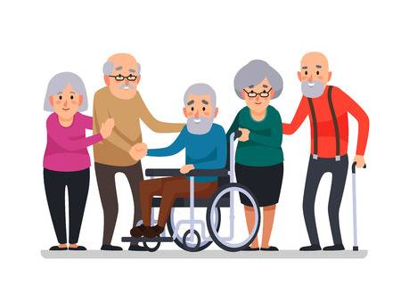
The Abandoned Generation
“When the times abandon you, they won’t even say goodbye.”
—— Zhang, Quanlin
Convenient ?
Inconvenient !

Slide 3
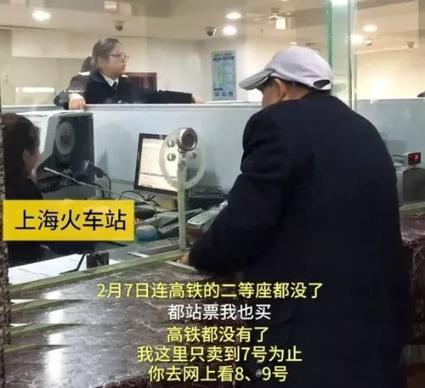
Why CAN’T buy tickets in railway station?
#Shanghai Railway Station
A 58 years old people, have been to ticket window for about 6 times, but can’t buy a ticket

Slide 4
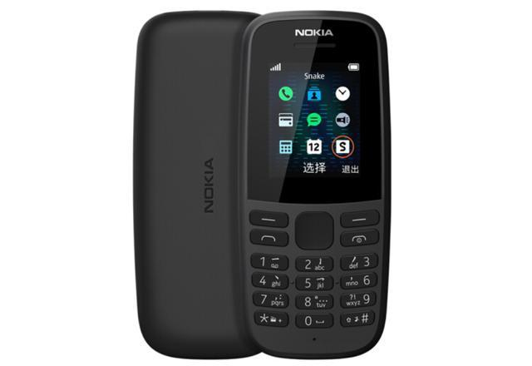


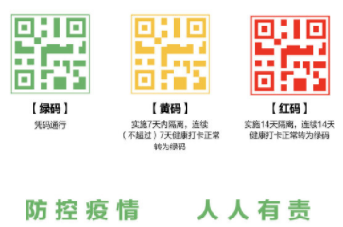
Why CAN’T go without a smart phone?
#Heilongjiang Province
An old man is stopped by an epidemic prevention worker because he don’t have a health code.

Slide 5


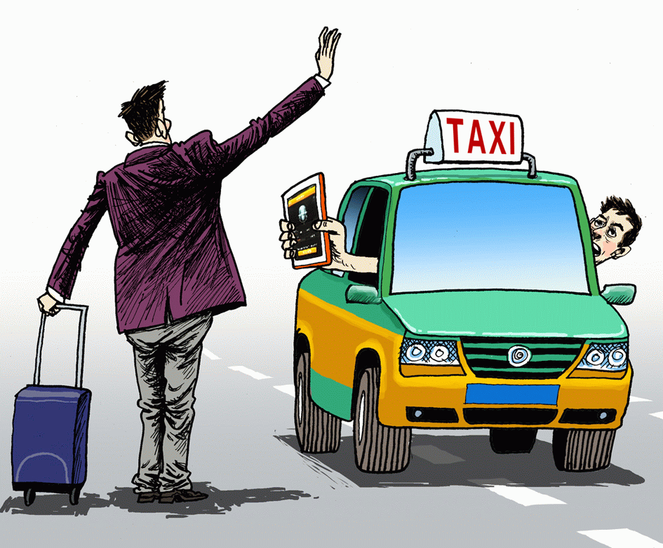

Why CAN’T … ?
BEFORE – Cash
NOW – Alipay
BEFORE – Waving Hands
NOW – DiDi

Slide 6
Bridge the generation gap
“No one if forever young, and everyone eventually becomes an old man.”
Put Respect front and center
Provide a variety of communication channels between young people and old people
Don’t make assumption
Show more kindness

Slide 7
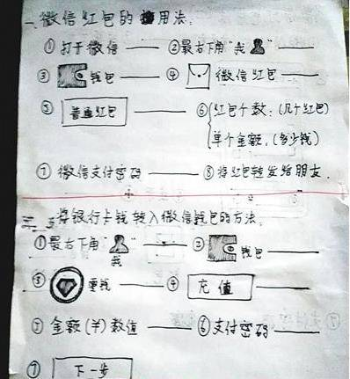
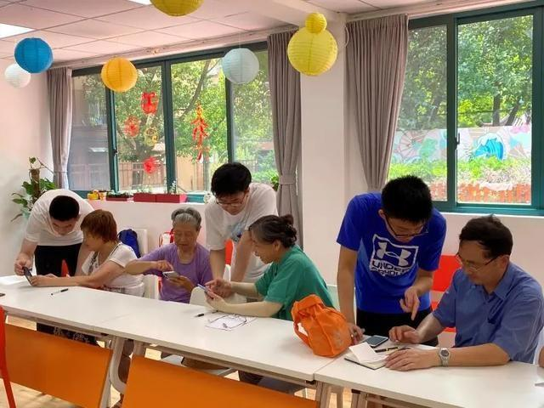
Bridge the generation gap
> Hand-written WeChat Tutorial
> Lesson on smart phone for old people

