Slide 1
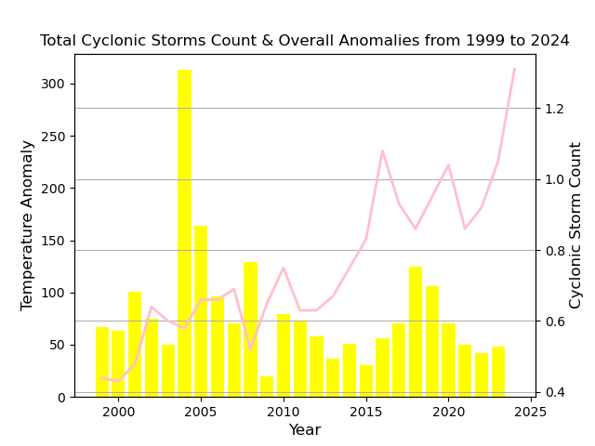
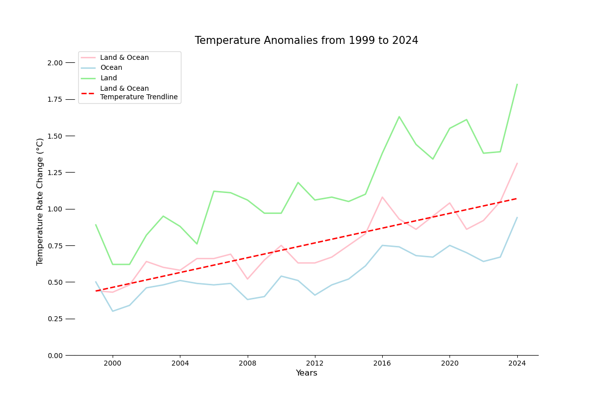
What Is The Effect Of The Earth's Temperature on Cyclonic Storms?
Anomaly: Change from 30 years average
Earth’s temperature is getting warmer in past 25 years.
Both Land and Ocean temperatures are getting warmer.
This leads to more cyclonic storms.

Slide 2
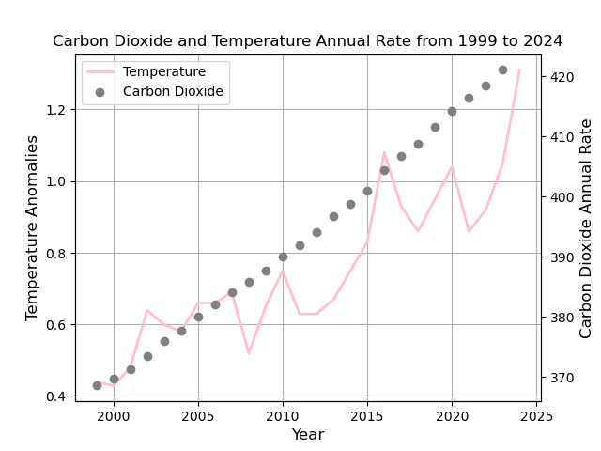
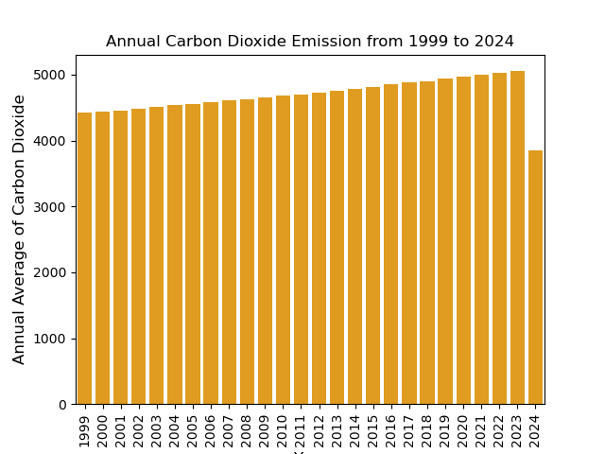
Carbon Dioxide Impact
As anomalies get higher, the carbon dioxides increases as well.
With higher emissions of carbon dioxides, the climates become warmer.
This becomes a breeding ground for cyclonic storms.

Slide 3
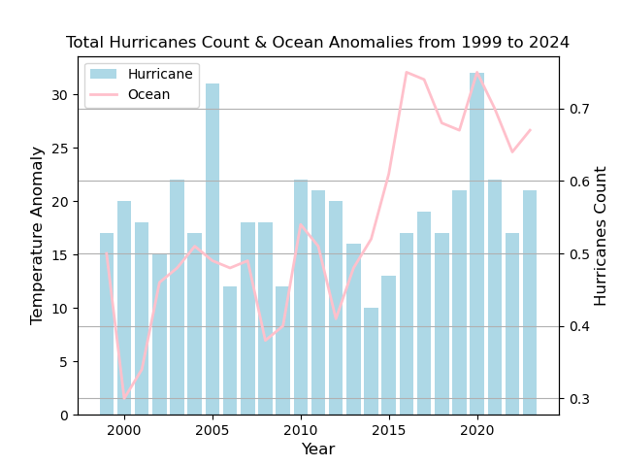
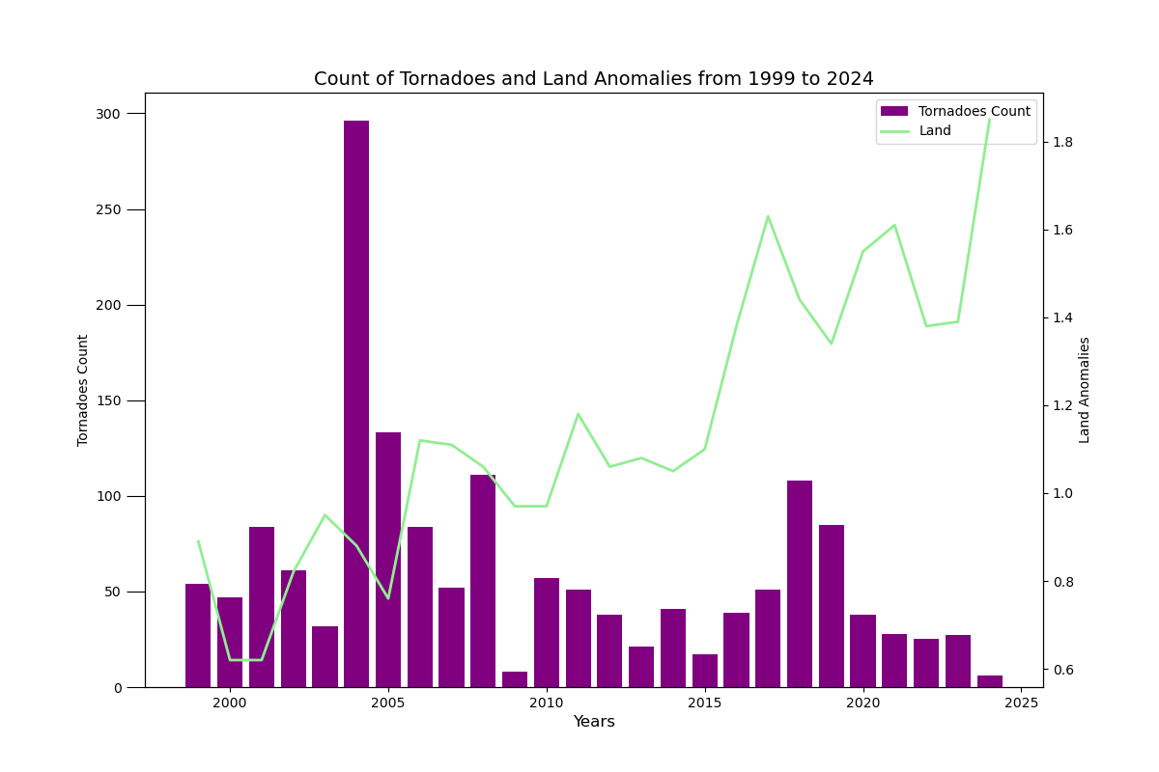
Hurricanes & Tornadoes
Because of the warmer climates, there are more cyclonic storms developed over time.

Slide 4
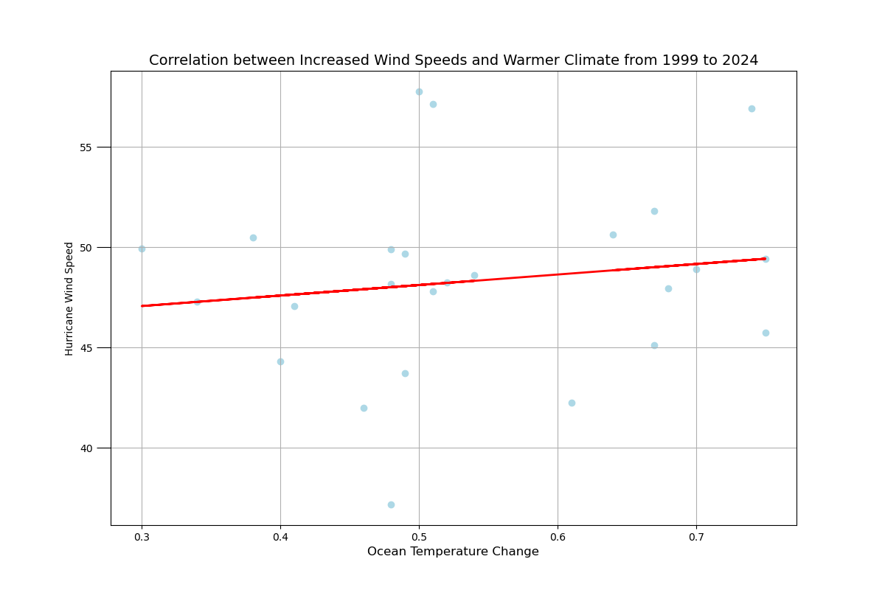
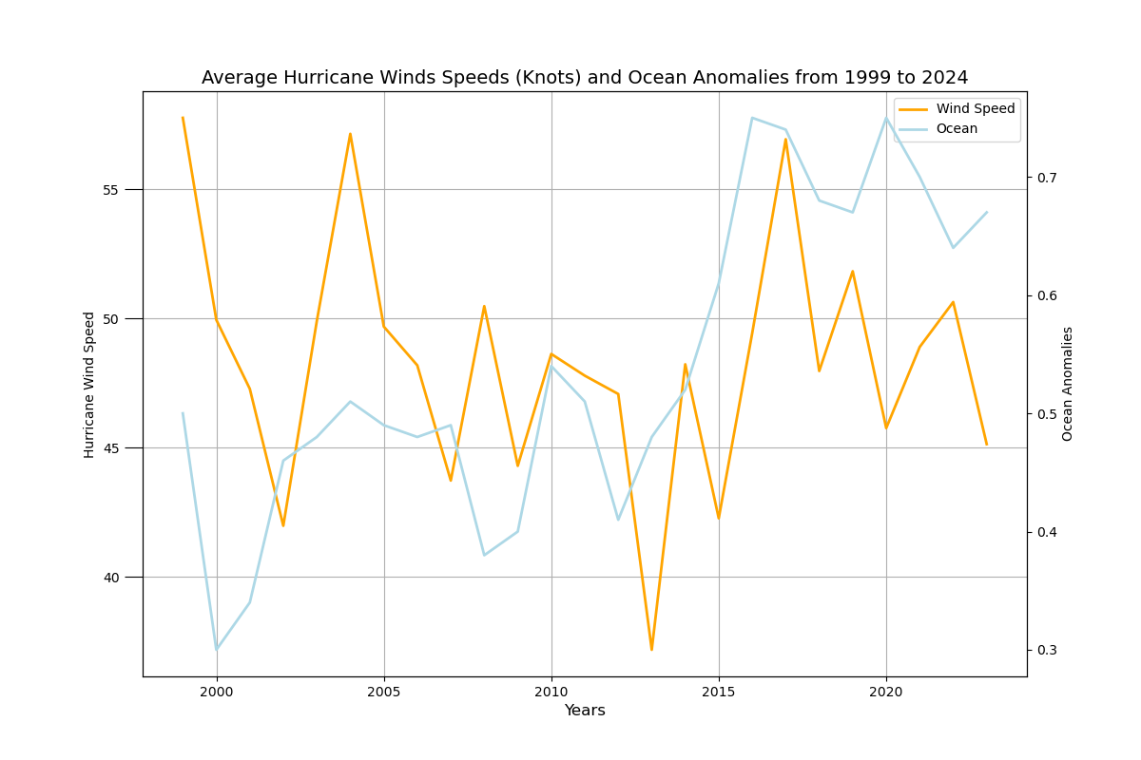
Cyclonic Storm Strength
As temperatures get warmer, the wind speed of cyclonic storms get stronger.
This leads to more powerful hurricanes and tornadoes.

Slide 5
Speaker notes
I located all data sources from National Oceanic and Atmospheric Administration.
I used python packages to perform data preparation and data visualization.
pandas and numpy packages to extract and transform the unstructured data sets.
matplotlib and seaborn package to create data visualizations to display the effect of earth’s temperature.
Datetime package to cleanse the date

