Slide 1
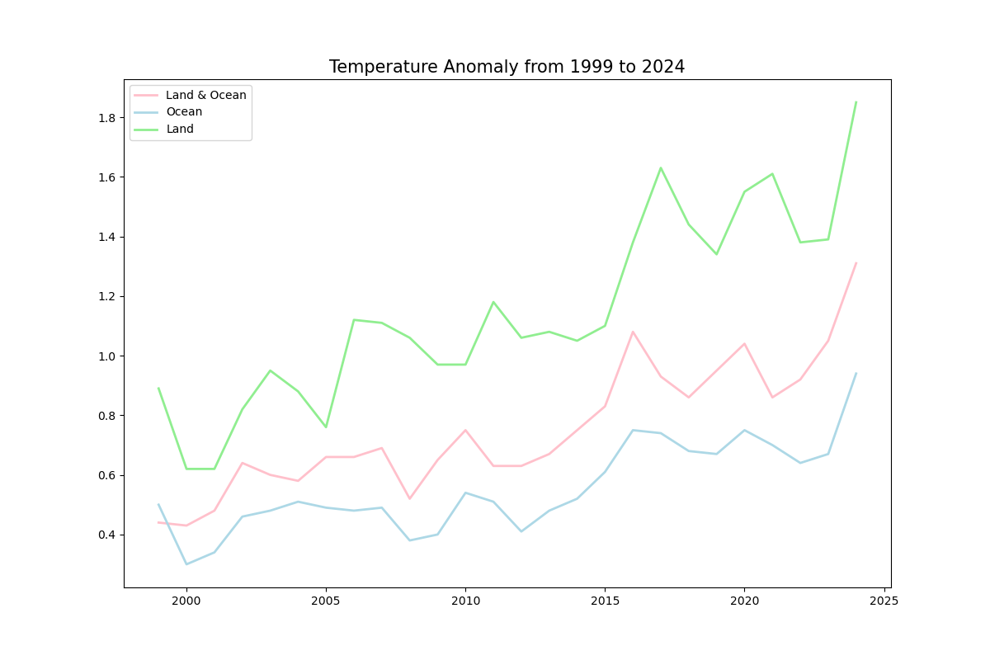
What Is The Effect Of The Earth's Temperature on Cyclonic Storms?
Anomaly: Change from 30 years average
Earth’s temperature is getting warmer in past 25 years.
Both Land and Ocean temperatures are getting warmer.

Slide 2
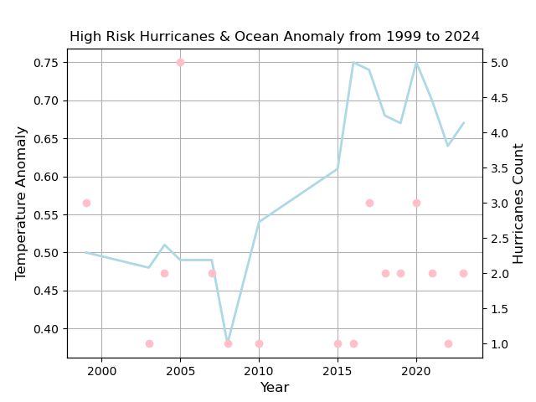
Hurricanes
Because of the warmer temperatures, there are more hurricanes developed over time.
High risk hurricanes (category 3 or higher) are developed more often since 2015.

Slide 3
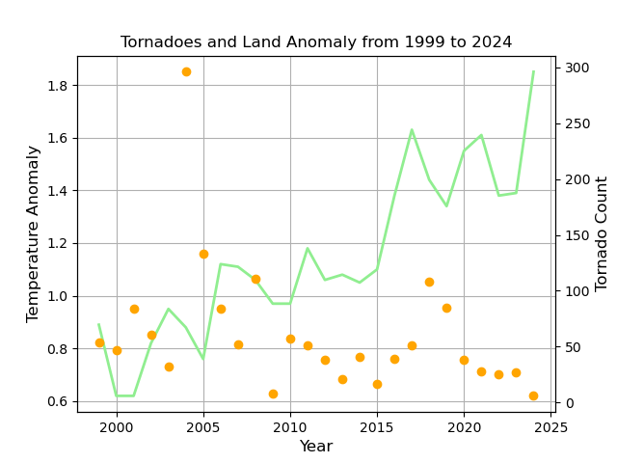
Tornadoes
With rapid temperature changes, more tornadoes are created due to warmer air.
In 2004, 296 tornadoes were created when the temperature changed drastically.

Slide 4
Speaker notes
I located all data sources from National Oceanic and Atmospheric Administration.
I used pandas and numpy packages to extract and transform the unstructured data sets.
I used matplotlib and seaborn package to create data visualizations to display the effect of earth’s temperature.

