Slide 1
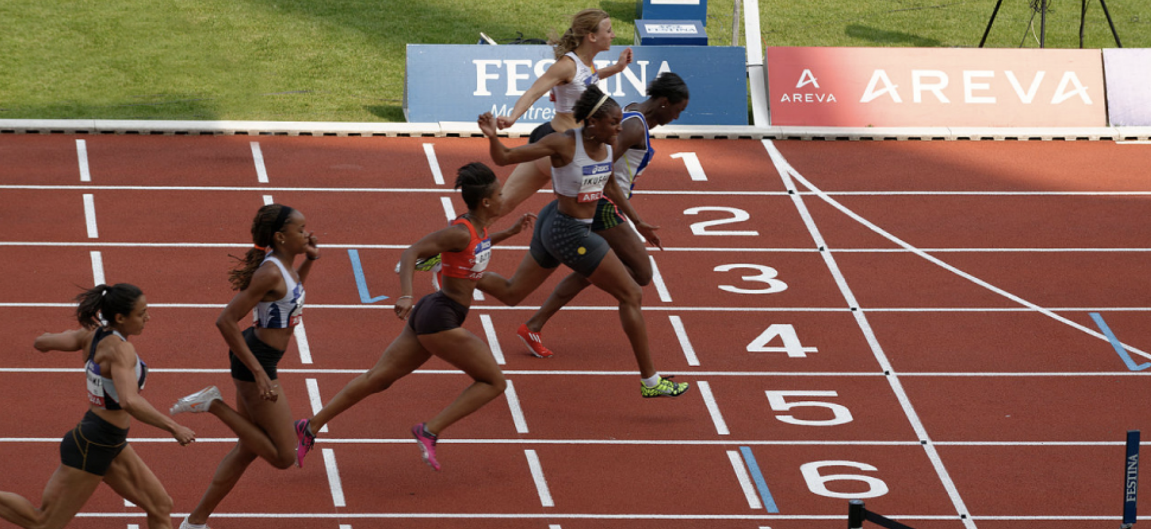

PHYS 2425
Physics for Scientists
and Engineers I
Chapter 7
Work and
Kinetic Energy
Download the textbook for free at https://openstax.org/details/books/university-physics-volume-1
Image credit: modification of work by Marie-Lan Nguyen

Slide 2

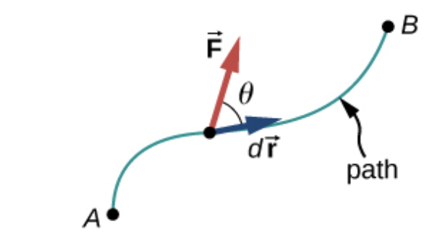
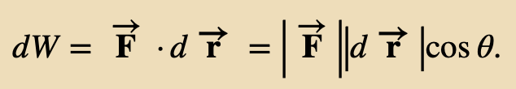
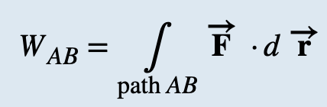
Work
Work is done on an object when energy is transferred to the object.
Work is done when a force acts on something that undergoes a displacement from one position to another.
Forces can vary as a function of position, and displacements can be along various paths between two points.
The increment of work
The work done by a force is the integral of the force with respect to displacement along the path of the displacement:
Vectors used to define work. The force acting on a particle and its infinitesimal displacement are shown at one point along the path between A and B.
The infinitesimal work is the dot product of these two vectors; the total work is the integral of the dot product along the path.
The units of work are units of force multiplied by units of length, which in the SI system is newtons times meters, N · m
This combination is called a joule, and is abbreviated as J.

Slide 3
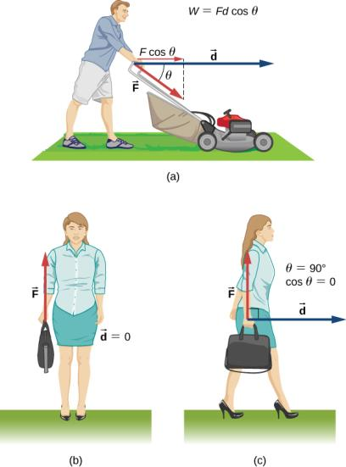
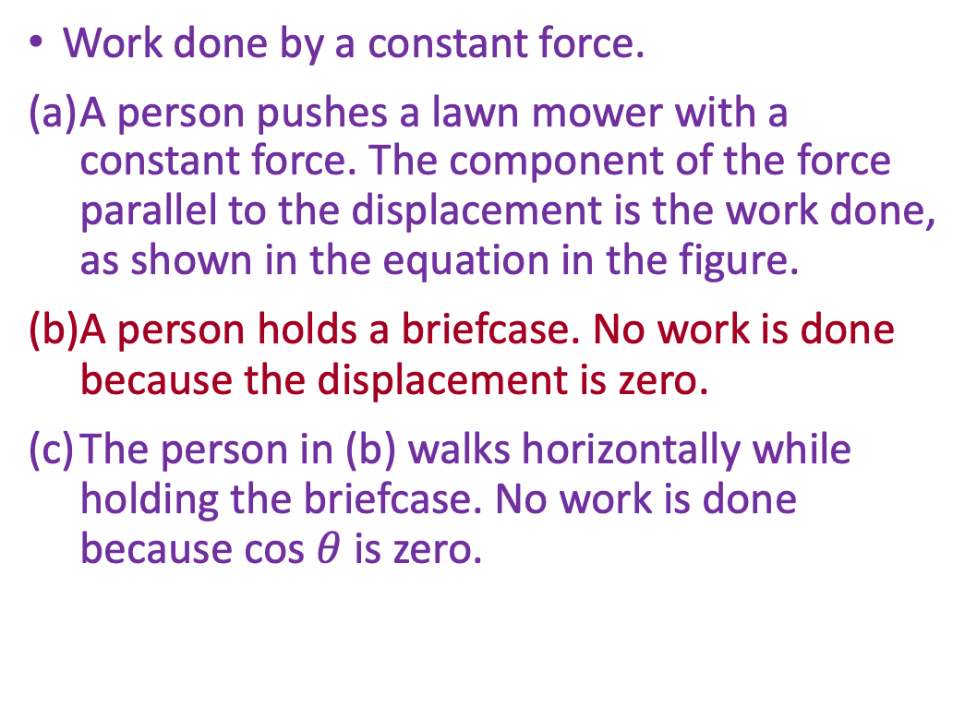
Work
Work done by a constant force.
A person pushes a lawn mower with a constant force. The component of the force parallel to the displacement is the work done, as shown in the equation in the figure.
A person holds a briefcase. No work is done because the displacement is zero.
The person in (b) walks horizontally while holding the briefcase. No work is done because cos $θ$ is zero.

Slide 4
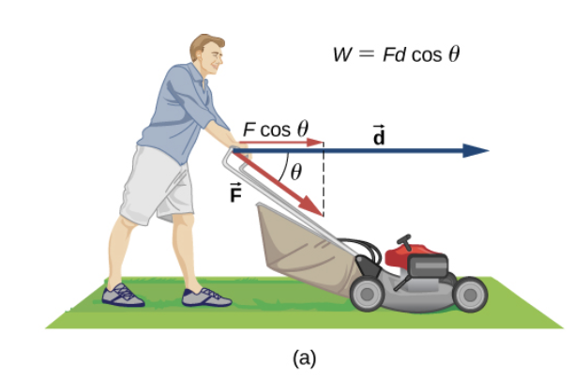

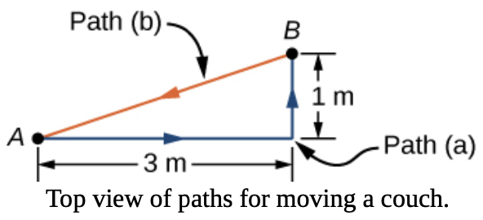

Work
Example
How much work is done on the lawn mower by the person if he exerts a constant force of 75.0 N at an angle 35° below the horizontal and pushes the mower 25.0 m on level ground?
Example
You decide to move your couch to a new position on your horizontal living room floor. The normal force on the couch is 1 kN and the coefficient of friction is 0.6.
You first push the couch 3 m parallel to a wall and then 1 m perpendicular to the wall (A to B). How much work is done by the frictional force?
You don’t like the new position, so you move the couch straight back to its original position (B to A). What was the total work done against friction moving the couch away from its original position and back again?
(a)
(b)
Total displacement of the couch was zero. However, the total work was not zero. The reason is that forces like friction are classified as nonconservative forces, or dissipative forces, as we discuss in the next chapter.

Slide 5
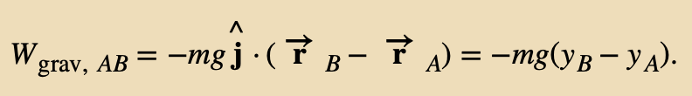
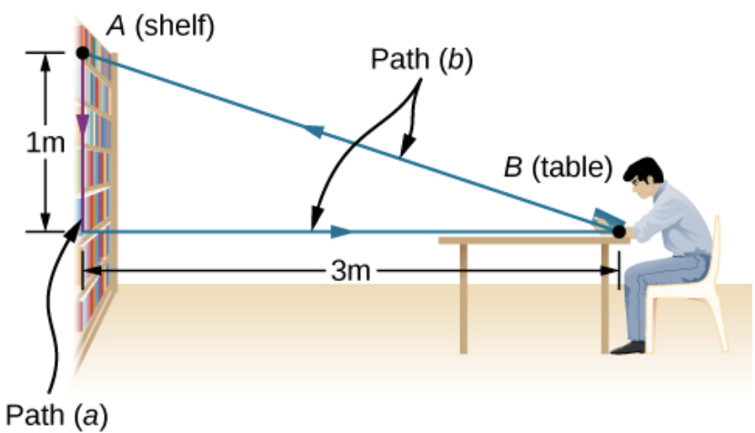

Work
A typical coordinate system has the x-axis horizontal and the y-axis vertically up. Then the gravitational force is −mg ^j , so the work done by gravity, over any path from A to B, is
Gravity does negative work on an object that moves upward ( y_{B} > y_{A} )
Example
(a) You lift an oversized library book, weighing 20 N, 1 m vertically down from a shelf, and carry it 3 m horizontally to a table. How much work does gravity do on the book?
(b) When you’re finished, you move the book in a straight line back to its original place on the shelf. What was the total work done against gravity, moving the book away from its original position on the shelf and back again?
(a) Since the book starts on the shelf and is lifted down y_{B} − y_{A} = −1 m , we have
(b) There is zero difference in height for any path that begins and ends at the same place on the shelf, so W = 0.
Unlike friction or other dissipative forces, described in previous example, the total work done against gravity, over any closed path, is zero. Forces like gravity (those that do zero work over any closed path) are classified as conservative forces and play an important role in physics.

Slide 6
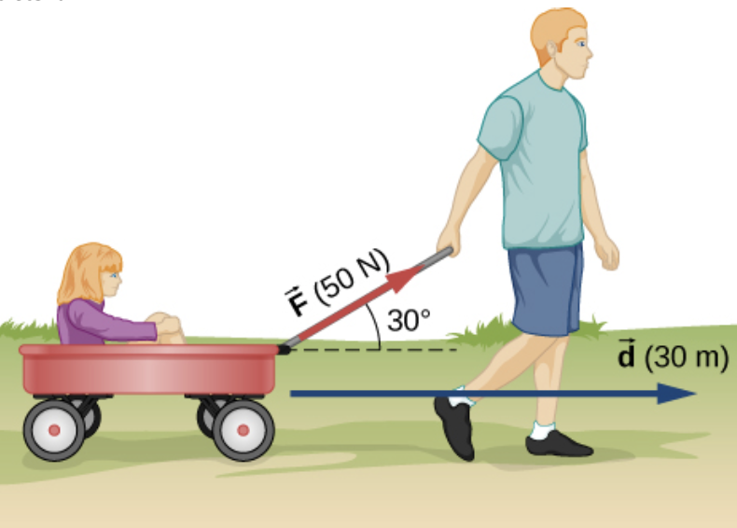
Work
A typical coordinate system has the x-axis horizontal and the y-axis vertically up. Then the gravitational force is −mg ^j , so the work done by gravity, over any path from A to B, is
Gravity does negative work on an object that moves upward ( y_{B} > y_{A} )
Assignment 1
A 75.0-kg person climbs stairs, gaining 2.50 m in height. Find the work done to accomplish this task.
b) How much work is done by the boy pulling his sister 30.0 m in a wagon as shown here? Assume no friction acts on the wagon.

Slide 7

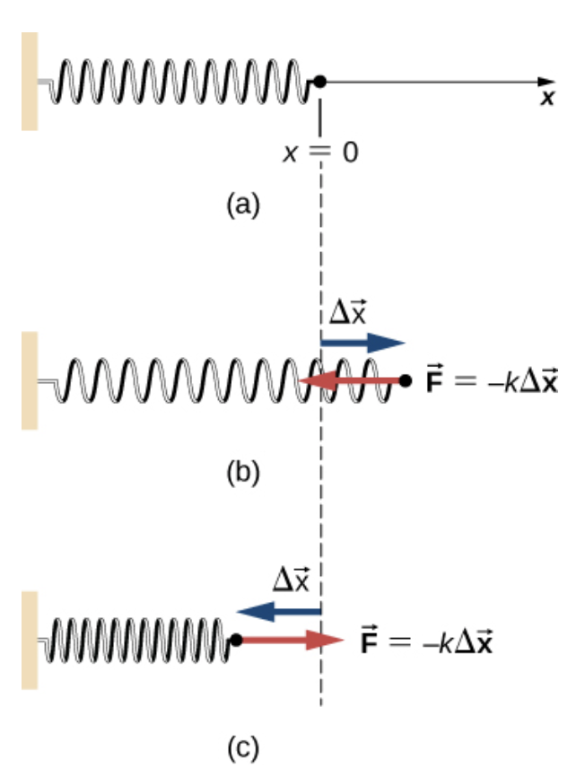



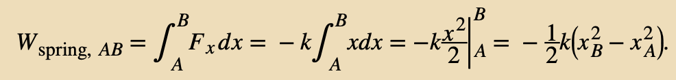
Work Done by Forces that Vary
Forces may vary in magnitude and direction at points in space, and paths between two points may be curved.
The infinitesimal work done by a variable force can be expressed in terms of the components of the force and the displacement along the path.
One very important and widely applicable variable force is the force exerted by a perfectly elastic spring, which
satisfies Hooke’s law
where k is the spring constant, and
is the displacement from the spring’s unstretched (equilibrium) position.
To calculate the work done by a spring force, we can choose the x-axis along the length of the spring, in the direction of increasing length, with the origin at the equilibrium position x_{eq} = 0.
The work done when x changes from x_{A} to x_{B} is ( )

Slide 8

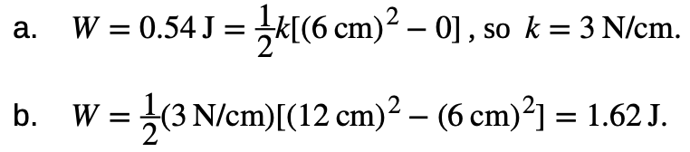
Work Done by Forces that Vary
Forces may vary in magnitude and direction at points in space, and paths between two points may be curved.
The infinitesimal work done by a variable force can be expressed in terms of the components of the force and the displacement along the path.
Example
A perfectly elastic spring requires 0.54 J of work to stretch 6 cm from its equilibrium position, as in Figure (b).
What is its spring constant k?
How much work is required to stretch it an additional 6 cm?
Work “required” means work done against the spring force, which is the negative of the work in performed by spring, so

Slide 9
Work Done by Forces that Vary
Forces may vary in magnitude and direction at points in space, and paths between two points may be curved.
The infinitesimal work done by a variable force can be expressed in terms of the components of the force and the displacement along the path.
Work “required” means work done against the spring force, which is the negative of the work in performed by spring, so
Assignment 2
It takes 500 J of work to compress a spring 10 cm. What is the force constant of the spring?

Slide 10

Kinetic Energy
The kinetic energy is the energy of motion.
We then extend this definition to any system of particles by adding up the kinetic energies of all the constituent particles:
Assignment 3
Show that the units of kinetic energy are the same as the units of work (J, or N · m).

Slide 11
Kinetic Energy
The kinetic energy is the energy of motion.
Example: Kinetic Energy of an Object
What is the kinetic energy of an 80-kg athlete, running at 10 m/s?
The Chicxulub crater in Yucatan, one of the largest existing impact craters on Earth, is thought to have been created by an asteroid, traveling at 22 km/s and releasing 4.2 × 10²³ J of kinetic energy upon impact. What was its mass?
In nuclear reactors, thermal neutrons, traveling at about 2.2 km/s, play an important role. What is the kinetic energy of such a particle?

Slide 12
Kinetic Energy
The kinetic energy is the energy of motion.
Assignment 4
Compare the kinetic energy of a 20 000-kg truck moving at 110 km/h
with that of an 80.0-kg astronaut in orbit moving at 27 500 km/h.

Slide 13




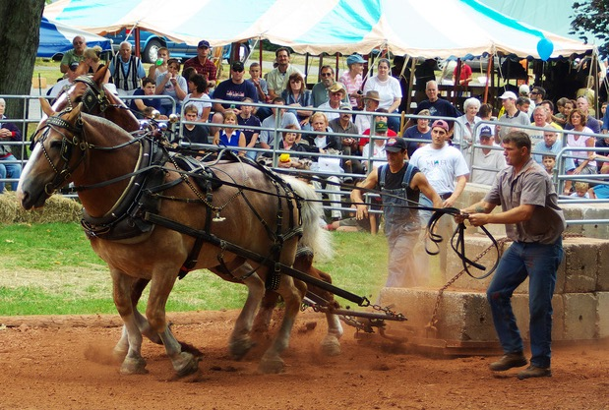
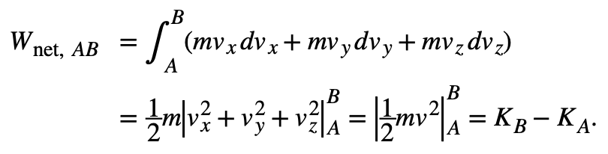
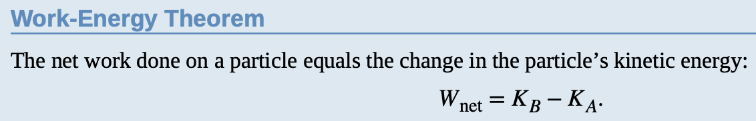
Work-Energy Theorem
Let’s consider the net work done on a particle as it moves over an infinitesimal displacement:
According to Newton’s second law so
Rearrangement gives
This gives us the net work done on the particle:
This important result is called the work-energy theorem
Horse pulls are common events at state fairs. The work done by the horses pulling on the load results in a change in kinetic energy of the load, ultimately going faster. (credit: modification of work by “Jassen”/ Flickr)

Slide 14
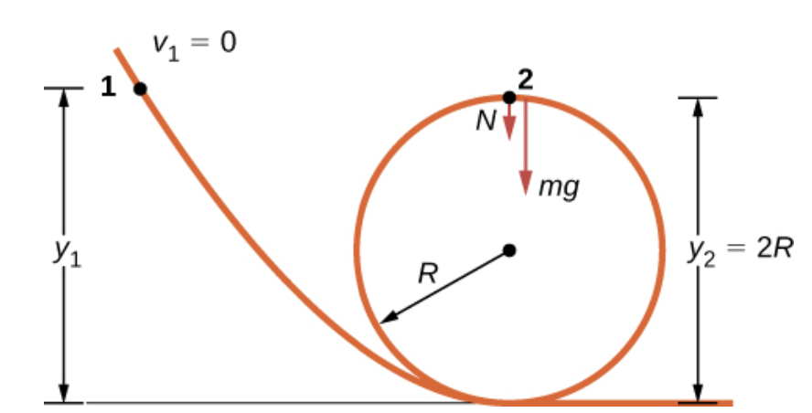


Work-Energy Theorem
Example: Loop-the-Loop
The frictionless track for a toy car includes a loop-the-loop of radius R. How high, measured from the bottom of the loop, must the car be placed to start from rest on the approaching section of track and go all the way around the loop?
From the work-energy theorem, the starting height determines the speed of the car at the top of the loop
Since the weight points in the same direction as the net vertical displacement, the total work done by the gravitational force is positive. At the top of the loop, the normal force and gravity are both down and the acceleration is centripetal, so
The condition for maintaining contact with the track is that there must be some slight normal force, that is, N > 0 . Substituting for v₂ and N, we can find the condition for y₁ .

Slide 15
Work-Energy Theorem
Assignment 5
A constant 10-N horizontal force is applied to a 20-kg cart at rest on a level floor.
If friction is negligible, what is the speed of the cart when it has been pushed 8.0 m?

Slide 16
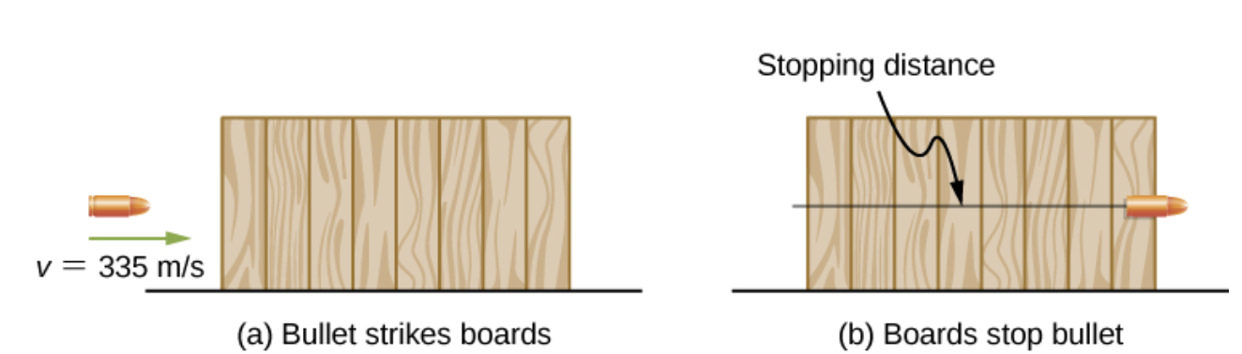
Work-Energy Theorem
Example: Determining a Stopping Force
A bullet from a 0.22LR-caliber cartridge has a mass of 40 grains (2.60 g) and a muzzle velocity of 1100 ft./s (335 m/s). It can penetrate eight 1-inch pine boards, each with thickness 0.75 inches.
What is the average stopping force exerted by the wood, as shown in Figure?
The boards exert a force to stop the bullet. As a result, the boards do work, and the bullet loses kinetic energy.

Slide 17
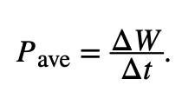
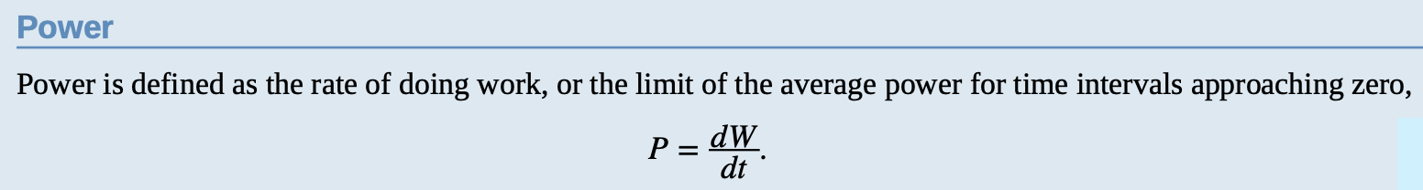

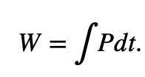
Power
The average power as the work done during a time interval, divided by the interval:
We can also define the instantaneous power (frequently referred to as just plain power).
If the power is constant over a time interval, the average power for that interval equals the instantaneous power, and the work done by the agent supplying the power is W = PΔt
If the power during an interval varies with time, then

Slide 18
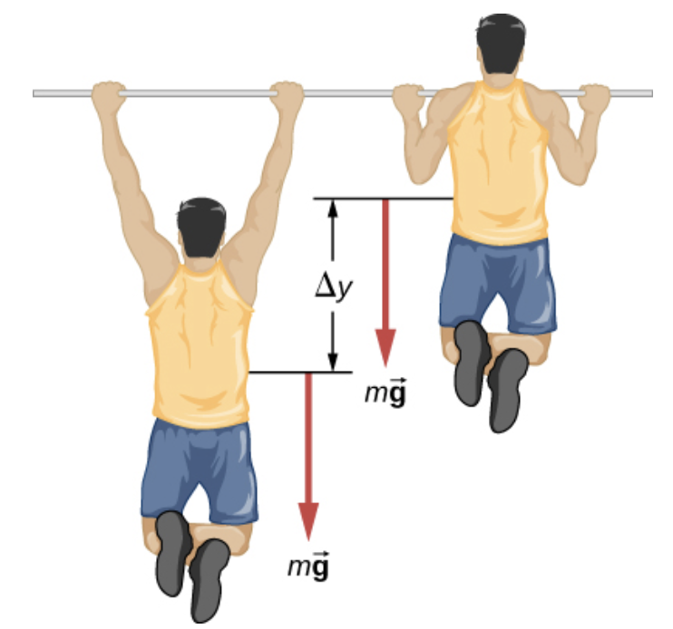
Power
Work and energy are measured in units of joules, so power is measured in units of joules per second, which has been given the SI name watts, abbreviation W:
1 J/s = 1 W
Another common unit for expressing the power capability of everyday devices is
horsepower: 1 hp = 746 W
Example: Pull-Up Power
An 80-kg army trainee does 10 pull-ups in 10 s.
How much average power do the trainee’s muscles supply moving his body? Make reasonable estimates for any quantities needed.

Slide 19
Power
Work and energy are measured in units of joules, so power is measured in units of joules per second, which has been given the SI name watts, abbreviation W:
1 J/s = 1 W
Another common unit for expressing the power capability of everyday devices is
horsepower: 1 hp = 746 W
Assignment 6
Estimate the power expended by a weightlifter raising a 150-kg barbell 2 m in 3 s.

Slide 20
Power
Work and energy are measured in units of joules, so power is measured in units of joules per second, which has been given the SI name watts, abbreviation W:
1 J/s = 1 W
Another common unit for expressing the power capability of everyday devices is
horsepower: 1 hp = 746 W
Assignment 7
What is the cost of operating a 3.00-W electric clock for a year if the cost of electricity is $0.0900 per kW · h ?

Slide 21
Attribution
These slides are a derivative of the “University Physics Vol. 1” slides by OpenStax, used under a Creative Commons Attribution 4.0 license by Mkhitar Hobosyan.

