Slide 1
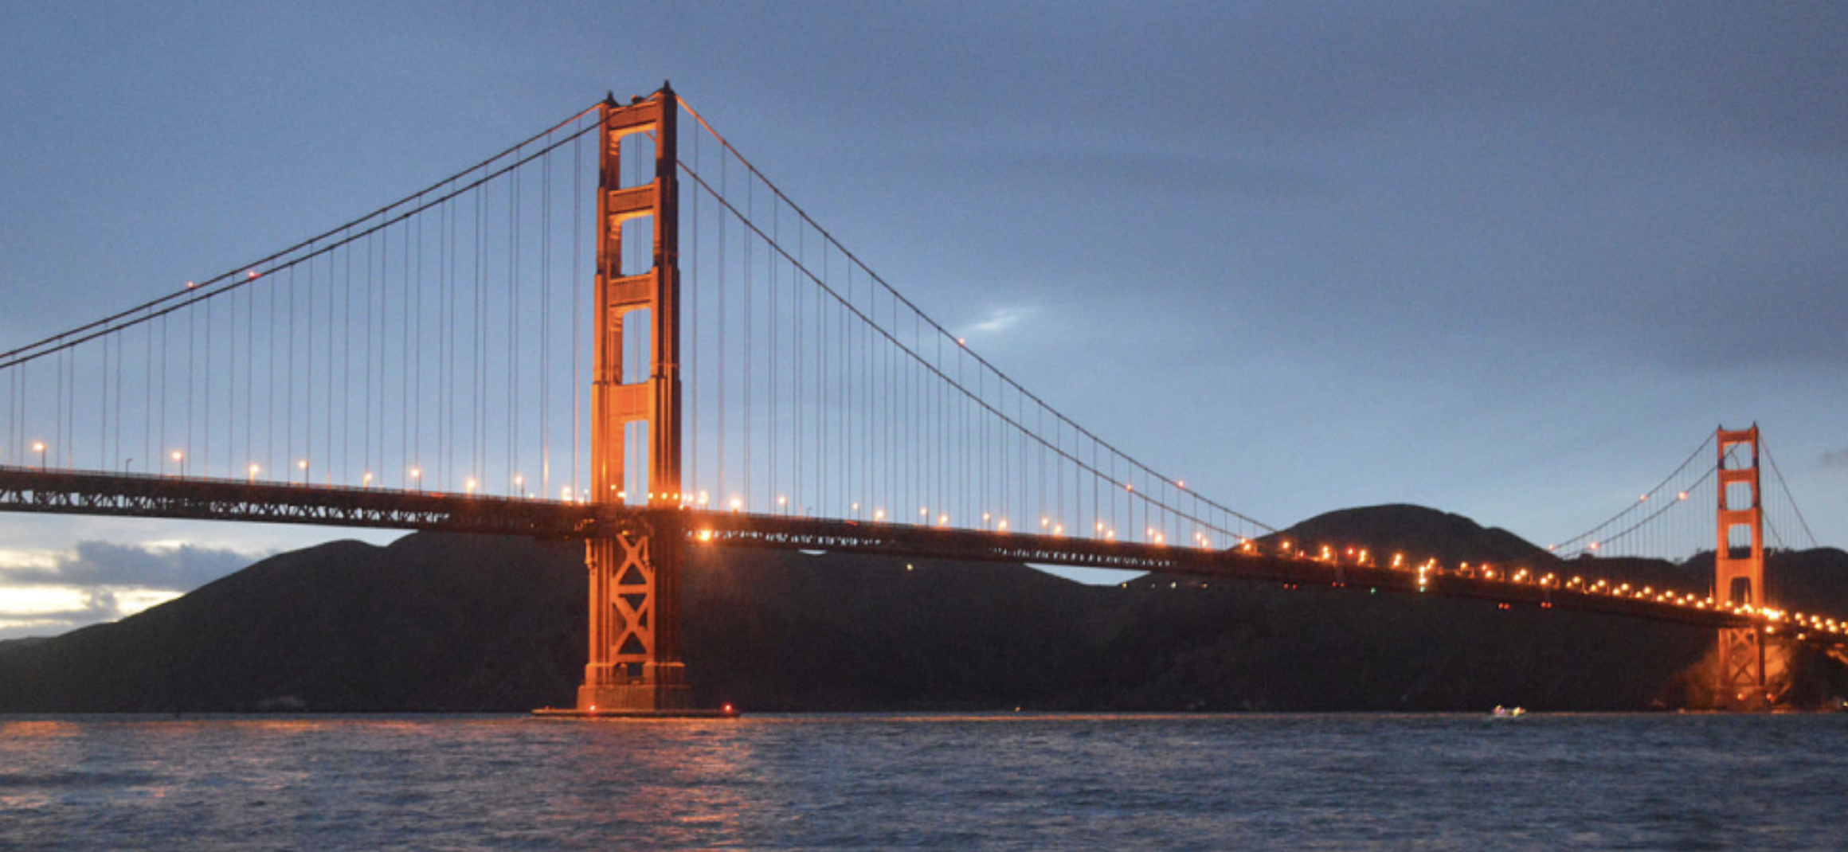

PHYS 2425
Physics for Scientists
and Engineers I
Chapter 5
Newton’s Laws of Motion
Download the textbook for free at https://openstax.org/details/books/university-physics-volume-1

Slide 2

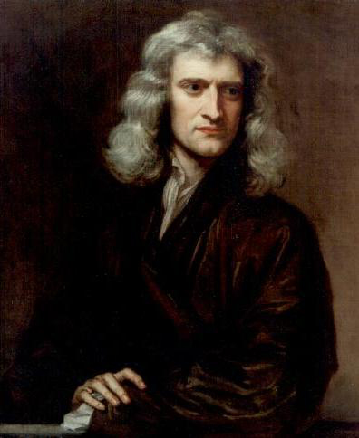
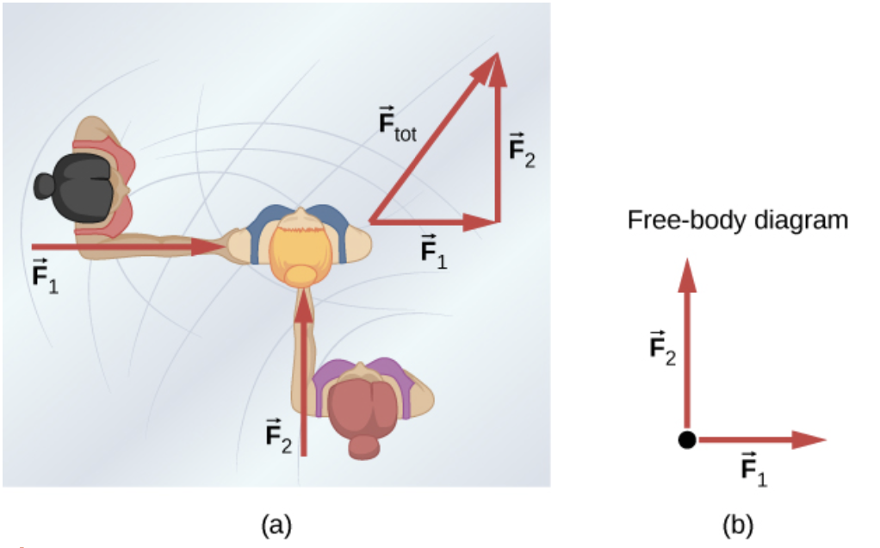
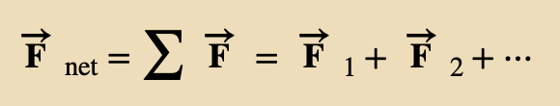
Forces
Kinematics only describes the way objects move—their velocity and their acceleration. Dynamics is the study of how forces affect the motion of objects and systems.
Forces are vectors and should be treated accordingly. Forces can change the velocity of an object. Forces are the push or pull on an object with a specific magnitude and direction.
Free-body diagram is a sketch showing all external forces acting on an object or system.
Isaac Newton (1642–1727) published Philosophiae Naturalis Principia Mathematica, in 1687. It proposed scientific laws that still apply today to describe the motion of objects (the laws of motion).
An overhead view of two ice skaters pushing on a third skater. Forces are vectors and add like other vectors, so the total force on the third skater is in the direction shown.
A free-body diagram representing the forces acting on the third skater.

Slide 3
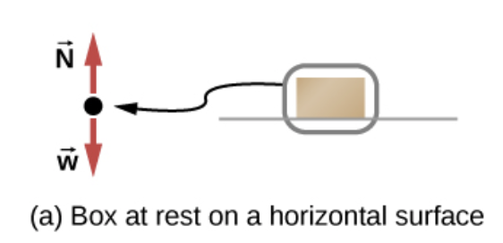
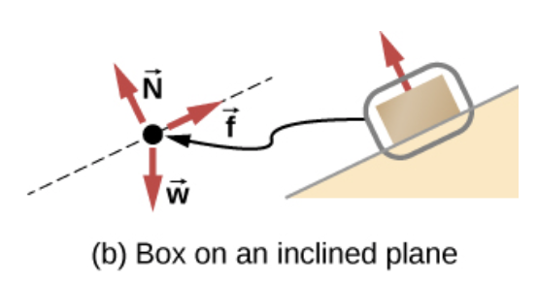
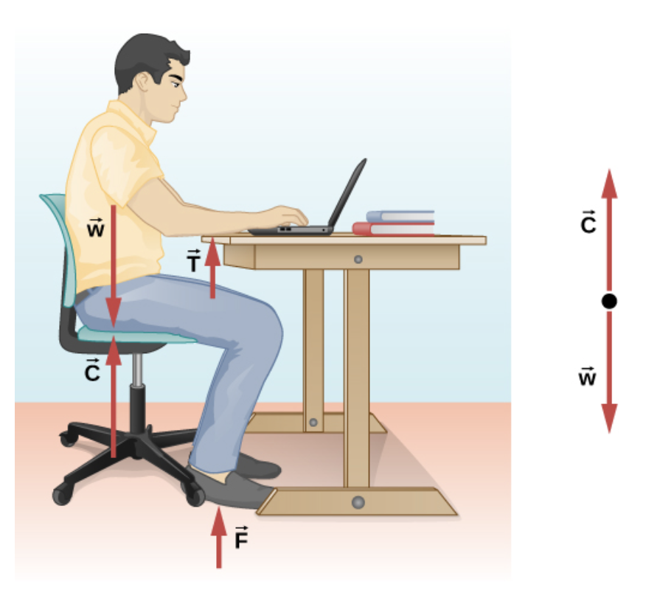
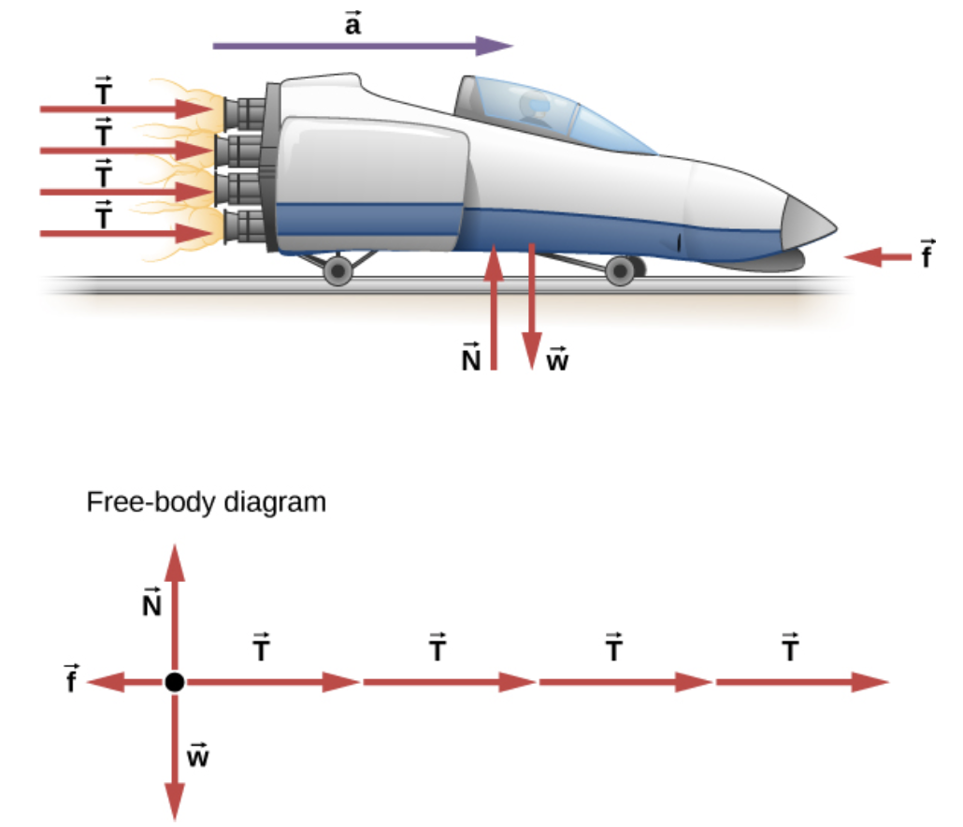
Forces
Other examples of Free-body diagrams.

Slide 4
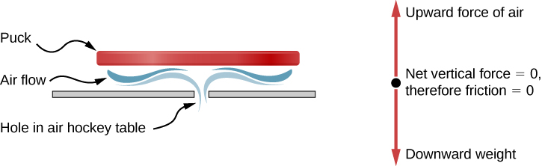
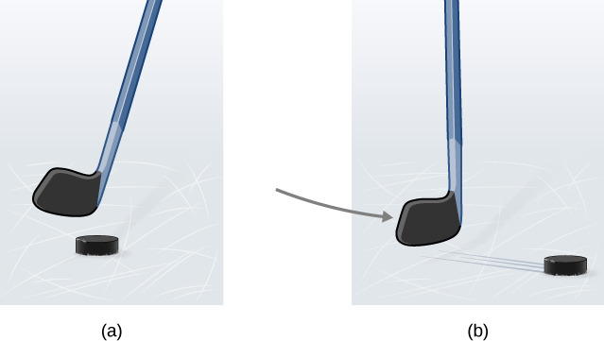
Newton's First Law
A body at rest remains at rest or, if in motion, remains in motion at constant velocity unless acted on by a net external force.
A hockey puck is shown at rest; it remains at rest until an outside force such as a hockey stick changes its state of rest;
a hockey puck is shown in motion; it continues in motion in a straight line until an outside force causes it to change its state of motion. Although it is slick, an ice surface provides some friction that slows the puck.
An air hockey table is useful in illustrating Newton’s laws. When the air is off, friction quickly slows the puck; but when the air is on, it minimizes contact between the puck and the hockey table, and the puck glides far down the table.
If the net force on object is zero, it will have zero acceleration.

Slide 5
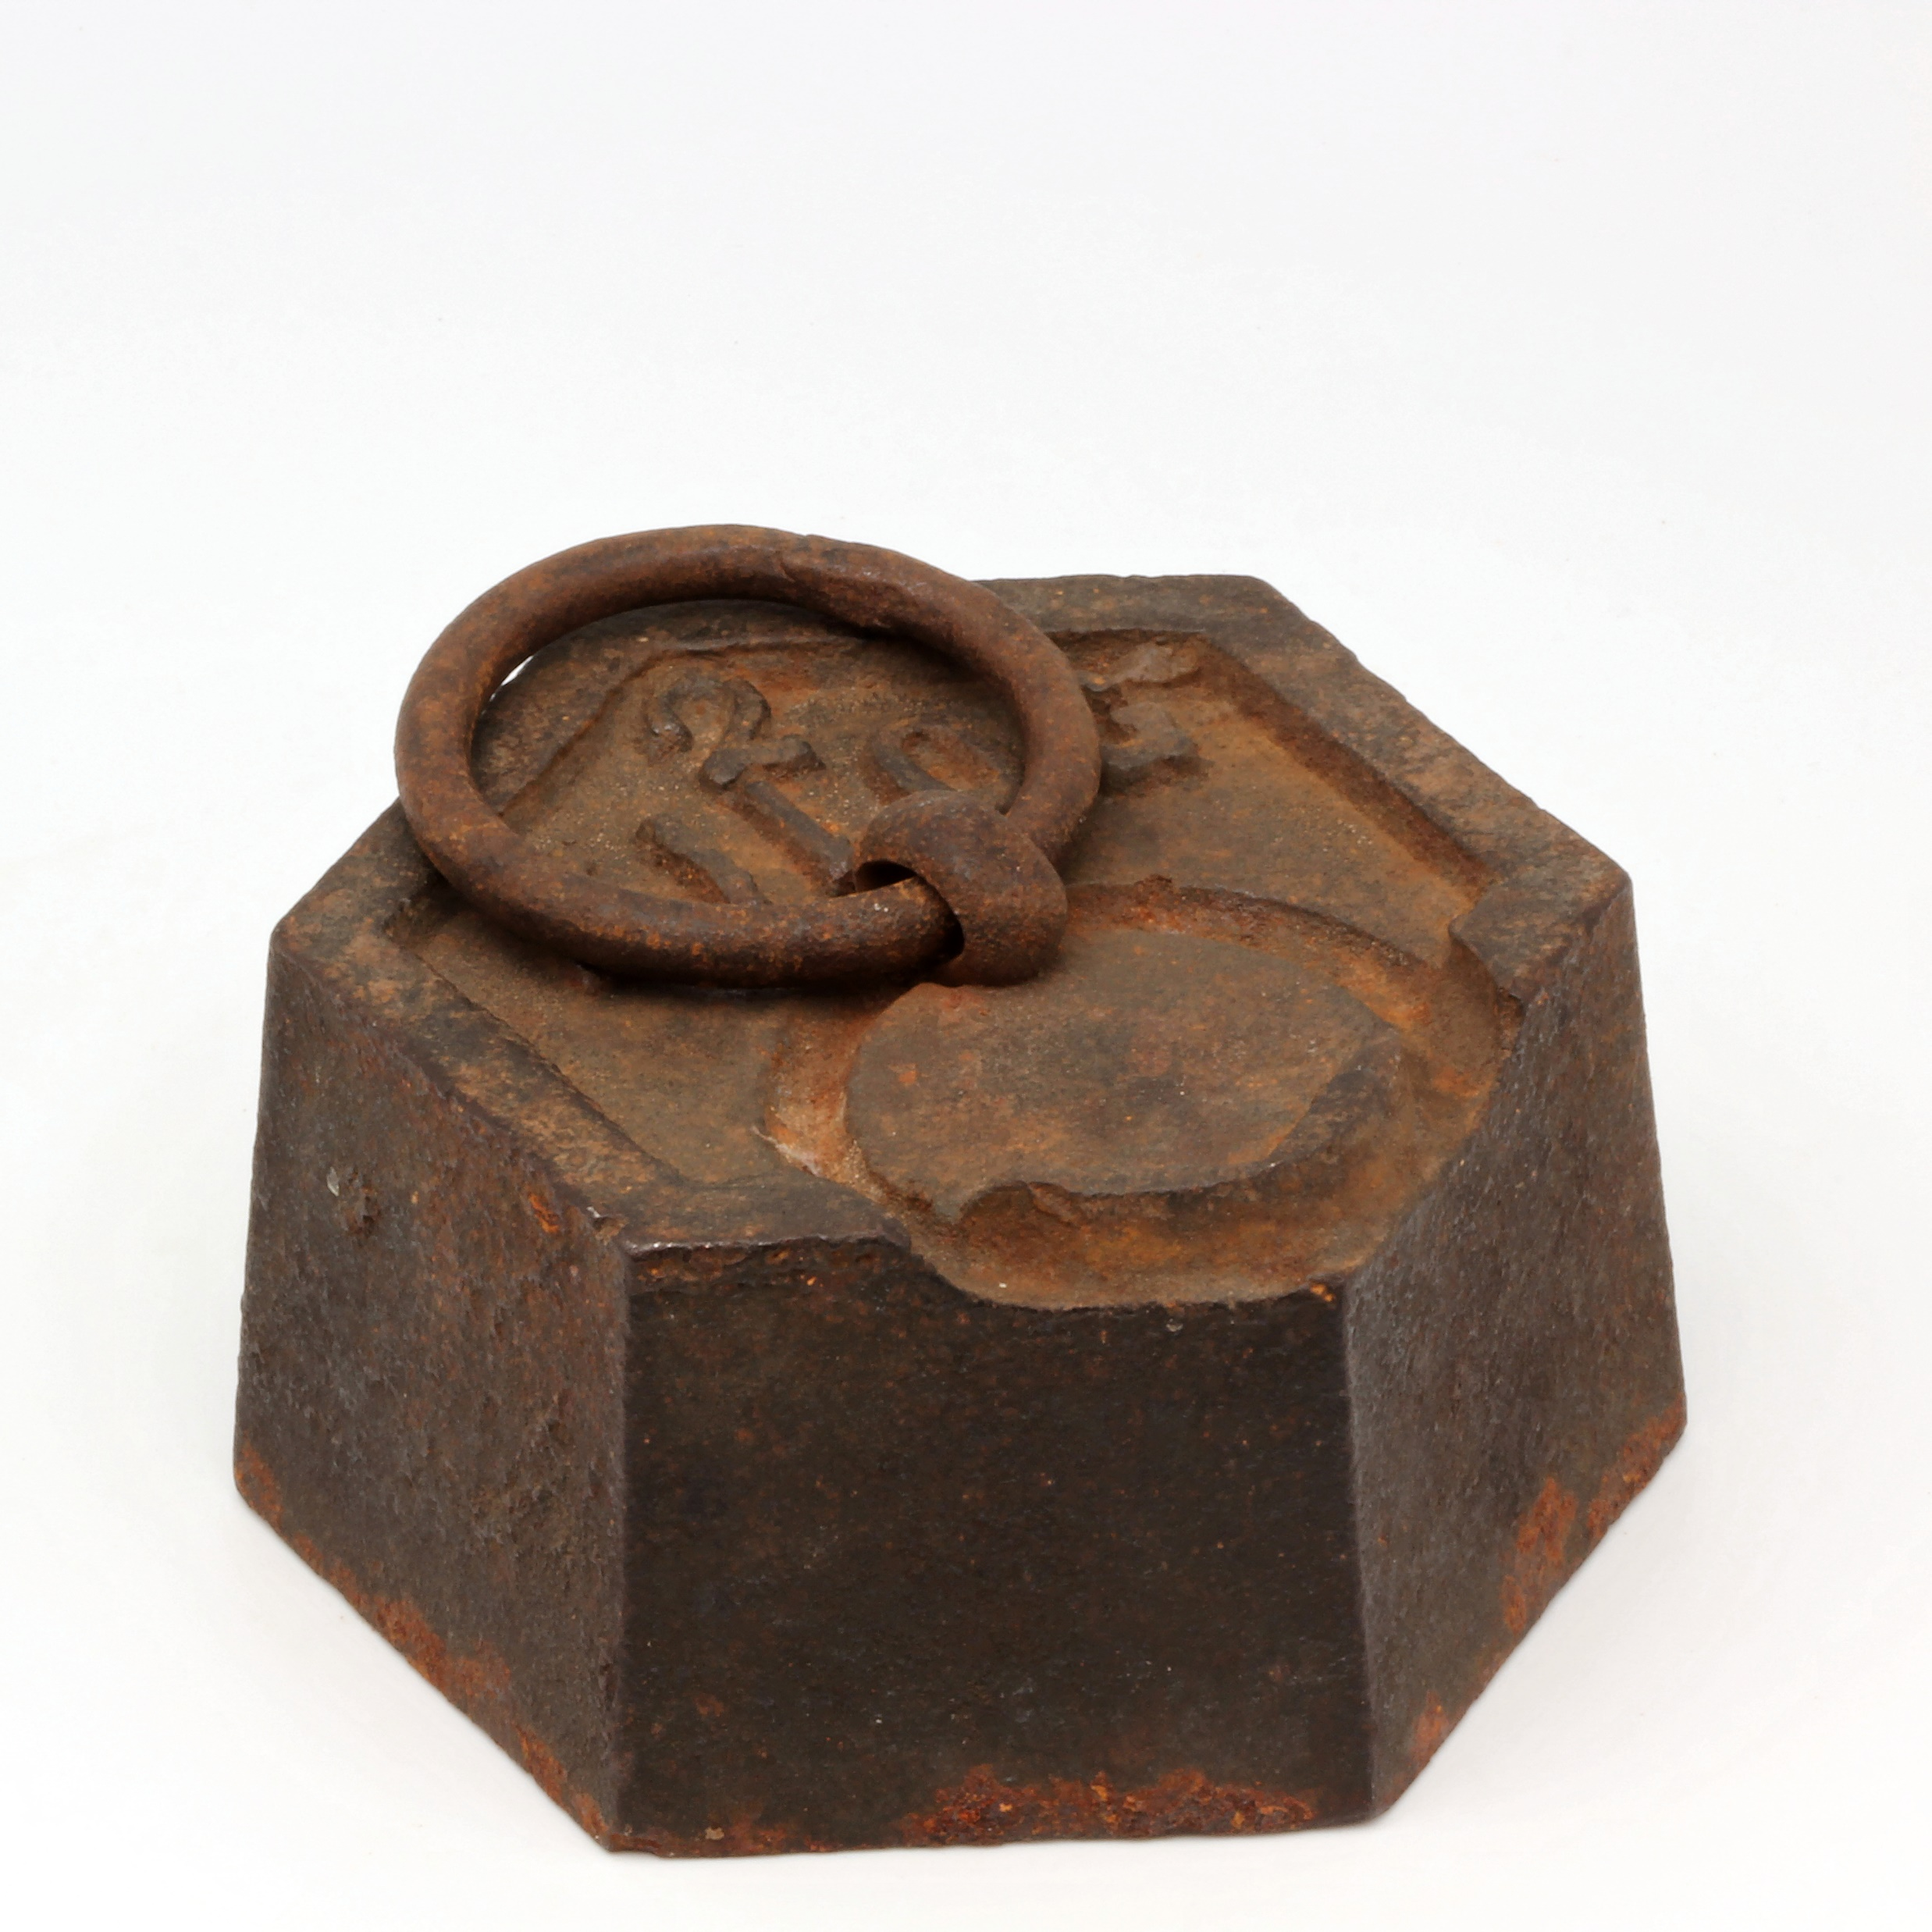

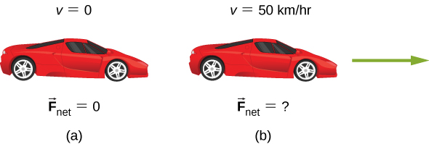
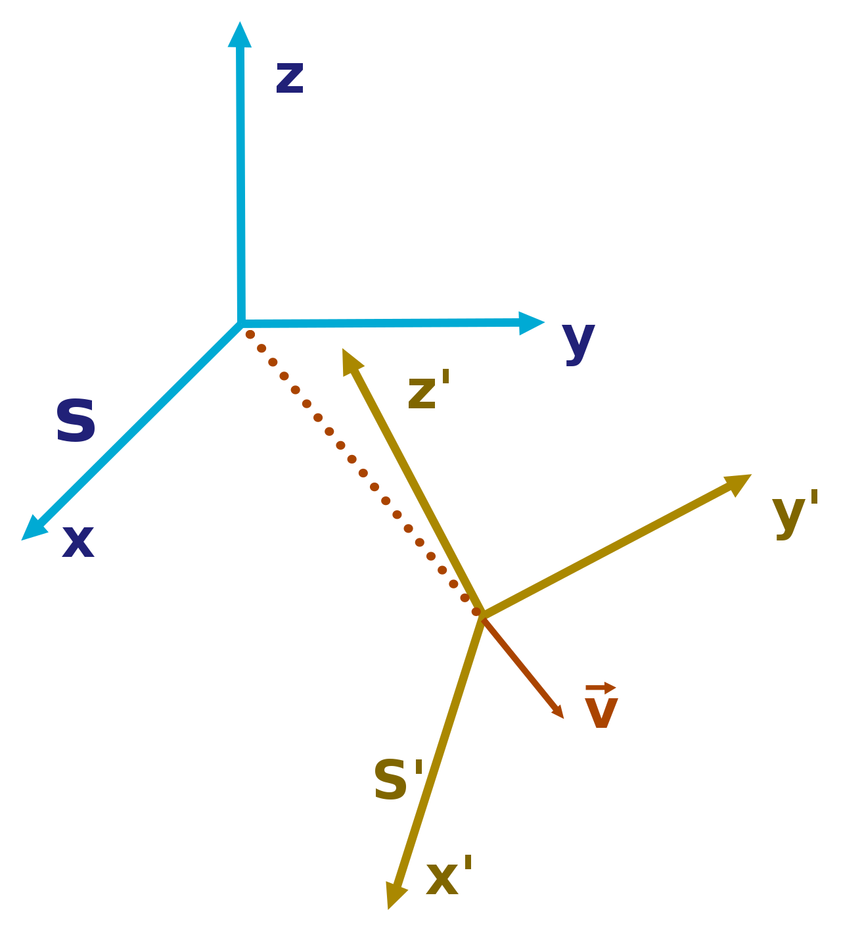
Newton's First Law
Some definitions
Mass is a measure of the amount of matter in something.
Gravitation is the attraction of one mass to another.
Mass is also related to inertia, the ability of an object to resist changes in its motion. Thus, inertia is the tendency of an object to resist any attempt to change its velocity.
Any reference frame that is at rest or that moves with constant velocity is inertial reference frame. A reference frame moving at constant velocity relative to an inertial frame is also inertial. A reference frame accelerating relative to an inertial frame is not inertial. This includes rotating reference frames (centripetal acceleration!).
https://en.wikipedia.org/wiki/Mass
https://en.wikipedia.org/wiki/Gravity
Two inertial reference frames moving with relative velocity v with respect to each other.
all forces on the car must be balanced; the vector sum is 0 N
the net force must also be zero, car moves with constant velocity.
https://en.wikipedia.org/wiki/Inertial_frame_of_reference

Slide 6
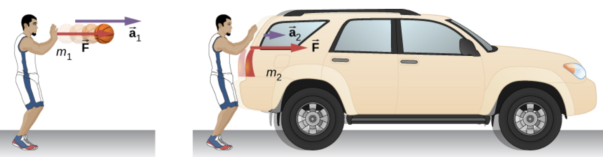
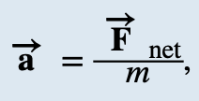


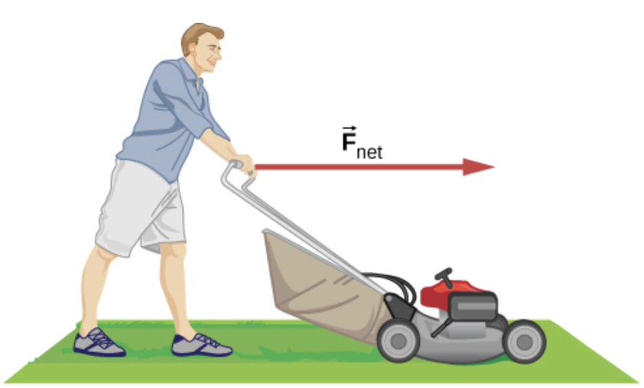


Newton's Second Law
The acceleration of a system is directly proportional to the net external force acting on the system and is inversely proportional to its mass.
Acceleration is in the same direction as the net external force. We can also write
or, if only the magnitude of force and acceleration are considered,
Example
Suppose that the net external force (push minus friction) exerted on a lawn mower is 51 N parallel to the ground. The mass of the mower is 24 kg. What is its acceleration?

Slide 7
Newton's Second Law
The acceleration of a system is directly proportional to the net external force acting on the system and is inversely proportional to its mass.
Acceleration is in the same direction as the net external force. We can also write
or, if only the magnitude of force and acceleration are considered,
Assignment 1
Astronauts in orbit are apparently weightless. This means that a clever method of measuring the mass of astronauts is needed to monitor their mass gains or losses and adjust their diet. One way to do this is to exert a known force on an astronaut and measure the acceleration produced.
Suppose a net external force of 50.0 N is exerted, and an astronaut’s acceleration is measured to be
0.893 m/s². Calculate her mass.

Slide 8




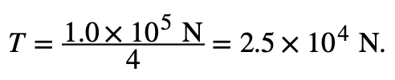
Newton's Second Law
Example
Before manned space flights, rocket sleds were used to test aircraft, missile equipment, and physiological effects on human subjects at high speeds. They consisted of a platform that was mounted on one or two rails and propelled by several rockets.
Calculate the magnitude of force exerted by each rocket, called its thrust T, for the four-rocket propulsion system shown in Figure. The sled’s initial acceleration is 49 m/s² , the mass of the system is 2100 kg, and the force of friction opposing the motion is 650 N.

Slide 9
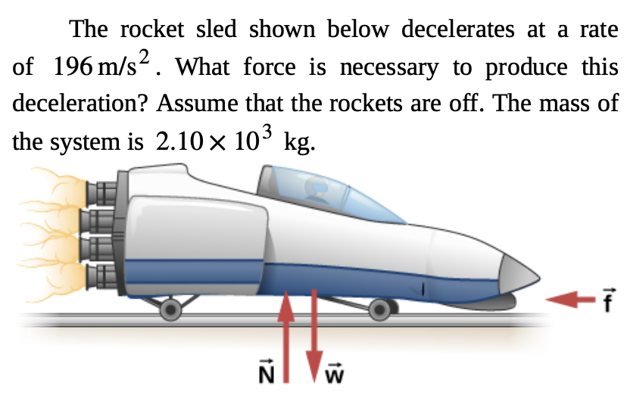
Newton's Second Law
Before manned space flights, rocket sleds were used to test aircraft, missile equipment, and physiological effects on human subjects at high speeds. They consisted of a platform that was mounted on one or two rails and propelled by several rockets.
Assignment 2

Slide 10
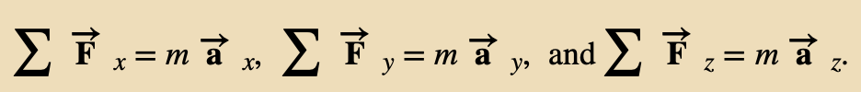
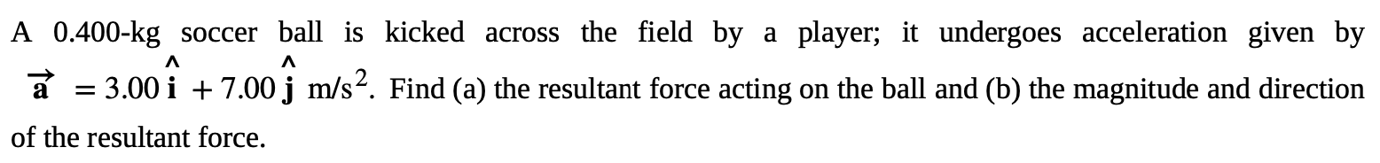
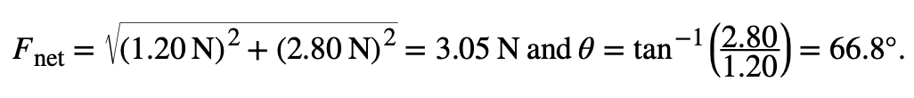
Component Form of Newton’s Second Law
Newton’s second law is as a vector equation and can be written as three component equations:
Example

Slide 11
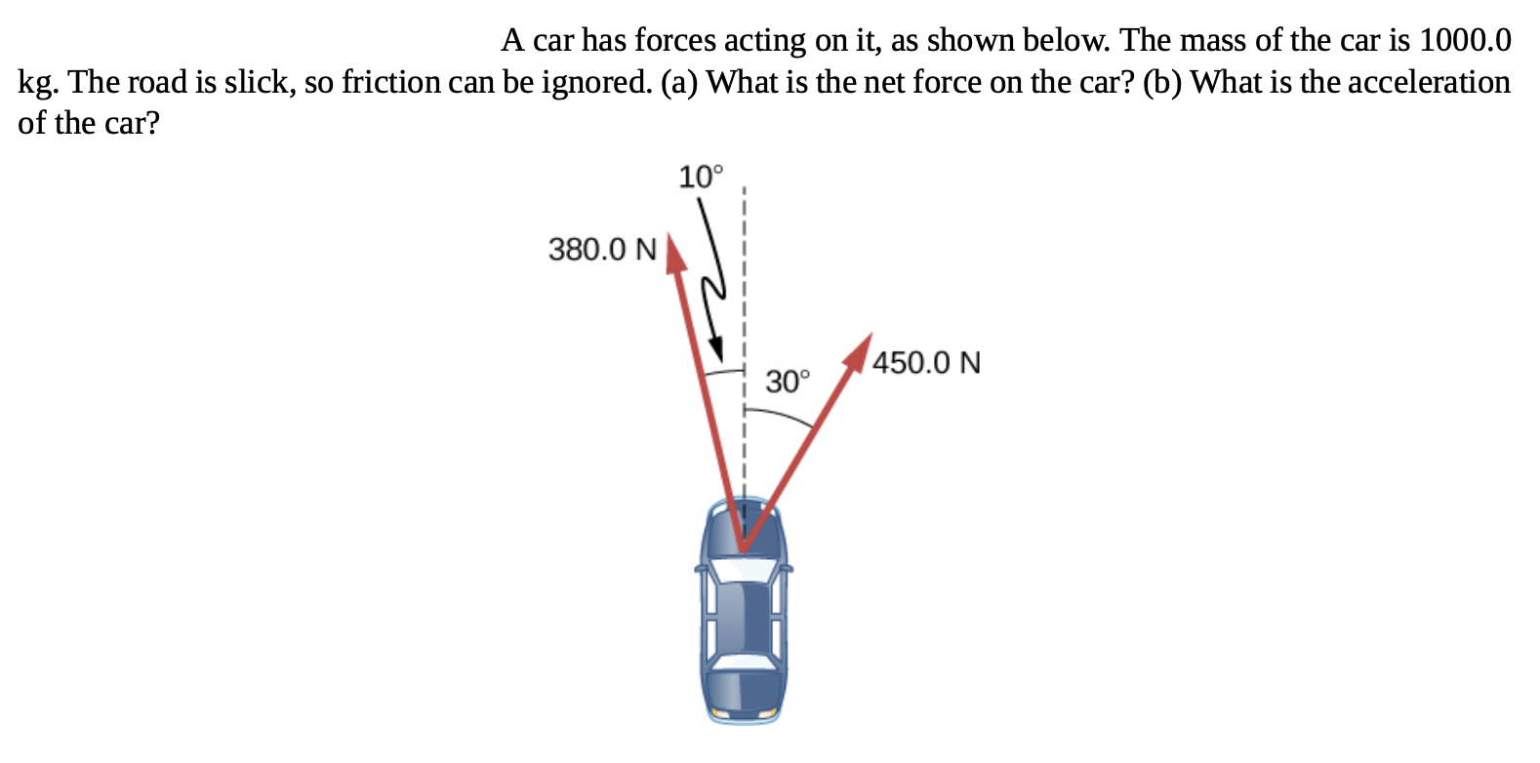
Component Form of Newton’s Second Law
Newton’s second law is as a vector equation and can be written as three component equations:
Example

Slide 12
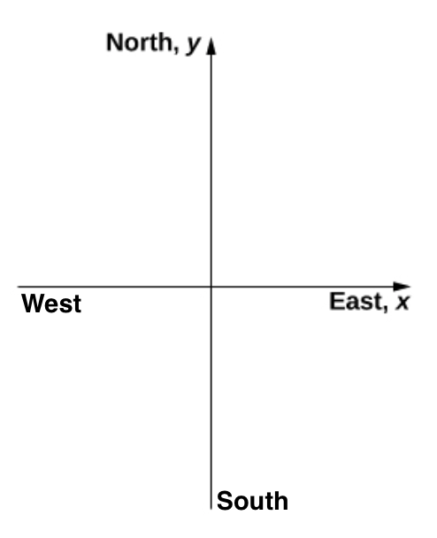
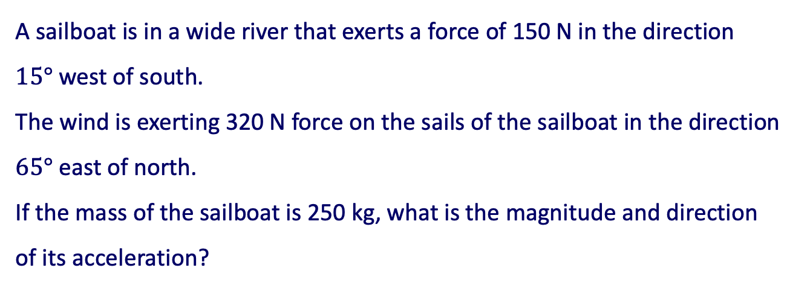
Component Form of Newton’s Second Law
Newton’s second law is as a vector equation and can be written as three component equations:
Assignment 3
A sailboat is in a wide river that exerts a force of 150 N in the direction
$15°$ west of south.
The wind is exerting 320 N force on the sails of the sailboat in the direction $65°$ east of north.
If the mass of the sailboat is 250 kg, what is the magnitude and direction
of its acceleration?

Slide 13
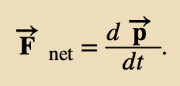

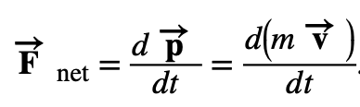
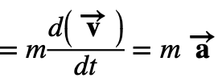
Newton’s Second Law and Momentum
Newton stated his second law in terms of momentum:
“The instantaneous rate at which a body’s momentum changes is equal to the net force acting on the body.”
where the momentum
The substitution gives
Which is the familiar Newton’s Second Law

Slide 14



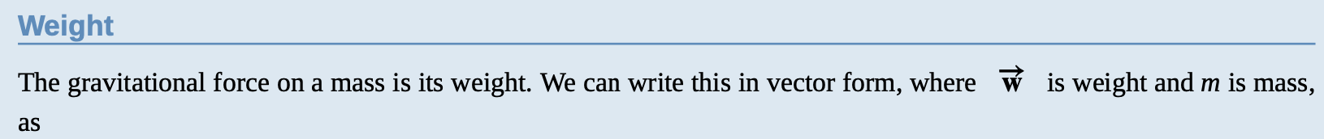
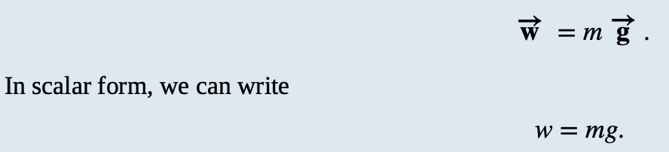

Mass and Weight
The SI unit of force is the newton. Since F_{net} = ma
When an object is dropped, it accelerates toward the center of Earth due to gravitational force, which we call weight.
  F_{g} = w = m g is a special case of Newton’s Second Law
    g is the acceleration due to gravity
Weight can be denoted as a vector because it has a direction; down is, by definition, the direction of gravity, and hence, weight is a downward force.
Since g = 9.80 m/s² on Earth, the weight of a 1.00-kg object on Earth is 9.80 N:
Note: Weight is not an inherent property of an object. Mass is an inherent property. Weight depends upon location.

Slide 15
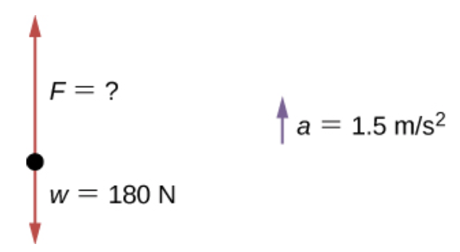
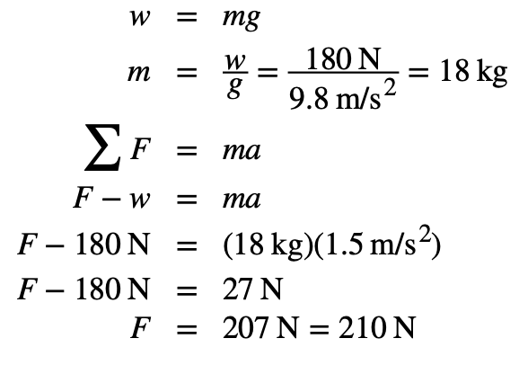
Mass and Weight
Example
A farmer is lifting some moderately heavy rocks from a field to plant crops. He lifts a stone that weighs 40.0 lb. (about 180 N). What force does he apply if the stone accelerates at a rate of 1.5 m/s² ?
(two significant figures)

Slide 16
Mass and Weight
Example
A farmer is lifting some moderately heavy rocks from a field to plant crops. He lifts a stone that weighs 40.0 lb. (about 180 N). What force does he apply if the stone accelerates at a rate of 1.5 m/s² ?
(two significant figures)
Assignment 4
Find the acceleration when the farmer’s applied force is 230.0 N.

Slide 17
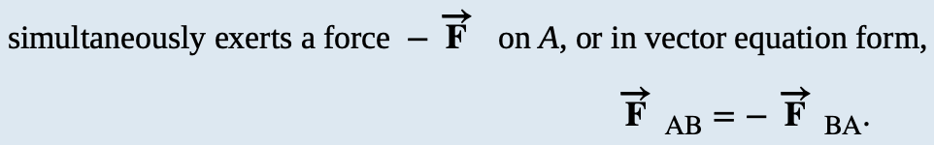
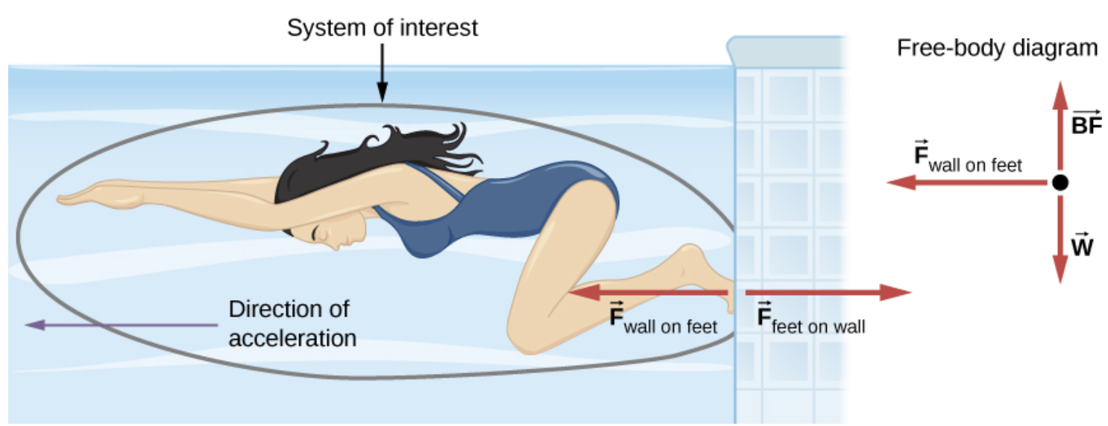
Newton’s Third Law
Whenever one body exerts a force on a second body, the first body experiences a force that is equal in magnitude and opposite in direction to the force that it exerts.
When the swimmer exerts a force on the wall, she accelerates in the opposite direction; in other words, the net external force on her is in the direction opposite of F_{feet on wall}.

Slide 18
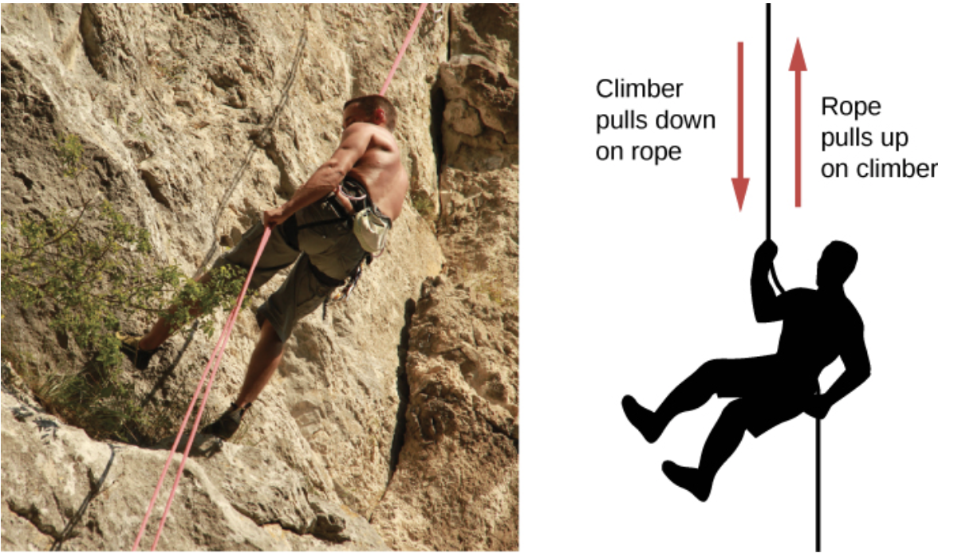
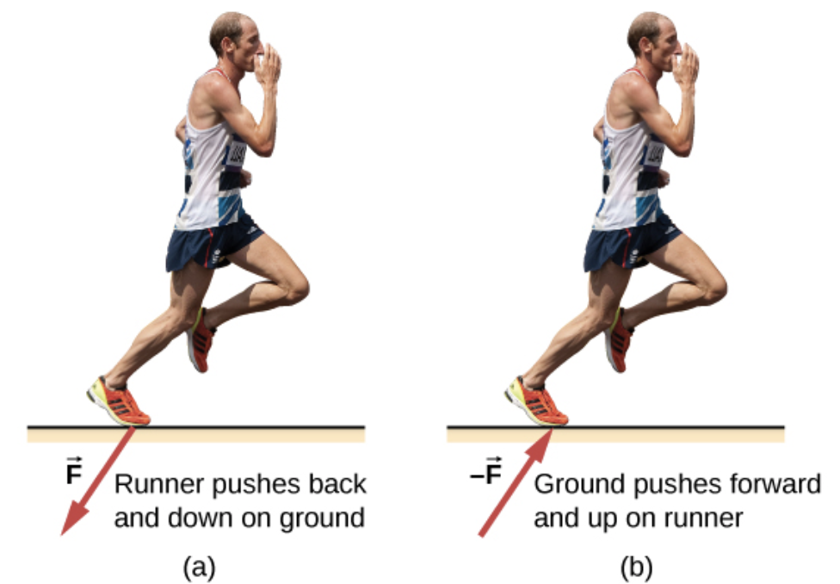
Newton’s Third Law
Whenever one body exerts a force on a second body, the first body experiences a force that is equal in magnitude and opposite in direction to the force that it exerts.
credit left: modification of work by Cristian Bortes
credit "runner": modification of work by "Greenwich Photography"/Flickr

Slide 19
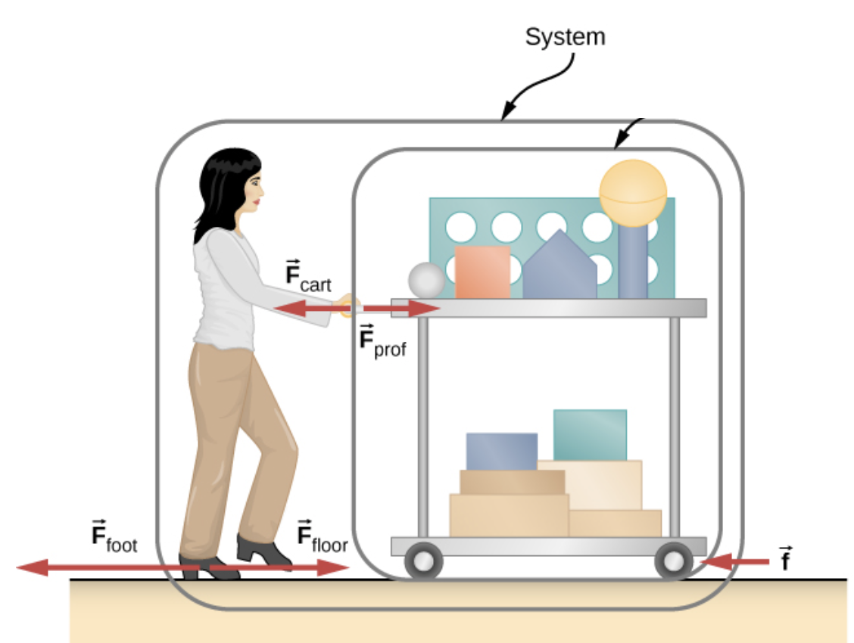
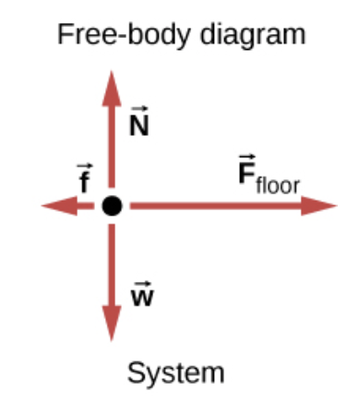



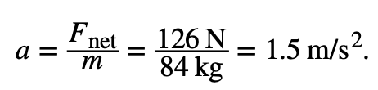
Newton’s Third Law
A physics professor pushes a cart of demonstration equipment to a lecture hall. Her mass is 65.0 kg, the cart’s mass is 12.0 kg, and the equipment’s mass is 7.0 kg. Calculate the acceleration produced when the professor exerts a backward force of 150 N on the floor. All forces opposing the motion, such as friction on the cart’s wheels and air resistance, total 24.0 N.

Slide 20
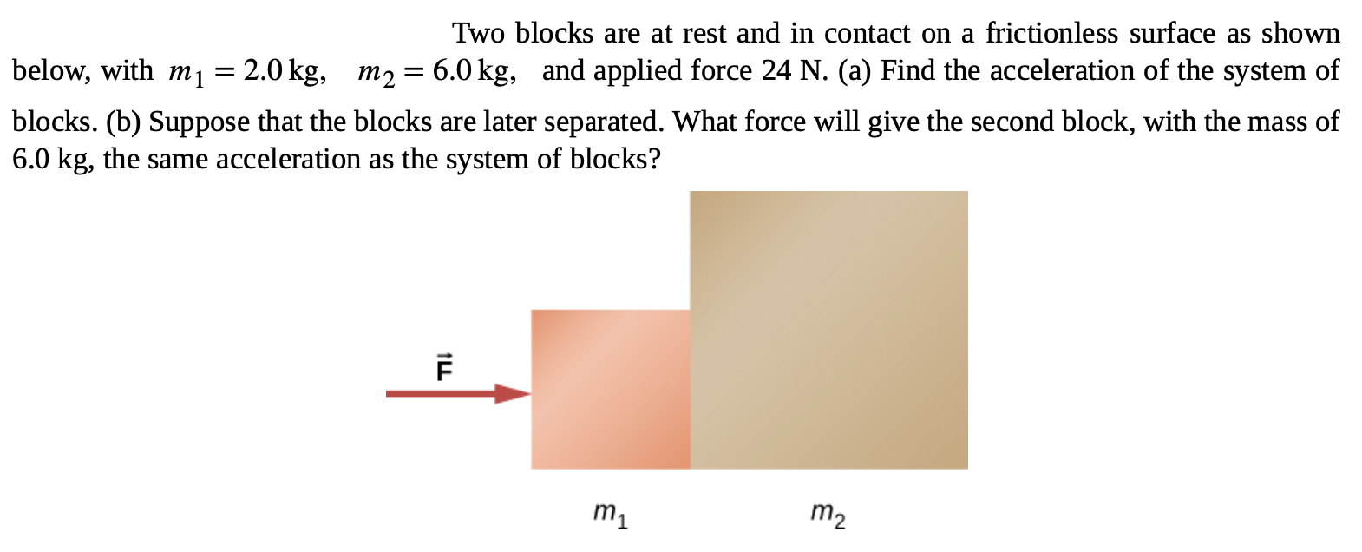
Newton’s Third Law
Assignment 5
Draw the force diagram

Slide 21
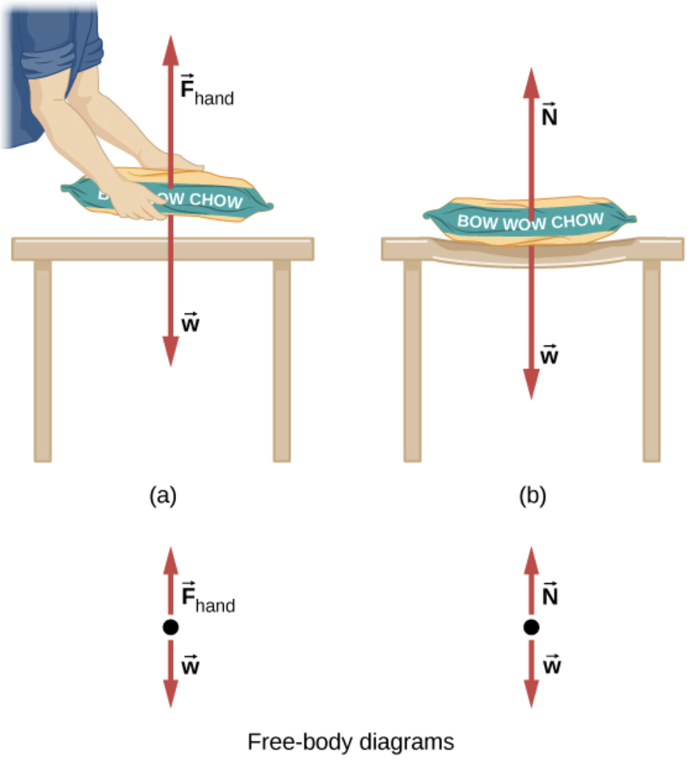


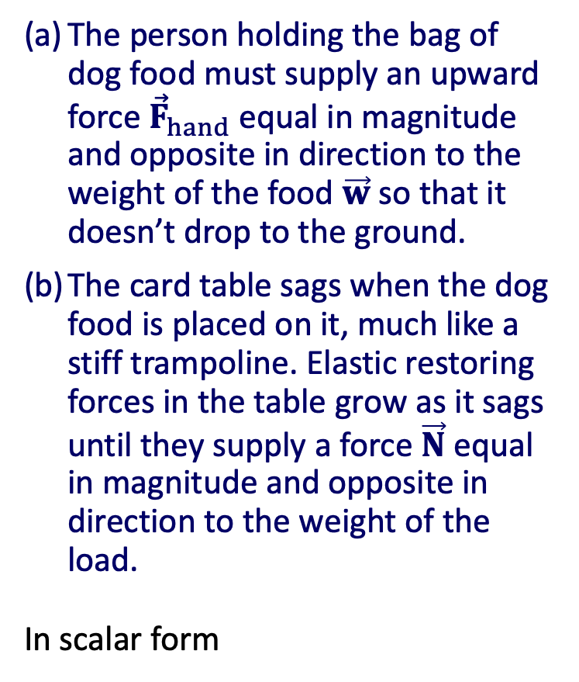
Common Forces
Normal force
The person holding the bag of dog food must supply an upward force ${\vec{F}}_{hand}$equal in magnitude and opposite in direction to the weight of the food $\vec{w}$ so that it doesn’t drop to the ground.
The card table sags when the dog food is placed on it, much like a stiff trampoline. Elastic restoring forces in the table grow as it sags until they supply a force $\vec{N}$equal in magnitude and opposite in direction to the weight of the load.
In scalar form

Slide 22
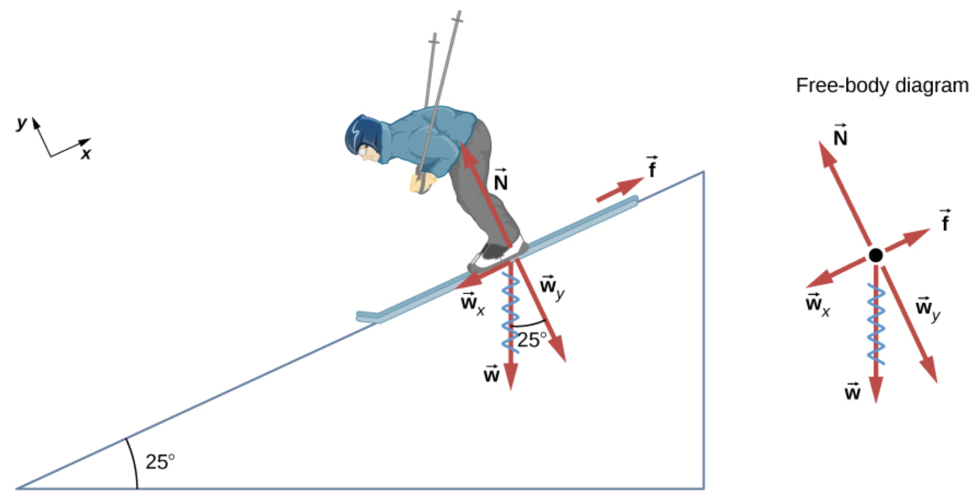
Common Forces
if the surface is horizontal. The normal force can be less than the object’s weight if the object is on an incline.
Example
Consider the skier on the slope in Figure. Her mass including equipment is 60.0 kg. (a) What is her acceleration if friction is negligible? (b) What is her acceleration if friction is 45.0 N?
The force $\vec{N}$is equal in magnitude to w_{y}, so there is no acceleration perpendicular to the slope. f is less than w_{x}, so there is a downslope acceleration (along the axis parallel to the slope).

Slide 23






Common Forces
if the surface is horizontal. The normal force can be less than the object’s weight if the object is on an incline.
Example
Consider the skier on the slope in Figure. Her mass including equipment is 60.0 kg. (a) What is her acceleration if friction is negligible? (b) What is her acceleration if friction is 45.0 N?
+x
(a) What is her acceleration if friction is negligible?
=

Slide 24


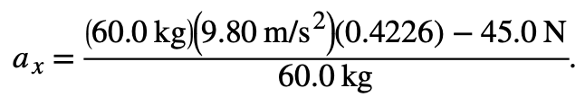

Common Forces
if the surface is horizontal. The normal force can be less than the object’s weight if the object is on an incline.
Example
Consider the skier on the slope in Figure. Her mass including equipment is 60.0 kg. (a) What is her acceleration if friction is negligible? (b) What is her acceleration if friction is 45.0 N?
+x
It is a general result that if friction on an incline is negligible, then the acceleration down the incline is a = g sin θ , regardless of mass.
(b) What is her acceleration if friction is 45.0 N?

Slide 25
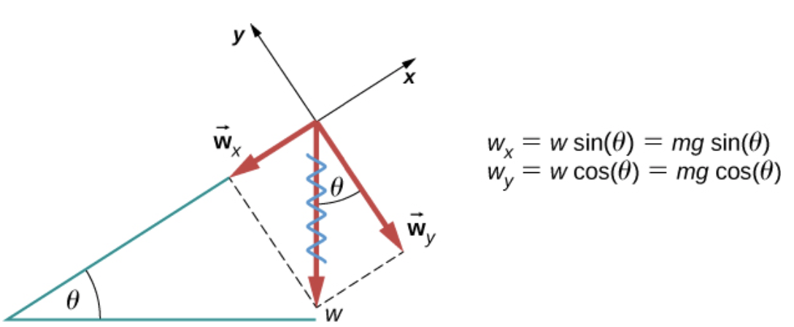
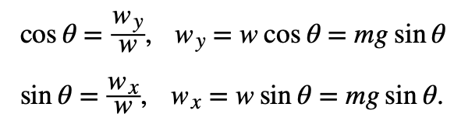


Common Forces
When an object rests on an incline that makes an angle θ with the horizontal, the force of gravity acting on the object is divided into two components.
These equations are easy to derive
The normal force is typically equal in magnitude and opposite in direction to the perpendicular component of the weight w_{y} .
The force acting parallel to the plane, w_{x} , causes the object to accelerate down the incline.

Slide 26
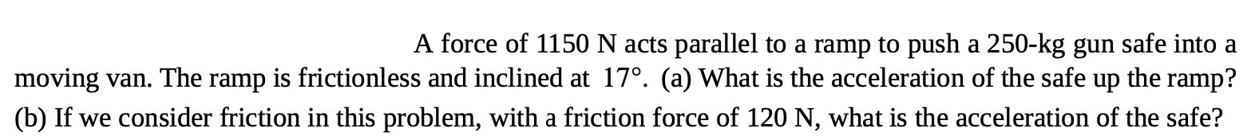
Common Forces
When an object rests on an incline that makes an angle θ with the horizontal, the force of gravity acting on the object is divided into two components.
These equations are easy to derive
Assignment 6

Slide 27
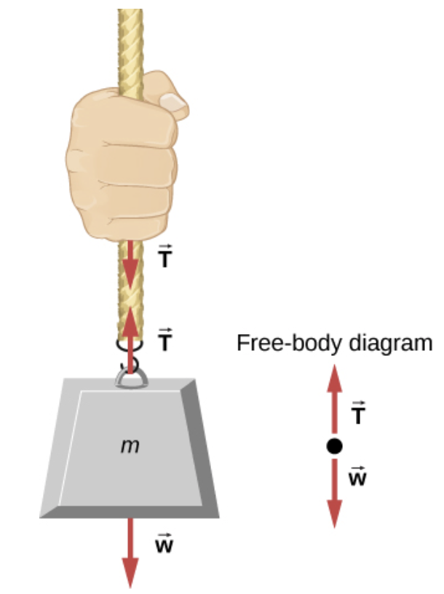
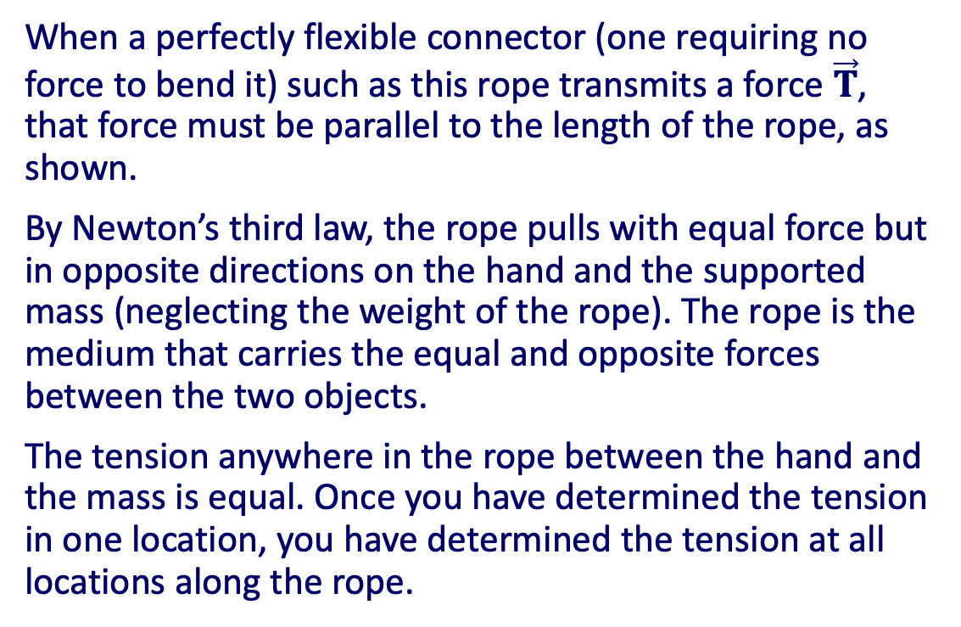
Common Forces
Tension
When a perfectly flexible connector (one requiring no force to bend it) such as this rope transmits a force $\vec{T}$, that force must be parallel to the length of the rope, as shown.
By Newton’s third law, the rope pulls with equal force but in opposite directions on the hand and the supported mass (neglecting the weight of the rope). The rope is the medium that carries the equal and opposite forces between the two objects.
The tension anywhere in the rope between the hand and the mass is equal. Once you have determined the tension in one location, you have determined the tension at all locations along the rope.

Slide 28
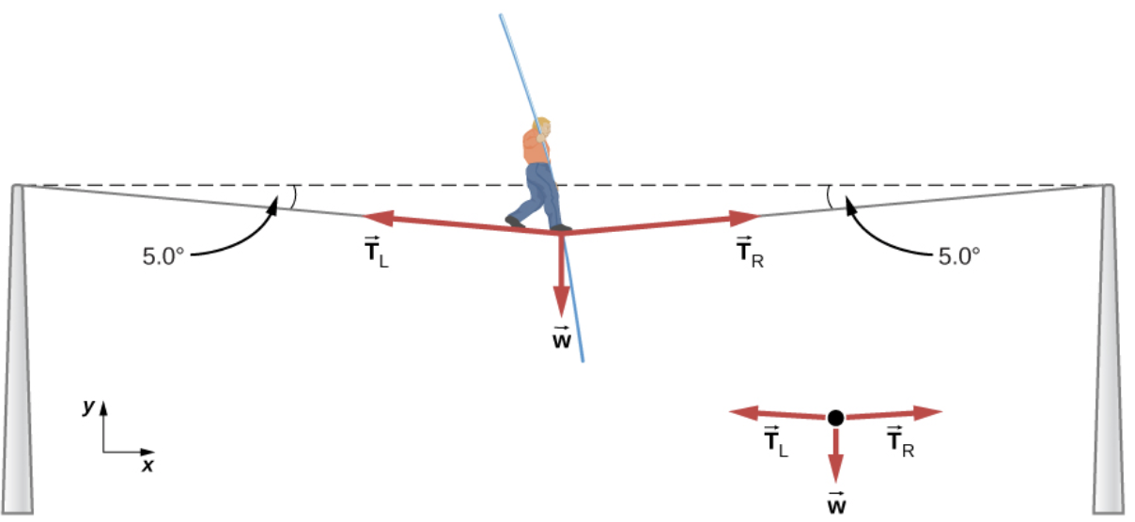
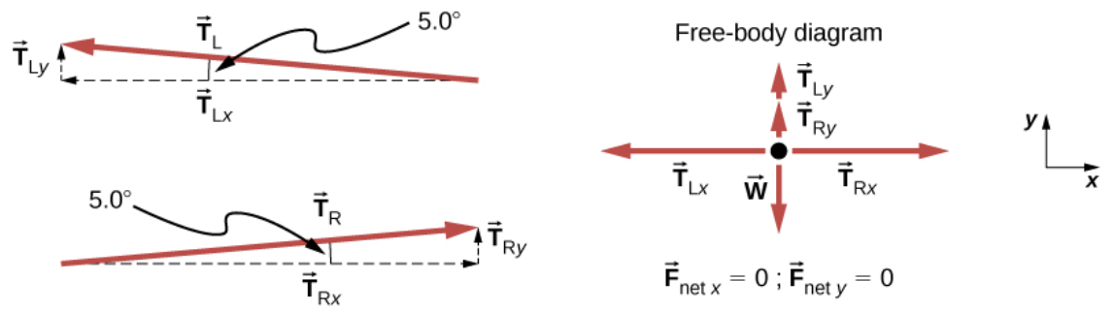
Common Forces
Example
Calculate the tension in the wire supporting the 70.0-kg tightrope walker shown in Figure.
The weight of a tightrope walker causes a wire to sag by 5.0°. The system of interest is the point in the wire at which the tightrope walker is standing.
When the vectors are projected onto vertical and horizontal axes, their components along these axes must add to zero, since the tightrope walker is stationary. The small angle results in T being much greater than w.

Slide 29


Common Forces
We can create a large tension in the chain—and potentially a big mess—by pushing on it perpendicular to its length, as shown.
Assignment 7

Slide 30



Common Forces
Friction
Friction is a resistive force opposing motion or its tendency. Friction is discussed in greater detail in the next chapter.
Spring force
When a spring is deformed – stretched or compressed, it has the ability to restore its shape.
To restore its shape, a spring exerts a restoring force that is proportional to and in the opposite direction in which it is stretched or compressed. This is the statement of a law known as Hooke’s law, which has the mathematical form
A spring exerts its force proportional to a displacement, whether it is compressed or stretched.
The spring is in a relaxed position and exerts no force on the block.
The spring is compressed by displacement $∆{\vec{x}}_{1}$ of the object and exerts restoring force $−k∆{\vec{x}}_{1}$.
The spring is stretched by displacement $∆{\vec{x}}_{2}$ of the object and exerts restoring force $−k∆{\vec{x}}_{2}$.

Slide 31
Attribution
These slides are a derivative of the “University Physics Vol. 1” slides by OpenStax, used under a Creative Commons Attribution 4.0 license by Mkhitar Hobosyan.

