Slide 1
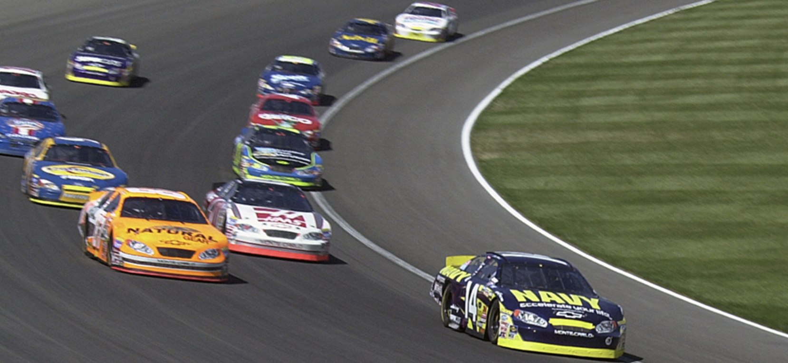

PHYS 2425
Physics for Scientists
and Engineers I
Chapter 6
Applications of Newton’s Laws
Download the textbook for free at https://openstax.org/details/books/university-physics-volume-1
Image credit: modification of work by Erik Schneider/U.S. Navy

Slide 2

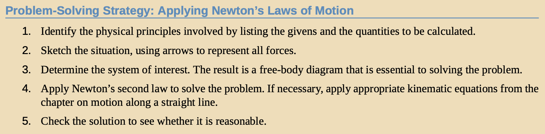
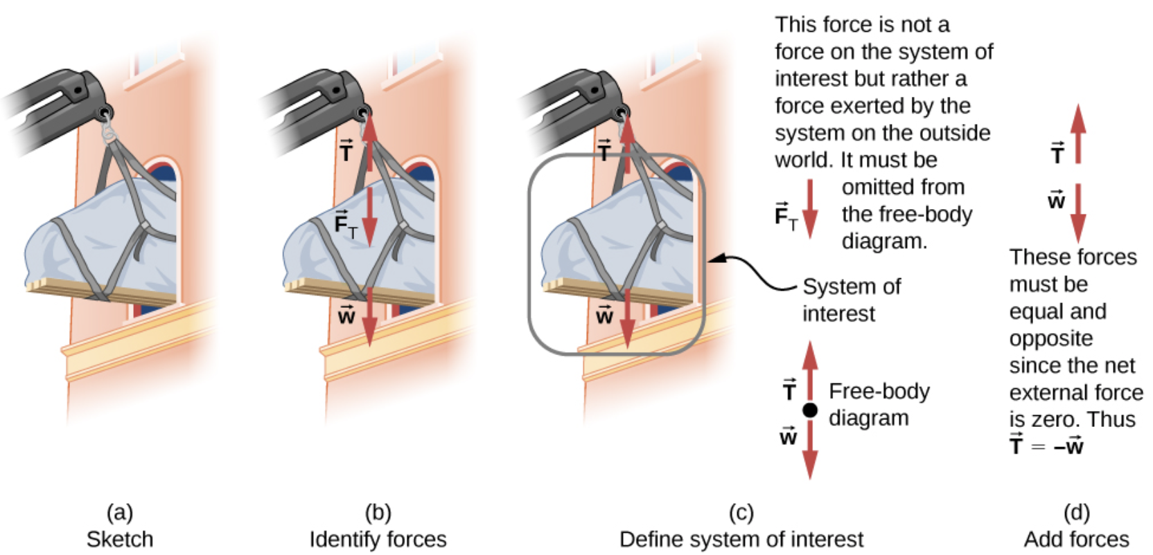
Solving Problems with Newton’s Laws
A grand piano is being lifted to a second-story apartment. Arrows are used to represent all forces. All other forces, such as the nudge of a breeze, are assumed to be negligible.

Slide 3
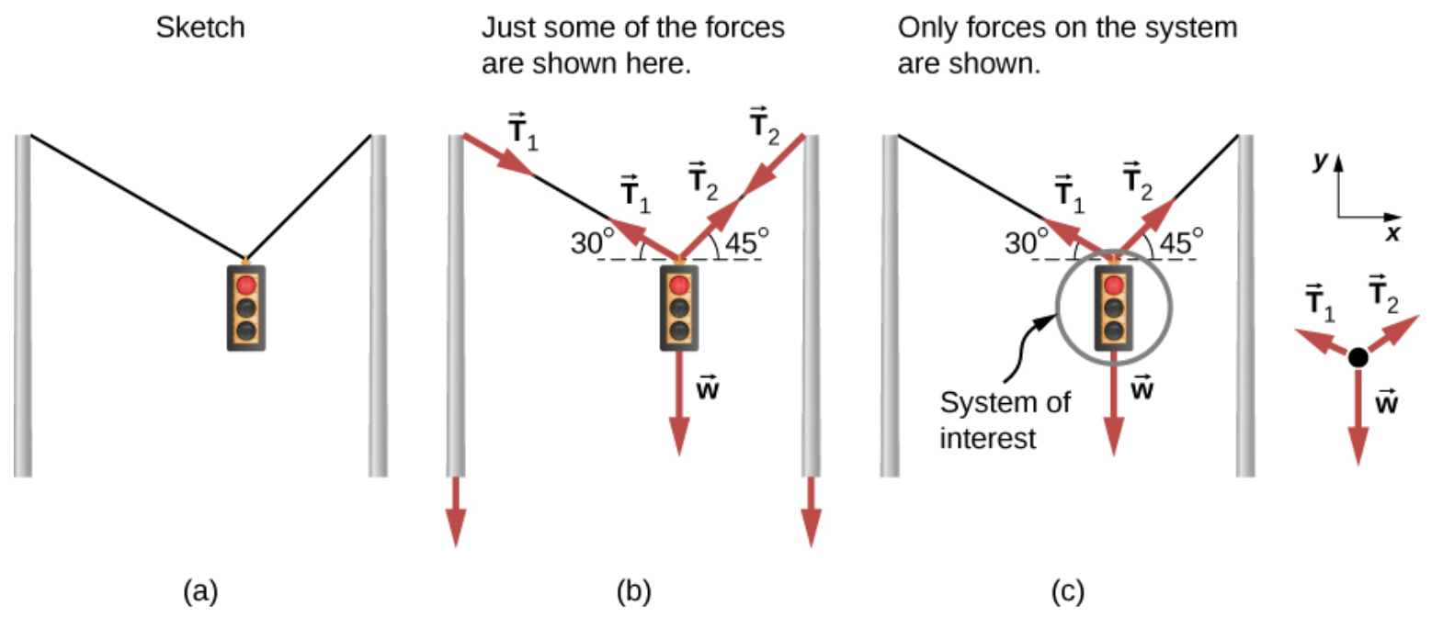
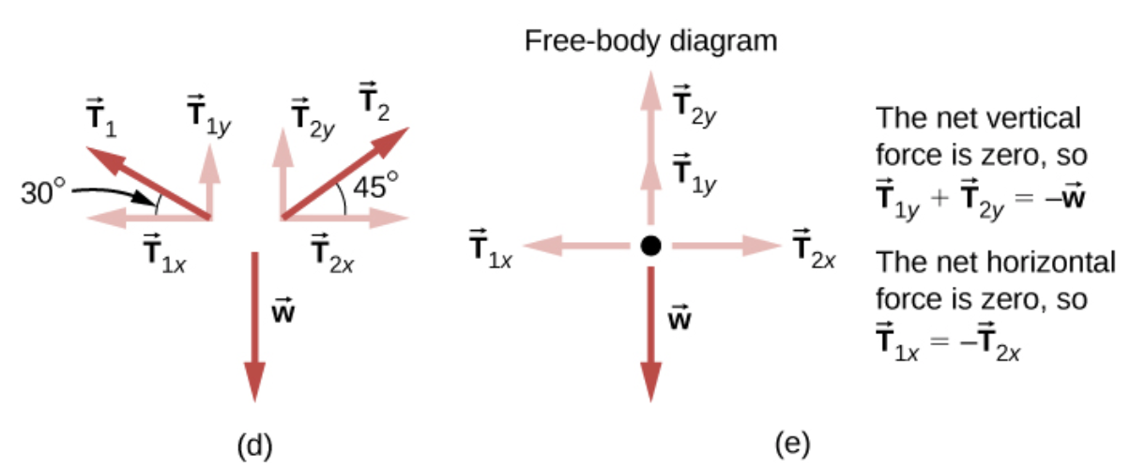
Solving Problems with Newton’s Laws
Particle Equilibrium
A particle in equilibrium is one for which the external forces are balanced.
Example
Consider the traffic light (mass of 15.0 kg) suspended from two wires as shown in Figure 6.3. Find the tension in each wire, neglecting the masses of the wires.
A traffic light is suspended from two wires. (b) Some of the forces involved. (c) Only forces acting on the system are shown here. The free-body diagram for the traffic light is also shown. (d) The forces projected onto vertical (y) and horizontal (x) axes. The horizontal components of the tensions must cancel, and the sum of the vertical components of the tensions must equal the weight of the traffic light. (e) The free-body diagram shows the vertical and horizontal forces acting on the traffic light.

Slide 4
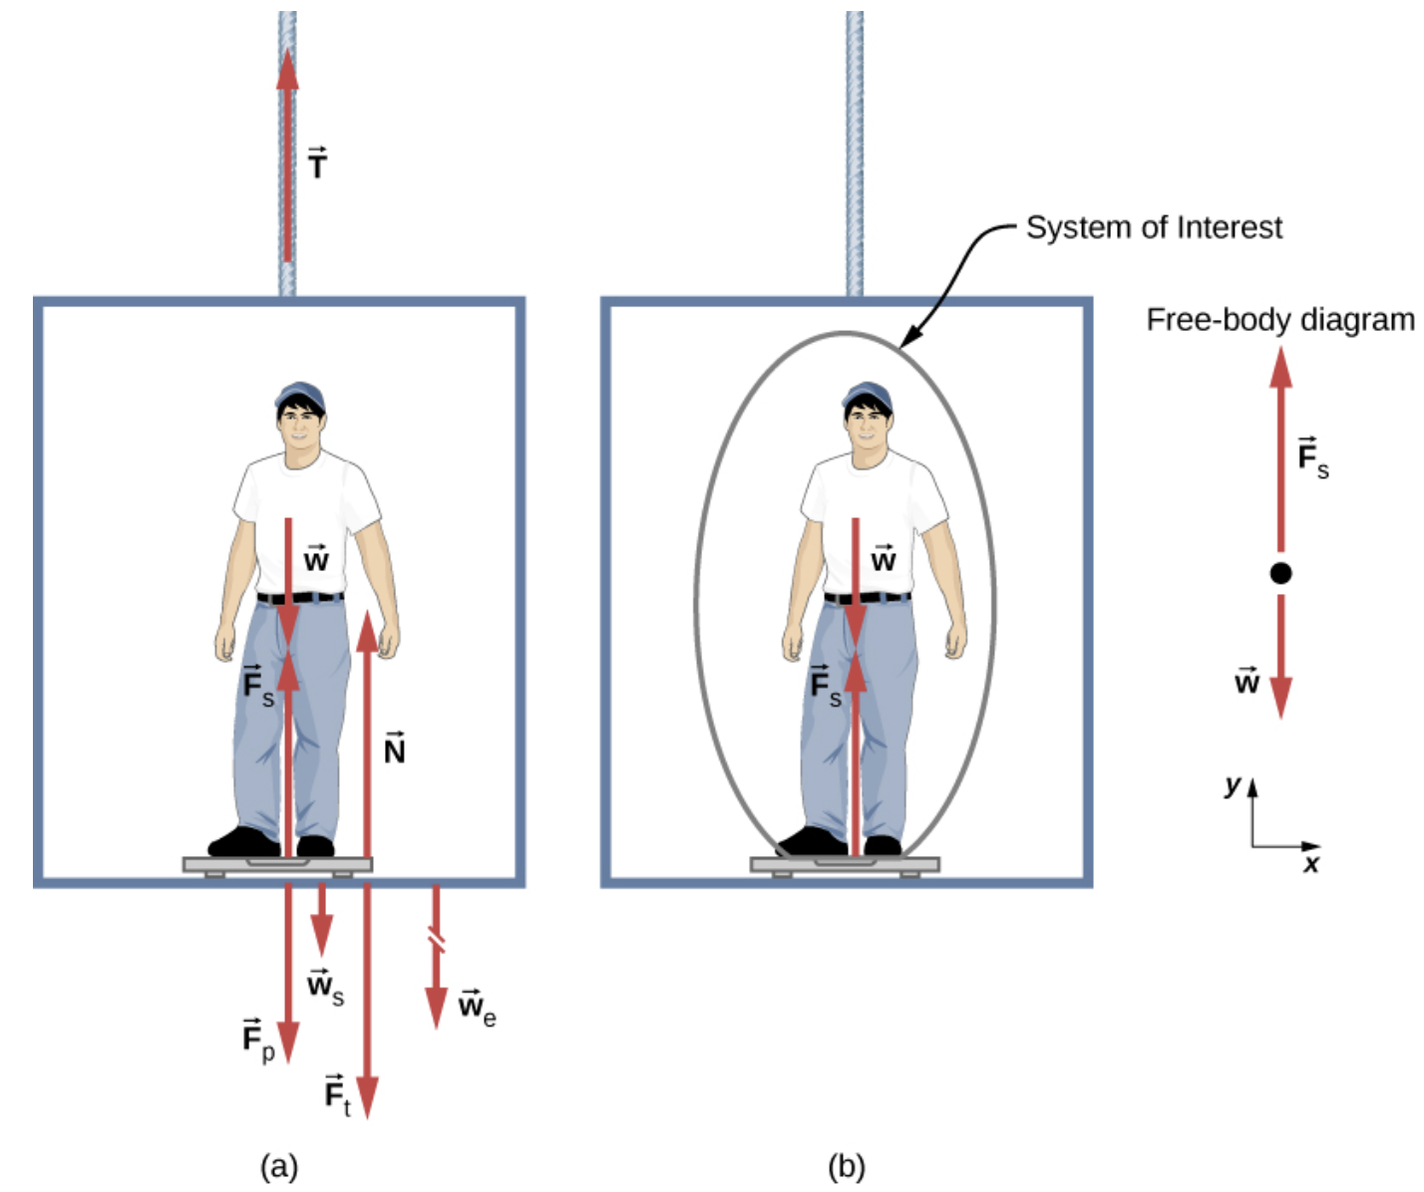
Solving Problems with Newton’s Laws
Particle Acceleration
Particle acceleration problems are the result of a nonzero net force.
Example
Figure shows a 75.0-kg man (weight of about 165 lb.) standing on a bathroom scale in an elevator. Calculate the scale reading:
if the elevator accelerates upward at a rate of 1.20 m/s², and
if the elevator moves upward at a constant speed of 1 m/s.

Slide 5
Solving Problems with Newton’s Laws
Particle Acceleration
Particle acceleration problems are the result of a nonzero net force.
Example
Figure shows a 75.0-kg man (weight of about 165 lb.) standing on a bathroom scale in an elevator. Calculate the scale reading:
if the elevator accelerates upward at a rate of 1.20 m/s², and
if the elevator moves upward at a constant speed of 1 m/s.
Assignment 1
Calculate the scale reading when the elevator accelerates downward at a rate of 1.20 m/s².

Slide 6
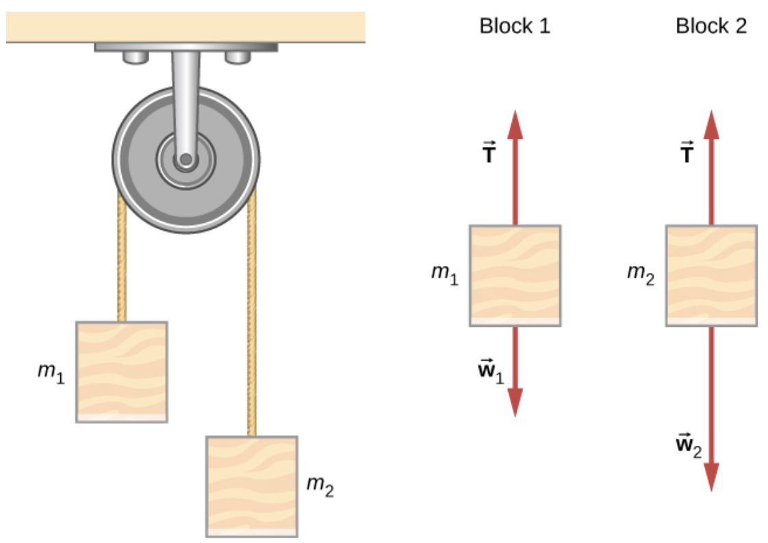
Solving Problems with Newton’s Laws
Atwood Machine
A classic problem in physics is that of the Atwood machine, which consists of a rope running over a pulley, with two objects of different mass attached. It is particularly useful in understanding the connection between force and motion. In Figure, m₁ = 2.00 kg and m₂ = 4.00 kg. Consider the
pulley to be frictionless.
If m₂ is released, what will its
acceleration be?
(b) What is the tension in the string?

Slide 7

Solving Problems with Newton’s Laws
Newton’s Laws of Motion and Kinematics
Newton’s laws of motion can be integrated with other concepts that have been discussed previously to solve problems of motion.
Example
A soccer player starts at rest and accelerates forward, reaching a velocity of 8.00 m/s in 2.50 s. (a) What is her average acceleration? (b) What average force does the ground exert forward on the runner so that she achieves this acceleration? The player’s mass is 70.0 kg, and air resistance is negligible.
Image credit: https://en.wikipedia.org/wiki/Adriana_Leon

Slide 8
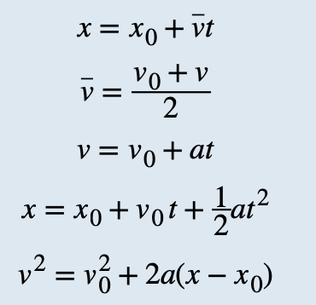
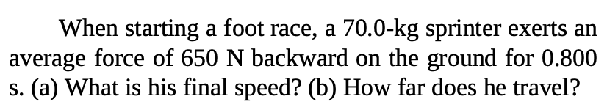
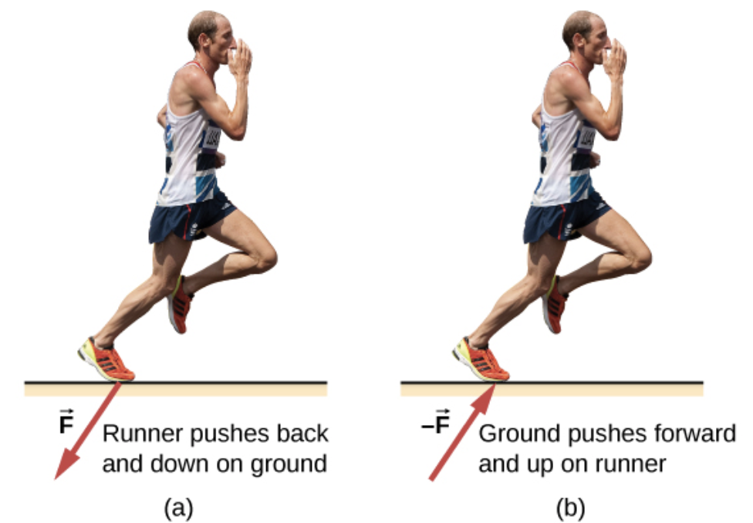
Solving Problems with Newton’s Laws
Assignment 2
credit "runner": modification of work by "Greenwich Photography"/Flickr

Slide 9
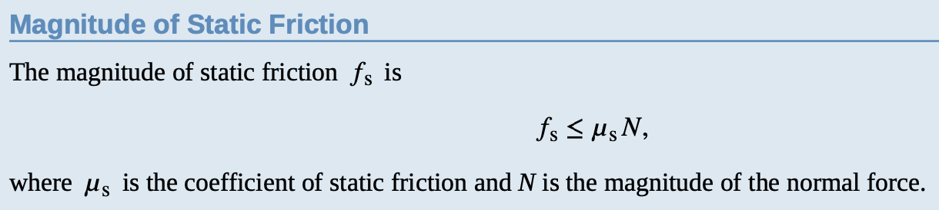
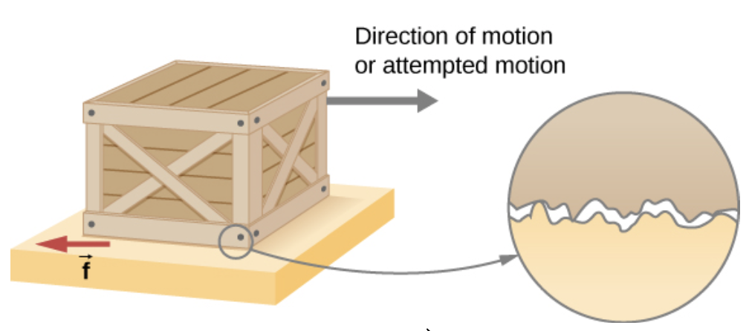
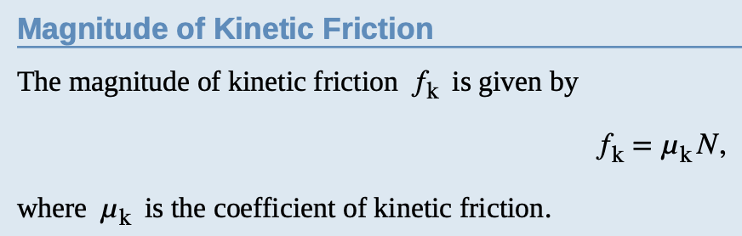
Friction
When a body is in motion, it has resistance because the body interacts with its surroundings. This resistance is a force of friction.
Friction opposes relative motion between systems in contact but also allows us to move, a concept that becomes obvious if you try to walk on ice.
Static and Kinetic Friction
Friction is a force that opposes relative motion between systems in contact.
If two systems are in contact and stationary relative to one another, then the friction between them is called static friction. If two systems are in contact and moving relative to one another, then the friction between them is called kinetic friction.
Friction arises in part because of the roughness of the surfaces in contact, as seen in the expanded view.
Much of the friction is due to attractive forces between molecules making up the two objects, so that even perfectly smooth surfaces are not friction-free. In fact, perfectly smooth, clean surfaces of similar materials would adhere, forming a bond called a “cold weld.”

Slide 10
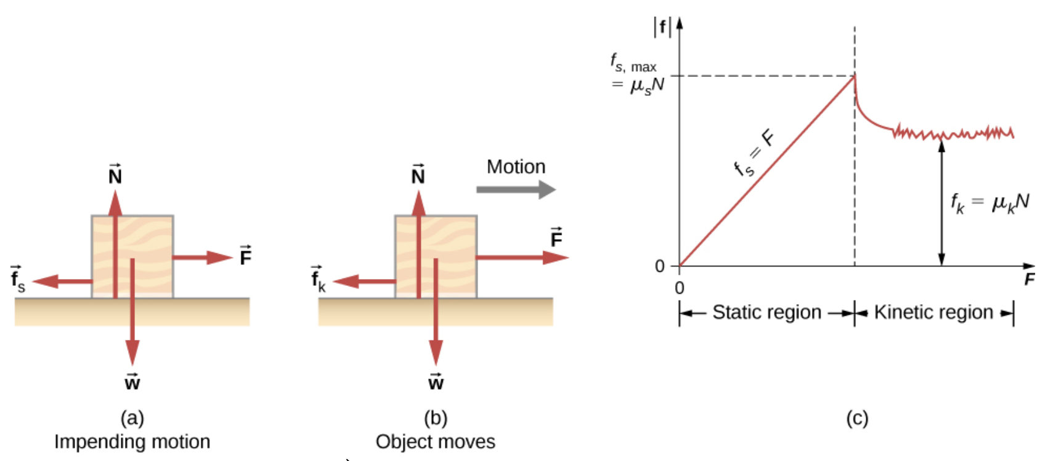
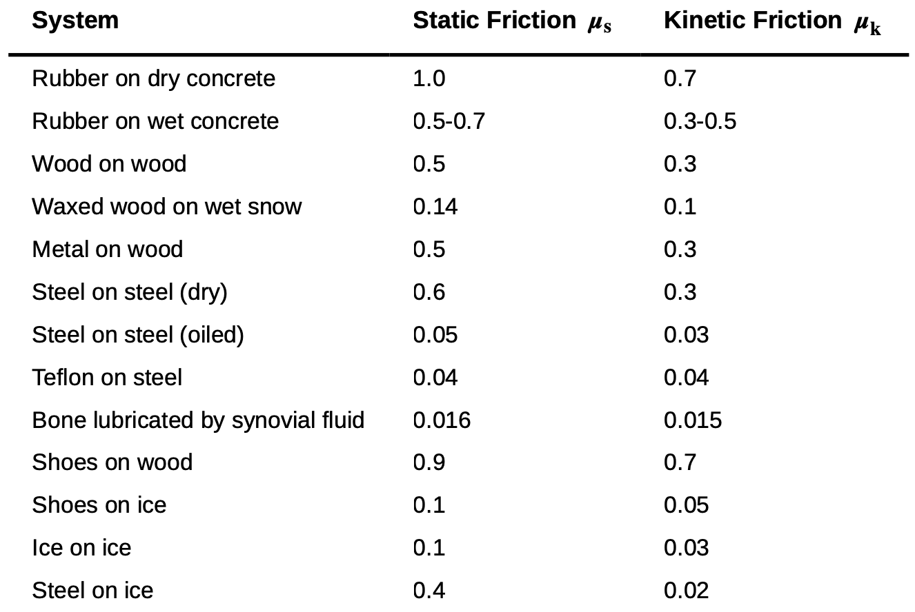




Friction
Static and Kinetic Friction
Approximate Coefficients of Static and Kinetic Friction
Example: 100 kg crate. The normal force is equal to its weight.

Slide 11
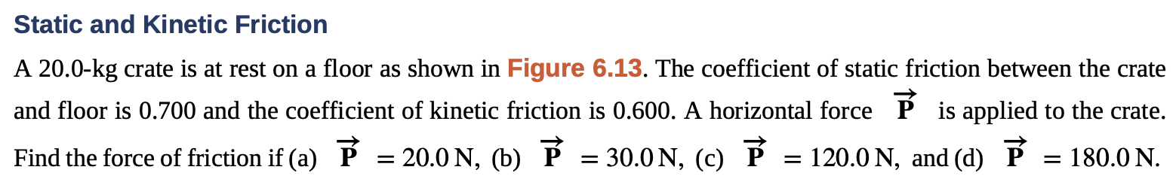
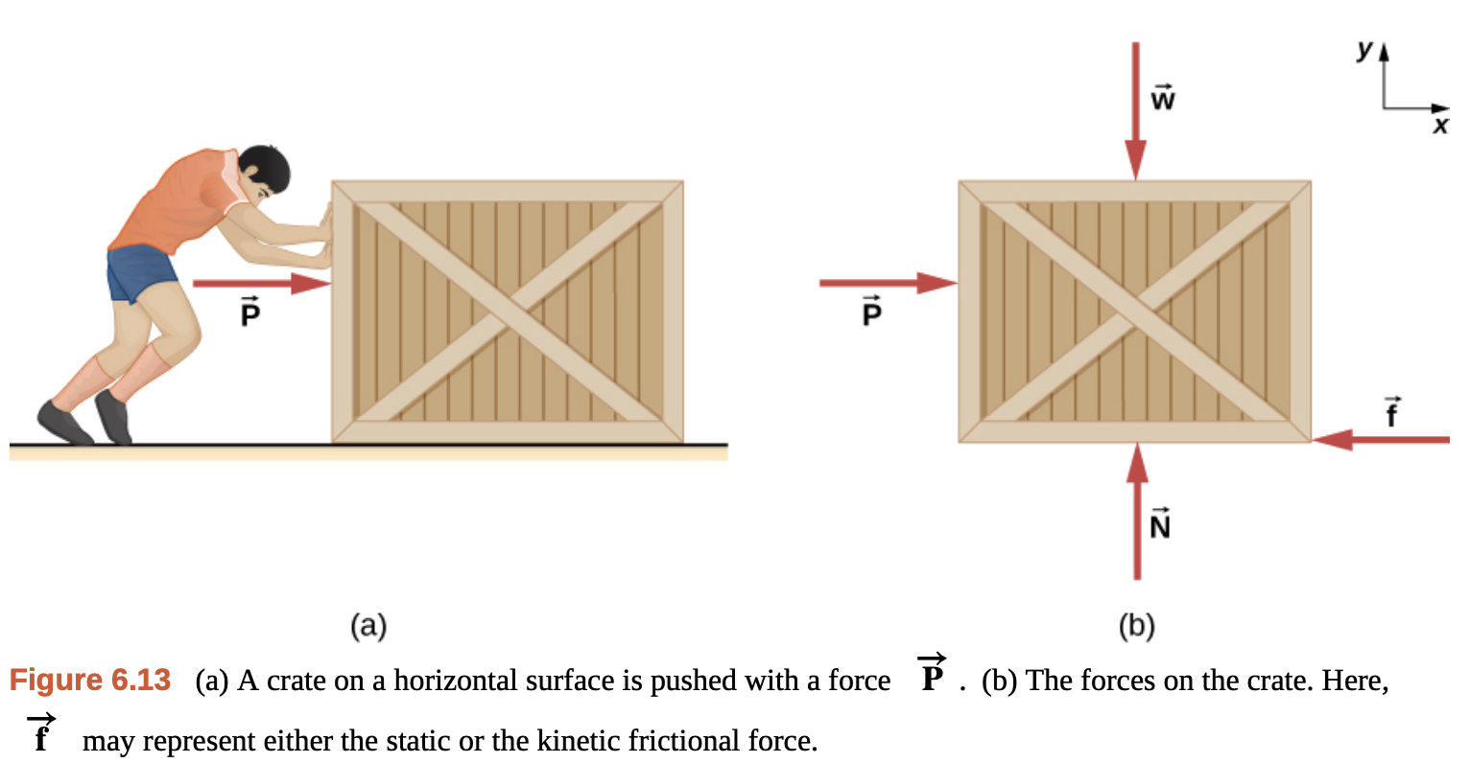
Friction
Example

Slide 12
Friction
Example
Assignment 3
A block of mass 1.0 kg rests on a horizontal surface. The frictional coefficients for the block and surface are μ_{s} = 0.50 and μ_{k} = 0.40.
(a) What is the minimum horizontal force
required to move the block?
(b) What is the block’s acceleration when this force is applied?

Slide 13
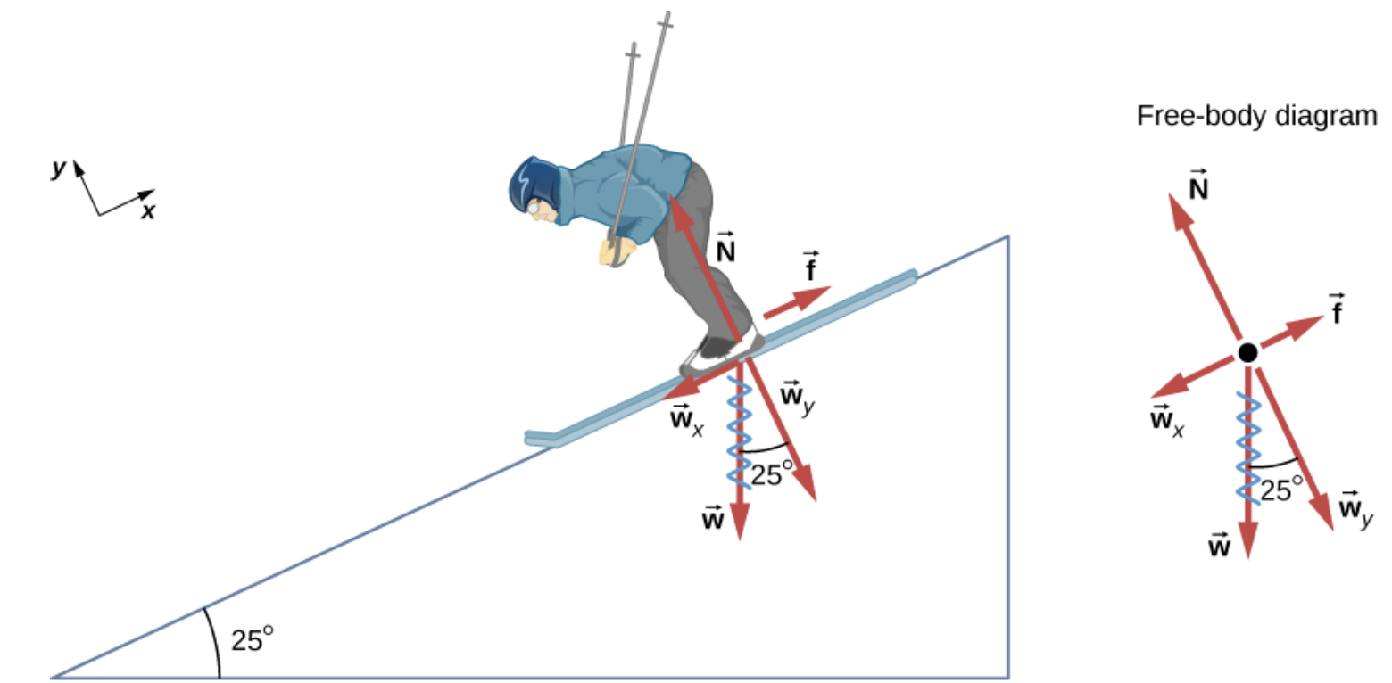
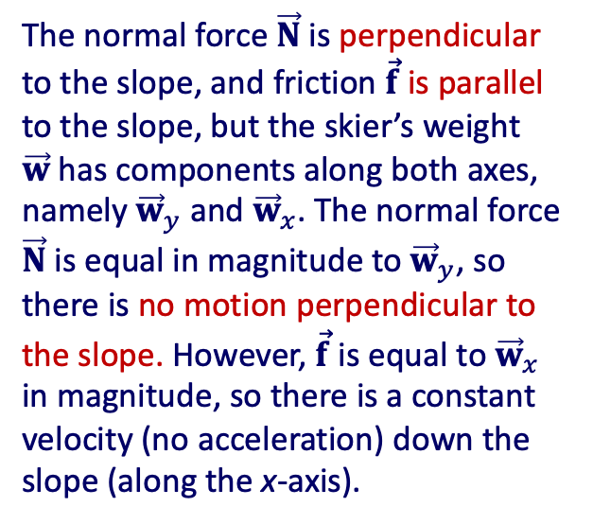
Friction and the Inclined Plane
Example
The normal force $\vec{N}$is perpendicular to the slope, and friction $\vec{f}$is parallel to the slope, but the skier’s weight $\vec{w}$has components along both axes, namely ${\vec{w}}_{y}$ and ${\vec{w}}_{x}$. The normal force $\vec{N}$is equal in magnitude to ${\vec{w}}_{y}$, so there is no motion perpendicular to the slope. However, $\vec{f}$is equal to ${\vec{w}}_{x}$ in magnitude, so there is a constant velocity (no acceleration) down the slope (along the x-axis).
The motion of the skier and friction are parallel to the slope, so it is most convenient to project all forces onto a coordinate system where one axis is parallel to the slope and the other is perpendicular (axes shown to left of skier).

Slide 14
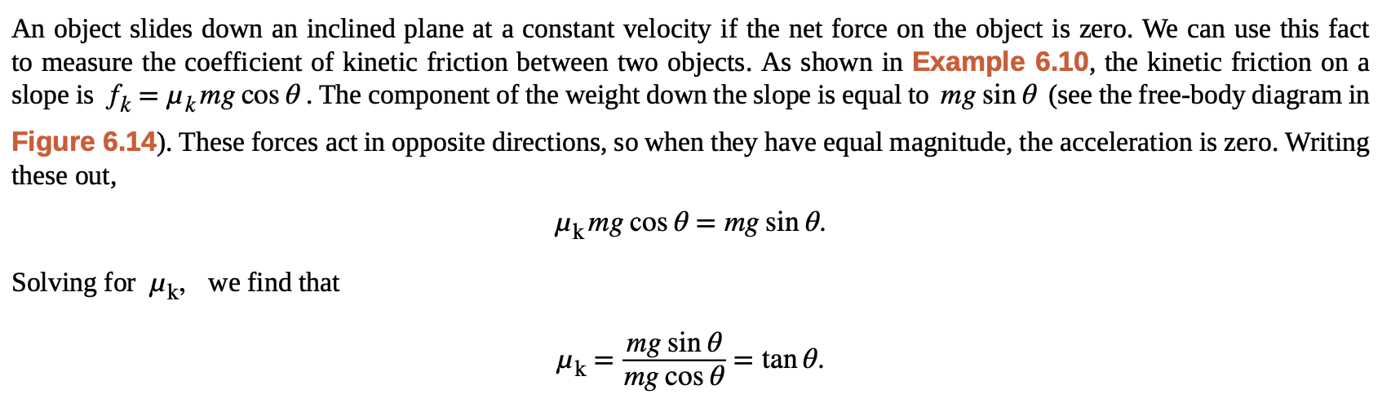
Friction and the Inclined Plane

Slide 15
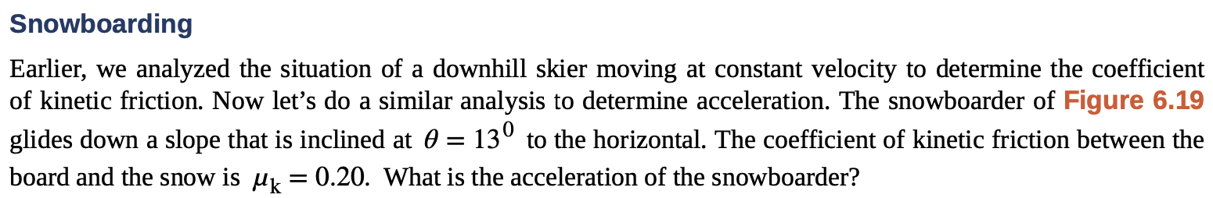
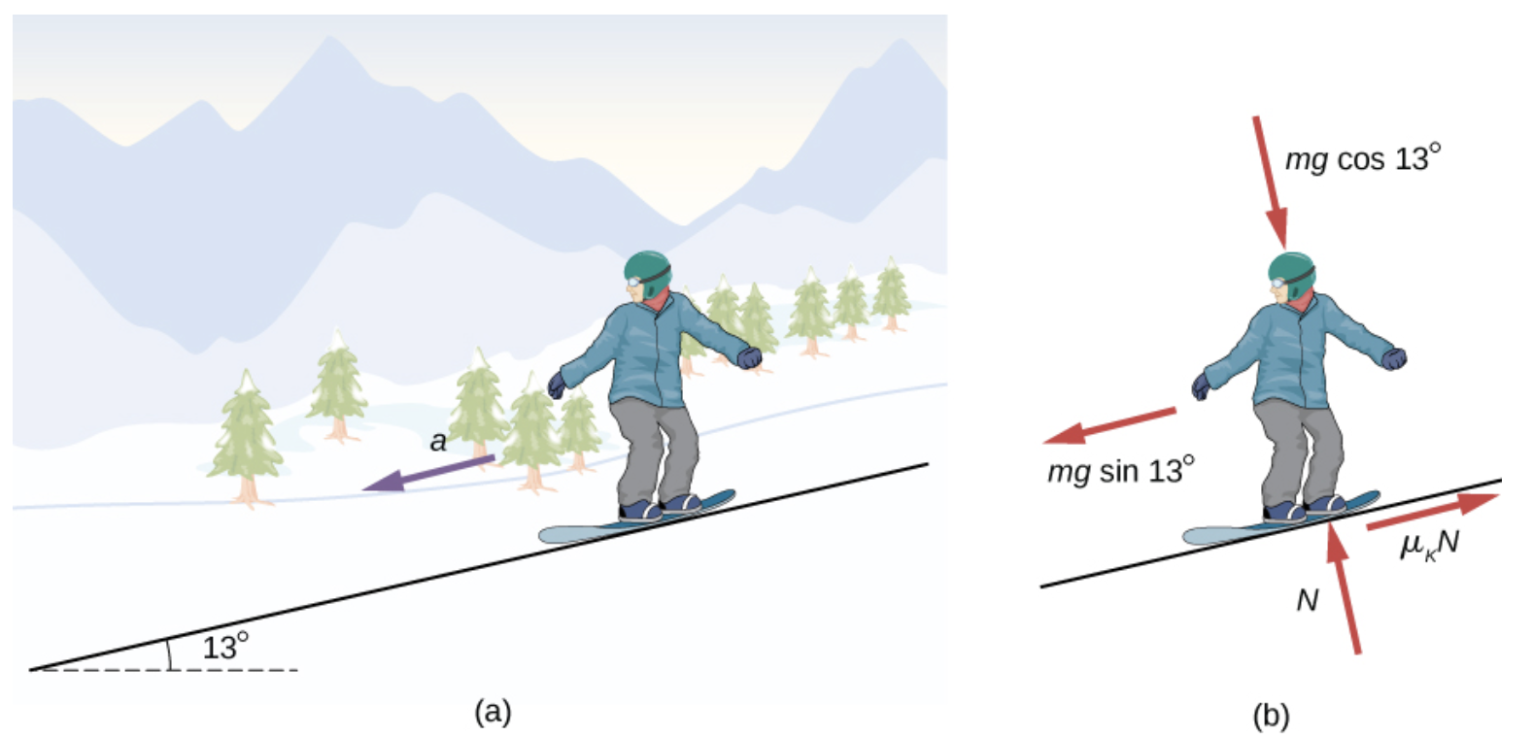
Friction and the Inclined Plane
Example
A snowboarder glides down a slope inclined at 13° to the horizontal.
The free-body diagram of the snowboarder.

Slide 16
Friction and the Inclined Plane
Example
Assignment 4
The snowboarder is now moving down a hill with incline 10.0° . What is the skier’s acceleration?
A snowboarder glides down a slope inclined at 13° to the horizontal.
The free-body diagram of the snowboarder.

Slide 17
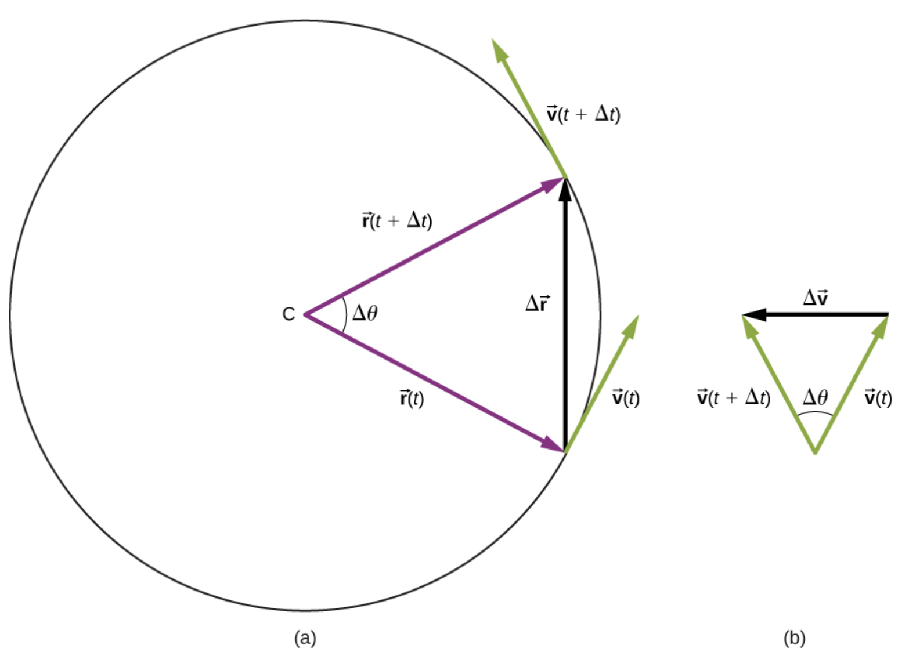


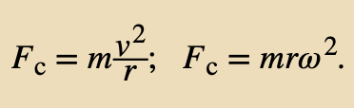



Centripetal Force
An object undergoing circular motion must be accelerating because it is changing the direction of its velocity.
This centrally directed acceleration, called centripetal acceleration, is given by the formula
If we know the angular velocity ω , then we can use
Angular velocity gives the rate at which the object is turning through the curve, in units of rad/s. This acceleration acts along the radius of the curved path and is thus also referred to as a radial acceleration.
Any net force causing uniform circular motion is called a centripetal force.

Slide 18

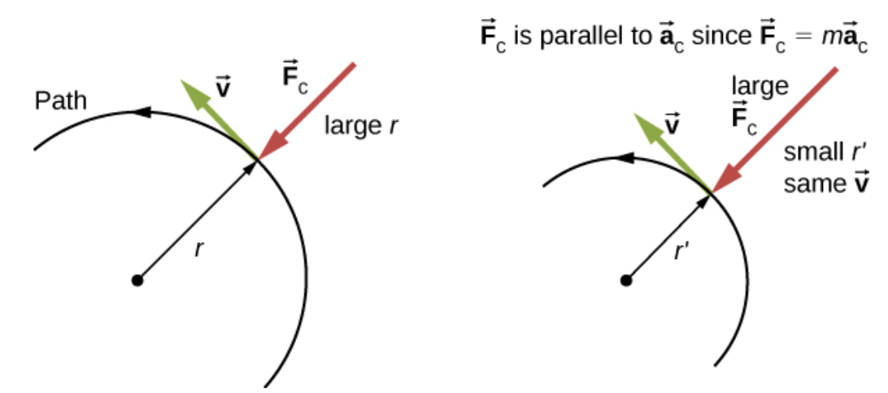
Centripetal Force
The radius of curvature
The frictional force (car negotiating the curved road) supplies the centripetal force and is numerically equal to it.
Centripetal force is perpendicular to velocity and causes uniform circular motion.
The larger the F_{c}, the smaller the radius of curvature r and the sharper the curve.
The second curve has the same v, but a larger F_{c} produces a smaller r′.

Slide 19
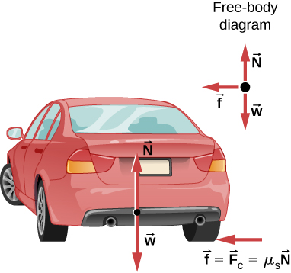
Centripetal Force
Example
What Coefficient of Friction Do Cars Need on a Flat Curve?
(a) Calculate the centripetal force exerted on a 900.0-kg car that negotiates a 500.0-m radius curve at 25.00 m/s. (b) Assuming an unbanked curve, find the minimum static coefficient of friction between the tires and the road, static friction being the reason that keeps the car from slipping
This car on level ground is moving away and turning to the left.
The centripetal force causing the car to turn in a circular path is due to friction between the tires and the road.
A minimum coefficient of friction is needed, or the car will move in a larger-radius curve and leave the roadway.

Slide 20
Centripetal Force
Example
What Coefficient of Friction Do Cars Need on a Flat Curve?
(a) Calculate the centripetal force exerted on a 900.0-kg car that negotiates a 500.0-m radius curve at 25.00 m/s. (b) Assuming an unbanked curve, find the minimum static coefficient of friction between the tires and the road, static friction being the reason that keeps the car from slipping
This car on level ground is moving away and turning to the left.
The centripetal force causing the car to turn in a circular path is due to friction between the tires and the road.
A minimum coefficient of friction is needed, or the car will move in a larger-radius curve and leave the roadway.
Assignment 5
A car moving at 96.8 km/h travels around a circular curve of radius 182.9 m on a flat country road. What must be the minimum coefficient of static friction to keep the car from slipping?

Slide 21

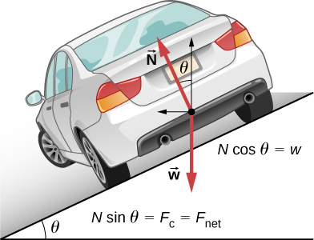


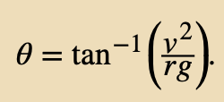
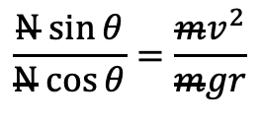
Centripetal Force
Banked Curves
In banked curves, the slope of the road helps you negotiate the curve.
The greater the angle θ , the faster you can take the curve.
Race tracks for bikes as well as cars often have steeply banked curves.
In an “ideally banked curve,” the angle θ is such that you can negotiate the curve at a certain speed without the aid of friction between the tires and the road.
Combine and solve for θ
e.g. divide 1st to 2nd
$$\frac{N sin{θ}}{N cos{θ}}=\frac{mv^{2}}{mgr}$$
The car on this banked curve is moving away and turning to the left.

Slide 22
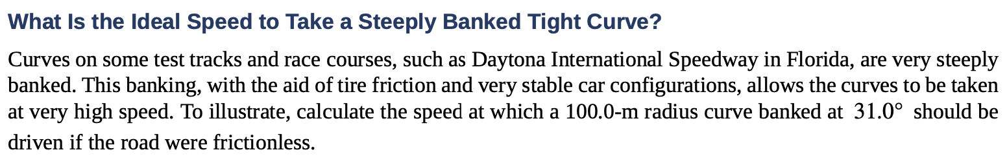
Centripetal Force
Banked Curves, example
Combine and solve for θ
e.g. divide 1st to 2nd
$$\frac{N sin{θ}}{N cos{θ}}=\frac{mv^{2}}{mgr}$$
The car on this banked curve is moving away and turning to the left.

Slide 23
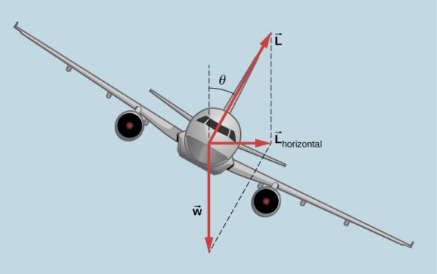
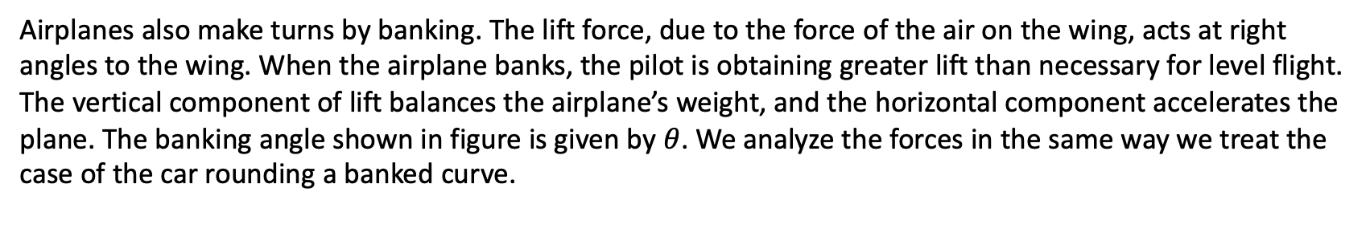

Centripetal Force
Banked Curves
Airplanes also make turns by banking. The lift force, due to the force of the air on the wing, acts at right angles to the wing. When the airplane banks, the pilot is obtaining greater lift than necessary for level flight. The vertical component of lift balances the airplane’s weight, and the horizontal component accelerates the plane. The banking angle shown in figure is given by $θ$. We analyze the forces in the same way we treat the case of the car rounding a banked curve.
In a banked turn, the horizontal component of lift is unbalanced and accelerates the plane. The normal component of lift balances the plane’s weight. The banking angle is given by $θ$. Compare the vector diagram with that shown in figure below.
How aircraft turn

Slide 24
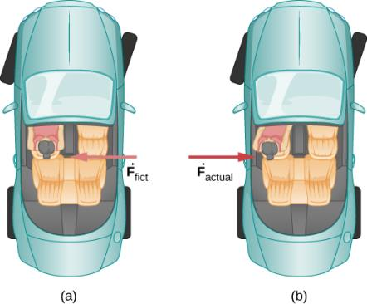
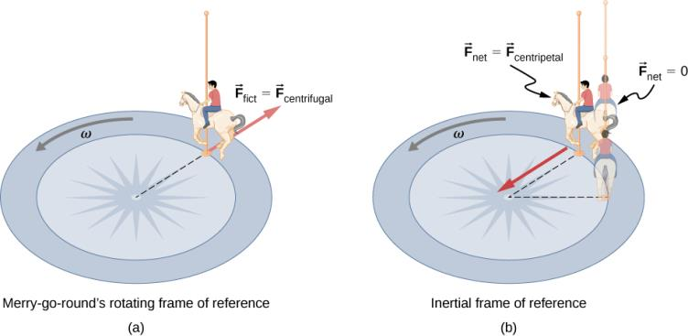
Inertial Forces and Noninertial (Accelerated) Frames. The Coriolis Force
Inertial forces—forces that merely seem to arise from motion (e.g. driver pushed back to seat when accelerating), appear due to the observer’s frame of reference is accelerating or rotating.
The car driver feels herself forced to the left relative to the car when she makes a right turn. This is an inertial force arising from the use of the car as a frame of reference.
In Earth’s frame of reference, the driver moves in a straight line, obeying Newton’s first law, and the car moves to the right. There is no force to the left on the driver relative to Earth. Instead, there is a force to the right on the car to make it turn.
A rider on a merry-go-round feels as if he is being thrown off. This inertial force is sometimes mistakenly called the centrifugal force in an effort to explain the rider’s motion in the rotating frame of reference.
In an inertial frame of reference and according to Newton’s laws, it is his inertia that carries him off (the unshaded rider has and heads in a straight line). A force F_{centripetal} is needed to cause a circular path.

Slide 25
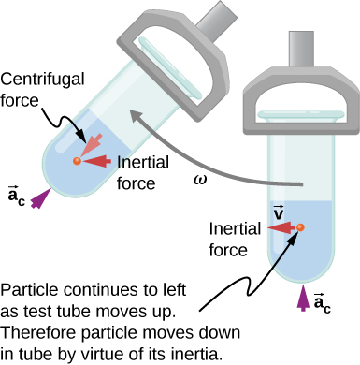
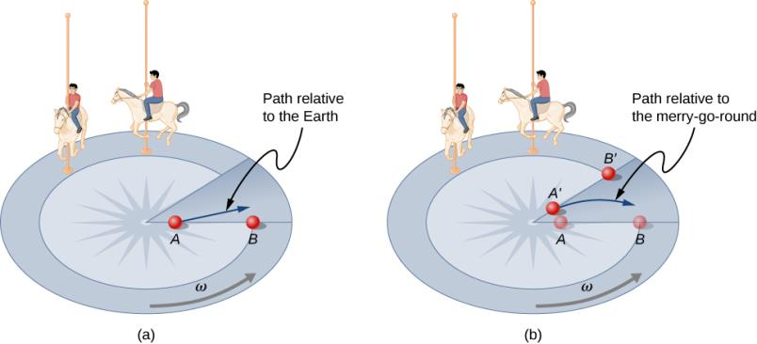
Inertial Forces and Noninertial (Accelerated) Frames. The Coriolis Force
Looking down on the counterclockwise rotation of a merry-go-round, we see that a ball slid straight toward the edge follows a path curved to the right. The person slides the ball toward point B, starting at point A.
Both points rotate to the shaded positions (A’ and B’) shown in the time that the ball follows the curved path in the rotating frame and a straight path in Earth’s frame.
Centrifuges use inertia to perform their task. Particles in the fluid sediment settle out because their inertia carries them away from the center of rotation.
Click to see the Coriolis Effect Demonstration

Slide 26
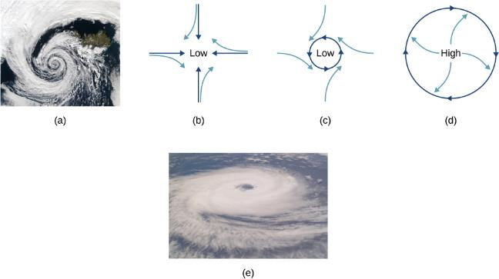
Inertial Forces and Noninertial (Accelerated) Frames. The Coriolis Force
The counterclockwise rotation of this Northern Hemisphere hurricane is a major consequence of the Coriolis force.
Without the Coriolis force, air would flow straight into a low-pressure zone, such as that found in tropical cyclones.
The Coriolis force deflects the winds to the right, producing a counterclockwise rotation.
Wind flowing away from a high-pressure zone is also deflected to the right, producing a clockwise rotation.
The opposite direction of rotation is produced by the Coriolis force in the Southern Hemisphere, leading to tropical cyclones. (credit a and credit e: modifications of work by NASA)

Slide 27


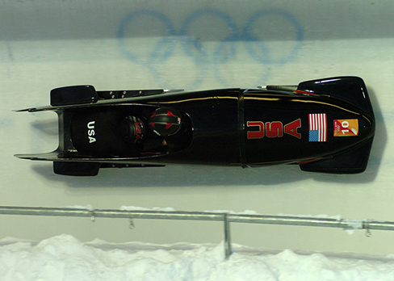
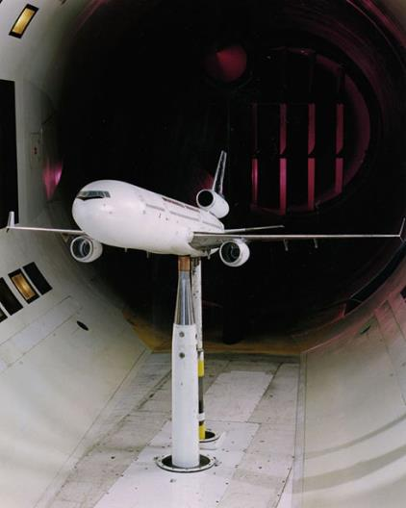
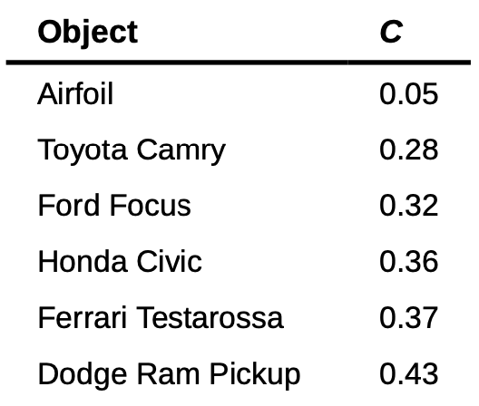

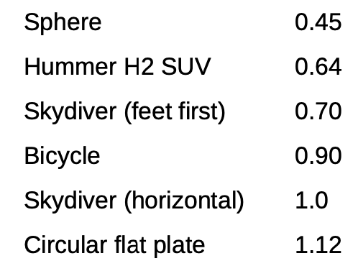
Drag Force and Terminal Speed
Drag force acts on an object when it is moving in a fluid (either a gas or a liquid).
The drag force always opposes the motion of an object.
Generally
When taking into account other factors, this relationship becomes
Exponent n is 2 if the object is moving at high velocity through air.
At low speeds n is 1
where:
C is the drag coefficient,
A is the area of the object facing the fluid,
ρ is the density of the fluid.
This equation can also be written in a more generalized fashion as F_{D} = bv², where b is a constant equivalent to 0.5CρA.
From racing cars to bobsled racers, aerodynamic shaping is crucial to achieving top speeds. Bobsleds are designed for speed and are shaped like a bullet with tapered fins.
(credit: “U.S. Army”/Wikimedia Commons)
NASA researchers test a model plane in a wind tunnel. (credit: NASA/Ames)

Slide 28
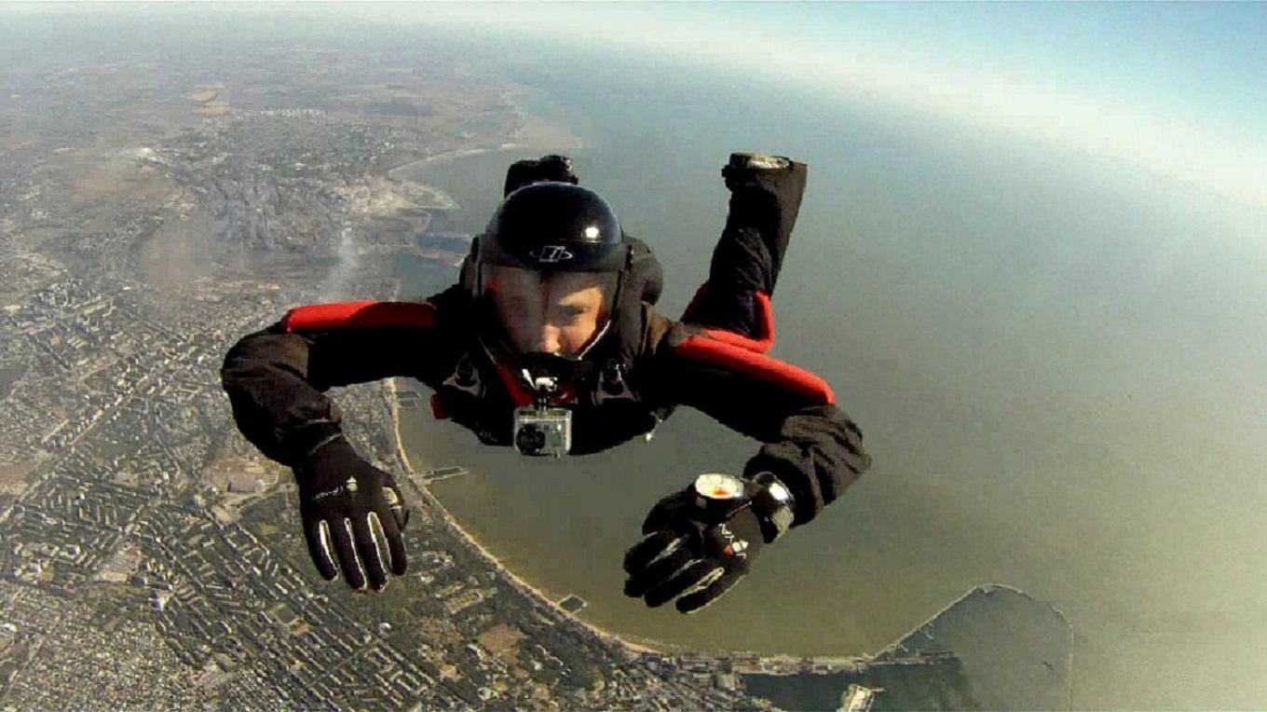
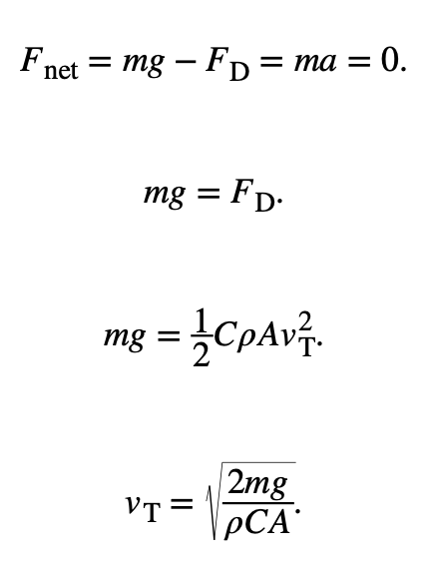
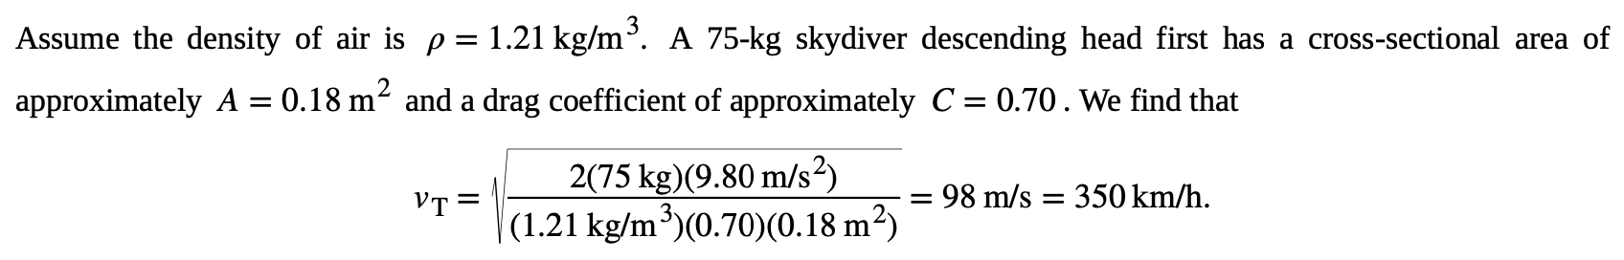
Drag Force and Terminal Speed
Terminal Velocity
Image credit: https://en.wikipedia.org/wiki/Parachuting
Consider a skydiver falling through air under the influence of gravity.
As the skydiver’s velocity increases, the magnitude of the drag force increases until the magnitude of the drag force is equal to the gravitational force, thus producing a net force of zero.
A zero net force means that there is no acceleration. At this point, the person’s velocity remains constant and we say that the person has reached his terminal velocity (v_{τ}).
This means a skydiver with a mass of 75 kg achieves a terminal velocity of about 350 km/h while traveling in a pike (head first) position, minimizing the area and his drag. In a spread-eagle position, that terminal velocity may decrease to about 200 km/h as the area increases. This terminal velocity becomes much smaller after the parachute opens.

Slide 29
Drag Force and Terminal Speed
Terminal Velocity
Image credit: https://en.wikipedia.org/wiki/Parachuting
Consider a skydiver falling through air under the influence of gravity.
As the skydiver’s velocity increases, the magnitude of the drag force increases until the magnitude of the drag force is equal to the gravitational force, thus producing a net force of zero.
A zero net force means that there is no acceleration. At this point, the person’s velocity remains constant and we say that the person has reached his terminal velocity (v_{τ}).
This means a skydiver with a mass of 75 kg achieves a terminal velocity of about 350 km/h while traveling in a pike (head first) position, minimizing the area and his drag. In a spread-eagle position, that terminal velocity may decrease to about 200 km/h as the area increases. This terminal velocity becomes much smaller after the parachute opens.
Assignment 6
Find the terminal velocity of an 85-kg skydiver falling in a spread-eagle position. A=0.70 m².

Slide 30
Attribution
These slides are a derivative of the “University Physics Vol. 1” slides by OpenStax, used under a Creative Commons Attribution 4.0 license by Mkhitar Hobosyan.

