Slide 1
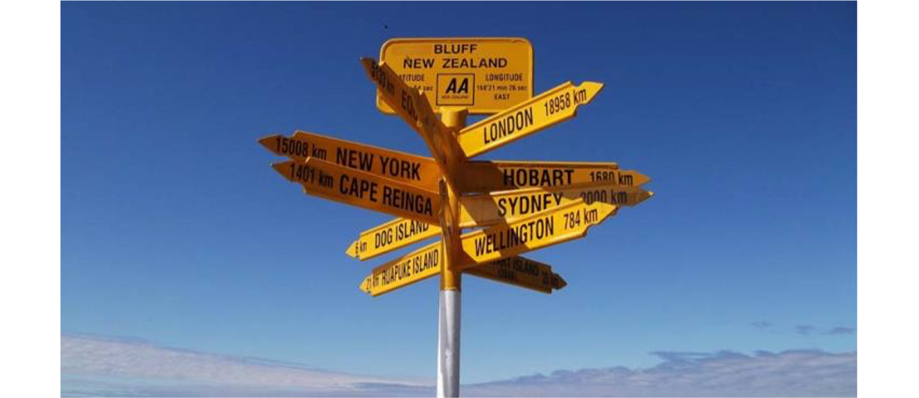
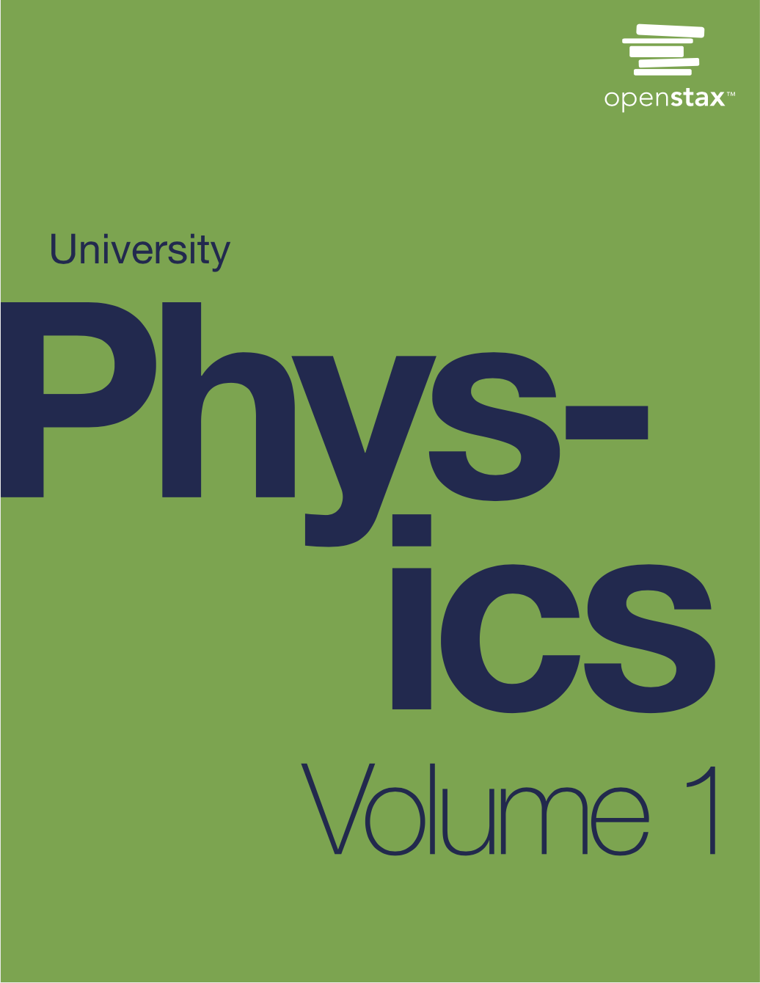
PHYS 2425
Physics for Scientists
and Engineers I
Chapter 2
Vectors
Download the textbook for free at https://openstax.org/details/books/university-physics-volume-1
Image credit modification of work by “studio tdes”/Flickr

Slide 2

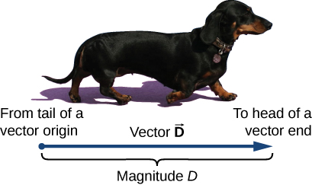
Vector and Scalar Quantities
A scalar quantity is completely specified by a single value with an appropriate unit and has no direction.
Time, mass, distance, length, volume, temperature, and energy are examples of scalar quantities.
A vector quantity is completely specified by a number with an appropriate unit (the magnitude of the vector) plus a direction.
Examples of vector quantities include displacement, velocity, position, force, and torque.
We note vectors with boldface letter with an arrow over the letter.
We draw a vector from the initial point or origin (called the “tail” of a vector) to the end or terminal point (called the “head” of a vector), marked by an arrowhead. Magnitude is the length of a vector and is always a positive scalar quantity.
(credit: modification of work by Cate Sevilla)

Slide 3
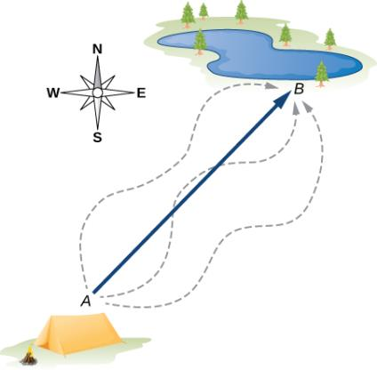
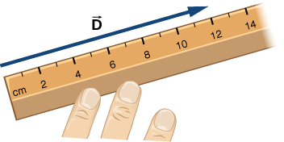
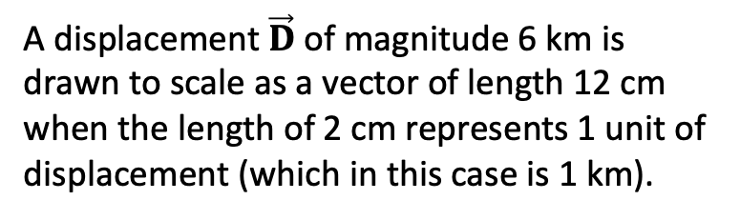
Properties of vectors
Example: Displacement is a vector
The displacement vector from point A (the initial position at the campsite) to point B (the final position at the fishing hole) is indicated by an arrow with origin at point A and end at point B. The displacement is the same for any of the actual paths (dashed curves) that may be taken between points A and B.
Let’s say this displacement is 6 km.
A displacement $\vec{D}$of magnitude 6 km is drawn to scale as a vector of length 12 cm when the length of 2 cm represents 1 unit of displacement (which in this case is 1 km).

Slide 4
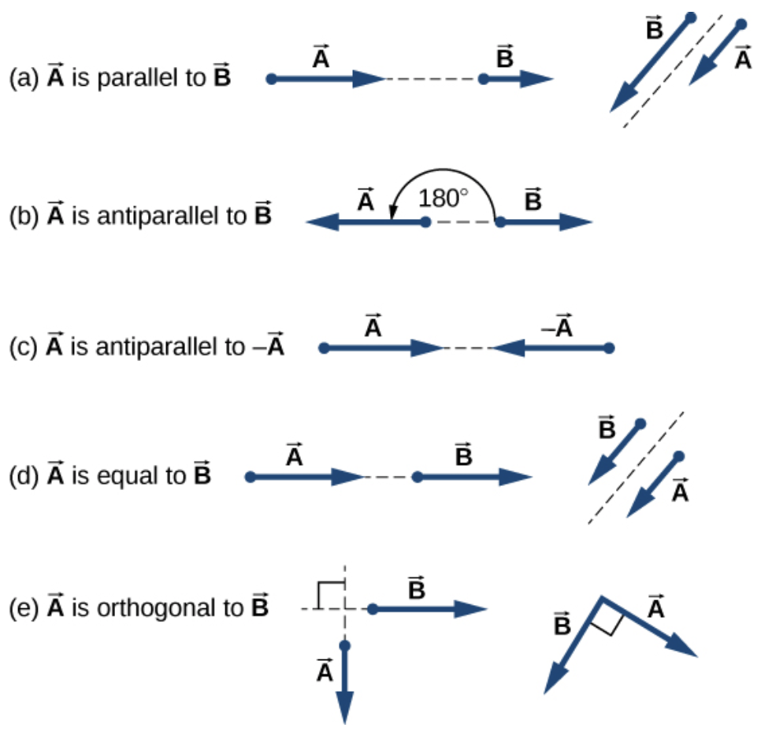
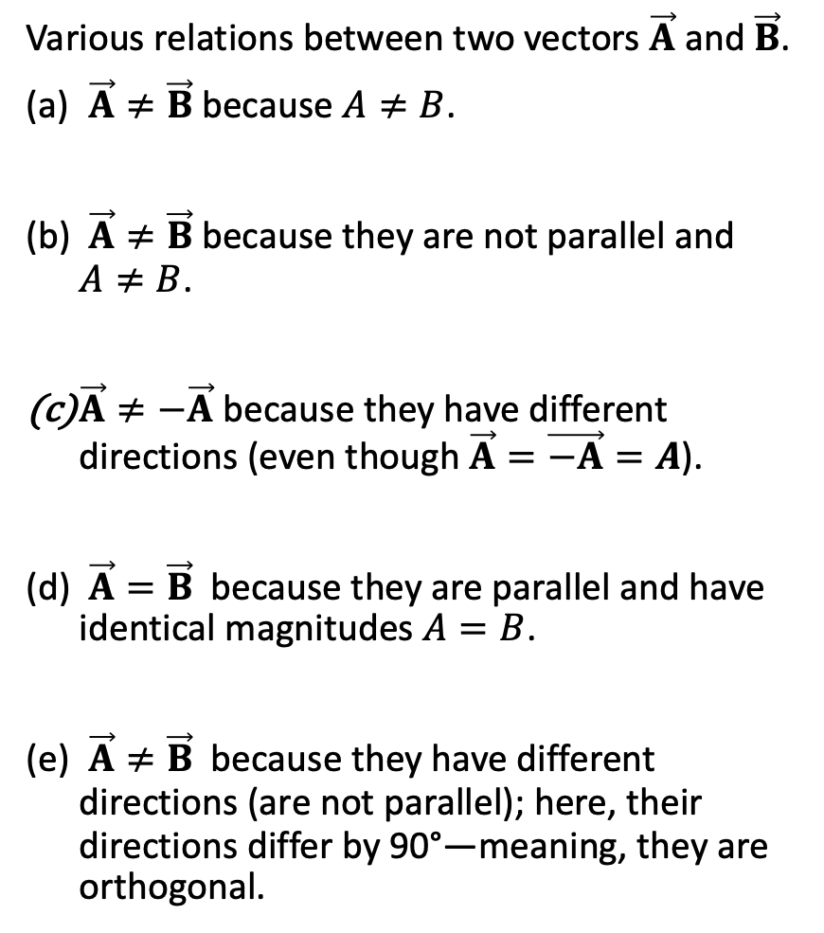
Properties of vectors
Two vectors are equal if they have the same magnitude and if they point in the same direction.
Various relations between two vectors $\vec{A}$ and $\vec{B}$.
$\vec{A}≠\vec{B}$ because $A≠B$.
$\vec{A}≠\vec{B}$ because they are not parallel and $A≠B$.
$\vec{A}≠−\vec{A}$ because they have different directions (even though $\vec{A}=\vec{−A}=A$).
$\vec{A}=\vec{B}$ because they are parallel and have identical magnitudes $A=B$.
$\vec{A}≠\vec{B}$ because they have different directions (are not parallel); here, their directions differ by 90°—meaning, they are orthogonal.

Slide 5
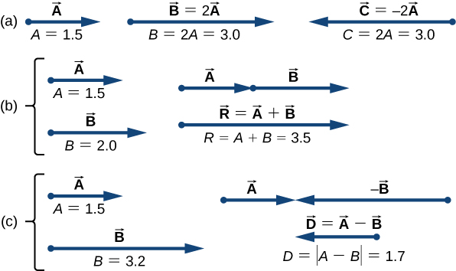
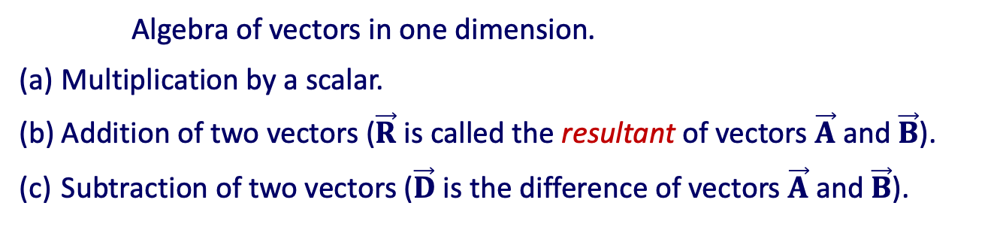
Properties of vectors
Algebra of vectors in one dimension.
Multiplication by a scalar.
Addition of two vectors ($\vec{R}$ is called the resultant of vectors $\vec{A}$ and $\vec{B}$).
Subtraction of two vectors ($\vec{D}$ is the difference of vectors $\vec{A}$ and $\vec{B}$).

Slide 6
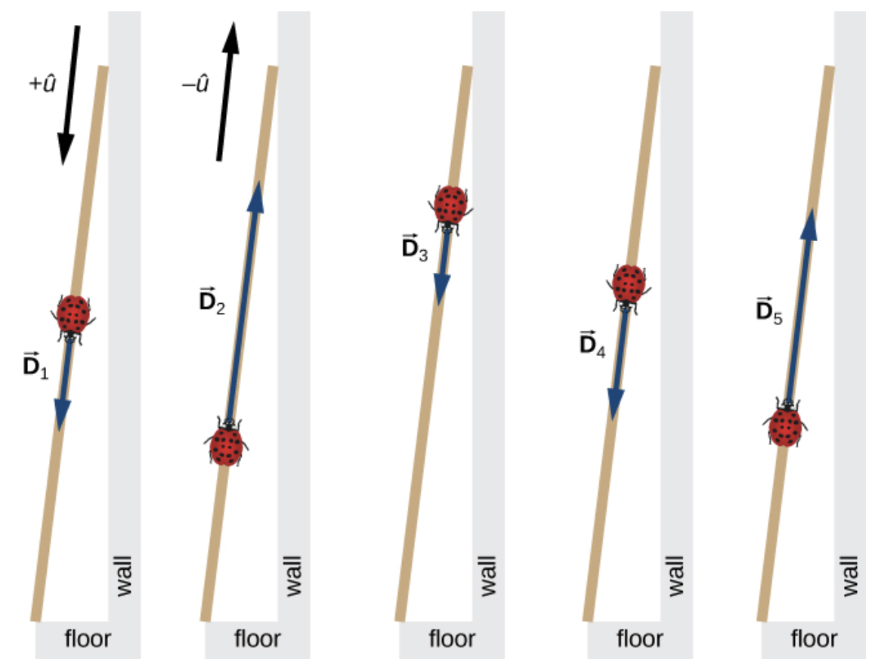
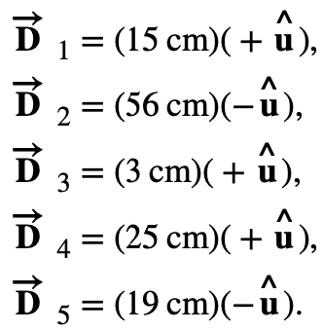
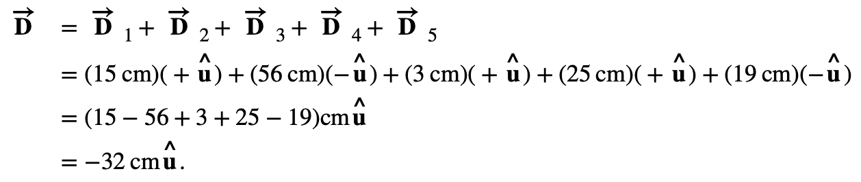
Properties of vectors
Five displacements of the ladybug. Note that in this schematic drawing, magnitudes of displacements are not drawn to scale. (credit: modification of work by “Persian Poet Gal”/Wikimedia Commons)
Algebra of vectors in one dimension.
Multiplication by a scalar.
Addition of two vectors ($\vec{R}$ is called the resultant of vectors $\vec{A}$ and $\vec{B}$).
Subtraction of two vectors ($\vec{D}$ is the difference of vectors $\vec{A}$ and $\vec{B}$).
Assignment 1
Calculate the total distance the ladybug has traveled.

Slide 7
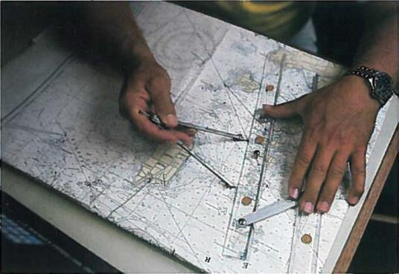
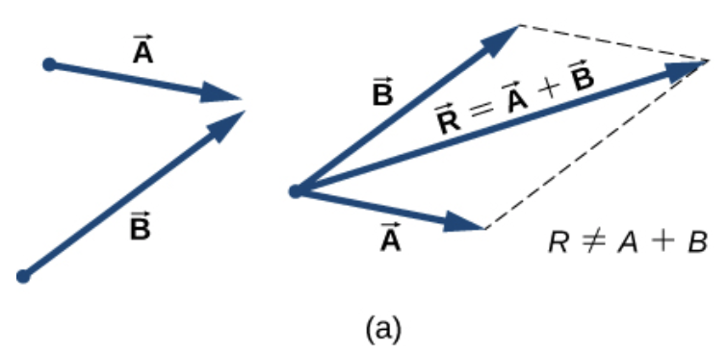
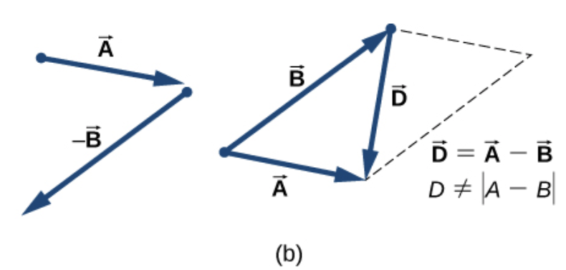
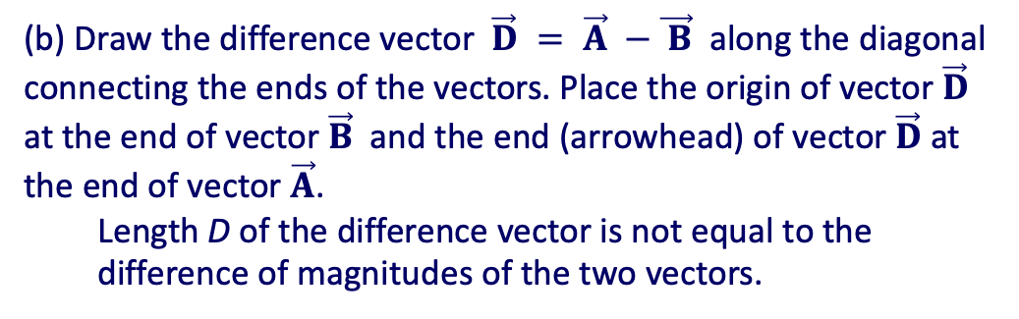
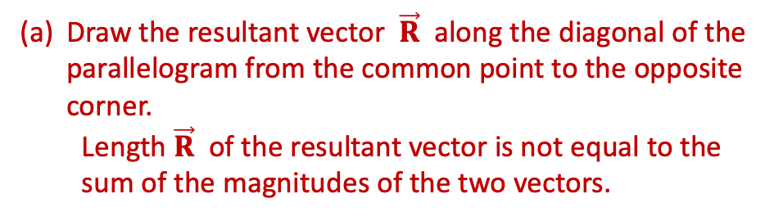
Algebra of Vectors in Two Dimensions
The parallelogram rule for the addition of two vectors.
In navigation, the laws of geometry are used to draw resultant displacements on nautical maps.
Draw the resultant vector $\vec{R}$ along the diagonal of the parallelogram from the common point to the opposite corner.
Length $\vec{R}$ of the resultant vector is not equal to the sum of the magnitudes of the two vectors.
(b) Draw the difference vector $\vec{D} = \vec{A} −\vec{ B}$ along the diagonal connecting the ends of the vectors. Place the origin of vector $\vec{D}$ at the end of vector $\vec{B}$ and the end (arrowhead) of vector $\vec{D}$ at the end of vector $\vec{A}$.
Length D of the difference vector is not equal to the difference of magnitudes of the two vectors.

Slide 8
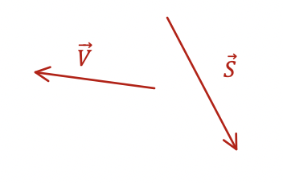
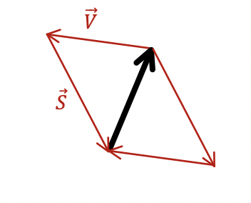
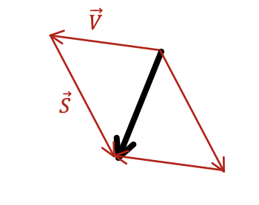
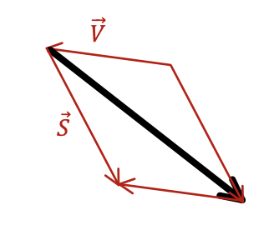
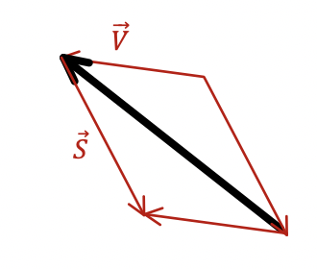
Algebra of Vectors in Two Dimensions
For vectors $\vec{S}$and $\vec{V}$which option represents $\vec{S}$ - $\vec{V}$
a
b
c
d

Slide 9
Algebra of Vectors in Two Dimensions
For vectors $\vec{S}$and $\vec{V}$what would be the resultant vector $\vec{S}$+$\vec{V}$
a
b
c
d

Slide 10
Algebra of Vectors in Two Dimensions
For vectors $\vec{S}$and $\vec{V}$which option represents $\vec{V}$ - $\vec{S}$
a
b
c
d

Slide 11
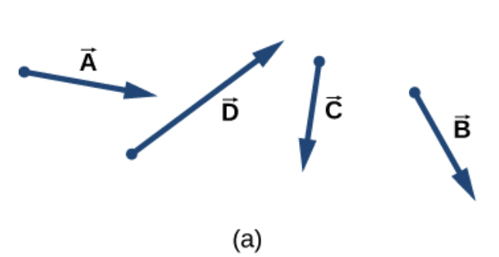
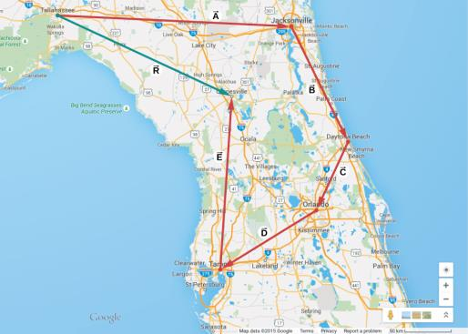
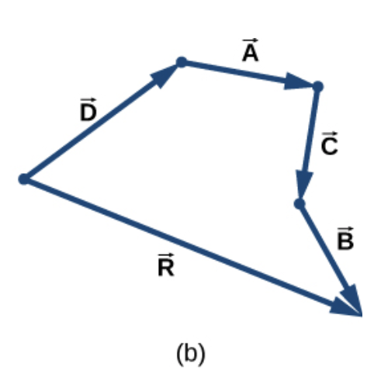
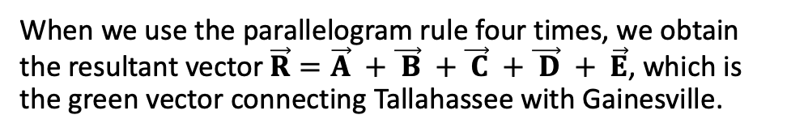
Algebra of Vectors in Two Dimensions
When we use the parallelogram rule four times, we obtain the resultant vector $\vec{R}=\vec{A} +\vec{ B} +\vec{ C} +\vec{ D} + \vec{E}$, which is the green vector connecting Tallahassee with Gainesville.
Tail-to-head method for drawing the resultant vector $\vec{R}=\vec{A} +\vec{ B} +\vec{ C} +\vec{ D}$.
Four vectors of different magnitudes and directions.
Vectors in (a) are translated to new positions, and the resultant vector is drawn.

Slide 12
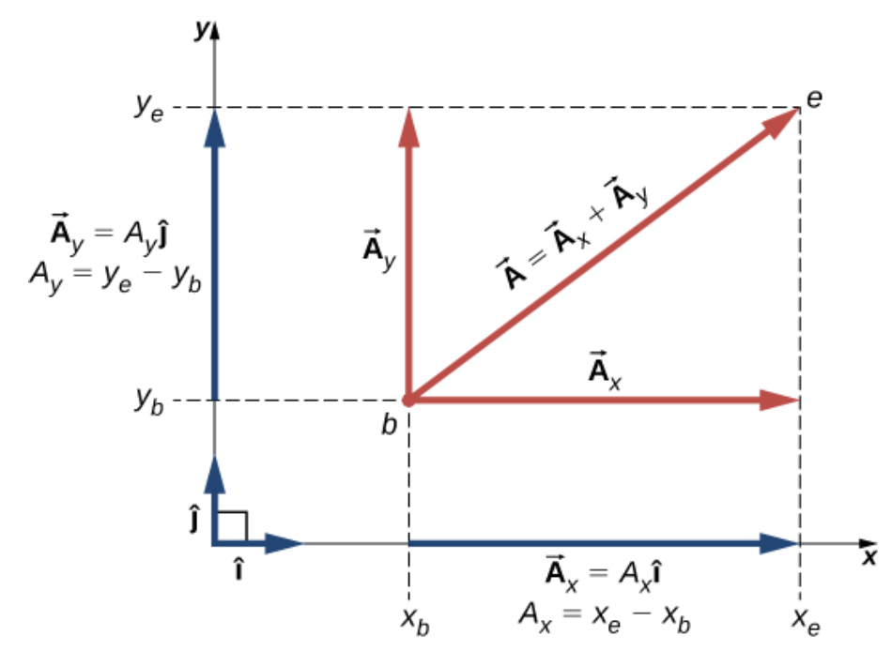
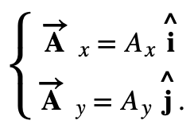

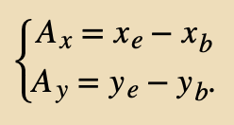
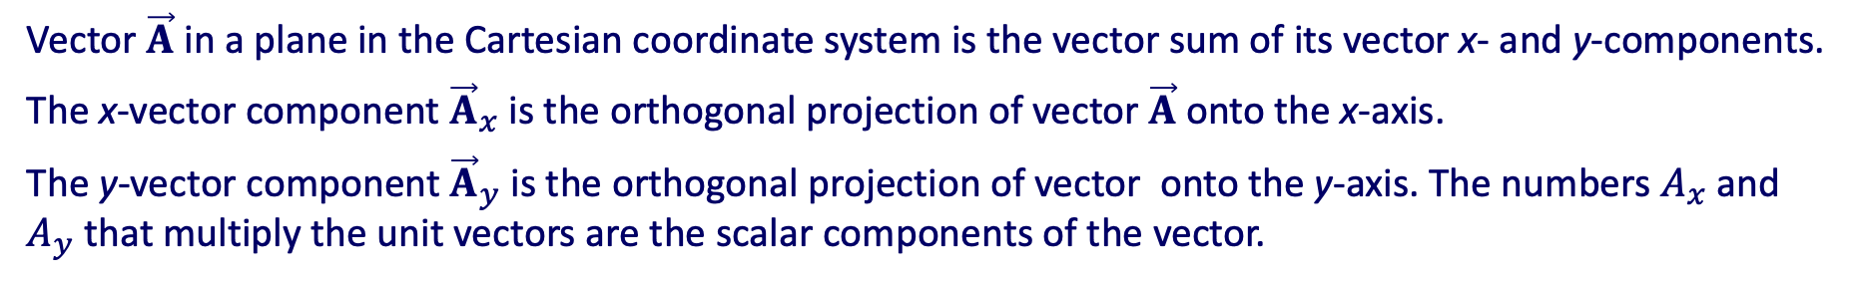
Coordinate Systems and Components of a Vector
Vector $\vec{A}$ in a plane in the Cartesian coordinate system is the vector sum of its vector x- and y-components.
The x-vector component ${\vec{A}}_{x}$ is the orthogonal projection of vector $\vec{A}$ onto the x-axis.
The y-vector component ${\vec{A}}_{y}$ is the orthogonal projection of vector onto the y-axis. The numbers $A_{x}$ and $A_{y}$ that multiply the unit vectors are the scalar components of the vector.

Slide 13
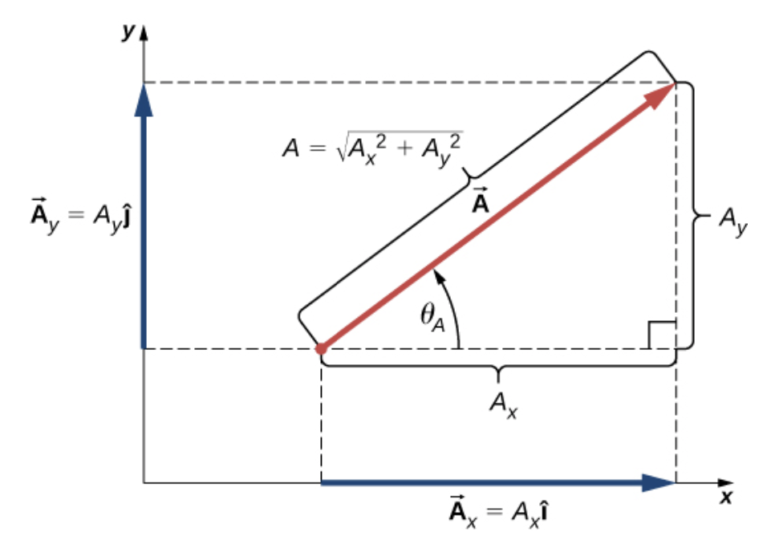
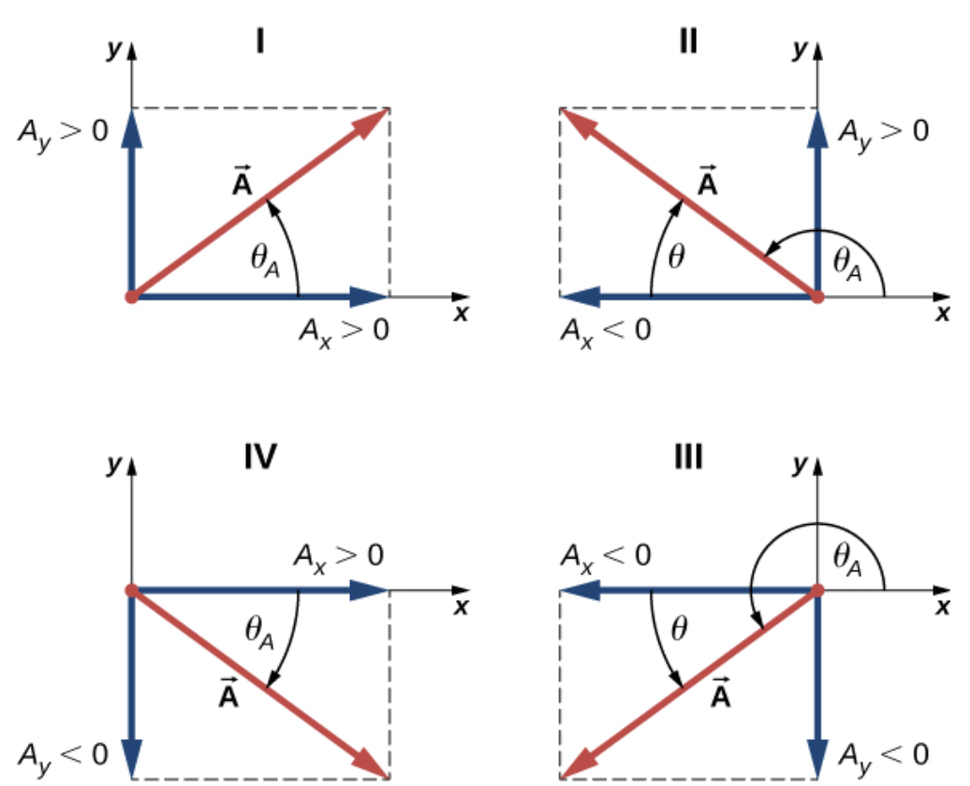

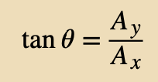
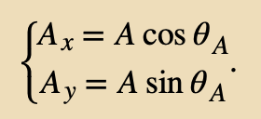
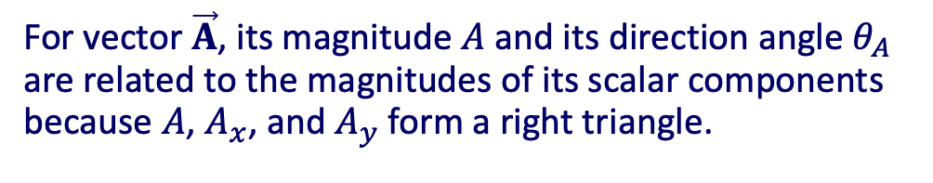
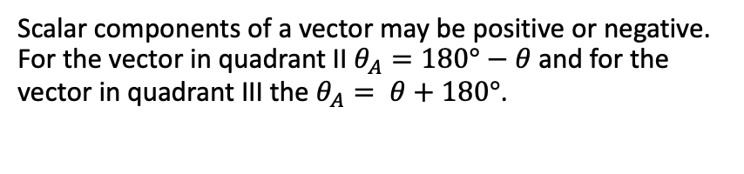
Coordinate Systems and Components of a Vector
For vector $\vec{A}$, its magnitude $A$ and its direction angle $θ_{A}$ are related to the magnitudes of its scalar components because $A$, $A_{x}$, and $A_{y}$ form a right triangle.
Scalar components of a vector may be positive or negative. For the vector in quadrant II $θ_{A}=180°−θ$ and for the vector in quadrant III the $θ_{A}= θ+180°$.

Slide 14
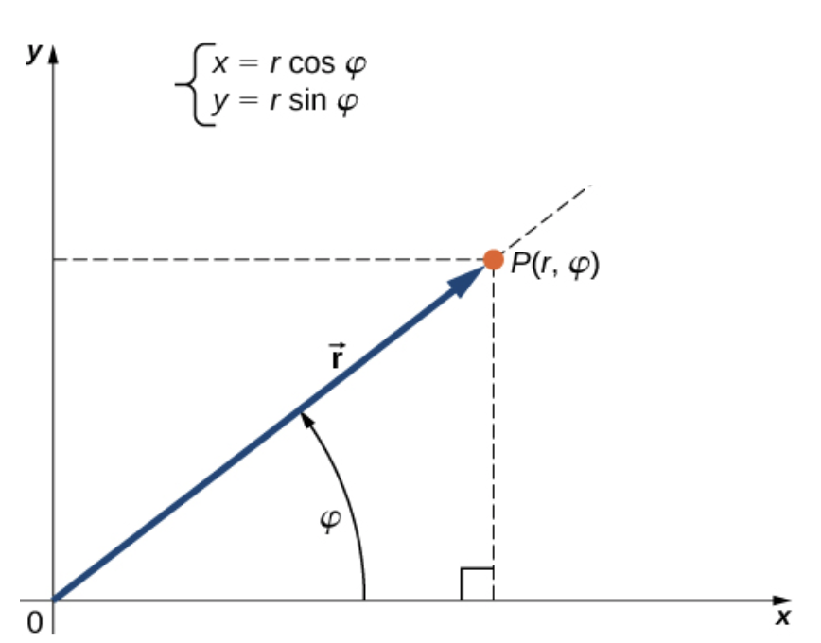
Coordinate Systems and Components of a Vector
Polar Coordinates
For vector $\vec{A}$, its magnitude $A$ and its direction angle $θ_{A}$ are related to the magnitudes of its scalar components because $A$, $A_{x}$, and $A_{y}$ form a right triangle.

Slide 15
Coordinate Systems and Components of a Vector
Polar Coordinates
Example
A treasure hunter finds one silver coin at a location 20.0 m away from a dry well in the direction 20° north of east and finds one gold coin at a location 10.0 m away from the well in the direction 20° north of west. What are the polar and rectangular coordinates of these findings with respect to the well?

Slide 16
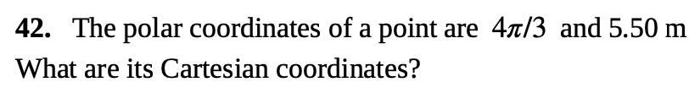
Coordinate Systems and Components of a Vector
Polar Coordinates
Assignment 2
For vector $\vec{A}$, its magnitude $A$ and its direction angle $θ_{A}$ are related to the magnitudes of its scalar components because $A$, $A_{x}$, and $A_{y}$ form a right triangle.

Slide 17
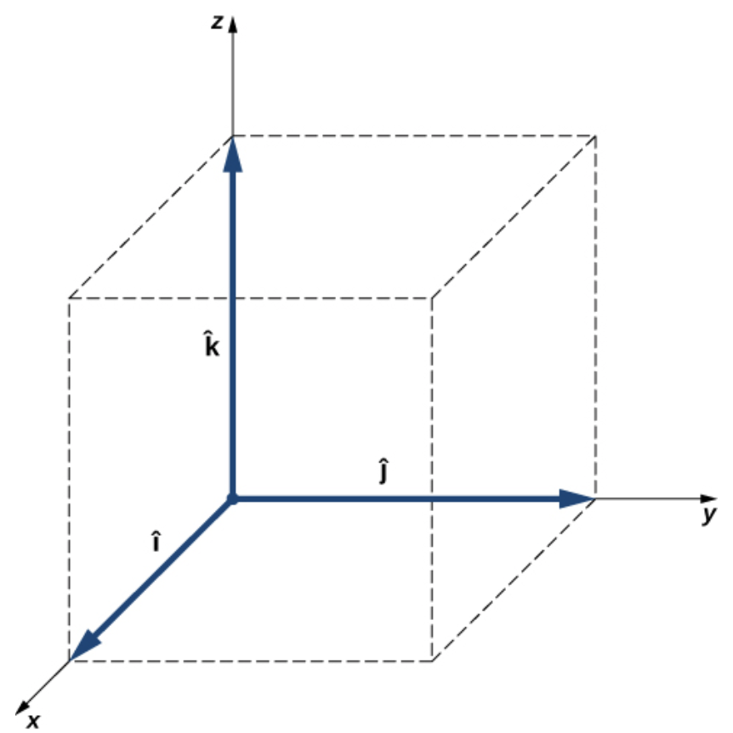
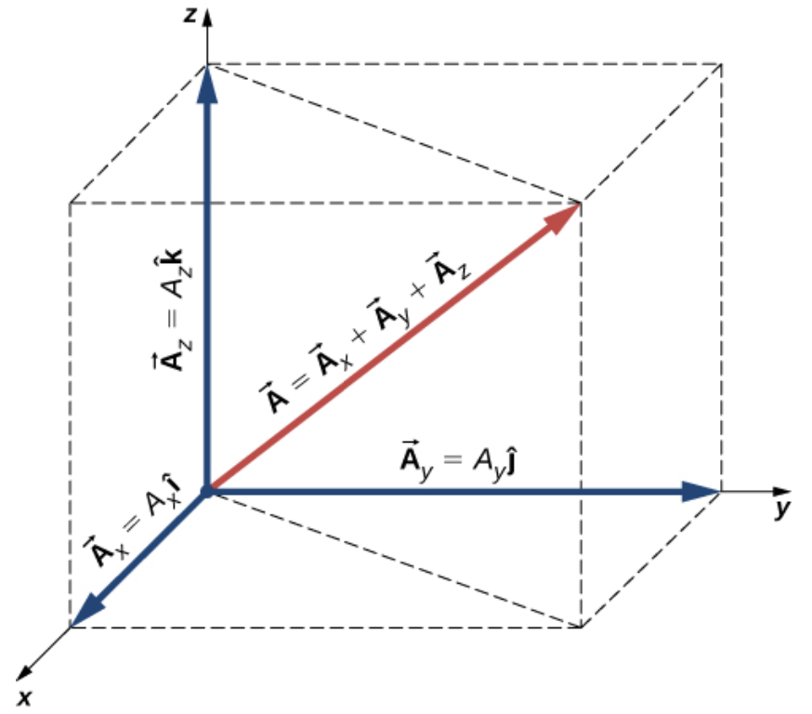
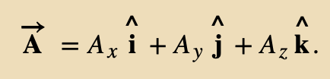

Vectors in Three Dimensions
Three unit vectors define a Cartesian system in three-dimensional space. The order in which these unit vectors appear defines the orientation of the coordinate system. The order shown here defines the right-handed orientation.
A vector in three-dimensional space is the vector sum of its three vector components.

Slide 18
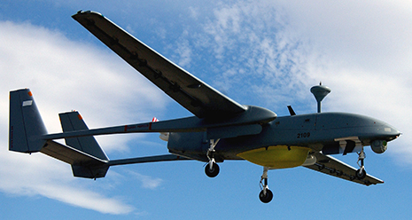
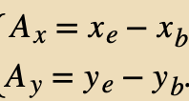

Vectors in Three Dimensions
The drone IAI Heron in flight.
(credit: SSgt Reynaldo Ramon, USAF)
A vector in three-dimensional space is the vector sum of its three vector components.
Example
During a takeoff of IAI Heron, its position with respect to a control tower is 100 m above the ground, 300 m to the east, and 200 m to the north. One minute later, its position is 250 m above the ground, 1200 m to the east, and 2100 m to the north. What is the drone’s displacement vector with respect to the control tower? What is the magnitude of its displacement vector?

Slide 19






Algebra of Vectors
Vectors can be added together and multiplied by scalars.
Vector addition is associative
Vector addition is commutative
Vector multiplication by a sum of scalars is distributive
Scalar multiplication by a sum of vectors is distributive
For example, a vector antiparallel to vector
can be expressed simply by multiplying it by the scalar α = −1

Slide 20


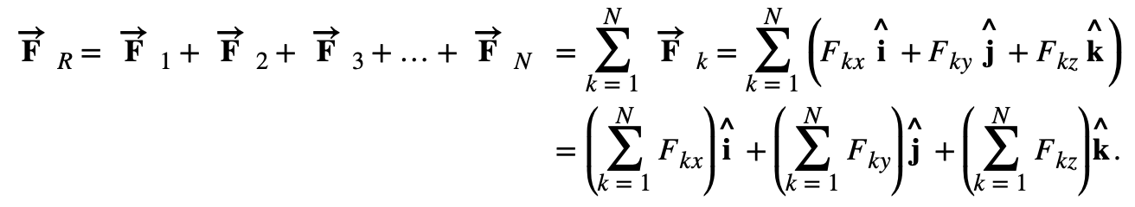
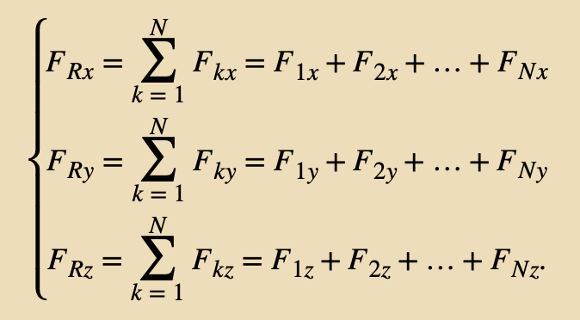

Algebra of Vectors
Analytical methods can be used to find components of a resultant of many vectors. For example, if we are to sum up N vectors
where each vector is
The resultant vector will be
Therefore, scalar components of the resultant vector are
And the resultant in vector component form

Slide 21

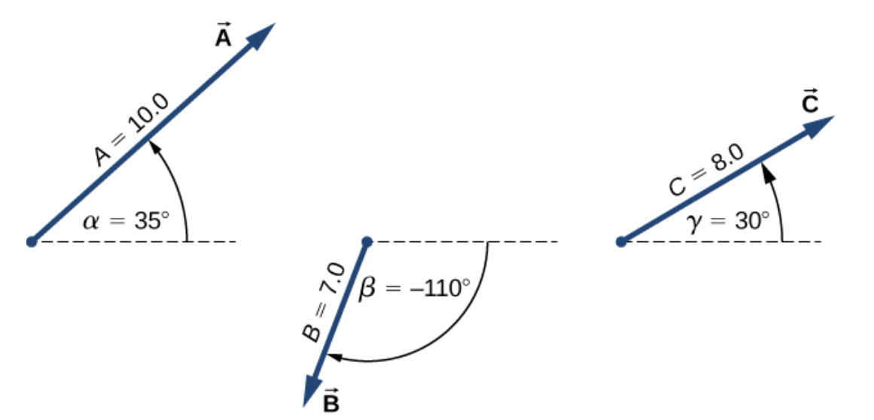
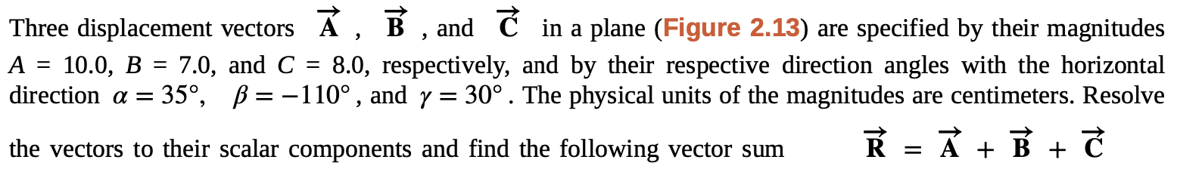
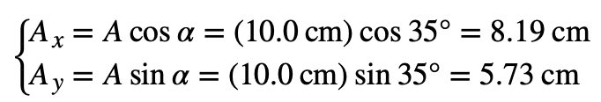
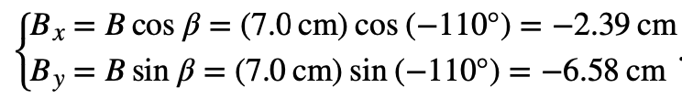



Algebra of Vectors
Example
The resultant vector is

Slide 22


Algebra of Vectors
Assignment 3

Slide 23




Products of Vectors
A vector can be multiplied by another vector but may not be divided by another vector.
There are two kinds of products of vectors used broadly in physics and engineering.
The Scalar Product of Two Vectors (the Dot Product)
The Vector Product of Two Vectors (the Cross Product)
The scalar product is a scalar (number)
The vector product is a vector!

Slide 24




Products of Vectors
A vector can be multiplied by another vector but may not be divided by another vector.
The Scalar Product of Two Vectors (the Dot Product)
The scalar product is a scalar (number)
Example
Find the scalar product

Slide 25

Products of Vectors
A vector can be multiplied by another vector but may not be divided by another vector.
The Scalar Product of Two Vectors (the Dot Product)
The scalar product is a scalar (number)
Assignment 4
Find the scalar products $\vec{A}∙\vec{B}$ and $\vec{A}∙\vec{C}$

Slide 26


Products of Vectors
A vector can be multiplied by another vector but may not be divided by another vector.
The Scalar Product of Two Vectors (the Dot Product)
The scalar product is a scalar (number)
Scalar multiplication of vectors is commutative
and obeys the distributive law

Slide 27





Products of Vectors
A vector can be multiplied by another vector but may not be divided by another vector.
using
and
and
The Scalar Product of Two Vectors (the Dot Product)
The scalar product is a scalar (number)
The scalar product simplifies to
and

Slide 28




Products of Vectors
A vector can be multiplied by another vector but may not be divided by another vector.
Example
Three dogs are playing with a stick.

Slide 29

Products of Vectors
Assignment 5:
Three dogs are playing with a stick.

Slide 30



Products of Vectors
A vector can be multiplied by another vector but may not be divided by another vector.
The vector product $\vec{B} × \vec{A}$ is a vector antiparallel to vector $\vec{A} × \vec{B}$.
The Vector Product of Two Vectors (the Cross Product)
The vector product is a vector!

Slide 31


Products of Vectors
The corkscrew right-hand rule can be used to determine the direction of the cross product $\vec{A} × \vec{B}$ . Place a corkscrew in the direction perpendicular to the plane that contains vectors $\vec{A}$ and $\vec{B}$ and turn it in the direction from the first to the second vector in the product. The direction of the cross product is given by the progression of the corkscrew.
Upward movement means the cross-product vector points up.
Downward movement means the cross-product vector points downward.

Slide 32


Products of Vectors
Example
To loosen a rusty nut, a 20.00-N force is applied to the wrench handle at angle φ = 40° and at a distance of 0.25 m from the nut, as shown in Figure in the left (a). Find the magnitude and direction of the torque applied to the nut.
What would the magnitude and direction of the torque be if the force were applied at angle φ = 45°, as shown in Figure (b)? For what value of angle φ does the torque have the largest magnitude?
A wrench provides grip and mechanical advantage in applying torque to turn a nut.
Turn counterclockwise to loosen the nut.
Turn clockwise to tighten the nut.
(a)
(b)
so
The wrench is most effective when we apply the force perpendicular to the wrench handle.

Slide 33

Products of Vectors
Assignment 6:
Also, determine the direction of the resulting vector.

Slide 34




Products of Vectors
The cross product is distributive:
For unit vectors, let’s apply
we get
and using corkscrew rule
The diagram of the cyclic order of the unit vectors of the axes.
The only cross products where the unit vectors appear in the cyclic order. These products have the positive sign.
(d) Two examples of cross products where the unit vectors do not appear in the cyclic order. These products have the negative sign.

Slide 35


Products of Vectors
We can show that
In this expression, the scalar components of the cross-product vector are
Assignment 7
Problem-solving skills are essential to your success in physics.
(credit: “scui3asteveo”/Flickr)

Slide 36
Attribution
These slides are a derivative of the “University Physics Vol. 1” slides by OpenStax, used under a Creative Commons Attribution 4.0 license by Mkhitar Hobosyan.

