Slide 1
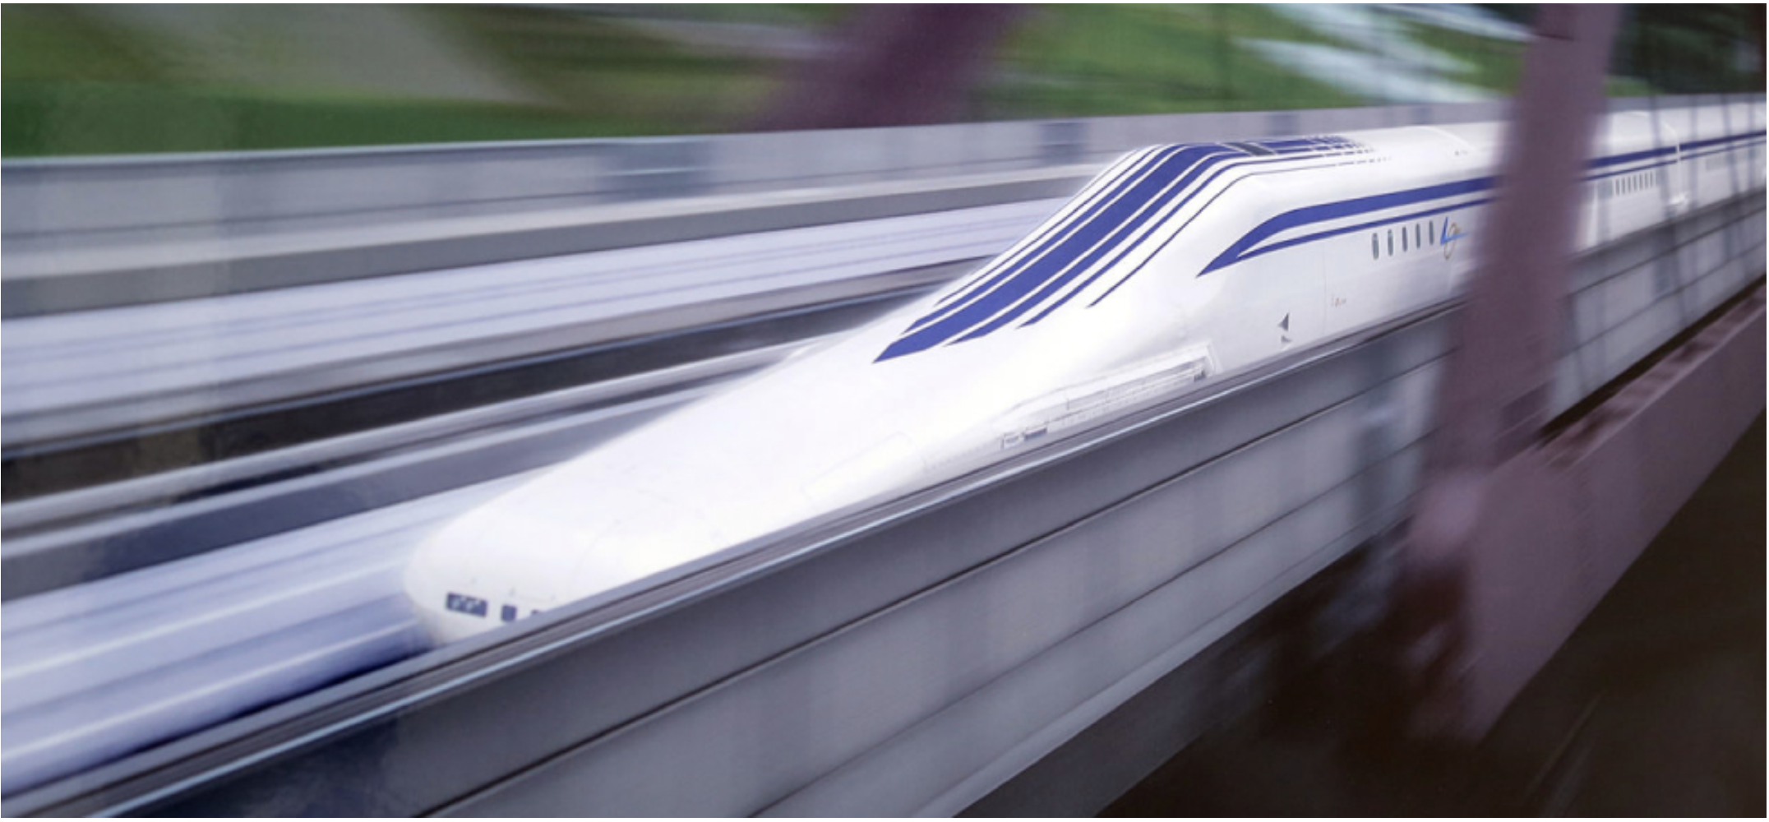

PHYS 2425
Physics for Scientists
and Engineers I
Chapter 3
Motion along a
straight line
Download the textbook for free at https://openstax.org/details/books/university-physics-volume-1
Image credit: modification of work by “Maryland GovPics”/Flickr

Slide 2


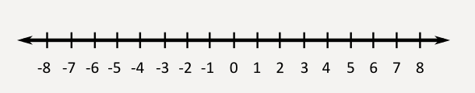
Position, Displacement, and Average Velocity
Position of an object shows
where it is at any particular time.
The position is defined in terms of a frame of reference. You need to
Specify a coordinate axis
Choose starting point to measure the motion
  For one dimensional motion, we usually choose x coordinate (horizontal motion) or y coordinate (vertical motion)
These cyclists in Vietnam can be described by their position relative to buildings or a canal. Their motion can be described by their change in position, or displacement, in a frame of reference.
(credit: Suzan Black)
(credit: http://www.projectglobalawakening.com/cartesian-coordinate-system/)

Slide 3
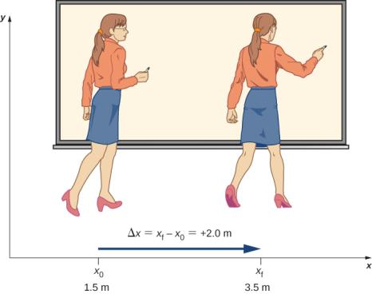


Position, Displacement, and Average Velocity
If an object moves relative to a frame of reference, then the object’s position changes. This change in position is called displacement. The word displacement implies that an object has moved or has been displaced.
Displacement Δx is the change in position of an object:
The +2.0-m displacement of the professor relative to Earth is represented by an arrow pointing to the right.
Displacement is a vector
(has magnitude and direction)
where Δx is displacement, x_{f} is the final position, and x₀ is the initial position.
A professor paces left and right while lecturing. Her position relative to Earth is given by x.
The total displacement Δx_{Total} is the sum of the individual displacements where Δx_{i} are the individual displacements.

Slide 4
Position, Displacement, and Average Velocity
If an object moves relative to a frame of reference, then the object’s position changes. This change in position is called displacement. The word displacement implies that an object has moved or has been displaced.
Displacement Δx is the change in position of an object:
Example
A cyclist rides 8.0 km east, then he turns and heads west 3.2 km. Finally, he rides east for 16.0 km. a) What is the total displacement of the cyclist? B) What is the distance traveled in this trip?
where Δx is displacement, x_{f} is the final position, and x₀ is the initial position.
The total displacement Δx_{Total} is the sum of the individual displacements where Δx_{i} are the individual displacements.

Slide 5

Position, Displacement, and Average Velocity
If an object moves relative to a frame of reference, then the object’s position changes. This change in position is called displacement. The word displacement implies that an object has moved or has been displaced.
Displacement Δx is the change in position of an object:
Assignment 1
A rabbit runs 40 ft to south, sees the farmer, turns back and runs 60 ft to north. What is the displacement of the rabbit?
where Δx is displacement, x_{f} is the final position, and x₀ is the initial position.
The total displacement Δx_{Total} is the sum of the individual displacements where Δx_{i} are the individual displacements.

Slide 6
Position, Displacement, and Average Velocity
If an object moves relative to a frame of reference, then the object’s position changes. This change in position is called displacement. The word displacement implies that an object has moved or has been displaced.
Displacement Δx is the change in position of an object:
Assignment 2
The puppy runs 8.0 ft to west, then turns left and runs 15 ft south. What is the magnitude of puppy's total displacement?
where Δx is displacement, x_{f} is the final position, and x₀ is the initial position.
The total displacement Δx_{Total} is the sum of the individual displacements where Δx_{i} are the individual displacements.

Slide 7
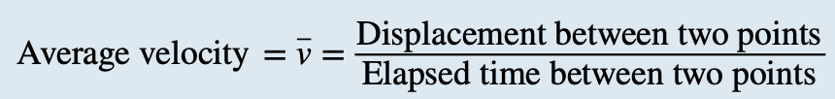

Position, Displacement, and Average Velocity
The average velocity is the total displacement between two points divided by the time taken to travel between them
where x₁ and x₂ are the positions of an object at times t₁ and t₂ , respectively.
Note: average velocity is a vector and can be negative, depending on positions x₁ and x₂ .
Example
Jill sets out from her home to deliver flyers for her yard sale, traveling due east along her street lined with houses. At 0.5 km and 9 minutes later she runs out of flyers and has to retrace her steps back to her house to get more.
This takes an additional 9 minutes. After picking up more flyers, she sets out again on the same path, continuing where she left off, and ends up 1.0 km from her house. This third leg of her trip takes 15 minutes. At this point
she turns back toward her house, heading west. After 1.75 km and 25 minutes she stops to rest.
a. What is Jill’s total displacement when she stops to rest?
b. What is the magnitude of the final displacement?
c. What is the average velocity during her entire trip?
d. What is the total distance traveled?
e. Make a graph of position versus time.

Slide 8
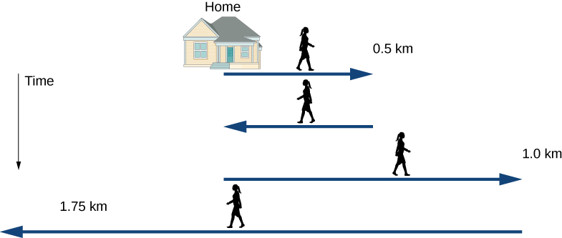
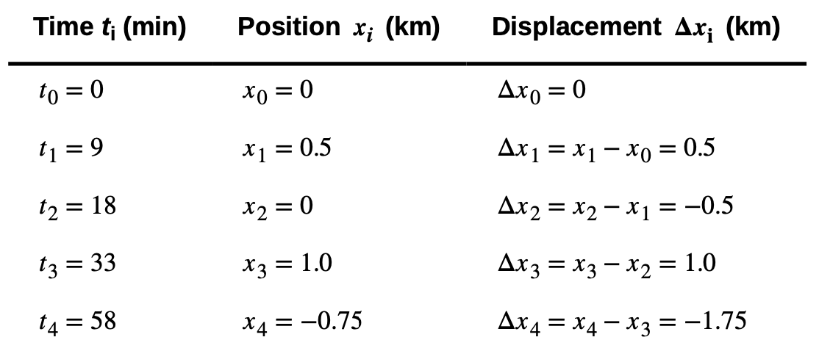
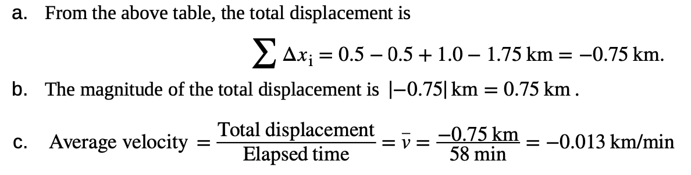
Position, Displacement, and Average Velocity
Example
Jill sets out from her home to deliver flyers for her yard sale, traveling due east along her street lined with houses. At 0.5 km and 9 minutes later she runs out of flyers and has to retrace her steps back to her house to get more.
This takes an additional 9 minutes. After picking up more flyers, she sets out again on the same path, continuing where she left off, and ends up 1.0 km from her house. This third leg of her trip takes 15 minutes. At this point
she turns back toward her house, heading west. After 1.75 km and 25 minutes she stops to rest.
a. What is Jill’s total displacement when she stops to rest?
b. What is the magnitude of the final displacement?
c. What is the average velocity during her entire trip?
d. What is the total distance traveled?
e. Make a graph of position versus time.

Slide 9
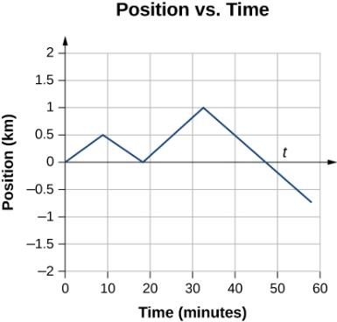
Position, Displacement, and Average Velocity
This graph depicts Jill’s position versus time.
The average velocity is the slope of a line connecting the initial and final points.
Example
Jill sets out from her home to deliver flyers for her yard sale, traveling due east along her street lined with houses. At 0.5 km and 9 minutes later she runs out of flyers and has to retrace her steps back to her house to get more.
This takes an additional 9 minutes. After picking up more flyers, she sets out again on the same path, continuing where she left off, and ends up 1.0 km from her house. This third leg of her trip takes 15 minutes. At this point
she turns back toward her house, heading west. After 1.75 km and 25 minutes she stops to rest.
a. What is Jill’s total displacement when she stops to rest?
b. What is the magnitude of the final displacement?
c. What is the average velocity during her entire trip?
d. What is the total distance traveled?
e. Make a graph of position versus time.
d. The total distance traveled (sum of magnitudes of individual displacements) is
e. We can graph Jill’s position versus time as a useful aid to see the motion; the graph is shown in figure above.

Slide 10
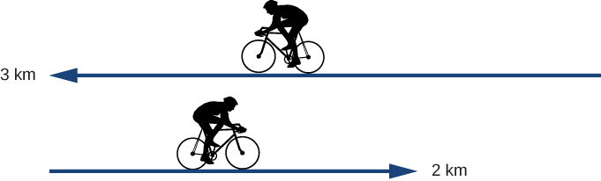
Position, Displacement, and Average Velocity
Displacement Δx is the change in position of an object:
Assignment 3
A cyclist rides 3 km west for 10 minutes and then turns around and rides 2 km east in 5 minutes.
What is his displacement?
What is the distance traveled?
What is his average velocity in km/h?
where Δx is displacement, x_{f} is the final position, and x₀ is the initial position.
The total displacement Δx_{Total} is the sum of the individual displacements where Δx_{i} are the individual displacements.

Slide 11
Position, Displacement, and Average Velocity
Assignment 4
John walks 12 meters from his apartment in the 10th floor to reach the elevator in 22 seconds, then rides the elevator which brings him to the ground floor at the street in 38 seconds. If the height of each floor is 2.8 meters, calculate the magnitude of average velocity for the John from his apartment to the street.
Displacement Δx is the change in position of an object:
where Δx is displacement, x_{f} is the final position, and x₀ is the initial position.
The total displacement Δx_{Total} is the sum of the individual displacements where Δx_{i} are the individual displacements.

Slide 12
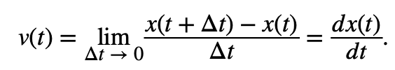

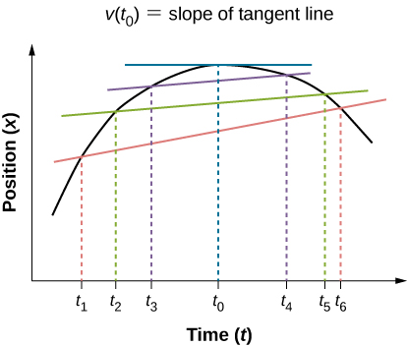
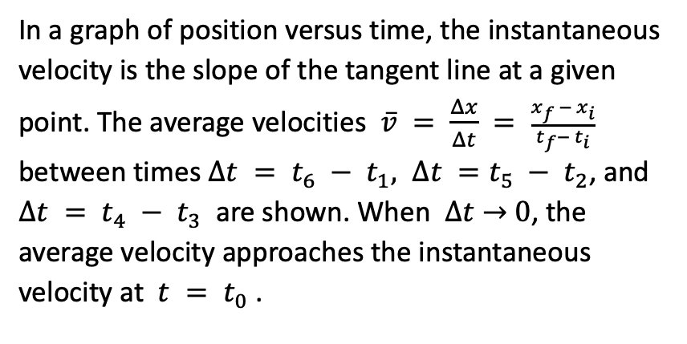
Instantaneous Velocity and Speed
The quantity that tells us how fast an object is moving anywhere along its path is the instantaneous velocity.
It is the average velocity between two points on the path in the limit that the time (and therefore the displacement) between the two points approaches zero.
By other words, the instantaneous velocity of an object is the limit of the average velocity as the elapsed time approaches zero, or the derivative of x with respect to t:
In a graph of position versus time, the instantaneous velocity is the slope of the tangent line at a given point. The average velocities $\overline{v} = \frac{Δx}{Δt} = \frac{x_{f }− x_{i}}{t_{f}−{ t}_{i}}$ between times $∆t = t_{6} − t_{1}, ∆t =t_{5} − t_{2}$, and $∆t = t_{4} −{ t}_{3}$ are shown. When $∆t$ → 0, the average velocity approaches the instantaneous velocity at $t = t_{0}$ .
Assignment 5
A particle moves along the x-axis according to
x(t) = 10t − 2t² m. What is the instantaneous velocity at t = 2 s and t = 3 s?

Slide 13
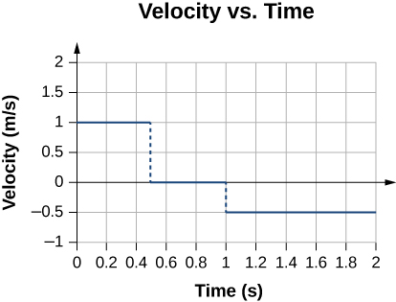
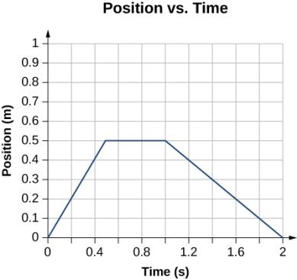



Instantaneous Velocity and Speed
Example
Given the position-versus-time graph of Figure below, find the velocity-versus-time graph.
The object starts out in the positive direction, stops for a short time, and then reverses direction, heading back toward the origin.
The velocity is positive for the first part of the trip, zero when the object is stopped, and negative when the object reverses direction.

Slide 14
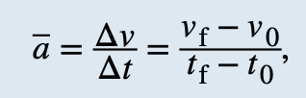
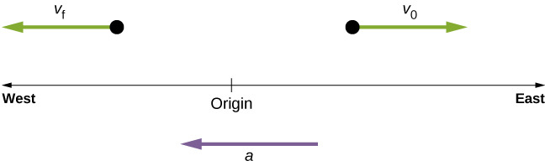
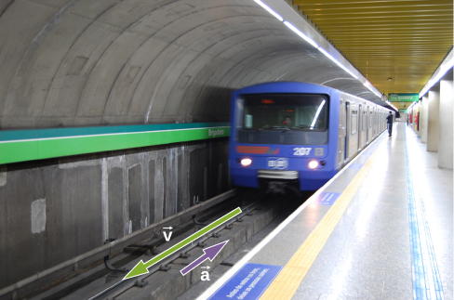
Average and Instantaneous Acceleration
Average acceleration is the rate at which velocity changes:
The bar over the a means average acceleration.
Acceleration is a vector in the same direction as the change in velocity, Δv . Since velocity is a vector, it can change in magnitude or in direction, or both. Acceleration is, therefore, a change in speed or direction, or both.
When an object slows down, its acceleration is opposite to the direction of its motion. Although this is commonly referred to as deceleration, we say the train is accelerating in a direction opposite to its direction of motion.
An object in motion with a velocity vector toward the east under negative acceleration comes to a rest and reverses direction. It passes the origin going in the opposite direction after a long enough time.
https://The moving man: set position –9, v=9, a=-3

Slide 15
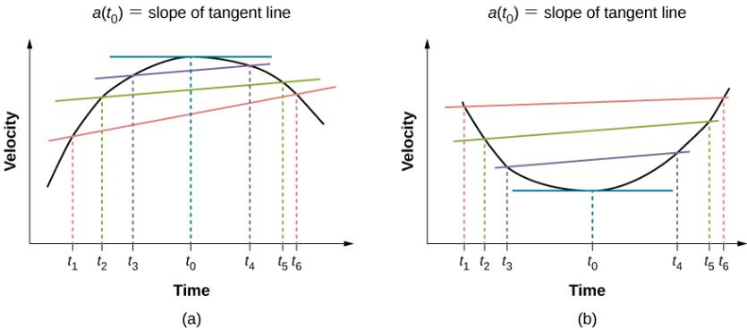
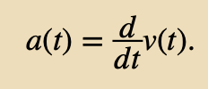

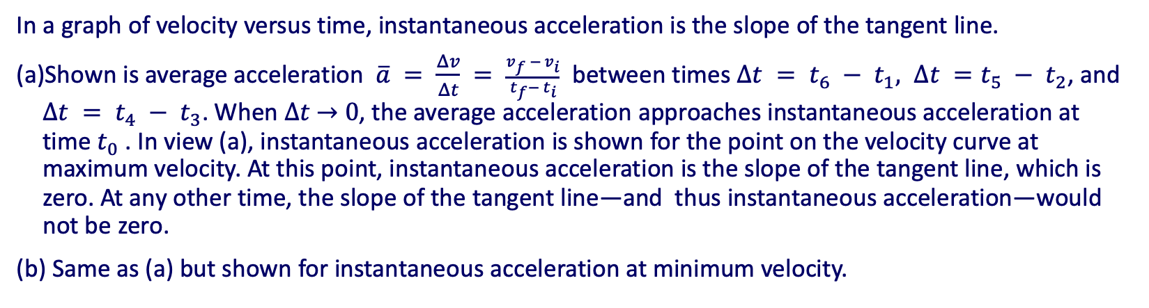
Average and Instantaneous Acceleration
Instantaneous acceleration is calculated using the same process discussed for instantaneous velocity.
Average acceleration
approaches instantaneous acceleration as Δt approaches zero.
In a graph of velocity versus time, instantaneous acceleration is the slope of the tangent line.
Shown is average acceleration $\overline{a} = \frac{Δv}{Δt} = \frac{v_{f }− v_{i}}{t_{f}−{ t}_{i}}$ between times $∆t = t_{6} − t_{1}, ∆t =t_{5} − t_{2}$, and $∆t = t_{4} −{ t}_{3}$. When $∆t$ → 0, the average acceleration approaches instantaneous acceleration at time $t_{0}$. In view (a), instantaneous acceleration is shown for the point on the velocity curve at maximum velocity. At this point, instantaneous acceleration is the slope of the tangent line, which is zero. At any other time, the slope of the tangent line—and thus instantaneous acceleration—would not be zero.
Same as (a) but shown for instantaneous acceleration at minimum velocity.

Slide 16
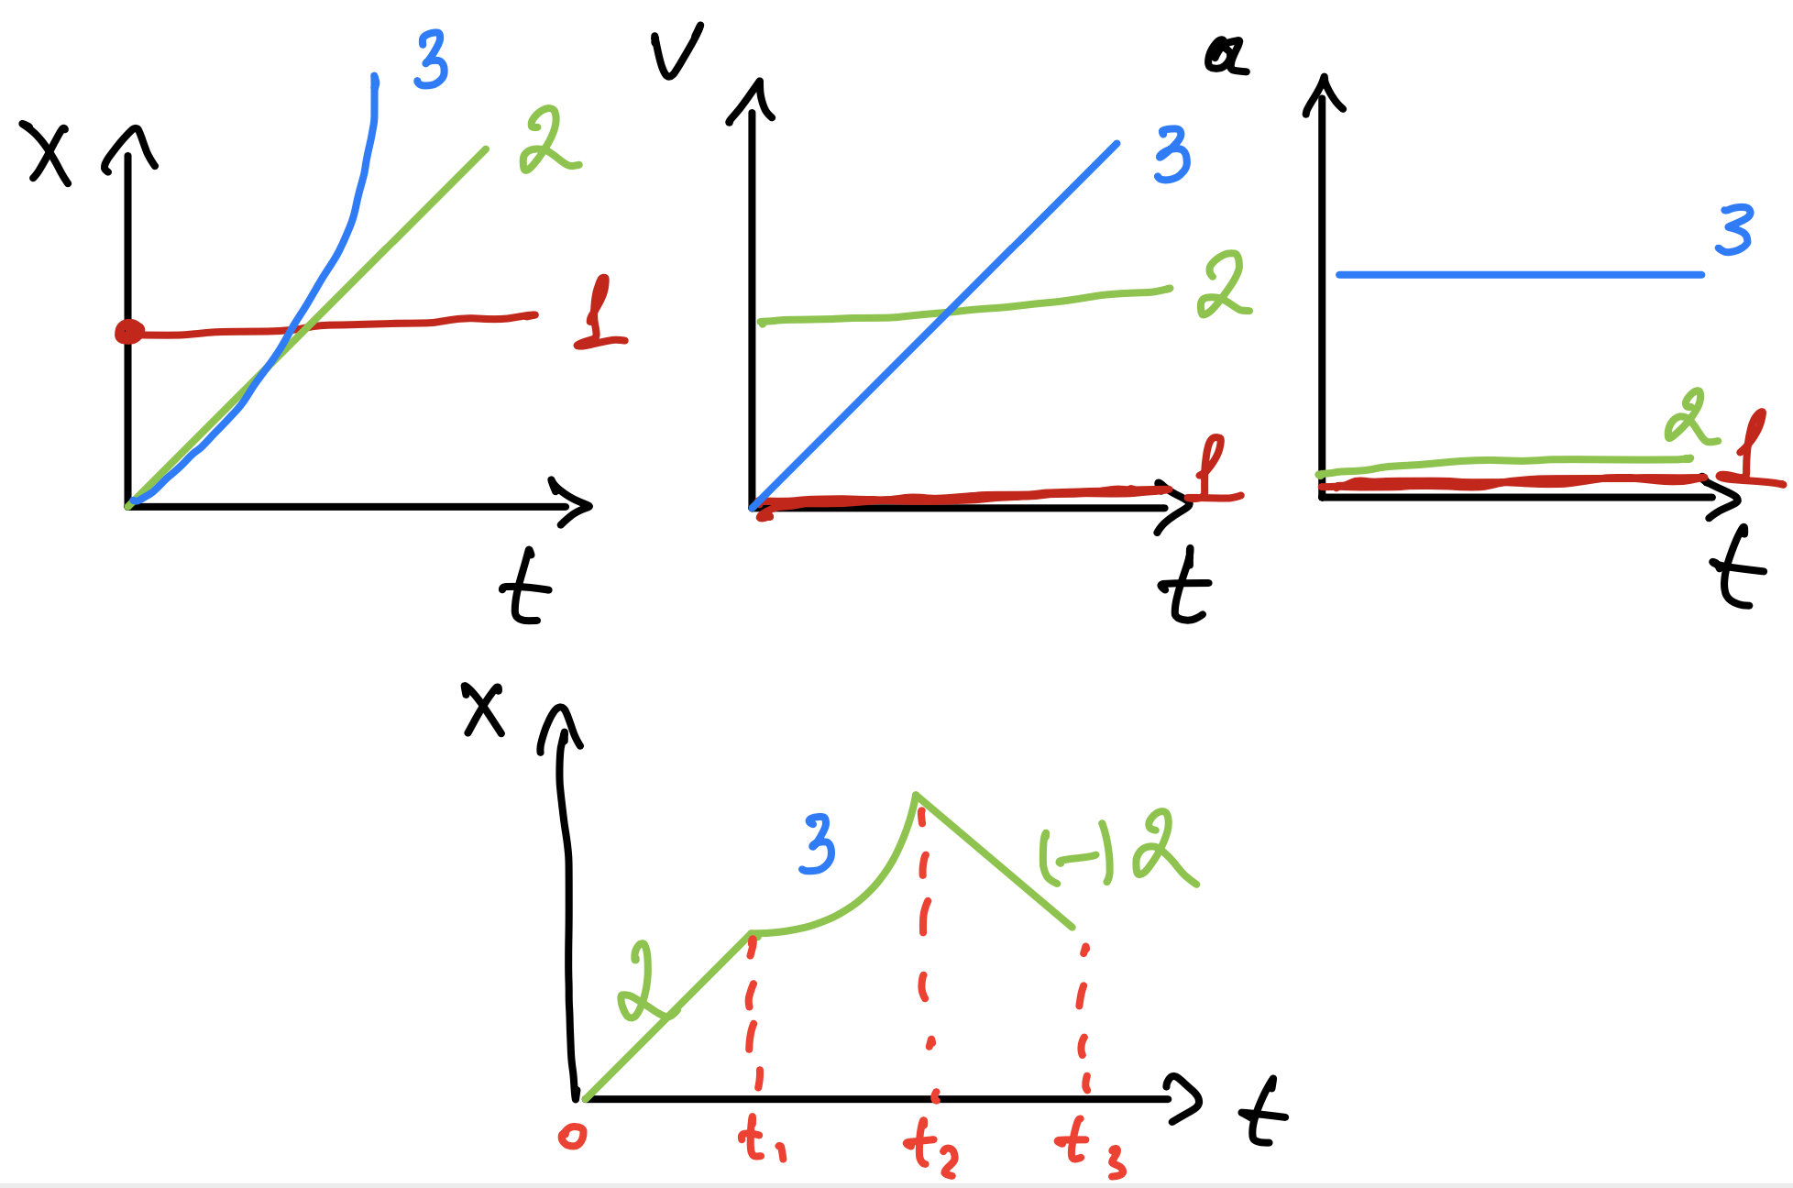
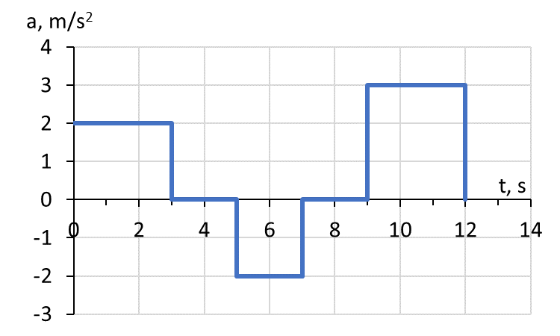
Average and Instantaneous Acceleration
Example
A particle starts from rest and accelerates as shown in the figure. Construct the velocity-time graph (with correct axis numbers and labels) and determine the total displacement.

Slide 17
Average and Instantaneous Acceleration
Assignment 6
A particle starts from rest and accelerates as shown in the figure. Construct the velocity-time graph (with correct axis numbers and labels).

Slide 18
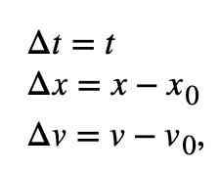









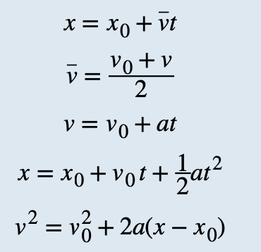





Motion with Constant Acceleration
If the acceleration of a particle varies in time, its motion can be complex and difficult to analyze.
However, at constant acceleration, the motion becomes predictable using kinematic equations.
simplified notation
Because velocity at constant acceleration varies linearly in time
where
Adding v₀ to each side of this equation and dividing by 2 gives
we get
substitute in
we get

Slide 19
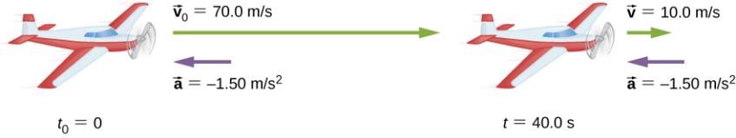
Motion with Constant Acceleration
Example
An airplane lands with an initial velocity of 70.0 m/s and then decelerates at 1.50 m/s² for 40.0 s. What is its final velocity?
The airplane lands with an initial velocity of 70.0 m/s and slows to a final velocity of 10.0 m/s before heading for the terminal. Note the acceleration is negative because its direction is opposite to its velocity, which is positive.

Slide 20
Motion with Constant Acceleration
Example
An airplane lands with an initial velocity of 70.0 m/s and then decelerates at 1.50 m/s² for 40.0 s. What is its final velocity?
The airplane lands with an initial velocity of 70.0 m/s and slows to a final velocity of 10.0 m/s before heading for the terminal. Note the acceleration is negative because its direction is opposite to its velocity, which is positive.
Assignment 7
A manned rocket accelerates at a rate of 20 m/s² during launch. How long does it take the rocket to reach a velocity of 400 m/s?

Slide 21
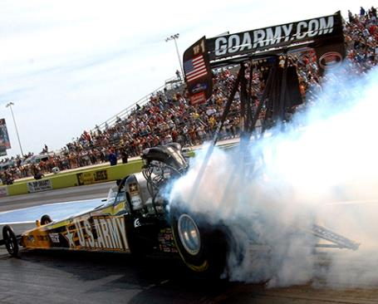
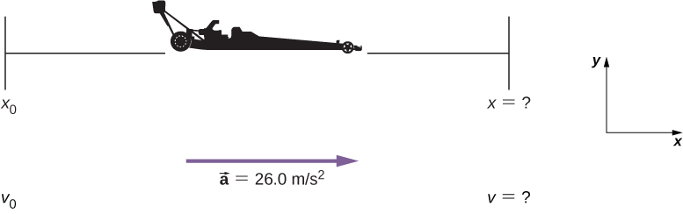
Motion with Constant Acceleration
Example
Dragsters can achieve an average acceleration of 26.0 m/s².
a) Suppose a dragster accelerates from rest at this rate for 5.56 s. How far does it travel in this time?
b) Calculate the final velocity of the dragster without using information about time. Report in mph.
Sketch of an accelerating dragster.
U.S. Army Top Fuel pilot Tony “The Sarge” Schumacher begins a race with a controlled burnout.
(credit: Lt. Col. William Thurmond. Photo Courtesy of U.S. Army.)

Slide 22
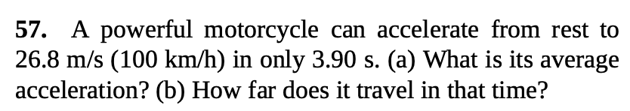
Motion with Constant Acceleration
Assignment 8

Slide 23
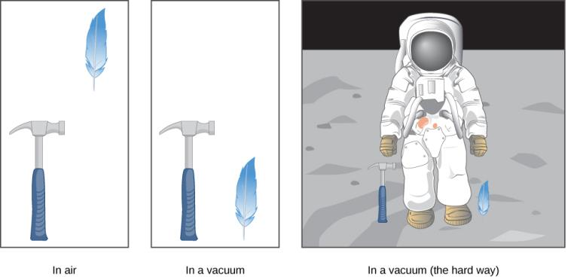

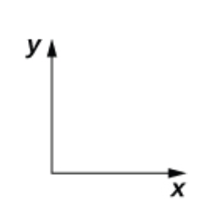

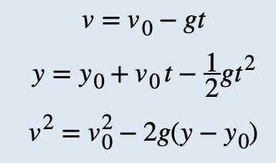
Free Fall
Free fall describes the motion of an object falling in a gravitational field, such as near the surface of Earth.
If air resistance and friction are negligible, then in a given location all objects fall toward the center of Earth with the same constant acceleration, independent of their mass.
Acceleration due to gravity is
g
If we define the upward direction as positive, then
And our kinematic equations for y direction become
A hammer and a feather fall with the same constant acceleration if air resistance is negligible. This is a general characteristic of gravity not unique to Earth, as astronaut David R. Scott demonstrated in 1971 on the Moon, where the acceleration from gravity is only 1.67 m/s² and there is no atmosphere.

Slide 24
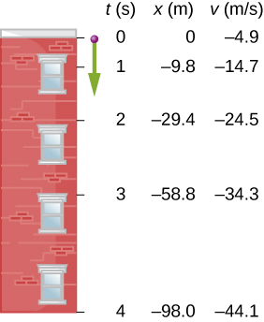
Free Fall
Free fall describes the motion of an object falling in a gravitational field, such as near the surface of Earth.
If air resistance and friction are negligible, then in a given location all objects fall toward the center of Earth with the same constant acceleration, independent of their mass.
Acceleration due to gravity is
g
Example
If we define the upward direction as positive, then
And our kinematic equations for y direction become
Figure shows the positions of a ball, at 1-s intervals, with an initial velocity of 4.9 m/s downward, that is thrown from the top of a 98-m-high building.
How much time elapses before the ball reaches the ground?
What is the velocity when it arrives at the ground?
The positions and velocities at 1-s intervals of a ball thrown downward from a tall building at 4.9 m/s.

Slide 25
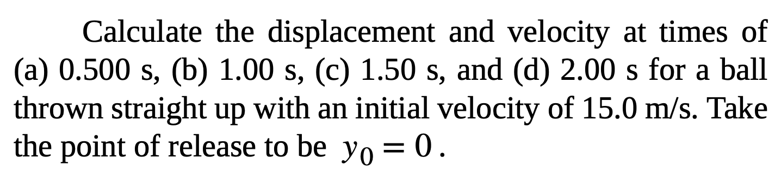
Free Fall
Free fall describes the motion of an object falling in a gravitational field, such as near the surface of Earth.
If air resistance and friction are negligible, then in a given location all objects fall toward the center of Earth with the same constant acceleration, independent of their mass.
Acceleration due to gravity is
g
If we define the upward direction as positive, then
And our kinematic equations for y direction become
Assignment 9

Slide 26
Attribution
These slides are a derivative of the “University Physics Vol. 1” slides by OpenStax, used under a Creative Commons Attribution 4.0 license by Mkhitar Hobosyan.

