Slide 1
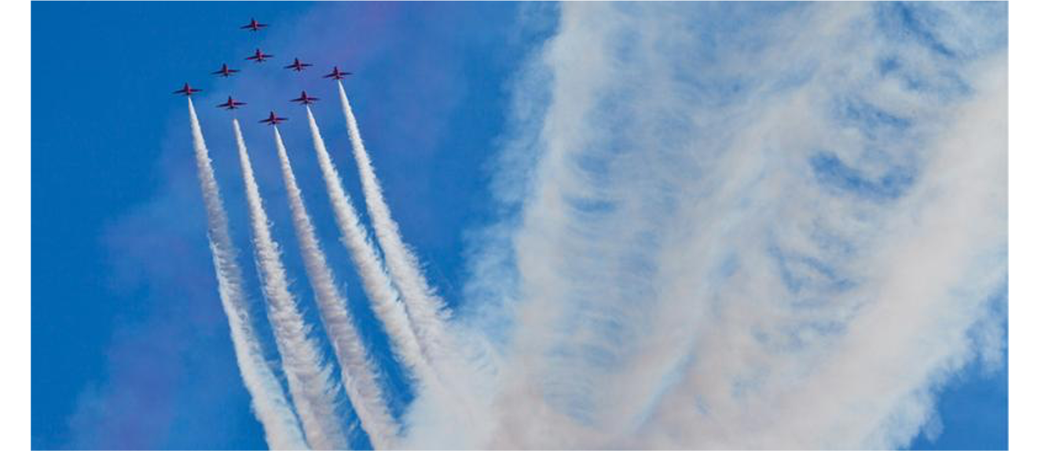

PHYS 2425
Physics for Scientists
and Engineers I
Chapter 4
Motion in Two and Three Dimensions
Download the textbook for free at https://openstax.org/details/books/university-physics-volume-1
Image credit: modification of work by Phil Long

Slide 2



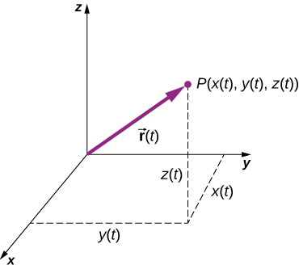
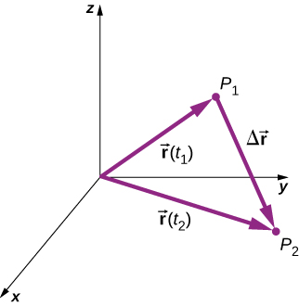

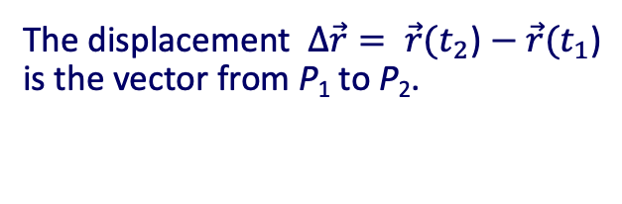
Displacement and Velocity Vectors
Displacement and velocity in two or three dimensions are straightforward extensions of the one-dimensional definitions.
They are vector quantities, so calculations with them should follow the rules of vector algebra.
The position vector from the origin of the coordinate system to point P is
If the particle is moving, the variables x, y, and z are functions of time (t):
For moving particle, the
displacement vector
Follows the rules of vector algebra.
A three-dimensional coordinate system with a particle at position P(x(t), y(t), z(t)).
The displacement $∆\vec{r}= \vec{r}(t_{2}$) $− \vec{r}(t_{1}\text{)}$ is the vector from P₁ to P₂.

Slide 3
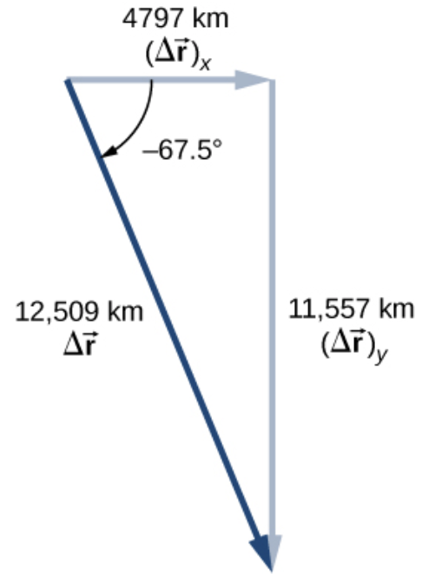
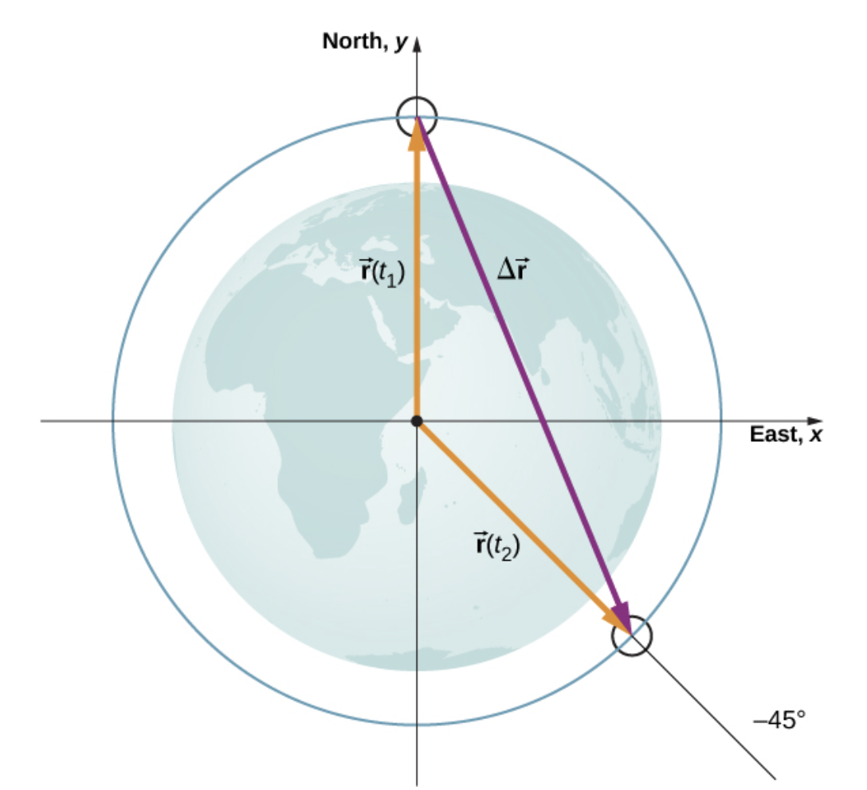
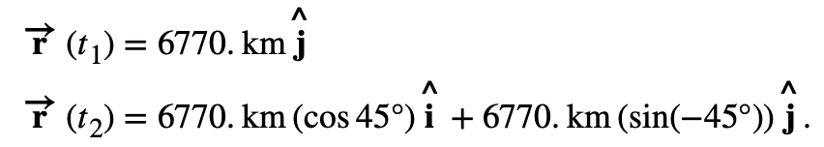
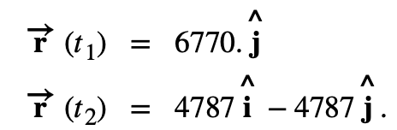



Displacement and Velocity Vectors
Example
A satellite is in a circular polar orbit around Earth at an altitude of 400 km, meaning, it passes directly overhead at the North and South Poles. What is the magnitude and direction of the displacement vector from when it is directly over the North Pole to when it is at −45° latitude?
We take the radius of Earth as 6370 km, so the length of each position vector is 6770 km.
In unit vector notation, the position vectors are
or
magnitude direction

Slide 4

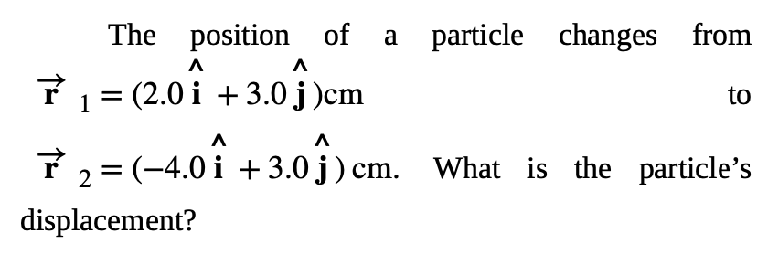

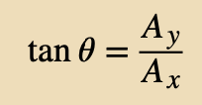
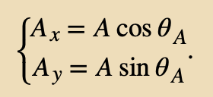
Displacement and Velocity Vectors
Assignment 1

Slide 5
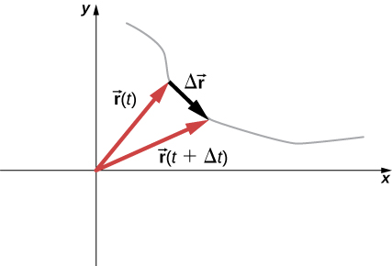
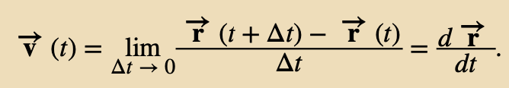

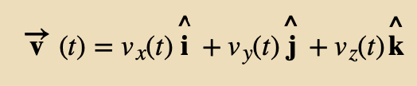
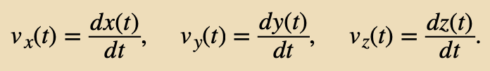
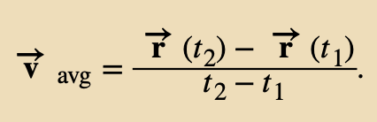
Displacement and Velocity Vectors
Let’s say particle is moving along the trajectory in the figure.
The displacement is shown. The instantaneous velocity vector is
As Δt goes to zero, the velocity vector becomes tangent to the path of the particle at time t.
A particle moves along a path given by the gray line. In the limit as Δt approaches zero, the velocity vector becomes tangent to the path of the particle.
Since
we can write
where
The average velocity

Slide 6
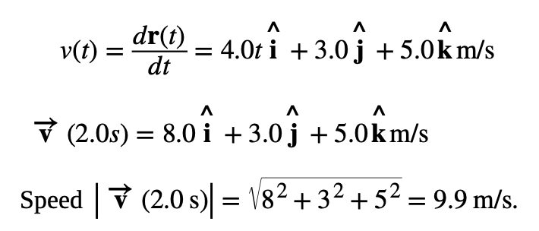
Displacement and Velocity Vectors
Example
we can write
where
The average velocity

Slide 7

Displacement and Velocity Vectors
Let’s say particle is moving along the trajectory in the figure.
The displacement is shown. The instantaneous velocity vector is
Assignment 2
As Δt goes to zero, the velocity vector becomes tangent to the path of the particle at time t.
The position function of a particle is
Since
What is the instantaneous velocity at t = 3 s?
we can write
where
The average velocity

Slide 8
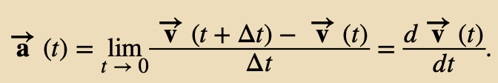
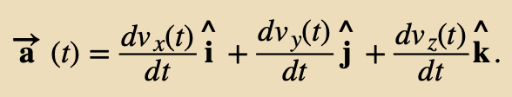
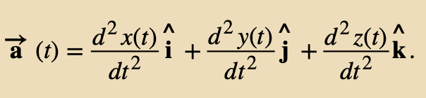


Acceleration Vector
The acceleration vector at any point in time along its trajectory is the instantaneous acceleration:
The acceleration in terms of components is
Since the velocity is the derivative of the position function, we can write the acceleration in terms of the second derivative of the position function:
Example
The derivative is taken component by component:
A particle has a velocity of
What is the acceleration function?

Slide 9



Acceleration Vector
The acceleration vector at any point in time along its trajectory is the instantaneous acceleration:
The acceleration in terms of components is
Since the velocity is the derivative of the position function, we can write the acceleration in terms of the second derivative of the position function:
The velocity function
Example
A particle has a position function
The acceleration vector
(constant in the negative x-direction)
What is the velocity?
What is the acceleration?
no time
dependence

Slide 10
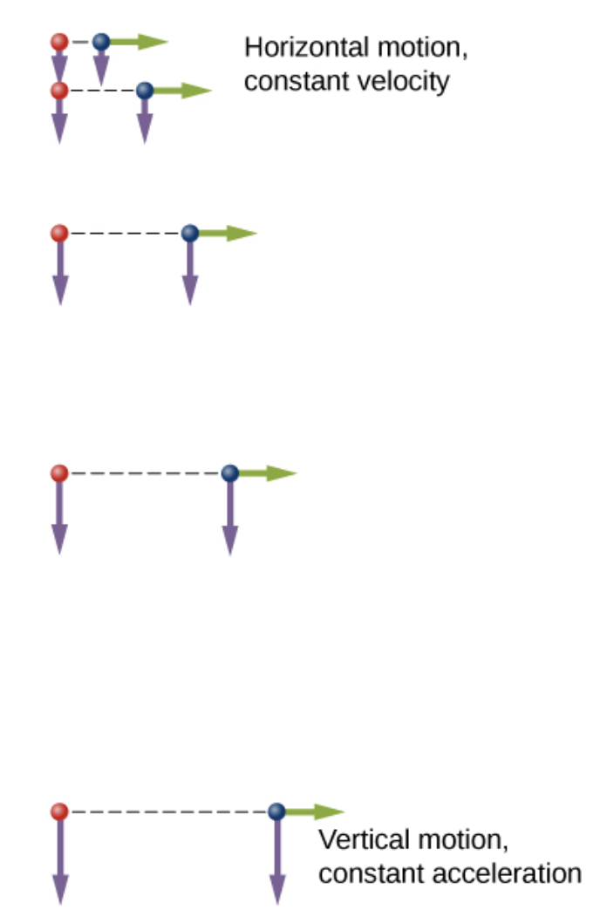
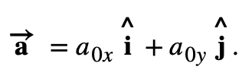
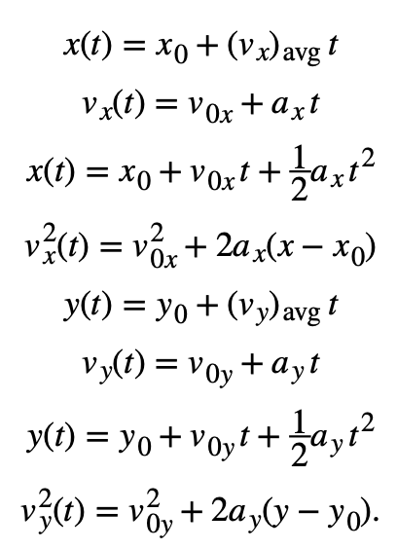
Constant Acceleration
Multidimensional motion with constant acceleration can be treated the same way as for one-dimensional motion we saw in previous chapter.
In two dimension the (constant) acceleration vector is
A diagram of the motions of two identical balls: one falls from rest and the other has an initial horizontal velocity. Each subsequent position is an equal time interval.
Arrows represent the horizontal and vertical velocities at each position.
Despite the difference in horizontal velocities, the vertical velocities and positions are identical for both balls, which shows the vertical and horizontal motions are independent.
kinematic equations become
The subscript 0 denotes the initial position or velocity.

Slide 11
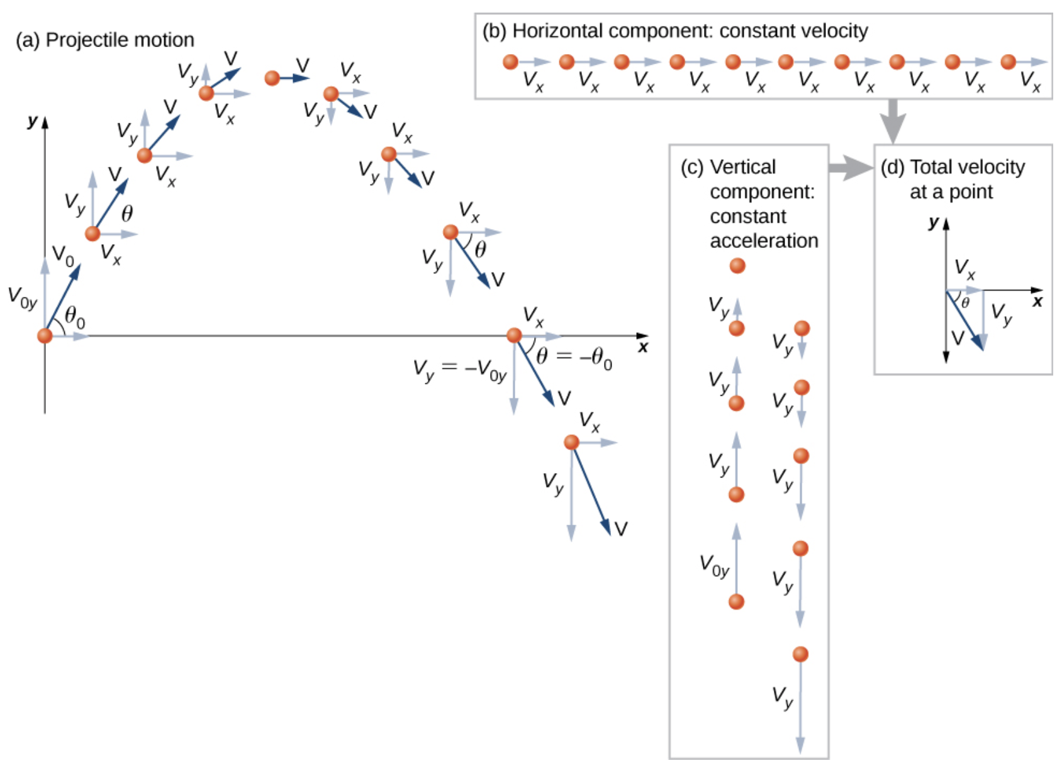
Projectile Motion
Projectile motion is the motion of an object thrown or projected into the air, subject only to acceleration as a result of gravity.
We analyze two-dimensional projectile motion by breaking it into two independent one-dimensional motions along the vertical and horizontal axes.
The horizontal motion is simple, because a_{x} = 0 and v_{x} is a constant.
The velocity in the vertical direction begins to decrease as the object rises. At its highest point, the vertical velocity is zero. As the object falls toward Earth again, the vertical velocity increases again in magnitude but points in the opposite direction to the initial vertical velocity.
The x and y motions are recombined to give the total velocity at any given point on the trajectory.

Slide 12


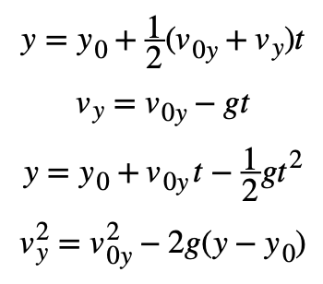
Projectile Motion
Defining the positive direction to be upward, the components of acceleration are
Because gravity is vertical, a_{x}=0.
Kinematic equations become
Horizontal Motion
Vertical Motion
We analyze two-dimensional projectile motion by breaking it into two independent one-dimensional motions along the vertical and horizontal axes.
The horizontal motion is simple, because a_{x} = 0 and v_{x} is a constant.
The velocity in the vertical direction begins to decrease as the object rises. At its highest point, the vertical velocity is zero. As the object falls toward Earth again, the vertical velocity increases again in magnitude but points in the opposite direction to the initial vertical velocity.
The x and y motions are recombined to give the total velocity at any given point on the trajectory.
The only common variable between the motions is time t

Slide 13
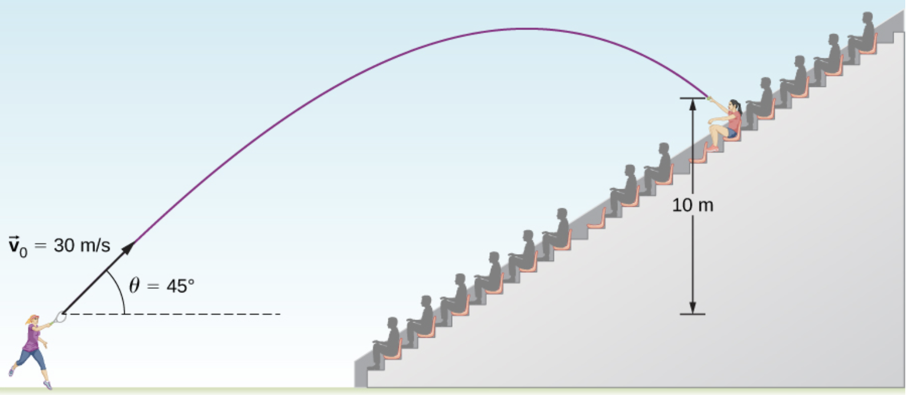
Projectile Motion
Defining the positive direction to be upward, the components of acceleration are
Example
A tennis player wins a match at Arthur Ashe stadium and hits a ball into the stands at 30.0 m/s and at an angle 45.0° above the horizontal. On its way down, the ball is caught by a spectator 10.0 m above the point where the ball was hit. (a) Calculate the time it takes the tennis ball to reach the spectator. (b) What are the magnitude and direction of the ball’s velocity at impact?
Because gravity is vertical, a_{x}=0.
Kinematic equations become
Horizontal Motion
Vertical Motion
The only common variable between the motions is time t

Slide 14
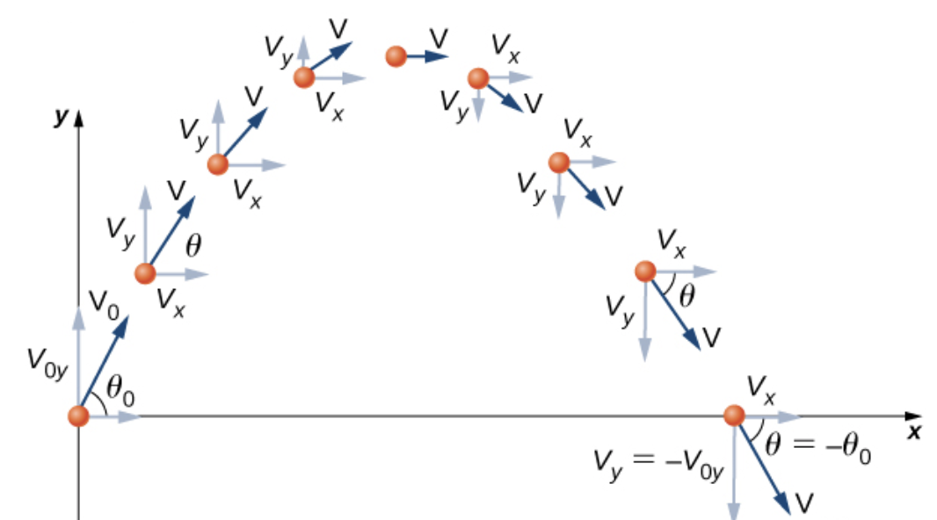
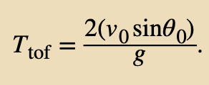
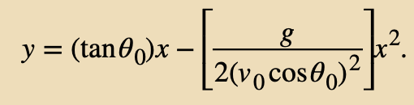


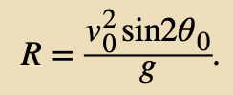
Time of Flight, Trajectory, and Range
The time of flight of a projectile that is both launched and impacts on a flat horizontal surface:
The trajectory of a projectile can be found by eliminating the time variable t from the kinematic equations:
This is of the form y = ax + bx², which is an equation of a parabola with coefficients
From the trajectory equation we can also find the range:
The range is the horizontal distance from launch to impact site.

Slide 15
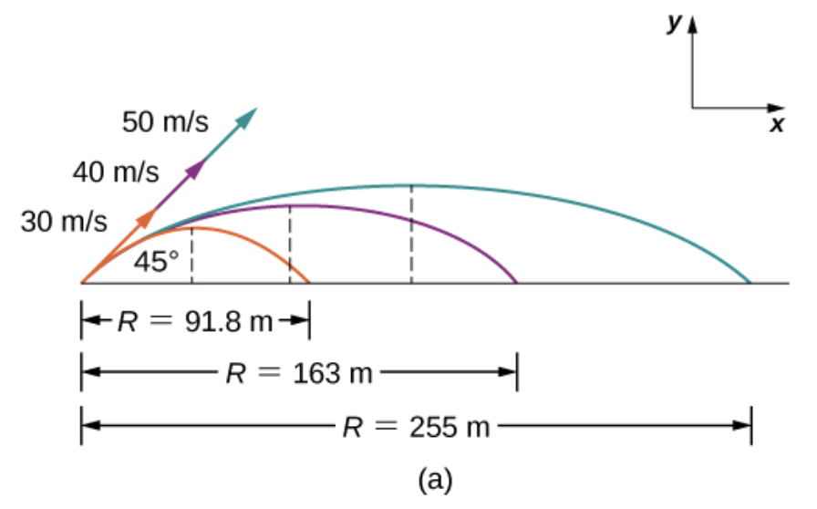
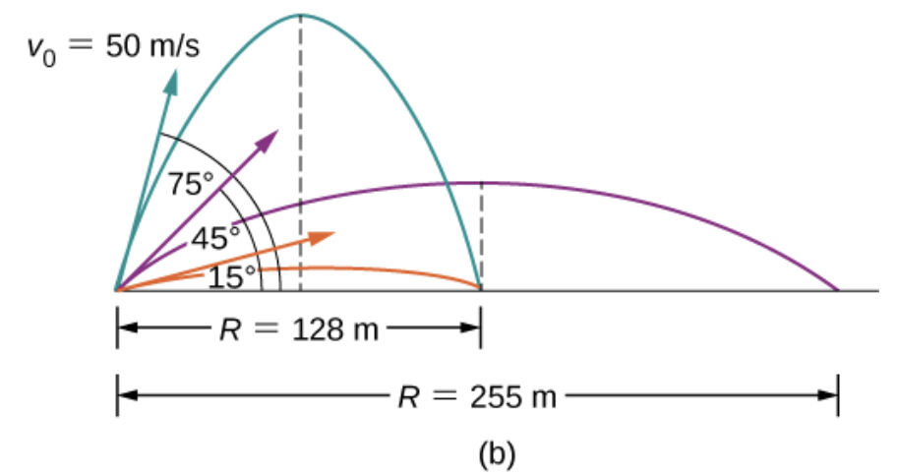
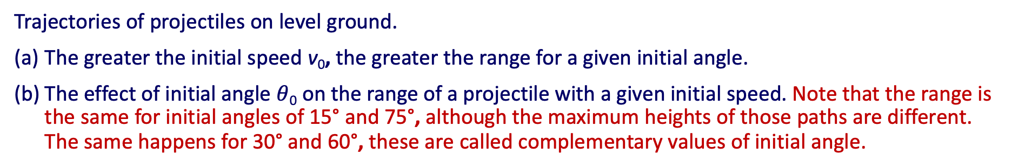
Time of Flight, Trajectory, and Range
Trajectories of projectiles on level ground.
The greater the initial speed v₀, the greater the range for a given initial angle.
The effect of initial angle $θ$₀ on the range of a projectile with a given initial speed. Note that the range is the same for initial angles of 15° and 75°, although the maximum heights of those paths are different. The same happens for 30° and 60°, these are called complementary values of initial angle.

Slide 16
Time of Flight, Trajectory, and Range
Assignment 3
An astronaut on a strange planet finds that she can jump a horizontal distance of 10 m if her initial speed is 2.5 m/s and the angle of take-off is 30⁰. What is the free fall acceleration on that planet?

Slide 17
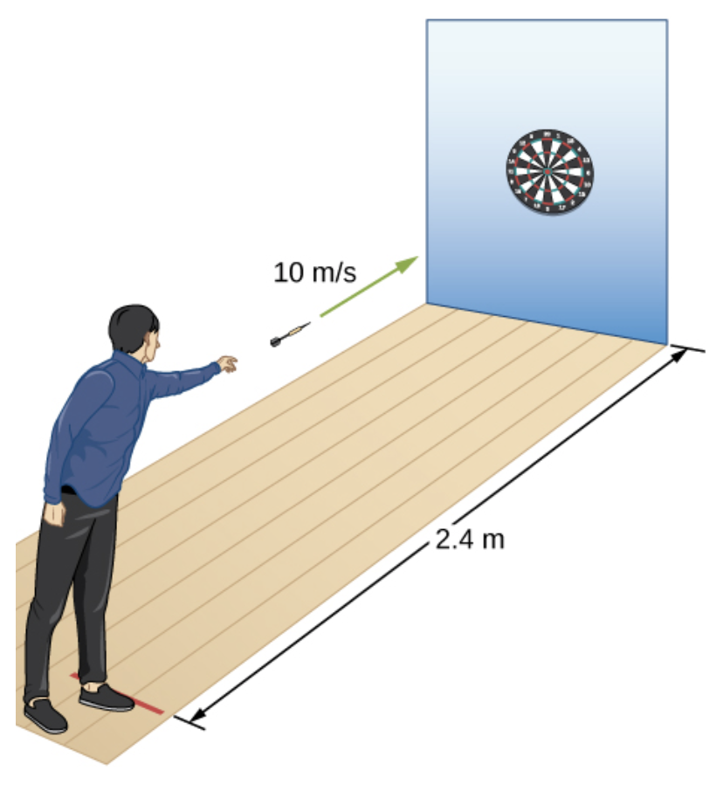
Acceleration Vector
Example
A dart is thrown horizontally at a speed of 10 m/s at the bull’s-eye of a dartboard 2.4 m away, as in the figure.
How far below the intended target does the dart hit?
What does your answer tell you about how proficient dart players throw their darts?

Slide 18
Time of Flight, Trajectory, and Range
Assignment 4
A bullet is shot horizontally from shoulder height (1.5 m) with an initial speed 200 m/s.
(a) How much time elapses before the bullet hits the ground?
(b) How far does the bullet travel horizontally?

Slide 19
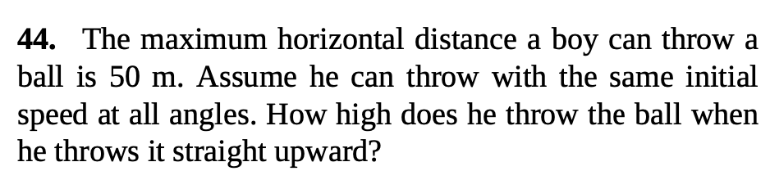
Time of Flight, Trajectory, and Range
Example

Slide 20
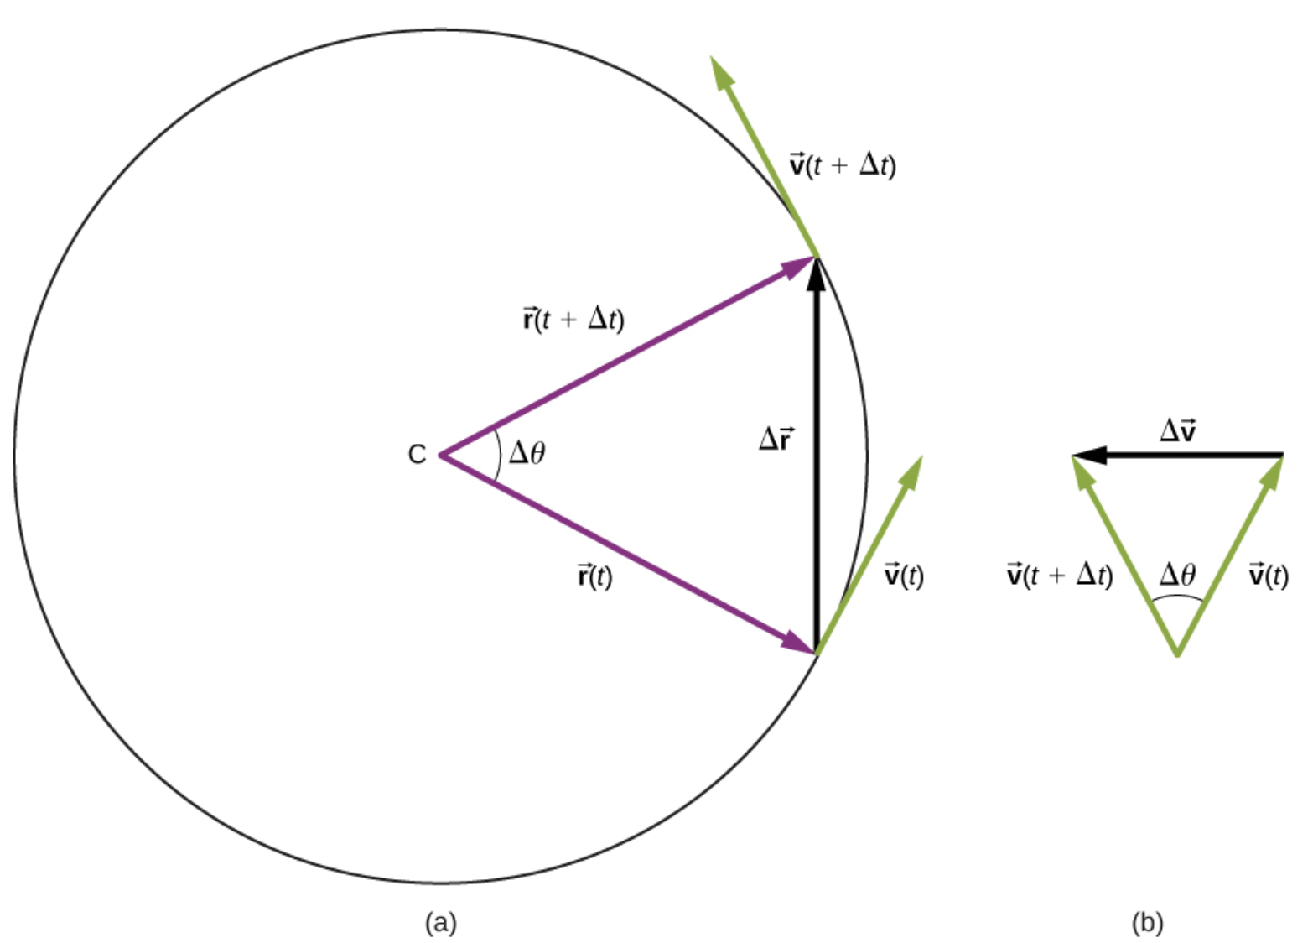
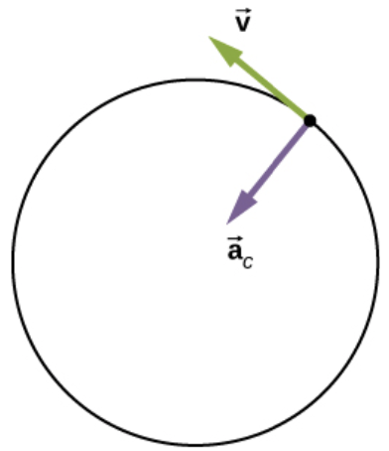



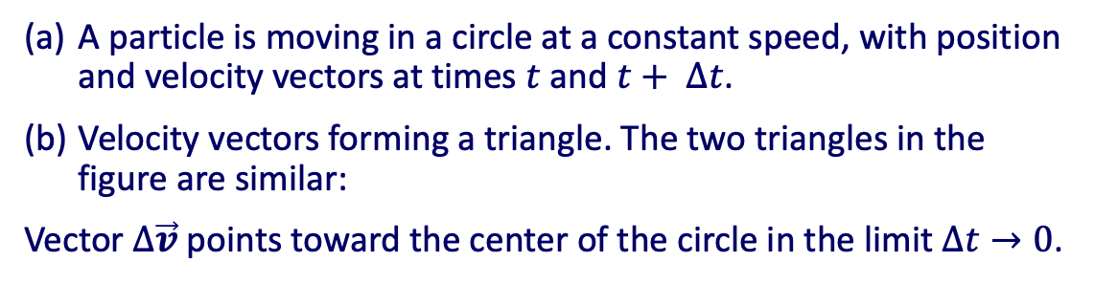
Uniform Circular Motion
An object moving in circular path experiences centripetal acceleration even if it moves with constant speed. The reason is due to the change in direction of velocity vector.
We can find the magnitude of the acceleration from
Thus, a particle moving in a circle at a constant speed has an acceleration with magnitude
The direction of the acceleration vector is toward the center of the circle (centripetal acceleration, which is why we give it the subscript c). The word centripetal comes from the Latin words centrum (meaning “center”) and petere (meaning “to seek”), and thus takes the meaning “center seeking.”
A particle is moving in a circle at a constant speed, with position and velocity vectors at times $t$ and $t+ ∆t$.
Velocity vectors forming a triangle. The two triangles in the figure are similar:
Vector $∆\vec{v}$ points toward the center of the circle in the limit $∆t→0$.

Slide 21

Uniform Circular Motion
An object moving in circular path experiences centripetal acceleration even if it moves with constant speed. The reason is due to the change in direction of velocity vector.
Example
We can find the magnitude of the acceleration from
A jet is flying at 134.1 m/s along a straight line and makes a turn along a circular path level with the ground. What does the radius of the circle have to be to produce a centripetal acceleration of 1 g on the pilot and jet toward the center of the circular trajectory?
Thus, a particle moving in a circle at a constant speed has an acceleration with magnitude
Solution
Set the centripetal acceleration equal to the acceleration of gravity: 9.8 m/s² = v²/r.
The direction of the acceleration vector is toward the center of the circle (centripetal acceleration, which is why we give it the subscript c). The word centripetal comes from the Latin words centrum (meaning “center”) and petere (meaning “to seek”), and thus takes the meaning “center seeking.”
Solving for the radius, we find

Slide 22

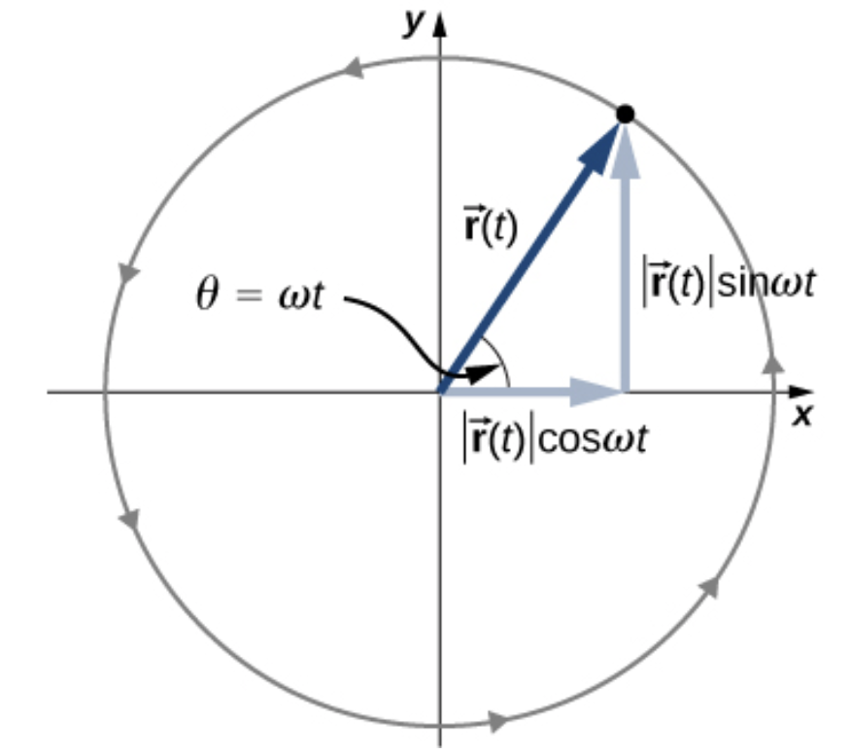



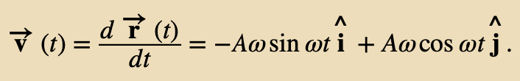


Equations of Motion for Uniform Circular Motion
A particle executing circular motion can be described by its position vector
The magnitude of the position vector is
This is also the radius of the circle, so that in terms of its components
ω is a constant called the angular frequency of the particle
The angle θ that the position vector has at any particular time is ωt .
Velocity and acceleration can be obtained from the position function by differentiation:
We see that the acceleration vector has magnitude Aω² and is directed opposite the position vector, toward the origin, because

Slide 23
Equations of Motion for Uniform Circular Motion
A particle executing circular motion can be described by its position vector
The magnitude of the position vector is
This is also the radius of the circle, so that in terms of its components
Assignment 5
A fan is rotating at a constant 360.0 rev/min. What is the magnitude of the acceleration of a point on one of its blades 10.0 cm from the axis of rotation?
ω is a constant called the angular frequency of the particle
The angle θ that the position vector has at any particular time is ωt .
Velocity and acceleration can be obtained from the position function by differentiation:
We see that the acceleration vector has magnitude Aω² and is directed opposite the position vector, toward the origin, because

Slide 24
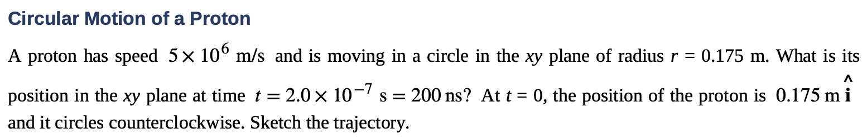
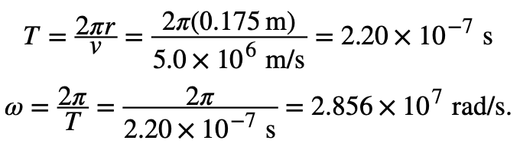
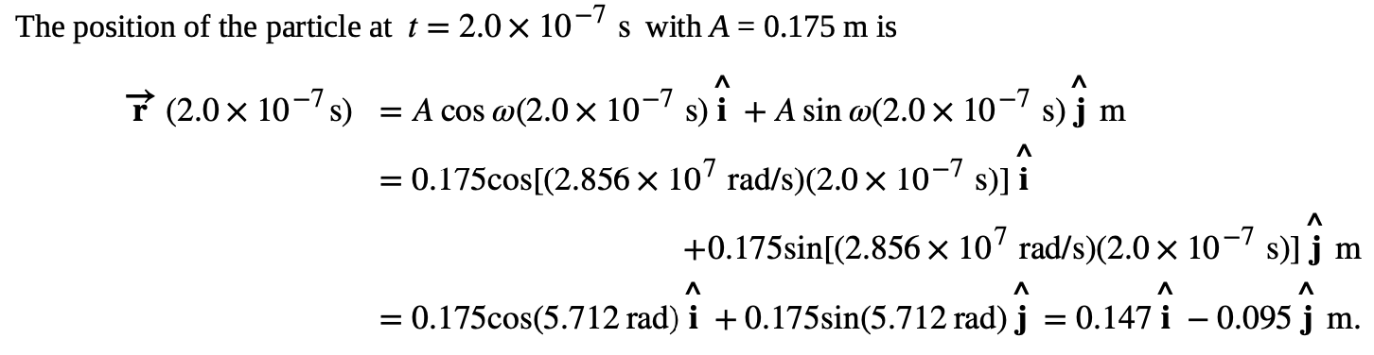
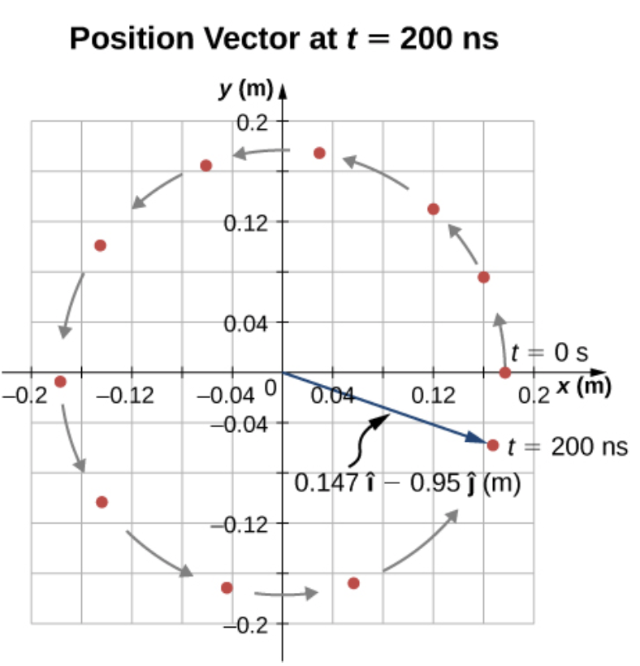
Equations of Motion for Uniform Circular Motion
Example
From the given data, the proton has period and angular frequency:

Slide 25
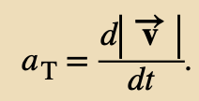
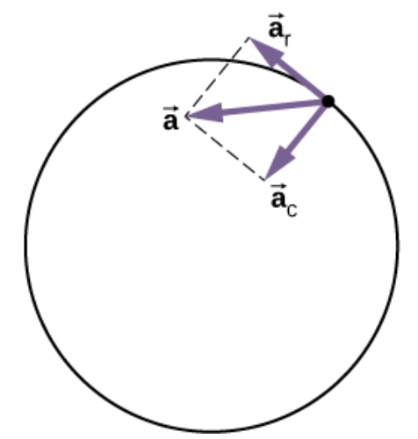

Nonuniform Circular Motion
Circular motion does not have to be at a constant speed. A particle can travel in a circle and speed up or slow down, showing an acceleration in the direction of the motion.
If the speed of the particle is changing, then it has a tangential acceleration that is the time rate of change of the magnitude of the velocity:
Thus, a particle in circular motion with a tangential acceleration has a total acceleration that is the vector sum of the centripetal and tangential accelerations:
The centripetal acceleration points toward the center of the circle. The tangential acceleration is tangential to the circle at the particle’s position. The total acceleration is the vector sum of the tangential and centripetal accelerations, which are perpendicular.

Slide 26
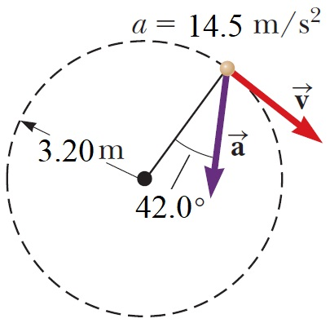
Nonuniform Circular Motion
Assignment 6
The figure on the right represents the total acceleration of a particle moving clockwise in a circle of radius 3.20 m at a certain instant of time. For that instant, for the particle find its
radial acceleration
the speed
tangential acceleration.
The centripetal acceleration points toward the center of the circle. The tangential acceleration is tangential to the circle at the particle’s position. The total acceleration is the vector sum of the tangential and centripetal accelerations, which are perpendicular.

Slide 27
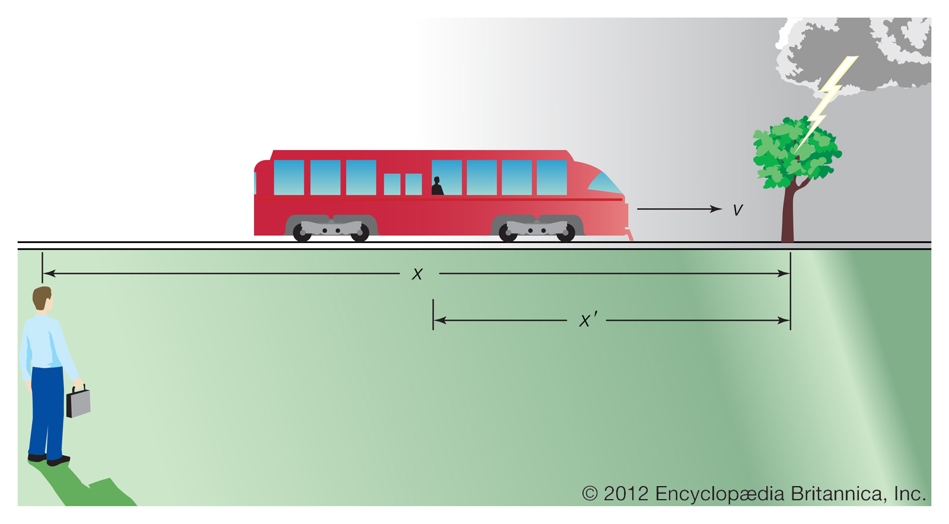


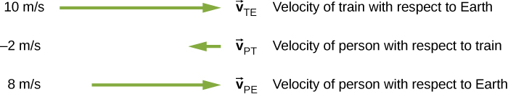
Relative Motion in One and Two Dimensions
A frame of reference
a Cartesian coordinate system for which an observer is at rest with respect to the origin
Take the example of the person sitting in a train moving east.
V_{AB} velocity of A with respect to B
Image credit: https://www.britannica.com/science/relativity/Special-relativity
Velocity vectors of the train with respect to Earth, person with respect to the train, and person with respect to Earth.
Image credit: https://www.sciencefocus.com/science/is-it-possible-to-run-along-the-top-of-a-moving-train/

Slide 28
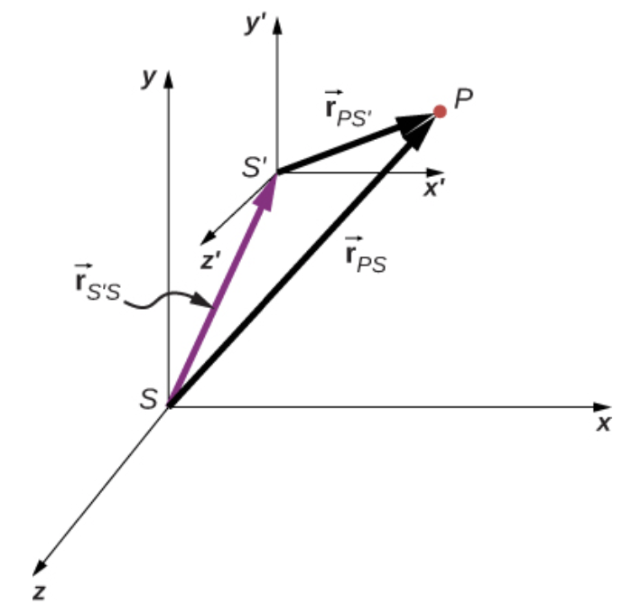




Relative Motion in One and Two Dimensions
The positions of particle P relative to frames S and S′ are ${\vec{r}}_{PS}$ and ${\vec{r}}_{{PS}^{′}}$, respectively.
The relative velocities are the time derivatives of the position vectors. Therefore,
The velocity of a particle relative to S is equal to its velocity relative to S′ plus the velocity of S′ relative to S.
The accelerations are also related as observed in two reference frames

Slide 29






Relative Motion in One and Two Dimensions
Example
Motion of a Car Relative to a Truck
A truck is traveling south at a speed of 70 km/h toward an intersection. A car is traveling east toward the intersection at a speed of 80 km/h. What is the velocity of the car relative to the truck?
A car travels east toward an intersection while a truck travels south toward the same intersection.
We can solve for the velocity of the car with respect to the truck:
What Is Relative Velocity?

Slide 30
Relative Motion in One and Two Dimensions
Assignment 6
A helicopter is flying at 160 mph in the northeast direction relative to the earth, and a plane is flying at 520 mph in the north direction relative to the earth. What is the speed of the plane as observed by the helicopter pilot?

Slide 31
Attribution
These slides are a derivative of the “University Physics Vol. 1” slides by OpenStax, used under a Creative Commons Attribution 4.0 license by Mkhitar Hobosyan.

