Slide 1
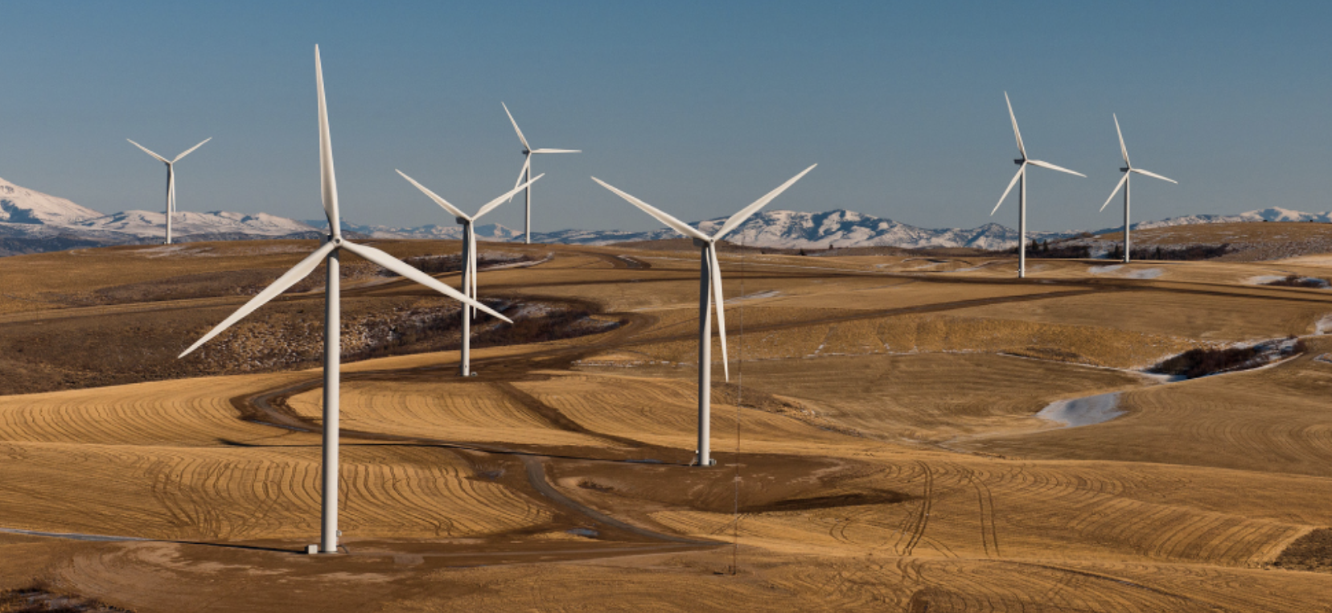

PHYS 2425
Physics for Scientists
and Engineers I
Chapter 10
Fixed-Axis Rotation
Download the textbook for free at https://openstax.org/details/books/university-physics-volume-1
Image credit: modification of work by U.S. Department of Energy

Slide 2

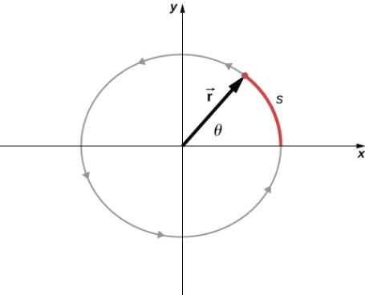

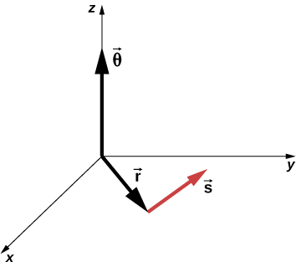
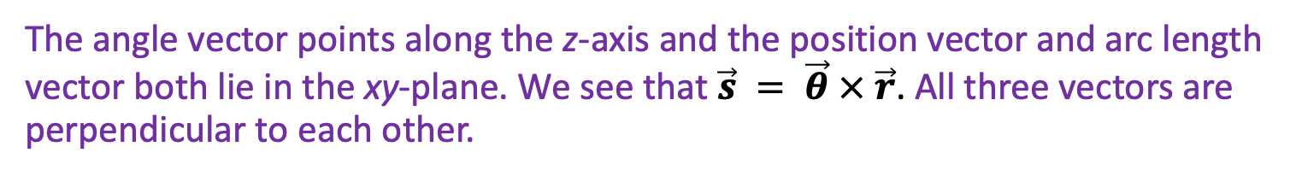
Rotational Variables
Uniform circular motion is motion in a circle at constant speed.
A particle follows a circular path. As it moves counterclockwise, it sweeps out a positive angle θ with respect to the x-axis and traces out an arc of length s.
The angle is related to the radius of the circle and the arc length by
The angle θ , the angular position of the particle along its path, has units of radians (rad). There are 2π radians in 360°.
Radian is a ratio of length measurements, and therefore is a dimensionless quantity.
The angle vector points along the z-axis and the position vector and arc length vector both lie in the xy-plane. We see that $\vec{s} = \vec{θ} × \vec{r}$. All three vectors are perpendicular to each other.

Slide 3
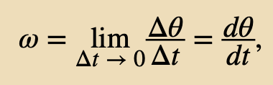
Rotational Variables
Uniform circular motion is motion in a circle at constant speed.
A particle follows a circular path. As it moves counterclockwise, it sweeps out a positive angle θ with respect to the x-axis and traces out an arc of length s.
The angle is related to the radius of the circle and the arc length by
The magnitude of the angular velocity, denoted by ω , is the time rate of change of the angle θ as the particle moves in its circular path. The instantaneous angular velocity is defined as the limit in which Δt → 0 in the average angular velocity
The units of angular velocity are radians per second (rad/s).
We take counterclockwise rotations as being positive and clockwise rotations as negative.

Slide 4

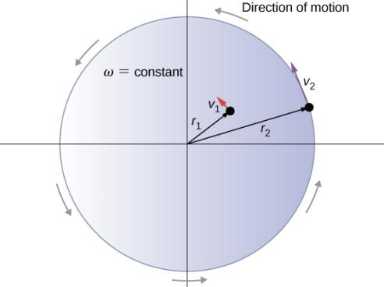
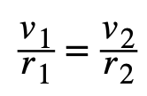
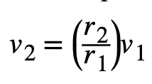

Rotational Variables
The angular velocity is related to the tangential speed of the particle
The tangential speed of the particle increases with its distance from the axis of rotation for a constant angular velocity.
We see that v₁ = r₁ ω₁ and v₂ = r₂ ω₂ . But the disk has a constant angular velocity, so ω₁ = ω₂ . This means
or
since r₂ > r₁ , v₂ > v₁
Assignment 1
A compact disc rotates at 500 rev/min.
If the diameter of the disc is 120 mm, (a) what is the tangential speed of a point at the edge of the disc? (b) At a point halfway to the center of the disc?
Two particles on a rotating disk have different tangential speeds, depending on their distance to the axis of rotation.

Slide 5
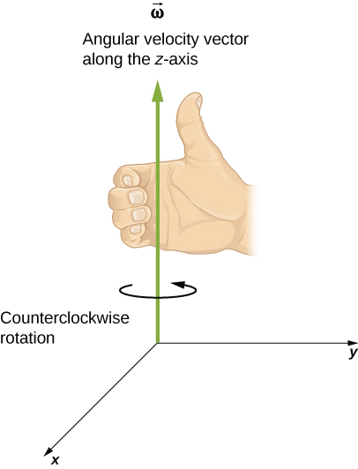
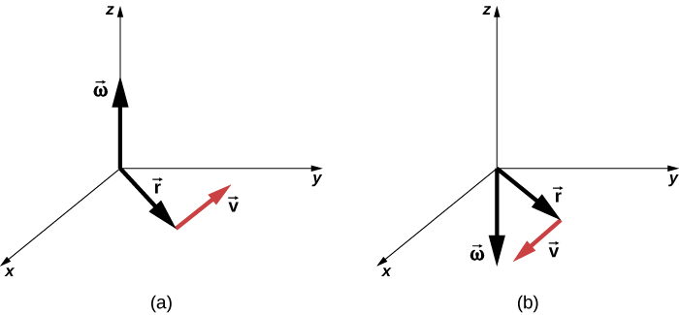

Rotational Variables
The vectors shown are the angular velocity, position, and tangential velocity.
The angular velocity points in the positive z-direction, giving a counterclockwise rotation in the xy-plane.
The angular velocity points in the negative z-direction, giving a clockwise rotation.
For counterclockwise rotation in the coordinate system shown, the angular velocity points in the positive z-direction by the right-hand-rule.
The tangential velocity is the cross product of the angular velocity and the position vector

Slide 6
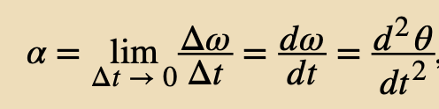
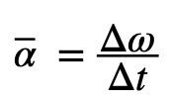
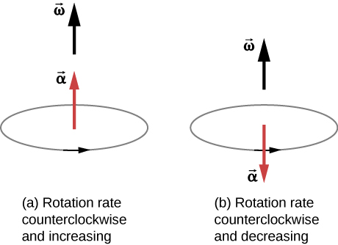
Rotational Variables
Angular Acceleration
The instantaneous angular acceleration α is the derivative of angular velocity with respect to time:
where we have taken the limit of the average angular acceleration
The rotation is counterclockwise in both (a) and (b) with the angular velocity in the same direction.
The angular acceleration is in the same direction as the angular velocity, which increases the rotation rate.
The angular acceleration is in the opposite direction to the angular velocity, which decreases the rotation rate.

Slide 7
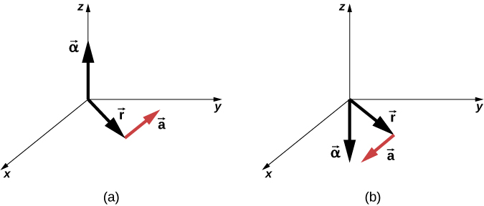


Rotational Variables
We can express the tangential acceleration vector as a cross product of the angular acceleration and the position vector. This expression can be found by taking the time derivative of
giving
The angular acceleration is the positive z-direction and produces a tangential acceleration in a counterclockwise sense.
The angular acceleration is in the negative z-direction and produces a tangential acceleration in the clockwise sense.
We can relate the tangential acceleration of a point on a rotating body at a distance from the axis of rotation in the same way that we related the tangential speed to the angular velocity.
If we differentiate with respect to time we get

Slide 8
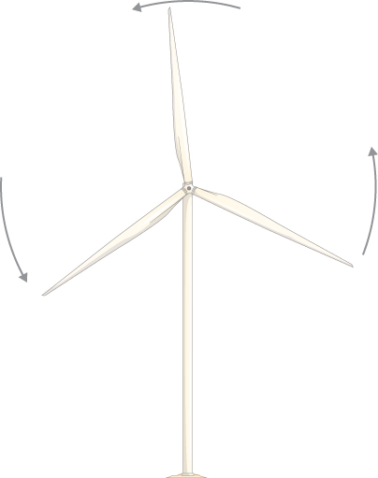
Rotational Variables
Example
A Spinning Bicycle Wheel
A bicycle mechanic mounts a bicycle on the repair stand and starts the rear wheel spinning from rest to a final angular velocity of 250 rpm in 5.00 s.
Calculate the average angular acceleration in rad/s² .
(b) If she now hits the brakes, causing an angular acceleration of −87.3 rad/s² , how long does it take the wheel to stop?
Think about it
A wind turbine in a wind farm is being shut down for maintenance. If the turbine is rotating counterclockwise looking into the page, what are the directions of the angular velocity and acceleration vectors as the turbine stops?
ω into the screen, α out of the screen
ω into the screen, α into the screen
ω out of the screen, α into the screen
ω out of the screen, α out of the screen

Slide 9
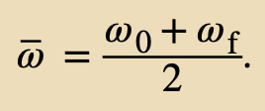
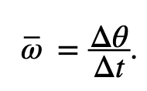


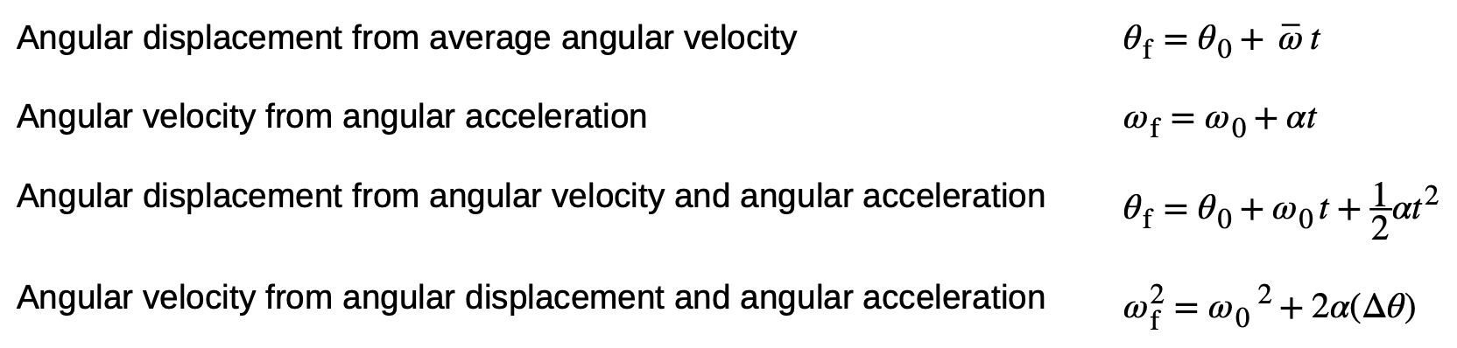
Rotation with Constant Angular Acceleration
If the system is rotating under a constant acceleration, then the average angular velocity follows a simple relation because the angular velocity is increasing linearly with time.
We already defined the average angular velocity
Solving for θ
Looks familiar? …

Slide 10
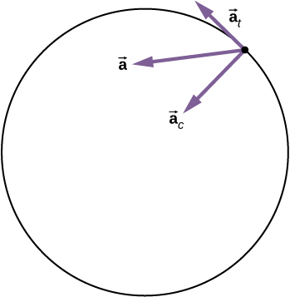
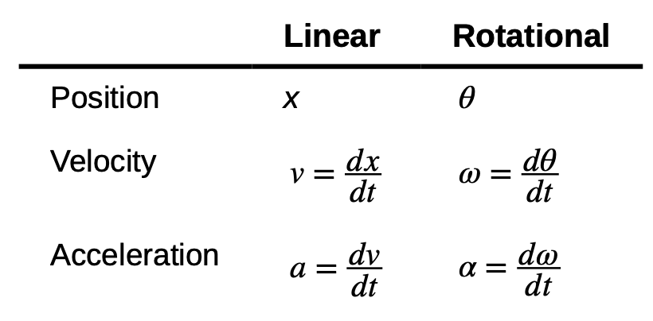
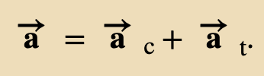
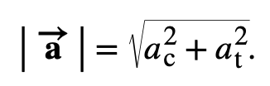
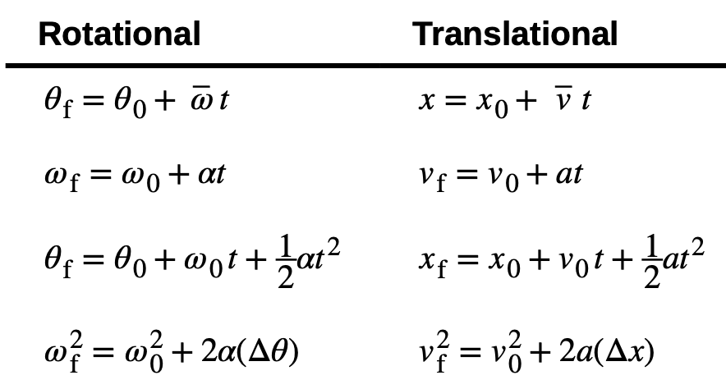
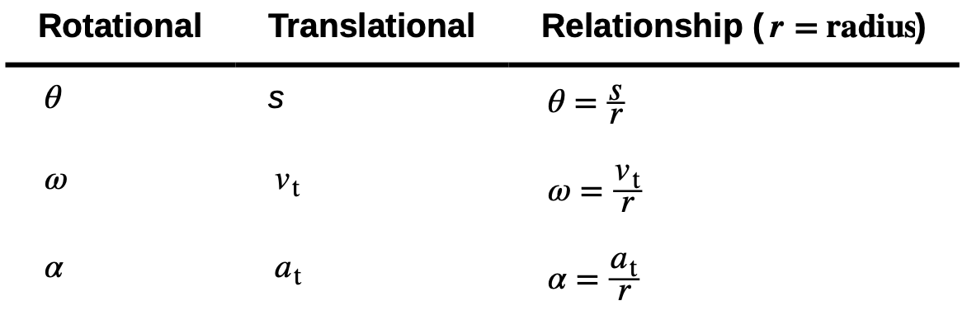

Relating Angular and Translational Quantities
Linear position, velocity, and acceleration have their rotational counterparts
Rotational and Translational Kinematic Equations
Rotational and Translational Quantities: Circular Motion

Slide 11
Relating Angular and Translational Quantities
Example
Linear Acceleration of a Centrifuge
A centrifuge has a radius of 20 cm and accelerates from a maximum rotation rate of 10,000 rpm to rest in 30 seconds under a constant angular acceleration. It is rotating counterclockwise. What is the magnitude of the total acceleration of a point at the tip of the centrifuge at t = 29.0s? What is the direction of the total acceleration vector?
Rotational and Translational Kinematic Equations
Rotational and Translational Quantities: Circular Motion

Slide 12
Relating Angular and Translational Quantities
Assignment 2
A bicycle wheel with radius 0.3 m rotates from rest to 3 rev/s in 5 s. What is the magnitude and direction of the total acceleration vector at the edge of the wheel at 1.0 s?
Rotational and Translational Kinematic Equations
Rotational and Translational Quantities: Circular Motion

Slide 13
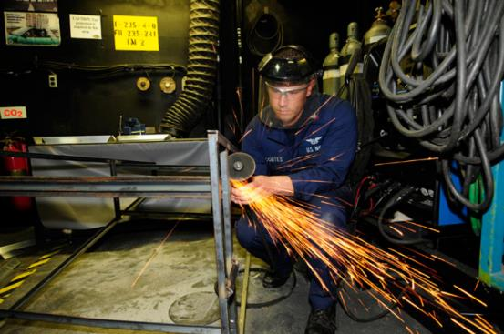

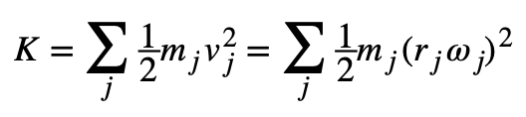
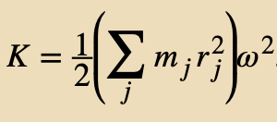
Moment of Inertia and Rotational Kinetic Energy
Energy in rotational motion is not a new form of energy; rather, it is the energy associated with rotational motion, the same as kinetic energy in translational motion.
Using the relation v_{t} = ωr
Rotational Kinetic Energy
The rotational kinetic energy of the grindstone is converted to heat, light, sound, and vibration. (credit: Zachary David Bell, US Navy)
In the case of a rigid rotating body, we can divide up any body into a large number of smaller masses, each with a mass m_{j} and distance to the axis of rotation r_{j} , such that the total mass of the body is equal to the sum of the individual masses.
Each smaller mass has tangential speed v_{j} so
and since ω_{j} = ω for all masses

Slide 14
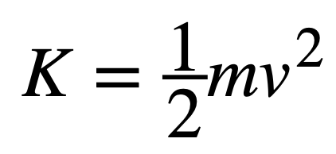
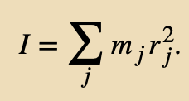
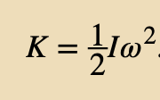
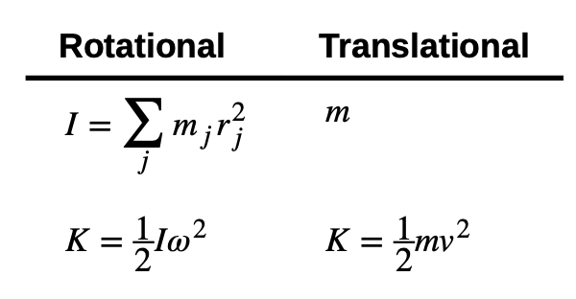
Moment of Inertia and Rotational Kinetic Energy
Compare with
Counterpart for mass
This quantity is called the moment of inertia I, with units of kg · m²
Rotational and Translational Kinetic Energies and Inertia
The kinetic energy of a rotating rigid body

Slide 15
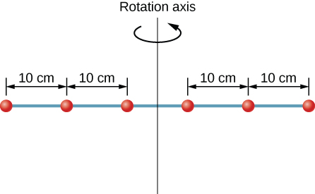
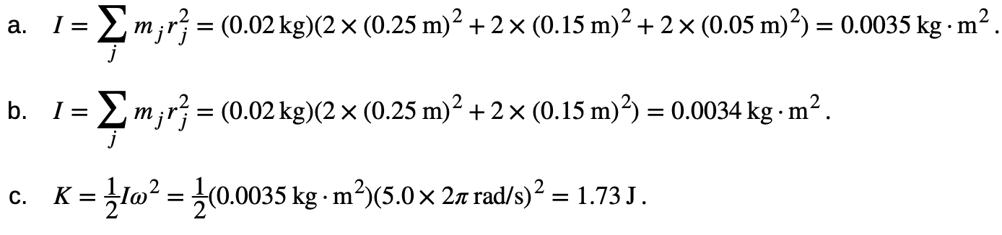
Moment of Inertia and Rotational Kinetic Energy
Example
moment of inertia
The kinetic energy of a rotating rigid body
Moment of Inertia of a System of Particles
Six small washers are spaced 10 cm apart on a rod of negligible mass and 0.5 m in length. The mass of each washer is 20 g. The rod rotates about an axis located at 25 cm, as shown in Figure. (a) What is the moment of inertia of the system? (b) If the two washers closest to the axis are removed, what is the moment of inertia of the remaining four washers? (c) If the system with six washers rotates at 5 rev/s, what is its rotational kinetic energy?

Slide 16
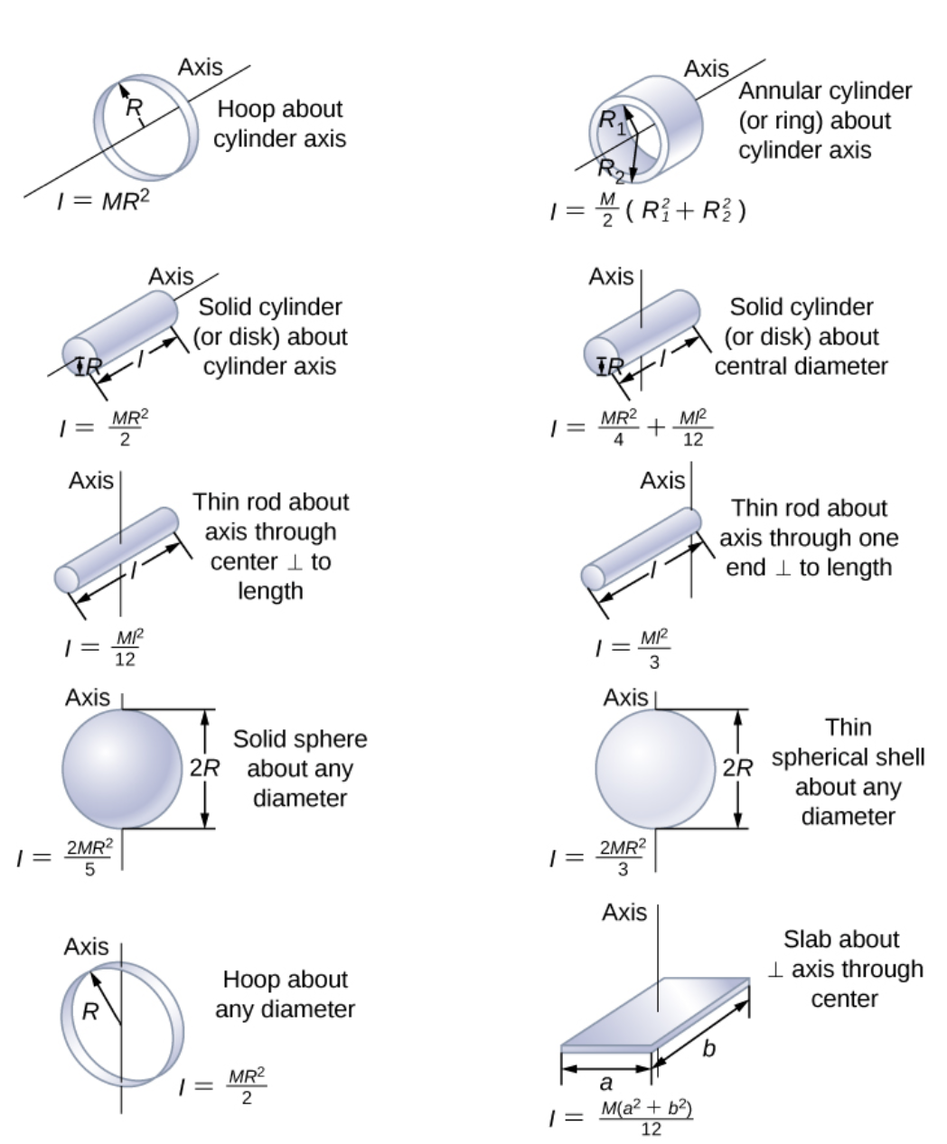
Values of rotational inertia for common shapes of objects.
Recall that mass is the quantitative measure of linear inertia—that is, the more massive an object is, the more inertia it has, and the greater is its resistance to change in linear velocity.
Similarly, the moment of inertia is the quantitative measure of rotational inertia. The greater the moment of inertia of a rigid body is, the greater is its resistance to change in angular velocity about a fixed axis of rotation.

Slide 17
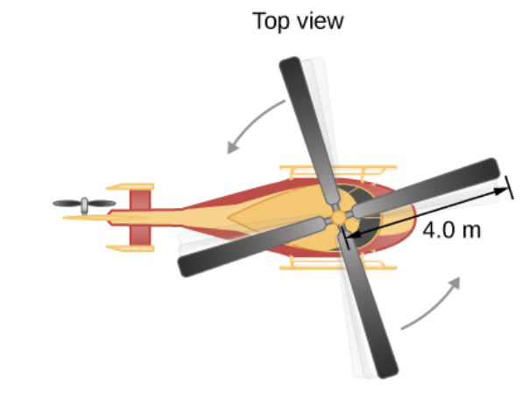

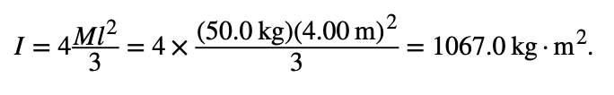

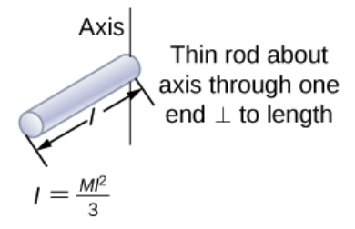


Moment of Inertia and Rotational Kinetic Energy
Example
Calculating Helicopter Energies
A typical small rescue helicopter has four blades: Each is 4.00 m long and has a mass of 50.0 kg (Figure 10.21). The blades can be approximated as thin rods that rotate about one end of an axis perpendicular to their length. The helicopter has a total loaded mass of 1000 kg. (a) Calculate the rotational kinetic energy in the blades when they rotate at 300 rpm. (b) Calculate the translational kinetic energy of the helicopter when it flies at 20.0 m/s, and compare it with the rotational energy in the blades.
a)
b) Entering the given values into the equation for translational kinetic energy, we obtain
most of the kinetic energy of the helicopter is in its spinning blades.

Slide 18
Rotation with Constant Angular Acceleration
Assignment 3
Calculate the rotational kinetic energy of a 12-kg motorcycle wheel if its angular velocity is 120 rad/s and its inner radius is 0.280 m and outer radius 0.330 m.

Slide 19
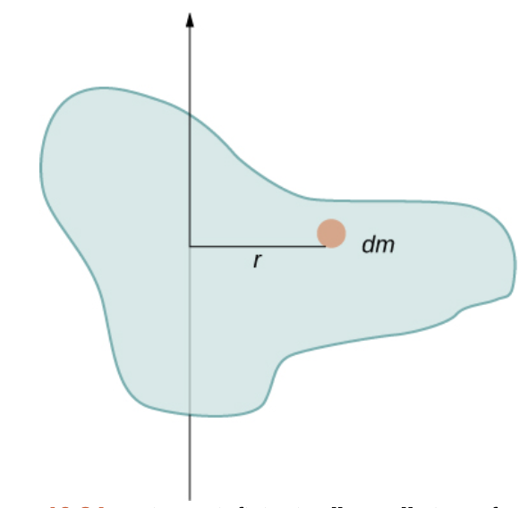
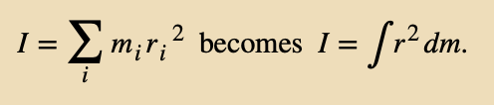
Calculating Moments of Inertia
The moment of inertia is for all the point masses that make up the object.
Because r is the distance to the axis of rotation from each piece of mass that makes up the object, the moment of inertia for any object depends on the chosen axis.
Each piece of mass should have the same magnitude of velocity, which means the whole piece has to have a single distance r to the axis of rotation. However, this is not possible unless we take an infinitesimally small piece of mass dm, as shown in figure below.
Thus, we should have integral over infinitesimal masses rather than doing a discrete sum over finite masses:
Using an infinitesimally small piece of mass to calculate the contribution to the total moment of inertia.

Slide 20
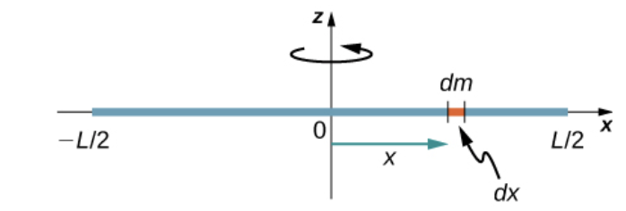



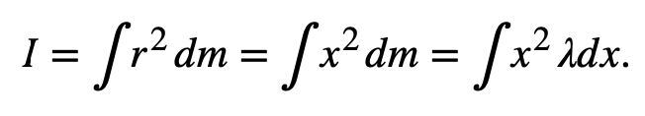
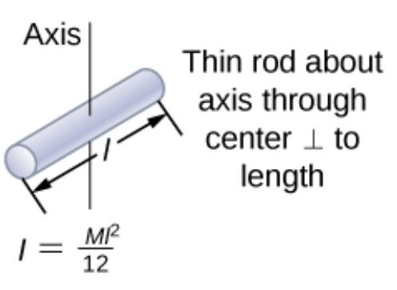
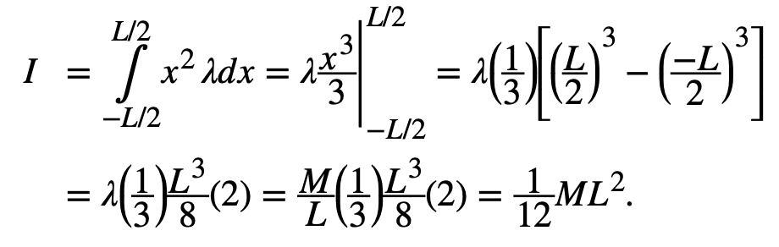
Calculating Moments of Inertia
Example
A uniform thin rod with an axis through the center
linear mass density
take the differential of each side of this equation,
in our case
Calculation of the moment of inertia I for a uniform thin rod about an axis through the center of the rod.
The rod extends from
x = −L/2 to x = L/2,
this gives

Slide 21
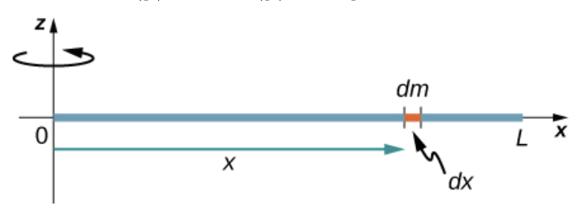
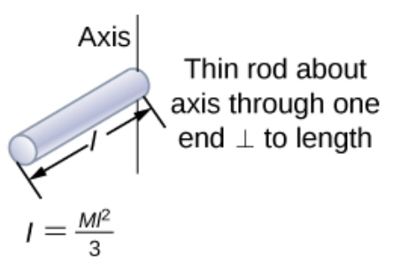
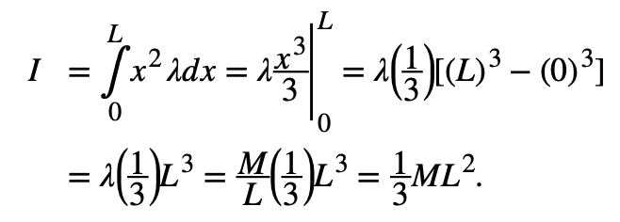
Calculating Moments of Inertia
Example
A uniform thin rod with axis at the end
linear mass density
take the differential of each side of this equation,
in our case
Calculation of the moment of inertia I for a uniform thin rod about an axis through the end of the rod.
The rod extends from
x = 0 to x = L,
this gives

Slide 22
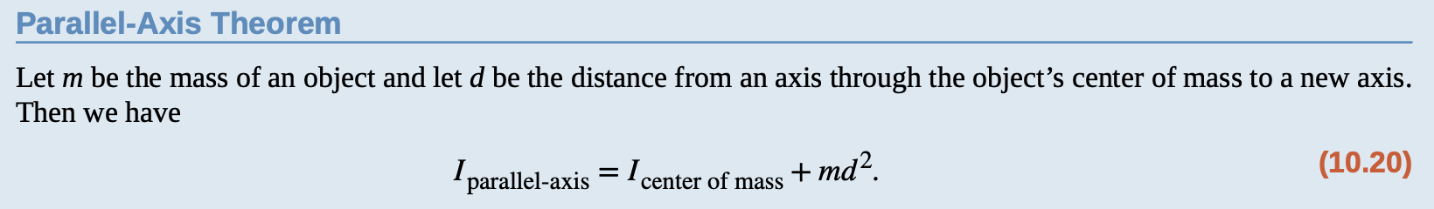

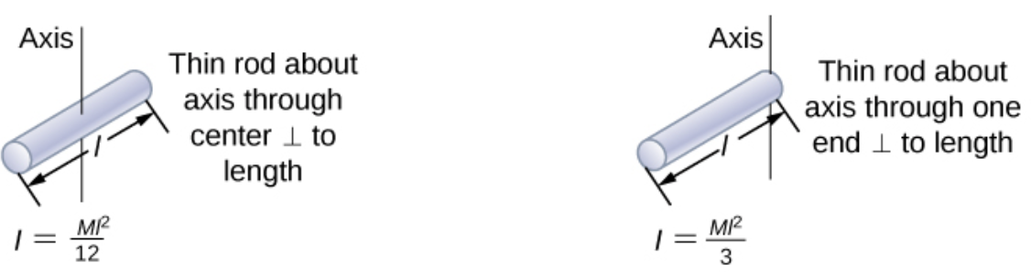
Calculating Moments of Inertia
The Parallel-Axis Theorem
The similarity between the process of finding the moment of inertia of a rod about an axis through its middle and about an axis through its end is striking and suggests that there might be a simpler method for determining the moment of inertia for a rod about any axis parallel to the axis through the center of mass. Such an axis is called a parallel axis. There is a theorem for this, called the parallel-axis theorem:
d
.
Let’s apply this to the rod examples we just solved:

Slide 23
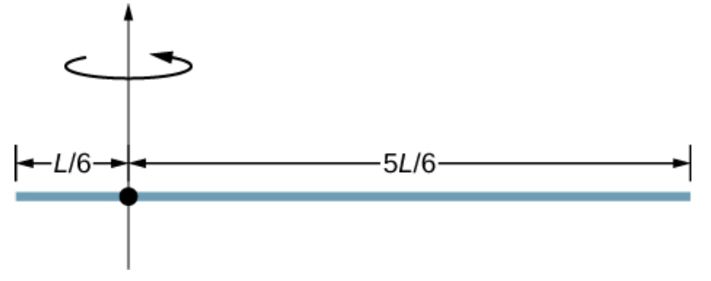
Calculating Moments of Inertia
Assignment 4
Using the parallel axis theorem, what is the moment of inertia of the rod of mass m about the axis shown on the right?
d
.
Let’s apply this to the rod examples we just solved:

Slide 24
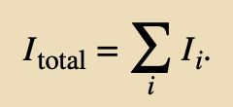








Calculating Moments of Inertia
Calculating the moment of inertia for compound objects
For a compound object we cannot easily integrate to find the moment of inertia because it is not a uniformly shaped object.
However, the compound object’s moment of inertia can be found from the sum of each part of the object.
Example
The moment of inertia of the rod is simply
We have to use the parallel-axis theorem to find the moment of inertia of the disk about the axis shown.
The moment of inertia of the disk about its center is
Apply the parallel-axis theorem
R
Compound object consisting of a disk at the end of a rod. The axis of rotation is located at A.
Thus, the moment of inertia for the compound object is

Slide 25











Calculating Moments of Inertia
Example
Angular Velocity of a Pendulum
A pendulum in the shape of a rod is released from rest at an angle of 30°. It has a length 30 cm and mass 300 g. What is its angular velocity at its lowest point?
Use conservation of energy to solve the problem.
The change in potential energy of center of the mass is equal to the change in rotational kinetic energy: ΔU+ΔK=0
For center of the mass, at the top of the swing
At the bottom of the swing
$$U=mg\left(\frac{L}{2}−\frac{L}{2}\cos{θ}\right)$$
$$h=\left(\frac{L}{2}−\frac{L}{2}\cos{θ}\right)$$
$U=0$ assuming CM lowest point is
zero height
Therefore:
$$0−\left(mg\frac{L}{2}−mg\frac{L}{2}\cos{θ}\right)+\frac{1}{2}Iω^{2}−0=0$$
Note that the angular velocity of the pendulum does not depend on its mass.

Slide 26


Torque
Since forces change the translational motion of objects, the rotational counterpart must be related to changing the rotational motion of an object about an axis.
We call this rotational counterpart torque.
Torque is the turning or twisting effectiveness of a force, illustrated here for door rotation on its hinges (as viewed from overhead). Torque has both magnitude and direction.
A counterclockwise torque is produced by a force $\vec{F}$ acting at a distance r from the hinges (the pivot point).
A smaller counterclockwise torque is produced when a smaller force $\vec{F}$′ acts at the same distance r from the hinges.
The same force as in (a) produces a smaller counterclockwise torque when applied at a smaller distance from the hinges.
A smaller counterclockwise torque is produced by the same magnitude force as (a) acting at the same distance as (a) but at an angle $θ$ that is less than 90°.

Slide 27





Torque
The torque is perpendicular to the plane defined by $\vec{r}$ and $\vec{F}$and its direction is determined by the right-hand rule.

Slide 28

Torque
A disk is free to rotate about its axis through the center. The magnitude of the torque on the disk is rF sin θ.
When θ = 0°, the torque is zero and the disk does not rotate.
When θ = 90°, the torque is maximum, and the disk rotates with maximum angular acceleration.
Assignment 5
The cylindrical head bolts on a car are to be tightened with a torque of 62.0 N · m . If a mechanic uses a wrench of length 20 cm, what perpendicular force must he exert on the end of the wrench to tighten a bolt correctly?

Slide 29



Torque
Any number of torques can be calculated about a given axis.
The individual torques add to produce a net torque about the axis.
Counterclockwise-positive
Clockwise-negative
Example

Slide 30









Newton’s Second Law for Rotation
Is there an analogous equation to Newton’s second law, which involves torque and rotational motion?
Multiply both sides of this equation by r,
An object is supported by a horizontal frictionless table and is attached to a pivot point by a cord that supplies centripetal force. A force $\vec{F}$ is applied to the object perpendicular to the radius r, causing it to accelerate about the pivot point. The force is perpendicular to r.
Newton’s Second Law for Rotation

Slide 31

Newton’s Second Law for Rotation
Example
Calculating the Effect of Mass Distribution on a Merry-Go-Round
Consider the father pushing a playground merry-go-round in figure below. He exerts a force of 250 N at the edge of the 50.0-kg merry-go-round, which has a 1.50-m radius.
Calculate the angular acceleration produced
when no one is on the merry-go-round and
when an 18.0-kg child sits 1.25 m away from the center. Consider the merry-go-round itself to be a uniform disk with negligible friction.
The net torque is given directly by the expression
To solve for α , we must first calculate the net torque τ (which is the same in both cases) and moment of inertia I (which is greater in the second case).

Slide 32

Newton’s Second Law for Rotation
Assignment 6

Slide 33




Work and Power for Rotational Motion
A rigid body rotates through an angle $dθ$ from A to B by the action of an external force $\vec{F}$ applied to point P.
The rotational work done on a rigid body is
The total work done on a rigid body is the sum of the torques integrated over the angle through which the body rotates.
The incremental work is
the net torque on the body due to external forces.

Slide 34




Work and Power for Rotational Motion
Rotational and Translational Equations: Dynamics
From Work and Kinetic Energy, the power is defined as the rate of doing work:
or
Example
Torque on a Boat Propeller
A boat engine operating at 9.0 × 10⁴ W is running at 300 rev/min. What is the torque on the propeller shaft?
ω

Slide 35
Attribution
These slides are a derivative of the “University Physics Vol. 1” slides by OpenStax, used under a Creative Commons Attribution 4.0 license by Mkhitar Hobosyan.

