Slide 1
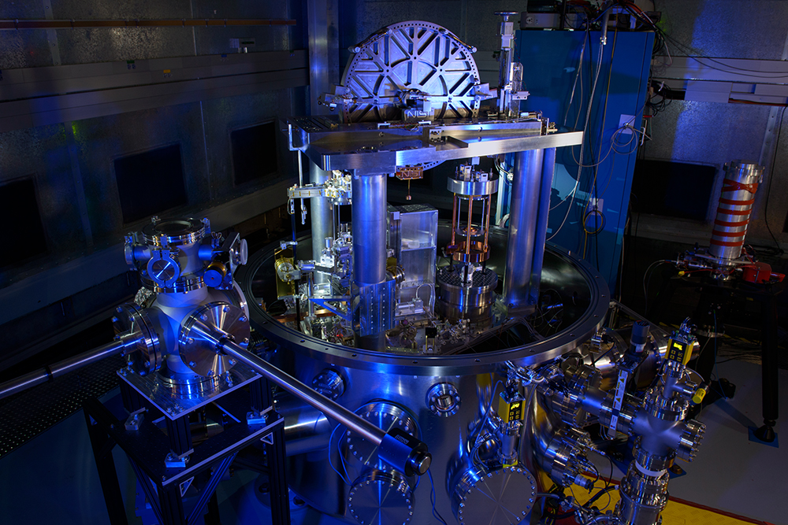
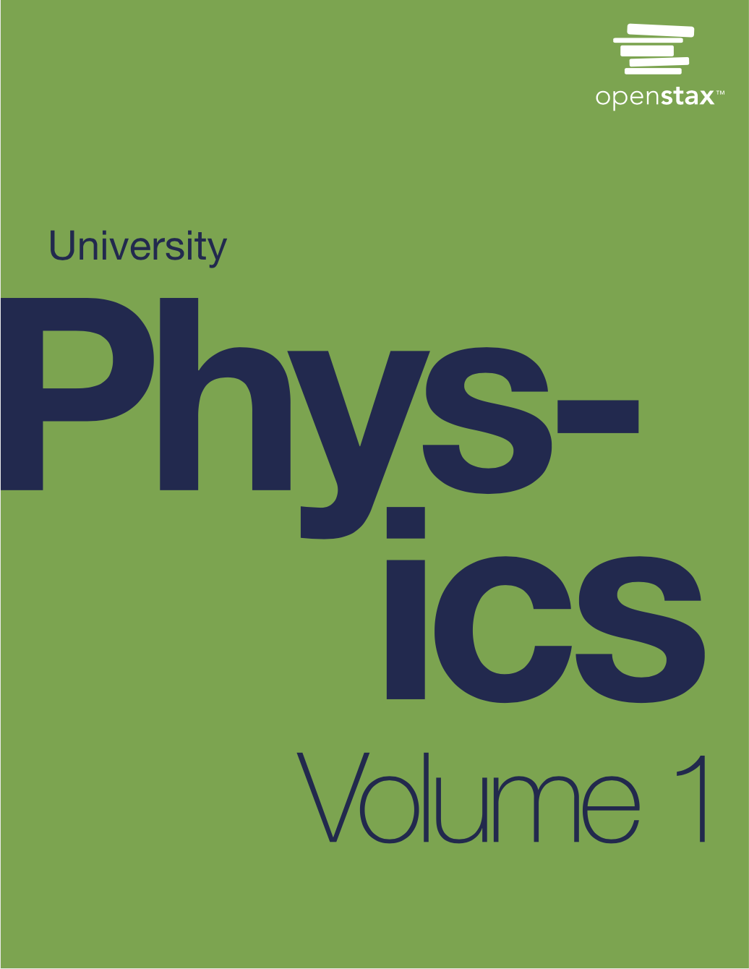
PHYS 2425
Physics for Scientists
and Engineers I
Chapter 1
Units and Measurement
Download the textbook for free at https://openstax.org/details/books/university-physics-volume-1
Image credit
https://www.nist.gov/image/wattbalancersicover-3000resizedjpg

Slide 2
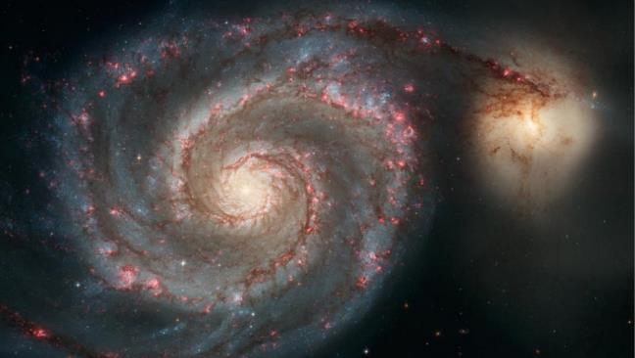

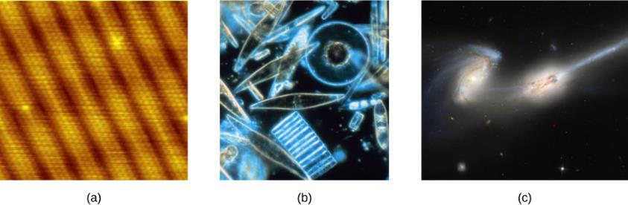
Physics*
Fundamental Science
  Concerned with the fundamental principles of the Universe: from subatomic particles to galaxies
  Foundation of other physical sciences (Chemistry, Biology, Geology, Space Science/Astronomy)
Why do you need it
The same basic training in physics will prepare you to work in any area of physics and the related areas of science and engineering.
Most branches of engineering are concerned with designing new technologies, processes, or structures within the constraints set by the laws of physics.
*Physics comes from the Greek phúsis, meaning “nature,” it is concerned with describing the interactions of energy, matter, space, and time to uncover the fundamental mechanisms that underlie every phenomenon.

Slide 3
The Scale of Physics
Using a scanning tunneling microscope, scientists can see the individual atoms (diameters around 10^{–10} m) that compose this sheet of gold.
Tiny phytoplankton swim among crystals of ice in the Antarctic Sea. They range from a few micrometers (1 μm is 10^{–6} m) to as much as 2 mm (1 mm is 10^{–2} m) in length.
These two colliding galaxies, known as NGC 4676A (right) and NGC 4676B (left), are nicknamed “The Mice” because of the tail of gas emanating from each one. They are located 300 million light-years from Earth in the constellation Coma Berenices. Eventually, these two galaxies will merge into one.
(credit a: modification of work by Erwinrossen; credit b: modification of work by Prof. Gordon T. Taylor, Stony Brook University; NOAA Corps Collections; credit c: modification of work by NASA, H. Ford (JHU), G. Illingworth (UCSC/LO), M. Clampin (STScI), G. Hartig (STScI), the ACS Science Team, and ESA)

Slide 4
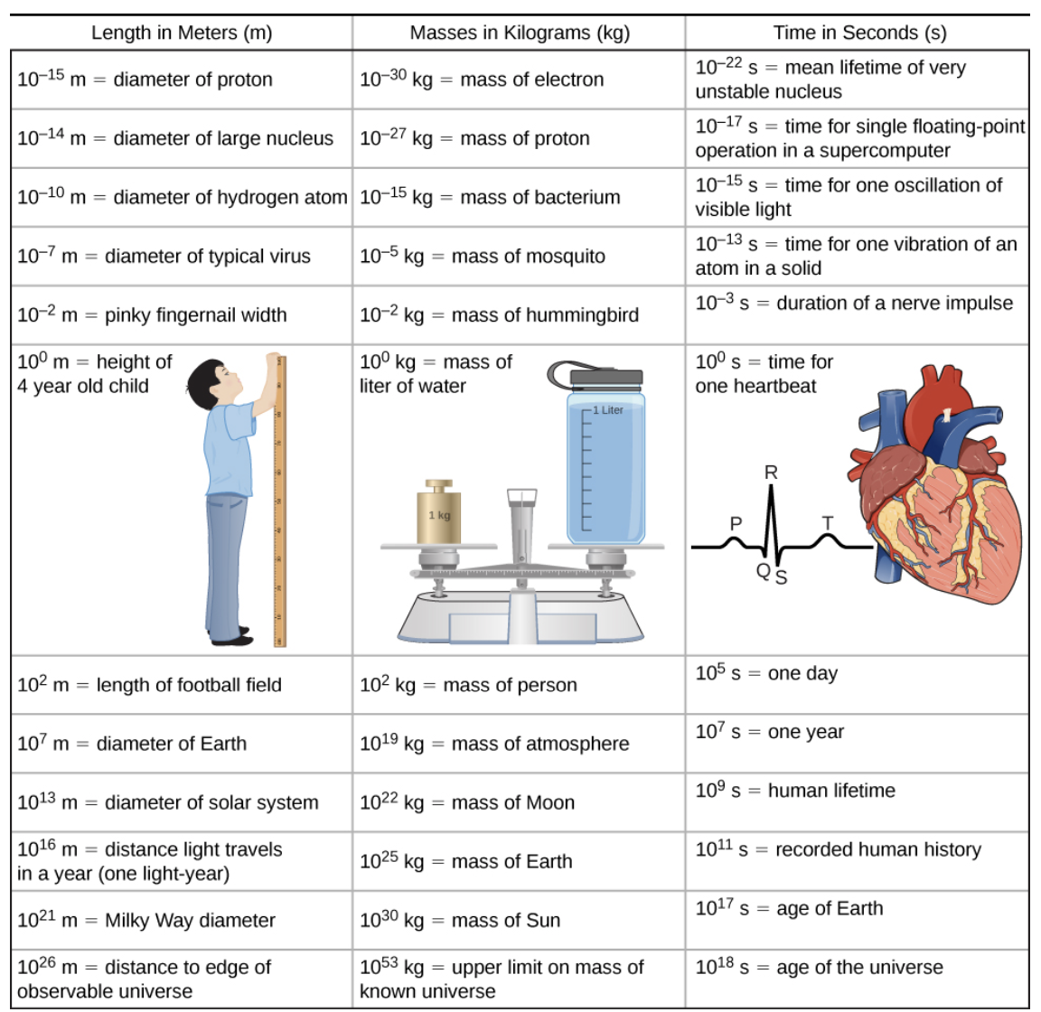
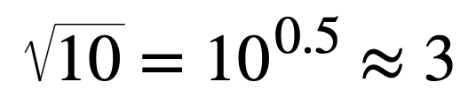

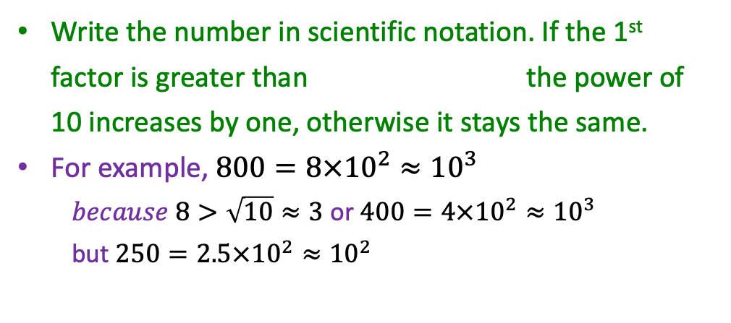
Order of Magnitude
The order of magnitude of a number is the power of 10 that most closely approximates it. It refers to the scale (or size) of a value. It is given in powers of 10.
Write the number in scientific notation. If the 1st factor is greater than the power of 10 increases by one, otherwise it stays the same.
For example, $800=8×{10}^{2}≈{10}^{3}$
$because 8>\sqrt{10}≈3$ or $400=4×{10}^{2}≈{10}^{3}$
but $250=2.5×{10}^{2}≈{10}^{2}$
Example: Estimate number of seconds in one year
$$={365.25}_{days/yr}×{24}_{hr/day}{×60}_{min/hr}{×60}_{s/min}=$$
$$=31557600 s=3.15576×{10}^{7} s≈{10}^{7}s$$
In this case we were very close to $\sqrt{10}=3.1623$
Assignment 1: If you could drive to the moon, how many gallons of gasoline would you need. Assume 25 mile/gal
and distance to the moon 238 900 miles.
Give your answer in order of magnitude (power of 10)

Slide 5
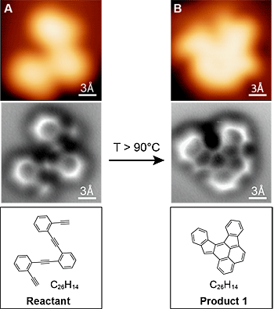
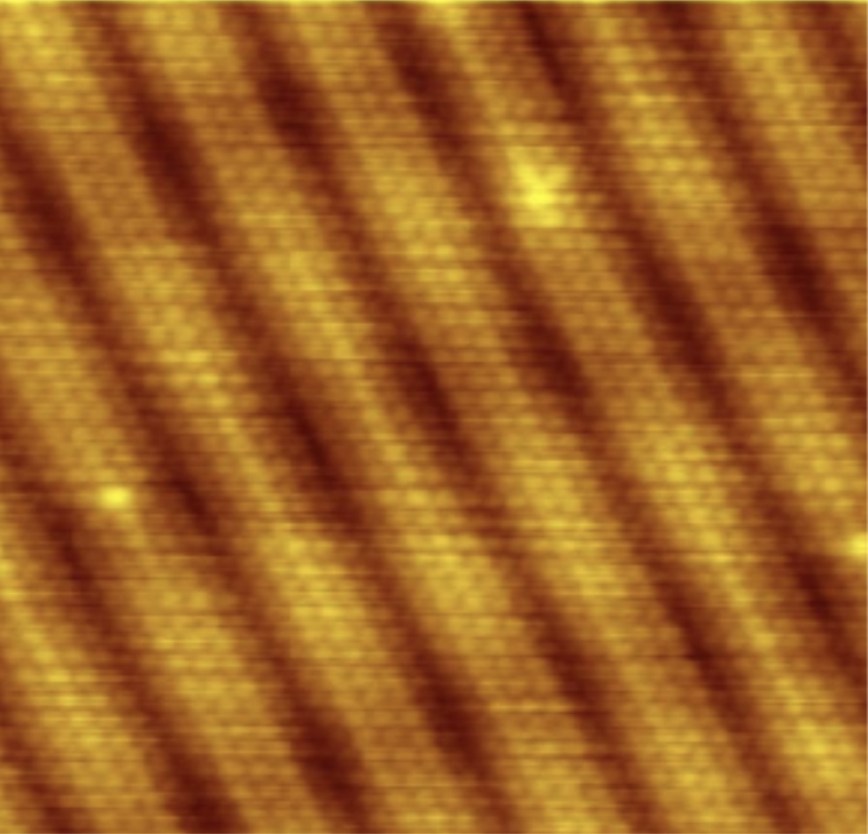
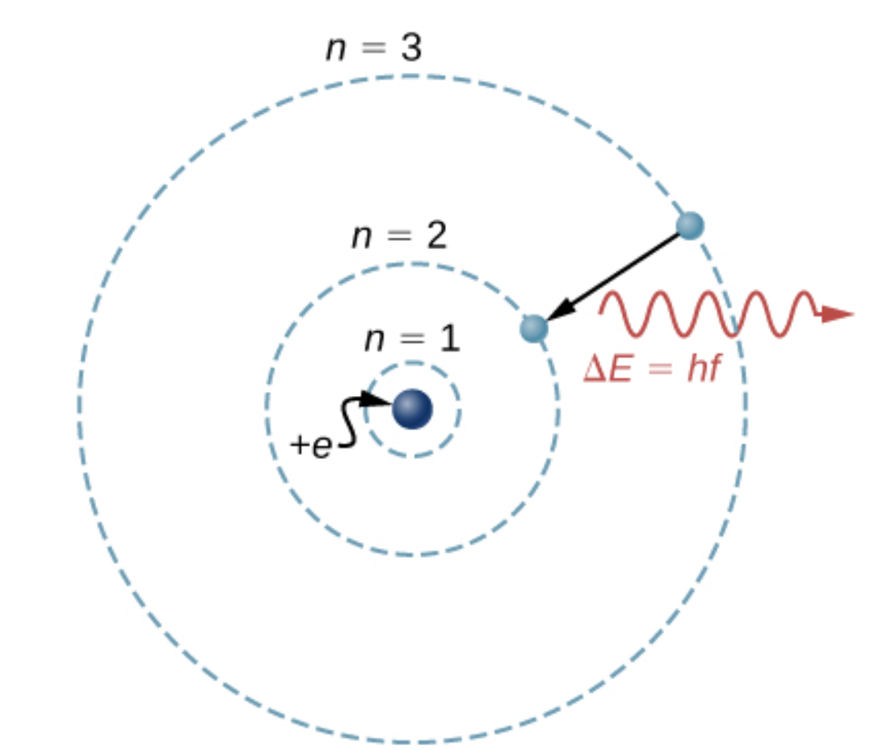
Building Models
A model is a representation of something that is often too difficult (or impossible) to display directly.
Individual atoms in sheet of gold, taken by scanning tunneling microscope
Credit: modification of work by Erwinrossen
The Bohr model of a single-electron atom shows the electron orbiting the nucleus in one of several possible circular orbits. Like all models, it captures some, but not all, aspects of the physical system.
Non-contact atomic force microscope (nc-AFM) images (center) of a molecule before and after a reaction improve immensely over images (top) from a scanning tunneling microscope. Credit: Berkley Lab
https://news.berkeley.edu/2013/05/30/scientists-capture-first-images-of-molecules-before-and-after-reaction/

Slide 6
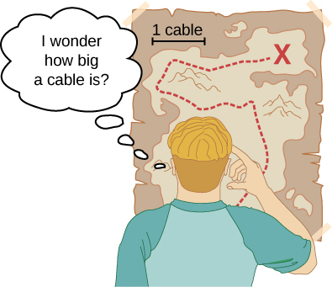
Units and Standards
Measurements of physical quantities are expressed in terms of units.
Two major systems of units are used in the world:
SI units (for the French Système International d’Unités), also known as the metric system, and
English units (also known as the customary or imperial system, widely used in the United States).
SI (Système International)
U.S. customary
Length
Mass
Time
meter (m)
kilogram (kg)
second (s)
inch, foot, yard, mile..
ounce, pound, ton..
second

Slide 7
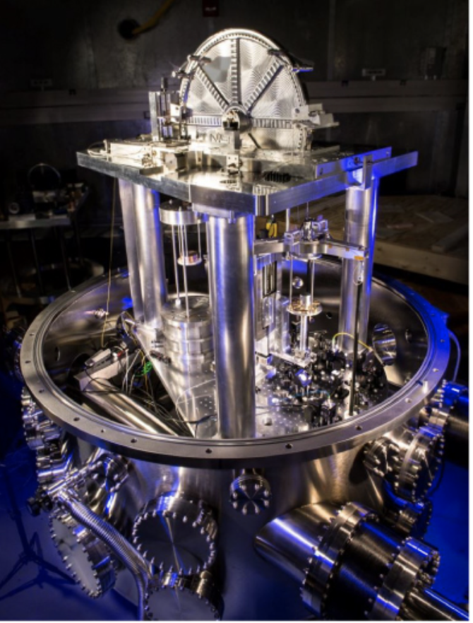
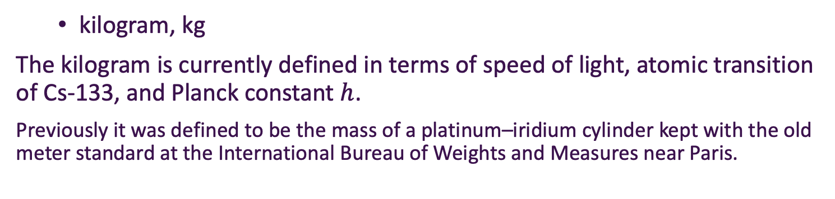
Units and Standards
  meter, m
The meter is currently defined in terms of the distance traveled by light in a vacuum during a given time
  Also establishes the value for the speed of light in a vacuum
  seconds, s
The second is currently defined in terms of the oscillation of radiation from a cesium atom Cs-133
An atomic clock such as this one uses the vibrations of cesium atoms to keep time to a precision of better than a microsecond per year. The fundamental unit of time, the second, is based on such clocks. This image looks down from the top of an atomic fountain nearly 30 feet tall. (credit: Steve Jurvetson)
The U.S. National Institute of Standards and Technology’s watt balance is a machine that balances the weight of a test mass against the current and voltage (the “watt”) produced by a strong system of magnets.
  kilogram, kg
The kilogram is currently defined in terms of speed of light, atomic transition of Cs-133, and Planck constant $h$.
Previously it was defined to be the mass of a platinum–iridium cylinder kept with the old meter standard at the International Bureau of Weights and Measures near Paris.
credit: modification of work by National Institute of Standards and Technology

Slide 8
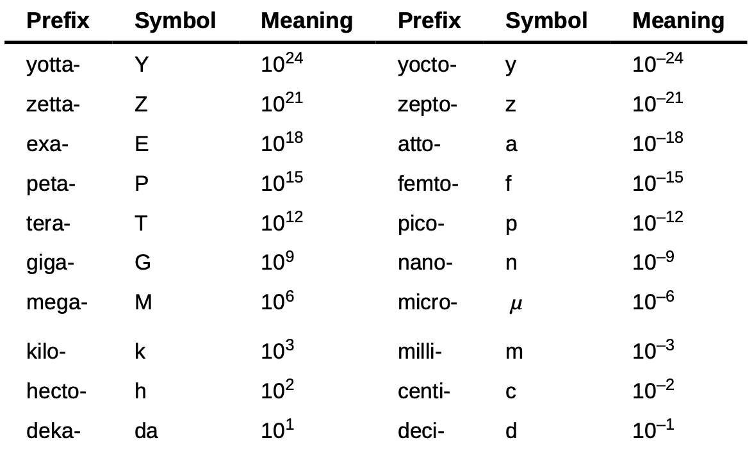

Metric Prefixes
Prefixes correspond to powers of 10. Each prefix has a specific symbol.
Examples:
1 km = 1000 m
1 mm = ${10}^{−3}$ m = 0.001m

Slide 9
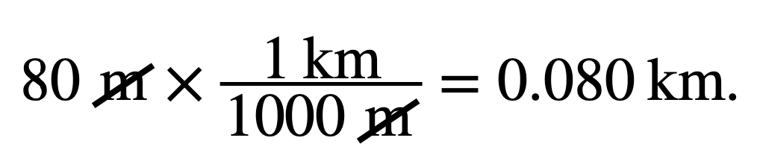
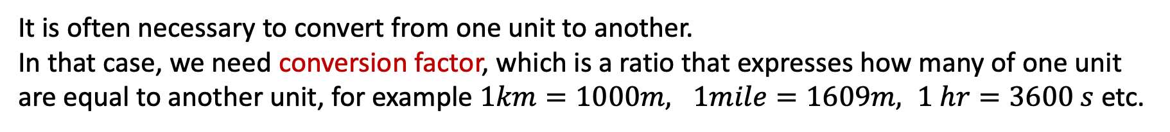
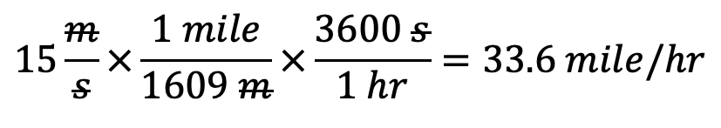

Unit Conversion
It is often necessary to convert from one unit to another.
In that case, we need conversion factor, which is a ratio that expresses how many of one unit are equal to another unit, for example $1km=1000m, 1mile=1609m, 1 hr=3600 s$etc.
Example: Convert 80 m to km
Convert $15 m/s to mi/hr$
$$15\frac{m}{s}×\frac{1 mile}{1609 m}×\frac{3600 s}{1 hr}=33.6 mile/hr$$
Assignment 2: Convert 65 mi/h to meters/seconds (m/s)

Slide 10
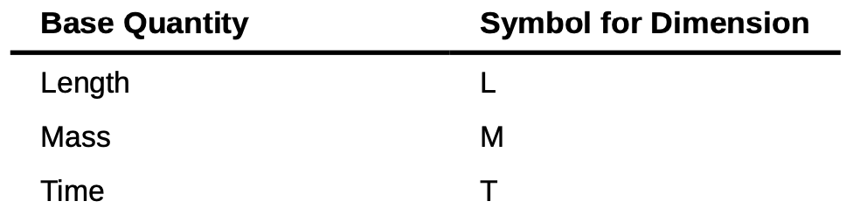
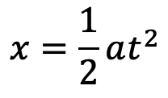
Dimensional Analysis
The dimension of any physical quantity expresses its dependence on the base quantities as a product of symbols (or powers of symbols) representing the base quantities.
Use brackets [ ] to denote the dimensions of a physical quantity.
Speed, [v] = L / T
Area, [A] = L²
How does dimensional analysis help ?
To verify the dimension of a specific equation.
Both sides of an equation must have the same dimensions.
Quantities can be added or subtracted only if they have the same dimensions
$$x=\frac{1}{2}at^{2}$$
Both sides of equation must have the same dimensions
Dimension→ L = (L/T²)* T² = L

Slide 11
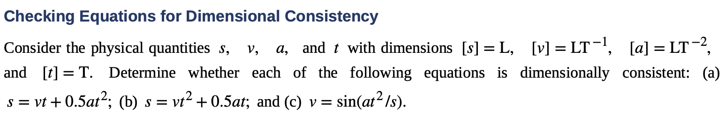
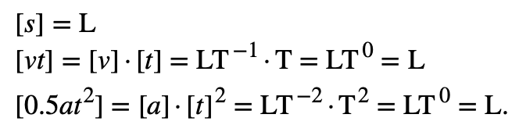
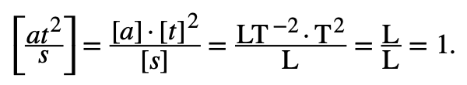
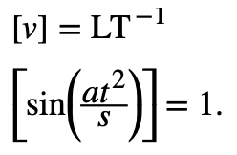
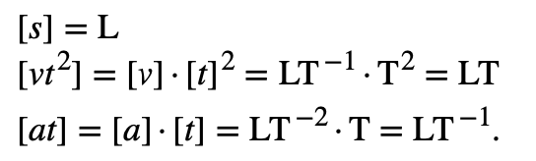
Dimensional Analysis
Example
a)
c)
this equation is dimensionally consistent.
b)
dimensionally NOT consistent
dimensionally NOT consistent

Slide 12
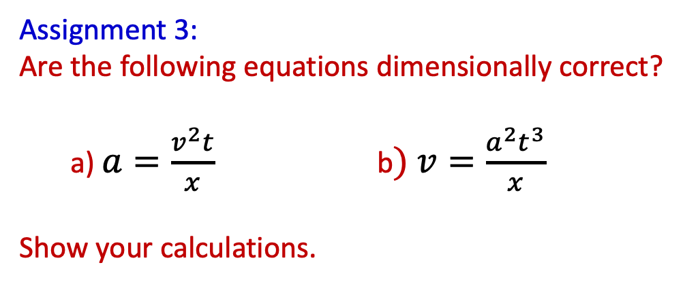
Dimensional Analysis
Assignment 3:
Are the following equations dimensionally correct?
a) $a=\frac{v^{2}t}{x}$ b$) v=\frac{a^{2}t^{3}}{x}$
Show your calculations.

Slide 13
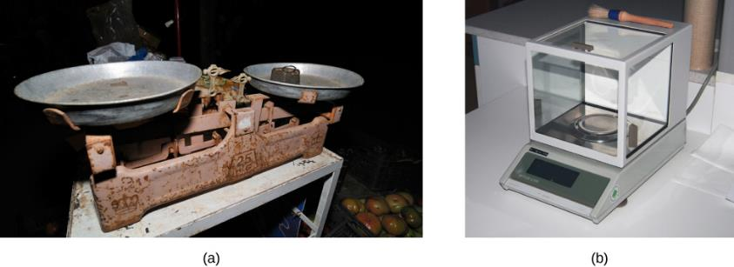
Significant Figures
A double-pan mechanical balance is used to compare different masses. Usually, an object with unknown mass is placed in one pan and objects of known mass are placed in the other pan. When the bar that connects the two pans is horizontal, then the masses in both pans are equal. The “known masses” are typically metal cylinders of standard mass such as 1 g, 10 g, and 100 g.
Many mechanical balances, such as double-pan balances, have been replaced by digital scales, which can typically measure the mass of an object more precisely. A mechanical balance may read only the mass of an object to the nearest tenth of a gram, but many digital scales can measure the mass of an object up to the nearest thousandth of a gram.
(credit a: modification of work by Serge Melki; credit b: modification of work by Karel Jakubec)

Slide 14
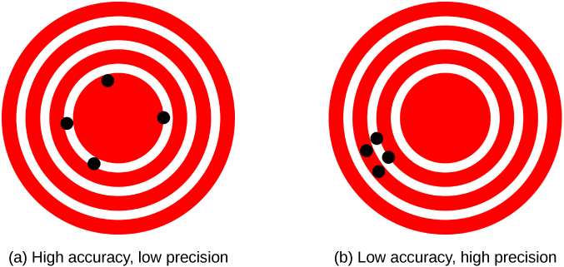
Significant Figures
Accuracy and Precision
A GPS attempts to locate a restaurant at the center of the bull’s-eye. The black dots represent each attempt to pinpoint the location of the restaurant.
The dots are spread out quite far apart from one another, indicating low precision, but they are each rather close to the actual location of the restaurant, indicating high accuracy.
The dots are concentrated rather closely to one another, indicating high precision, but they are rather far away from the actual location of the restaurant, indicating low accuracy.
(credit a and credit b: modification of works by Dark Evil)

Slide 15
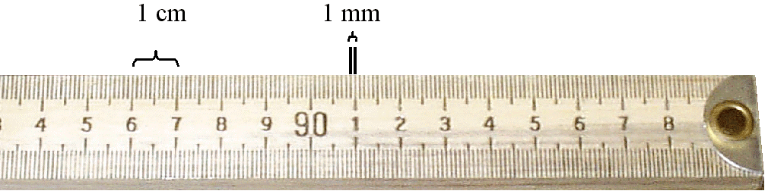
Significant Figures
The measured values are known only to within the limits of the experimental uncertainty (error)
Uncertainty can depend on various factors,
  Quality of the apparatus
  The skill of the experimenter
  The number of measurements performed
The number of significant figures in a measurement can be used to express something about the uncertainty and is related to the number of numerical digits used to express the measurement.
1mm = 0.1 cm
uncertainty = ± 0.1 cm
Measurement = 6.0 cm
Record the value as (6.0 ± 0.1) cm
Two significant figures

Slide 16
Significant Figures
The zeroes used to position the decimal point in a number is not significant.
0.1 mm = 0.0001 m
0.03 mm has one significant figures
0.0075 mm has two significant figures
significant or not significant.
The zeros come after other digits is ________________
e.g. 15000 g
we do not know whether the last three zeros are being used to locate the decimal point or whether they represent significant figures in the measurement
To remove this ambiguity, use scientific notation to indicate the number of significant figures.
1.5 X10⁴ g has two significant figures
three
1.50 X10⁴ g has ____ significant figures
1.500 X10⁴ g has ____ significant figures
four

Slide 17
Significant Figures
Significant figures for multiplication and division
  The number of significant figures in the final answer is the same as the number of significant figures in the quantity having the smallest number of significant figures.
6.276
Correct answer but not significant figures
1.2 x 5.23
6.3
Correct significant figures
Significant figures for addition and subtraction
  The number of decimal places in the result should equal the smallest number of decimal places of any term in the sum or difference.
28.374
Correct answer but not significant figures
23.2 + 5.174
28.4
Correct significant figures

Slide 18
Significant Figures
The last digit retained is increased by 1 if the last digit dropped is greater than 5.
Round to first decimal
28.4
28.374
The last digit dropped is less than 5, the last digit retained remains as it is.
Round to first decimal
28.3
28.314
If the last digit dropped is equal to 5, the remaining digit should be rounded to the nearest even number
Round to first decimal
28.4 as .35 is closer to 0.4 than to 0.2)
28.354
Round to first decimal
28.6 as .65 is closer to 0.6 than to 0.8)
28.654
Example: 2.5+7.5+12.0+9.3+4.5+6.6=42.4
Assignment 4: 5.6+6.5+12.7+9.2+9.5+6.1=?

Slide 19

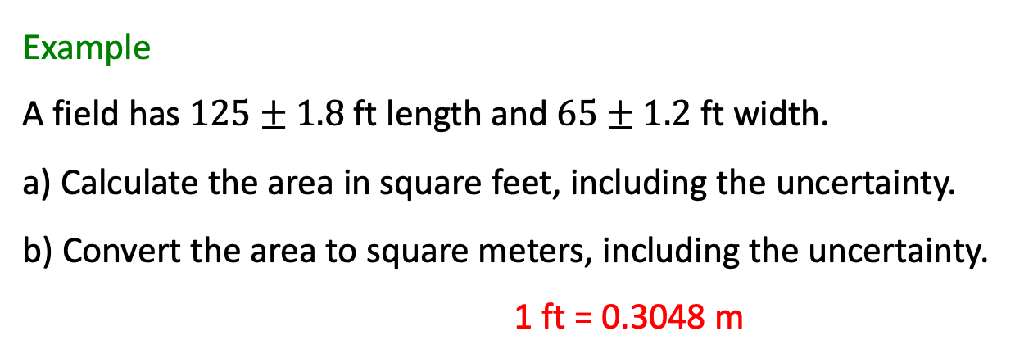
Problem solving
Problem-solving skills are essential to your success in physics.
(credit: “scui3asteveo”/Flickr)
Example
A field has $125±1.8$ ft length and $65±1.2$ ft width.
a) Calculate the area in square feet, including the uncertainty.
b) Convert the area to square meters, including the uncertainty.
1 ft = 0.3048 m

Slide 20
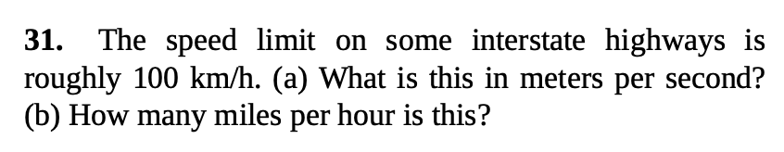
Problem solving
Problem-solving skills are essential to your success in physics.
(credit: “scui3asteveo”/Flickr)
Example

Slide 21
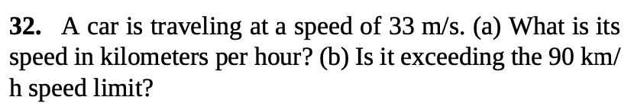
Problem solving
Problem-solving skills are essential to your success in physics.
(credit: “scui3asteveo”/Flickr)
Assignment 5

Slide 22
Problem solving
Problem-solving skills are essential to your success in physics.
(credit: “scui3asteveo”/Flickr)
Example

Slide 23
Problem solving
Problem-solving skills are essential to your success in physics.
(credit: “scui3asteveo”/Flickr)
Assignment 6
Calculate the radius of a circle that has area of 32.650 cm².

Slide 24
Attribution
These slides are a derivative of the “University Physics Vol. 1” slides by OpenStax, used under a Creative Commons Attribution 4.0 license by Mkhitar Hobosyan.

