Slide 1
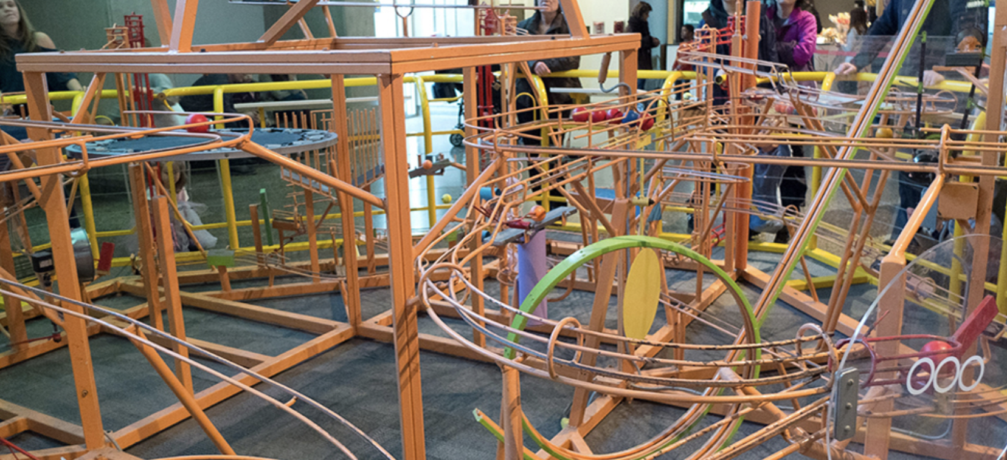
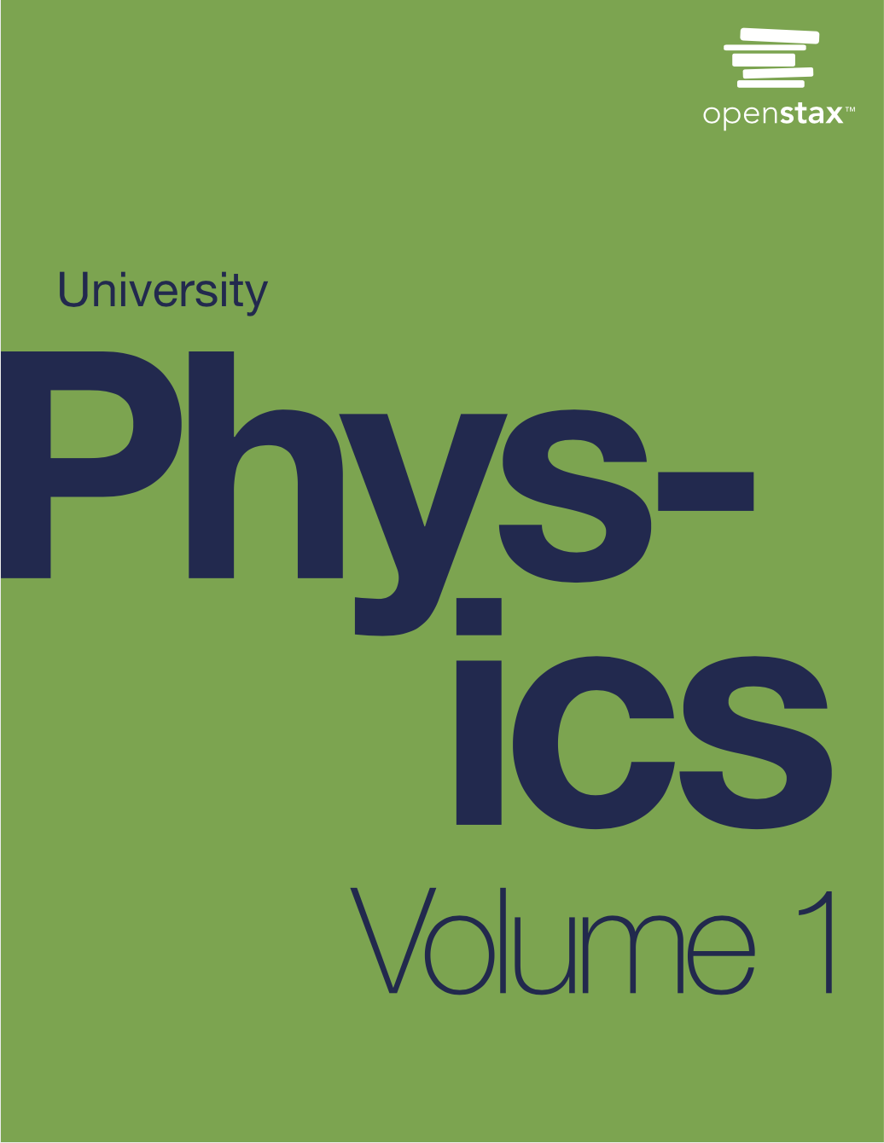
PHYS 2425
Physics for Scientists
and Engineers I
Chapter 8
Potential Energy and Conservation of Energy
Download the textbook for free at https://openstax.org/details/books/university-physics-volume-1
Image credit:modification of work by Roland Tanglao

Slide 2

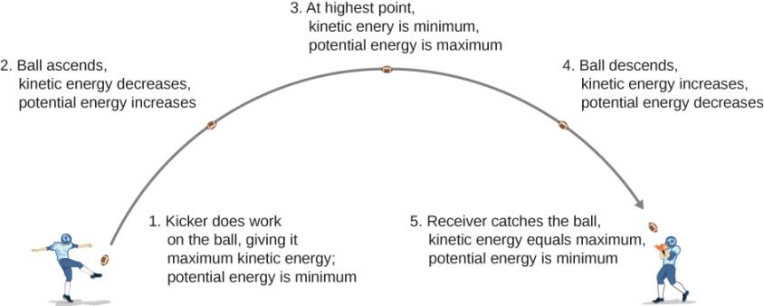




Potential Energy Basics
We can define the difference of potential energy from point A to point B as the negative of the work done:
or
Taking initial potential energy as zero, the potential energy is just
As a football starts its descent toward the wide receiver, gravitational potential energy is converted back into kinetic energy.
As long as there is no friction or air resistance, the change in kinetic energy of the football equals the change in gravitational potential energy of the football. This can be generalized to any potential energy:

Slide 3


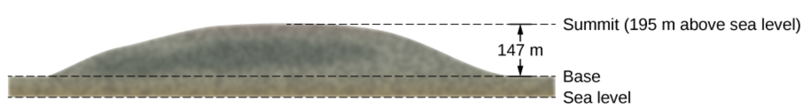
Types of Potential Energy
Gravitational potential energy near Earth’s surface
The gravitational potential energy function near Earth’s surface is
where the constant can be taken as zero at some convenient point.
Example
The summit of Great Blue Hill in Milton, MA, is 147 m above its base and has an elevation above sea level of 195 m. A 75-kg hiker ascends from the base to the summit. What is the gravitational potential energy of the hiker-Earth system with respect to zero gravitational potential energy at base height, when the hiker is (a) at the base of the hill, (b) at the summit, and (c) at sea level, afterward?

Slide 4
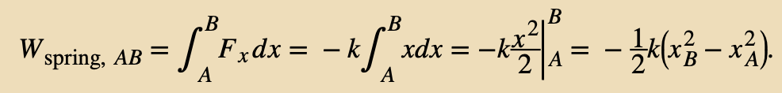

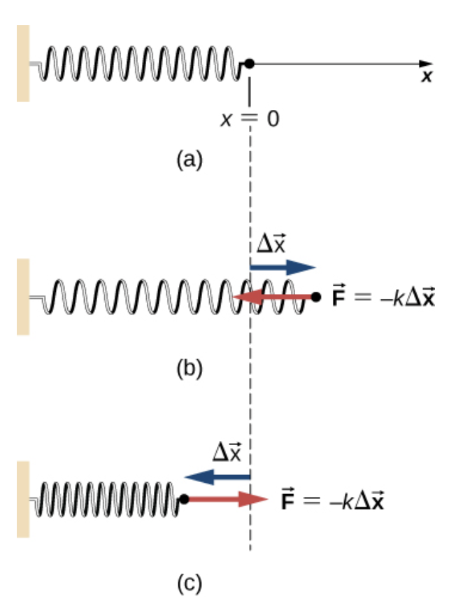
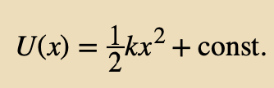
Types of Potential Energy
Elastic potential energy
We have already seen that the work done by a perfectly elastic spring, in one dimension, depends only on the spring constant and the squares of the displacements from the unstretched position:
We can define the difference of elastic potential energy for a spring force as the negative of the work done by the spring force in this equation:
where the object travels from point A to point B. The potential energy function corresponding to this difference is
If the spring force is the only force acting, it is simplest to take the zero of potential energy at x = 0 , when the spring is at its unstretched length. Then the constant is is zero.
Example
A system contains a perfectly elastic spring, with an unstretched length of 20 cm and a spring constant of 4 N/cm. (a) How much elastic potential energy does the spring contribute when its length is 23 cm? (b) How much more potential energy does it contribute if its length increases to 26 cm?

Slide 5
Types of Potential Energy
Elastic potential energy
Assignment 1
When the length of the spring in previous Example changes from an initial value of 22.0 cm to a final value, the elastic potential energy it contributes changes by −0.0800 J.
Find the final length.
If the spring force is the only force acting, it is simplest to take the zero of potential energy at x = 0 , when the spring is at its unstretched length. Then the constant is is zero.
Example
A system contains a perfectly elastic spring, with an unstretched length of 20 cm and a spring constant of 4 N/cm. (a) How much elastic potential energy does the spring contribute when its length is 23 cm? (b) How much more potential energy does it contribute if its length increases to 26 cm?

Slide 6
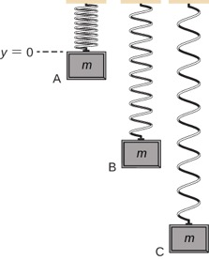
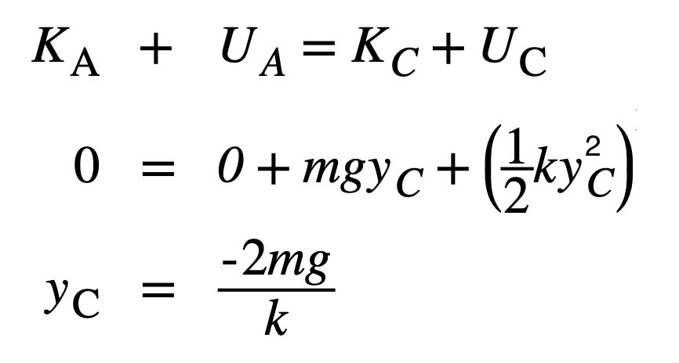
Types of Potential Energy
Gravitational and elastic potential energy
A vertical mass-spring system, with the y-axis pointing upward. The mass is initially at an unstretched spring length, point A. Then it is released, expanding past point B to point C, where it comes to a stop.
Example
A block weighing 1.2 N is hung from a spring with a spring constant of 6.0 N/m , as shown in Figure.
What is the maximum expansion of the spring, as seen at point C?
What is the total potential energy at point B, halfway between A and C?
(c) What is the speed of the block at point B?
The total energy of the system is conserved, the energy at point A equals point C.

Slide 7
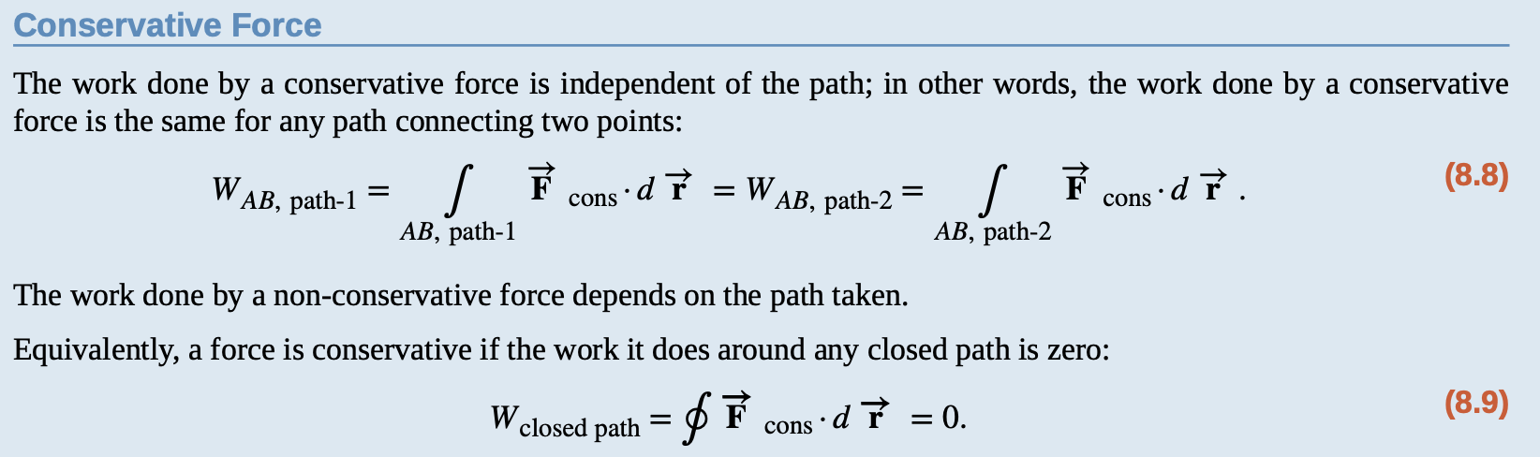




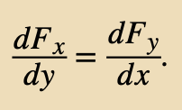
Conservative and Non-Conservative Forces
In previous examples, any transition between kinetic and potential energy conserved the total energy of the system. This was path independent, meaning that we can start and stop at any two points in the problem, and the total energy of the system—kinetic plus potential—at these points are equal to each other. This is characteristic of a conservative force.
A grinding wheel applies a non-conservative force, because the work done depends on how many rotations the wheel makes, so it is path-dependent.
The work done is independent of path if the infinitesimal work
is an exact differential
In two dimensions, the condition for
to be an exact differential is

Slide 8
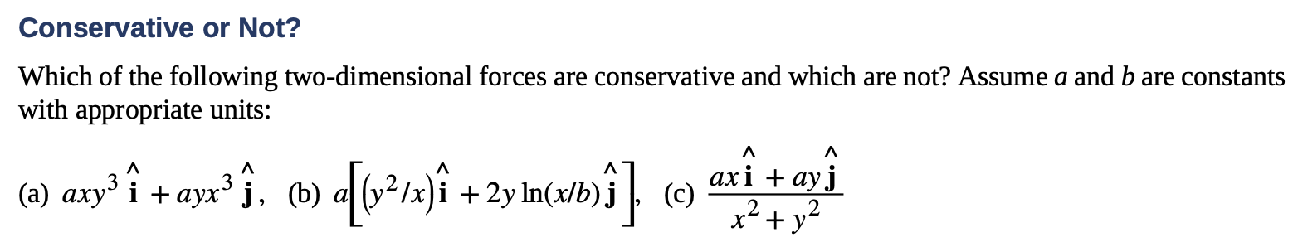
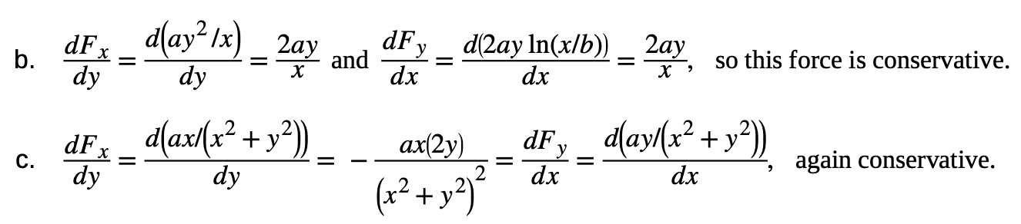
Conservative and Non-Conservative Forces
Example
The work done is independent of path if the infinitesimal work
is an exact differential
In two dimensions, the condition for
to be an exact differential is

Slide 9
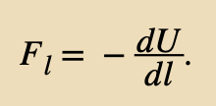

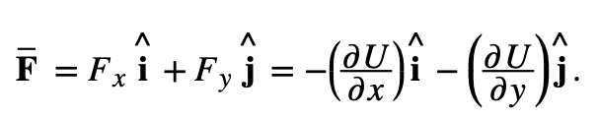
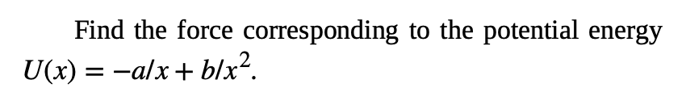
Conservative and Non-Conservative Forces
Non-conservative forces do not have potential energy associated with them because the energy is lost to the system and can’t be turned into useful work later.
There is always a conservative force associated with every potential energy. The relationship between force and potential energy associated with it is:
For one-dimensional motion
In two dimensions,
Assignment 2

Slide 10
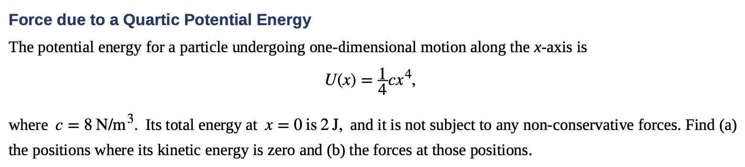
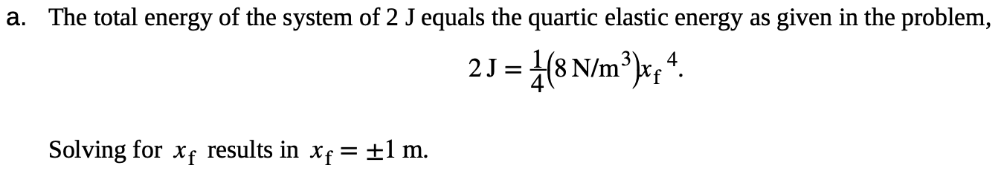

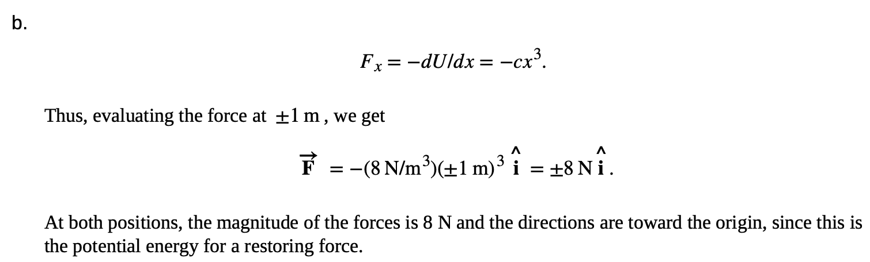
Conservative and Non-Conservative Forces
Example

Slide 11
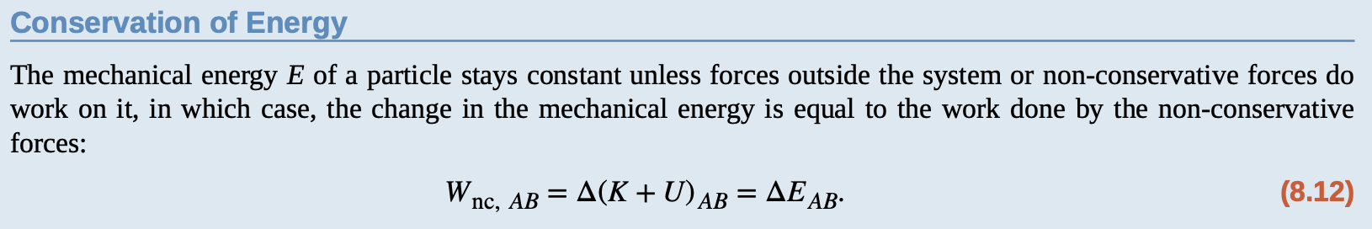

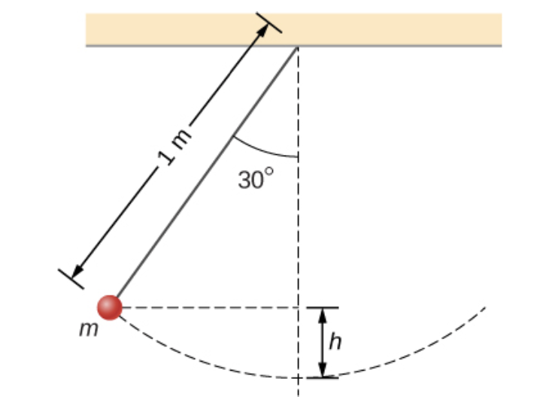

Conservation of Energy
We define the sum of the kinetic and potential energies,
K + U = E; to be the mechanical energy of the particle.
The mechanical energy of a particle does not change if all the non-conservative forces that may act on it do no work.
Example
A particle of mass m is hung from the ceiling by a massless string of length 1.0 m, as shown in Figure. The particle is released from rest, when the angle between the string and the downward vertical direction is 30°.
What is its speed when it reaches the lowest point of its arc?

Slide 12
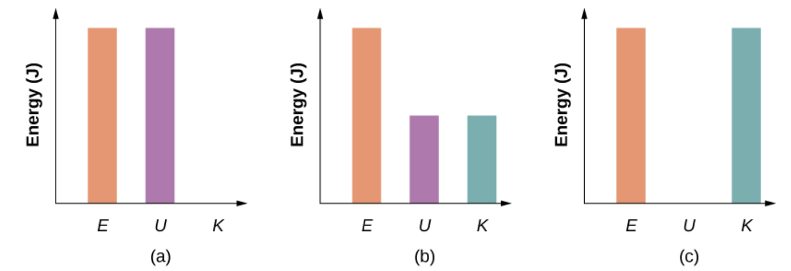
Conservation of Energy
Demonstration
Example
A particle of mass m is hung from the ceiling by a massless string of length 1.0 m, as shown in Figure. The particle is released from rest, when the angle between the string and the downward vertical direction is 30°.
What is its speed when it reaches the lowest point of its arc?

Slide 13
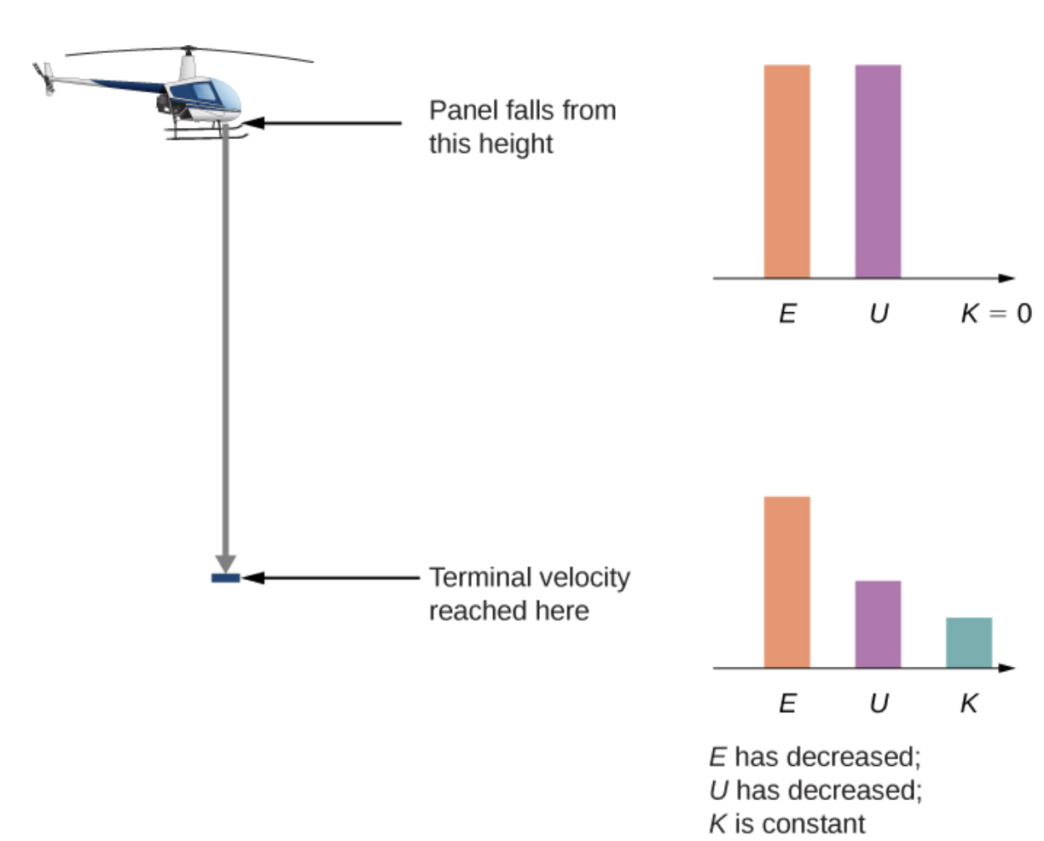

Conservation of Energy
Example
A helicopter is hovering at an altitude of 1 km when a panel from its underside breaks loose and plummets to the ground.
The mass of the panel is 15 kg, and it hits the ground with a speed of 45 m/s .
How much mechanical energy was dissipated by air resistance during the panel’s descent?

Slide 14
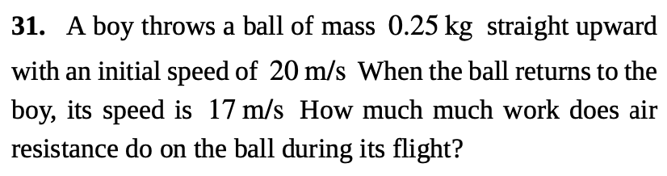
Conservation of Energy
Assignment 3

Slide 15
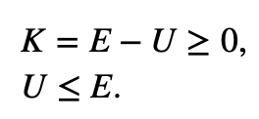
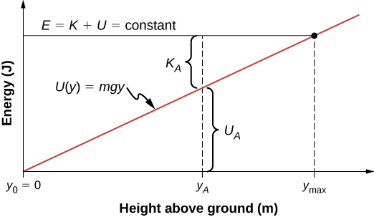

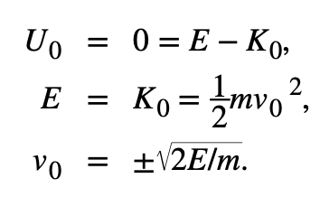
Potential Energy Diagrams and Stability
Potential energy diagrams provide useful information about the dynamical behavior of a mechanical system. This is most easily accomplished for a one-dimensional system.
If we use the gravitational potential energy reference point of zero at y₀, we can rewrite the gravitational potential energy U as mgy. Solving for y results in
At the maximum height, the kinetic energy and the speed are zero, so if the object were initially traveling upward, its velocity would go through zero there, and ymax would be a turning point in the motion.
At ground level, y₀ = 0 , the potential energy is zero, and the kinetic energy and the speed are maximum:
The potential energy graph for an object in vertical free fall, with various quantities indicated.

Slide 16
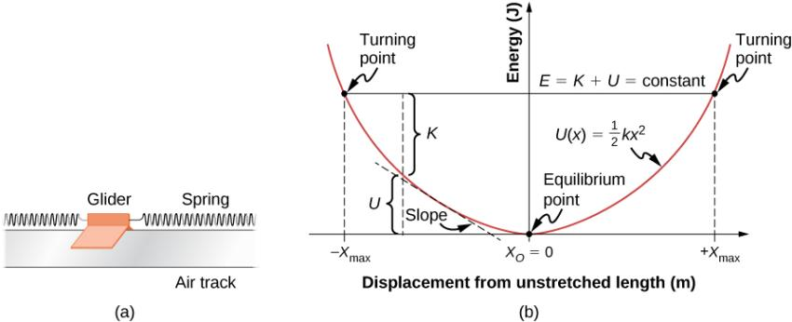


Potential Energy Diagrams and Stability
A glider between springs on an air track is an example of a horizontal mass-spring system.
The potential energy diagram for this system, with various quantities indicated.
K = 0 and U = E at a turning point, of which there are two for the elastic spring potential energy,
At the bottom of the potential well, x = 0, U = 0 and the kinetic energy is a maximum, K = E, so

Slide 17
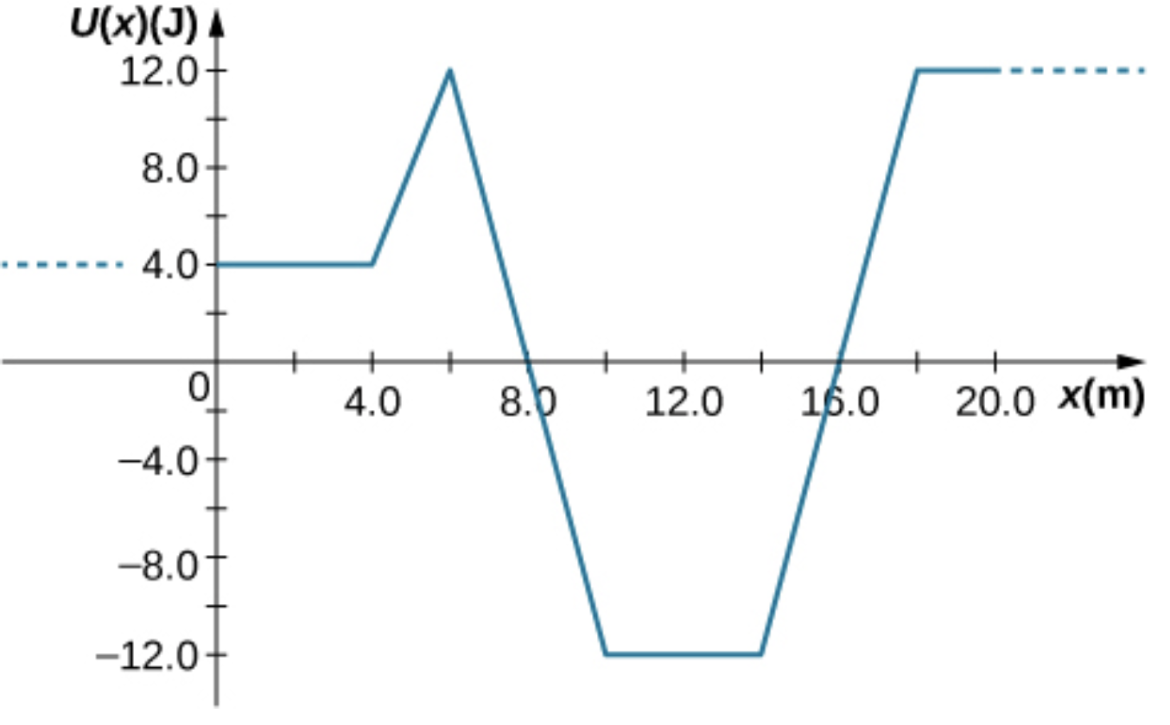
Potential Energy Diagrams and Stability
Assignment 4
A particle of mass 0.50 kg moves along the x-axis with a potential energy whose dependence on x is shown below. What is the force on the particle at x = 2.0, 5.0, 8.0, and 12 m?

Slide 18
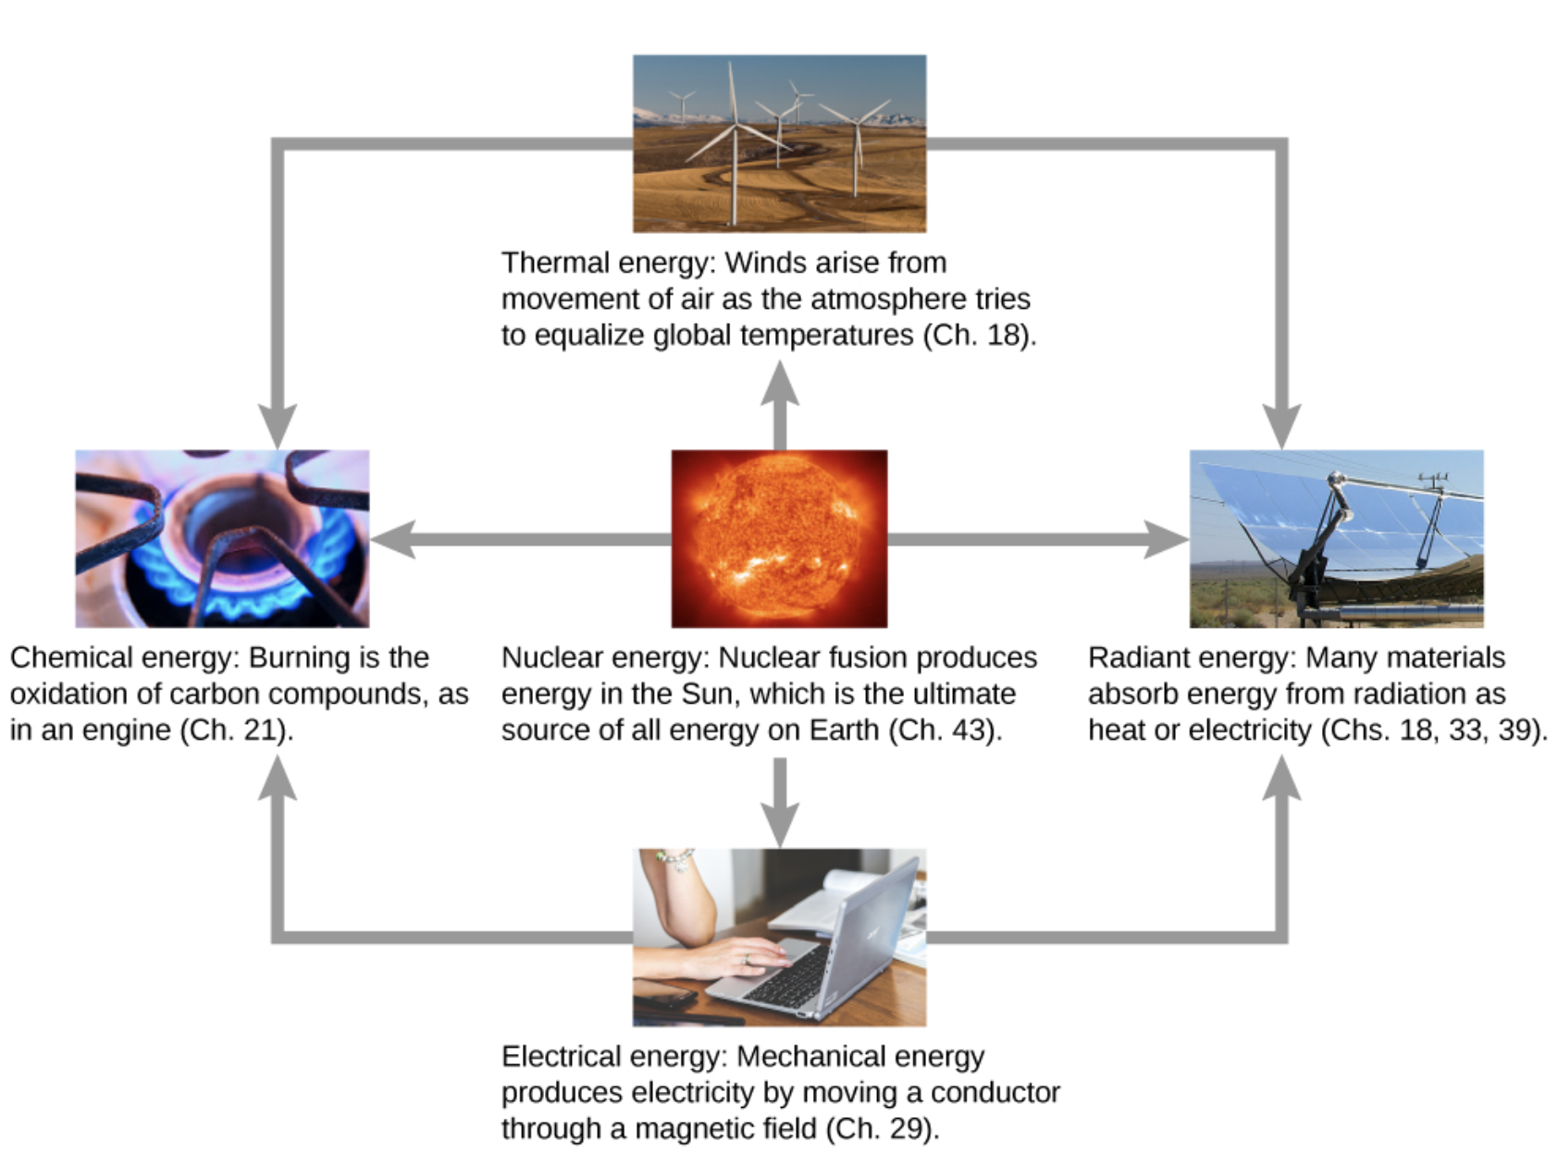
Sources of Energy
Energy that we use in society takes many forms, which is converted from one into another depending on the process involved.
(credit “sun”: EIT SOHO Consortium, ESA, NASA; credit “solar panels”: “kjkolb”/Wikimedia Commons; credit “gas burner”: Steven Depolo)
Atoms and molecules inside all objects are in random motion. The internal kinetic energy from these random motions is called thermal energy, because it is related to the temperature of the object.
Electrical energy is a common form that is converted to many other forms and does work in a wide range of practical situations.

Slide 19
Sources of Energy
Fuels, such as gasoline and food, have chemical energy, which is potential energy arising from their molecular structure.
Light is just one kind of electromagnetic radiation, or radiant energy, which also includes radio, infrared, ultraviolet, X-rays, and gamma rays. All bodies with thermal energy can radiate energy in electromagnetic waves.
Nuclear energy comes from reactions and processes that convert measurable amounts of mass into energy. Nuclear energy is transformed into radiant energy in the Sun, into thermal energy in the boilers of nuclear power plants, and then into electrical energy in the generators of power plants.

Slide 20
Attribution
These slides are a derivative of the “University Physics Vol. 1” slides by OpenStax, used under a Creative Commons Attribution 4.0 license by Mkhitar Hobosyan.

