Slide 1
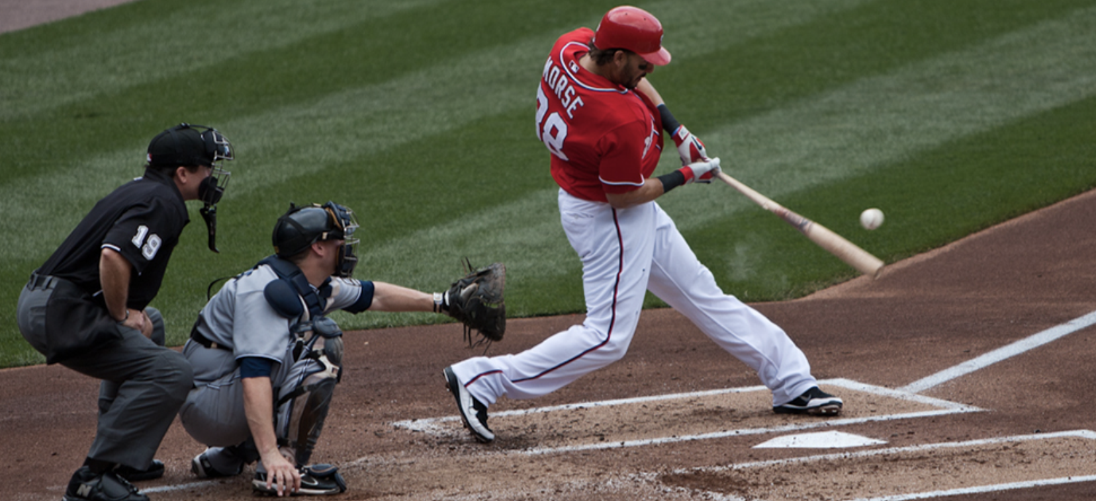

PHYS 2425
Physics for Scientists
and Engineers I
Chapter 9
Linear Momentum and Collisions
Image credit:modification of work by “Cathy T”/Flickr
Download the textbook for free at https://openstax.org/details/books/university-physics-volume-1

Slide 2

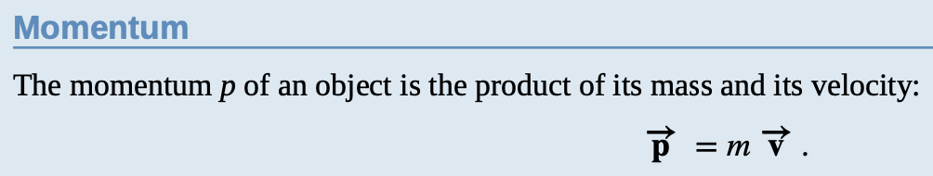
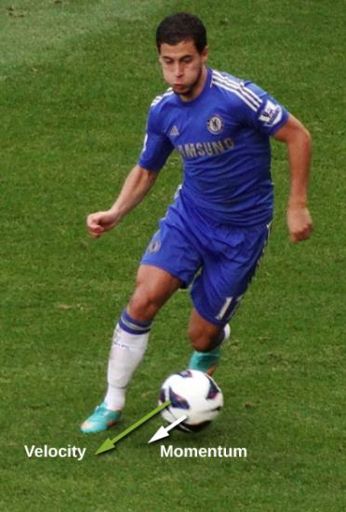
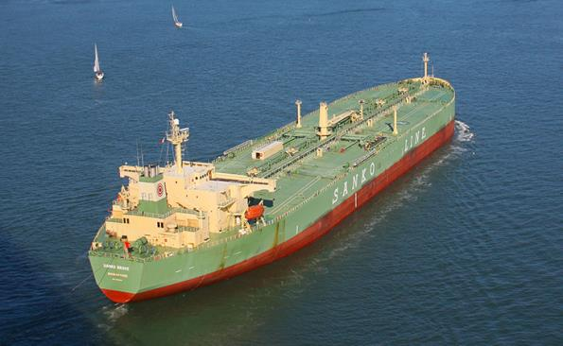
Linear Momentum
Since velocity is a vector quantity, momentum is also a vector, it has the same direction as velocity vector.
The velocity and momentum vectors for the ball are in the same direction. The mass of the ball is about 0.5 kg, so the momentum vector is about half the length of the velocity vector because momentum is velocity time mass.
(credit: modification of work by Ben Sutherland)
This supertanker transports a huge mass of oil; as a consequence, it takes a long time for a force to change its (comparatively small) velocity. (credit: modification of work by “the_tahoe_guy”/Flickr)

Slide 3
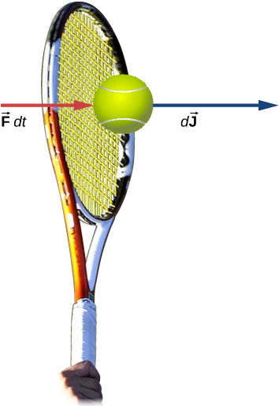
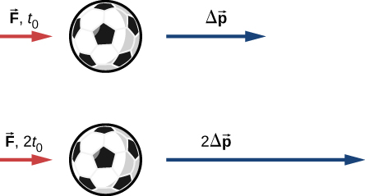

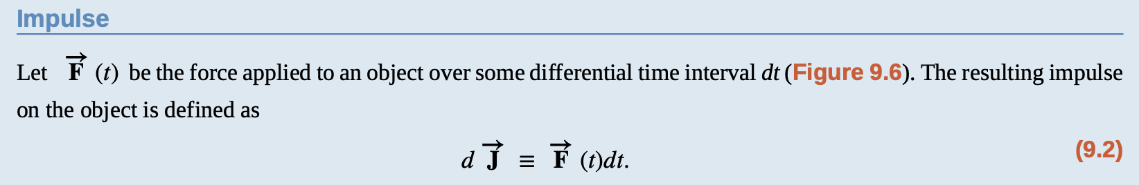

Impulse and Collisions
The product of a force and a time interval (over which that force acts) is called impulse, and is given the symbol
The change in momentum of an object is proportional to the length of time during which the force is applied. If a force is exerted on the lower ball for twice as long as on the upper ball, then the change in the momentum of the lower ball is twice that of the upper ball.
A force applied by a tennis racquet to a tennis ball over a time interval generates an impulse acting on the ball.

Slide 4
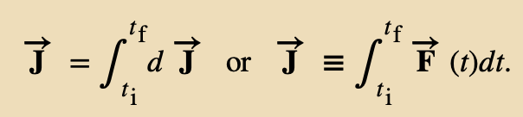

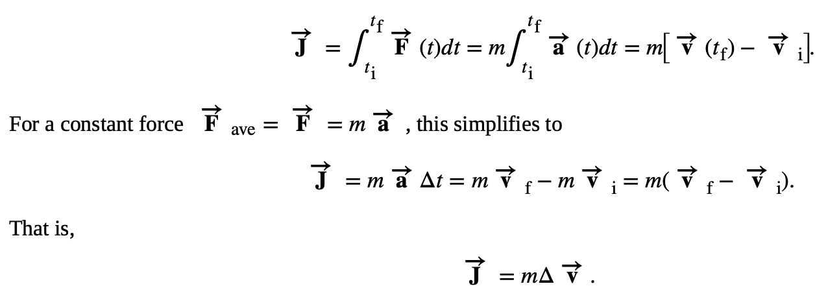
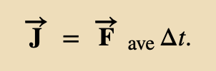
Impulse and Collisions
The total impulse over the interval t_{f} − t_{i} is
To calculate the impulse, a useful result follows from
writing the force as
We often don’t know the fore function F(t), but if we know the average force, then

Slide 5
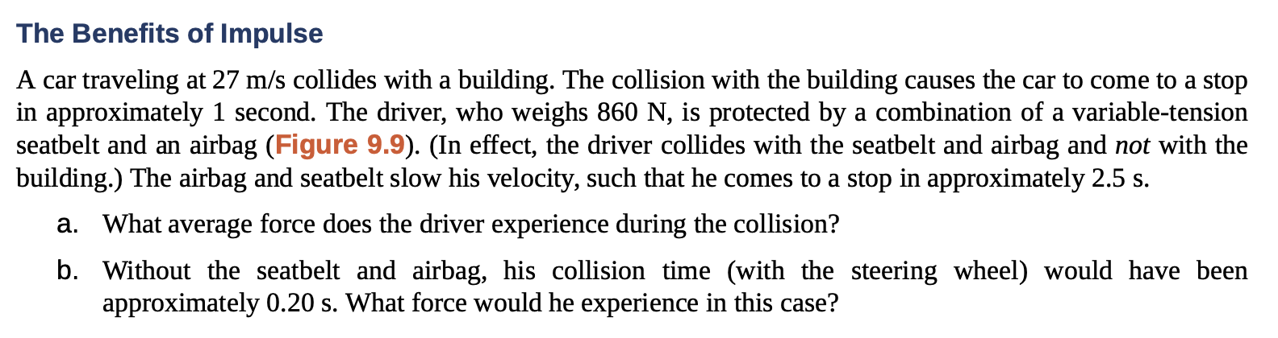
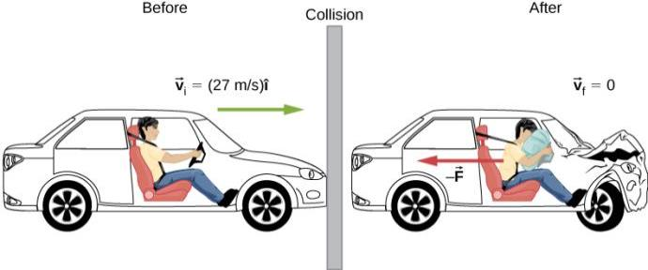
Impulse and Collisions
Example
The motion of a car and its driver at the instant before and the instant after colliding with the wall.

Slide 6
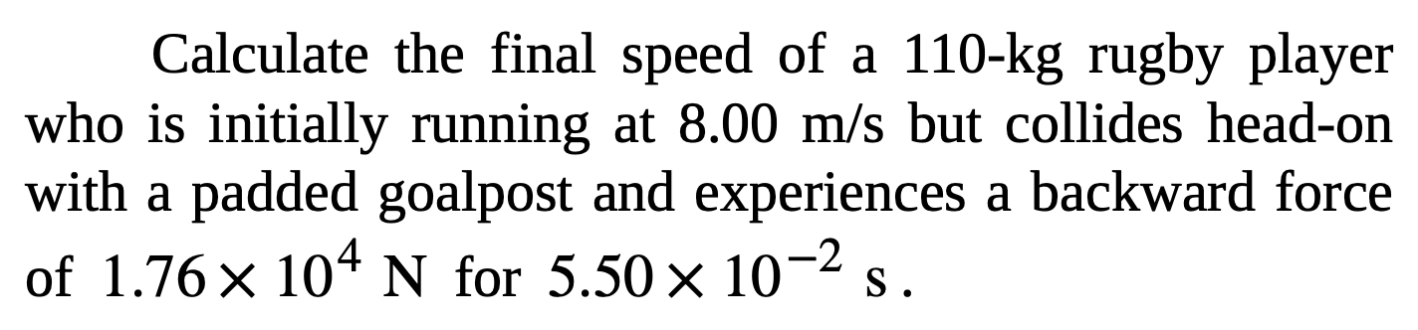
Impulse and Collisions
Assignment 1

Slide 7

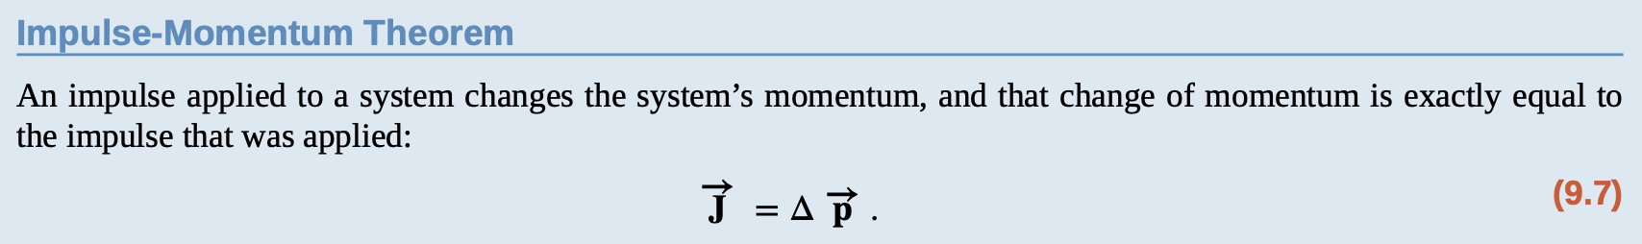
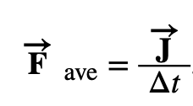
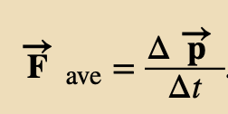
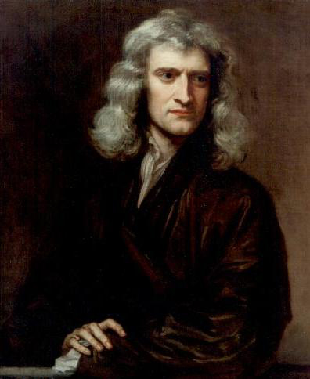

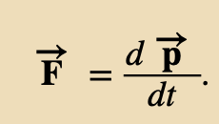
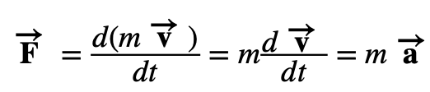
Momentum and Force
As we have seen
This is the change in momentum, thus:
Taking into account
For a continuously changing momentum—due to a continuously changing force— in the limit
This is, in fact, Newton’s second law, written in terms of momentum rather than acceleration.
This is the relationship Newton himself presented in his Principia Mathematica.
If the mass of the system remains constant

Slide 8
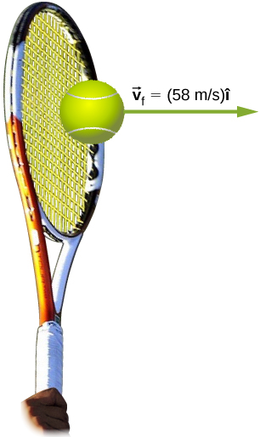
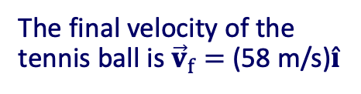
Momentum and Force
Example
Calculating Force: Venus Williams’ Tennis Serve
During the 2007 French Open, Venus Williams hit the fastest recorded serve in a premier women’s match, reaching a speed of 58 m/s (209 km/h).
What is the average force exerted on the 0.057-kg tennis ball by Venus Williams’ racquet? Assume that the ball’s speed just after impact is 58 m/s, as shown in figure, that the initial horizontal component of the velocity before impact is negligible, and that the ball remained in contact with the racquet for 5.0 ms.
The final velocity of the tennis ball is ${\vec{v}}_{f}=$ (58 m/s)$\hat{i}$

Slide 9
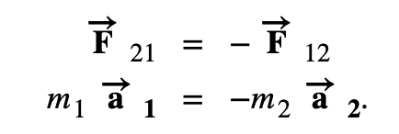

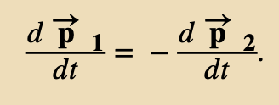
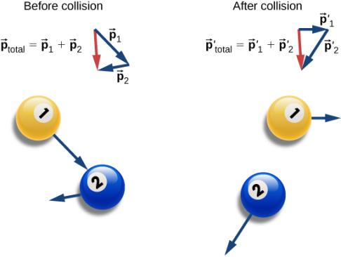
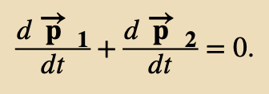
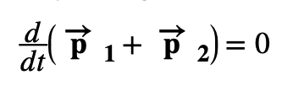

Conservation of Linear Momentum
Newton’s third law says
Then, if masses are not changing
or
which means
These two forces do not cancel because they are applied to different objects.
F₂₁ causes m₁ to accelerate, and F₁₂ causes m₂ to accelerate.
Before and after the collision, the two billiard balls travel with different momenta.
The total momentum, however, has not changed, as shown by the red vector arrow.
The total momentum of the system before and after the collision remains the same.

Slide 10
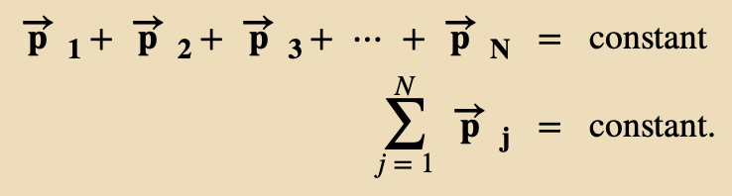
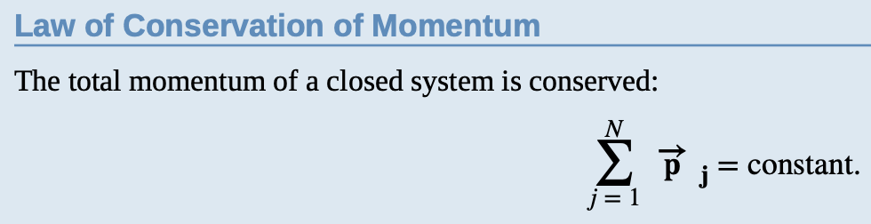
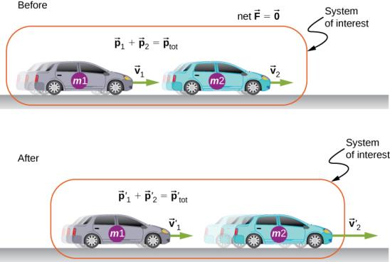
Conservation of Linear Momentum
Generalizing
The mass of the system must remain constant during the interaction.
The net external force on the system must be zero.
A system of objects that meets these two requirements is said to be a closed system (also called an isolated system).
In a closed system, the total momentum never changes.
The two cars together form the system that is to be analyzed.
It is important to remember that the contents (the mass) of the system do not change before, during, or after the objects in the system interact.

Slide 11
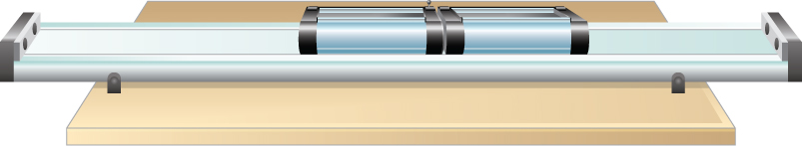
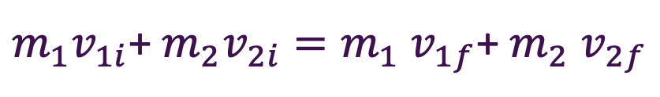
Conservation of Linear Momentum
Example
Colliding Carts
Two carts in a physics lab roll on a level track, with negligible friction. These carts have small magnets at their ends, so that when they collide, they stick together. The first cart has a mass of 675 grams and is rolling at 0.75 m/s to the right; the second has a mass of 500 grams and is rolling at 1.33 m/s, also to the right. After the collision, what is the velocity of the two joined carts?
$m_{1}v_{1i}$+ $m_{2}v_{2i}=m_{1}$ $v_{1f}$+ $m_{2}$ $v_{2f}$

Slide 12
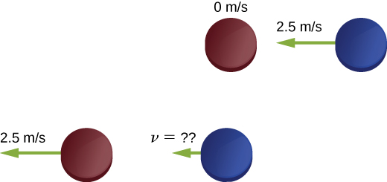
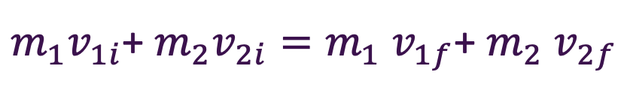
Conservation of Linear Momentum
Assignment 2
Two hockey pucks of identical mass are on a flat, horizontal ice hockey rink. The red puck is motionless; the blue puck is moving at 2.5 m/s to the left. It collides with the motionless red puck. The pucks have a mass of 15 g. After the collision, the red puck is moving at 2.5 m/s, to the left. What is the final velocity of the blue puck?
$m_{1}v_{1i}$+ $m_{2}v_{2i}=m_{1}$ $v_{1f}$+ $m_{2}$ $v_{2f}$

Slide 13

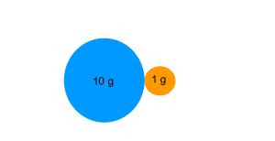
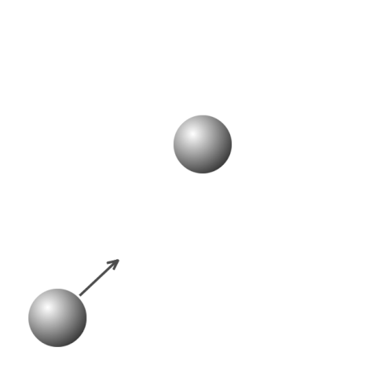
Types of Collisions
Multiple objects can collide and stick together, forming a single object. This type of collision is called inelastic.
Momentum is conserved, kinetic energy is not conserved (some energy is transformed to heat, deformation of objects, sound, etc.
If after collision the objects become motionless, we call it perfectly inelastic (max. KE loss).
The inverse of perfectly inelastic collision is explosion: a single object may break apart into two or more pieces. An example of this is a firecracker, or a bow and arrow, or a rocket rising through the air toward space. Momentum still conserved, KE increases (at the expense of some other energy source, for example potential energy, chemical energy…)
https://gifer.com/en/EHm8
http://www.dynamicscience.com.au/tester/solutions1/war/newton/monetumexes.htm
Finally, two or more objects approach each other, collide, and bounce off each other, moving away from each other at the same relative speed at which they approached each other (for example, two billiard balls). In this case, the total kinetic energy of the system is conserved and the momentum is conserved. Such an interaction is called elastic.
https://gifer.com/en/gifs/elastic-collision

Slide 14
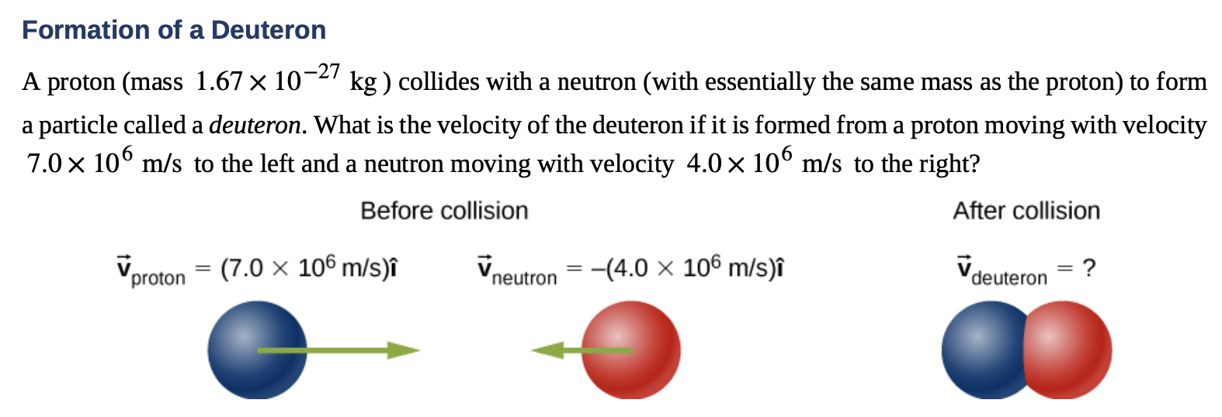


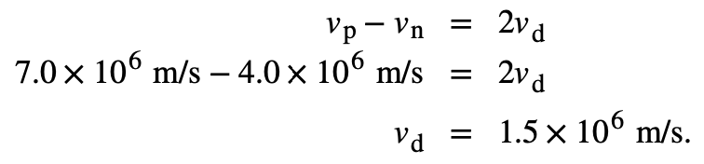
Momentum and Force
Example: inelastic collision
This is essentially how particle colliders like the Large Hadron Collider work: They accelerate particles up to very high speeds (large momenta), but in opposite directions. This maximizes the creation of so-called “daughter particles.”

Slide 15
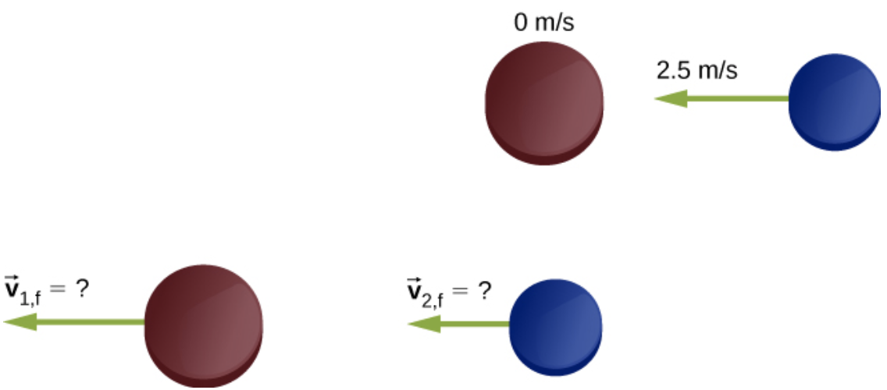
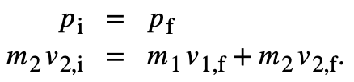
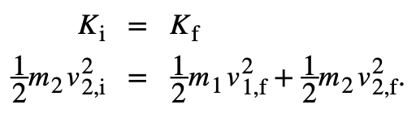
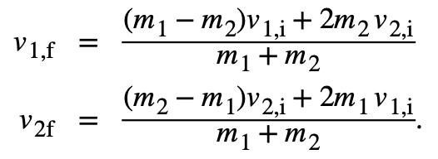
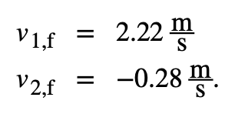
Momentum and Force
Example: perfectly elastic collision
Two ice hockey pucks of different masses are on a flat, horizontal hockey rink. The red puck has a mass of 15 grams and is motionless; the blue puck has a mass of 12 grams and is moving at 2.5 m/s to the left. It collides with the motionless red puck. If the collision is perfectly elastic, what are the final velocities of the two pucks?
Conservation of momentum
Conservation of kinetic energy
There are our two equations in two unknowns
Negative, now moves to the right

Slide 16
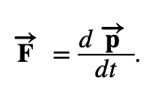
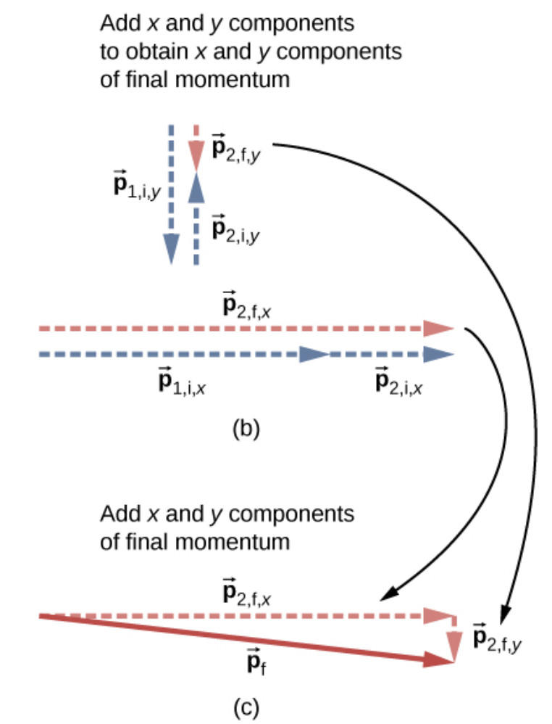
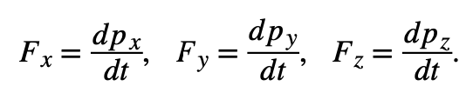
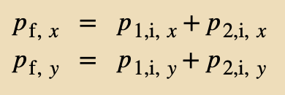
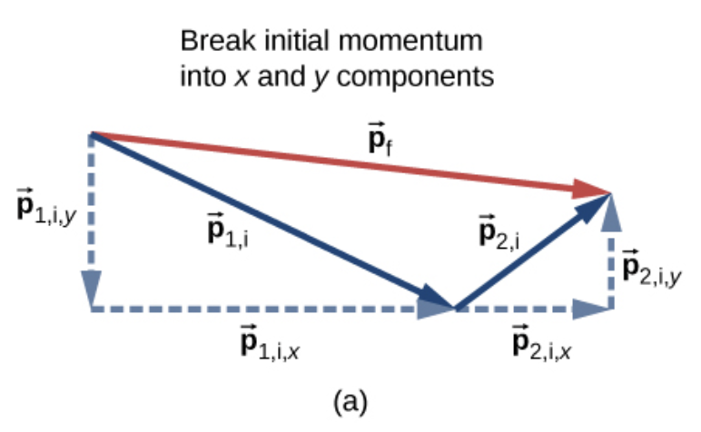
Collisions in Multiple Dimensions
For collisions that occur in two or three dimensions, we use the component form of equations
Expressing both the force and the momentum in component form
The momentum conservation equation can be written separately for x, y and z directions and solved.
For x and y directions:

Slide 17

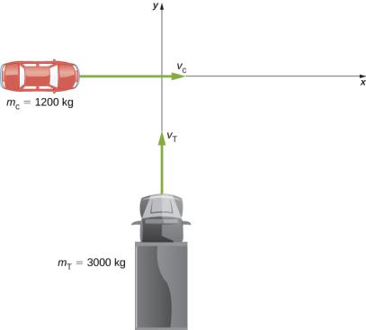


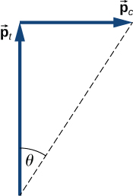
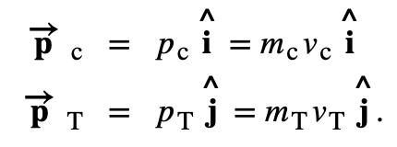
Collisions in Multiple Dimensions
Example
Traffic Collision
A small car of mass 1200 kg traveling east at 60 km/hr collides at an intersection with a truck of mass 3000 kg that is traveling due north at 40 km/hr. The two vehicles are locked together. What is the velocity of the combined wreckage?
Before the collision the total momentum
After the collision, the wreckage has momentum
Since the system is closed, momentum must be conserved

Slide 18




Collisions in Multiple Dimensions
Example
Traffic Collision
A small car of mass 1200 kg traveling east at 60 km/hr collides at an intersection with a truck of mass 3000 kg that is traveling due north at 40 km/hr. The two vehicles are locked together. What is the velocity of the combined wreckage?
in the x-direction:
in the y-direction:
Applying the Pythagorean theorem gives

Slide 19


Collisions in Multiple Dimensions
Example
Traffic Collision
A small car of mass 1200 kg traveling east at 60 km/hr collides at an intersection with a truck of mass 3000 kg that is traveling due north at 40 km/hr. The two vehicles are locked together. What is the velocity of the combined wreckage?

Slide 20








Collisions in Multiple Dimensions
$m_{1}v_{1i}$+ $m_{2}v_{2i}=m_{1}$ $v_{1f}$+ $m_{2}$ $v_{2f}$
Assignment 3
$m_{2}$
$$m_{1}$$
$$θ$$
$$θ$$
$$m_{1}$$
$m_{2}$

Slide 21






Center of Mass
Suppose we have an extended object of mass M, made of N interacting particles. The total mass
When some net external force is applied, every particle experiences some fraction (“share”) of that force. Every particle is also interacting with other particles with internal forces, but these forces cancel each other.
The net external force will change the momentum of every particle, and the sum is
The center of the mass of an extended object is the point to which if the force was applied, the object would move similarly. We note

Slide 22





Center of Mass
Note that
Dividing both sides by M (the total mass of the extended object) gives us
This is the center of mass of the object

Slide 23




Center of Mass
Since
it follows that:
The instantaneous velocity of the center of mass
This is the center of mass of the object

Slide 24

Center of Mass
Example

Slide 25








Center of Mass of Continuous Objects
If the object in question has its mass distributed uniformly in space, rather than as a collection of discrete particles, then m_{j} → dm , and the summation becomes an integral:
Example
Find the center of mass of a uniform hoop. We express the coordinates of a differential piece of the hoop, and then integrate around the hoop.
Substitute
where λ is the linear mass density (kilograms of material per meter)
The hoop’s symmetry suggests the center of mass should be at its geometric center.
the arc length ds subtends a differential angle dθ , so we have

Slide 26




Center of Mass of Continuous Objects
λ is the linear mass density, it is computed by dividing the total mass by the length of the hoop:
The variable of integration is now the angle θ . The limits of integration (around the
circular hoop) are θ = 0 to θ = 2π , so a = 0 and b = 2π . Separating the integral into the x- and y-components
as expected.
Conservation of momentum expressed in terms of the center of mass of the system

Slide 27




Rocket Propulsion
The mass and velocity of the rocket are changing; also, the total mass of ejected gases is changing. If we define our system to be the rocket + fuel, then this is a closed system (since the rocket is in deep space, there are no external forces acting on this system); as a result, momentum is conserved for this system.
(credit: modification of work by NASA)

Slide 28







Rocket Propulsion
dmg and dv are each very small; thus, their product dmg dv is very, very small, so ignore. We get:
since dmg represents an increase in the mass of ejected gases, it must also represent a decrease of mass of the rocket:
Integrating from the initial mass m_{i} to the final mass m of the rocket
The rocket equation.

Slide 29

Rocket Propulsion
Assignment 4
A rocket initially moving at v_{i}=2.3 km/s in space fires its engines. The initial mass of rocket is m_{i}=100 000 kg and the final mass of the rocket is m=10 000 kg. If the exhaust velocity is u=4.0 km/s, calculate the final speed in km/s.
During the acceleration of the rocket, it gains kinetic energy. Where is this energy coming from?

Slide 30

Rocket Propulsion
The velocity change of the rocket during the launch phase, from the surface of Earth.
Restricting our attention to distances for which the acceleration caused by gravity can be treated as a constant g.
Δt is the burn time of the fuel.
−g Δt term tells us that the longer the burn time is, the
smaller the rocket’s change of velocity will be.
This is the reason that the launch of a rocket is so spectacular at the first moment of liftoff: It’s essential to burn the fuel as quickly as possible, to get as large a Δv as possible.
(In the absence of gravity, it makes no difference how much time it takes to burn the entire mass of fuel; the change of velocity does not depend on Δt).
(credit: modification of work by NASA)

Slide 31
Attribution
These slides are a derivative of the “University Physics Vol. 1” slides by OpenStax, used under a Creative Commons Attribution 4.0 license by Mkhitar Hobosyan.

