Slide 1

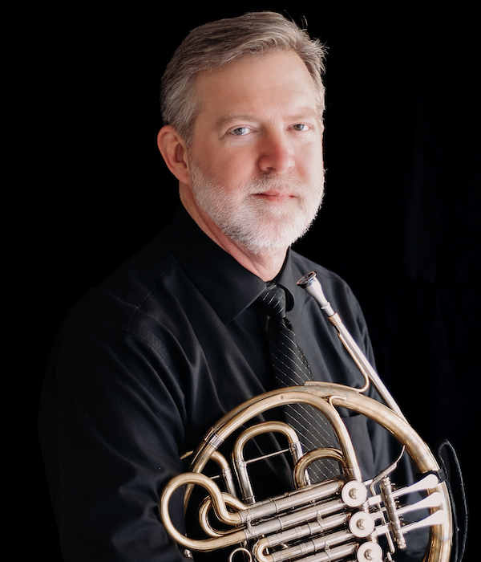
Horn Journey
Steve Eddins

