Slide 1

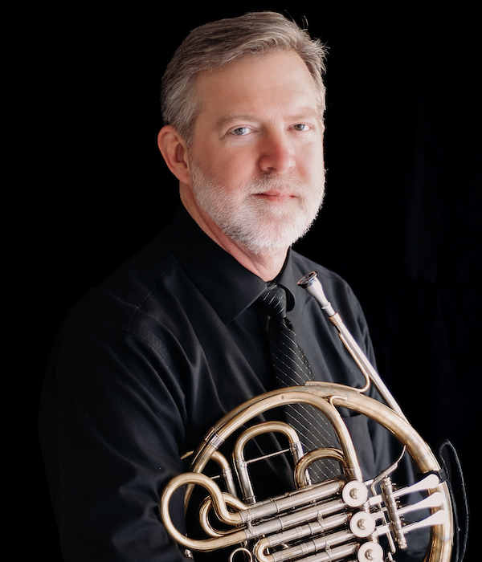
Horn Journey
By Steve Eddins

