Slide 1
Ideal User Workflow
User Goal
Input
Energy Start, (Energy End,) Polarisation Start, (Polarisation End,) Steps, Polarisation Mode, (Raster/Direct, Harmonic)
Output
Data correlating Energy and Polarisation to Sensor Readout.
Pretty Graphics…
Peak fitting…
Analysis

Slide 2
Invisible Workflow
User Goal
Input
Energy Start, (Energy End,) Polarisation Start, (Polarisation End,) Steps, Polarisation Type, (Raster/Direct, Harmonic)
Undulator Trajectory and Monochromator Trajectory
Other control magics (data collection triggers etc).
Output
Data correlating Energy and Polarisation to Sensor Readout.
Data analysis workflows, jiggery pokery
Pretty Graphics…
Peak fitting…
Analysis

Slide 3
Undulator Tables
User Goal
Input
Energy Start, (Energy End,) Polarisation Start, (Polarisation End,) Steps, Polarisation Type, (Raster/Direct, Harmonic)
Undulator Trajectory and Monochromator Trajectory
Other control magics (data collection triggers etc).
Output
Data correlating Energy and Polarisation to Sensor Readout.
Data analysis workflows, jiggery pokery
Pretty Graphics…
Peak fitting…
Prompt Analysis

Slide 4
Undulator Tables
Present Situation
1-D Undulator Tables allowing fixed POLARISATION or fixed ENERGY
Requires new tables to be loaded for each use case (although most common use cases are fixed horizontal or vertical polarisation)
does not allow for input of the form
Energy Start, (Energy End,) Polarisation Start, (Polarisation End,) Polarisation Type, (Raster/Direct, Harmonic)
Desired Situation
A single table for all seasons that can be used to calculate all undulator trajectories
Implications…
We have 5 dimensions of data required, with 4 parameters needed to calculate the final variable pair
Each parameter (Energy, Polarisation, Polarisation Mode, Harmonic) maps to a 1-D variable (Gap, Shift)
Produce 5D data
Or 3 dimensions of 2D text tables… somehow.

Slide 5
Code/Script – ‘Ephitogapshift’
Object Oriented Python Script
Key Classes & Methods
Undulator Motion
GapShiftEnergyPoln
__init__
__init__
create_motion_trajectory
check_valid_motion
save_motion_txt
save_lookup_json
save_lookup_h5
create_inverse_lookups
save_lookup_txt
save_lookup_pickle

Slide 6
Meat of Script – GapShiftEnergyPoln class
Purpose of class
To create an inverse lookup table based on a pre-calculated table of Gap/Shift/Energy/Polarisation/Harmonic/Polarisation Mode.
Loads a table calculated from a Radia model, stored as an ASCII text file (at the moment)
Methods
__init__(self, pre-calculated gap-shift table)
instantiates the class with an attribute containing the table from the pre-calculated gap-shift table.
create_inverse_lookup(self)
uses the matplotlib.tri library to interpolate the gap-shift table and create a reverse lookup function.
very iffy at the low gap boundary
Notable Attributes
gapshifttable
A numpy array holding information from the precalculated Radia model
inverse_lookup
Dict of 2N elements, where N is the number of harmonics available in the gapshifttable
Dict names as [‘{} Gap’.format(harmonic)]; [‘{} Shift’.format(harmonic)],
where harmonic is ‘Harmonic 1’, ‘Harmonic 3’, ‘Harmonic 5’,…
Each dict element contains inverse lookup method, that are CubicTriInterpolator from matplotlib.tri

Slide 7
Bookkeeping element of script – UndulatorMotion
Purpose of Class
Create final trajectories for move requests.
Save as text (or other format) file outputs
Create_Motion_Trajectory(Scientist input parameters for energy, polarisation, steps etc)
Simply creates the first 4-D of the 5-D table (i.e. the parameters for the inverse_lookup function)
energy, polarisation, mode, harmonic values
check_valid_motion(self)
Calls the GSEP.inverse_lookup function to calculate the gap/shift values of the trajectory for all requested harmonics
GSEP.inverse_lookup returns NaN for unavailable interpolations.
check_valid_motion excludes any motion containing unavailable positions
Saves a list of allowed harmonics for the complete move
Saves the trajectories to the motion attribute
save_motion_txt(self)
Creates a separate tab separated text file with four columns for each allowed harmonic trajectory
Energy Polarisation Gap Shift
Harmonic is given in file name

Slide 8
Saving Out Lookup Tables– UndulatorMotion
Purpose of Class
Functions to save data as table or dict to various file formats
Save Functions
save_lookup_txt
save_lookup_json
save_lookup_pickle
save_lookup_h5

Slide 9
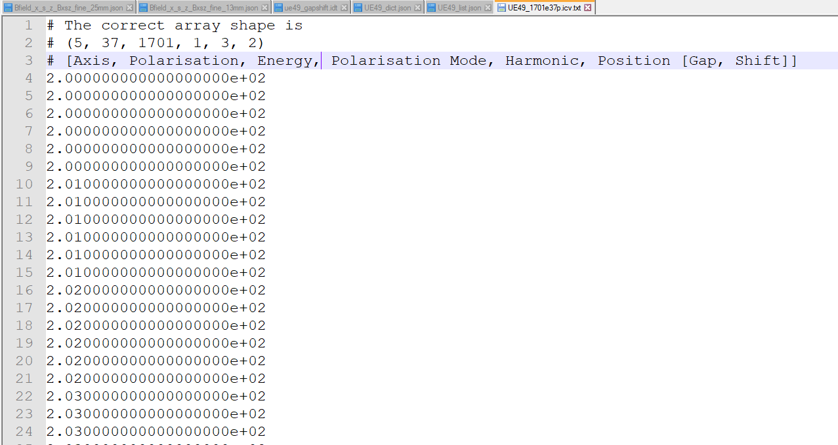
Potential File Formats – ASCII Text 1701 x 37 = 62937 elements
ASCII Table Formats
.icv.txt
Because we are dealing with 5/6 dimensional arrays, 2D table files Just Don’t Work
Tables must be reconstituted to original dimensions to be addressed
Held in a comment line
.icv.txt file (“I Choose Violence” text file)
flattened 6D table that includes axis values. (VERY LARGE file)
1.9 Million lines
44 Mb
Direct editing practically impossible

Slide 10
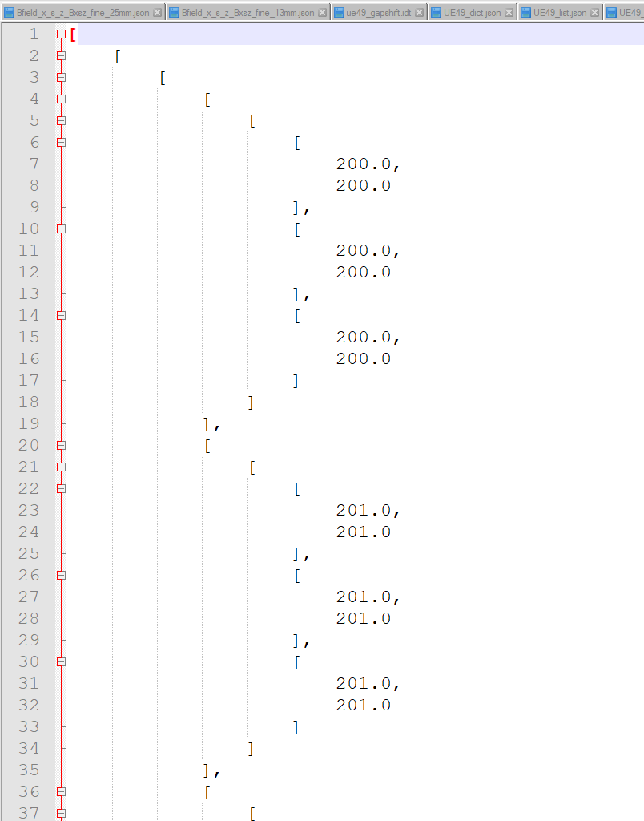
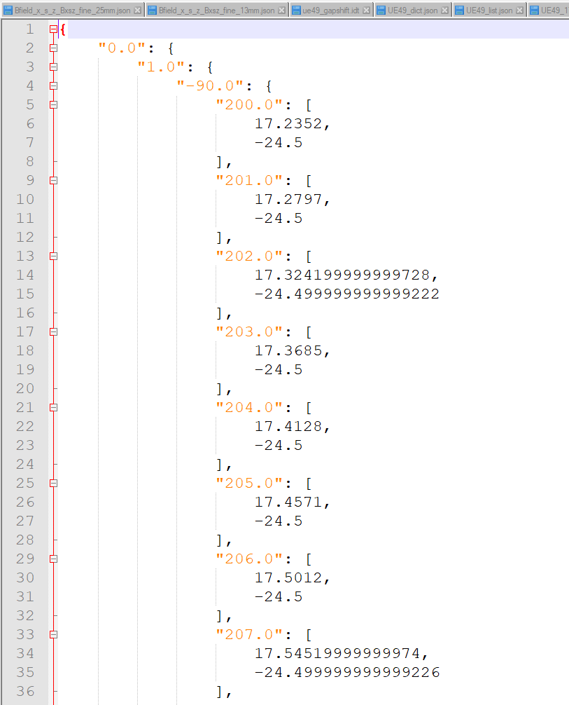
Potential File Formats – JSON 1701 x 37 = 62937 elements
list.json
(Numpy) arrays are not json serialisable, so must be converted to either a list or a dict
List.json
must be reconverted to an arrays to be sensibly addressed
All data is there, including column headers.
Table Shape is retained
5M lines
48 Mb
Metadata needed in comment lines
Direct editing practically impossible
Dict.json
Dict can be directly addressed once loaded
755 thousand lines
10 Mb
Metadata possibly included in dict structure
direct editing difficult – locating edit point

Slide 11
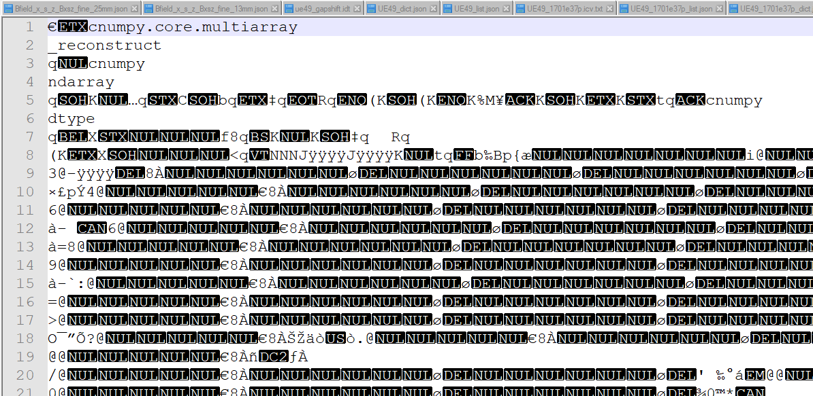
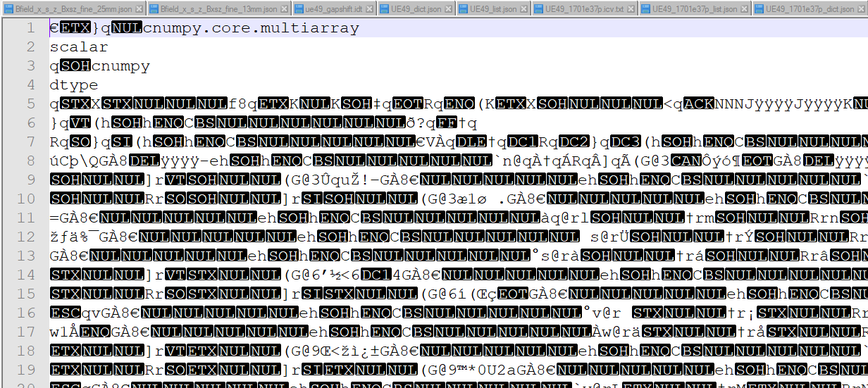
Potential File Formats – Pickle 1701 x 37 = 62937 elements
table.pkl
(Numpy) arrays can be pickled
binary format, can be reloaded into python quickly
Table.pkl
must be unpickled
Metadata not in direct table
14Mb
Not human readable
utter gibberish
impossible to directly edit
Dict.pkl
Must be unpickled
Dict can be directly addressed once loaded
11 MbMetadata possibly included in dict structure
Not human readable
utter gibberish
impossible to directly edit

Slide 12
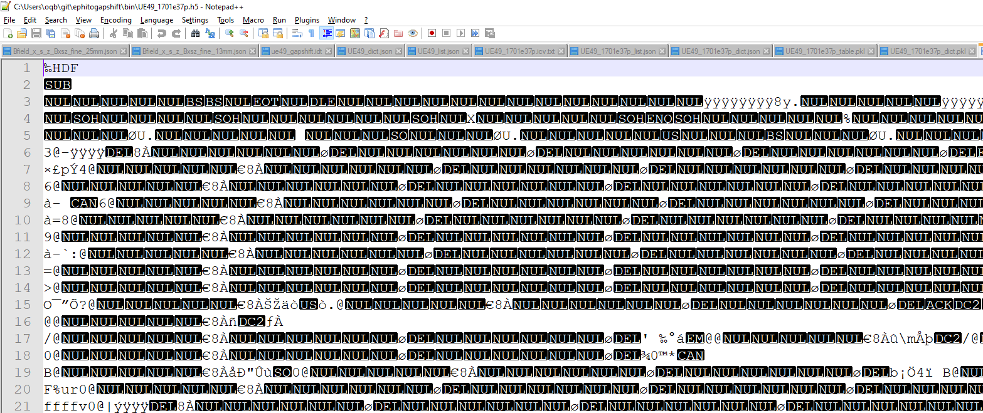
Potential File Formats – hdf5 1701 x 37 = 62937 elements
.h5
Not really ‘table vs dict’
it’s own format
binary format, can be reloaded into python quickly
Axes
Axis information stored separately and ‘attached’ to array axes in object-oriented manner
range, units, label
Metadata tightly bound to data
Data
With appropriate viewer
e.g. DataVis in DAWN
(Numpy) array can be saved
.h5
Not human readable with text editor

Slide 13
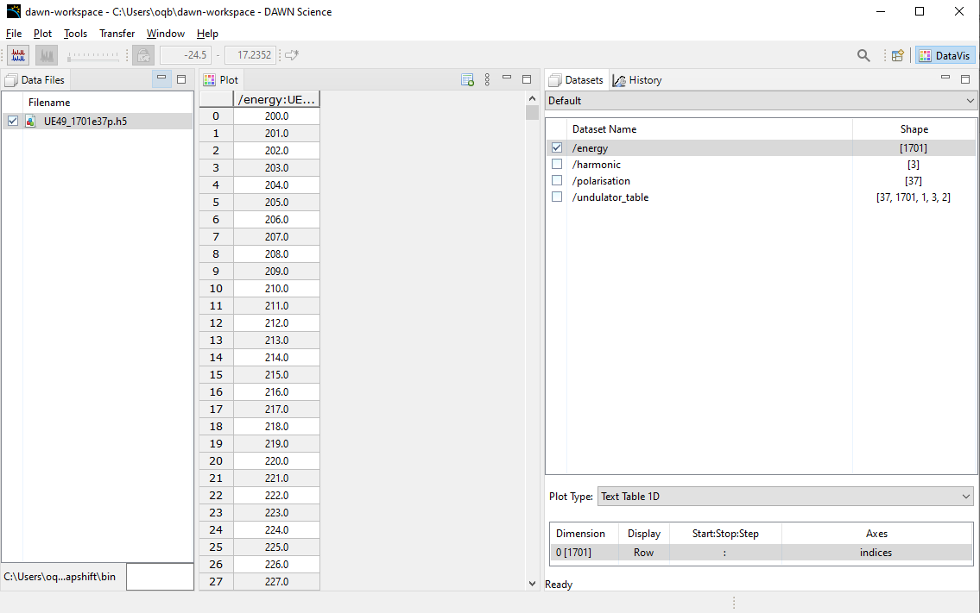
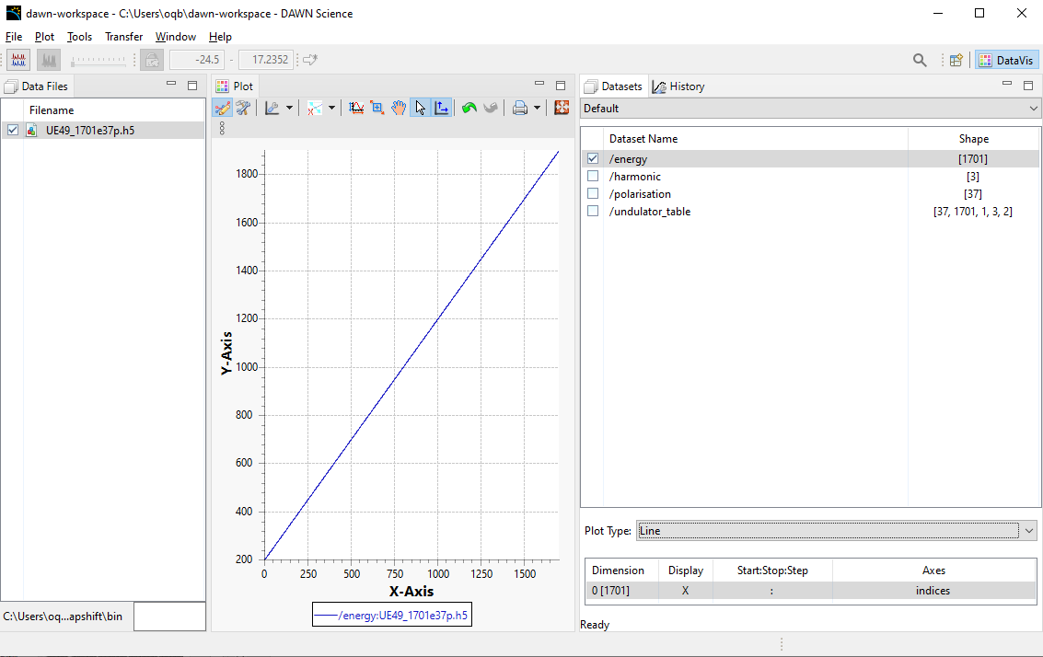
Potential File Formats – hdf5 1701 x 37 = 62937 elements
But with the right viewer/editor
DataVis in DAWN
Axis information viewable as table or plot

Slide 14
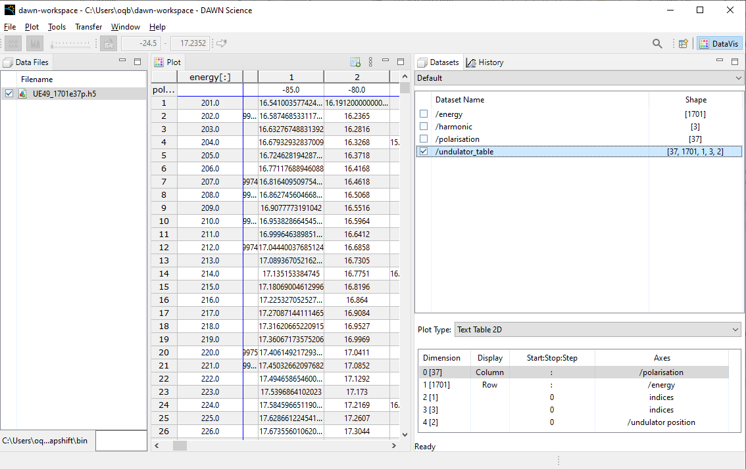
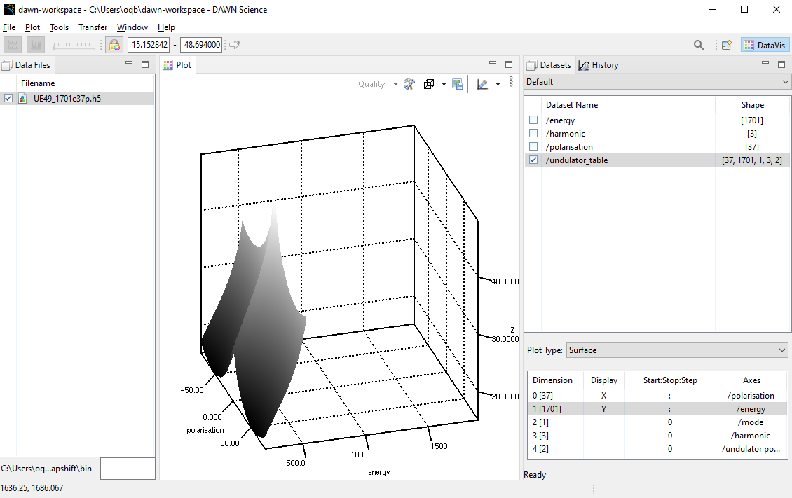
Potential File Formats – hdf5 1701 x 37 = 62937 elements
But with the right viewer/editor
DataVis in DAWN
Data viewable as table or surface plot

Slide 15
Next Steps
User Tuning
Figure out a way of sensibly correcting the tables using User Data
Interpolating to user data risks fitting to noise
Directly calculated data has the right surface shape, but is often in the wrong position
Apertures, electron beam position, magnetic measurement errors &c
Requirement
Fitting surface to data…
Apply an Nth order 2D polynomial fit to the differences between measured and calculated values.
Subtract fitted ‘difference surface’ to calculated data.

