Slide 1
DAG unified Environment
Scheduling Policies

Slide 2
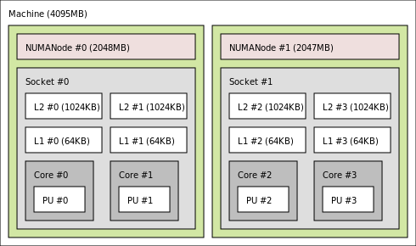
Global Dequeue
Scheduling (push task)
Selecting (pop task)
Atomic CAS
Atomic CAS

Slide 3
Priority
Users can define a priority in the JDF
Integer expression (arbitrary)
Bigger is better
At task creation (when all dependencies resolved), the system computes a rank for the task
Function of priority
Bigger is better

Slide 4
Absolute Priorities
Scheduling (push task)
Selecting (pop task)
9
9
5
3
1
Lock_sorted
insert
Lock_pop
9
9
5
3
1
8
3
0

Slide 5
Local Queues
Goal: to improve data re-use
Architecture Aware (hwloc-based)
Avoid stealing data that is far away in memory (or has a better chance to be far away in memory)
Each thread has a local queue
Bounded array of tasks
Threads will pull from these queues preferably, using the distance information of the hardware

Slide 6
Local Flat Queues
Push in local queue if there is a slot
Push in global dequeue if local queue is full
Pull from local queue, or from closest (memory-wise) core’s queue
Pull from global dequeue if all threads queues are empty

Slide 7
Local Flat Queues (1)
Scheduling (push task)
Selecting (pop task)
CAS
CAS
CAS

Slide 8
Local Flat Queues (2)
Selecting (pop task)
Selecting (pop task)
CAS
CAS

Slide 9
Local Hierarchical Queue
Similar to Local Flat Queue
Except at push:
Push in local queue if slot
Try other threads queues (using distance algorithm) if queue is full

Slide 10
Local Hierarchical Queues (1)
Scheduling (push task)
Scheduling (push task)
CAS
CAS
CAS

Slide 11
Local Hierarchical Queues (2)
Selecting (pop task)
Selecting (pop task)
CAS
CAS

Slide 12
Priority Based Queues
Similar to Local Flat Queues, except:
Order local queues by priority.
Eject lower priority tasks to the global dequeue, in order to push higher priority tasks in local queue

Slide 13
Priority Based Queues (1)
Scheduling (push task)
Selecting (pop task)
9
5
9
3
1
CAS
9
5
9
3
1
5
3
2
4
2
5
3
2
4
2
lock
sort
lock
sort
2
5
3

Slide 14
Priority Based Queues (2)
Selecting (pop task)
Selecting (pop task)
9
5
9
3
1
CAS
9
5
9
3
1
5
3
2
Lock
sort

