Slide 1
MASTER CLASS
Eddie Cheteni| Belgium Campus | BASE

Slide 2
WHAT WILL YOU DISCOVER IN THIS MASTERCLASS?
To learn about the Tidyverse ecosystem
Create github repository
Read and write data (csv, excel, rds)
Create directory - fs
Clean names – janitor
Quick summary – skimr & DataExplorer
Correlation analysis - correlationfunnel
Notes:
This is the question that your experiment answers

Slide 3
Create a repository
Github desktop
Github Account
Rstudio
R
Notes:
Summarize your research in three to five points.

Slide 4
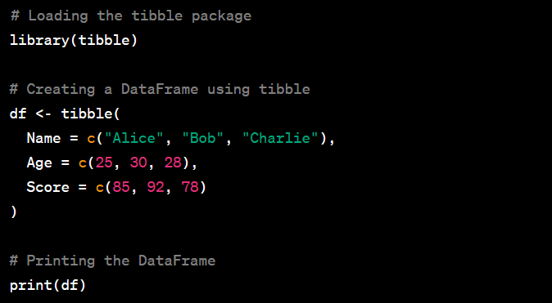
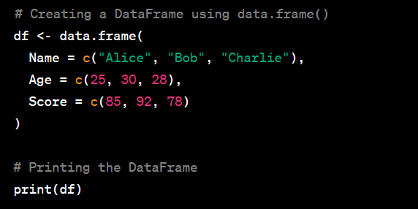
Create a tables
Tibble
Dplyr- Data.frame
Notes:
Summarize your research in three to five points.

Slide 5
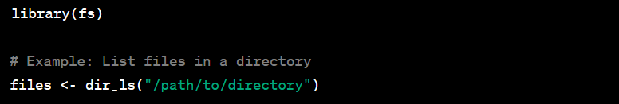

Create directory
fs
Notes:
Summarize your research in three to five points.

Slide 6
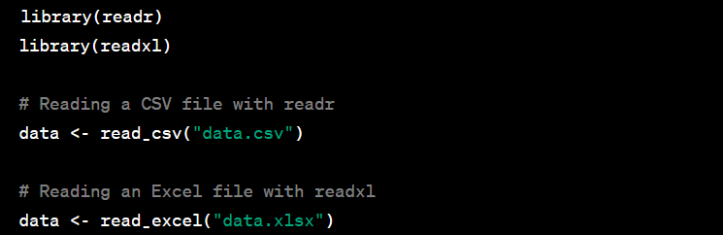
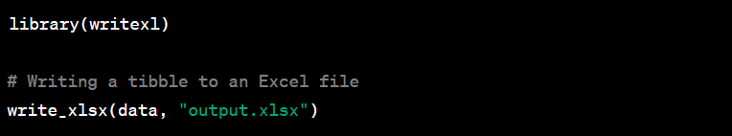
Read and write data (csv, excel, rds)
Rds
Xls
Csv
Notes:
Summarize your research in three to five points.

Slide 7

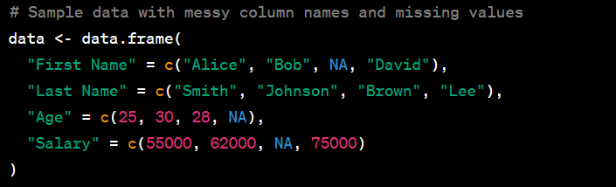
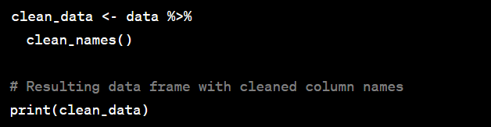
Clean names
janitor
Notes:
Summarize your research in three to five points.

Slide 8
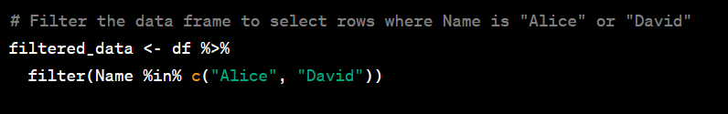
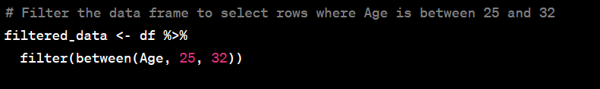
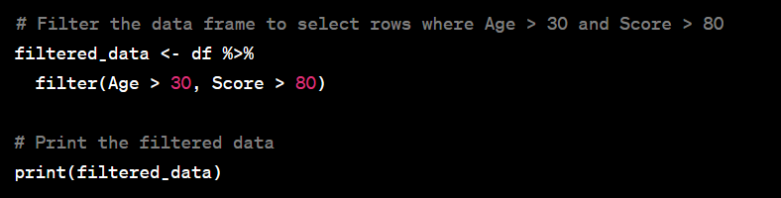
Data filtering
dplyr
Notes:
Summarize your research in three to five points.

Slide 9
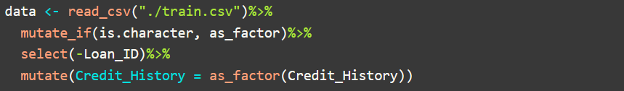

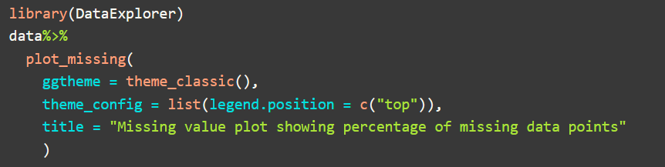
Quick summary
Skimr
DataExplorer
Notes:
Summarize your research in three to five points.

Slide 10
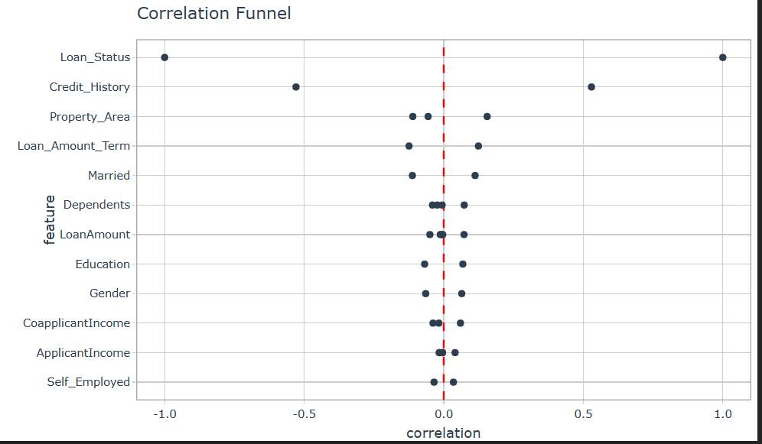
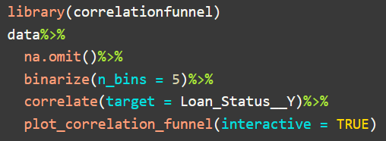
Correlation analysis
correlationfunnel
Notes:
Summarize your research in three to five points.

Slide 11
Conclusion
Now you understand how to work with data in R to achieve the following:
Create file directory
Read and write data
Clean names
Quick summary
Correlation analysis

Slide 12
Works Cited
Thanks to the Data Science with R Workflow prepared by Matt Dancho, you can learn more about free R tips.

