Slide 1






McStas do’s and don’ts
Peter Willendrup^{1,5}
Emmanuel Farhi²
Erik Knudsen^{1,5}
Uwe Filges³
Kim Lefmann^{4,5}
¹DTU Physics, Lyngby, Denmark
²Calcul Scientifique, Institut Laue-Langevin (ILL), Grenoble, France
³Niels Bohr Institute, University of Copenhagen, Copenhagen, Denmark
4Paul Scherrer Institut, Villigen, Switzerland
5ESS DMSC, Copenhagen, Denmark

Slide 2
What is really the information content…?
McStas sources generally provide “intensity” in units of neutrons/s (into a chosen solid angle)
That intensity is carried through the instrument on a discrete set of “neutron rays”

Slide 3
Onto efficiency…
Apply focusing techniques
At the source (spatially, temporally, in wavelength…)
At the sample, if possible
(carefully!) Apply SPLIT - but only if immediately followed by Monte Carlo choices, e.g. in sample
Alternatively use MCPL o/i which allows repetition - beware of biases!

Slide 4
Onto efficiency…
Apply focusing techniques
At the source (spatially, temporally, in wavelength…)
At the sample, if possible
(carefully!) Apply SPLIT - but only if immediately followed by Monte Carlo choices, e.g. in sample
Alternatively use MCPL o/i which allows repetition - beware of biases!
All of this can be considered “variance reduction”
or biasing

Slide 5
Onto efficiency…
Use MPI parallelisation - included in macOS install from 2.4, easy to get on Linux…
The Intel C compiler is known to give ~factor of 2 wrt. gcc in most cases
- Still consider if you are asking the right question if runtimes reach days/weeks…

Slide 6
Cluster utility scripts
./mcsub_slurm.pl
Usage: ./mcsub_slurm.pl [options] [mcrun params]
-h --help Show this help
-rN --runtime=N Specify maximum runtime (hours) [default 1]
-qQNAME --queue=QNAME Specify wanted SLURM queue [default 'express']
-e<mail> --email=<mail> Specify address to notify in reg. sim status [default none]
--nodes=NUM Specify wanted number of nodes [default 1]
--name=NAME Specify slurm job name [default "McSub_<USERNAME>_<TIMESTAMP>"]
After running ./mcsub_slurm.pl NAME.batch is ready for submission using the sbatch command
mcsub cluster scripts
Takes a “mcrun commandline”
Writes batch file “template” for use with PBS or slurm cluster queue systems
https://github.com/McStasMcXtrace/McCode/tree/master/tools/cluster-scripts

Slide 7
Vitess - compatibility
Utility script for converting Vitess reflectivity files for use with McStas (https://github.com/McStasMcXtrace/McCode/blob/master/tools/other/Refl_Vitess2McStas.sh)
mcstas2vitess generates Vitess module + tcl snippet from McStas component (poor docs, will improve)

Slide 8
Examples Directory
Simple grep →
370 examples of Monitor_nD
51 examples of Source_gen
10 examples of ISIS_moderator
10 examples of Single_crystal
Unix/Linux:
grep ISIS_moderator /usr/share/mcstas/2.4pre01/examples/*

Slide 9
Examples Directory
Simple grep →
370 examples of Monitor_nD
51 examples of Source_gen
10 examples of ISIS_moderator
10 examples of Single_crystal
They have an author name!
For instance:
ISIS_CRISP → R. Dalgliesh
SE_example → E. Knudsen

Slide 10
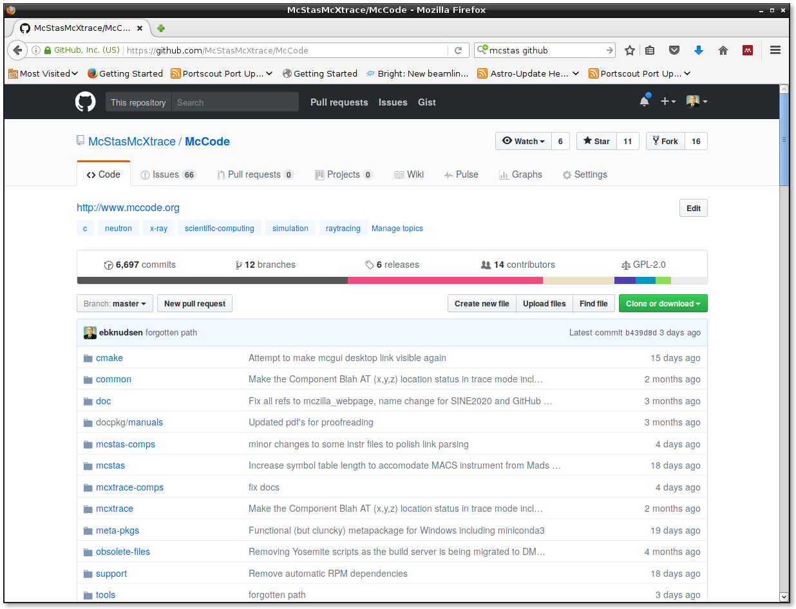
GitHub.com
https://github.com/McStasMcXtrace/McCode

Slide 11
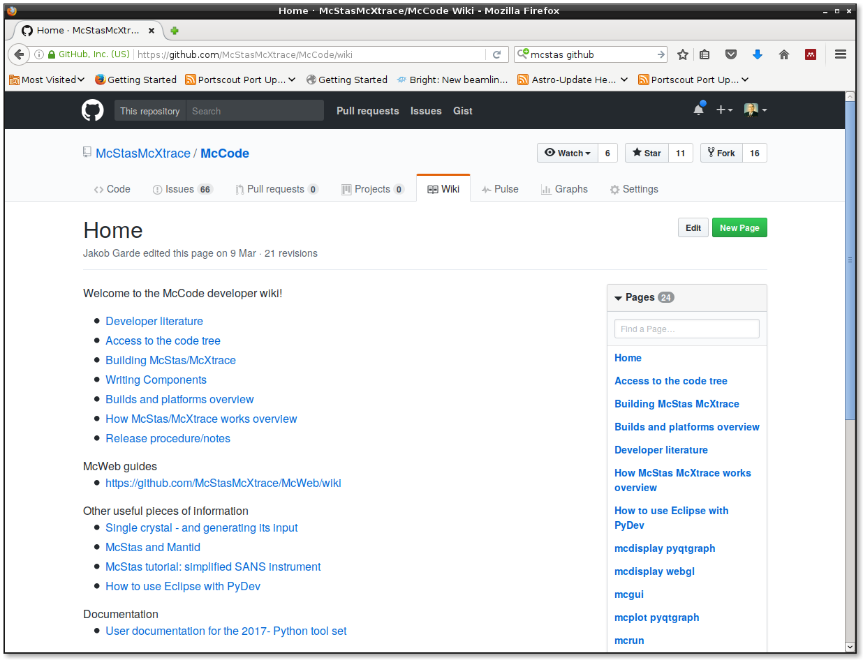
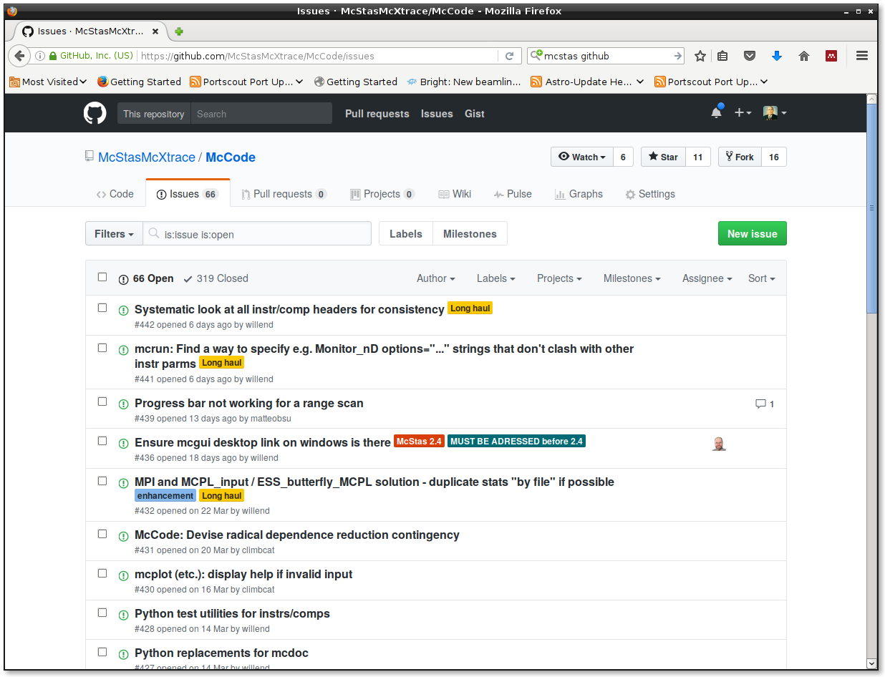
GitHub.com: wiki
Mostly developer oriented docs so far
https://github.com/McStasMcXtrace/McCode

Slide 12
GitHub.com: Issue Tracker
https://github.com/McStasMcXtrace/McCode

Slide 13
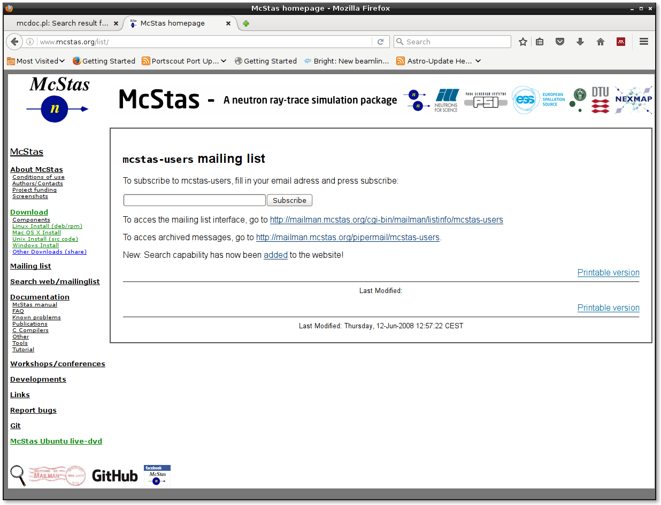
Mailing List

Slide 14
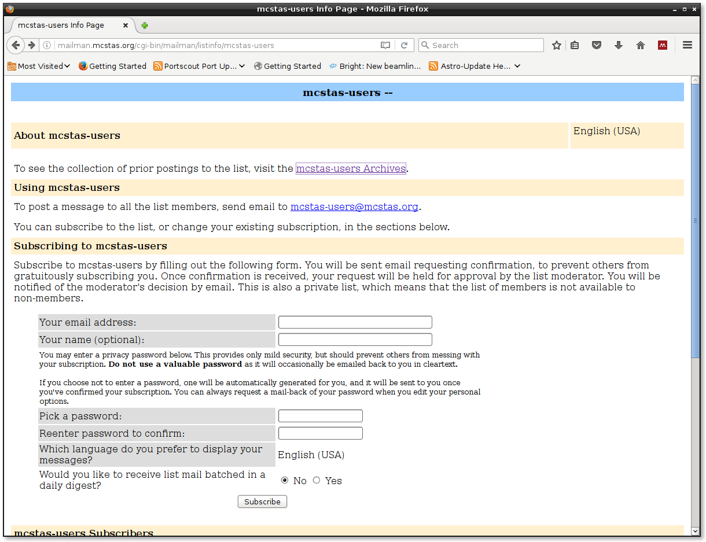
Mailing List

Slide 15
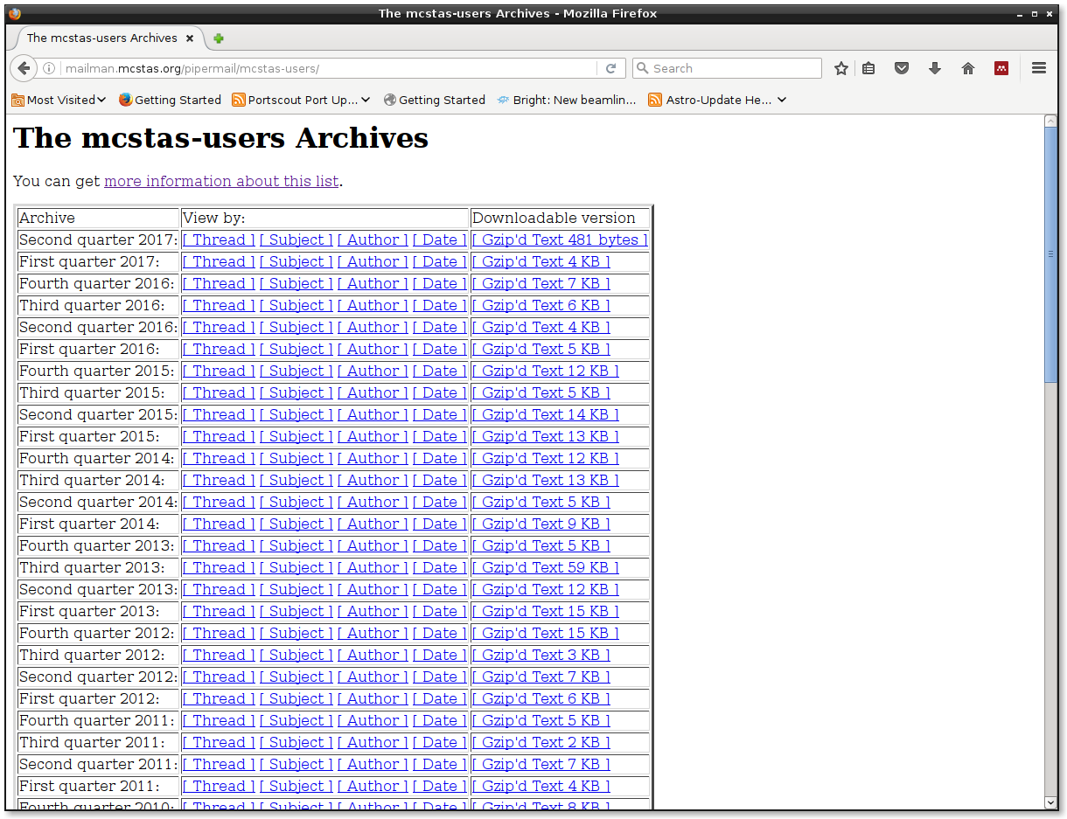
Mailing List - Archive
User forum and help since 1997!!
Spirit of the mailinglist:
Very friendly and open!
There is no such thing as a stupid question!
Often answers are given from McStas users rather than the developers, especially in areas that include very specific domain science.

Slide 16
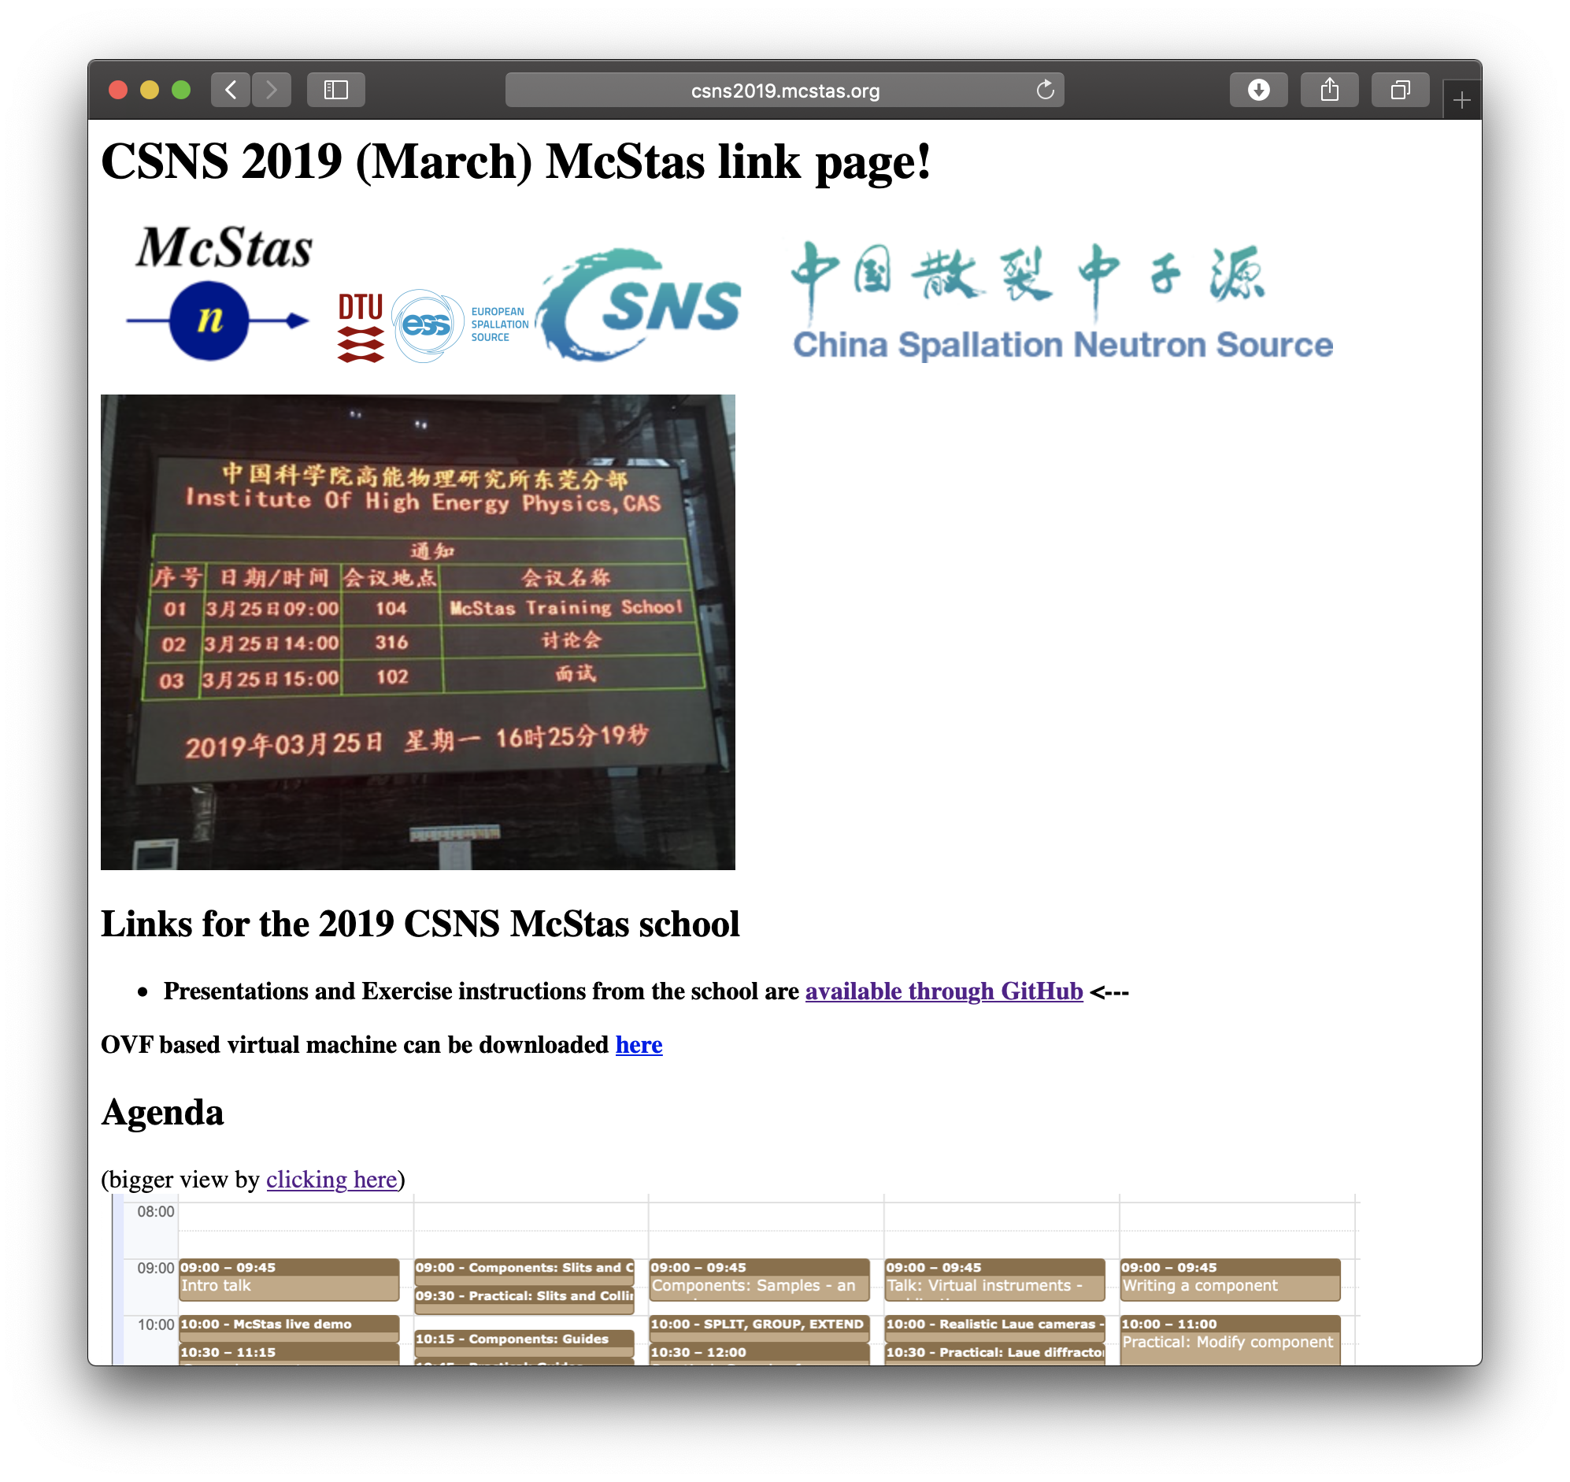
http://csns2019.mcstas.org
Useful links below….

Slide 17
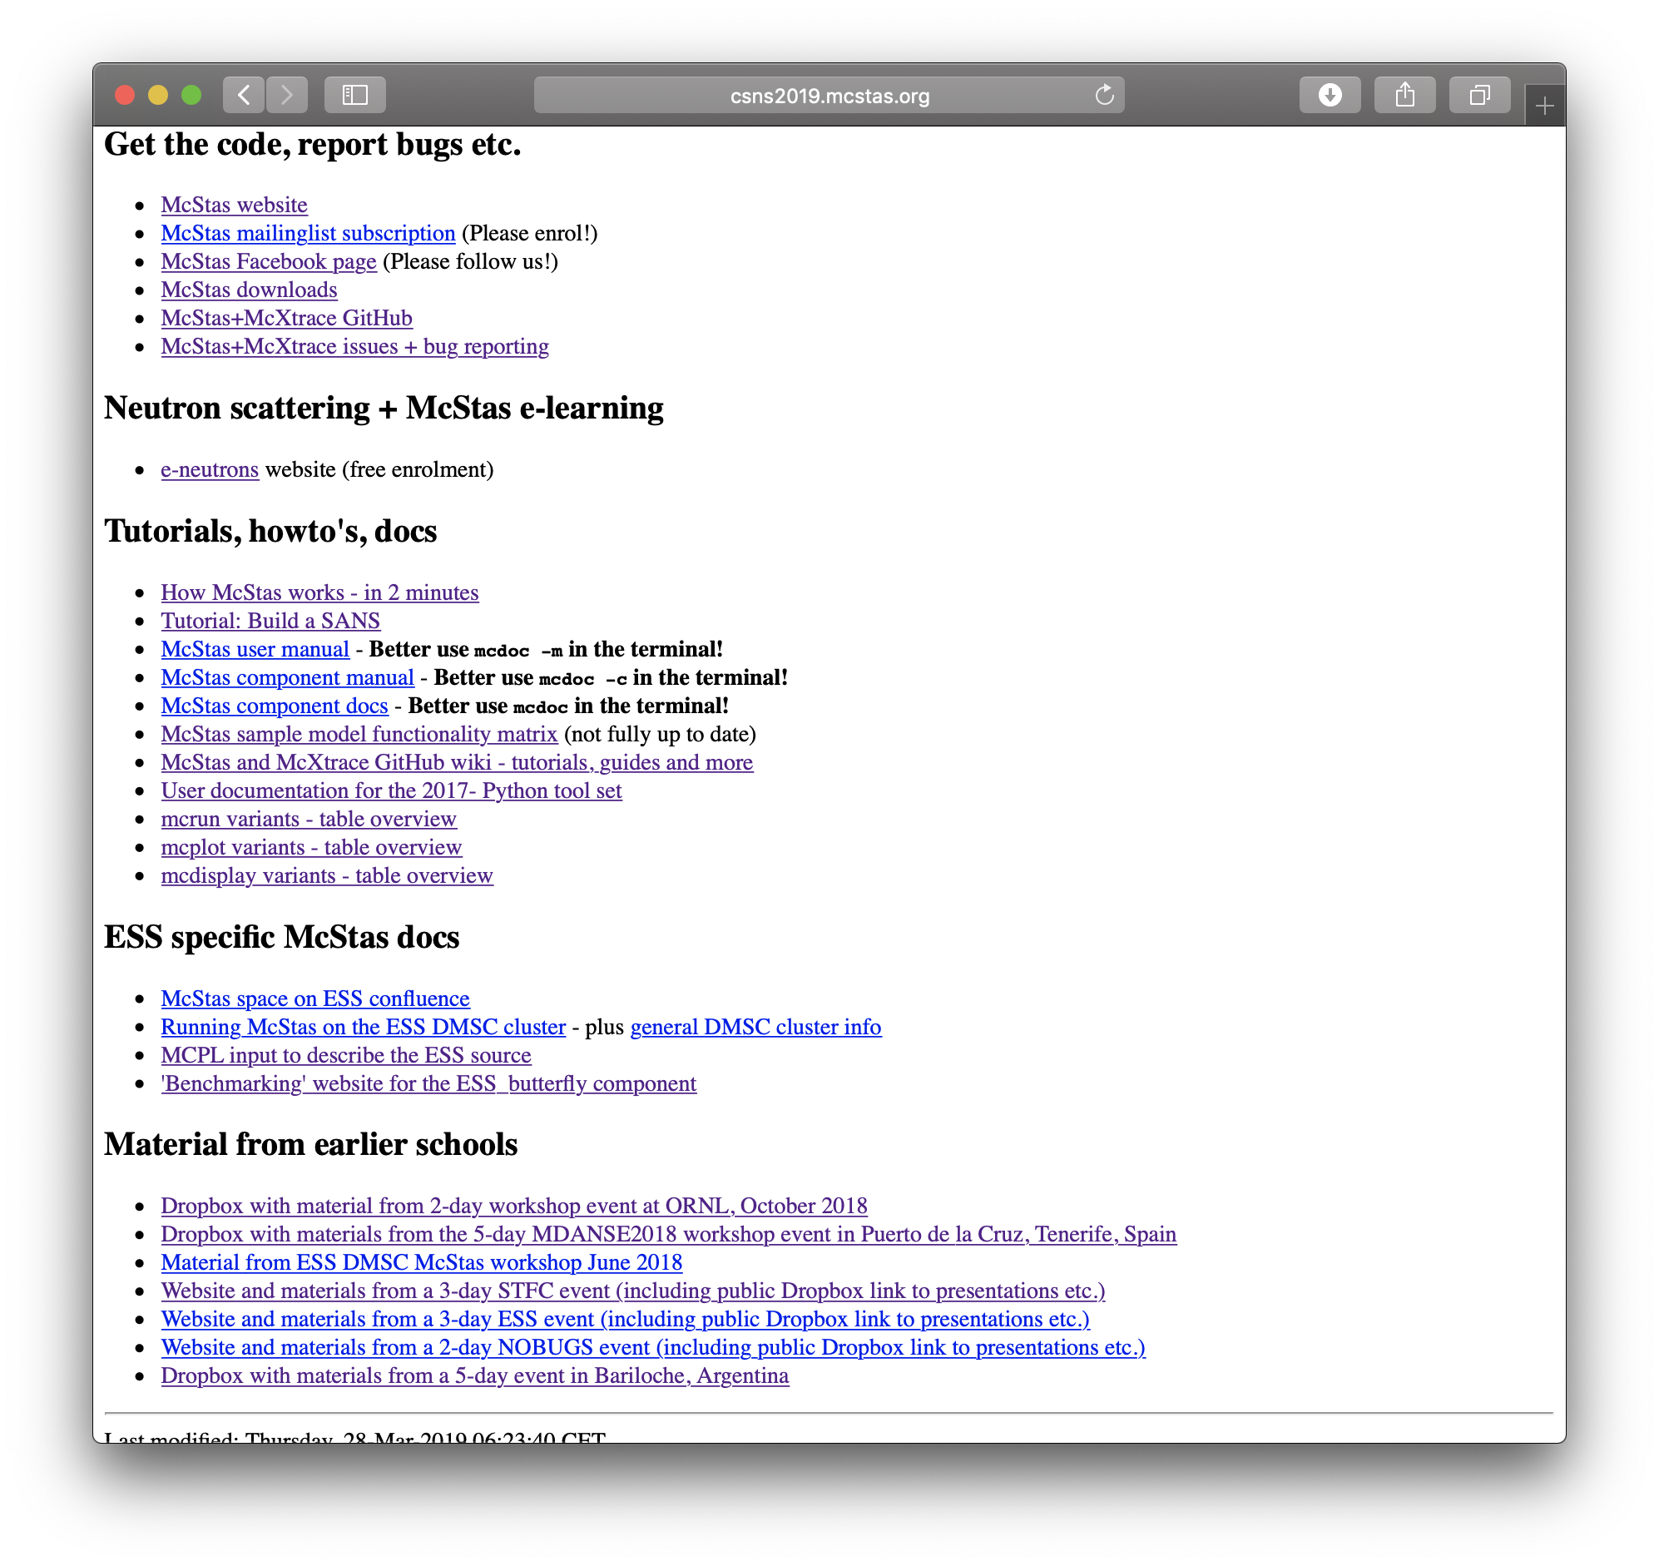
http://csns2019.mcstas.org
Useful links below….
(Older schools currently
DropBox, will transport
these to GitHub soon!

