Slide 1
Sources and Monitors part 2.
DTU Physics

Slide 2
Sources: Source model overview
Mathematical:
  Source_simple.comp
  Source_div.comp
Pulsed sources:
  ESS_butterfly.comp
  ESS_moderator.comp
  Moderator.comp
  SNS_source.comp (*)
  SNS_source_analytic (*)
  ViewModISIS (*)
  ISIS_moderator.comp (*)
Reactors :
Source_Maxwell_3.comp
Source_gen.comp
Source_gen4.comp
Source_multi_surfaces.comp (*)
I/O mechanisms:
  MCPL_input/output.comp
  Virtual_input/output.comp
  Virtual_mcnp_ss_input/output.comp
  Virtual_tripoli4_input/output.comp
  Vitess_input/output.comp

Slide 3
Sources: Source_Maxwell_3
COMPONENT source = Source_Maxwell_3(yheight=0.156, xwidth=0.126,
Lmin=0.1, Lmax=9.0, dist=1.5, focus_xw = 0.025, focus_yh = 0.12,
T1=150.42, I1=3.67E11, T2=38.74, I2=3.64E11, T3=14.84, I3=0.95E11)
Parameters from the PSI cold source
Initial position and direction: as for Source_simple

Slide 4
Sources: Source_Maxwell_3
COMPONENT source = Source_Maxwell_3(yheight=0.156, xwidth=0.126,
Lmin=0.1, Lmax=9.0, dist=1.5, focus_xw = 0.025, focus_yh = 0.12,
T1=150.42, I1=3.67E11, T2=38.74, I2=3.64E11, T3=14.84, I3=0.95E11)
Parameters from the PSI cold source
Intensity at a given wavelength drawn from a sum of (up to) 3 normalized Maxwellian distributions:

Slide 5
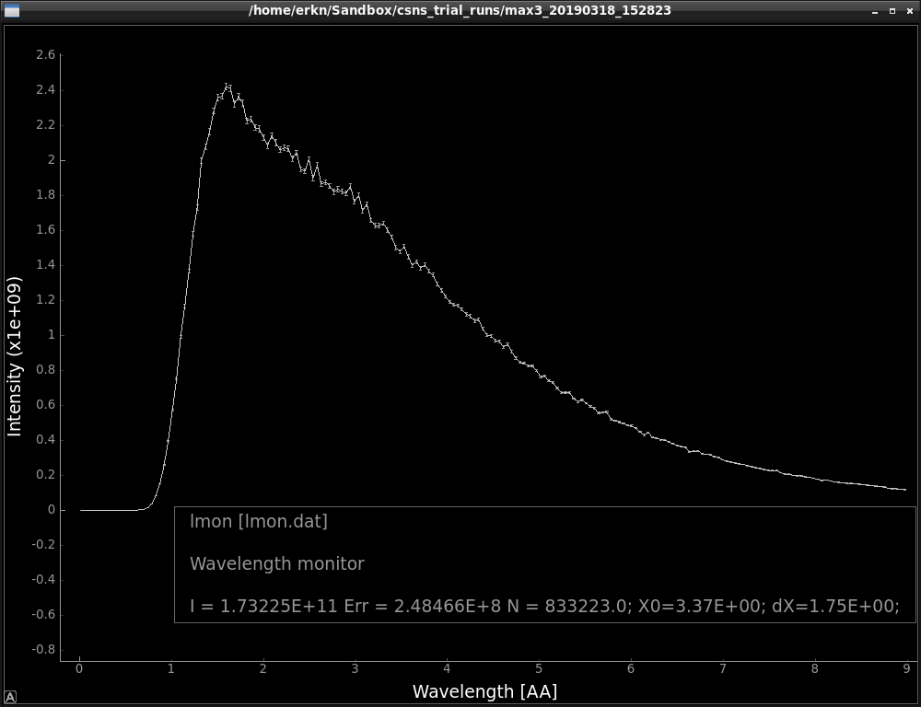
Sources: Source_Maxwell_3
COMPONENT source = Source_Maxwell_3(yheight=0.156, xwidth=0.126,
Lmin=0.1, Lmax=9.0, dist=1.5, focus_xw = 0.025, focus_yh = 0.12,
T1=150.42, I1=3.67E11, T2=38.74, I2=3.64E11, T3=14.84, I3=0.95E11)
Parameters from the PSI cold source

Slide 6
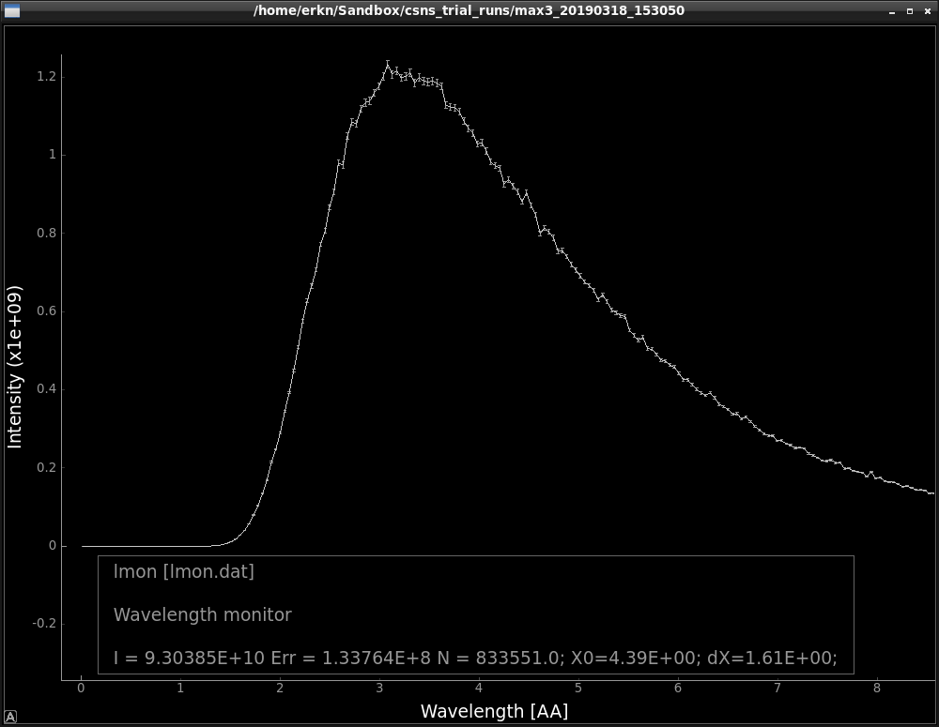
Sources: Source_Maxwell_3
COMPONENT source = Source_Maxwell_3(yheight=0.156, xwidth=0.126,
Lmin=0.1, Lmax=9.0, dist=1.5, focus_xw = 0.025, focus_yh = 0.12,
T1=150.42, I1=3.67E11, T2=38.74, I2=3.64E11, T3=14.84, I3=0.95E11)
Parameters from the PSI cold source
Just for fun – let’s see what happens if we remove the fast peak…

Slide 7
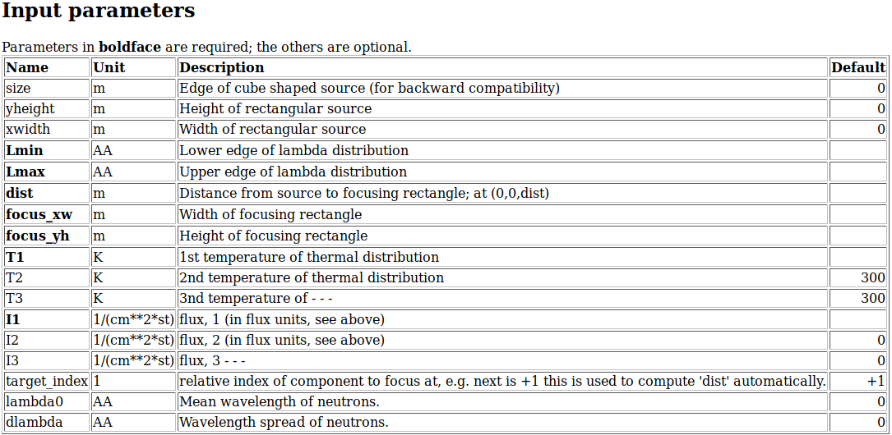
Sources: Source_Maxwell_3
COMPONENT source = Source_Maxwell_3(yheight=0.156, xwidth=0.126,
Lmin=0.1, Lmax=9.0, dist=1.5, focus_xw = 0.025, focus_yh = 0.12,
T1=150.42, I1=3.67E11, T2=38.74, I2=3.64E11, T3=14.84, I3=0.95E11)
Parameters from the PSI cold source
Just for fun – let’s see what happens if we remove the fast peak…

Slide 8
Sources: Source_gen (Source_gen4)
COMPONENT source = Source_gen(yheight=0.156, xwidth=0.126,
Lmin=0.1, Lmax=9.0, dist=1.5, focus_xw = 0.025, focus_yh = 0.12,
T1=150.42, I1=3.67E11, T2=38.74, I2=3.64E11, T3=14.84, I3=0.95E11)
Almost the same as Source_Maxwell_3: but with optional flux-files as input.

Slide 9
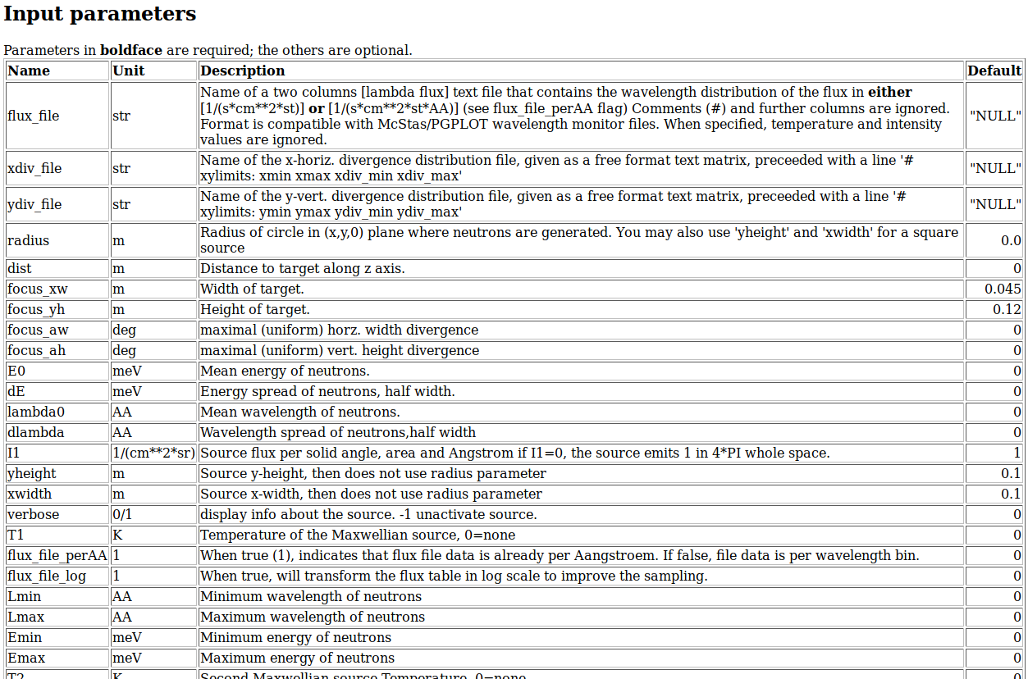
Sources: Source_gen (Source_gen4)
COMPONENT source = Source_gen(yheight=0.156, xwidth=0.126,
Lmin=0.1, Lmax=9.0, dist=1.5, focus_xw = 0.025, focus_yh = 0.12,
T1=150.42, I1=3.67E11, T2=38.74, I2=3.64E11, T3=14.84, I3=0.95E11)
Almost the same as Source_Maxwell_3: but with optional flux-files as input.

Slide 10
Sources: Source_gen (Source_gen4)
COMPONENT source = Source_gen(yheight=0.156, xwidth=0.126,
flux_file=”file1.dat”, xdiv_file=”file2.dat”, ydiv_file=”file3.dat”)
Almost the same as Source_Maxwell_3: but with optional flux-and divergence-files as input.
Source_gen4: Same as for Source_gen but more accurate tail-description for PSI.
To generate files – e.g.
Monitor_nD(options="auto lambda per cm2", filename=”file1.dat”)
Monitor_nD(options="x hdiv, all auto", filename=”file2.dat”)
Monitor_nD(options="y vdiv, all auto", filename=”file3.dat”)

Slide 11
Sources: Source_gen (Source_gen4)
COMPONENT source = Source_gen(yheight=0.156, xwidth=0.126,
Lmin=0.1, Lmax=9.0, dist=1.5, focus_xw = 0.025, focus_yh = 0.12,
T1=150.42, I1=3.67E11, T2=38.74, I2=3.64E11, T3=14.84, I3=0.95E11)
Almost the same as Source_Maxwell_3: but with optional flux-files as input.

Slide 12
Sources: Pulsed sources
Simplest case:
Use a continuous source!
Model a source with given wavelength and spatial distribution
and
… an infinitely short pulse length. I.e. t = 0 for all neutron rays.
COMPONENT src = Source_simple(
radius=0.05, lambda0=2.5, dlambda=1.5,
focus_xw=0.1, focus_yh=0.1, dist=5 )
AT(0,0,0) RELATIVE origin

Slide 13
Sources: Pulsed sources
Add a sample here TOF_monitor.
Simplest case:
Use a continuous source!
Model a source with given wavelength and spatial distribution
and
… an infinitely short pulse length. I.e. t = 0 for all neutron rays.
COMPONENT src = Source_simple(
radius=0.05, lambda0=2.5, dlambda=1.5,
focus_xw=0.1, focus_yh=0.1, dist=5 )
AT(0,0,0) RELATIVE origin

Slide 14
Pulsed Sources:
Simplest case:
Use a continuous source!
Model a source with given wavelength and spatial distribution
and
… an infinitely short pulse length. I.e. t = 0 for all neutron rays.
Or: Use a chopper
(Wednesday)
COMPONENT src = Source_simple(
radius=0.05, lambda0=2.5, dlambda=1.5,
focus_xw=0.1, focus_yh=0.1, dist=5 )
AT(0,0,0) RELATIVE origin

Slide 15
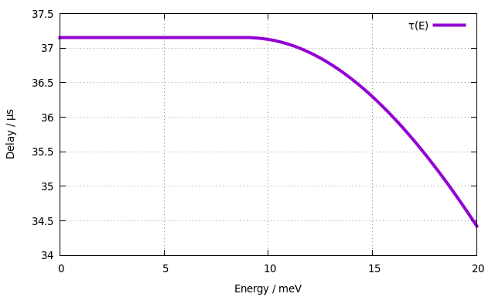
Pulsed Sources: Moderator
A flat pulsed source with uniform energy spectrum:
Time structure is given by energy dependent probability density function:

Slide 16
Pulsed Sources: SNS_source
Samples directly from tallies coming from e.g. MCNP target+moderator calculations.
Originally from SNS but also used extensively at J-PARC
Can be used (with the proper input files) to model CSNS-source.
Example (coming from you) is expected to be included in next release of McStas.

Slide 17
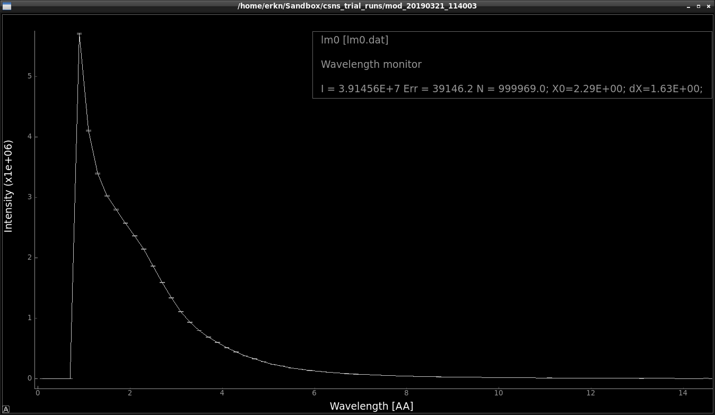
Pulsed Sources: SNS_source
Samples directly from tallies coming from e.g. MCNP target+moderator calculations.
Can be used (with the proper input files) to model CSNS-source.
Example (coming from you) is expected to be included in next release of McStas.

Slide 18
Pulsed Sources: SNS_source_analytic
Samples from fits of Padé-functions to tallies from SNS_source.
- Requires a complex fitting campaign
+ Much faster than SNS_source
+ “Cleaner” distributions where statistics are sketchy
Can be used (with the proper input files) to model CSNS-source.

Slide 19
Pulsed Sources: ViewModISIS
Samples directly from tallies coming from e.g. MCNP target+moderator calculations.
Data file supplied for each beam port at ISIS.

Slide 20
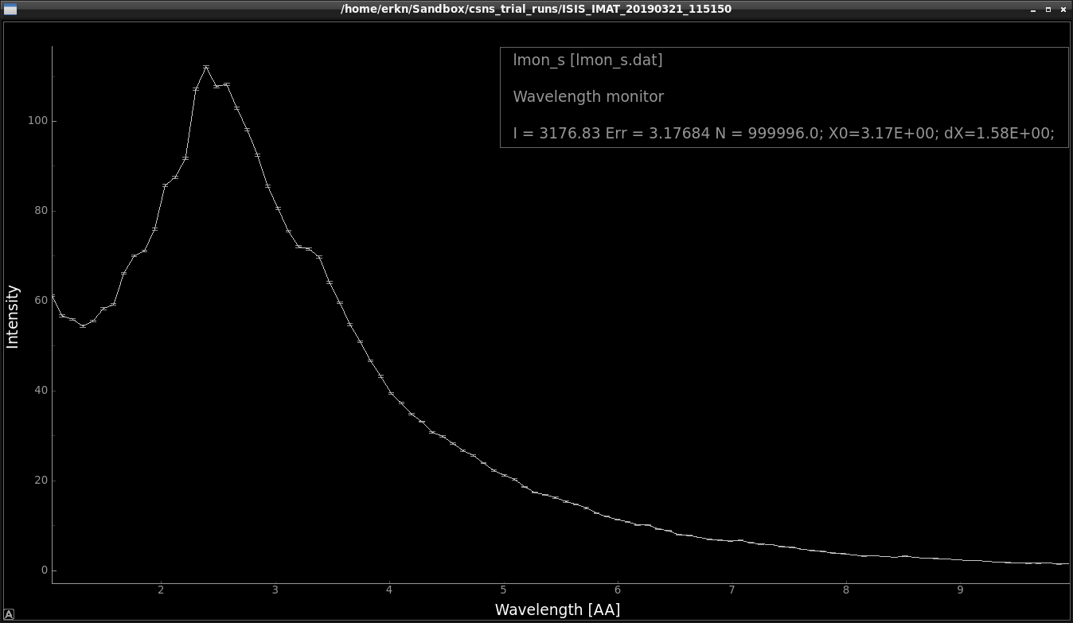
Pulsed Sources: ViewModISIS
ISIS T2: IMAT
Samples directly from tallies coming from e.g. MCNP target+moderator calculations.
Data file supplied for each beam port at ISIS.

Slide 21

Monitors (some)
1D
L_monitor →
TOF_monitor →
Hdiv_monitor →
MeanPolLambda →
E_monitor →
2D
PSD_monitor →
PSD_monitor_4PI →
PolLambda_monitor →
Divergence_monitor →
DivPos_monitor →
nD
Monitor_nD →
or
or
or ...

Slide 22
Monitors: Quick examples
COMPONENT my_L_monitor = L_monitor(xwidth=0.2, yheight=0.2,
nL=20, filename="Output.L", Lmin=2, Lmax=10)

Slide 23

In a histogram sense
Imagine a histogram, e.g. I(λ)
The RMS variance over that set becomes our statistical error bar E
…
…
In bin i, N events each carrying a fractional intensity pj so that
1
2
3
i
k

Slide 24
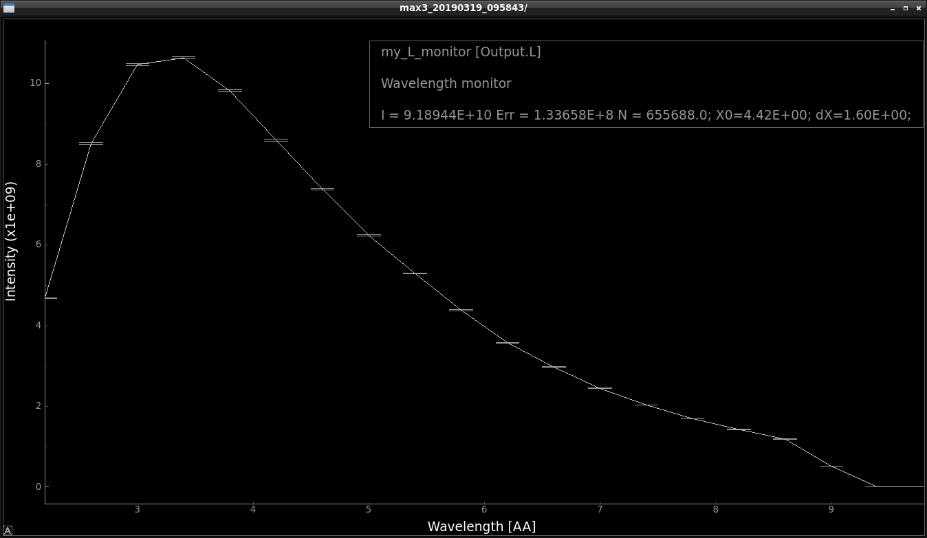
In a histogram sense
Monitors: Quick examples
Statistics computed on the fly
Imagine a histogram, e.g. I(λ)
The RMS variance over that set becomes our statistical error bar E
I
E
N
…
…
In bin i, N events each carrying a fractional intensity pj so that
1
2
3
i
k
# Events
Intensity / n/s
1st and 2nd moments of data
Estimated RMS MC error

Slide 25
In a histogram sense
Monitors: Quick examples
Statistics computed on the fly
Imagine a histogram, e.g. I(λ)
The RMS variance over that set becomes our statistical error bar E
I
E
N
…
…
In bin i, N events each carrying a fractional intensity pj so that
1
2
3
i
k
# Events
Intensity / n/s
1st and 2nd moments of data
Estimated RMS MC error
Statistics also available per bin (inside data file)

Slide 26
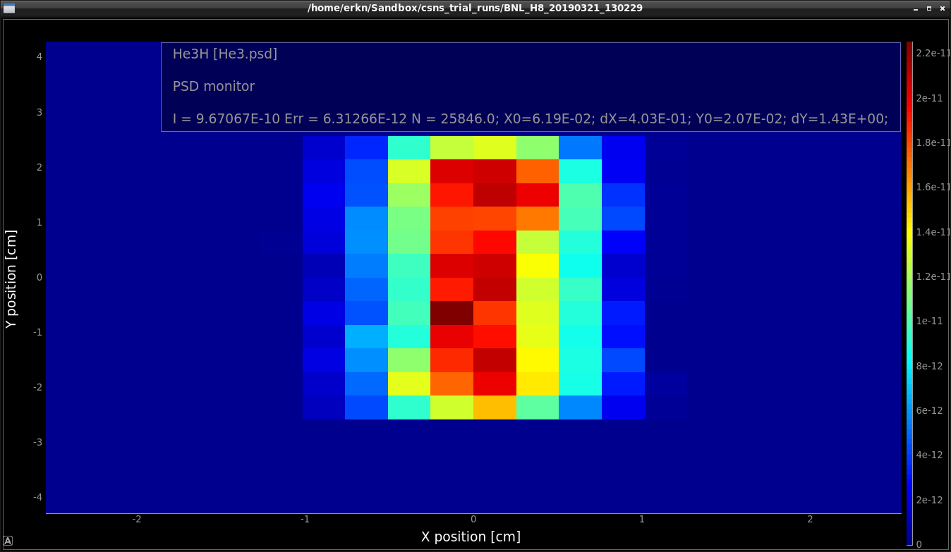
Monitors: Quick examples
In 2D
1st and 2nd moments

Slide 27
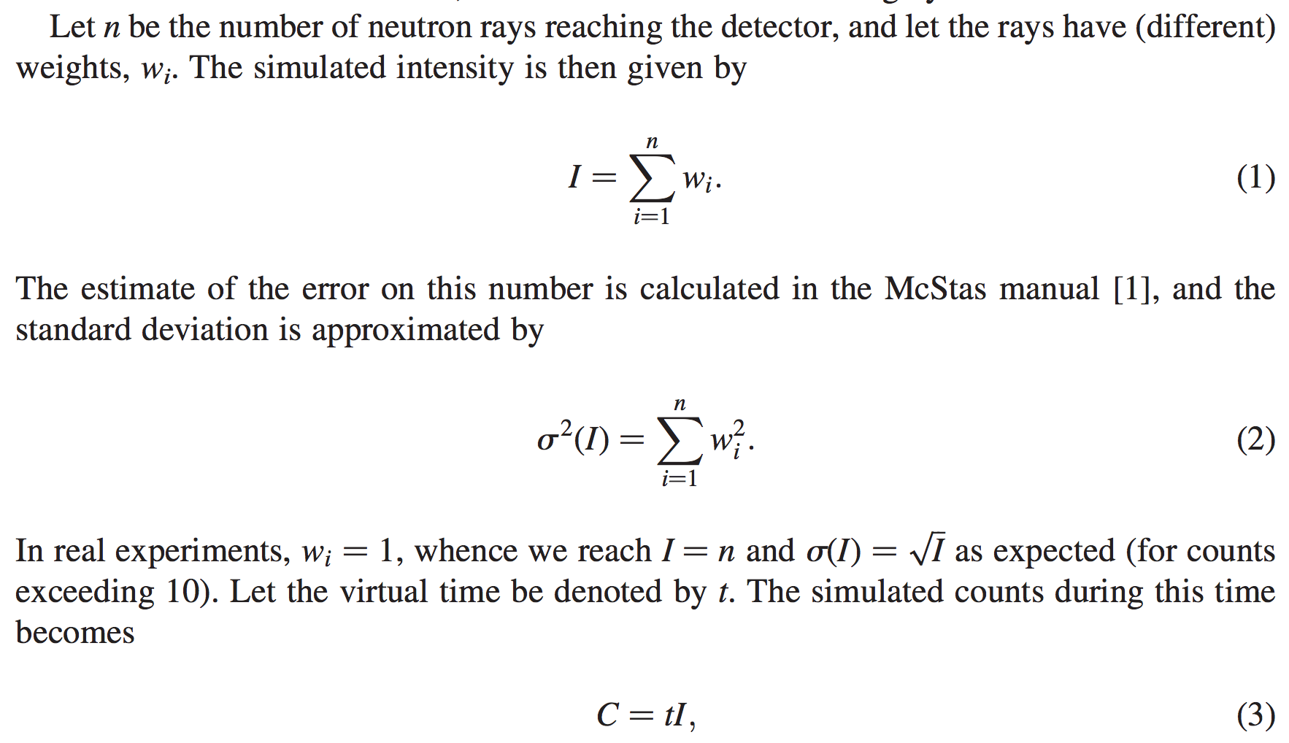
From "Virtual experiments - the ultimate aim of neutron ray-tracing simulations", K. Lefmann et al., Journal of Neutron Research 16, 97-111 (2008)

Slide 28
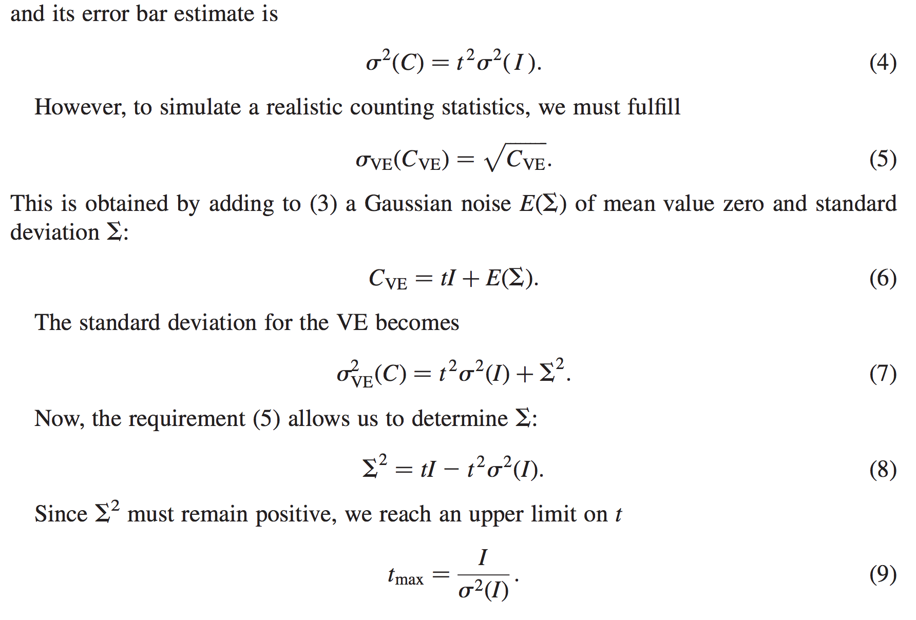
From "Virtual experiments - the ultimate aim of neutron ray-tracing simulations", K. Lefmann et al., Journal of Neutron Research 16, 97-111 (2008)

Slide 29
Sketch of an algorithm…
On a given McStas histogram
For the non-zero bins, calculate
The smallest defines the “maximal counting time” allowed by your statistics
Preferably a “background” should be added - use a “known experimental value” or an estimate…

