Slide 1
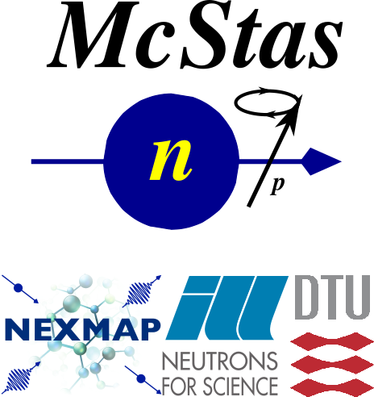
Simulating Polarized Neutron Scattering Experiments and Equipment with McStas
Erik Bergbäck Knudsen, DTU Physics

Slide 2
Mcstas “particle” model
Neutron ray/package:
Weight: (p) # neutrons left in the package Position: (x, y, z)
Velocity: (v_{x}, v_{y}, v_{z})
Polarization: (p_{x}, p_{y}, p_{z})
Time: (t)
Neutron ray/package:
Weight: (p) # neutrons left in the package Position: (x, y, z)
Velocity: (v_{x}, v_{y}, v_{z})
Polarization: (p_{x}, p_{y}, p_{z})
Time: (t)
Neutron ray/package:
Weight: (p) # neutrons left in the package Position: (x, y, z)
Velocity: (v_{x}, v_{y}, v_{z})
Polarization: (s_{x}, s_{y}, s_{z})
Time: (t)
$$P_{n}=\frac{1}{p}\sum_{i}^{p}{P_{i}},n=raynumber$$
$$P_{n}$$
n
$$P$$
$$P_{i}=2\left(\left\langle {\overset{^}{s}}_{x,i}\right\rangle {\overset{^}{i}}_{x,i}+\left\langle {\overset{^}{s}}_{y,i}\right\rangle {\overset{^}{i}}_{y,i}+\left\langle {\overset{^}{s}}_{z,i}\right\rangle {\overset{^}{i}}_{z,i}\right)$$
$$P=\frac{1}{N}\sum_{n=0}^{N}{P_{n}}$$
From G. Williams: “Polarized neutrons”, Oxford Science Publ., 1988

Slide 3
McStas detectors/monitors
Monitoring: How and What do we monitor?
$$P_{\overset{^}{h}}=\frac{\sum_{n=0}^{N}{p_{n}}P_{n}⋅\overset{^}{h}}{\sum_{n}^{N}{p_{n}}}$$
n
n
n
n
n
$$\overset{^}{h}$$
n
$$P$$

Slide 4
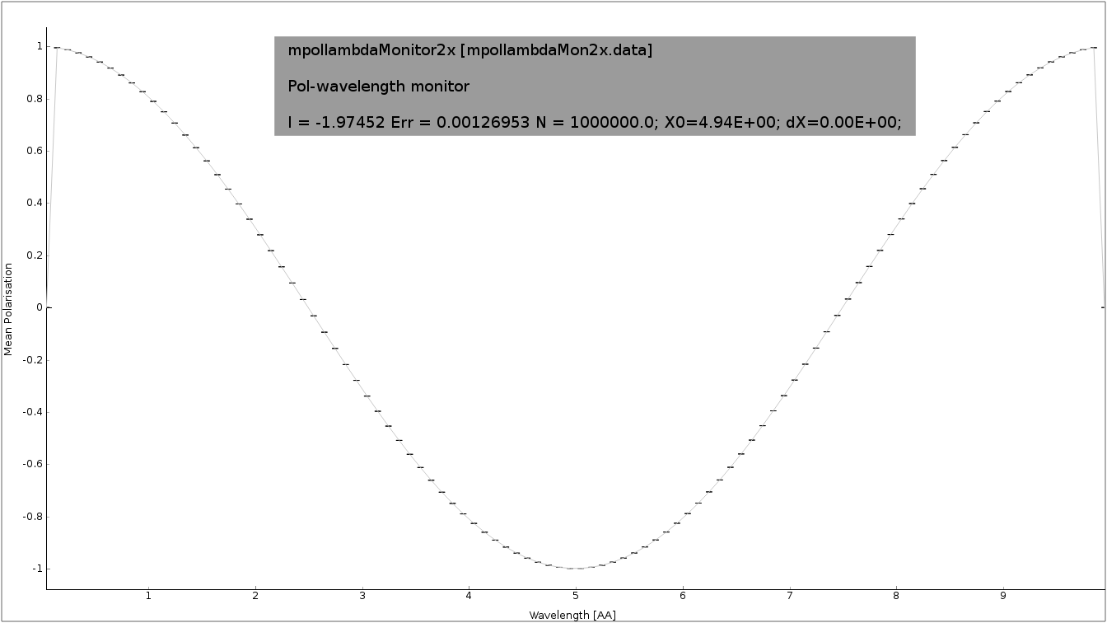
McStas detectors/monitors
Monitoring: How and What do we monitor?
n
n
n
n
n
$$\overset{^}{h}$$
n
$$P$$

Slide 5
McStas detectors/monitors
Monitoring: How and What do we monitor?
n
n
n
n
n
$$\overset{^}{h}$$
n
$$P$$

Slide 6



Polarization monitors
Available monitors:
Pol_monitor.comp: 0D
PolLambda_monitor.comp: 2D
MeanPolLambda_monitor.comp: 1D

Slide 7



McStas precession algorithm
Magnetic fields in McStas
The challenge:
Fast beam/ray transport: #
Unknown magnetic field and field strength
>1 Magnet → nested fields.
$$rays>{10}^{6}$$

Slide 8
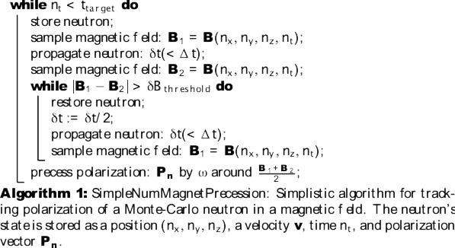
McStas precession algorithm
From: Knudsen et.al., J. Neutron Research, 2014

Slide 9
McStas precession algorithm
B₂
B₁
n
$$δt$$

Slide 10
McStas precession algorithm
B₂
B₁
n
$$δ\overset{^}{t}=δt/2$$

Slide 11
McStas precession algorithm
From: Knudsen et.al., J. Neutron Research, 2014

Slide 12
McStas precession algorithm
From: Knudsen et.al., J. Neutron Research, 2014

Slide 13
McStas precession algorithm
void mc_pol_set_timestep(double dt);
void mc_pol_set_angular_accuracy(double domega);
From: Knudsen et.al., J. Neutron Research, 2014

Slide 14
McStas polarization components
Magnetic fields:
Pol_FieldBox.comp
Pol_constBfield.comp
Pol_simpleBfield.comp
Pol_simpleBfield_stop.comp
Pol_triafield.comp
Optics:
Monochromator_pol.comp
Pol_bender.comp
Pol_guide_vmirror.comp
Pol_mirror.comp
Pol_pi_2_rotator.comp
Transmission_polarisatorABSnT.comp
Pol_bender_tapering.comp
Monitors:
Pol_monitor.comp
MeanPolLambda_monitor.comp
PolLambda_monitor.comp
Idealized components:
PolAnalyser_ideal.comp
Set_pol.comp
Contrib:
Foil_flipper_magnet.comp

Slide 15
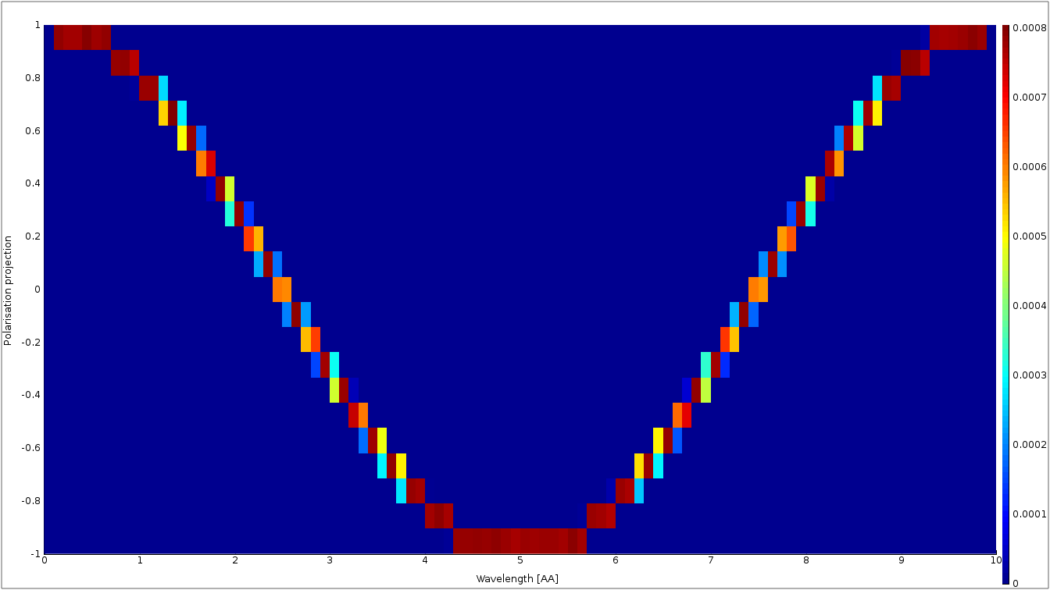
McStas polarization monitors
PolLambda_monitor
Monitors
MeanPolLambda_monitor
n
n
n
n
n
n
$$P$$
Pol_monitor
$$P∥\left(m_{x},m_{y},m_{z}\right)=0.87$$

Slide 16
McStas magnetic fields
Pol_constBfield.comp
Single constant Magnetic field in a “box”.
- user may specify a wavelength to flip. - blocking walls

Slide 17
McStas magnetic fields
Pol_FieldBox.comp
Single Magnetic field in a “box”
- optional user supplied field c-function

Slide 18
McStas magnetic fields
Pol_simpleBfield.comp
Pol_simpleBfield_stop.comp
- Entry/Exit contruction allows for nested magnetic field descriptions. - Any magnetic fields through user supplied c-function - Tabled magnetic fields

Slide 19
McStas Polarization Capabilities IV
Pol_simpleBfield.comp
Pol_simpleBfield_stop.comp
- Entry/Exit contruction allows for nested magnetic field descriptions. - Any magnetic fields through user supplied c-function - Tabled magnetic fields

Slide 20
Pol_monitors along the way...

Slide 21
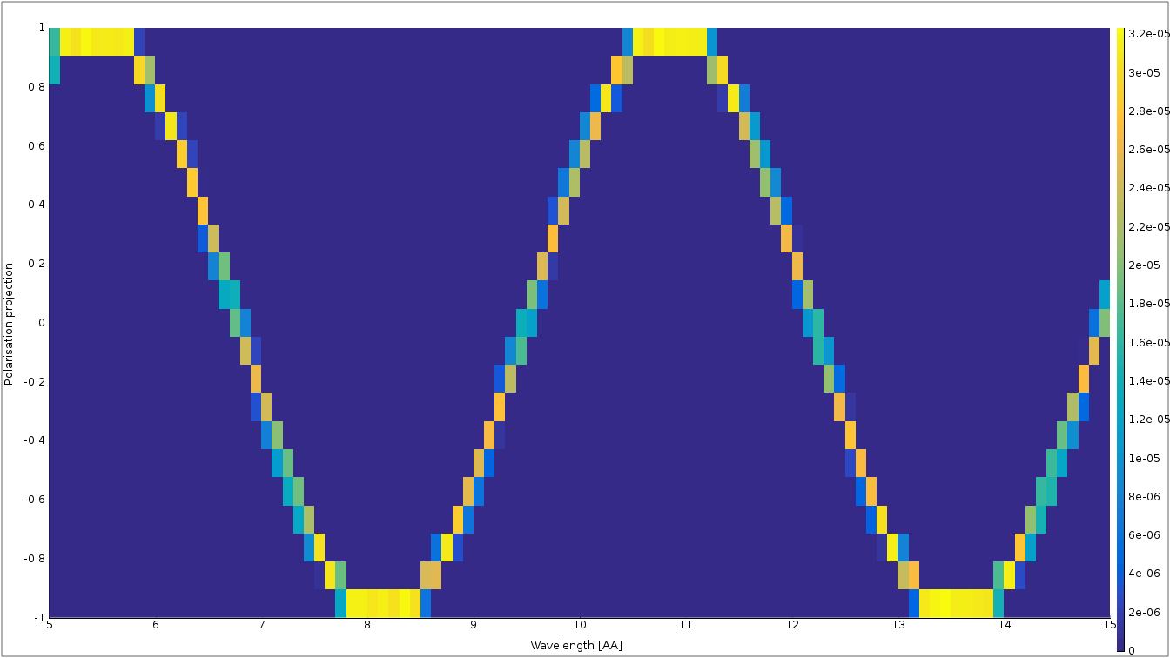
Pol_monitors along the way...
Pol_lambda_mon 1 placeholder

Slide 22
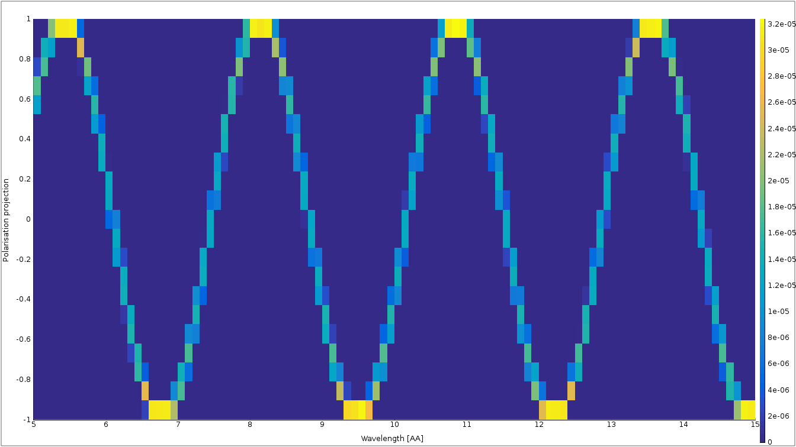
Pol_monitors along the way...

Slide 23
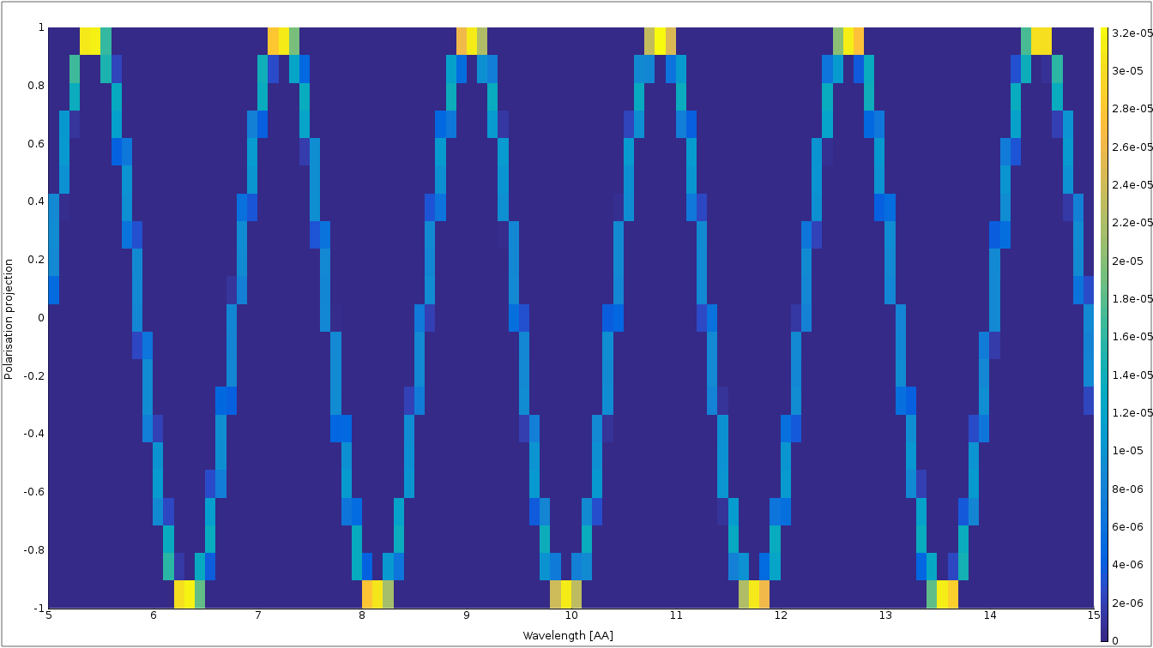
Pol_monitors along the way...

Slide 24
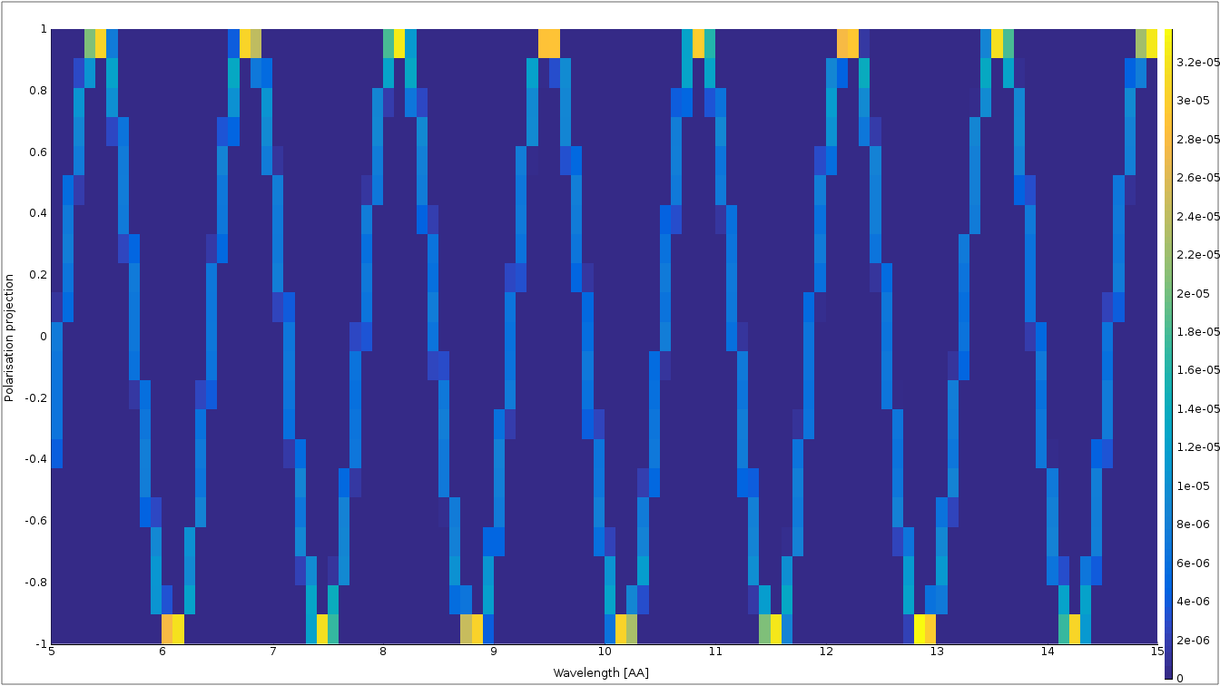
Nested fields

Slide 25
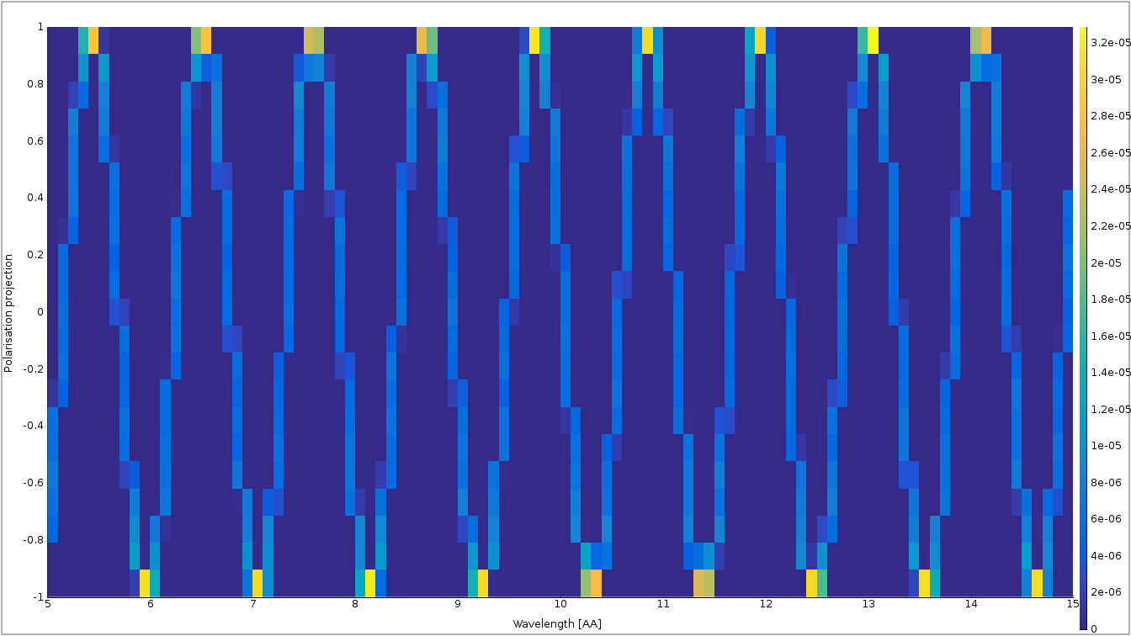
Nested fields

Slide 26



Getting help
Check example header.
Use mcdoc
Read/check the manual
User mailing list: mcstas-users@mcstas.org
Give us a call/write us an email!

Slide 27
McStas components on the way
Things on the way
Magnetic fields:
Pol_FieldBox.comp
Tabled fields
Pol_constBfield.comp
Pol_simpleBfield.comp
3D entry/exit windows
Pol_simpleBfield_stop.comp
Pol_triafield.comp
Optics:
Monochromator_pol.comp
Pol_bender.comp
Pol_guide_vmirror.comp
Pol_mirror.comp
Pol_pi_2_rotator.comp
Transmission_polarisatorABSnT.comp
Pol_bender_tapering.comp
Pol_McRadia.comp
Dynamic coupling to RADIA
Monitors:
Pol_monitor.comp
MeanPolLambda_monitor.comp
PolLambda_monitor.comp
Pol_PSD_monitor.comp
Idealized components:
PolAnalyser_ideal.comp
Set_pol.comp
Pol_SF_ideal.comp
Contrib:
Foil_flipper_magnet.comp
Sample component
Magnetic_single_crystal.comp

Slide 28
McStas components on the way
Generalized Simple B-Fields: constant, functional, tabled, … but in more general shapes
RF-flipper
He3-objects

Slide 29
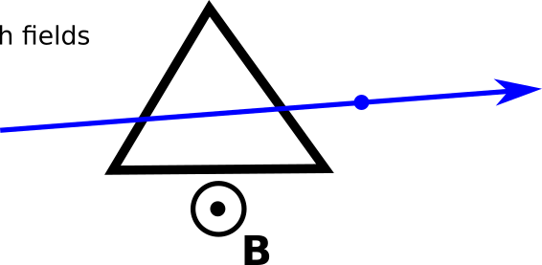
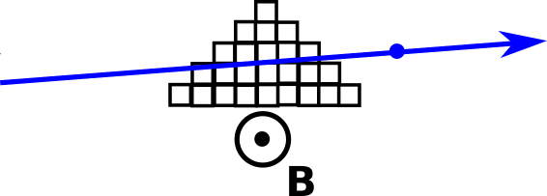
McStas components on the way
McRadia compared with analytical field description
Requires a mathematica license.
Analytical using Pol_triafield.comp
Voxelized 5x9 pts.

Slide 30
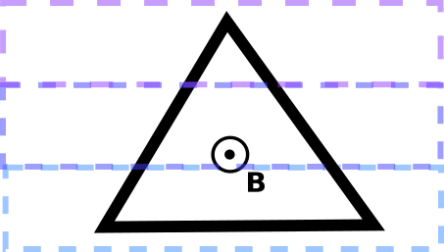
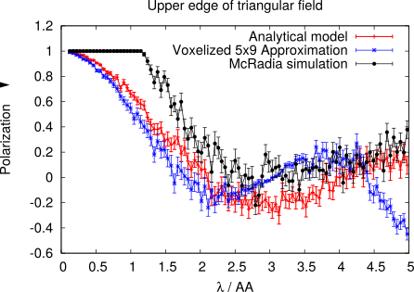
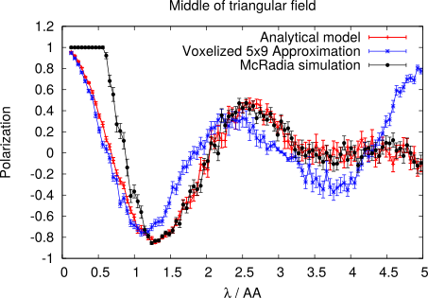
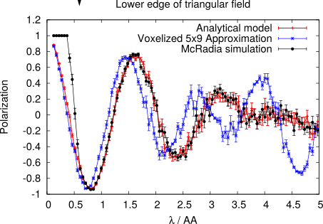
McStas components on the way
McRadia compared with other field descriptions
P

Slide 31
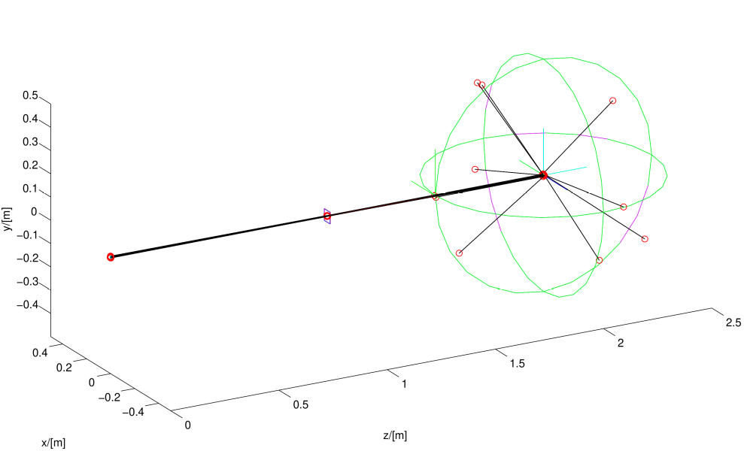
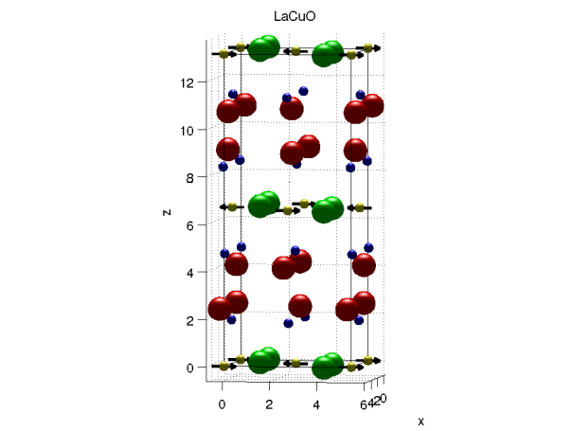

McStas components on the way
Magnetic single crystal

Slide 32
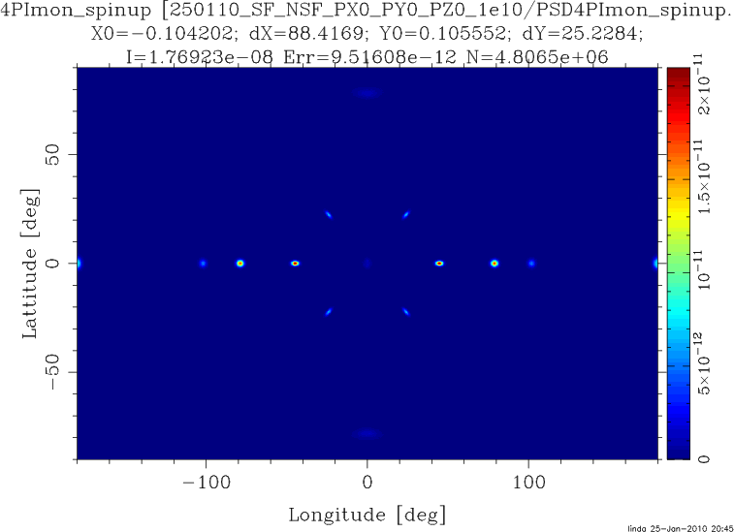
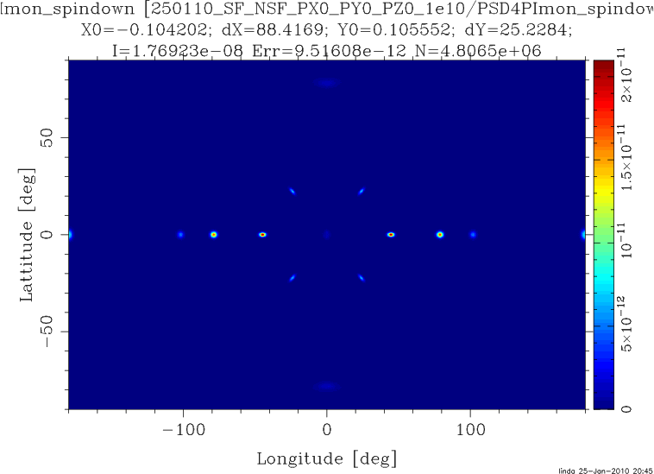
McStas components on the way
Magnetic single crystal – Unpolarized beam

Slide 33
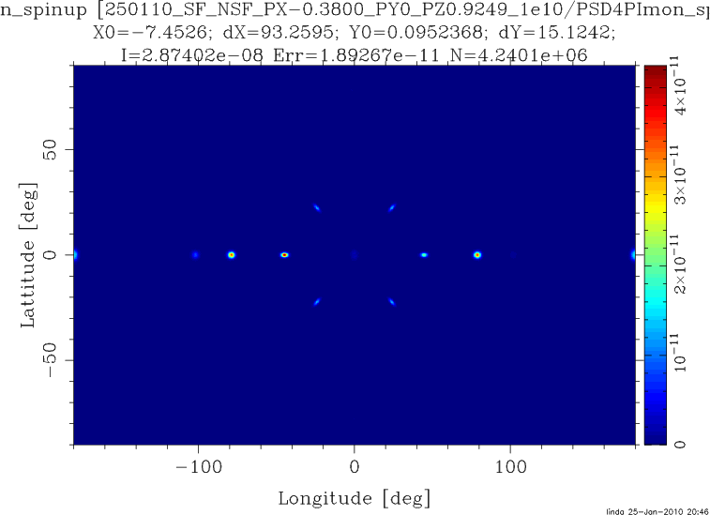
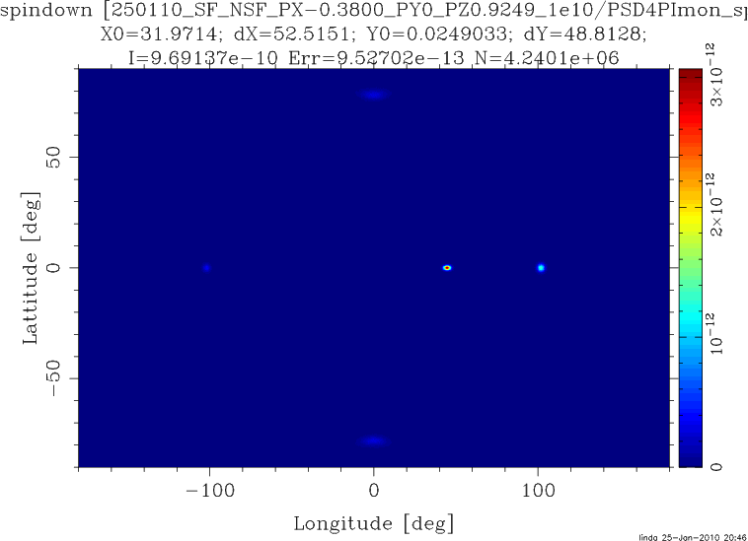
McStas components on the way
Magnetic single crystal – Polarized beam

Slide 34
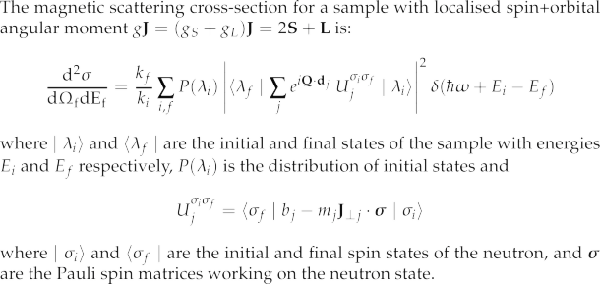
McStas components on the way
Magnetic single crystal
From: G. Shirane et.al. ,”Neutron Scattering with Triple-Axis Spectrometer”, Cambridge Univ. Press, 2002

Slide 35
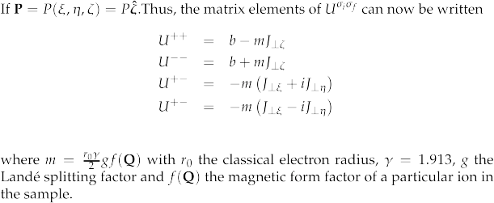
McStas components on the way
Magnetic single crystal

