Slide 1
TEAM 10
NGUYỄN CHÍ THÀNH – 18127212
LÊ QUANG BẢO SƠN - 18127198

Slide 2
I. Introduce
Axie Infinity ?
Opensea ?
NFT ?

Slide 3
II. Collect data
MongoDB
OpenseaAPI
Axie Marketplace

Slide 4
III. Explore data
Preprocessing data ( duplicates, null).
Know info of columns.
Analysis data ( popular, top, total, number, trade, buyer, seller….)
Overview of data we have.

Slide 5
IV. Model
Preprocess :
+ bodyshape : Name - > int
+ class : Name -> int

Slide 6
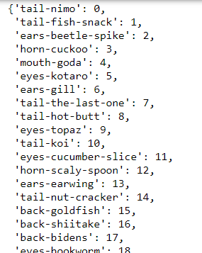
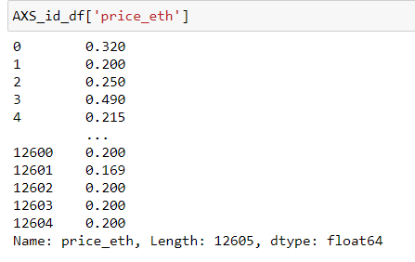
IV. Model
Preprocess :
+ Price ETH : gas wei - > eth
+ Card id : Name -> int

Slide 7
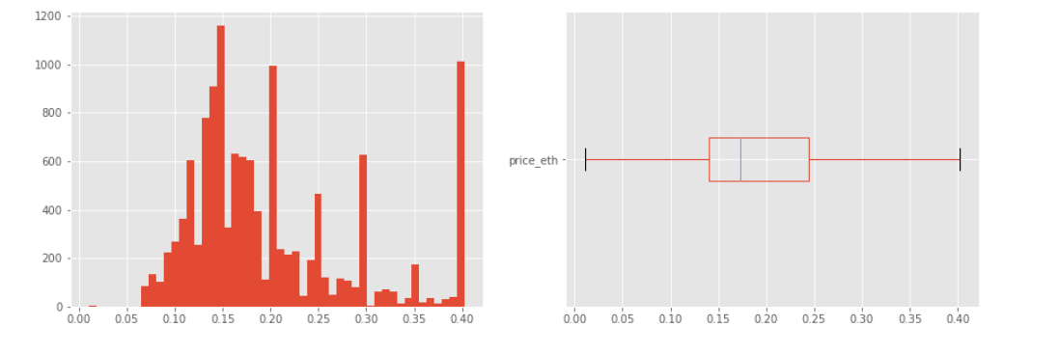
IV. Model
Preprocess :
+ Eliminate outlier

Slide 8
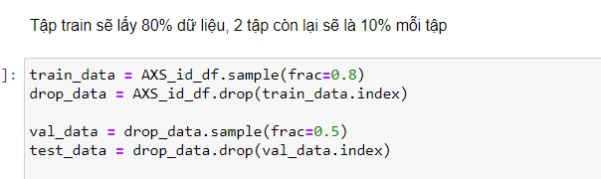
IV. Model
Split data :
+ train : 80%
+ validation : 10%
+ test : 10%

Slide 9
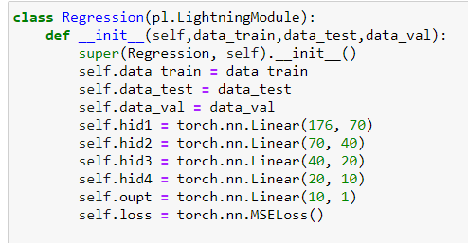
IV. Model
Architect :
+ 4 Layer : 4 linear , 1 output.
+ Loss function : MSEloss.
+ No activation function.

Slide 10
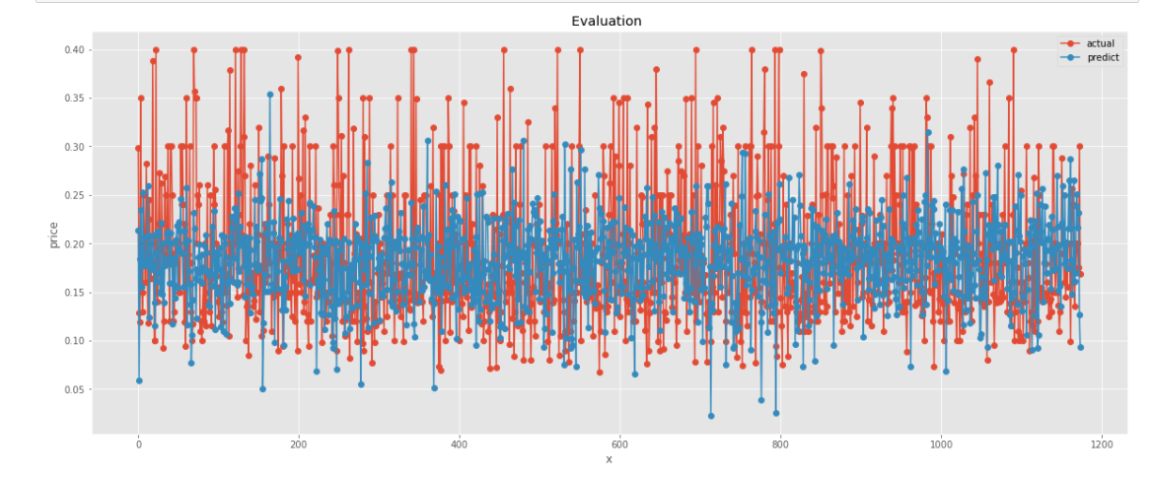
IV. Model
Result

Slide 11
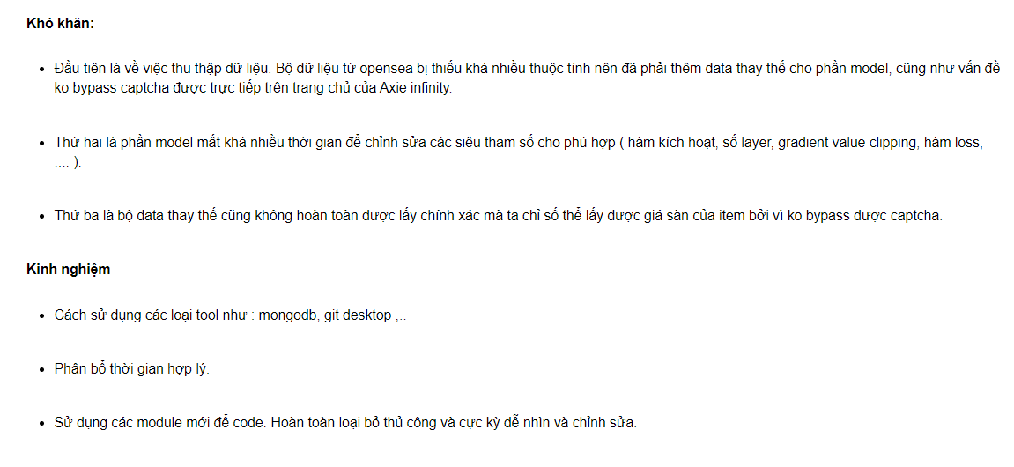
V. Reflection

Slide 12
VI. Reference
[1] https://towardsdatascience.com/deep-neural-networks-for-regression-problems-81321897ca33
[2] https://axieinfinity.com/
[3] https://docs.opensea.io/reference/api-overview
[4] https://www.pytorchlightning.ai/
[5] https://docs.mongodb.com/tools/
[6] https://www.phamduytung.com/blog/2019-05-05-deep-learning-dropout/
[7] Xử lý các giá trị ngoại lệ — Machine Learning cho dữ liệu dạng bảng (machinelearningcoban.com)

Slide 13
END

