Slide 1

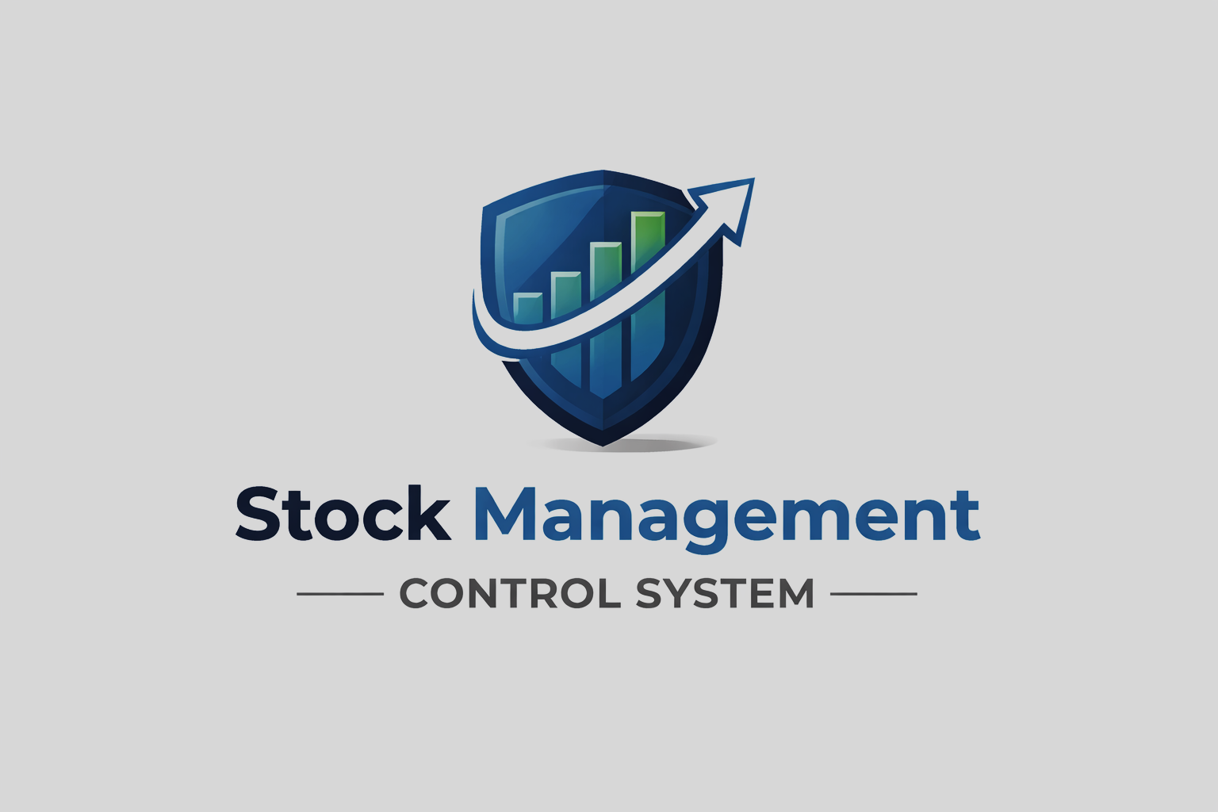

Stock Management Control System
System description, use case, class, data flow & sequence diagrams
Cyubahiro Eddy Prince : 24881

Slide 2
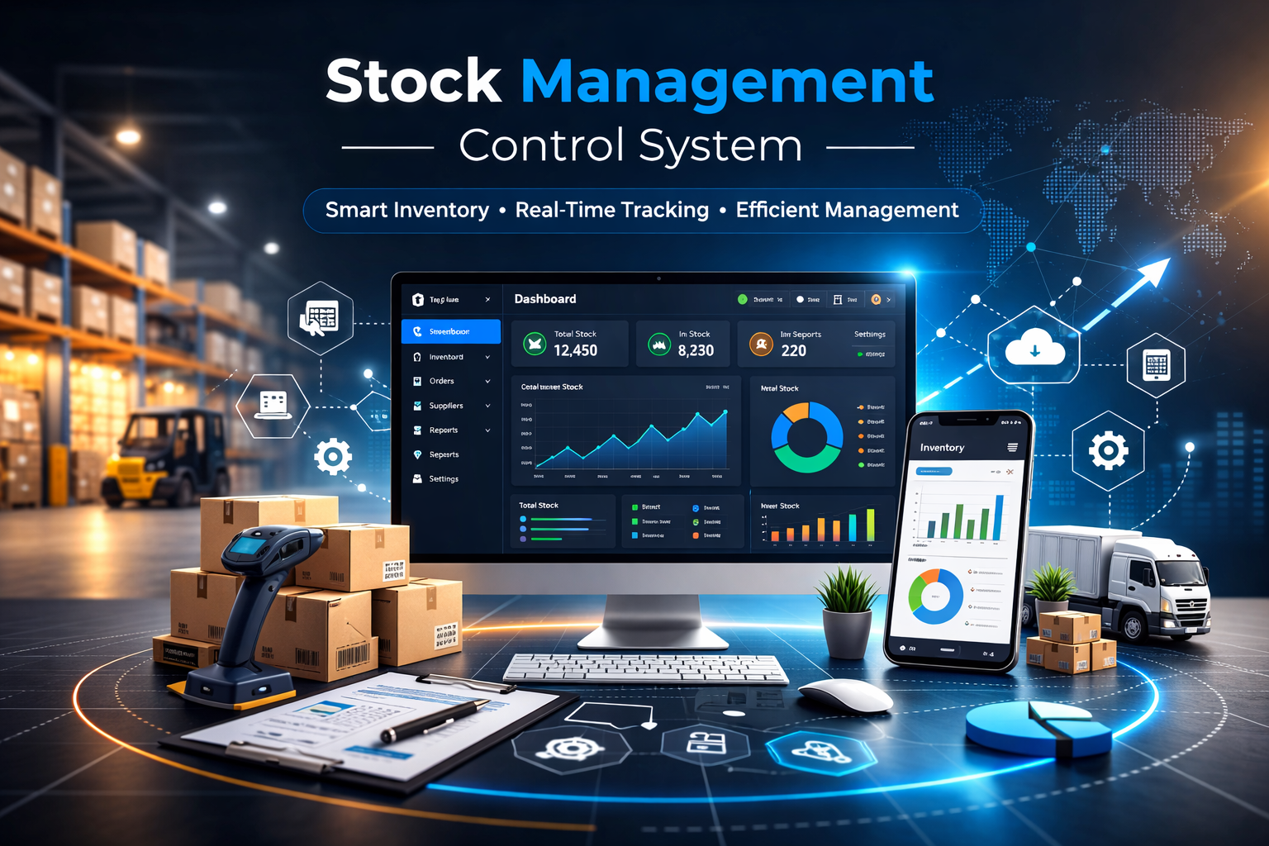
System Description
Purpose: Web app for authorized users to view and manage stock (expired, in stock, out of stock, damaged).
Users log in by role: Account, Stock Manager, Admin, Director.
High-level flow:
• User visits app → SPA loads (Vue).
• Login → backend validates, returns JWT; frontend stores token.
• Role-based access: router and API enforce permissions.
• Stock data: products with supplier, total supplied, expiry.
• Reports: Director/Admin view dashboards (expired, in/out stock, damaged).
Tech: Vue 3, Vite, Pinia, Vue Router (frontend); Node.js, Express, MongoDB (backend).

Slide 3
Use Case Diagram
Actors: User, Admin, Stock Manager, Director, Account.
Main use cases:
• Login / Logout — all roles.
• View Stock Info, View Expired Stock, View Damaged Qty — Director, Stock Manager, Admin.
• Manage Products — Stock Manager, Admin.
• Record Supply / Supplier — Stock Manager, Admin (where from, total supplied).
• View Reports — Director, Admin.
• Manage Users — Admin only.
• Account Operations — Account role.

Slide 4
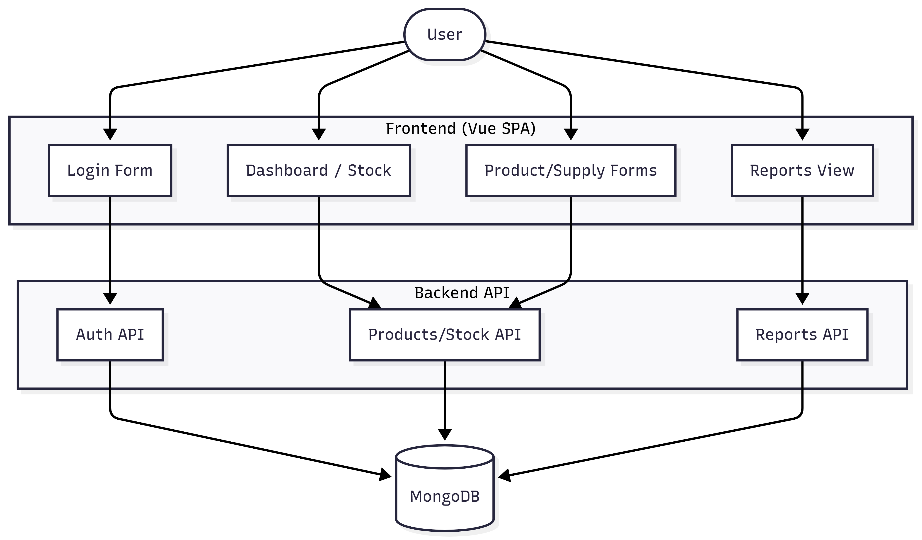

Slide 5
Class Diagram
User: _id, username, passwordHash, role, email, createdAt.
Product: _id, name, sku, quantityInStock, quantityDamaged, totalSupplied, supplierId, expiryDate; isExpired().
Supplier: _id, name, contact.
StockTransaction: _id, productId, type, quantity, amount, userId, createdAt.
Relationships:
• Product → Supplier (from).
• Product → StockTransaction (has).
• User → StockTransaction (creates).

Slide 6
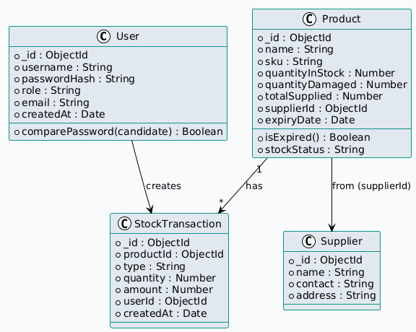

Slide 7
Data Flow Diagram
Level 0 (context): User ↔ Stock Management System ↔ MongoDB.
Level 1 (main processes):
• User → Login Form → Auth API → MongoDB.
• User → Dashboard/Stock → Products/Stock API → MongoDB.
• User → Product/Supply Forms → Products/Stock API → MongoDB.
• User → Reports View → Reports API → MongoDB.
• Data: Login/CRUD/Reports to System; System reads/writes DB; responses/UI to User.

Slide 8
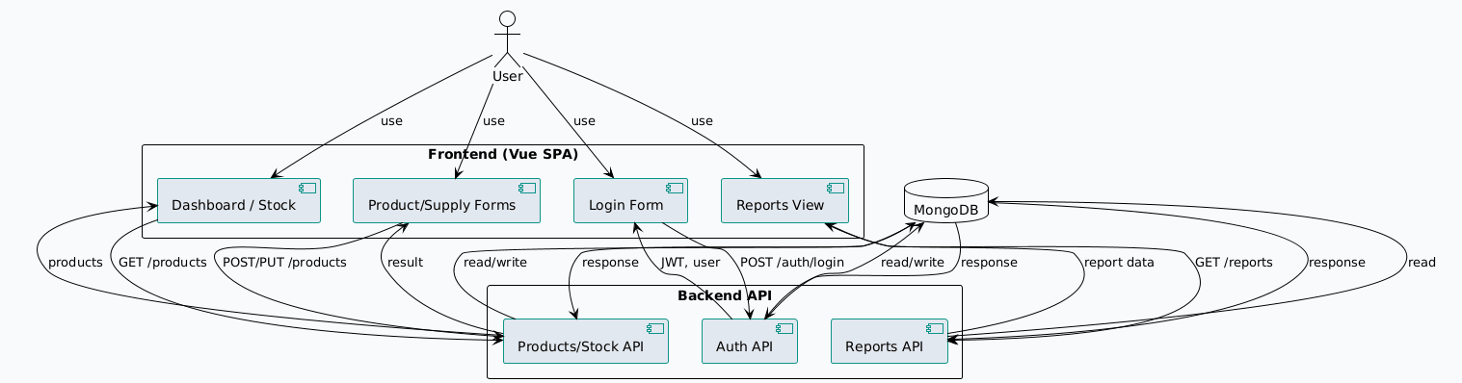

Slide 9
Sequence Diagram (Login & View Stock)
1. User opens app → Vue loads.
2. Router checks route; no token → redirect to Login.
3. User enters credentials → Vue sends POST /auth/login to API.
4. API verifies user in MongoDB → returns JWT.
5. Vue stores token, redirects (e.g. to Dashboard).
6. Vue sends GET /products with JWT.
7. API queries MongoDB → returns stock data.
8. Vue displays dashboard.

Slide 10
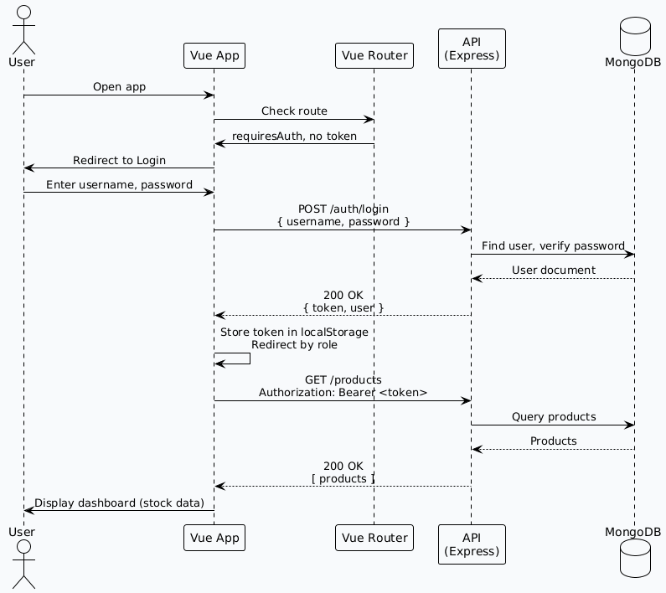

Slide 11



