Slide 1


Data Analytics:
Unveiling Insights for Informed Decisions
.
SAP Training Template
www.zktutorials.com
Presented by :- Sachin Sahebrao Rajput

Slide 2

Topics.
What is Data Analytics?
Why Data Analytics?
What are the types Data Analytics?
What are the steps involved in Data Analytics?
What Tools can be used for Data Analytics?
Which other skills can help you?
.
SAP Training Template
www.zktutorials.com

Slide 3
What is Data Analytics?
Data :- Collection Of values/Facts/Numbers that convey information.
Analytics :- Analytics is the scientific process of discovering and communicating the meaningful patterns
Data Analytics means using data, techniques and tools that identify patterns and trends, which in turn generate actionable insights that support informed decision-making
Data Analytics is not a tool or technology, rather it is way of thinking and acting on data.
.
SAP Training Template
www.zktutorials.com

Slide 4
Why Data Analytics?
Gather hidden insights
Generate reports
Perform market analysis
Improve business requirements
Cut costs
Attract customers
.
SAP Training Template
www.zktutorials.com

Slide 5
What are the types Data Analytics?
Descriptive :- answers What has happened?
E.g. Netflix movie recommendation
Predictive :- answers What could happen?
E.g. Manufacturing industry to predict future requirements and optimize warehouse stocking accordingly.
Prescriptive :- What should be done?
E.g. Fraud detection in banks
.
SAP Training Template
www.zktutorials.com

Slide 6
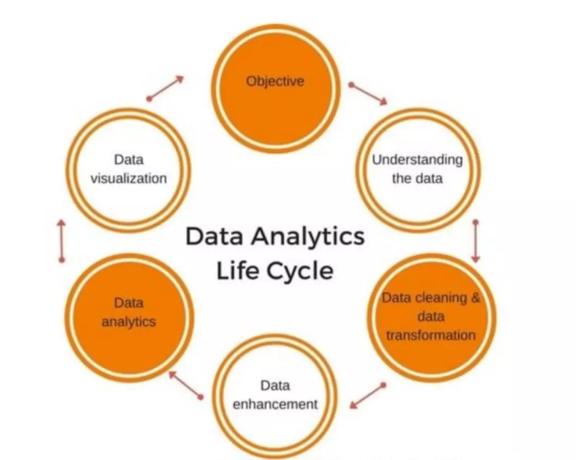
What are the steps involved in Data Analytics?
.
SAP Training Template
www.zktutorials.com

Slide 7
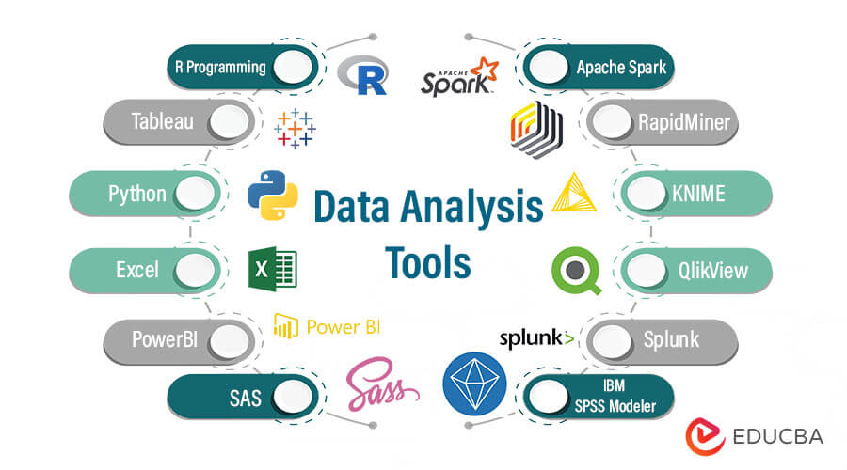
What Tools can be used for Data Analytics?
.
SAP Training Template
www.zktutorials.com

Slide 8

With what tools you can start?
.
SAP Training Template
www.zktutorials.com
Microsoft Excel
Sort/Filter
VLOOKUP
Aggregation functions
Conditional formatting
Pivot tables
Basic cleaning

Slide 9

With what tools you can start?
.
SAP Training Template
www.zktutorials.com
MySQL/SQL
Primary key & foreign key
Select/From/Where
Group by
Order by
Joins
Relationship between tables

Slide 10

With what tools you can start ?
.
SAP Training Template
www.zktutorials.com
Power BI
Data visualization
Data modelling
Dax
Power query
Analyse and provide insights

Slide 11
Tools Trend in Job Description.
.
SAP Training Template
www.zktutorials.com

