Slide 1
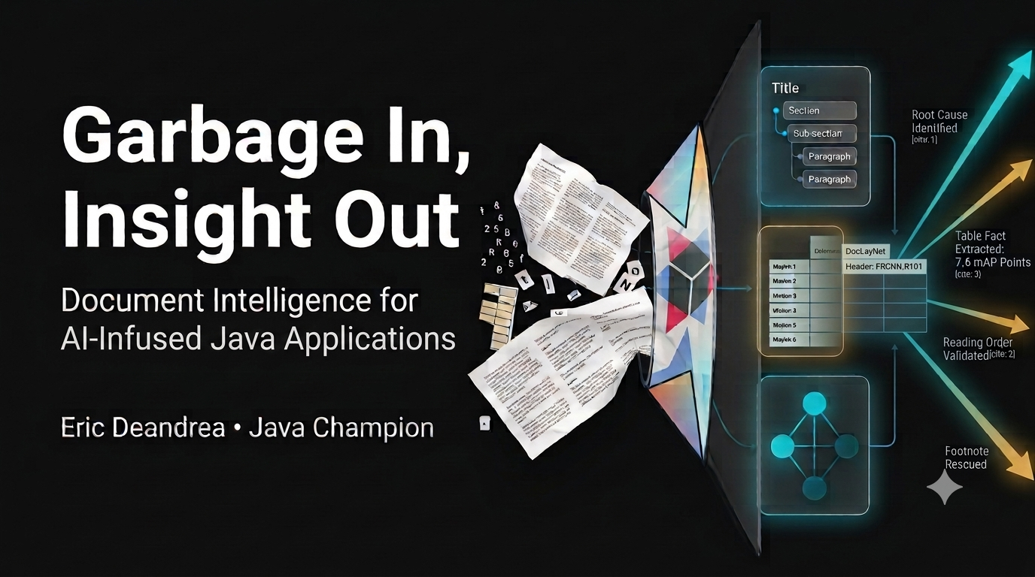
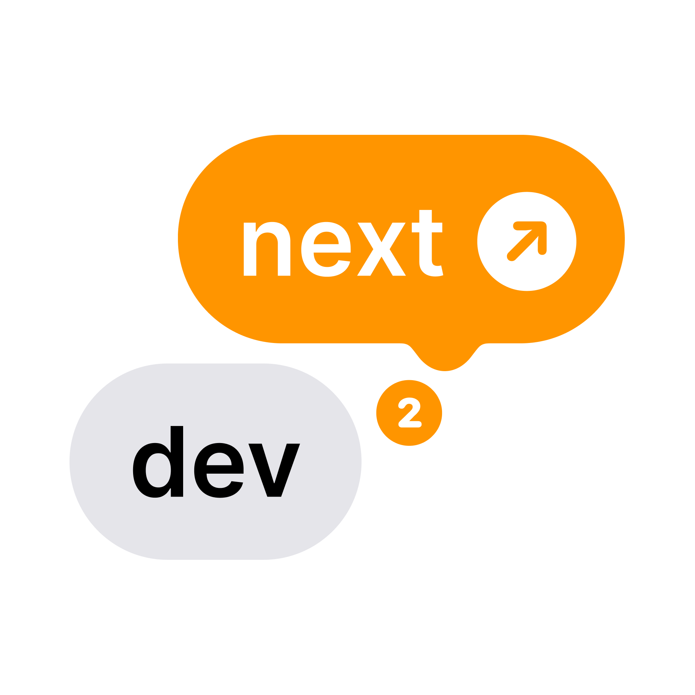
Notes:
On screen before the talk starts, the resting state while the room fills.
Swap the logo in the corner per conference.
Don't linger here when you start, advance straight into the pre-tease.

Slide 2
Who wrote this paper?
“...the paper titled “Segmentation for document layout analysis: not dead yet” was written by Logan Markewich, Hao Zhang, Yubin Xing, Navid Lambert-Shirzad, Jiang Zhexin, Roy Lee, Zhi Li, and Seok-Bum Ko.”
Notes:
Flash this. No explanation, no setup.
Let it sit a beat, then something like 'hold that thought.'
This is Mode A's real captured wrong answer to the author question.
Comes back in Act 2's verdict.

Slide 3












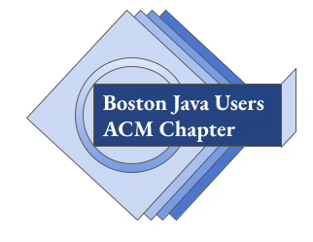
Who am I?
Java Champion
27+ years software development experience
Works on Open Source projects
Quarkus
LangChain4j, Quarkus LangChain4j
Docling Java, Quarkus Docling
Langfuse Java, Quarkus Langfuse
Spring Boot, Spring Framework, Spring Security
Testcontainers
Wiremock
Microcks
Boston Java Users ACM Chapter Vice Chair & Board Member
Published Author
Cat lover
Notes:
Quick credibility beat, keep it fast, this isn't the hook.
Java Champion, 27+ years, docling-java and quarkus-docling project lead.
Dual credibility: Spring Boot committer history plus deep Quarkus work.

Slide 4
Quick Primer
Let's get into it
Notes:
Marks the end of intro/bio, start of the actual talk content.
Quick beat, don't linger.
Wording is a placeholder, easy to swap.

Slide 5
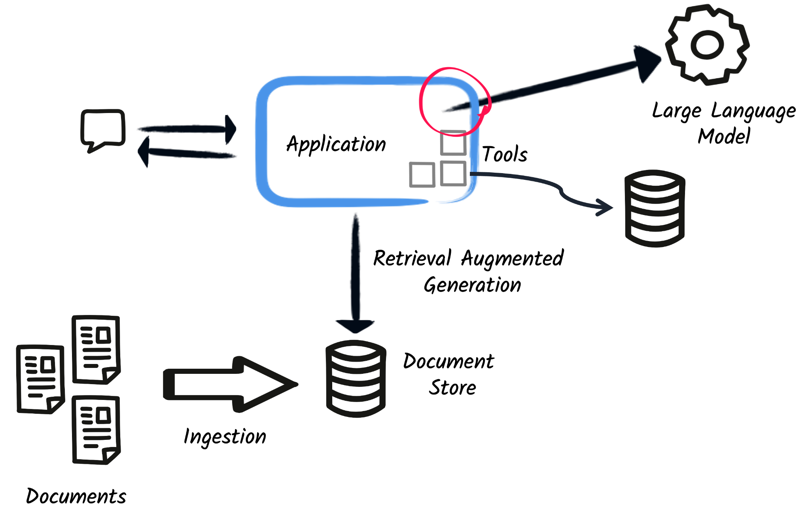
Retrieval Augmented Generation (RAG)
Enhance LLM knowledge by providing relevant information in real-time from other sources
Dynamic data that changes frequently
Fine-tuning is expensive!
2 stages
Indexing / Ingestion
Retrieval / Augmentation
Notes:
Fast primer, ~5 min total for this slide plus the two pipeline diagrams.
Just enough vocabulary, ingest, chunk, embed, retrieve, generate, to orient the room.

Slide 6
Retrieval Augmented Generation (RAG)
Enhance LLM knowledge by providing relevant information in real-time from other sources
Dynamic data that changes frequently
Fine-tuning is expensive!
2 stages
Indexing / Ingestion
Retrieval / Augmentation
Notes:
This is the visual anchor. Ingestion is the scene of the crime.
Let the circle sit for a beat before moving on.
This is what the room should remember once Act 1 starts pulling ingestion apart.

Slide 7
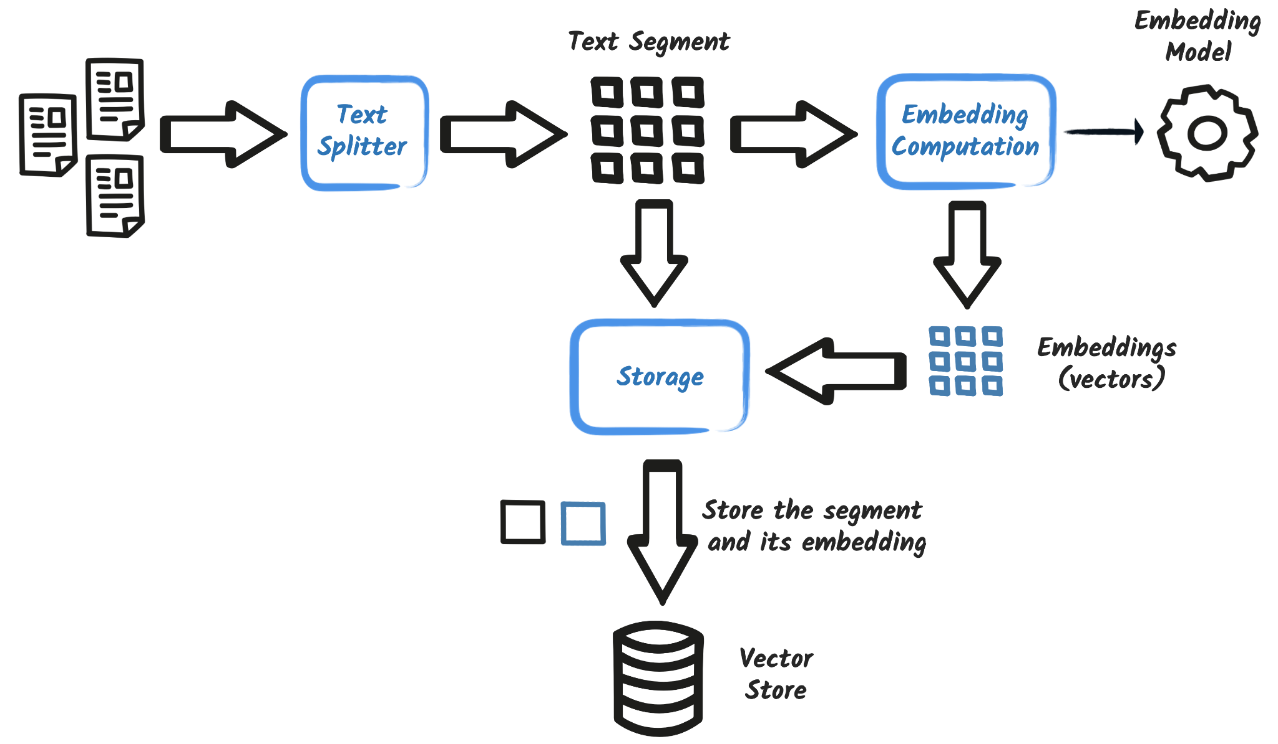
Indexing / Ingestion
Notes:
This is the pipeline stage the entire talk lives in.
Don't over-explain each icon.
Just establish the shape: documents in, split, embedded, stored.

Slide 8
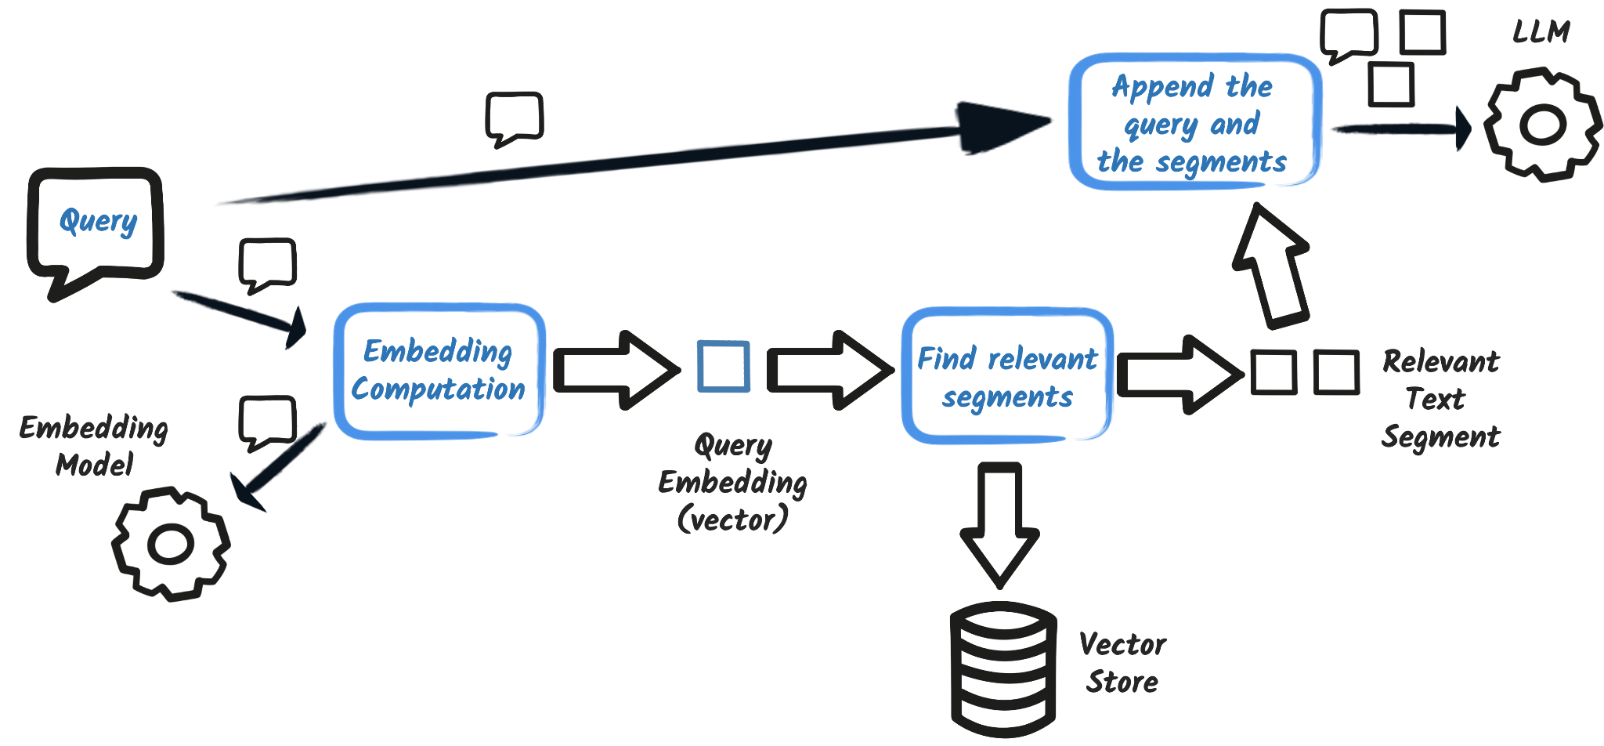
Retrieval / Augmentation
Notes:
Keep this lighter and faster than the ingestion slide, it's not the focus.
Just enough to complete the mental model before Act 1 breaks ingestion.

Slide 9
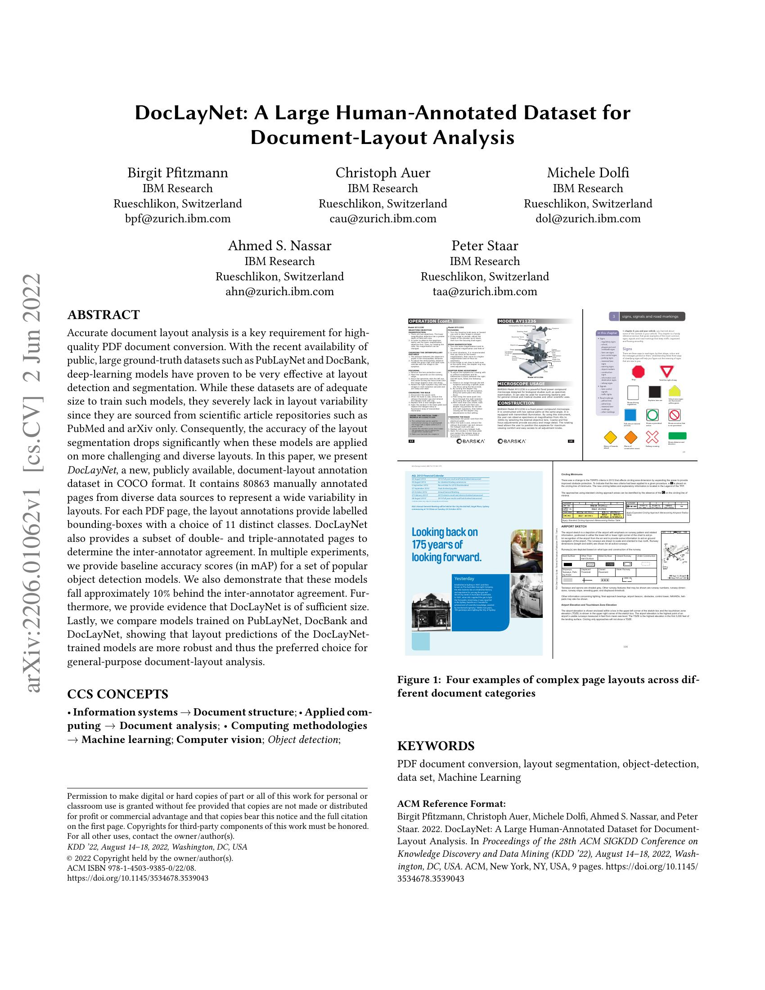

DocLayNet
Pfitzmann, Auer, Dolfi, Nassar, Staar (IBM Research, KDD 2022)
A real, peer-reviewed paper. Five-author header, dense two-column body, complex tables, figures, footnotes: everything our abstract complains about.
It's a paper about document-layout analysis. It's about to have its own layout analyzed.
Not cherry-picked: this is the same PDF Docling's own team uses to demo naive-extraction failure.
arxiv.org/abs/2206.01062
Notes:
DocLayNet, KDD 2022, IBM Research. Real peer-reviewed paper, not synthetic.
The joke: a paper about document-layout analysis about to have its own layout analyzed. Let it land.
Credibility beat: the same PDF Docling's own team uses to demo naive-extraction failure. Not cherry-picked.

Slide 10
Act 1: Mode A
The obvious way
Notes:
Section marker, quick. Don't linger.

Slide 11
Mode A: The obvious way
Extract
Apache Tika: plain text, no layout awareness
Chunk
Sentence splitter: fixed rules, no table sense
This is the same code most people reach for first. Here's what it actually does to our document.
Notes:
Conceptual only, no code yet, that's the next beat.
Tika for extraction, a naive sentence splitter for chunking.
Frame this as the code most people reach for first instinctively, not a strawman.
🔴 LIVE DEMO NEXT: switch to the app now.
Mode: A. Ask: “Who wrote the paper?”
Let the room see the real answer land, then come back to slides 11-13.

Slide 12
🔴 LIVE
Mode A: “Who wrote the paper?”
“...the paper titled “Segmentation for document layout analysis: not dead yet” was written by Logan Markewich, Hao Zhang, Yubin Xing, Navid Lambert-Shirzad, Jiang Zhexin, Roy Lee, Zhi Li, and Seok-Bum Ko.”
“This is the most clearly identified paper in the context with its author list provided.”
Notes:
📌 FALLBACK for the live query above.
If it worked live: breeze through this, don't re-read it verbatim.
If live failed or skipped: this is your primary content now, deliver it fresh.
This is real, captured from the actual running app, nothing invented.
The scarier part isn't that it's wrong, it's how confident it sounds. Land that line, then pause.

Slide 13
🔴 LIVE
Mode A: “Who wrote the paper?”
“...the paper titled “Segmentation for document layout analysis: not dead yet” was written by Logan Markewich, Hao Zhang, Yubin Xing, Navid Lambert-Shirzad, Jiang Zhexin, Roy Lee, Zhi Li, and Seok-Bum Ko.”
“This is the most clearly identified paper in the context with its author list provided.”
That's citation [5]. Not this paper.
Notes:
Advance to reveal why: it's citation [5] from the bibliography, not the paper itself.
Let the audience place it themselves for a beat before you say anything.

Slide 14
🔴 LIVE
Mode A: “Who wrote the paper?”
“...the paper titled “Segmentation for document layout analysis: not dead yet” was written by Logan Markewich, Hao Zhang, Yubin Xing, Navid Lambert-Shirzad, Jiang Zhexin, Roy Lee, Zhi Li, and Seok-Bum Ko.”
“This is the most clearly identified paper in the context with its author list provided.”
That's citation [5]. Not this paper.
What actually got retrieved (top 4, by score):
0.80 “In 2017 14th IAPR International Conference on Document Analysis and Recognition …”
0.79 “In Proceedings of the 28th International Conference on Computational Linguistics…”
0.79 “In Proceedings of the International Conference on Document Analysis and Recognit…”
0.78 “In Proceedings of the International Conference on Document Analysis and Recognit…”
Notes:
All four retrieved chunks are bibliography entries, scores 0.78-0.80.
Close enough that the retriever can't tell a citation from the actual byline.
This exact question comes back in Act 2's verdict, plant that expectation here.

Slide 15
Mode A: The Extractor
package dev.ericdeandrea.docling.ai.ingestion.extraction;
public class TikaExtractor {
private final ApacheTikaDocumentParser parser = new ApacheTikaDocumentParser();
public ExtractionResult extract(Path documentPath) {
return new ExtractionResult(FileSystemDocumentLoader.loadDocument(documentPath, parser));
}
}
The extraction logic, imports omitted. No configuration, no tuning, no reason to suspect it's wrong.
Notes:
Real source, straight from the repo. Imports trimmed for the slide.
Let the brevity land, this is genuinely all it takes to wire up. Nothing here looks wrong.
LangChain4j's FileSystemDocumentLoader plus Apache Tika's parser, four lines of actual logic.

Slide 16
Mode A: The Chunker
package dev.ericdeandrea.docling.ai.ingestion.chunking;
public class NaiveChunker {
public List<TextSegment> chunk(ExtractionResult result, Mode mode) {
var splitter = new DocumentBySentenceSplitter(maxTokens, overlap);
var segments = splitter.split(result.document());
// 2 sentences before + after, joined as "extended_content" metadata
enrichWithSurroundingContext(segments, 2, 2);
return segments.stream()
// attachMetadata() tries to attach provenance, but there isn't any here.
.map(segment -> attachMetadata(segment, result, mode))
.toList();
}
}
Notes:
This is the real chunker, trimmed from 111 lines to the core method.
The full file also does provenance attachment and context enrichment, mentioned, not shown in full.
The code's own comment makes the point for you: 'the chunker is identical, only extraction quality differs.' Let that land, it's basically the thesis of the whole talk.
The attachMetadata() comment connects back to the pre-tease/verdict screenshots: this is why Mode A's chunk table had blank Page/Type/Label columns. Not a UI bug, Tika just doesn't have that data.

Slide 17
Retrieval: the boring part, on purpose
package dev.ericdeandrea.docling.ai.rag;
final class ExtendedContentRetrievalAugmentorBuilder {
static RetrievalAugmentor build(EmbeddingStore<TextSegment> embeddingStore,
EmbeddingModel embeddingModel, DemoConfig config) {
var retriever = EmbeddingStoreContentRetriever.builder()
.embeddingStore(embeddingStore)
.embeddingModel(embeddingModel)
.maxResults(config.rag().topK())
.build();
// This is the line that surfaces the chunker's "extended_content"
// enrichment to the LLM. Everything else here is default wiring.
var contentInjector = DefaultContentInjector.builder()
.metadataKeysToInclude(List.of("extended_content"))
.build();
return DefaultRetrievalAugmentor.builder()
.contentRetriever(retriever)
.contentInjector(contentInjector)
.build();
}
}
Same for all three modes. Mostly LangChain4j's own builder vocabulary, barely any of it is ours.
Notes:
Real source, verified from the repo. Method signature trimmed to (&#8230;) for space, full params are embeddingStore/embeddingModel/config.
Land this as a quick, almost throwaway beat, ~1-2 min. The point is how UNinteresting this is, don't over-explain the builder calls.
The payoff is the metadataKeysToInclude line, that's literally the mechanism that takes the chunker's 'extended_content' enrichment and puts it in front of the LLM. Tie it back explicitly: 'remember that comment on the chunker slide? This is where it actually matters.'
Explicitly say this is identical across Modes A, B, and C, reinforces the 'only extraction changes' discipline with actual code, not just an assertion.

Slide 18

“vegetative electron microscopy”
A phrase that means nothing. It's appeared in dozens of papers anyway.
It's now used as a fingerprint by paper-mill screening tools.
One theory, not confirmed: a column-misread spliced two phrases together.
Reading order isn't just a demo inconvenience. It's already real.
retractionwatch.com/2025/02/10/vegetative-electron-microscopy-fingerprint-paper-mill
Notes:
🎤 TRANSITION IN: “And this isn't just a problem for my demo. Here's what document-parsing chaos actually causes, out in the real world.”
Real, sourced from Retraction Watch reporting, not invented.
Present the column-misread explanation as a theory, not a settled fact.
There's a competing Persian-mistranslation theory that's arguably stronger evidence-wise, don't overclaim certainty.
What's not in dispute: the phrase is real, documented, now used as a fraud-detection fingerprint. That's the point, not the origin story.
Landing line: this isn't hypothetical stakes, it already happened.

Slide 19
Why not just a bigger model?
Cost
Running a vision-language model over every page doesn't scale the way a purpose-built extraction step does.
Latency
Big vision models are slow. Fine for a demo, not fine for a pipeline processing real volume.
Capacity
Throwing the whole document at a bigger model just moves the chunking problem earlier. It doesn't remove it.
Privacy
A lot of enterprises can't send proprietary documents to a third-party API. On-prem isn't optional for them.
Notes:
Quick beat, ~5 min, this is a bridge, not a deep dive.
The obvious objection: why not skip extraction and point a big multimodal model at the raw PDF?
These four reasons, briefly, no need to defend each one at length.
The point is there's no free lunch, not that any single reason is airtight alone.
Land the transition into Act 2: extraction still matters, so let's fix extraction properly.

Slide 20
Act 2: Mode B
Enter Docling
Notes:
Quick beat, just the section marker. Don't linger.

Slide 21


Meet Docling
Open source
MIT license, Linux Foundation project
Document intelligence
Advanced, cost-efficient
Multi-format
PDF, Word, PowerPoint, HTML, and more
Unified representation
Rich, LLM-friendly
Privacy & security
Self-host it, or use the managed service
Plug-and-play
For building apps & agents
docling.ai
Notes:
Content sourced from Docling's own official overview deck (Panos Vagenas, Technical Steering Committee), rebuilt in our own visual style, not copied.
Quick beat, this is context-setting before the Java-specific story on the next slide.
Leads straight into 'but everything here is Python', the next slide picks that up immediately.

Slide 22


Notes:
“Everything we've described lives in the Python ecosystem. And last time I checked, I'm a Java Champion! Even though it gets cold in Colorado, Java developers shouldn't have to be left out in it.”

Slide 23


docling-project.github.io/docling-java
Notes:
The official Java integration, one of the project's own listed key repositories, not a scrappy side fork.

Slide 24
Mode B: One thing changes
Extract
Docling instead of Tika: structured extraction, layout & table aware.
Chunk
The exact same sentence splitter as Mode A. Unchanged. On purpose.
Everything downstream of extraction (embedding model, vector store, retrieval, prompt, LLM) stays identical to Mode A.
Notes:
Conceptual, no code yet, that's next.
Say the constraint out loud: everything except extraction is held constant.

Slide 25
Mode B: One thing changes
Extract
Docling instead of Tika: structured extraction, layout & table aware.
Chunk
The exact same sentence splitter as Mode A. Unchanged. On purpose.
Everything downstream of extraction (embedding model, vector store, retrieval, prompt, LLM) stays identical to Mode A.
If the answer changes, extraction is the only thing that could have caused it.
Notes:
That's what makes this a real experiment, not just a vibe.
Beat, then: '...well, that or the LLM just felt like hallucinating differently this time. That's always on the table too.' Said with a grin, not defensively.
🔴 LIVE DEMO NEXT: switch to the app now.
Mode: B (or A+B side by side if the UI supports it). Ask: “Who wrote the paper?”
Then advance to the verdict slide, left already matches Mode A's known answer, right needs your real Mode B capture.

Slide 26
🔴 LIVE
“Who wrote the paper?” again
Mode A (Tika)
Mode B (Docling)
“...the paper titled “Segmentation for document layout analysis: not dead yet” was written by Logan Markewich, Hao Zhang, Yubin Xing, Navid Lambert-Shirzad, Jiang Zhexin, Roy Lee, Zhi Li, and Seok-Bum Ko.”
Wrong. Still.
“...the paper “DocLayNet: A Large Human-Annotated Dataset for Document-Layout Analysis” was written by: Birgit Pfitzmann, Christoph Auer, Ahmed S. Nassar, Michele Dolfi, and Peter Staar”
...then confirms it by walking through every author's IBM Research Rueschlikon address and email from the extended-content block, plus the arXiv:2206.01062v1 metadata.
Correct. Verbose.
Notes:
Both panels now real, sourced from docs/images/q5-who-wrote-paper-results.png. Safe to present as-is.
Mode A panel uses the deck's original captured text throughout, not this screenshot's run (LLM non-determinism). Keep that consistent.
Mode B's real answer is genuinely long, the panel is condensed on purpose, the length itself is the joke.
Once real: same question, right answer this time, extraction was the only thing that changed. Let that land.

Slide 27
Mode B: The Extractor Swap
package dev.ericdeandrea.docling.ai.ingestion.extraction;
public class DoclingNaiveExtractor {
public Uni<ExtractionResult> extract(Path documentPath) {
var parser = DoclingDocumentParser.builder()
.doclingClient(this.doclingServeApi)
.documentRequest(request)
.documentExtractor(response -> {
// Flattens the structured DoclingDocument into the
// full-text Document the naive chunker sentence-splits
var doclingDoc = response.getDocument().getJsonContent();
doclingDocumentHolder.set(doclingDoc);
return Document.from(buildFullText(doclingDoc));
})
.build();
return Uni.createFrom()
.completionStage(Unchecked.supplier(() -> {
var in = Files.newInputStream(documentPath);
return parser.parseAsync(in)
.whenComplete((_, _) -> closeQuietly(in));
}))
.map(document -> new ExtractionResult(
document, buildProvenance(doclingDocumentHolder.get(), document.text())));
}
}
buildFullText() and buildProvenance() do the real work here.
Notes:
Real source, trimmed to the core extract() method. buildFullText/buildProvenance/tableToText are all real helper methods, just not shown in full here.
Class name correction: it's DoclingNaiveExtractor, not a single shared DoclingExtractor. Docling Serve is called reactively via Mutiny (Uni), worth a one-line mention if anyone asks why this doesn't look like a plain synchronous call.
Explicitly reinforce: NaiveChunker doesn't appear in this file at all, that's the point, it's untouched from Act 1.
Say it out loud, this is the real payoff: provenance is why Mode B's retrieved chunks carry real Page/Type/Label values where Mode A's were blank. That's the whole reason Mode B's answers are more grounded than Mode A's.

Slide 28
Act 3: Mode C
How far this goes
Notes:
Section marker, quick.

Slide 29
Mode C: One more thing changes
Extract + chunk
Docling's hybrid chunker, in one server-side round trip. No local NaiveChunker at all this time, it's a genuinely different shape.
Table rows become facts
Each cell keeps its row and column label attached, e.g. “All, FRCNN.R101 = 73.4”, so one chunk carries a complete fact instead of needing to correlate headers across chunks.
Orphaned figure text gets rescued
Chart labels that would otherwise be silently dropped get collected into their own retrievable chunk.
Notes:
This is the real mechanism, sourced directly from DoclingHybridExtractor's own javadoc.
The 'table rows become facts' line sets up the Q5 knockout, plant it here.
The orphaned-figure-text line explains why Q1/Q2 tie across all three modes.
It's not that Mode A/B are secretly fine with charts, Mode C had to build a specific rescue mechanism (spec 006).
🔴 LIVE DEMO NEXT: switch to the app now. Ask Q3 ("Who wrote the paper?") in Mode C. A and B already answered this in Acts 1 & 2, leave their panels as captured; only C is new. This is the callback, let it breathe.

Slide 30
🔴 LIVE
Full circle: “Who wrote the paper?”
Mode A
Mode B
Mode C
“...Segmentation for document layout analysis: not dead yet… Logan Markewich, Hao Zhang, et al.”
Wrong.
“...the paper … was written by: Birgit Pfitzmann, Christoph Auer, Ahmed S. Nassar, Michele Dolfi, and Peter Staar”
...then walks through every author's IBM Research address and email from the extended-content block, plus the arXiv metadata, to confirm it.
Correct. Verbose.
“...the authors of the paper are: Birgit Pfitzmann, Christoph Auer, Michele Dolfi, Ahmed S. Nassar, and Peter Staar”
“...clearly stated in the ACM Reference Format section at the beginning of the document.”
Correct. Direct.
Notes:
All three panels now real, sourced from docs/images/q5-who-wrote-paper-results.png. Safe to present as-is.
This screenshot's Mode A answer differs from the one used elsewhere (LLM non-determinism), keep using the original captured text everywhere else.
This is the callback moment, the same question, now answered a third time.
Mode B's answer is real but long, the panel is intentionally condensed, the verbosity is the point.
Mode C's directness after B's verbosity is the actual joke, page-1 ACM Reference block vs. five paragraphs of addresses.
📌 FALLBACK for the Q3 live call above. Worked live: breeze through, confirm C's page-1 ACM Reference answer against B's verbosity. Didn't: present these captured panels as primary content.
🔴 LIVE DEMO NEXT: back to the app. Ask Q1 ("how many annotators, how long") then Q2 ("what % are Patents") across A+B+C. Both tie, keep it fast (~30-45s), this is the "not cherry-picking" beat, not suspense.

Slide 31
🔴 LIVE
The easy questions tie too
“How many annotators were used in the production annotation phase, and how long did it take?”
A, B, and C: 32 annotators, approximately three months. All three, correct.
“What percentage of DocLayNet pages are Patents?”
A, B, and C: 8%. All three, correct. (Mode C only gets there because of the orphaned-picture rescue from the last slide.)
Notes:
Both fully real, sourced from the README, safe to present as-is.
Keep this fast, ~30-45 seconds total for both.
Credibility beat, not a suspense beat, 'we're not cherry-picking,' not 'watch this closely.'
Worth saying out loud: Mode C only ties on Patents because of a rescue mechanism someone had to build.
📌 FALLBACK for the Q1 + Q2 live calls above. Worked live: confirm the ties fast. Didn't: present both rows as captured.
🔴 LIVE DEMO NEXT: back to the app. Ask Q4 (Table 2, which architecture won) across A+B+C. Same answer, escalating evidence.

Slide 32
🔴 LIVE
Same answer, wildly different evidence
“What does Table 2 show, and what network architecture won overall?”
Mode A
“YOLOv5x won overall.”
Correct. Bare assertion, no scores, no metadata.
Mode B
“YOLOv5x6 won overall in Table 2.”
Correct. Same assertion, now with page/type metadata in the chunks.
Mode C
YOLOv5x6: 77.7, R101: 71.5, FRCNN: 70.1, R50: 68.4
Correct, with the actual scores.
Notes:
Fully real, all three panels, safe to present as-is.
Middle beat of the escalation: tie → same answer, different evidence → only one can answer.
Let the audience notice Mode C's panel has actual numbers before you point it out.
Don't rush this one, first time evidence quality, not just correctness, becomes visible.
📌 FALLBACK for the Q4 live call above. Worked live: let the audience notice Mode C's actual numbers before you point them out. Didn't: present these panels as captured.
🔴 LIVE DEMO NEXT: back to the app, one last time. Ask Q5 (the knockout: mAP gap, Caption row: YOLOv5x6 77.7 vs FRCNN R101 70.1) across A+B+C. Isolated on purpose, this is the closer.

Slide 33
🔴 LIVE
Only Mode C can answer
“By how many mAP points does YOLOv5x outperform Faster R-CNN overall?”
Mode A
“I don't have enough information.”
Mode B
“The actual table with numerical values is not included in the provided context.”
Mode C
“FRCNN.R101: 70.1, YOLOv5x6: 77.7. The difference is 77.7 - 70.1 = 7.6 mAP points.”
Notes:
Fully real, all three panels, safe to present as-is. This is the closer.
Let Mode A and B's panels sit for a beat, both genuinely can't answer, a full stop.
Then Mode C. Don't read the whole quote, let '7.6 mAP points' land visually.
This is where you can go back to the cold open: same document, same LLM, only the processing changed.
📌 FALLBACK for the Q5 live call above. The knockout. Worked live: let A and B's "can't answer" sit for a beat, then C computing 7.6 points. Didn't: deliver these panels fresh as primary content. Close the app after, this is the last live call.

Slide 34
Mode C: extract and chunk, one call
package dev.ericdeandrea.docling.ai.ingestion.extraction;
public class DoclingHybridExtractor {
public Uni<List<TextSegment>> extractAndChunk(Path documentPath) {
// One request: extraction AND structure-aware chunking, server-side.
var request = HybridChunkDocumentRequest.builder()
.includeConvertedDoc(true).build();
doclingServeApi.chunkFilesWithHybridChunkerAsync(request, documentPath)
.map(response -> {
// Server already returns fully-formed chunks. No local chunker.
var segments = response.getChunks().stream()
.map(chunk -> TextSegment.from(chunk.getText(), metadataFor(chunk)))
.collect(toCollection(ArrayList::new));
// Rescue chart labels the chunker would otherwise drop.
rescueOrphanedPictureText(response, segments);
return segments;
});
}
}
Simplified for the slide: the real method inlines this logic rather than calling named helpers. Same behavior.
Notes:
Simplified for the slide, the real chunk-mapping and orphan-rescue logic is inline, not separate named calls.
Contrast with Act 2's extractor: that one calls extract(), this calls extractAndChunk().
Different return type (List<TextSegment>, not ExtractionResult), chunking happens here now.
includeConvertedDoc(true) is why this method can still resolve captions/element types from chunks alone.

Slide 35

Not just a Quarkus thing
LangChain4j
What this whole demo runs on
Quarkus
quarkus-docling, co-maintained with Alex Soto
Spring Boot
Arconia by Thomas Vitale, plugs into Spring AI's RAG pipeline
Thomas Vitale and I built the same idea independently, then joined forces: docling-java, one foundation under all three.
Notes:
Verified current, not stale marketing copy.
Arconia Docling is real and actively maintained; DoclingDocumentReader implements Spring AI's own DocumentReader API directly.
The Thomas Vitale story is genuinely warm, two Java Champions independently solving the same problem, then combining efforts.
Keep this beat brisk, ~4 min total, breadth and goodwill, not deep technical detail.
Quarkus and Spring Boot both get zero-config Testcontainers dev services for Docling Serve.

Slide 36
Takeaways
What we actually proved
Notes:
Section marker, quick. Don't linger.

Slide 37
Five questions, three modes, all real
Question
Mode A
Mode B
Mode C
Annotators & timeline
✓
✓
✓
Patents percentage
✓
✓
✓
Who wrote the paper?
✗
✓
✓
Table 2 winner (bare → metadata → scores)
✓
✓
✓✓
mAP difference (only C answers)
✗
✗
✓✓
✗ couldn't ✓ answered ✓✓ answered with grounded evidence (page / table / scores)
Notes:
Every mark on this slide is real, sourced from the demo, the README, and the two screenshots used throughout. Nothing here is invented for the recap.
Let this sit for a beat before talking through it, Table 2 is no longer a flat tie, C's green double checks on the last two rows are the tell.
Don't re-explain every row, the audience just watched all five live or in fallback. Land on the last row, mAP difference, only C, that's the whole talk in one line of a table.

Slide 38

Thank You!
Demo app source
These slides
QR CODE
TBD
github.com/edeandrea/ garbage-in-insight-out
URL not yet published
Notes:
⚠ Slides QR is a placeholder, dashed border, 'TBD' text, not a working code. Fill in once the slides URL exists, before presenting for real.
Repo QR is real and live, github.com/edeandrea/garbage-in-insight-out, safe to present as-is.
Style matches the closing slide from the BJUACM testing-practices talk, same blue background, same 'Thank You!' treatment, adapted for two links instead of one.

