Slide 1
Extensible Probabilistic Programming
Matt Johnson & Eyal Dechter

Slide 2
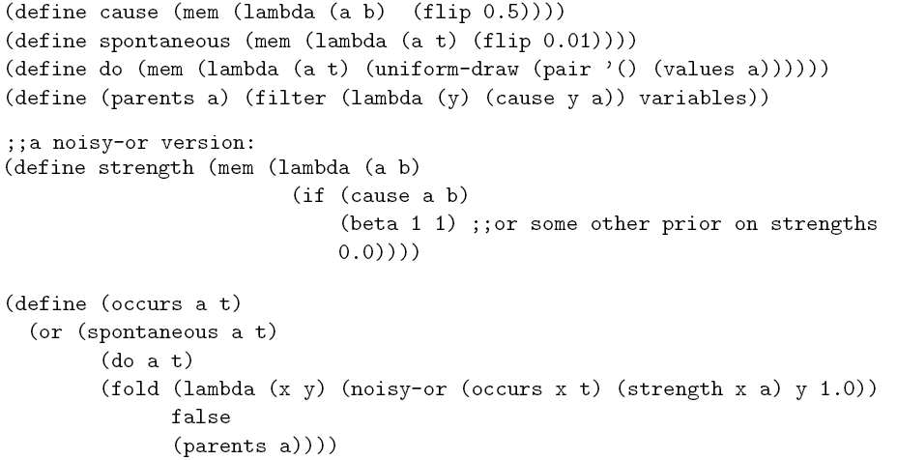
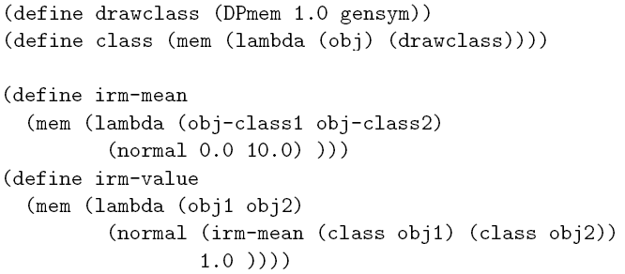
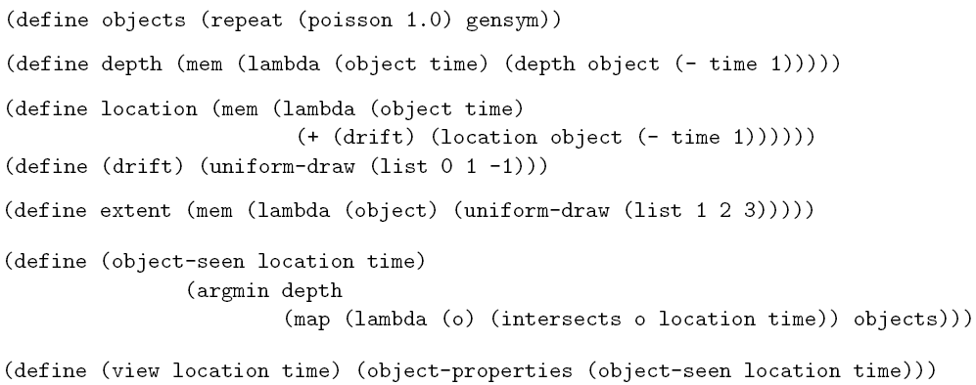
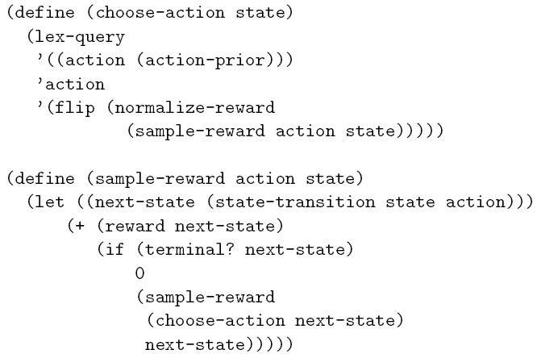
Motivation
Causal networks
Category hierarchies
Physical objects
Rational agents
(Goodman, Mansinghka, Roy, Bonawitz, Tenenbaum, UAI 2008)

Slide 3
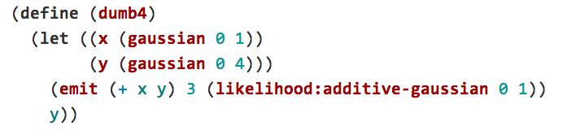
Motivation
A simple example:

Slide 4

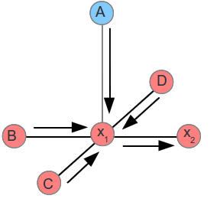
Our Approach
Metropolis - Hastings
Extensions to exploit structure.
Small treewidth graphical models
Gaussians
HMC
Conjugate pairs
Gibbs sampling
…

Slide 5
Our Approach

Slide 6
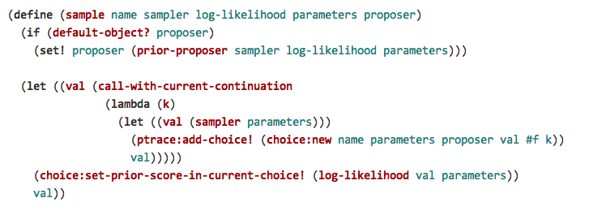
Our Approach
Metropolis-Hastings over program traces with continuations.

Slide 7
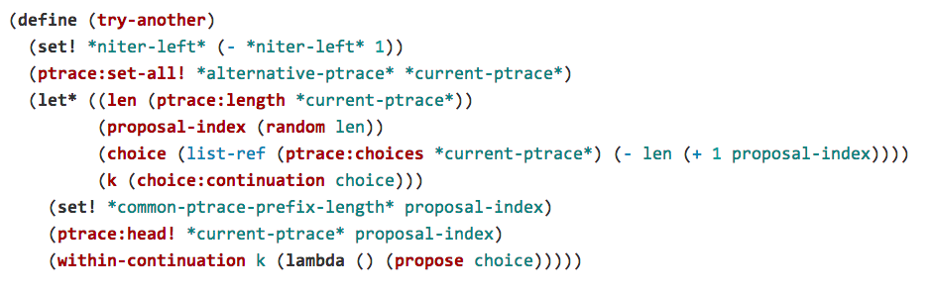
Our Approach
Metropolis-Hastings over program traces with continuations.

Slide 8
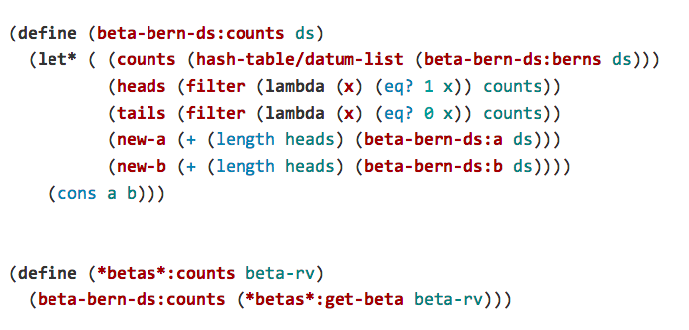
Our Approach
Maintaining joint distributions in the background.

